Slide 1
HDFS on Kubernetes -- Lessons Learned
Kimoon Kim, Pepperdata

Slide 2
Agenda
Kubernetes intro
Spark and HDFS on Kubernetes
Demo
Problems we fixed in Spark on K8s -- HDFS data locality, Secure HDFS

Slide 3
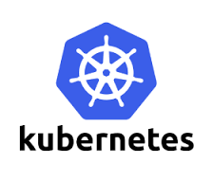
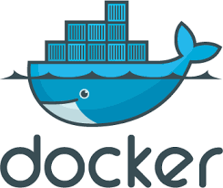
Kubernetes
New open-source cluster manager.
Runs programs in Linux containers.
1000+ contributors and 40,000+ commits.
Notes:
Designed and built for containers

Slide 4
“My app was running fine until someone installed their software”
Notes:
My spark job failed with ClassNotFound exception
I had to change my Tomcat port

Slide 5
More isolation is good
Kubernetes provides each program with:
a lightweight virtual file system -- Docker image
an independent set of S/W packages
a virtual network interface
a unique virtual IP address
an entire range of ports
Notes:
Containers create more isolation layers
Still very fast
This other person install only on his container
What if I have a server program like Tomcat
Both my Tomcat and your Tomcat can open the same port under different IPs
Like having VMS such that each program is the only program running

Slide 6
Other isolation layers
Separate process ID space
Max memory limit
CPU share throttling
Mountable volumes
Config files -- ConfigMaps
Credentials -- Secrets
Local storages -- EmptyDir, HostPath
Network storages -- PersistentVolumes

Slide 7
Kubernetes architecture
Pod, a unit of scheduling and isolation.
runs a user program in a primary container
holds isolation layers like a virtual IP in an infra container
Pod 1
Pod 2
Pod 3
10.0.0.2
10.0.0.3
10.0.1.2
node A
node B
196.0.0.5
196.0.0.6
Notes:
We have pod 1, 2, and 3.
Each pod gets a unique virtual IP address like 10.0.0.2.
Virtual pod IPs look very different from physical IP addresses of cluster nodes
Becomes important later when looking at Spark and HDFS together

Slide 8
Big Data on Kubernetes
github.com/apache-spark-on-k8s
Bloomberg, Google, Haiwen, Hyperpilot, Intel, Palantir, Pepperdata, Red Hat, and growing.
patching up Spark Driver and Executor code to work on Kubernetes.
being upstreamed with SPIP-Spark-on-Kubernetes.
Related talk: spark-summit.org/2017/events/apache-spark-on-kubernetes/

Slide 9
Spark on Kubernetes
Job 1
Job 2
Client
Driver Pod
Executor Pod 1
Executor Pod 2
10.0.0.2
10.0.0.3
10.0.1.2
Driver Pod
Executor Pod 1
Executor Pod 2
Client
10.0.0.4
10.0.0.5
10.0.1.3
node A
node B
196.0.0.5
196.0.0.6

Slide 10
What about storage?
Spark on Kubernetes supports cloud storages like S3.
Your data is often stored on HDFS.
Run HDFS itself on Kubernetes -- github.com/apache-spark-on-k8s/kubernetes-HDFS
Access remote HDFS running outside Kubernetes

Slide 11
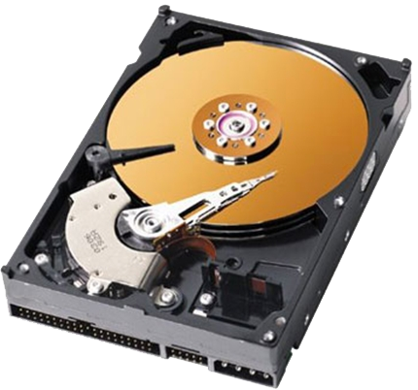
HDFS on Kubernetes
Job 1
github.com/apache-spark-on-k8s/kubernetes-HDFS
Job 2
HDFS
Client
Driver Pod
Executor Pod 1
Executor Pod 2
10.0.0.2
10.0.0.3
10.0.1.2
Driver Pod
Executor Pod 1
Executor Pod 2
Client
10.0.0.4
10.0.0.5
10.0.1.3
Namenode Pod
Datanode Pod 1
Datanode Pod 2
node A
node B
HostPath
196.0.0.5
HostPath
196.0.0.6
hdfs-namenode-selector = hdfs-namenode-0

Slide 12
Demo - Spark on K8s accessing secure HDFS
Launch HDFS on K8s
Run a Spark job on K8s to use HDFS
Check the job pods

Slide 13
Problems we fixed in Spark on K8s
HDFS data locality support -- Send compute to data
Node locality
Rack locality
Where to launch executors
Secure HDFS support
Executor 1
Executor 2
FAST
SLOW
Datanode 1
Datanode 2
node A
node B
Notes:
HDFS is faster than other distributed storage systems
Fast in part because it supports data locality.

Slide 14
Solved: Node locality
(/fileA → Datanode 1 → 196.0.0.5) == Location of Executor 1
(/fileA → Datanode 1 → 196.0.0.5) != (Executor 1 →10.0.0.3)
(/fileA → Datanode 1 → 196.0.0.5) == (Executor 1 →10.0.0.3 → 196.0.0.5)
Location of fileA == Location of Executor 1
Read /fileB
Driver
Read /fileA
Executor Pod 1
Executor Pod 2
10.0.0.2
10.0.0.3
10.0.1.2
/fileA
/fileB
Namenode Pod
Datanode Pod 1
Datanode Pod 2
node A
node B
196.0.0.5
196.0.0.6

Slide 15
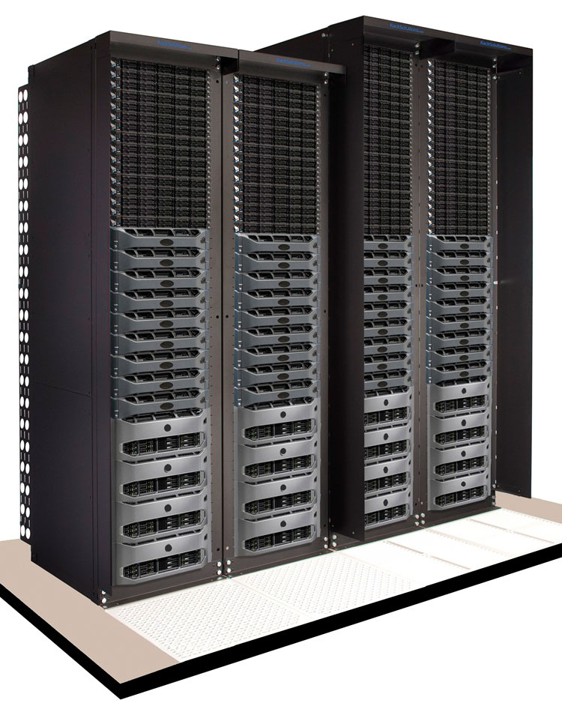
Solved: Rack locality
(/fileA → Datanode 1 → 196.0.0.5 → Rack 1) != (Executor 1 →10.0.1.2)
(/fileA → Datanode 1 → 196.0.0.5 → Rack 1) == (Executor 1 →10.0.1.2 → 196.0.0.6 → Rack 1)
Rack of fileA == Rack of Executor 1
Read /fileB
Driver
Read /fileA
Executor Pod 1
Executor Pod 2
10.0.0.2
10.0.1.2
10.0.2.2
SLOW
/fileA
/fileB
Datanode Pod 1
Datanode Pod 2
Datanode Pod 3
node A
node B
node C
196.0.0.5
196.0.0.6
196.0.1.5
Rack 1
Rack 2

Slide 16
Solved: Node preference
Hey K8s, I’d like node A much more for my executors
Node affinity
Driver
Executor Pod 1
Executor Pod 2
10.0.0.2
10.0.0.3
10.0.0.4
/fileA
Datanode Pod 1
/fileB
Datanode Pod 2
node A
node B
196.0.0.5
196.0.0.6

Slide 17
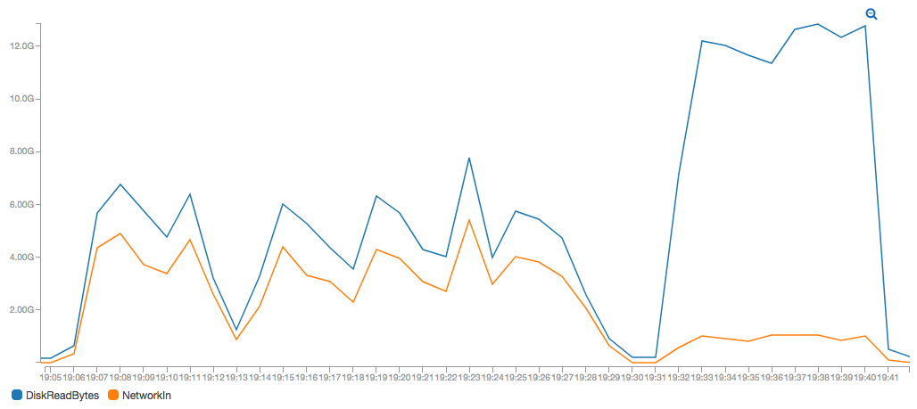
Rescued data locality!
without data locality fix
duration: 25 minutes
with data locality fix
duration: 10 minutes
Notes:
The job was TeraValidate
Two runs processed the same input
AWS CloudWatch chart

Slide 18
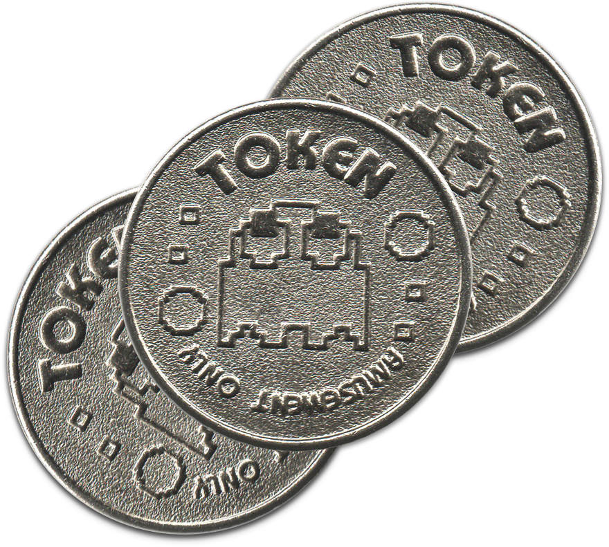
Problems we fixed in Spark on K8s
HDFS data locality support
Secure HDFS support
Kerberos tickets
HDFS tokens
Long running jobs

Slide 19
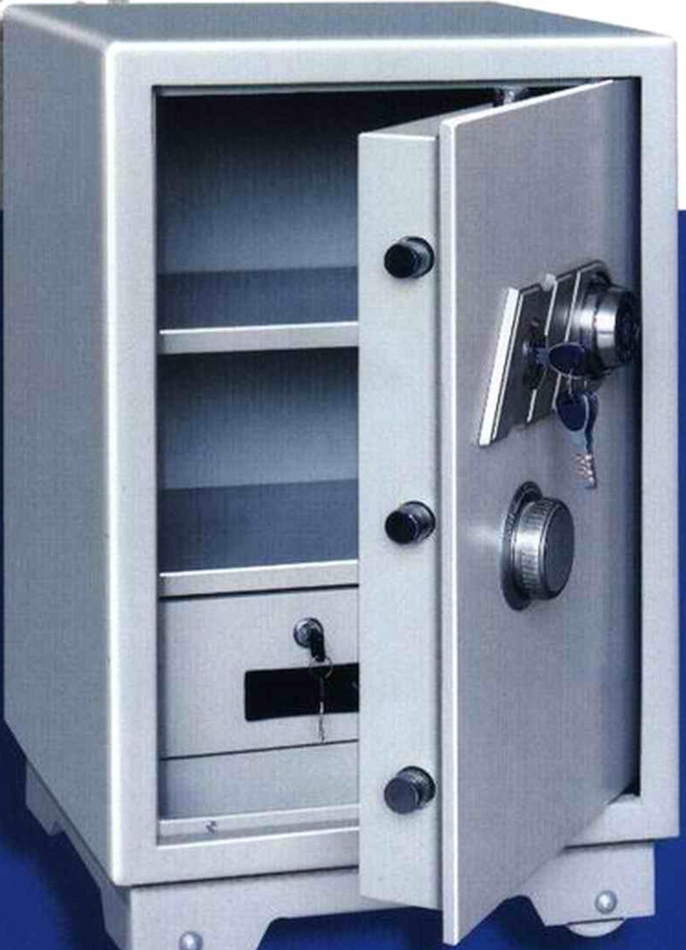
Kerberos, simplified
encrypted with HDFS’ password
encrypted with A’s password
encrypted with session key SK1
Order # SK1
Customer copy
Order # SK1
Merchant copy
I’m user A. May I talk to HDFS?
SK1
Kerberos Server
You guys should talk only if the other side knows SK1.
I’ll get SK1 to each of you secretly.
I guarantee that the other side is genuine if they know SK1.
SK1 copy for User A
SK1 copy for HDFS
A’s password
HDFS’ password
User A
Ticket to HDFS
SK1 copy for HDFS
SK1
SK1
Session 1 Requests/Responses
HDFS namenode
HDFS’ password

Slide 20
HDFS Delegation Token
Kerberos ticket, no good for executors on cluster nodes.
Stamped with the client IP.
Give tokens to driver and executors instead.
Issued by namenode only if the client has a valid Kerberos ticket.
No client IP stamped.
Permit for driver and executors to use HDFS on your behalf across all cluster nodes.

Slide 21
Solved: Share tokens via K8s Secret
Client
Driver Pod
Executor Pod 1
Executor Pod 2
10.0.0.2
10.0.0.3
10.0.1.2
Secret 1
Kerberos
Namenode Pod
Datanode Pod 1
Datanode Pod 2
node A
node B
196.0.0.5
196.0.0.6

Slide 22
Solved: Refresh tokens with K8s microservice
Client
Driver Pod
Executor Pod 1
Executor Pod 2
10.0.0.2
10.0.0.3
10.0.1.2
Refresh Pod
Secret 1
10.0.0.8
Kerberos
Namenode Pod
Datanode Pod 1
Datanode Pod 2
node A
node B
196.0.0.5
196.0.0.6

Slide 23
Solved: Keep Secret to yourself with K8s RBAC
Job 1
Job 2
Client
Driver Pod
Executor Pod 1
Executor Pod 2
10.0.0.2
10.0.0.3
Secret 1
10.0.1.2
Secret 1
Driver Pod
Executor Pod 1
Executor Pod 2
Client
10.0.0.4
10.0.0.5
10.0.1.3
node A
node B
196.0.0.5
196.0.0.6

Slide 24
Recap
Data locality works.
Supports secure HDFS.
Open problems
Performance?
Namenode High Availability

Slide 25
Join us!
github.com/apache-spark-on-k8s
kimoon@pepperdata.com

