Slide 1
Migrating Petabyte Scale Hadoop Clusters With Zero Downtime
Alon Elishkov
Strata London 2017

Slide 2
Outbrain’s Mission:
Helping people discover great content

Slide 3
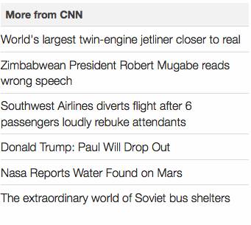
PROMOTED DISCOVERY
INTERNAL DISCOVERY

Slide 4
+550M
+250B
6000
Unique Monthly Global Audience
Recommendations Served Monthly
Servers Across 3 Data Center

Slide 5
Logical View of the Architecture
BI
Customer Reports
Outbrain Services
Events
Recommendations
Readers
Processing Pipeline
Serving Data Stores
Data Warehouses

Slide 6
Outbrain - Physical Architecture
Outbrain Services
Outbrain Services
Outbrain Services
Events
Events
Events
Cross DC Data Delivery

Slide 7
Migration Goals
Improve operational management:
New HW profile to better match workload
Consolidate H/W Profiles
Taking advantage of the ecosystem advancements:
Hive features and new capabilities
Easier Spark integration
YARN

Slide 8
The Processing Pipeline
5TB compressed data ingested into each hadoop cluster daily
~50 workflow developers on multiple teams around the globe
Dozens of changes to flows daily
Over 10k flows running each day
Multiple interfaces: Hive, Pig, Scalding, Sqoop, HDFS
330 machines in each cluster
2 PB in online clusters and 5 PB on research cluster

Slide 9
Business Constraint
No impact on service level for recommendations, BI and customers during the migration
Implies that:
Risk needs be managed
Process must be reversible

Slide 10
Possible Migration Paths
In place software upgrade followed by a rolling H/W upgrade

Slide 11
Possible Migration Paths
In place software upgrade followed by a rolling H/W upgrade
Flipping the switch - Create a new cluster, sync required data and move all processing to it

Slide 12
Possible Migration Paths
In place software upgrade followed by a rolling H/W upgrade
Flipping the switch - Create a new cluster, sync required data and move all processing to it
Side by side execution - start processing on new cluster without stopping the old cluster

Slide 13
Data Processing Layer
Outbrain Services
events
~500 hourly flows total
...
A Workflow Engine for each business
Workflow Engine A
Workflow Engine B
Workflow Engine Z

Slide 14
First Step - Side by Side Ingestion
Outbrain Apps
Events
Events
New Cluster
Old Cluster
No processing yet…
A
B
C
D

Slide 15
Migrate By Moving Processing ?
Outbrain Apps
Events
Events
New Cluster
Old Cluster
A
B
C
D

Slide 16
Keep Processing on Both Clusters
Outbrain Apps
Events
Events
New Cluster
Old Cluster
A’
A
B
C
D

Slide 17
Running Writes in Parallel
Data consistency issues
Harder to validate results
Double the load

Slide 18
Leader - Secondary
Leader Workflow Engine - Run all flows
Secondary Workflow Engine - Run all flows except those writing to external data sources

Slide 19
How Would It Look Like - Phase 1
New Cluster
Old Cluster
Workflow Engine A’
Workflow Engine A
Secondary
Leader
Secondary
Leader

Slide 20
How Would It Look Like - Phase 2
New Cluster
Old Cluster
WFE A’
WFE A
Leader
Secondary
Secondary
Leader

Slide 21
Plan Overview
Outbrain Apps
Events
Events
New Cluster
Old Cluster
A’
B’
C’
D’
A
B
C
D
Secondary
Leader

Slide 22
Goals for the Implementation
Continuous development
Minimize workflows developers intervention
Reduce noise & friction

Slide 23
Workflow Repository
Workflow Engine A
Workflow Engine B
...
Workflow Engine Z
Get jobs for group A
Get jobs for group Z
Workflow Repository

Slide 24
How is a Workflow Defined
Declarative definition
Multiple tasks
Configuration

Slide 25
Task Types
Each task can be one of many task types
Two examples:
Hive query configured with:
HQL query
Target hadoop cluster
Sqoop ETL configured with:
Sql query
Source mysql database
Target hadoop cluster

Slide 26
Rewriting Flow Definitions
New Cluster
Old Cluster
WFE A’
WFE A
Rewrite the flows dynamically!
Workflow Repository
Secondary
Leader

Slide 27
Rewrite Strategies – Endless Possibilities
Filter flows with external side effects
Change target Hadoop cluster
Redirect emails & pager duties to our team

Slide 28
What Did We Achieve
Gradual process -> Bounded risk
Measuring not guessing
Reversible process (used multiple times!)
No flow code duplication
Almost invisible process for flow developers

Slide 29
Side by Side Comparison of Different Distributions

Slide 30
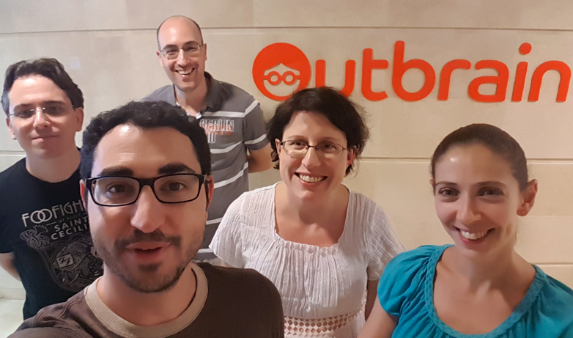
Thanks!
Questions?
Alon Elishkov
aelishkov@outbrain.com
@alonel

