Slide 1
From data dinosaurs to data stars in five weeks:
Lessons from completing 80+ data science projects
Dr Kim Nilsson
CEO of Pivigo
@kimknilsson

Slide 2
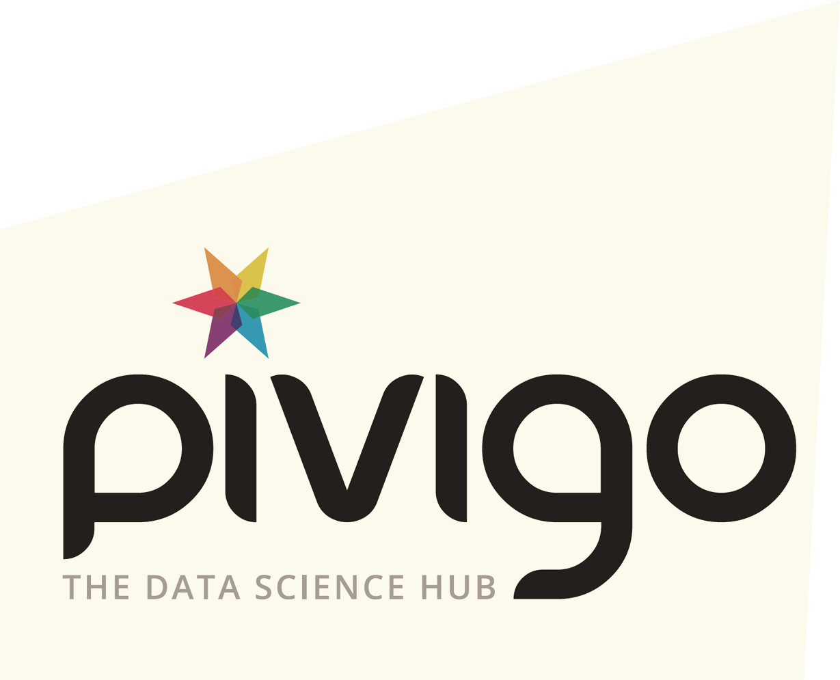
DATA SCIENCE IN NUMBERS
Revenue
$130 billion in 2016
$203 billion in 2020
100,000 – 190,000 jobs unfilled in US alone
Notes:
Slide 1 – Data science in numbers
The industry:
Worldwide, revenue for big data and business analytics will grow from $130.1 billion in 2016 to over $203 billion in 2020 (according to IDC)
Subsequently, the demand for data scientists is growing at an exponential rate, outpacing the supply of talent
Some experts estimate 100,000-190,000 data science jobs will go unfilled in the US alone, from 2011 to the end of this decade
These figures are great for showing the growth of the industry, the increasing demand and importance for data science, and the importance of encouraging more data scientists into the field
However, for what data science means to organisations, these figure is a bit abstract
So, let's look at numbers that you might relate to a little more:
£6million – the increase in company revenue from a price optimisation data science project
And it’s not just about business. Data science can have a positive impact on society too: 70% of high risk women could be prevented from developing Type 2 diabetes after pregnancy, using data science to develop bespoke meal plans and drive healthy lifestyle
These projects are real projects, completed in as little as five weeks
And there are tens of other likes them, ranging from startups to legacy companies boasting nearly a 200,000-strong headcount

Slide 3
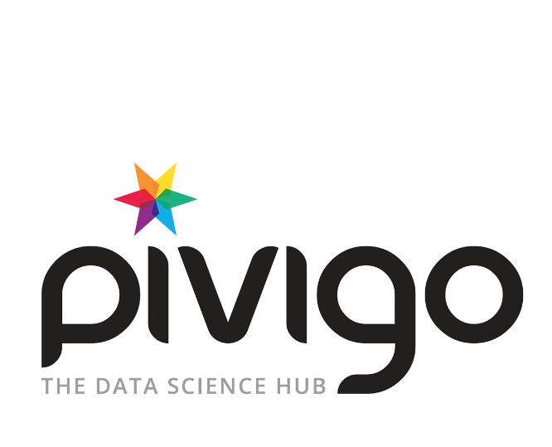
DATA SCIENCE IN NUMBERS
Revenue
£6 million increase in
revenue from price optimisation
£
70% of high risk women could be prevented from Type 2 diabetes after pregnancy
Notes:
Slide 1 – Data science in numbers
The industry:
Worldwide, revenue for big data and business analytics will grow from $130.1 billion in 2016 to over $203 billion in 2020 (according to IDC)
Subsequently, the demand for data scientists is growing at an exponential rate, outpacing the supply of talent
Some experts estimate 100,000-190,000 data science jobs will go unfilled in the US alone, from 2011 to the end of this decade
These figures are great for showing the growth of the industry, the increasing demand and importance for data science, and the importance of encouraging more data scientists into the field
However, for what data science means to organisations, these figure is a bit abstract
So, let's look at numbers that you might relate to a little more:
£6million – the increase in company revenue from a price optimisation data science project
And it’s not just about business. Data science can have a positive impact on society too: 70% of high risk women could be prevented from developing Type 2 diabetes after pregnancy, using data science to develop bespoke meal plans and drive healthy lifestyle
These projects are real projects, completed in as little as five weeks
And there are tens of other likes them, ranging from startups to legacy companies boasting nearly a 200,000-strong headcount

Slide 4
DATA SCIENCE IN NUMBERS
Real value delivered
in as little as 5 weeks
There are tens of other projects ranging from startups to legacy companies boasting nearly a 200,000-strong headcount
Notes:
Slide 1 – Data science in numbers
The industry:
Worldwide, revenue for big data and business analytics will grow from $130.1 billion in 2016 to over $203 billion in 2020 (according to IDC)
Subsequently, the demand for data scientists is growing at an exponential rate, outpacing the supply of talent
Some experts estimate 100,000-190,000 data science jobs will go unfilled in the US alone, from 2011 to the end of this decade
These figures are great for showing the growth of the industry, the increasing demand and importance for data science, and the importance of encouraging more data scientists into the field
However, for what data science means to organisations, these figure is a bit abstract
So, let's look at numbers that you might relate to a little more:
£6million – the increase in company revenue from a price optimisation data science project
And it’s not just about business. Data science can have a positive impact on society too: 70% of high risk women could be prevented from developing Type 2 diabetes after pregnancy, using data science to develop bespoke meal plans and drive healthy lifestyle
These projects are real projects, completed in as little as five weeks
And there are tens of other likes them, ranging from startups to legacy companies boasting nearly a 200,000-strong headcount

Slide 5
WHY ISN’T EVERYONE DOING IT?
Access to data
No clear starting points defined
Not asking the right questions to ask of the data
Insufficient resource planning - recruitment, outsourcing, procuring become a daunting undertaking
Lack of commitment
Notes:
Slide 2 – Why isn’t everyone doing it?
Despite the value, and the recognition of a problem they have that needs to be solved, many organisations are hesitant about undertaking data science projects – so what’s stopping them?
More often than not, the greatest barrier to a project is finding the starting point. Organisations need to identify the right question to ask of their data
Once they have identified the problem, they then must work out what resources they’ll need to be able to solve it – do they hire their own data scientist, a consultancy, do they need to procure software?
Very quickly, it becomes a daunting undertaking for a company – as they imagine the seemingly endless task ahead of them
My message to these organisations is that a data science project doesn’t have to be a massive undertaking – it doesn’t have to be a 12 month process
A small group of data scientists in five weeks can really get the low hanging fruit that would immediately make a big difference to a business

Slide 6
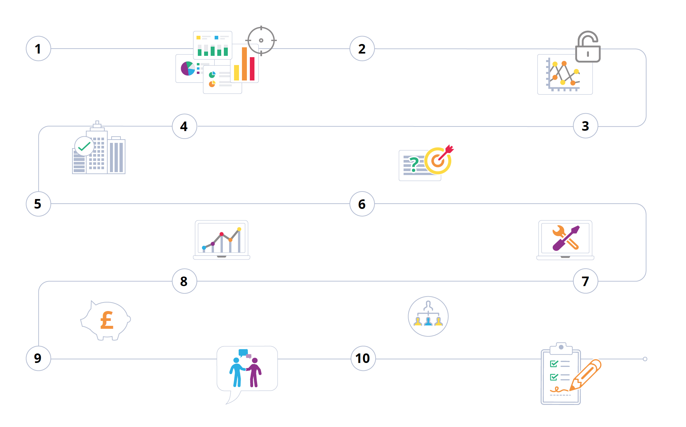
HOW DO YOU KNOW WHEN YOU ARE DATA READY?
Data
Data & quality & access
Management
support
Question
IT expertise
Tools & technology
Budget
Data expertise
Feedback &
communication
Buy in
Notes:
Slide 3 – How do you know when you are data ready?
So how can you maximise chances of success? At Pivigo these are ten steps we have in our mind to see if an organisation is “data ready” – i.e. prepared to undertake a successful project
Data – The obvious first step: do you have data? How much? What type?
Data quality and access – The data needed must be ready and available at the start of the project – the last thing you want to do is waste three out of five weeks getting the data ready. This means evaluating if the data is clean enough; is it in an accessible format and joined up?
Question – Does your organisation have a clear idea of what sort of questions could be answered? The absolute fundamental of a successful project is to ensure that you are asking a question that will lead to a business outcome, it is not just an academic exercise
Management support – are the business stakeholders convinced of the value of data? Buy in from the top goes a long way to ensuring a project can live out its life, and fulfil its purpose
IT expertise – Does your team have enough IT expertise to support data scientists in their work?
Tools and technology – Does your organisation have a clear strategy in place for what tools and technology is needed, and relationships with vendors?
Data expertise – Do you have data scientists employed in your team, or working with external data scientists?
Budget – Does your organisation have a dedicated budget for data science, or at least technology R&D?
Feedback and communication – Is communication and feedback flowing well between the data science team and the rest of the business?
Buy in – Is your team committed and excited about what data will bring to the organisation? Are decisions data driven?

Slide 7
80+ DATA SCIENCE PROJECTS IN 60+ ORGANISATIONS
Agility
Convince the skeptics
Start Small
Expectation Management
Right Skills
Notes:
Slide 4 – Lessons from completing 80 data science projects
So you’ve bought into data science, and your project is underway, how do you ensure the project stays on course?
While each project is different, having done 80 projects in over 50 organisations we have begun to identify common attributes of a successful project
Agility – is key to a successful project. We’ve all heard of agile software management, and a data science team can work in much the same way. Practice such as weekly sprints, goals to work towards each week, can ensure a project isn’t mired down
Start small – you aren’t going to be able to solve everything at once, and trying to do so is how a project becomes daunting. Start small and build bigger as you go
Get the right skills in place – it is very important that you have the right skills in the team working on the data science project. Coding skills are important and a good indicator of overall skill level. However, most important is to have good (not necessarily excellent) technical skills in combination with excellent communication skills and attitude
Expectation management – expectation management is a big part of communication. There is often a lot of fear involved in running a project; fear of failure, fear of ridicule, fear of what the outcome will be, possibly fear of losing jobs. There can also be inflated expectations, leading to disappointment. Setting expectations before, during and after a project, and for all parties, is therefore extremely important for success
Understanding who has the most to lose – fear can often create blockers to projects, so identifying who has the most to lose from the outset, setting expectations from the outset and having open and honest communication throughout can have a huge impact on the success of a project. Managing this in the right way gets them on board and can turn a blocker into an advocate

Slide 8
CASE STUDY: THE PARTS ALLIANCE
Purpose:
Increase revenue
Pricing engine targeted 14% of car parts
In 5 weeks:
4 PhD scientists from S2DS 2016 analysed sales history for 20 million transactions
Applied Machine Learning (ML) algorithms
Built a dynamic pricing engine to maximise sales revenue
Result:
£6 million in sales revenue through sales optimisation
Almost 30% revenue increase
Notes:
Slide 5 – Case study 1 – The Parts Alliance
So how does it work in practice, and what kind of results can we see?
Let’s return to the figure we had right at the beginning – a £6 million increase in sales revenue through sales optimisation
This was for the Parts Alliance, the UK and Ireland's largest group of wholly owned businesses and franchises, supplying 30,000 different manufactured car parts to national and local independent garages and workshops
Parts Alliance had a very clear purpose – to increase revenue – and therefore the pricing engine targeted the 14 percent of car parts where price is the main reason a sale takes place.
Within five weeks a team of four PhD Data Scientists from S2DS 2016, analysed the sales history of 20 million transactions and by using this data applied Machine Learning (ML) algorithms to build a dynamic pricing engine to maximise sales revenue
The result of this analysis could translate to an almost 30 percent revenue increase for the company, or up to £6 million

Slide 9
CASE STUDY: WATCH OUT DIABETES
Aim:
Develop a “Diabetic Nurse” with personalised lifestyle and nutritional advice to optimise diabetes prevention among women
In 5 weeks:
Team of 4 PhD scientists implemented the project
Machine learning used to understand patients’ preferences against the allowed calorie requirement
Produced a prototype algorithm being integrated into WOD app
Provides users with bespoke recommended meal plan and corresponding shopping lists
Notes:
Slide 6 – Case study 2 – Watch out Diabetes
Finally, how data science can be put to use to solve problems in society
Watch Out Diabetes is a research-oriented digital health programme focused on developing novel solutions for women at risk of type 2 diabetes – a life-long condition, but one that can be delayed or prevented with lifestyle interventions, weight loss and good cardiovascular health
Its aim was to develop a ‘Diabetic Nurse’ that could provide personalised lifestyle and nutritional advice and interact with women in order to optimise diabetes prevention
To do so, it needed a strong academic team to develop the intelligence of these features
Over a five-week period, a team of four PhD scientists implemented the project and used machine learning to understand patients’ preferences against the allowed calorie requirement, which was extracted from National Institute of Health and Care Excellence (NICE) and American Diabetes Association (ADA) guidelines using NLP
After the five weeks the team produced a prototype algorithm which is now being integrated into the Watch Out Diabetes app, which – using basic health information provided by the user such as, age, activity level, weight, etc. – determines the user’s nutritional requirements and creates recommendations based on their preferences
This provides individual users with a bespoke meal plan with corresponding shopping list – a novel but effective way to improve heath and prevent diabetes

Slide 10
CONCLUSION
Data science CAN and WILL touch and change every industry
A team + 1 clear = added value & critical edge
WHAT IS THE QUESTION YOU WANT YOUR DATA TO SOLVE?
Notes:
Slide 7 – Conclusion
Data science can and will touch and change every industry
Those companies who are pursuing it already are already giving themselves a competitive advantage
And as these case studies show, a data science project is not beyond any company – regardless of size or sector
It does not have to be a multi-million pound reworking of an entire organisation
A team of four over five weeks can tackle one problem, and bring a great deal of value to an organisation – very possibly giving it the critical edge it needs to succeed
Simply start at the beginning, and ask yourself – what is the question you want your data to solve?

Slide 11
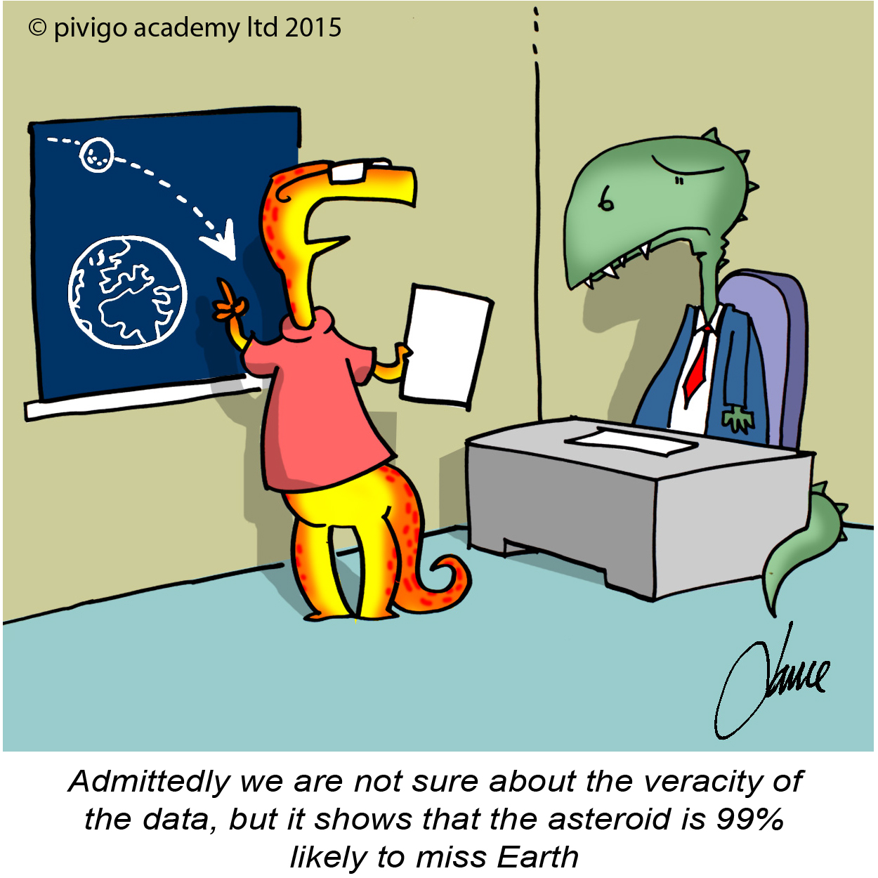
2015
Dr Kim Nilsson
CEO and Co-founder
@kimknilsson
@PivigoHub
80 Coleman Street
London EC2R 5BJ
+44 (0)207 788 4710
info@pivigo.com
www.pivigo.com
www.s2ds.org
#imadatascientist
imadatascientist.com
“Meet the Expert” at 2.55pm today

