Slide 1
Distributed Computations for Analytics: Benchmarking Druid, HAWQ and Kinetica
maY, 2017
Dr. Vijay Srinivas Agneeswaran,
Director and head of data Technologies,
SapientRazorfish

Slide 2
Distributed Merge Tree
Category
Pel_Count
Merged list of Pel_ID’s
Sub-Category
Sub-Category
Sub-Category
Pel_Count
Merged list of Pel_ID’s
Pel_Count
Merged list of Pel_ID’s
Pel_Count
Merged list of Pel_ID’s
Domain
Domain
Domain
Domain
Domain
Pel_Count
list of Pel_ID’s
Pel_Count
list of Pel_ID’s
Pel_Count
list of Pel_ID’s
Pel_Count
list of Pel_ID’s
Pel_Count
list of Pel_ID’s
Notes:
Category – social, entertainment: Sub-category – blog/chat, radio/news
Single node Java multi-threaded implementation – 45 minutes for reachability metric computation.

Slide 3
Apache Druid+S3 Deep Storage
Sweet spot:
Real-time ad-hoc/analytical queries
Viewed as an operations/network monitoring, video, online advertising analytical database
External Dependencies:
Deep Storage – S3
Metadata Store- derby
S3 Deep Storage
Broker
Zookeeper and Coordinator
Historical 1
Historical 2
Notes:
Best of OLAP systems such as IBM/Oracle, main memory DB systems such as SAP Hana, interactive query systems such as Dremel, distributed NoSQL stores such as Cassandra/DynamoDB.

Slide 4
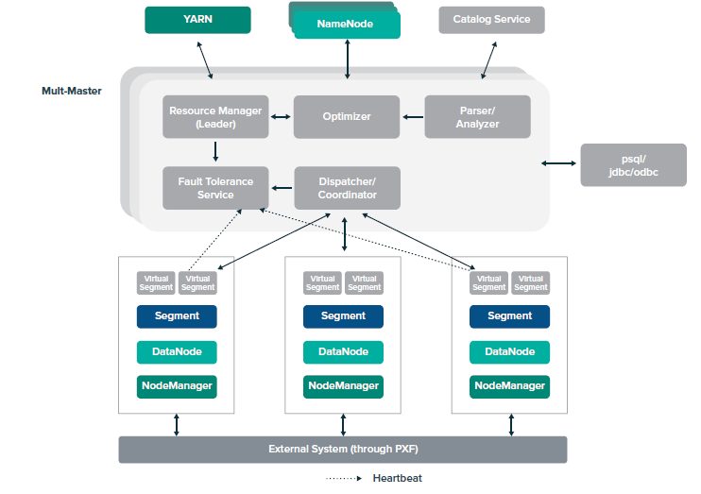
Apache HAWQ
Source of above diagram:
https://hortonworks.com/wp-content/uploads/2015/02/Introducing-the-Newly-Redesigned-Apache-HAWQ-Incubating-1.pdf

Slide 5
Apache Hawq: Custom Architecture
HAWQ uses a massively parallel architecture (MPP) and runs its own services, called Segments, to access data in HDFS directly. It is also the only other SQL on Hadoop solution to provide ANSI SQL compliance.
Broker
HAWQ/ Application Master
HAWQ Master
HAWQ Master
HDFS Data Node
HDFS Data Node
HAWQ Segment Host
HAWQ Segment Host
HAWQ Segment Host
HAWQ Segment Host
HAWQ Segment Host
HDFS Data Node
HDFS Data Node
HDFS Data Node
HDFS Data Node
HDFS Data Node

Slide 6
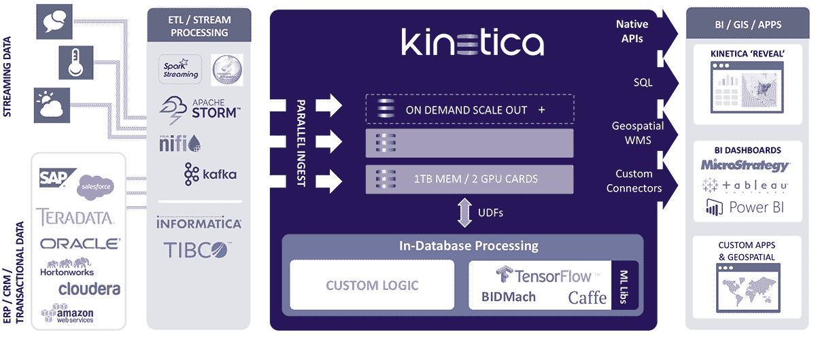
Kinetica Architecture
Built in connectors simplify integration with most common open source frameworks Hbase, Kibana, Kafka, Mapreduce, Spark and Strom
Real time and Batch Data from various sources can be parallelly ingested into kinetica using these connectors.
User-defined functions (UDFs) can receive table data, do arbitrary computations, and save output to a separate table in a distributed manner.
UDFs have direct access to CUDA APIs – enables compute-to-grid analytics for logic deployed within Kinetica.
ODBC/JDBC drivers provides Seamless integration with existing visualization and business intelligence tools like Tableau & caravel
Kinetica Revel also provides interface for SQL for adhoc querying.
Notes:
Columnar, distributed, GPU Compression, data skipping, distributed file stores, elastic compute, vectorization allows GPUs to efficiently implement code, LLVM compiler infrastructure. Rendering, rasterization of large data sets.

Slide 7
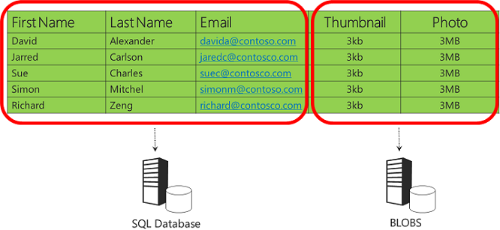
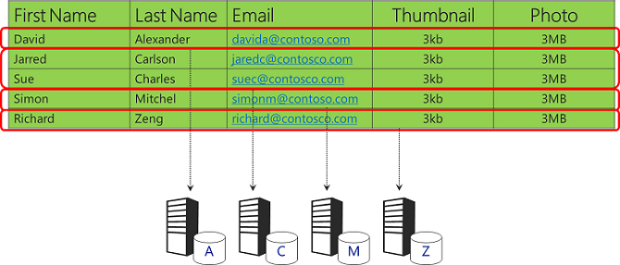
Partitioning Data Across a Cluster of Nodes
https://docs.microsoft.com/en-us/aspnet/aspnet/overview/developing-apps-with-windows-azure/building-real-world-cloud-apps-with-windows-azure/data-partitioning-strategies

Slide 8
Multi-dimensional Partitioning Strategy
 | JAN | FEB | MAR | APR | MAY | JUN | JUL | AUG | SEP | OCT | NOV | DEC
1-30 | 0 | 1 | 2 | 3 | 4 | 5 | 6 | 7 | 0 | 1 | 2 | 3
31-60
61-90
91-120
……
Simple 2-d grid partitioning.

Slide 9
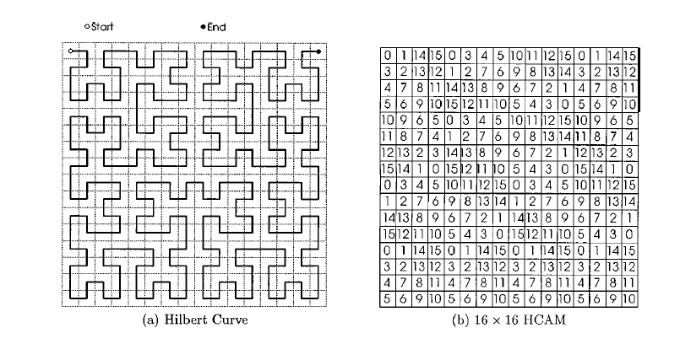
Hibert Curve Allocation Method (HCAM)

Slide 10
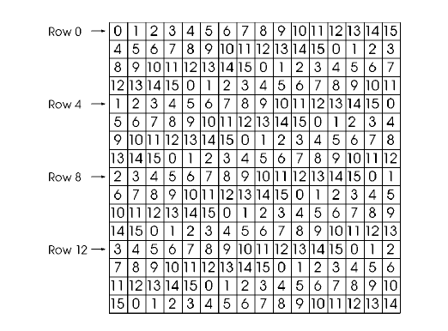
General Multi-dimensional Partitioning (GeMDA)
Yu-Lung Lo, Kien A. Hua, and Honesty C. Young. 2001. GeMDA: A Multidimensional Data Partitioning
Technique for Multiprocessor Database Systems. Distrib. Parallel Databases 9, 3 (May 2001), 211-236.
DOI=http://dx.doi.org/10.1023/A:1019265612794

Slide 11
Multi-dimensional Partitioning: Cluster Architecture
APPLICATION SERVER SIDE
Partition (1 to 35)
App Server
Slave
InMemory Database
Meta
Data
Partition (36 to 70)
AWS
Load Balancer
Master
Slave
InMemory Database
S
3
Client UI
Rest
Rest
Meta
Data
Rest
Meta
Data
Partition (71 to 100)
App Server
Slave
InMemory Database
Meta
Data
Partition (xx to xx)
Slave
Meta
Data
InMemory Database
Notes:
Each app server sends requests to master with all the parameters
Master will have full metadata (Category>Sub-Category>Domain tree)
Master will analyse the input and created separate requests for each slaves depending on partitions
Master send separate requests to slaves and collates all the responses and returns the output

Slide 12
Data Model: Flat table
Domain ID | Person_ID (Represents Pel_ID) | Session_ID | Session_Duration | Date
Multi-dimensional partitioning: date, domain
Date Range
1-30 | 0 | 1 | 2 | 3 | 4 | 5 | 6 | 7 | 0 | 1 | 2 | 3
31-60
61-90
91-120
……

Slide 13
Apache HAWQ
MULTI-DIMENSIONAL
PARTITIONING
OPTIMIZED DISTRIBUTED
QUERIES
Partition by
Sub-partition by
Partition Selector
Dynamic Scan
Lyublena Antova, Amr El-Helw, Mohamed A. Soliman, Zhongxian Gu, Michalis Petropoulos, and Florian Waas. 2014. Optimizing queries over partitioned tables in MPP systems. In Proceedings of the 2014 ACM SIGMOD International Conference on Management of Data (SIGMOD '14). ACM, New York, NY, USA, 373-384. DOI: https://doi.org/10.1145/2588555.2595640

Slide 14
Performance Studies
1 Month Range Queries for Specific Action IDs.
 | Timeframe | Cluster Config | Table Content | Table Record Count | Data load time/method | Reachability metric computation time (average of 3 runs)
Druid | Nov 15 | 4 ec2 R3.4X machines (2 storage nodes, 1 broker node and 1 zookeeper) | TV Ranker – program ids and pel_ids Filter criteria – action_ids and pel_ids | TV Ranker – 229 million Filter criteria – 240 million | 30 Mins(Druid Ingest Proc) And 12 minutes | 1.135 minutes
HAWQ | Nov 15 | 3 ec2 R3.4X machines (2 clusters and 1 application master) | same | Same | 15 seconds (gpfdist) | 20.33 seconds
Kinetica | Nov 15 | 1 EC2 P2.8X large(8GPU, 32 CPU’s, 488GB RAM) | Same | Same | 5 mins (custom Spark connector with 30 threads/splits) | 5.74 seconds
 |  |  |  |  |  | 3.59 secs on 2 P2.8X node cluster
Druid | Dec 15 | Same as above | Same | TV Ranker – 122 million Filter Criteria – 259 million | 14 minutes and 16 minutes | 1.153 minutes
HAWQ | Dec 15 | Same as above | Same | Same | 8 seconds and 12 seconds | 12.7 seconds
Kinetica | Dec 15 | Same as above | Same | Same | 5 minutes | 5.21 seconds
 |  |  |  |  |  | 3.65 secs on 2 P2.8X node cluster
Action IDs: 8137, 7752, 8045, 8031, 8003, 7987 for Druid, HAWQ and Kinetica

Slide 15
Performance Studies
1 Month Range Queries for Specific Action IDs.
 | Timeframe | Cluster Config | Table Content | Table Record Count | Data load time/method | Reachability metric computation time (average of 3 runs)
Druid | 1 day | 4 ec2 R3.4X machines (2 storage nodes, 1 broker node and 1 zookeeper) | TV Ranker – program ids and pel_ids Filter criteria – action_ids and pel_ids | TV Ranker – 229 million Filter criteria – 240 million | 30 Mins(Druid Ingest Proc) And 12 minutes | 2.76 seconds
HAWQ | 1 day | 3 ec2 R3.4X machines (2 clusters and 1 application master) | same | Same | 15 seconds (gpfdist) | 4.93 seconds
Kinetica | 1 day | 1 EC2 P2.8X large(8GPU, 32 CPU’s, 488GB RAM) | Same | Same | 5 mins (custom Spark connector with 30 threads/splits) | 2.64 seconds
Druid | 1 week | Same as above | Same | TV Ranker – 122 million Filter Criteria – 259 million | 14 minutes and 16 minutes | 20.66 seconds
HAWQ | 1 week | Same as above | Same | Same | 8 seconds and 12 seconds | 10.33 seconds
Kinetica | 1 week | Same as above | Same | Same | 5 minutes | 5.21 seconds
Action IDs: 8137, 7752, 8045, 8031, 8003, 7987 for both Druid, HAWQ and Kinetica

Slide 16
Performance Studies
Query for All Action IDs.
 |  |  |  | Cluster Details |  | Action IDs | Execution time
Table | Content | Record count | Time frame | Hawq | Druid |  | Hawq | Druid | Kinetica
Tv Ranker | Program id's and pels | 122 Million | Dec' 15 | 3 ec2 R3.4X machines (2 clusters and 1 application master) | 4 ec2 R3.4X machines (2 storage nodes, 1 broker node and 1 zookeeper) | All (22, 000) | 83 seconds | Indeterminate | 6.45 seconds |  | 2.45 secs on 2 node cluster
Filter Criteria | Action id's and pels | 259 Million | Dec' 15

Slide 17
Credits
Raghunadh Nittala
Sunil Madhusoodhan Nair
Vikram Hedge
Sreeman Narayana
Arunkumar Ramnatha
Sapient
Kinetica
James Mesney
Charles Sutton
Matt Hawkins
Ritesh Soni
IDIOM team – ZZ and others
Prashant Mehta

Slide 18
Thank you!
vagneeswaran@sapient.com

