Slide 1
Distributing and Monetizing Applications through the Windows® Marketplace for Mobile
Daniel Bouie & John Bruno
Microsoft

Slide 2







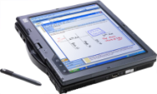
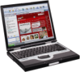





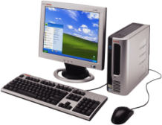
Why Mobile?
34.1%
Converged
Mobile Phones
35
30
25
20
15
10
5
0
YOY % shipping growth
18.6%
Mobile PCs
5.8%
Mobile Phones
3.9%
Desktop PCs
2006 – 2010
Source: Gartner Dataquest, and IDC 2006
Notes:
3/31/2009 1:32 PM
2
3/31/2009 1:32 PM
2
Gartner tells us that desktop pc sales are projected to grow at a utility-like 4 % through 2010
Basic mobile phones will do a little better at 5.8%, although my personal opinion is that even this category will outperform beyond 2010 as we start to see pent-up demand from emerging economies
Now here’s where it starts to get interesting as we see 18.6% growth in the mobile PC business. This is interesting because it not only reflects increased device capability and affordability; it also reflects the emergence of new user scenarios. Literally people living their life differently because of the mobile nature of their computer. Great example is me writing this presentation on the plane down from Seattle yesterday.
But again, everyone in the room is betting on software for converged devices, smartphones. How’s that going?
Turns out it’s going great. Our industry is looking at 34% YOY growth, so it looks like we’ve all made the right bet.
Let me give you some Microsoft context here. Last year I announced at the summit that we’d have a banner year in WM device sales. That news rang true and this fiscal year all of our forecasts are pointing towards 100% which will put us north of 20million WM devices sold this year.
KEY MESSAGES:
Mobility as a key business interest is taking off - Wireless e-mail population to double in 2006 (~25Million). By 2010 expect to be >100 million wireless e-mail users. (Gartner, May 2006)
As Desktop PC and traditional mobile phones sales slacken there is a growing surge in mobile device sales: laptops, tablets and smart converged mobile phones – (Converged phones = devices w/ high-functioning OS + telephony capabilities, able to multi-task, and perform robust functions like wireless e-mail and support LOB applications, incl.3rd party apps – NOT just mobile e-mail (RIM).
Desktop PC sales have matured – 3.9% avg growth til 2010 min replacement activity, emerging market growth – 165M 2008.
CLICK: Mobile phones – 1Billion devices shipped CY06, mobile phone shipments continue solid growth - 5.8% YoY
Businesses are investing at increasing rate in potential for mobile solutions to transform their business - they believe they will get a lot of bang for their buck.
CLICK: Making up for sluggish desktop PC sales is strong continued growth of mobile PCs - avg 18.6% YoY – 112M in 2008. Businesses no longer buying employees desktop PCs but are buying employees mobile PC’s with 3G data cards.
More people everyday thinking about what they can do w/ their mobile device in addition to making phone calls
CLICK: Converged Mobile devices / smartphones - fastest growing device segment - 34.1% YoY. ~1/4 Billion converged devices expected in 2010. By 2007 converged could be10% of total ww handset sales
Converged phone makers: Symbian, Linux (MOT) and RIM and Windows.
W Mobile sales forecast to grow faster than total mobile market:
Outsold Blackberry entire install base in CY06.
W Mobile users 2-10 times more likely than Symbian (Nokia) users to use advanced data services. W Mobile is preferred business platform for applications that will consume data services (Telephia Q4 2005 Enterprise Insights Report)
RIM/Blackberry (primarily e-mail only) sales are forecast to grow more slowly than the market, actually decreasing RIM’s total share of market = decline in share of shipments from 7.5% in CY05 to 4.7% in CY10.

Slide 3































Mobile Operator Partnerships
The Windows Mobile World
160 Mobile Operator Partners in 55 countries
50 Device Makers
Notes:
All those devices are being sold my our mobile operator partners around the world.
In fact WM devices are now being sold by 125 MO in 55 countries
And those devices are coming from 48 OEMs including some of the biggest names in our industry
But now, let’s switch back to demographics

Slide 4
Ecosystem Revolution
Applications and services are key drivers
Marketplaces are core part of experience
Developer revenue share is increasing
Notes:
Personalized experiences through mobile applications and services are a key driver for smartphone users.
The on-device marketplace is now a required feature of the smartphone landscape.
ISV revenue share is increasing, bringing a new level of competition and innovation to mobile software development.

Slide 5
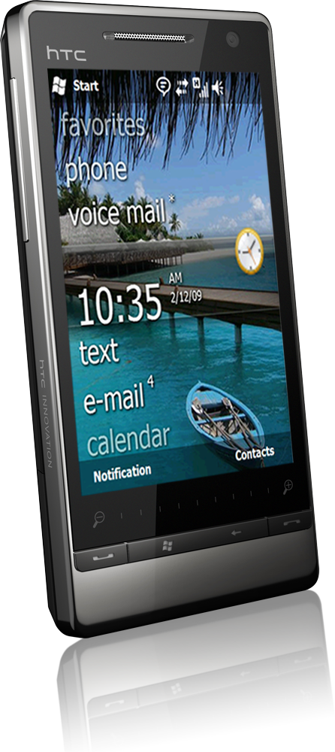
Windows Mobile 6.5
An introduction…
UX Upgrade
Improved browsing with Internet Explorer
Impressive touch capabilities
Widget platform
Application Marketplace
Notes:
Personalized experiences through mobile applications and services are a key driver for smartphone users.
The on-device marketplace is now a required feature of the smartphone landscape.
ISV revenue share is increasing, bringing a new level of competition and innovation to mobile software development.

Slide 6
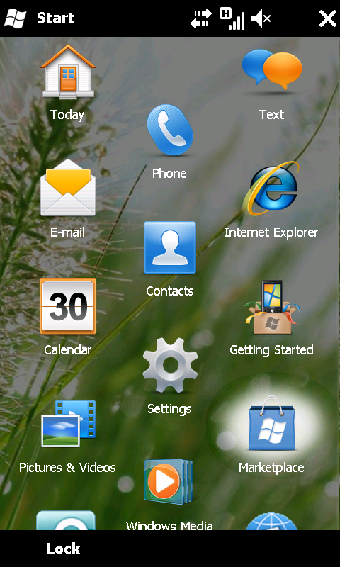
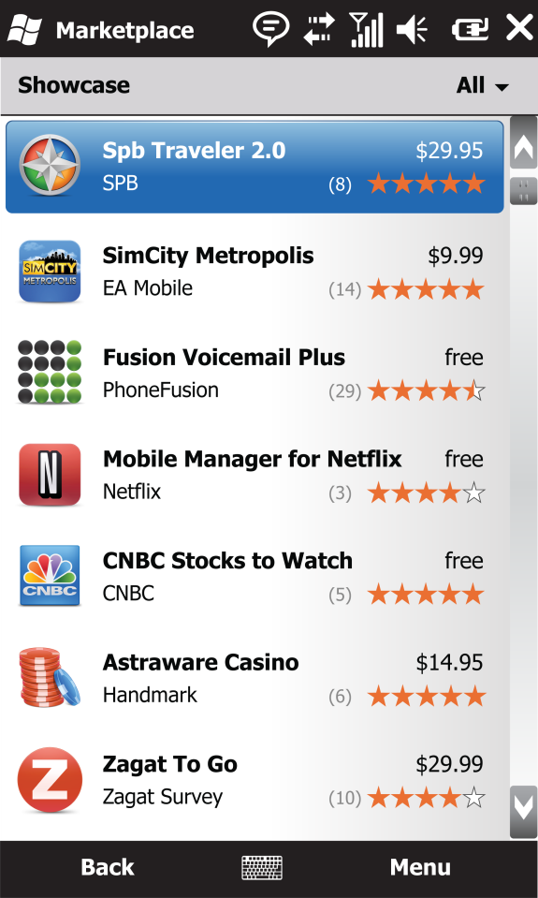
Windows Marketplace for Mobile
Connecting users with great apps!
Great discovery of the store and specific products
  Easily navigate a large library of applications
  Access user ratings and reviews
  Advanced search, sort and filter capabilities
Convenient purchase, download and installation
  Complete purchase from phone or web
  Seamless download and installation
  Pay with credit card or your mobile operator bill!
Worry-free shopping experience
  Applications tested to run on your phone model
  Automatic updates for purchased apps
  DIY refund
  Re-download purchased apps onto new phone
Notes:
Personalize your phone with applications
Explore and choose from thousands of commercial and free applications and content.
Search by category, keywords, price, or usage profile.
View ratings and recommendations and share yours.
Easily purchase and download
Buy “apps & content simply – on device or via Web.
Download content directly to the device wirelessly.
Enjoy peace of mind
All applications certified and tested to work on your device.
Transfer apps you already have to a new/replacement phone
View purchase record and move applications between devices

Slide 7
Catalog Architecture
Support for multiple content types
Key top-level content groups
Comprehensive category set
Mobile Operator
Showcase
Native Code
Most Popular
Managed Code
New
Widgets
Categories
Business
Health & Fitness
Search
Communications
Lifestyle
Games
Music & Video
Education
Productivity
Entertainment
Travel
Finance
Utilities
others…

Slide 8
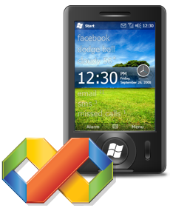

Value Proposition
Develop with familiar tools.
Simple and transparent publishing process.
Reach all Windows Phone users.
Strong ROI.
Notes:
Grow Distribution to every Windows Phone user
Pre-installed on every Windows phone (WM6.5+)
Global coverage with commerce in 29 countries at launch
Simple and Transparent publishing process
Transparent set of policies for what type of applications is permitted in the catalog
Centralized developer portal for sign-up, submissions, status checks and app management
Simplified certification and signing process
Maximize Return on Investment
Competitive revenue share
Promotional opportunities to drive up sales
Detailed and up-to-date sales report online

Slide 9
Familiar
Tools
Notes:
Visual Studio 2008
.NET CF 3.5
SQL CE
Javascript
XML
Hopper
AppVerifier

Slide 10
Transparent
Processes and Policies
Centralized developer portal for one-stop publishing and app management
Transparent policies for the types of applications allowed in the catalog
SDKs, documentation & support
Notes:
Support 3 tiers – forum based, email based, and for those more difficult and novel problems, 1:1 support.

Slide 11
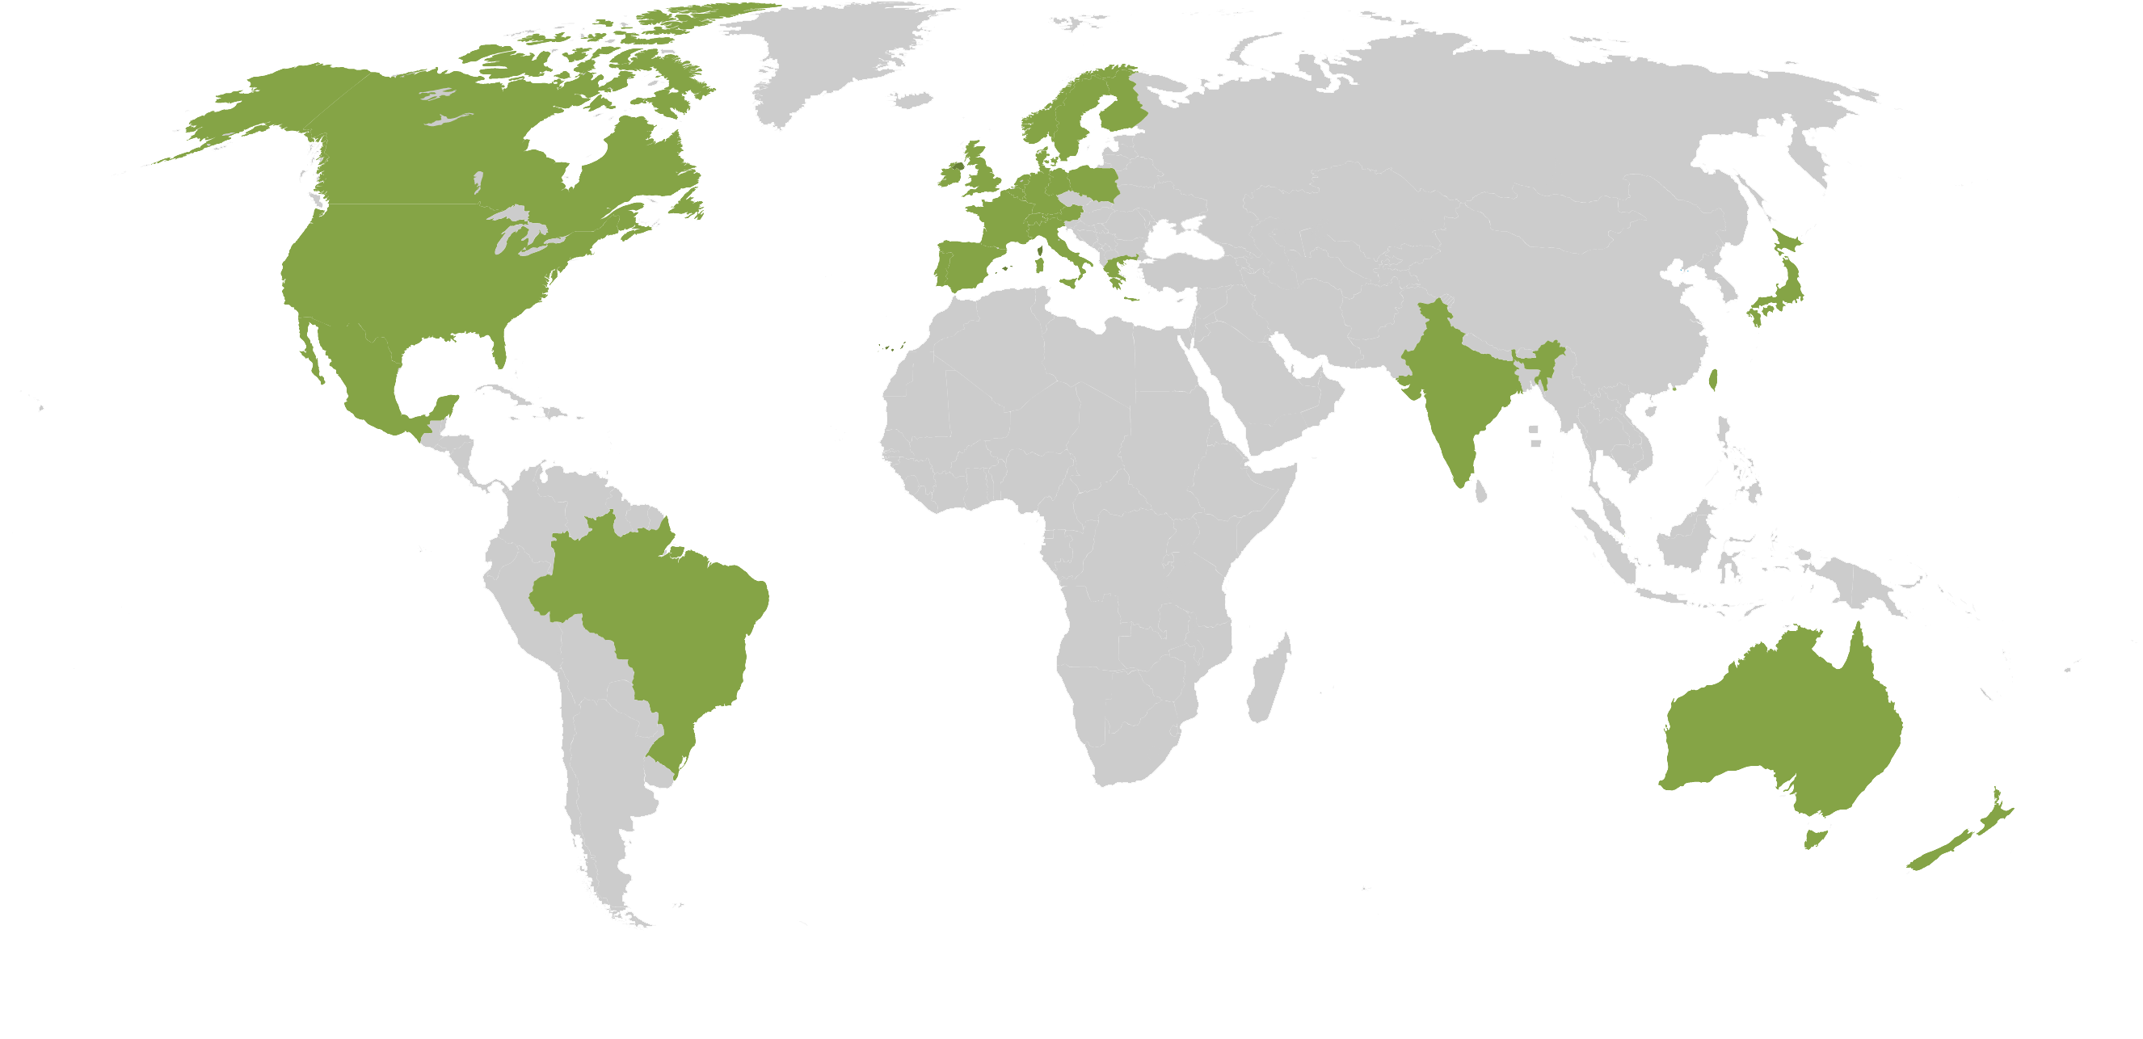
Global reach
EMEA
Austria
Greece
Poland
Belgium
Ireland
Portugal
Denmark
Italy
Spain
Finland
Luxembourg
Sweden
France
Netherlands
Switzerland
Germany
Norway
UK
ASIA/PACIFIC
Australia
New Zealand
Hong Kong
Singapore
AMERICAS
India
Taiwan
Brazil
Japan
Canada
Mexico
US
Notes:
The Windows Phone Footprint - 50 Mobile Device Manufacturers, 160 Mobile Operators, 55 Countries
Global coverage with commerce in 29 countries at launch
Localized products presented within localized catalogs.

Slide 12
Competitive Revenue Share
MSFT & Ecosystem
30%
Notes:
Covers operating costs, credit card commissions and rev share with other potential distribution partners

Slide 13
Portal
Demo
Notes:
Launch developer portal
Show basic info and connections to core set of developer information.
Show sign up for Marketplace

Slide 14
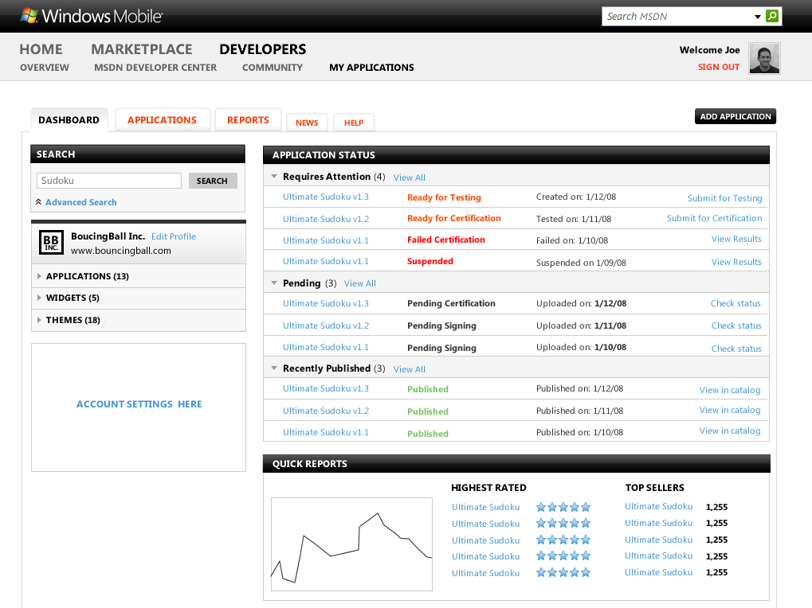
Developer Dashboard
Actionable notifications.
High level performance reporting.

Slide 15
Detailed Metadata
Simple Navigation.
Advanced Search.
Extensive metadata.

Slide 16
Signing up
Create a Marketplace publisher account @ http://developer.windowsmobile.com
        Establish a business profile
        Remit subscription fee
        Get vetted
        Start publishing

Slide 17
Application Provisioning
Provision
Distribute
Publish
Monetize
Certify
Sign
Sell
Support
Promote
Track progress
Author Metadata

Slide 18
Application Certification
Check that application is well written
Windows Mobile Logo Testing
Installs, uninstalls, no malware, no memory leaks, doesn’t change other apps on the device
Set of 60 objective criteria
Types of content prohibited within Windows Marketplace
Content Policies
Based on experience with other Microsoft marketplaces, and the Global Network Initiative
Application Policies
Types of applications which ISVs are not allowed to distribute via Windows Marketplace
Notes:
Content policy example: porn
App policy example: gambling

Slide 19
Reporting
Transactional reporting
User ratings and reviews
Geographical distribution reports

Slide 20



Getting Paid
Microsoft
Payment
Processor
EFT
Developer
Payout Currencies
US Dollar, Euro, British Pound, Canadian Dollar, Australian Dollar, Japanese Yen
Notes:
US Dollar
Euro
British Pound
Canadian Dollar
Australian Dollar
Japanese Yen

Slide 21
Timeline
SELL
LAUNCH
SUBMISSION
REGISTRATION
ANNOUNCEMENT
FEB
MAR
APR
MAY
JUN
JUL
AUG
SEP
OCT
NOV
DEC

Slide 22

Recap
Familiar Tools
Global Distribution
Competitive Revenue Share
Streamlined Transparent Publishing
Learn more @
http://developer.windowsmobile.com

Slide 23

Contact Us
http://developer.windowsmobile.com
http://blogs.msdn.com/windowsmobile
@wmdev
Daniel Bouie
dbouie@microsoft.com
John Bruno
jobruno@microsoft.com

Slide 24

Notes:
The information contained in this document represents the current view of Microsoft Corporation on the issues discussed as of the date of publication. Because Microsoft must respond to changing market conditions, it should not be interpreted to be a commitment on the part of Microsoft, and Microsoft cannot guarantee the accuracy of any information presented after the date of publication. Schedules and features contained in this document are subject to change.
This document is for informational purposes only. MICROSOFT MAKES NO WARRANTIES, EXPRESS, IMPLIED OR STATUTORY, AS TO THE INFORMATION IN THIS DOCUMENT.
Available programs, features, and functionality vary by device, Windows Mobile operating system version and version of Exchange Server used. Connectivity and synchronization may require separately purchased equipment and/or wireless products (e.g., WiFi card, network software, server hardware, and/or redirector software). Service plans are required for Internet, WiFi and phone access. Features and performance may vary by service provider and are subject to network limitations. See device manufacturer, service provider and/or corporate IT department for details.
©2008 Microsoft Corporation. All rights reserved.
Microsoft, Excel, Hotmail, Internet Explorer, Outlook, PowerPoint, SharePoint, Silverlight, Windows, Windows Live and Windows Mobile are either registered trademarks or trademarks of Microsoft Corporation in the United States and/or other countries.

