Slide 1
There is only Zuul
Configuring and customizing
the Zuul API gateway
Spencer Gibb
twitter: @spencerbgibb
email: sgibb@pivotal.io
Shoutout to
Michael Minella
for some slides and theme

Slide 2
MONOLITHS
Notes:
Let’s talk about the past
Tight coupling between data models and business logic
Operationally hard to deploy/troubleshoot/etc
Delayed time to market

Slide 3
MULTIPLE ENDPOINTS
& APPLICATIONS

Slide 4
LARGE COMPLEX
ARTIFACTS

Slide 5
DIFFICULT
TO TEST

Slide 6
HARD TO GET
TO PRODUCTION

Slide 7
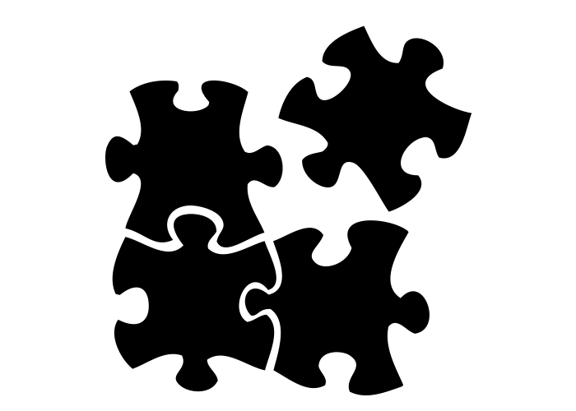
MICROSERVICES

Slide 8
CLOUD
NATIVE

Slide 9
DEVELOPED AND TESTED
IN ISOLATION

Slide 10
INDEPENDANTLY
SCALABLE

Slide 11
FAMILIAR DEVELOPMENT
MODEL

Slide 12
SMALL AND SIMPLE
TO TEST
Notes:
In isolation

Slide 13
OPERATIONALLY EASY TO
GOVERN

Slide 14
HOW DO EXTERNAL
CLIENTS CONNECT TO
MICROSERVICES?

Slide 15
You shall not pass!
Unless I know you…

Slide 16
What is an API Gateway
Server Side
MVC APP
API
Gateway
Product Info Service
Recommendation Service
Single Page
JS
or
Mobile APP
Review Service
Notes:
Single entry point for all clients
Common in microservice
Client insulation from services
Security, surgical routing, Load Shedding, etc…

Slide 17
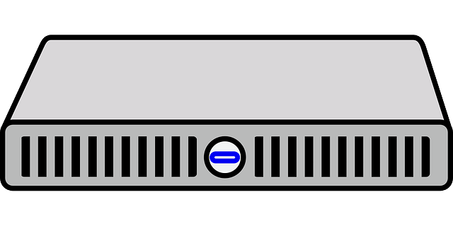
Spectrum of API Gateways
SASS
Notes:
Hardware Routers
SAAS Offerings
Open Source Infrastructure
We’ll be talking about developer oriented API Gateways

Slide 18
There is no Dana, only Zuul!
Notes:
AWS early adopter
Uses (Security, surgical routing, Load Shedding, etc...)
All Netflix clusters behind single Zuul behind ELB

Slide 19
SPRING CLOUD

Slide 20
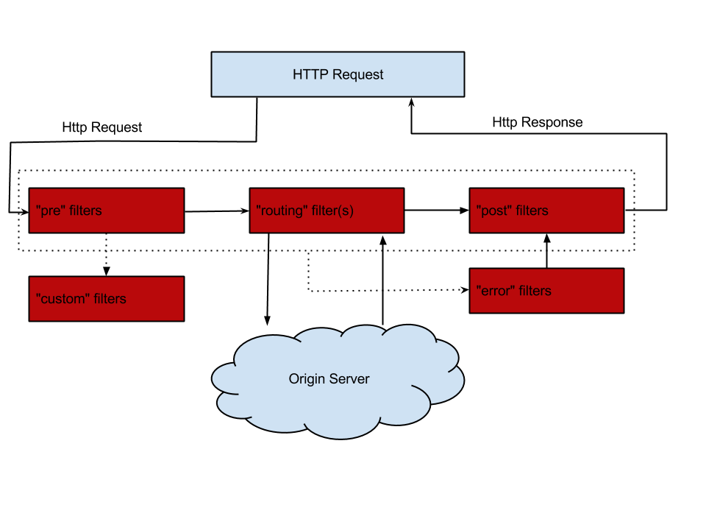
Zuul Design
Notes:
Global filter scope (each filter determines if it should be run)
Data shared via `RequestContext`

Slide 21
Notes:
Zuul is a blank canvas. No filters provided by the library.

Slide 22
@EnableZuulProxy
Notes:
Include: `spring-cloud-starter-zuul`
**Embedded** or **Dedicated**
Note:
- Default Filters installed
- URL Path routing only
- Properties & `DiscoveryClient` route definitions

Slide 23
1
PreDecorationFilter
Notes:
Request attributes are read and route destination is determined

Slide 24
2
RibbonRoutingFilter
Notes:
Ribbon is used as load balancer
Protected by Hystrix Circuit Breaker
Retry by Spring Retry
Choice of http clients: Apache HttpClient (default), OkHttp, Ribbon RestClient (deprecated)
Other routing filters: SimpleHostRoutingFilter, SendForwardFilter

Slide 25
3
SendResponseFilter
Notes:
Translates http client response to servlet response and sends back to api gateway client
Other Filters: SendErrorFilter

Slide 26
zuul:
routes:
users: /users/**
Notes:
Shortcut notation
Can specify the same serviceid using different keys and paths

Slide 27
DEMO
Demo

Slide 28
ZUUL 2
FUNKO POP
ANNOUNCED
http://techblog.netflix.com/2016/09/zuul-2-netflix-journey-to-asynchronous.html

Slide 29
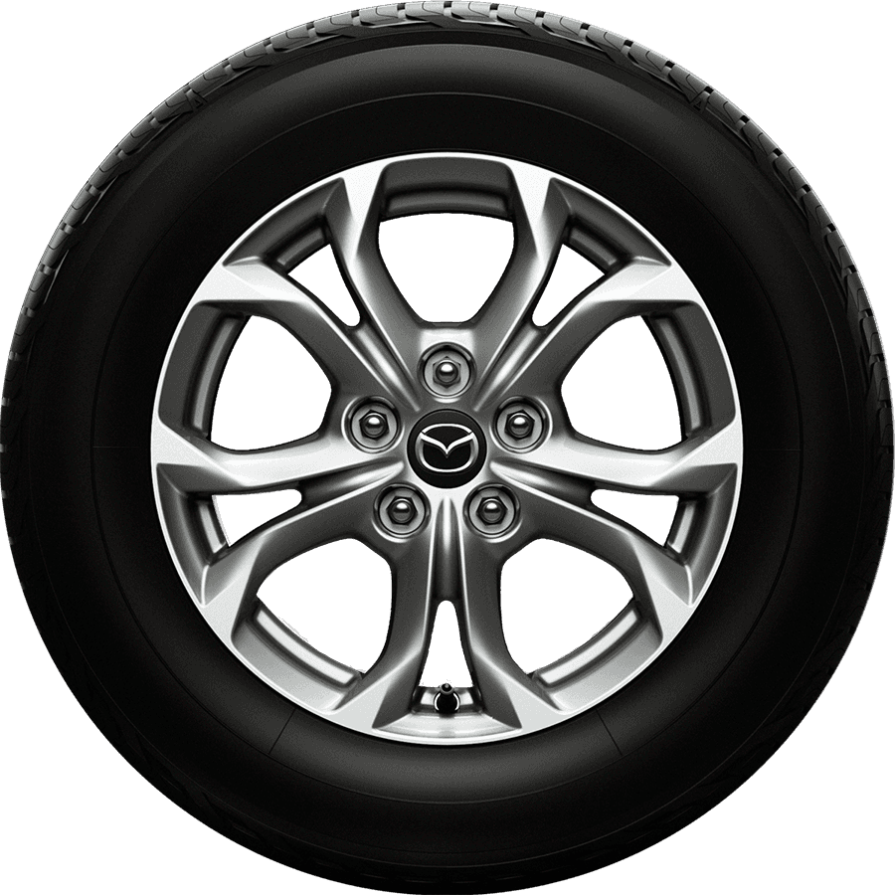
WIP
INCOMPATIBLE
W/ ZUUL 1
NETTY
NON-BLOCKING
MAJOR
REWRITE
HTTP/2**
WEBSOCKETS
SPRING
OVERLAP
Notes:
Not backwards compatible with Zuul 1
Announced last September, Not released yet
Lots of work to get async/non-blocking
HTTP/2 and Websockets are future enhancements
Overlap with Spring
Filters
HTTP API Classes
Etc…

Slide 30
Notes:
But this is a Zuul talk... awkward

Slide 31
SPRING CLOUD
GATEWAY

Slide 32
SPRING BOOT
2.0 Q4 2017
PROJECT
REACTOR
SPRING 5
SPRING CLOUD
GATEWAY
HTTP/2
WEBSOCKETS
SPRING
REUSE
API
DRIVEN
Notes:
Spring 5, Java 8 Baseline
Built on Spring Boot 2.0, Due Q4 2017
Reactive core based on Project Reactor (Non-blocking IO, Multiple runtimes, netty, jetty, undertow)
HTTP/2 and Websockets part of Spring Framework, planned to be delivered as part of first release
Reuse from Spring
Filters
Predicates
Route Mapping

Slide 33
1
ROUTE MGMT API
Notes:
Spring Boot Actuator
Production Ready
Security
Different Port

Slide 34
2
ROUTE: VIA CONFIG
Notes:
Spring Boot Configuration
If Spring Cloud Config is used, it can be updated and refreshed

Slide 35
2
ROUTE: VIA DISCOVERY
Notes:
Uses Spring Cloud DiscoveryClient abstraction
Opt-in (zuul 1 is opt-out)
Eureka, Consul, Zookeeper, etc…

Slide 36
2
ROUTE: VIA DB
Notes:
Simple repository interface
Plans to have reactive db impls (Cassandra, couchbase, redis)
Spring Data

Slide 37
3
ROUTE SCOPED FILTERS
Notes:
Zuul 1 Filters are scoped only by shouldFilter method
Clunky to match and then have to match again
Configuration per route
There are global filters and a shortcut to add filters to each route (default filters)

Slide 38
4
FLEXIBILE
Notes:
Easy to combine predicates for route matching
Easy to manipulate routes
Embedded or standalone

Slide 39
5
SIMPLIFIED
Notes:
Easier from user perspective
Easy to add filters and predicates
Easier from project maintainer perspective
Smaller more modular filters and predicates

Slide 40
spring.cloud.gateway.routes:
- id: users
uri: http://users-xyz:80
predicates:
- Host=**.example.org
- Path=/users/{segment}
filters:
- SetPath=/{segment}
Notes:
This is a list, not a map like zuul 1

Slide 41
spring.cloud.gateway.routes:
- id: users
uri: http://users-xyz:80
predicates:
- Host=**.example.org
- Path=/users/{segment}
filters:
- SetPath=/{segment}

Slide 42
spring.cloud.gateway.routes:
- id: users
uri: http://users-xyz:80
predicates:
- Host=**.example.org
- Path=/users/{segment}
filters:
- SetPath=/{segment}

Slide 43
spring.cloud.gateway.routes:
- id: users
uri: lb://users
predicates:
- Host=**.example.org
- Path=/users/{segment}
filters:
- SetPath=/{segment}
Notes:
Proposed URI syntax.
Activates Ribbon Load Balancer

Slide 44
spring.cloud.gateway.routes:
- id: users
uri: lb://users
predicates:
- Host=**.example.org
- Path=/users/{segment}
filters:
- SetPath=/{segment}
Notes:
Shortcut syntax

Slide 45
spring.cloud.gateway.routes:
- id: users
uri: lb://users
predicates:
- Host=**.example.org
- Path=/users/{segment}
filters:
- SetPath=/{segment}
Notes:
Curly braces are part of spring path matching

Slide 46
spring.cloud.gateway.routes:
- id: users
uri: lb://users
predicates:
- Host=**.example.org
- Path=/users/{segment}
filters:
- SetPath=/{segment}
Notes:
Filters can reuse path matched segments

Slide 47
spring.cloud.gateway.routes:
filters:
- AddResponseHeader=X-Response-Foo, Bar
- RemoveResponseHeader=X-Foo
- SecureHeaders
- RewritePath=/foo/(?<part>.*), /$\{part}
- Hystrix=foocmd
Notes:
Filters are scoped to the route
Filters are small and easy to comprehend

Slide 48
DEMO
Demo
Notes:
Time permitting

Slide 49
SPRING CLOUD
GATEWAY
MILESTONE 1 END OF MAY
Notes:
Should track boot milestones and release candidates fairly quickly

Slide 50
SPRING CLOUD
GATEWAY
RELEASE DECEMBER 2017
Notes:
After GA of Spring Boot 2.0

Slide 51
WHAT HAPPENS TO
ZUUL 1?
Notes:
Traditional Zuul 1 will stay around.
In the future there could be a possible compatibility layer.

Slide 52
Learn More. Stay Connected.
Pivotal: pivotal.io
Twitter: twitter.com/springcloud
YouTube: spring.io/video
LinkedIn: spring.io/linkedin
Google Plus: spring.io/gplus
Spencer Gibb
Blog: spencer.gibb.us
Twitter: @spencerbgibb
Spring Cloud Zuul Samples
github.com/spring-cloud-samples/sample-zuul-filters
Spring Cloud Gateway
github.com/spring-cloud-incubator/spring-cloud-gateway

Slide 53
QUESTIONS?

Slide 54
The
End

