Slide 1
Open Source &
Open Standards in VR
Stephanie Hurlburt

Slide 2
VR/XR is an exciting, rapidly evolving field
It touches every industry, from medical to construction to real estate to gaming
It changes the way we interact with our world, and the way we see computers
Every interaction needs to be rethought when designing for VR
“XR” encompasses VR, AR, MR, and more
Open source and open standards are crucial

Slide 3
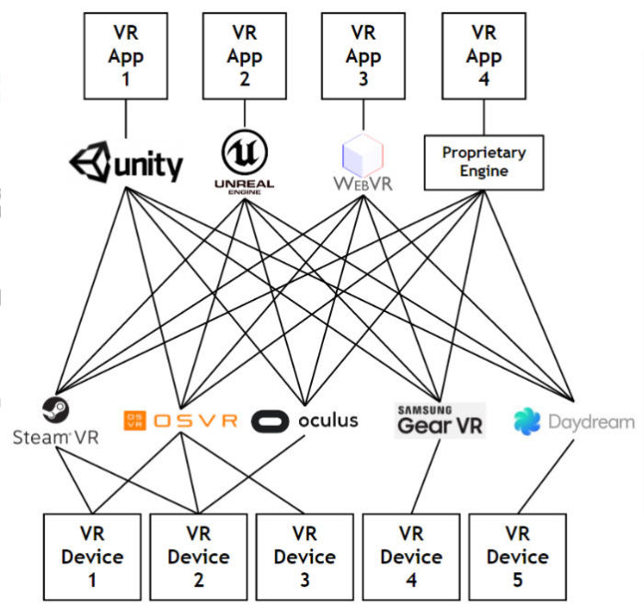
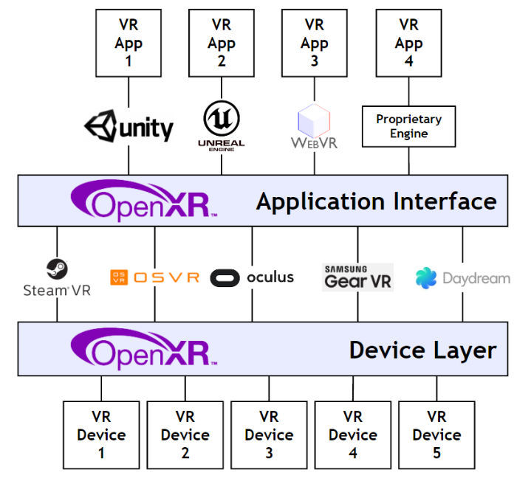
The Current Ecosystem & OpenXR

Slide 4
glTF and Basis
glTF will be an open standard owned by the Khronos Group to represent 3D scenes and models
I am working on Basis, an open standard for texture and image data
Good performance is crucial to VR. JPEG is uncompressed on GPUs-- Basis keeps your image compressed.
For this to actually succeed, it must be an open standard

Slide 5
Open Source VR Experiences

Slide 6
JanusVR

Slide 7
Experiences
Social VR is powerful-- we can interact with someone across the globe and feel more connected than ever before
Art is powerful in VR-- we are truly immersed in the medium
High Fidelity, JanusVR, HypVR
Many experiences built on open source engines are also open source

Slide 8
Engines and Frameworks

Slide 9
VRTK

Slide 10
Engines and Frameworks
The sheer amount of open source frameworks available demonstrates how important they are to the VR ecosystem
AFrame, AR.js, ARToolkit
Cinder, OpenFrameworks, Unreal Engine, Primrose, Gear VR Framework, G3D Innovation Engine, Towerengine, Falcor
NewtonVR, Bullet Physics

Slide 11
Interacting with the Hardware
Hardware is a crucial part of making VR work
There is a large movement to create open source drivers
OSVR, Libsurvive, OpenHMD

Slide 12
Open Source is Crucial
We want this powerful medium to be open
We need debuggability in a fast-paced, highly evolving ecosystem
We should stop reinventing the wheel so we can focus on powerful experiences
We should focus our efforts on building shared, good quality frameworks

Slide 13
Thank you.
@sehurlburt
binomial.info

