Slide 1
Virtualizing Big Data/Hadoop Workloads on vSphere
Justin Murray,
Technical Marketing, Big Data
VMware

Slide 2
Agenda
Why Virtualize Hadoop?
Performance
Reference Architectures
Conclusions
References
Q and A

Slide 3
Why Virtualize Hadoop?

Slide 4
Use Cases : Virtualization of Big Data
IT wants to provide Hadoop clusters as a service on-demand for its end users
Enterprises have development, test, pre-prod staging and production clusters that are required to be separated from each other and provisioned independently
Organizations need different versions of Hadoop to be available to different teams - with possibly different services available (e.g. HBase, MapReduce, Spark)
Enterprises do not wish to dedicate a set of hardware to each different requirement above, and want to reduce overall costs

Slide 5
The Hadoop Architecture
Master Roles
Job
Resourcemanager
Namenode
Input File
Split 1 – 64MB
Worker Node 1
Worker Node 2
Worker Node 3
Split 2 – 64MB
Nodemanager
Nodemanager
Nodemanager
Split 3 – 64MB
AppMaster - 1
Container - 2
Container - 3
Datanode
Datanode
Datanode
Block 1 – 64MB
Block 2 – 64MB
Block 3 – 64MB
Notes:
The terminology presented here will be used in the rest of the talk.
The input data for a job is broken down into multiple splits or blocks and spread across a set of DataNodes – each of these blocks are sized at a minimum size of 64MB. They can be sized at 128MB or higher also, depending on the parameters set.
A Job – such as a search job – is sent to a ResourceManager process first. The ResourceManager controls the allocation of NodeManagers to parts of that job. The ResourceManager is the central brain that controls the execution of the MapReduce algorithms by the NodeManagers. A job is broken down into multiple tasks -- map and reduce tasks -- that get scheduled on NodeManager nodes. A Mapper processes one block of data at a time. When the Mapper has processed the block, it makes sure the output is sorted and passes the data to a Reducer, which does further processing and writes the output data back to the Hadoop File System (HDFS).
Typically both the NodeManager and DataNode roles are components of a worker node
Tasks are scheduled as much as possible close to where the data resides. The ResourceManager checks with the NameNode, which knows where each data block is located, in order to figure out where best to place the work.
This is the end of a quick Hadoop primer for those new to Hadoop.

Slide 6
Hadoop – in Virtual Machines
Master Roles
Job
ResourceManager
Namenode
Input File
Split 1 – 64MB
Worker Node 1
Worker Node 2
Worker Node 3
Split 2 – 64MB
Nodemanager
Nodemanager
Nodemanager
Split 3 – 64MB
AppMaster - 1
Container - 2
Container - 3
Datanode
Datanode
Datanode
Block 1 – 64MB
Block 2 – 64MB
Block 3 – 64MB
Notes:
The terminology presented here will be used in the rest of the talk.
The input data for a job is broken down into multiple splits or blocks and spread across a set of DataNodes – each of these blocks are sized at a minimum size of 64MB. They can be sized at 128MB or higher also, depending on the parameters set.
A Job – such as a search job – is sent to a ResourceManager process first. The ResourceManager controls the allocation of NodeManagers to parts of that job. The ResourceManager is the central brain that controls the execution of the MapReduce algorithms by the NodeManagers. A job is broken down into multiple tasks -- map and reduce tasks -- that get scheduled on NodeManager nodes. A Mapper processes one block of data at a time. When the Mapper has processed the block, it makes sure the output is sorted and passes the data to a Reducer, which does further processing and writes the output data back to the Hadoop File System (HDFS).
Typically both the NodeManager and DataNode roles are components of a worker node
Tasks are scheduled as much as possible close to where the data resides. The ResourceManager checks with the NameNode, which knows where each data block is located, in order to figure out where best to place the work.
This is the end of a quick Hadoop primer for those new to Hadoop.

Slide 7
Spark Architecture - on YARN
Job
Driver
Namenode
Worker Node 1
Worker Node 2
Worker Node 3
Executor
Executor
Executor
AppMaster - 1
Container - 2
Container - 3
Datanode
Datanode
Datanode
Block 1 – 64MB
Block 2 – 64MB
Block 3 – 64MB

Slide 8
Performance

Slide 9
Workloads - Spark
Two standard analytic programs from the Spark MLLib (Machine Learning Library)
Driven using SparkBench (https://github.com/SparkTC/spark-bench)
Support Vector Machine
Logistic Regression
Notes:
Support Vector Machine
Binary classifier with different algorithm than Logistic Regression
Datasets from .5 to 1.5 TB tested
Algorithm handled all datasets in memory
Logistic Regression
Binary classifier – given an example with, say, 20 features, determine if the example falls in a class or not
Spam filters
Credit card fraud detectors
Datasets from .5 to 3 TB tested
On 5-node cluster all datasets overflowed memory and were written to disk
On 10-node cluster (virtualized and bare-metal) 1.5 TB and larger were written to disk

Slide 10
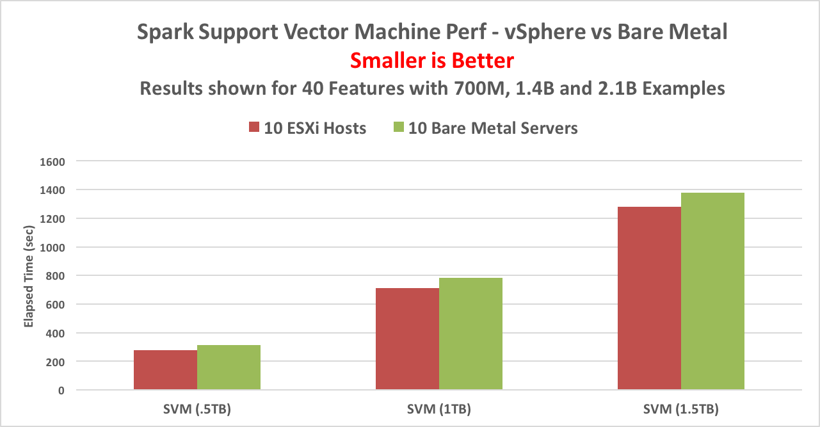
Spark Support Vector Machine Performance
Notes:
Both workloads showed linear scaling from 5 to 10 hosts and also as dataset size increased
Support Vector Machines workload, which stayed in memory, ran about 10% faster virtualized than on bare metal
despite the larger memory size available on bare metal
Logistic Regression workload, showed a slight advantage to bare metal as part of the dataset was cached to disk,
perhaps due to the larger memory of the bare metal Spark executors

Slide 11
Results - Spark
Support Vector Machines workload, which stayed in memory, ran about 10% faster in virtualized form than on bare metal
Workloads showed linear scaling from 5 to 10 hosts and as dataset size increased
“Big Data Performance on vSphere 6 – Best Practices” http://www.vmware.com/content/dam/digitalmarketing/vmware/en/pdf/techpaper/bigdata-perf-vsphere6.pdf

Slide 12
Virtualized Cluster
DataNode
NodeMgr
DataNode
NodeMgr
DataNode
NodeMgr
DataNode
NodeMgr
VMs
Host 1
Cloudera Manager
Master 1
Virtual Center
Host 3
Disks
Infrastructure nodes
...
Worker nodes
DataNode
NodeMgr
DataNode
NodeMgr
DataNode
NodeMgr
DataNode
NodeMgr
VMs
Host 2
Master 2
VRealize
Ops
VRealize
Log
Insight
Host 12
Disks

Slide 13
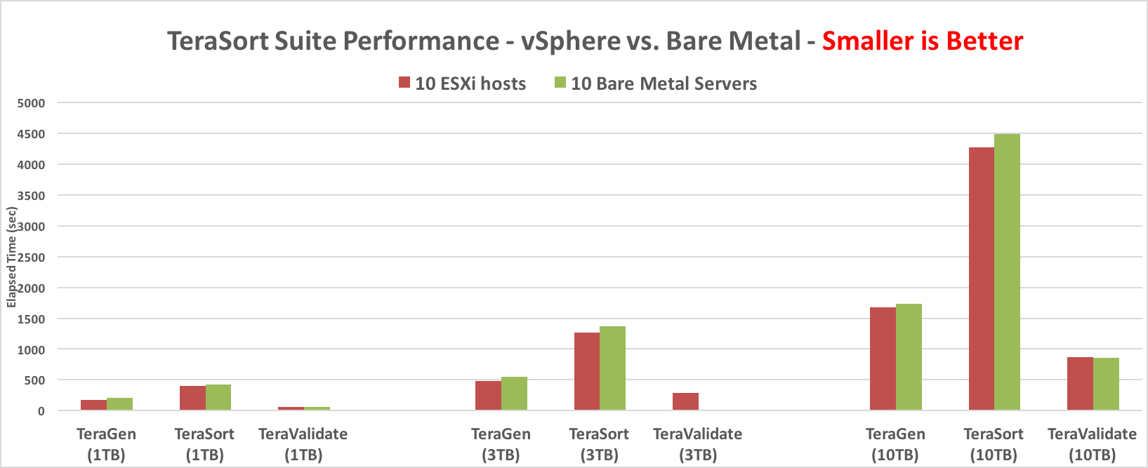
TeraSort Suite Performance - 1, 3 and 10 TB

Slide 14
Reference Architectures

Slide 15
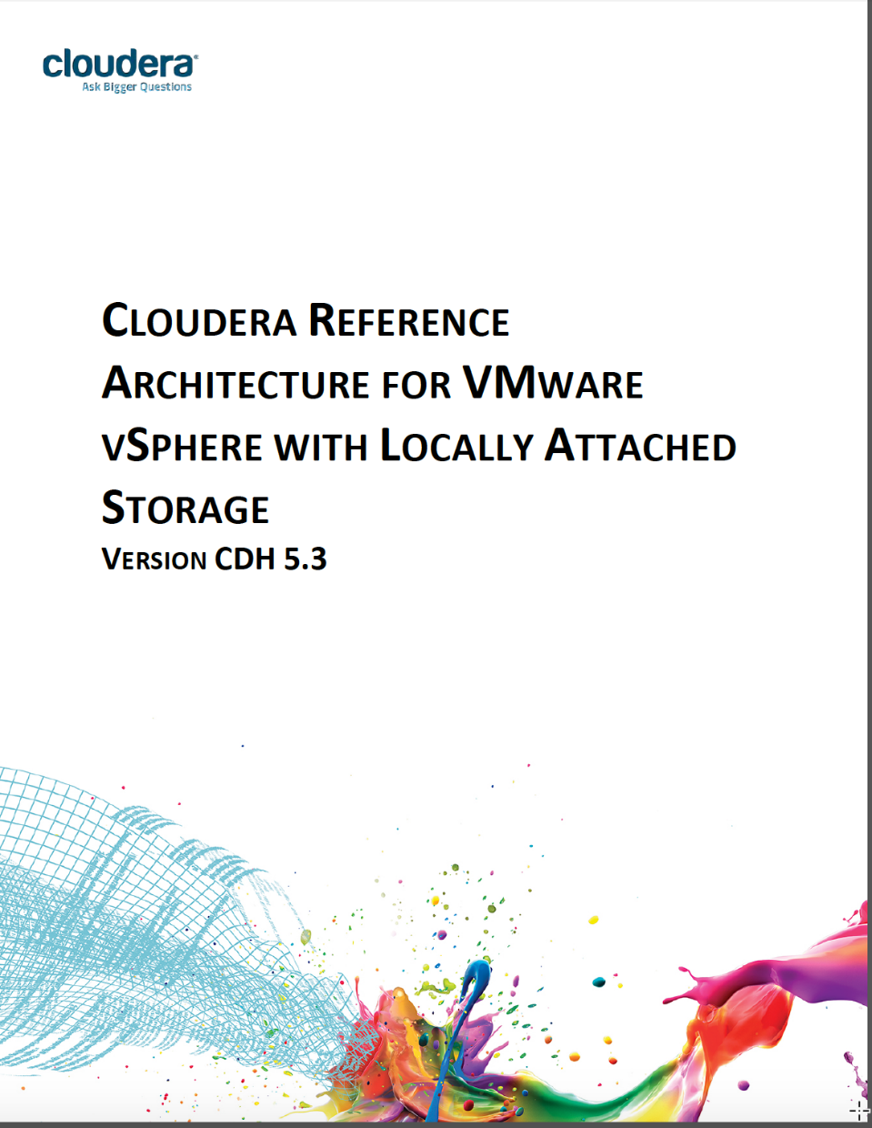
Direct Attached Storage – Reference Architecture from Cloudera

Slide 16
Combined Model: Two Virtual Machines on a Host
Hadoop
Node 1
Virtual
Machine
Hadoop
Node 2
Virtual
Machine
Nodemanager
Datanode
Nodemanager
Datanode
Ext4
Ext4
Ext4
Ext4
Ext4
Ext4
Ext4
Ext4
Ext4
Ext4
Ext4
Ext4
Virtualization
Host Server
VMDK
VMDK
VMDK
VMDK
VMDK
VMDK
VMDK
VMDK
VMDK
VMDK
VMDK
VMDK
Six Local DAS disks per Virtual Machine

Slide 17
Key Points to Know about the RA
Cloudera does not support Multi-homed cluster nodes, so use a single VLAN/IP subnet. Multiple NICs can be bonded to enable FT and higher capacity, but each VM should have only one IP address.
Disable automated movement of storage and VMs
Hadoop is a distributed computing framework and will take care of high availability
For Production workloads, ensure that the worker VMs are sized so that there is no resource contention
One CPU core/vCPU per disk spindle.
Ensure there are never two masters on the same physical node (use anti-affinity).
In the case where two or more VMs are provisioned on the same physical host, enable Hadoop Virtualization Extensions (HVE), with the physical host as a Nodegroup
Ensures HDFS block placement never places replicas of any block on the same physical node.

Slide 18
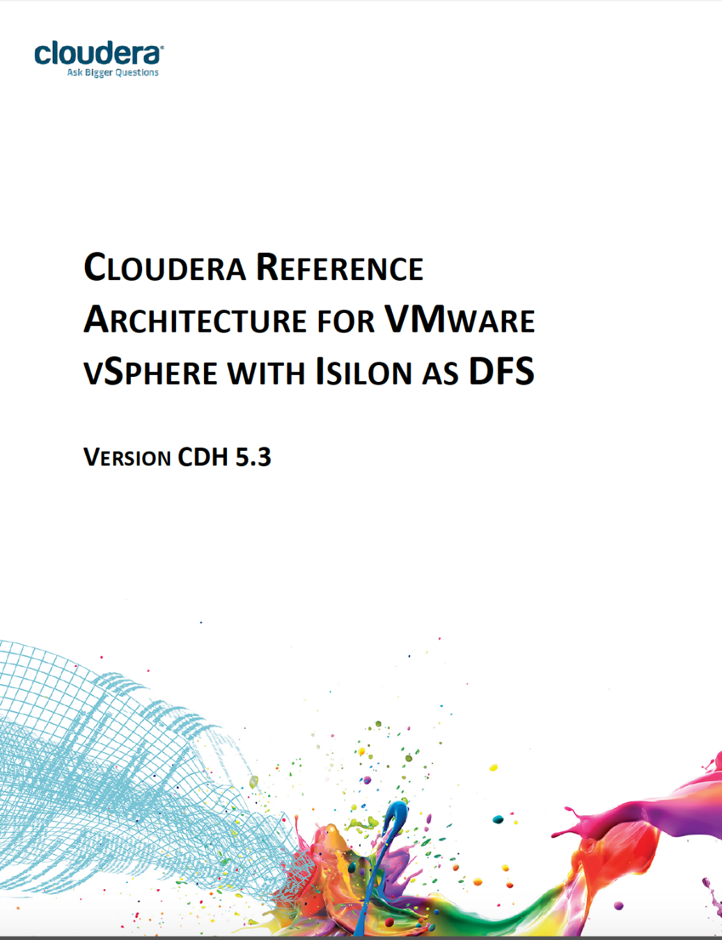
Isilon Reference Architecture from Cloudera

Slide 19
Data/Compute Separation with Isilon for HDFS
Hadoop
Virtual
Node 1
Hadoop
Virtual
Node 2
Hadoop
Virtual
Node 3
ResourceManager
NodeManager
NodeManager
Ext4
Ext4
Ext4
Ext4
Ext4
Ext4
Virtualization
Host
OS Image –
VMDK
VMDK
OS Image –
VMDK
VMDK
OS Image –
VMDK
VMDK
Temp
Shared storage
SAN/NAS
Temp
NN
NN
NN
data node
NN
NN
NN
Isilon
Notes:
This deployment model makes use of the EMC Isilon Network Attached Storage device, which can be seen as an expandable set of file servers that export the HDFS interfaces and contains a set of NameNodes to manage that data within its own proprietary OpenFS file system. In this model, all of the HDFS-related data is stored on the Isilon NAS device. Other data, such as the system disks for the operating systems and other installed items within the guest operating systems are held in VMDK files that are mapped to the shared storage mechanisms on the left – perhaps a SAN. This simplifies our design to a great degree in that we now need to concern ourselves only with the ResourceManager and NodeManager or “Compute” roles within Hadoop in virtual machines and all application data is stored securely on the Isilon device. Traffic to and from the Isilon is carried over dedicated network interfaces in the virtual machines that map to physical switches that front-end the Isilon device. This design has distinct advantages in centrally storing the data while still providing HDFS interfaces to it. This is an excellent option for customers with Blade-based infrastructures that cannot accommodate local storage, but need to expand beyond the bandwidth levels of a SAN based approach.

Slide 20
Key Points to Know about the RA (1)
Ensure that Master nodes are set up with anti-affinity (i.e. on separate host servers)
Disable automated movement of storage and VMs
Ensure compute nodes are configured with adequate resources and intermediate storage for MapReduce shuffle, Impala scratch storage, etc.
Typically the intermediate storage is ~ 20% of the total HDFS capacity. If you have 100TB of HDFS storage, have 20TB of intermediate storage. This can be provisioned as -
LUNs from a SAN storage array
local SATA or SAS drives
local SSDs
Ensure the scratch storage is evenly distributed across all compute nodes. If you have forty 500GB HDDs and eight compute nodes, provision five 500GB HDDs to each node and configure as YARN and impala local/scratch directories.

Slide 21
Key Points to Know about this RA (2)
Networking
All IO in this architecture is network bound, as every read and every write will traverse back and forth between the storage (Isilon) layer and the compute (CDH) layer.
Ensure multi-homing is not configured. Cloudera does not support multi-homed clusters.
Either use a full mesh topology, with a physical spine-leaf network architecture or ensure sufficient bandwidth between the Isilon switches and the CDH cluster switches to allow full bandwidth.
Recommend connecting the Isilon nodes to the same ToR switches as the CDH nodes. This will improve the network performance as network traffic will be localized to the ToR switches as much as possible.

Slide 22
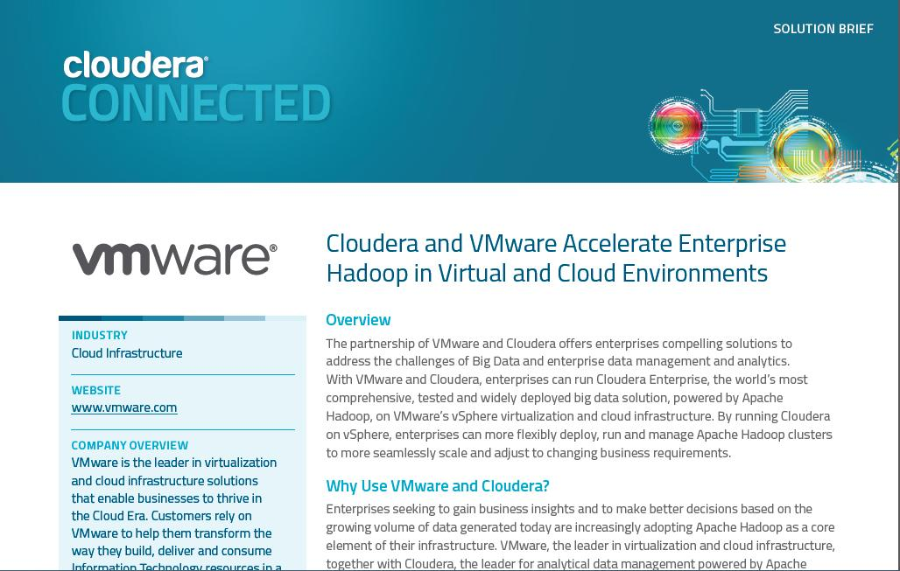
22

Slide 23
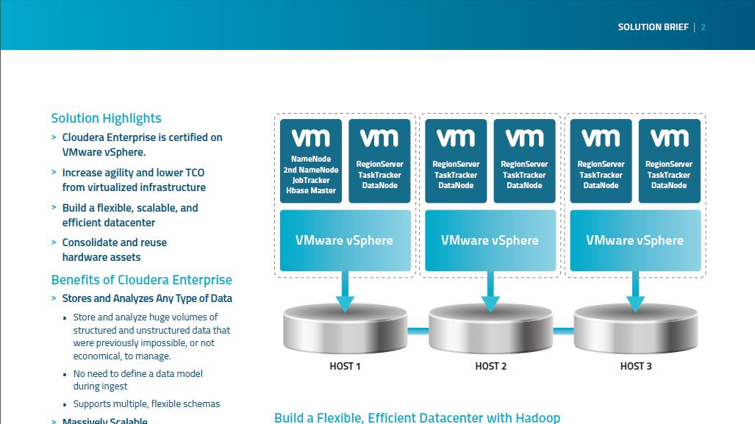
23

Slide 24
Virtualizing Big Data
Agility
Infrastructure on demand
Simplified Management
Centralized data center management
Apply known best practices
Efficiency
Resource pooling
Server and cluster consolidation
Performance
Sharing of physical resources – not dedicated clusters
As good as, and often better performance than native
No significant overhead
vSphere
Notes:
And that’s what I want to speak to you about today: the Value Proposition of Virtualizing Big Data Applications.

Slide 25
Tools for Cluster Lifecycle Management
Spin up, grow & shrink, terminate CDH clusters that read/write to object store
Easy Administration
Dynamic cluster lifecycle management
Single pane of glass: multi-cluster view
Cloudera node-based, usage-based pricing
Flexible Deployments
Multi-cloud: AWS, Azure, GCP
Easy cluster deployments
Scaling of CDH clusters
Enterprise-grade
Integration across Cloudera Enterprise
Management of CDH deployments at scale
Cloudera Director
The information in this presentation is intended to outline our general product direction and it should not be relied on in making a purchasing decision. It is for informational purposes only and may not be incorporated into any contract

Slide 26
VMware vSphere and Hadoop Resources
VMware vSphere Big Data web site
http://www.vmware.com/big-data
Big Data Performance on vSphere 6 – Best Practices for Optimizing Virtualized Big Data Applications http://www.vmware.com/content/dam/digitalmarketing/vmware/en/pdf/techpaper/bigdata-perf-vsphere6.pdf
Virtualized Hadoop Performance with VMware vSphere 6 on High-Performance Servers
http://www.vmware.com/resources/techresources/10452
Virtualized Hadoop Performance with VMware vSphere 5.1
http://www.vmware.com/resources/techresources/10360
Benchmarking Case Study of Virtualized Hadoop Performance on vSphere 5
http://vmware.com/files/pdf/VMW-Hadoop-Performance-vSphere5.pdf
Hadoop Virtualization Extensions (HVE) :
http://www.vmware.com/files/pdf/Hadoop-Virtualization-Extensions-on-VMware-vSphere-5.pdf
Apache Hadoop High Availability Solution on VMware vSphere 5.1
http://vmware.com/files/pdf/Apache-Hadoop-VMware-HA-solution.pdf

Slide 27
