Slide 1
Semantic natural language understanding at scale using Spark, machine-learned annotators and deep-learned ontologies
David Talby
@davidtalby
Claudiu Branzan
@melcutz

Slide 2
The problem
Who needs to be vaccinated?
Who is at risk for sepsis?
Who fits this clinical trial?
Who on this protocol did not have this side effect?
Who is getting meds they’re allergic to?

Slide 3
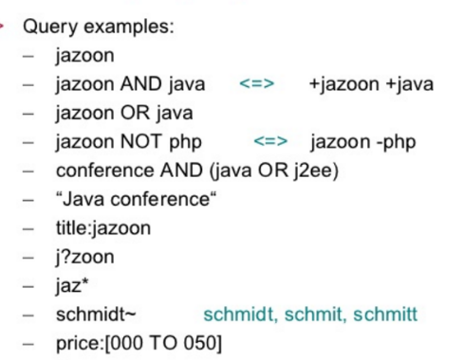
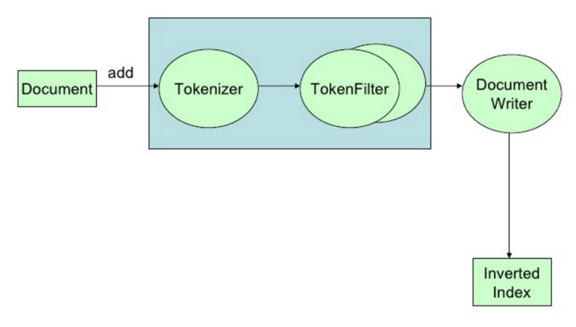
At the beginning, there was search
Scalable & robust Indexing pipeline
Tokenizers & analyzers
Synonyms, spellers & Auto-suggest
File formats & header boosting
Rankers, link & reputation boosting

Slide 4
Then there was semantic search
“cheap red prom dresses”
“laptops under $500”
“italian restaurants near me that deliver”
“captain america civil war tonight”
“nba scores”
Dictionary Based Attribute Extraction
Dell - XPS 15.6 4K Ultra HD Touch-Screen Laptop - Intel Core i5 - 8GB Memory - 256GB Solid State Drive - Silver
Machine Learned Attribute Extraction
If you go for the ambience, you'll be disappointed. If you go for good, inexpensive and authentic Mexican food, then you're in the right place.

Slide 5
And Then, you need to understand language
Prescribing sick days due to diagnosis of influenza. | Positive
Jane complains about flu-like symptoms. | Speculative
Jane may be experiencing some sort of flu episode. | Possible
Jane’s RIDT came back negative for influenza. | Negative
Jane is at high risk for flu if she’s not vaccinated. | Conditional
Jane’s older brother had the flu last month. | Family history
Jane had a severe case of flu last year. | Patient history

Slide 6
Language gets complex & domain specific
Joe expressed concerns about the risks of bird flu. | Nothing
Joe shows no signs of stroke, except for numbness. | Double Negative
Nausea, vomiting and ankle swelling negative. | Compound
Patient denies alcohol abuse. | Speculative
Allergies: Penicillin, Dust, Sneezing. | Compound
(it gets worse – in reality a lot of text isn’t valid English)

Slide 7
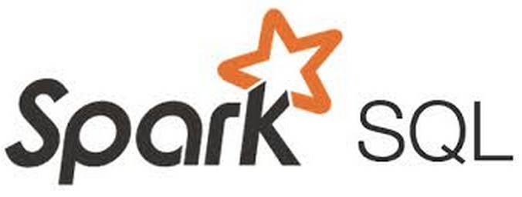
Let’s build this!
The input
(patient records)
The processing
framework
The output
The query engines
ASSERTIONS
ASSERTIONS

Slide 8
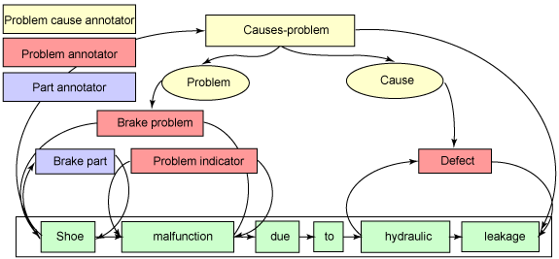
SENTENCE DETECTION
TOKENIZER
LEMMATIZER
STOPWORD REMOVAL
NAMED ENTITY EXTRACTION
PART OF SPEECH TAGGING
NEGATION DETECTION
DOCUMENT CLASSIFICATION
MEDICAL CONCEPT EXTRACTION

Slide 9
First Demo: quick primer on spaCy

Slide 10
Machine learned annotators
Sometimes, it’s easier to just code an annotation’s business logic
Grammatical Patterns
If … then …
Direct Inferences
Age < 18 ==> Child
Lookups
RIDT (lab test)
But sometimes it’s easier to learn it from examples:
Under-diagnosed conditions
Flu Depression
Implied by Context
relevant labs normal

Slide 11
Second Demo: Machine Learned Annotator using Tensorflow

Slide 12
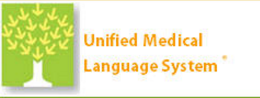
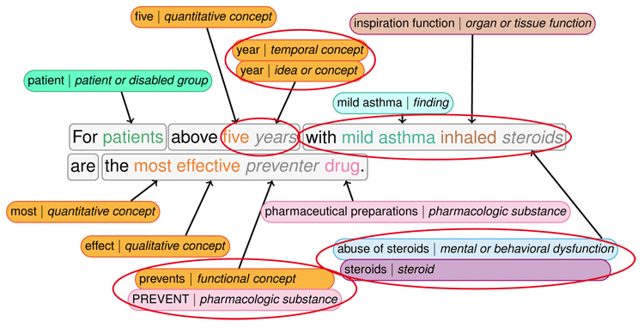

Slide 13
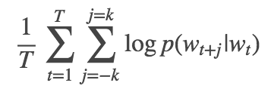
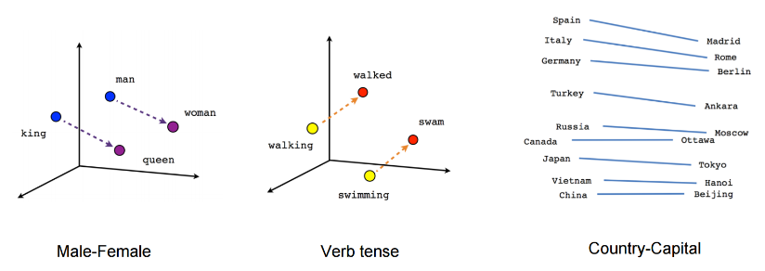
What about expanding & updating ontologies?
Word2Vec

Slide 14
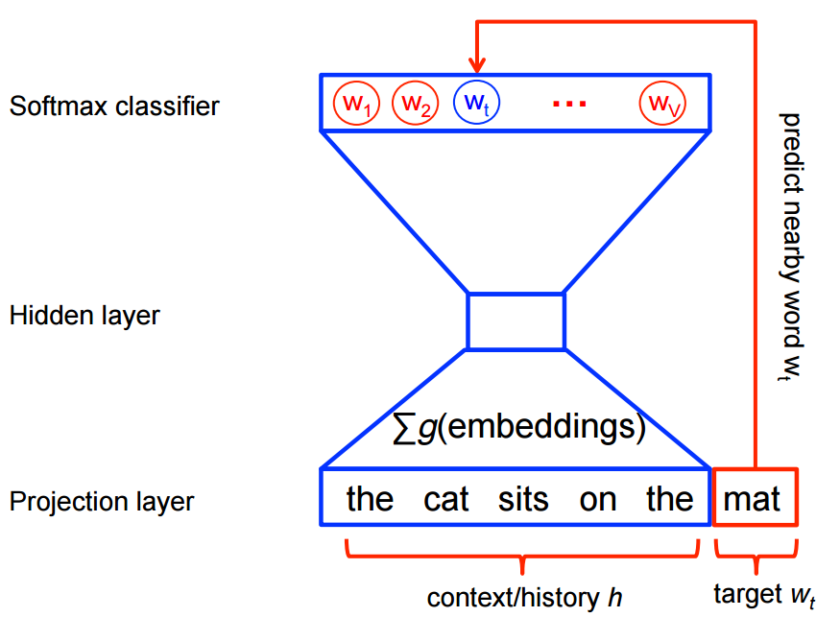
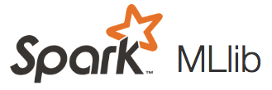
Let’s build this too!
Ontology

Slide 15
Third Demo: Ontology Enrichment

Slide 16
Summary & applications
Who needs to be vaccinated?
Who is at risk for sepsis?
Who fits this clinical trial?
Who on this protocol did not have this side effect?
Who is getting meds they’re allergic to?

Slide 17
Free notebooks: https://github.com/melcutz/NLP-demo-2017
@melcutz
@davidtalby

Slide 18
appendix
In case the live demo gets cold feet on stage

Slide 22
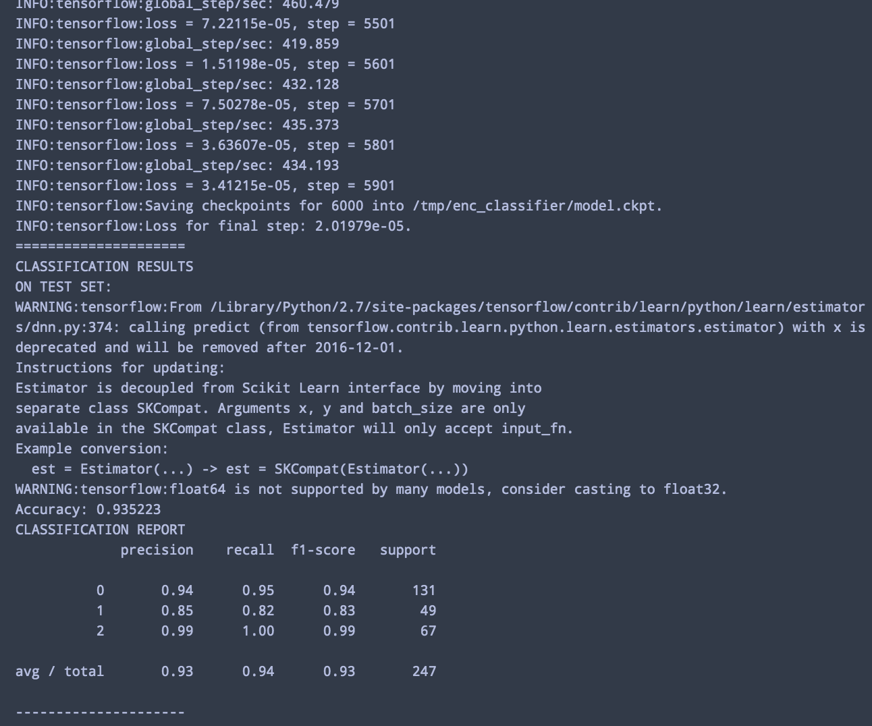

Slide 23
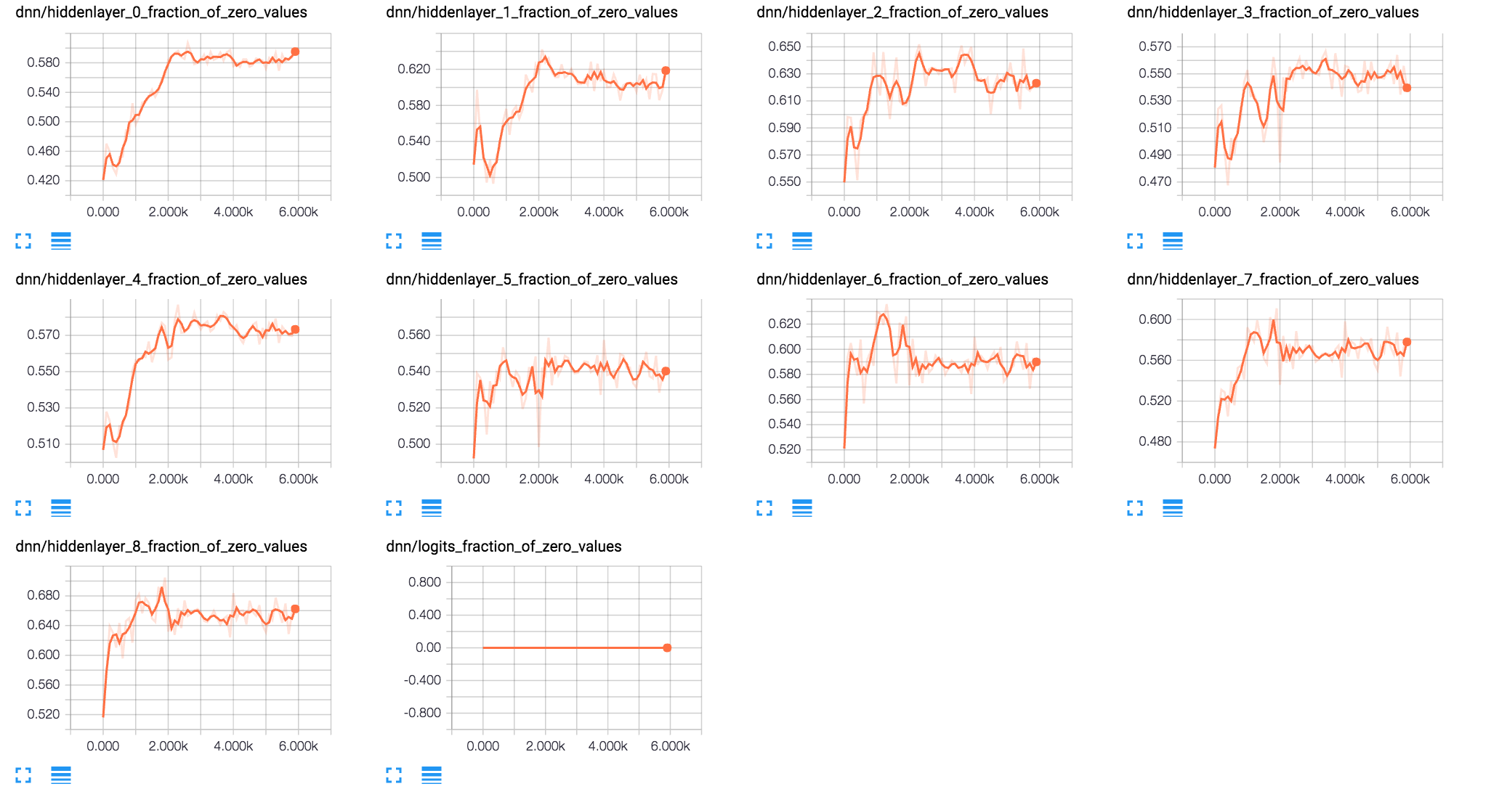
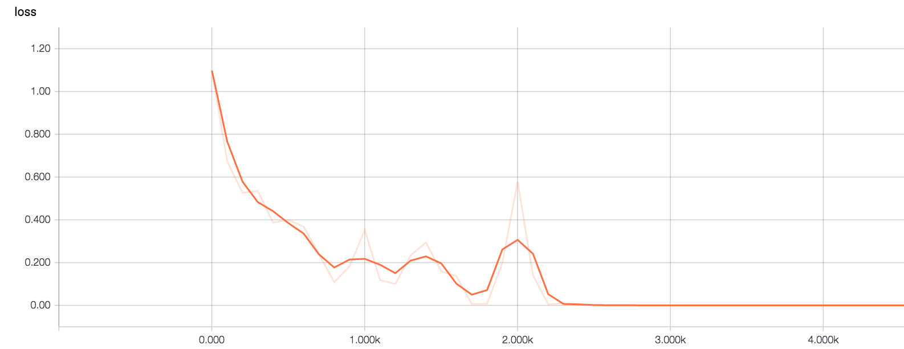

Slide 24
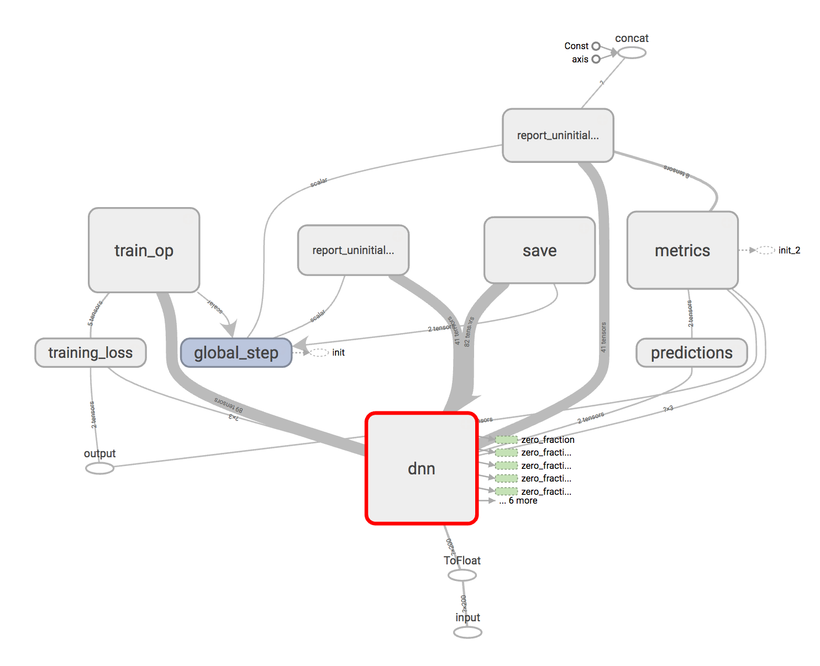

Slide 25
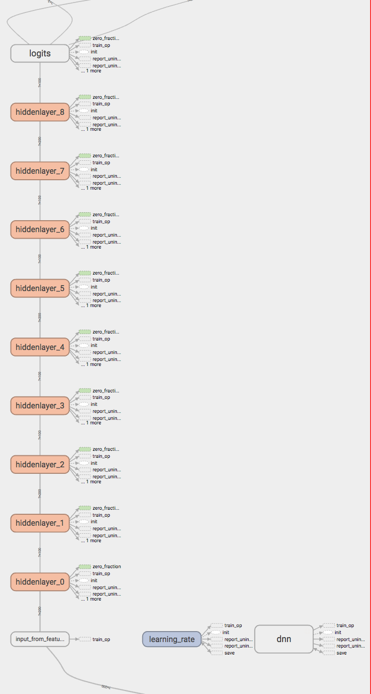

Slide 26
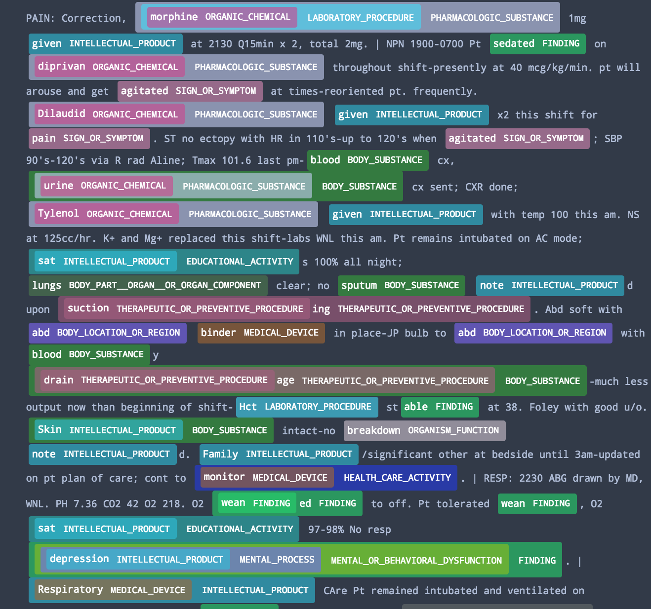

Slide 27
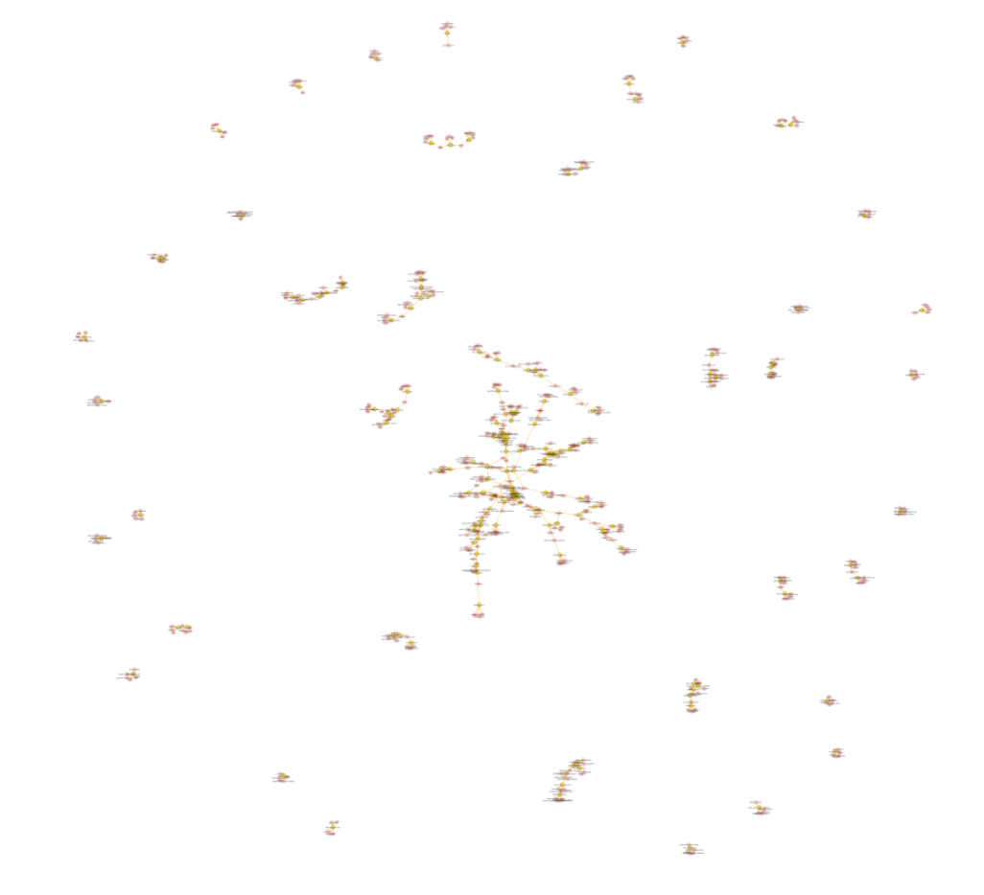

Slide 28
