Slide 1
Incremental Processing Framework
Hoodie
Vinoth Chandar | Prasanna Rajaperumal
D A T A

Slide 2
Who Are We
Staff Software Engineer, Uber
Linkedin : Voldemort k-v store, Stream processing
Oracle : Database replication, CEP
Senior Software Engineer, Uber
Cloudera : Data Pipelines, Log analysis
Cisco : Complex Event Processing

Slide 3
Agenda
Hadoop @ Uber
Motivation & Concepts
Deep Dive
Use-Cases
Comparisons
Future Plans

Slide 4
Adoption & Scale
~Few Thousand
Servers
~100k
Jobs/day
Many Many
PBs
~20k
Hive
queries/day
~100k
Presto queries/day
~100
Spark
Apps
Hadoop @ Uber

Slide 5
Hadoop Use-cases
Analytics
Dashboards
Ad Hoc-Analysis
Federated Querying
Interactive Analysis
Data Applications
ML Recommendations
Fraud Detection
Safe Driving
Incentive Spends
Data Warehousing
Curated Datafeeds
Standard ETL
DataLake => DataMart
Presto
Spark
Hive
Faster Data!
Faster Data!
Faster Data!
Hadoop @ Uber

Slide 6
We All Like A Nimble Elephant
Question: Can we get fresh data, directly on a petabyte scale Hadoop Data Lake?

Slide 7
Previously on .. Strata (2016)
“Uber, your Hadoop has arrived: Powering Intelligence for Uber’s Real-time marketplace”
Hadoop @ Uber

Slide 8
Late Arriving Updates
2010-2014
2015/XX/XX
New/Updated Trips
2016/XX/XX
Incremental update
Every 5 min
2017/(01-03)/XX
2017/04/16
New Data
Partitioned by day trip started
Unaffected Data
Day level partitions
Updated Data
Motivation
Notes:
Talk about why updates are needed before going to the prev generation which has hbase to solve mutations

Slide 9
NoSQL/DB Ingestion: Status Quo
Aug: 10 hr (1000 executors)
Apr: 8 hr (800 executors)
Jan: 6 hr (500 executors)
Snapshot
Replicated Trip Rows
trips
(compacted table)
Presto
upsert
Database
Kafka
HBase
Batch Recompute
logging
New
/updated trip rows
Derived Tables
8 hr
Changelog
12-18+ hr
Approximation
Motivation

Slide 10
Exponential Growth is fun ..
Also extremely hard, to keep up with …
Long waits for queue
Disks running out of space
Common Pitfalls
Massive re-computations
Batch jobs are too big fail
Hadoop @ Uber

Slide 11
Let’s go back 30 years
How did RDBMS-es solve this?
Update existing row with new value (Transactions)
Consume a log of changes downstream (Redo log)
Update again downstream
Update
MySQL
(Server A)
Pull Redo Log
Important Differences
Columnar file formats
Read-heavy workloads
Petabytes & 1000s of servers
Transformation
Update
MySQL
(Server B)
Concepts

Slide 12
Challenging Status Quo
10 hr (1000)
8 hr (800)
6 hr (500)
snapshot
Replicated Trip Rows
trips
(compacted table)
Presto
upsert
Database
Kafka
HBase
Batch Recompute
Hoodie.incrPull()
[2 mins to pull]
logging
New
/updated trip rows
Hoodie.upsert()
1 hr (100) - Today
10 min (50) - Q2 ‘17
1 hr
Derived Tables
8 hr
Changelog
12-18+ hr
Approximation
Accurate!!!
1 hr - 3 hr
(10x less resources)
Motivation

Slide 13
Incremental Processing
Upsert (Primitive #1)
Modify processed results
kv stores in stream processing
Incremental Pull (Primitive #2)
Log stream of changes, avoid costly scans
Enable chaining processing in DAG
Advantages: Increased Efficiency / Leverage Hadoop SQL Engines/ Simplify Architecture
For more, “Case For Incremental Processing on Hadoop” (link)
Hoodie Concepts

Slide 14
Introducing
Hoodie
Open Source
https://github.com/uber/hoodie
eng.uber.com/hoodie
Spark Library For Upserts & Incrementals
Scales horizontally like any job
Stores dataset directly on HDFS
Storage Abstraction to
Apply mutations to dataset
Pull changelog incrementally
Hive Table
(normal queries)
Large HDFS Dataset
Changelog
Changelog
Upsert
(Spark)
Incr Pull
(Hive/Spark/Presto)
Hoodie Concepts

Slide 15
Hoodie: Overview
Index
Hive Queries
Hoodie
WriteClient
(Spark)
Data Files
Presto Queries
Store & Index
Data
Read data
Spark DAGs
Timeline
Metadata
Storage Type
Views
Hoodie Dataset On HDFS
Hoodie Concepts

Slide 16
Hoodie: Storage Types & Views
Storage Type : How is Data stored?
Copy On Write
Purely columnar
Simply creates new versions of files
Views : How is Data read?
Read Optimized View
Parquet Query Performance
~30 mins latency for ~500GB
Real Time View
Hybrid of row & columnar data
~1-5 mins latency
Brings near-real time tables
Merge On Read
Near-real time
Shifts some write cost to reads
Merges on-the-fly
Log View
Stream of changes to dataset
Enables Incremental Pull
Hoodie Concepts

Slide 17
Hoodie: Storage Types & Views
Storage Type | Supported Views
Copy On Write | Read Optimized, LogView
Merge On Read | Read Optimized, RealTime, LogView
Hoodie Concepts
Notes:
2 storage types and 3 views
Copy on Write is the first version of storage
Provides 2 views - RO and LogView
Merge on Read is a strict superset of Copy on Write
Provides RealTime view in addition (1 liner - More recent data with cost of merge pushed on to query execution)

Slide 18
Storage: Basic Idea
200 GB
30min batch
Input
Changelog
10 GB
5min batch
10 GB
5 min batch
1825 Partitions (365 days * 5 yrs)
100 GB Partition Size
128 MB File Size
~800 Files Per Partition
Skew spread - 0.005 (single batch)
20 seconds to re-write 1 File (shuffle)
100 executors
7300 Files rewritten
24 minutes to write
1825 Partitions (365 days * 5 yrs)
100 GB Partition Size
128 MB File Size
~800 Files Per Partition
Skew spread - 0.5 % (single batch)
New Files - 0.005 % (single batch)
20 seconds to re-write 1 File (shuffle)
100 executors
10 executors
7300 Files rewritten
~ 8 new Files
24 minutes to write
~2 minutes to write
2017/02/17
2017/02/15
File1
2017/02/16
File1_v2.parquet
2017/02/17
Index
File1.parquet
File1_v1.parquet
Index
File1.avro.log
Hoodie Dataset
Deep Dive
Notes:
Visualization of Storage Types
Talk about a basic parquet dataset laid out in HDFS
We can to ingest say 200GB of data and upsert into this dataset
How do we support upsert primitive
First we need to tag updates and inserts - introduce index
Introduce multi version - to write out updates
Talk about how / why batch sizes matter - amortization - write amplification
Go over the numbers
30 minutes of queued data takes 30 minutes to ingest - 1 hour SLA
We wanted to take on more workloads by pushing that SLA even further down
Have a differential structure - a log of updates queued for a single file
Stream updates into the log file
compaction happens once in a while - compaction becomes similar to previous ingestion flow
Run through the change in numbers

Slide 19
Index and Storage
Index
Tag ingested record as update or insert
Index is immutable (record key to File mapping never changes)
Pluggable
Bloom Filter
HBase
Storage
HDFS Block aligned files
ROFormat - Default is Apache Parquet
WOFormat - Default is Apache Avro
Deep Dive
Notes:
Index should be super quick - Pure Overhead
Block Aligned Files - Balance compaction and query parallelism

Slide 20
Concurrency
Multi-row atomicity
Strong consistency (Same as HDFS guarantees)
Single Writer - Multiple Consumer pattern
MVCC for isolation
Running queries are run concurrently to ingestion
Deep Dive
Notes:
Lets talk about some of the challenges/Features of storing the data in the above format

Slide 21
Data Skew
Why skew is a problem?
Spark 2GB Remote Shuffle Block limit
Straggler problem
Hoodie handles data skew automatically
Index lookup skew
Data write skew handled by auto sub partitioning
Allocate sub-partitions (file ID) based on historical commit stats
Morph inserts as updates to fix small files
Deep Dive
Notes:
Explain hotspotting and 2GB Limit
Skew could be during index lookup or during data write
Custom partitioning which takes statistics of commits to determine the appropriate number of subpartitions
Auto Corrections of file sizes

Slide 22
Compaction
Essential for Query performance
Merge Write Optimized row format with Scan Optimized column format
Scheduled asynchronously to Ingestion
Ingestion already groups updates per File Id
Locks down versions of log files to compact
Pluggable strategy to prioritize compactions
Base File to Log file size ratio
Recent partitions compacted first
Deep Dive

Slide 23
Failure recovery
Automatic recovery via Spark RDD
Resilient Distributed Datasets!!
No Partial writes
Commit is atomic
Auto rollback last failed commit
Rollback specific commits
Savepoints/Snapshots
Deep Dive
Notes:
Spark RDD has automatic recovery and retries computations
Avro Log maintains the offset to the block and a partially written block will be skipped
SavePoints to rollback and re-ingest

Slide 24
Hoodie Write API
// WriteConfig contains basePath of hoodie dataset (among other configs)
HoodieWriteClient(JavaSparkContext jsc, HoodieWriteConfig clientConfig)
// Start a commit and get a commit time to atomically upsert a batch of records
String startCommit()
// Upsert the RDD<Records> into the hoodie dataset
JavaRDD<WriteStatus> upsert(JavaRDD<HoodieRecord<T>> records, final String commitTime)
// Bulk load the RDD<Records> into the hoodie dataset
JavaRDD<WriteStatus> bulkInsert(JavaRDD<HoodieRecord<T>> records, final String commitTime)
// Choose to commit
boolean commit(String commitTime, JavaRDD<WriteStatus> writeStatuses)
// Rollback
boolean rollback(final String commitTime) throws HoodieRollbackException
Deep Dive
Notes:
Talk about SparkContext and Config - Index, Storage Formats, Parallelism
StartCommit - Token

Slide 25
Hoodie Record
HoodieRecordPayload
// Combine Existing value with New incoming value and return the combined value
IndexedRecord combineAndGetUpdateValue(IndexedRecord currentValue, Schema schema);
// Get the Avro IndexedRecord for the dataset schema
IndexedRecord getInsertValue(Schema schema);
Deep Dive
Notes:
Take about what a hoodie record is and the record payload abstraction

Slide 26
Hoodie: Overview
Index
Hive Queries
Hoodie
WriteClient
(Spark)
Data Files
Presto Queries
Store & Index
Data
Read data
Spark DAGs
Timeline
Metadata
Storage Type
Views
Hoodie Dataset On HDFS
Hoodie Concepts
Notes:
Talk briefly about metadata storage.
Bring attention towards the views.

Slide 27
Hoodie Views
3 Logical views Of Dataset
Read Optimized View
Raw Parquet Query Performance
~30 mins latency for ~500GB
Targets existing Hive tables
REALTIME
Query execution time
Log View
Stream of changes to dataset
Enables Incr. Data Pipelines
READ
OPTIMIZED
Real Time View
Hybrid of row & columnar data
~1-5 mins latency
Brings near-real time tables
Data Latency
Hoodie Views
Notes:
A view is a inputformat - 3 different hive tables are essentially registered pointing to the same HDFS dataset

Slide 28
Hoodie Views
Input
Changelog
10 GB
5min batch
10 GB
5 min batch
Hive
2017/02/16
Read Optimized Table
2017/02/15
File1
2017/02/16
File1_v2.parquet
Real Time Table
2017/02/17
Index
File1.parquet
File1_v1.parquet
Incremental Log table
Index
File1.avro.log
Hoodie Views
Notes:
Recap the storage breifly
Introduce one view after next and explain how it works
Explain about hive - query plan generation

Slide 29
Read Optimized View
InputFormat picks only Compacted Columnar Files
Optimized for faster query runtime over data latency
Plug into GetSplits to filter out older versions
All Optimizations done to read parquet applies (Vectorized etc)
Data latency is the frequency of compaction
Works out of the box with Presto and Apache Spark
Hoodie Views
Notes:
Explain InputFormats for each view
Explain how read optimized inputformat works - generate query plan - getsplits - filter
Talk about optimizated for query runtime - chosen when compaction data latency is good enough
Talk about hive metastore registration

Slide 30
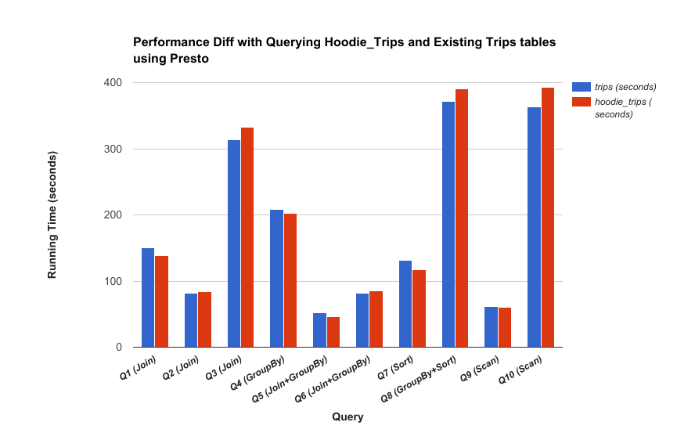
Presto Read Optimized Performance
Hoodie Views

Slide 31
Real Time View
InputFormat merges ROFile with WOFiles at query runtime
Custom RecordReader
Logs are grouped per FileID
Single split is usually a single FileID in Hoodie (Block Aligned files)
Latency is the frequency of ingestion (mini-batches)
Works out of the box with Presto and Apache Spark
Specialized parquet read path optimizations not supported
Hoodie Views

Slide 32
Incremental Log View
2010-2014
2015/XX/XX
Log
View
New/Updated Trips
2016/XX/XX
Incr Pull
Incremental update
Every 5 min
2017/(01-03)/XX
2017/04/16
New Data
Partitioned by day trip started
Unaffected Data
Day level partitions
Updated Data
Hoodie Views
Notes:
Another way to visualize log view

Slide 33
Incremental Log View
Pull ONLY changed records in a time range using SQL
‘startTs’ > _hoodie_commit_time < ‘endTs’
Avoid full table/partition scan
Do not rely on a custom sequence ID to tail
Lookback window restricted based on cleaning policy
Hoodie Views

Slide 34
Use Cases
Use Cases

Slide 35
Use Cases
Near Real-Time ingestion / stream into HDFS
Replicate online state in HDFS within few minutes
Offload analytics to HDFS
Use Cases

Slide 36
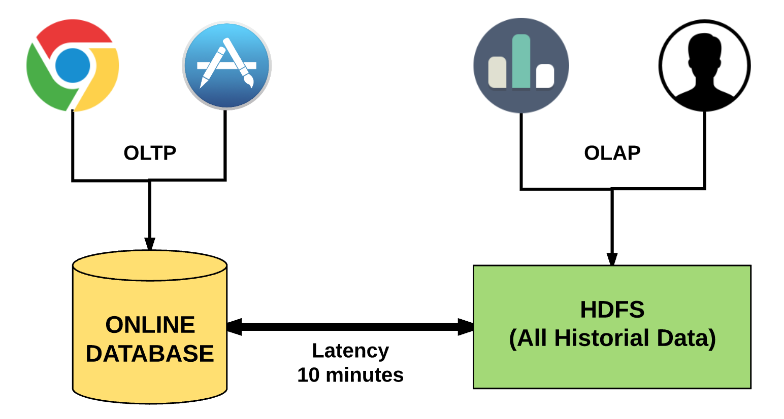
Near Real-Time Ingestion
Use Cases

Slide 37
Use Cases
Near Real-Time ingestion / stream into HDFS
Replicate online state in HDFS within few minutes
Offload analytics to HDFS
Incremental ETL processing
Don't tradeoff correctness to do incremental processing
Hoodie integration with Scheduler
Use Cases

Slide 38
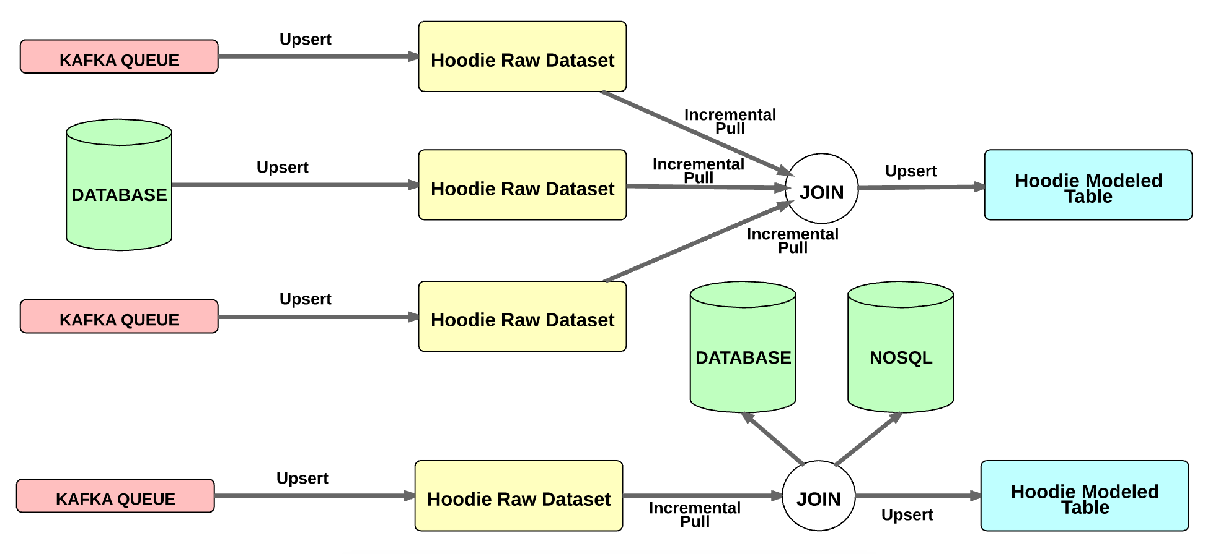
Incremental ETL
Use Cases

Slide 39
Use Cases
Near Real-Time ingestion / streaming into HDFS
Replicate online state in HDFS within few minutes
Offload analytics to HDFS
Incremental ETL processing
Don't tradeoff correctness to do incremental processing
Hoodie integration with Scheduler
Unified Analytical Serving Layer
Eliminate your specialized serving layer , if latency tolerated is > 10 min
Simplify serving with HDFS for the entire dataset
Use Cases

Slide 40
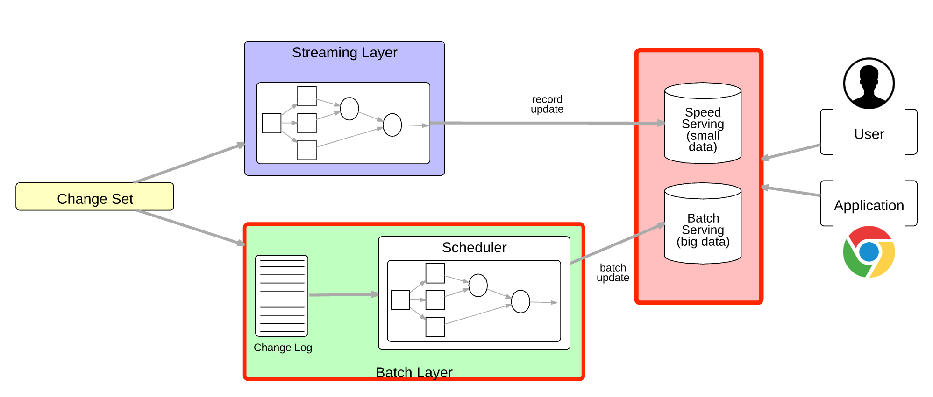
Lambda Architecture
Use Cases

Slide 41
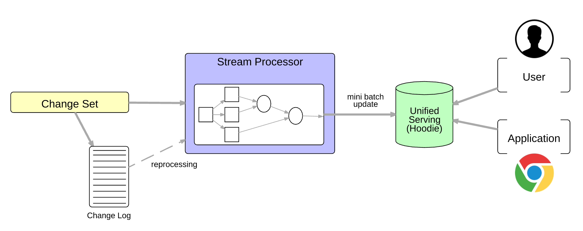
Unified Analytics Serving
Use Cases

Slide 42
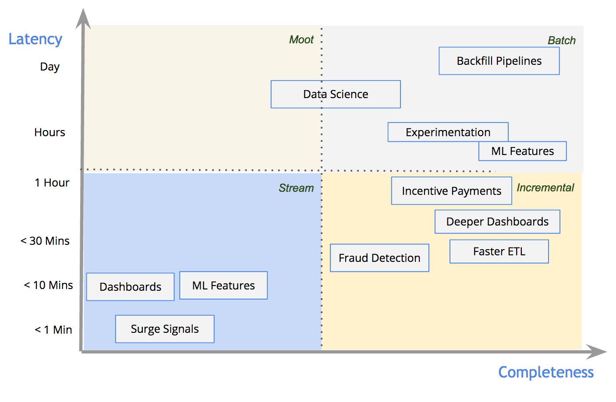
Spectrum Of Data Pipelines
Use Cases
Notes:
Batch stream is not a dichotomy - it is a spectrum
Workloads that can tolerate minutes level latency is common
Transition

Slide 43
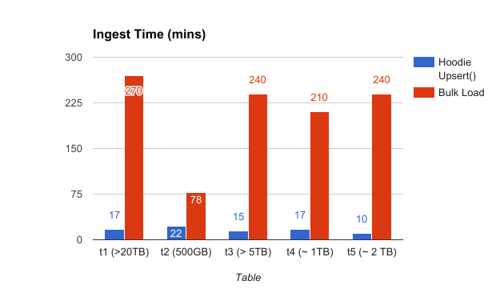
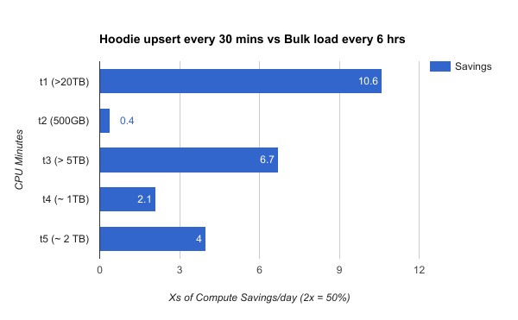
Adoption @ Uber
Powering ~1000 Data ingestion data feeds
Every 30 mins today, several TBs per hour
Towards < 10 min in the next few months
Reduced resource usage by 10x
In production for last 6 months
Hardened across rolling restarts, data node reboots
Incremental ETL for dimension tables
Data warehouse at large
Future
Self serve incremental pipelines (DeltaStreamer)
Use Cases

Slide 44
Comparison
Hoodie fills a big void in Hadoop land
Upserts & Faster data
Play well with Hadoop ecosystem & deployments
Leverage Spark vs re-inventing yet-another storage silo
Designed for Incremental Processing
Incremental Pull is a ‘Hoodie’ special
Comparison

Slide 45
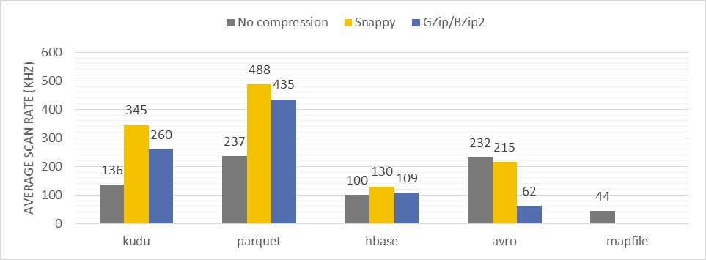
Comparison: Analytical Storage
Source: (CERN Blog) Performance comparison of different file formats and storage engines in the Hadoop ecosystem
Hoodie Views

Slide 46
Comparison
Apache Kudu Targets both OLTP and OLAP Dedicated storage servers Evolving Ecosystem support* | Hoodie OLAP Only Built on top of HDFS Already works with Spark/Hive/Presto
Hive Transactions Tight integration with Hive & ORC No read-optimized view Hive based impl | Hoodie Hive/Spark/Presto Parquet/Avro today, but pluggable Power of Spark!
Comparison

Slide 47
Comparison
HBase/Key-Value Stores Write Optimized for OLTP Bad Scan Performance Scaling farm of storage servers Multi row atomicity is tedious | Hoodie Read-Optimized for OLAP State-of-art columnar formats Scales like a normal job or query Multi row commits!!
Stream Processing Row oriented processing Flink/Spark typically upsert results to OLTP/specialized OLAP stores | Hoodie Columnar queries, at higher latency HDFS as Sink, Presto as OLAP engine Integrates with Spark/Spark Streaming
Comparison

Slide 48
Future Plans
Merge On Read (Project #1)
Active developement, Productionizing, Shipping!
Global Index (Project #2)
Fast, lightweight index to map key to fileID, globally (not just partitions)
Spark Datasource (Issue #7) & Presto Plugins (Issue #81)
Native support for incremental SQL (e.g: where _hoodie_commit_time > ... )
Beam Runner (Issue #8)
Build incremental pipelines that also port across batch or streaming modes
Future

Slide 49
Getting Involved
Engage with us on Github
Look for “beginner-task” tagged issues
Checkout tools/utilities
Uber is hiring for “Hoodie”
“Software Engineer - Data Processing Plaform (Hoodie)”
https://www.uber.com/careers/list/28811/
Swing by Office Hours after talk
2:40pm–3:20pm, Location: Table B
Contributions

Slide 50
source
Questions?
Notes:
Image source: https://openclipart.org/detail/50287/eleve-posant-une-question-student-asking-a-question

Slide 51
Extra Slides

Slide 52
Hoodie Views
3 Logical views Of Dataset
Read Optimized View
Raw Parquet Query Performance
~30 mins latency for ~500GB
Targets existing Hive tables
Log View
Stream of changes to dataset
Enables Incr. Data Pipelines
Real Time View
Hybrid of row & columnar data
~1-5 mins latency
Brings near-real time tables
Hoodie Concepts

Slide 53
Hoodie Storage Types
Define how data is written
Indexing & Storage of data
Impl of primitives and timeline actions
Support 1 or more views
2 Storage Types
Copy On Write : Purely columnar, simply creates new versions of files
Merge On Read : Near-real time, Shifts some write cost to reads, Merges on-the-fly
Storage Type | Supported Views
Copy On Write | Read Optimized, LogView
Merge On Read | Read Optimized, RealTime, LogView
Hoodie Concepts

Slide 54
Hoodie Timeline
Time-ordered sequence of actions
- Instantaneous views of dataset
- Arrival-order retrieval of data
Hoodie Concepts

Slide 55
Timeline Actions
Commit
Multi-row atomic publish of data to Queries
Detailed metadata to facilitate log view of changes
Clean
Remove older versions of files, to reclaim storage space
Cleaning modes : Retain Last X file versions, Retain Last X Commits
Compaction
Compact row based log to columnar snapshot, for real-time view
Savepoint
Roll back to a checkpoint and resume ingestion
Hoodie Concepts

Slide 56
Hoodie Terminology
Basepath: Root of a Hoodie dataset
Partition Path: Relative path to folder with partitions of data
Commit: Produce files identified with fileid & commit time
Record Key:
Uniquely identify a record within partition
Mapped consistently to a fileid
File Id Group: Files with all versions of a group of records
Metadata Directory: Stores a timeline of all metadata actions with atomically publish
Deep Dive
Notes:
Hoodie partitions HDFS directory further partitioning to a more finer granularity
Subpartitioned as <Partition Path, File Id>
Record Key <==> <Partition Path, File Id> is immutable
Dynamic sub partition automatically handles data skew
Fundamental unit of compaction is rewriting a single File Id
Sub partitioning is used for ingestion only
Query engines only see HDFS directory partitions

Slide 57
Hoodie Storage
Change Log
200 GB
10 GB
Hive
2017/02/16
2017/02/15
File1
Realtime View
2017/02/16
File1_v2.parquet
2017/02/17
Index
Read Optimized View
File1.parquet
File1_v1.parquet
Index
File1.avro.log

Slide 58
Hoodie Write Path
2017-03-11
Commit Time: 10:10
File Id1
File Id1 LogFile
updates
Change log
2017-03-10
Compacted (10:05)
commit (10:06)
commit (10:09)
2017-03-11
2017-03-12
Failed
commit (10:08)
inserts
Index lookup
2017-03-13
2017-03-14
commit (10:08)
2017-03-14
File Id2
Version 1
Version 2
Empty
Deep Dive

Slide 59
Hoodie Write Path
(Persistent) Index
Tag
Spark Application
Hoodie Spark Client
Stream
Data Layout in HDFS
Filter and Merge
HoodieInputFormat
Save
Get latest
commit
Metadata
Deep Dive

Slide 60
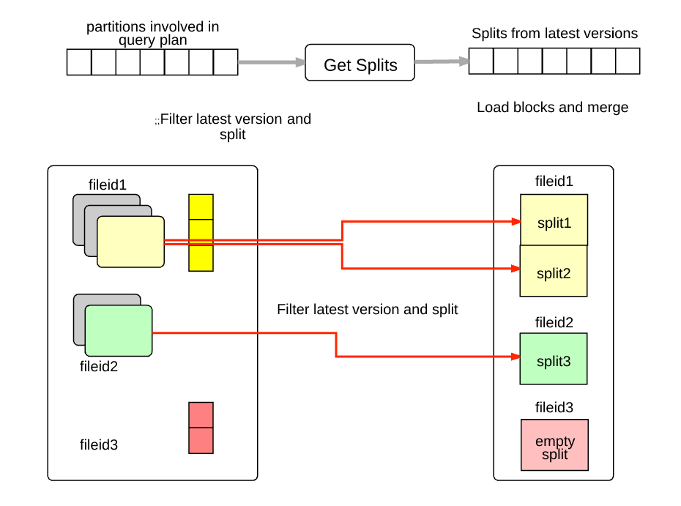
Read Optimized View
Hoodie Views

Slide 61
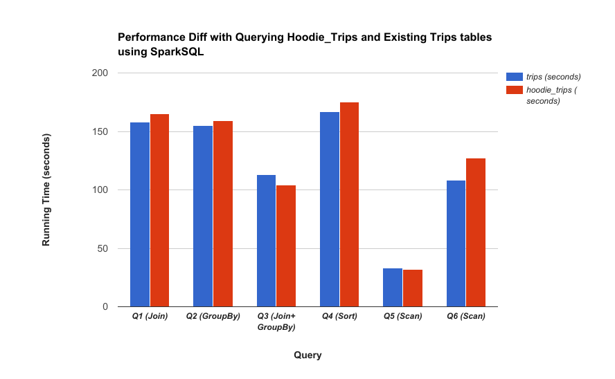
Spark SQL Performance Comparison
Hoodie Views

Slide 62
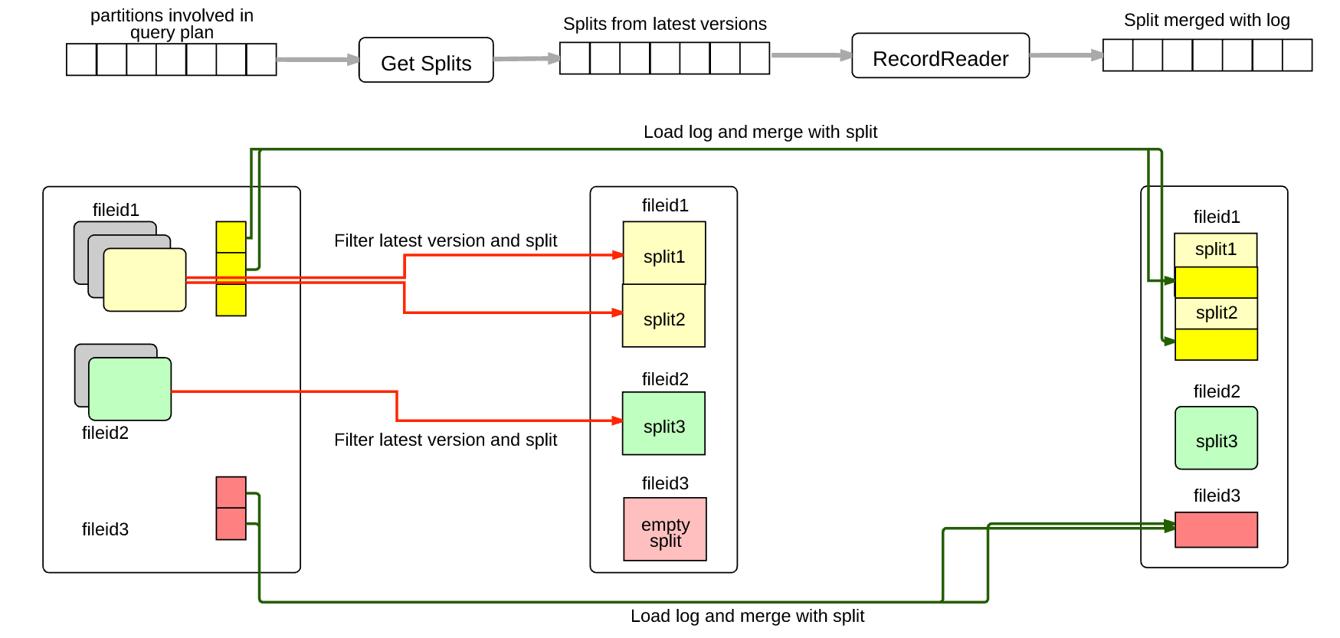
Realtime View
Hoodie Views

Slide 63
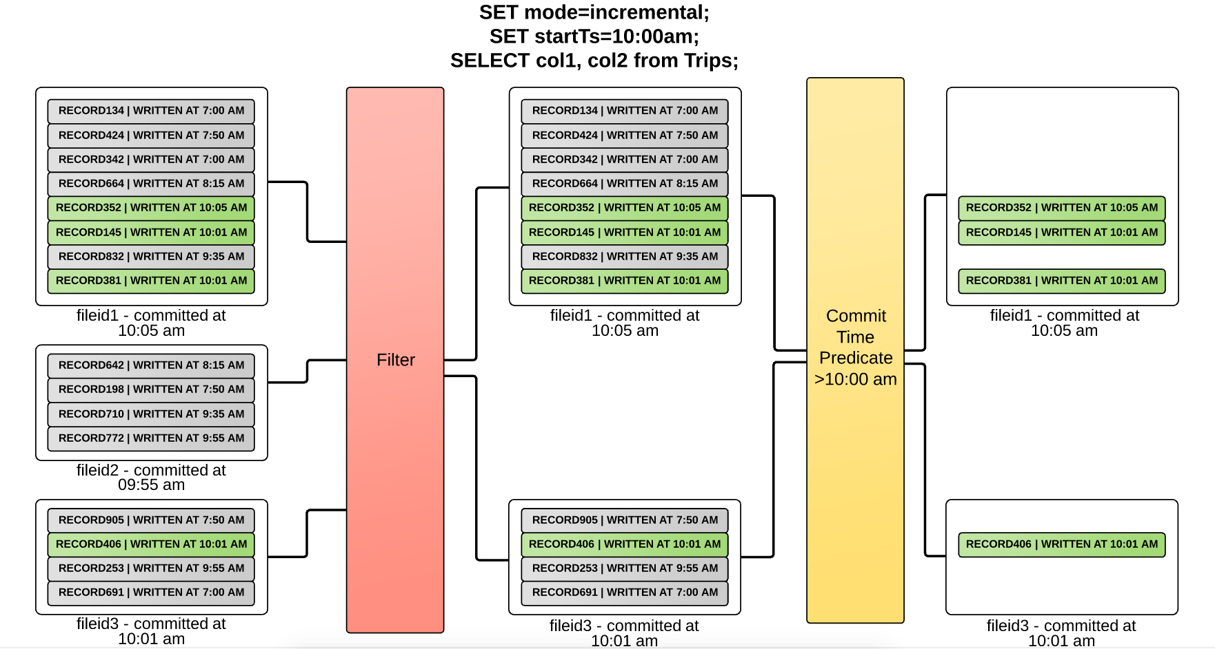
Incremental Log View
Hoodie Views

