Slide 1
IoT &
Unconventional Data
Teresa Tung, Ph.D.
Notes:
Business driven
Do I need a platform? How do I make the case for platform?
“IoT is driven by outcomes delivered by applications, but to gain operational efficiency many organizations are looking towards a horizontal platform for delivering and supporting a number of applications. This talk takes a look at how you make the choice and then the journey to a platform--overcoming that the platform is horizontal and application outcomes are vertical. We use case studies to show a journey from the first IoT application to how we scale and work across vertical needs to create a platform to add new data sources, to upgrade existing architectures, to create new analytics models, and to reuse enterprise data.”
4:20-5:00

Slide 2
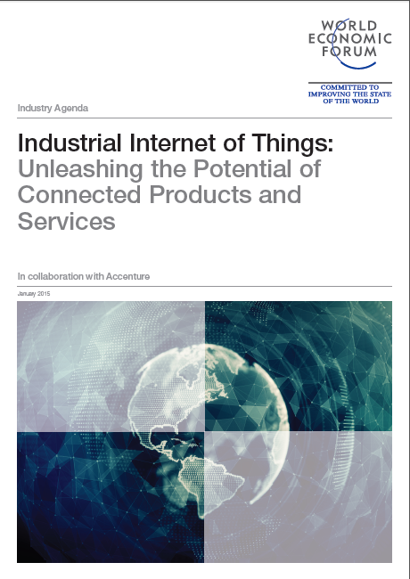

The promise of IoT
FROM WORLD ECONOMIC FORUM REPORT*
2015: INDUSTRIAL INTERNET OF THINGS…
http://www3.weforum.org/docs/WEFUSA_IndustrialInternet_Report2015.pdf
Driving to Outcomes and an Autonomous Pull Economy
Autonomous
Pull Economy
  Continuous demand-sensing
  Perceptive response
  Integrated human-machine / robot workforce
  Digital labor
  End to end automation
  Resource optimization
  and waste reduction
Outcome-based
Economy
New Products,
Services and
Business Models
  Pay-per-outcome models
  Shared risk
  New connected ecosystems
  Platform-enabled
  data marketplaces
  Products-as-a-platform
  Industry boundaries blur
  New ‘as-a-service’ business -models (e.g. pay-per-use)
  Product / Service hybrids
  Software based services
  Data monetization
  Open APIs /
  Developer Networks
Operational
Efficiency
Improved asset utilization
and tracking
Operational cost reduction
Equipment productivity enhancement
Improved worker productivity, safety and working conditions
Remote equipment operation
From
APPLICATIONS to
services
ecosystems
Economy
*WEF Report authored by Accenture
Notes:
Many of us started with initial IoT apps, that need to evolve and move towards outcome based, and pull economy
Agile DevOps for IoT: Implementation of IoT is not a one-shot deal, but an iterative process that starts with a set of applications and data complete enough to capture the initial use case and is then rapidly adapted. It allows for faster deployment and iteration cycles that result in better applications and more accurate analytics, better decision making.
Operational Efficiency
New products – e.g., Philips Healthcare
Outcome based – Patient Readmittance
Boston Scientific medical device company – heart care products to a service company – to accurately diagnose and manage patient care from hospital to home → ecosystem
Autonomous Pull - Self-acting ecosystem
one other example of application explored in the Tech Labs relates to health data sent by wearable devices that can be anonymised and protected and used by healthcare providers, doctors, etc.
in this example, my smart watch measures regularly my activity (number of steps, heartbeat, number of calories, etc.) which is sent to a dedicated blockchain, which then can in turn be used by a health coach, or my doctor, or with my family.
Exploring new opportunities around Blockchain and Healthcare to enable Health and Medical Data to be shared anonymously across multiple actors
First release of Smart Contract Enabled Personal Health PoC, that combines Blockchain-based distributed applications, Smart Contracts and Wearable devices.
Second version released using Proof-of-Stake Consensus Algorithm:
Users can register different Health Devices (e.g. Heart rate monitor, steps counter, etc.). Activities data are collected and stored through a distributed ledger.
Users can agree on and enroll on a Health Programs provided by Coaches. Health Programs defines conditions and rules to apply to activities data and to produce recommendation/suggestions to the users.
Each coach is able to adjust the Health Program according to user needs and progresses
Each user is able to enroll to different Health Programs according to the Health Devices he/she owns
Apple Watch Health Application connected to the distributed app released
Smart Contract Visualization Tool Released

Slide 3
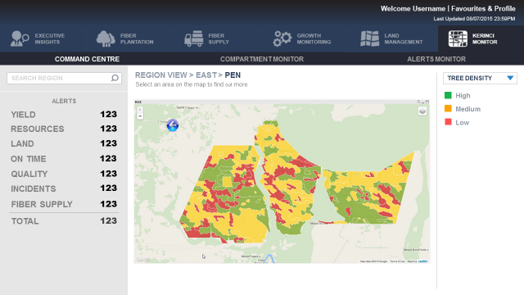
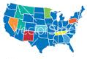
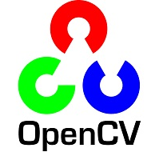
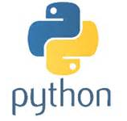

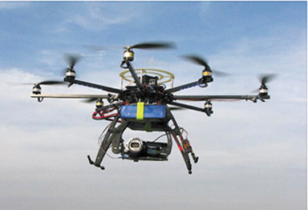
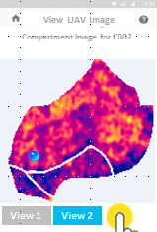
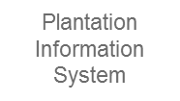
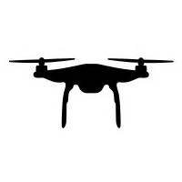

Operational efficiency through applications
Existing
New
APPLICATIONS
MODELS
New
DATA
DEVICES
New
CLOUD

Slide 4
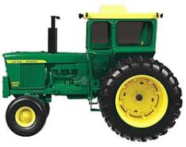
From Products TO SERVICEs
Driving UNCONVENTIONAL GROWTH
An Example
Information
Services
Soil, plant and equipment analysis results
PARTNER in agricultural information service marketplace
Equipment services
Machine maintenance services
Remote diagnostics and optimization services
PARTNER in agricultural services
Commercial offering categories
Products
Farm equipment
More Intelligent Farm equipment with sensors
PARTNER in agricultural products
Pre-digital product line
Digital product line
New market segment
Go to market approach
Notes:
Definitions:
Information services: sell data and insights, manage or participate in a market that sells data.
Equipment services: product operations and optimization service; sell the product along an as-a-service or –for-performance payment model
Sources:
vRad, Claas: company web sites
Case study: Outcome-based Agriculture
One industry at the forefront of the evolution to outcome-based services is agriculture. By connecting farm equipment to geo-location data, agricultural companies and farmers can now coordinate and optimize farm production in ways never before possible. For instance, automated tillers can inject nitrogen fertilizer at precise depths and
intervals, as seeders follow, placing corn seeds directly in the fertilized soil. Ultimately, turning such data into actionable insights will improve crop yield to help feed the
world’s growing population. One example of such “smart farms” comes from Monsanto, a multinational agrochemical and agricultural biotechnology company.
To help farmers increase crop productivity while conserving water and energy, Monsanto purchased Climate Corporation, a company which has used remote sensing
and cartographic techniques to map all 25 million farming fields in America by field shape, type of crop, crop yields, soil capacity and other critical metrics.
By adding Climate Corporation’s data to Monsanto’s data on seed yields, farmers can better understand which seeds will grow best in which fields and under what conditions. Outcome-based agriculture requires connected ecosystems and platforms. In Europe, the 365FarmNet brings together farm equipment makers Claas, Rauch, Horsch and Amazonen-Werke, financial service giant Allianz, chemical company Bayer, seed producer KWS Saat, agricultural software service provider LACOS, agricultural advisory service company Agravis, and the European Global Navigation Satellite Systems Agency. This ecosystem provides farmers with easy access to data and analysis on geo-location, diagnostics, crops, fertilizers, weather and other factors, over smartphones or through direct connections with farm equipment.
Farm equipment manufacturers are also taking an active role in developing their own ecosystems. John Deere is building intelligence into its large combines, tractors and sprayers through sensors that make the machines into mobile platforms. The company is also vying to become a trusted source of agriculture data by forming digital partnerships with companies such as DuPont, Pioneer, Dow Chemical and others to supply precision agriculture solutions to growers. And John Deere and AGCO are working together to connect irrigation systems, soil and nutrient sources, with information on weather, crop prices and commodity futures to optimize overall farm performance.
While prescriptive agriculture offers many potential benefits, there is also potential for conflict among stakeholders. Many farmers, for example, do not trust companies that offer prescriptive agriculture systems since they fear that the stream of detailed data they are providing on their harvests may be misused. They also worry that these firms could buy underperforming farms and run them in competition, or use the data on harvests to trade against farmers on the commodity markets.

Slide 5
From Products TO SERVICEs what has changed
From: Product centric
To: Platform centric
Indirect revenue streams: “Outcome is the product”
Digital content
provider
Direct revenue streams: “Physical product is revenue source”
Multi-channel interaction
Dealership
Digitized
Digitally enhanced product
Partner
ecosystem
Seamless connected experience
New
Consolidation of metadata across multiple and unconventional data sources
Sporadic, low quality customer contact resulting in experience breaks
Digitized
New
Customer-Centric & Data-driven
Platform
Product
New
New
Transition App to Platform
The partner ecosystem becomes the differentiating factor
Conventional sources of data
Consumer
Software developer
Developer
community
Data science

Slide 6
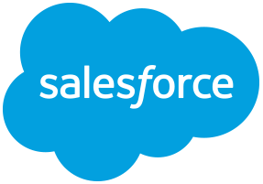
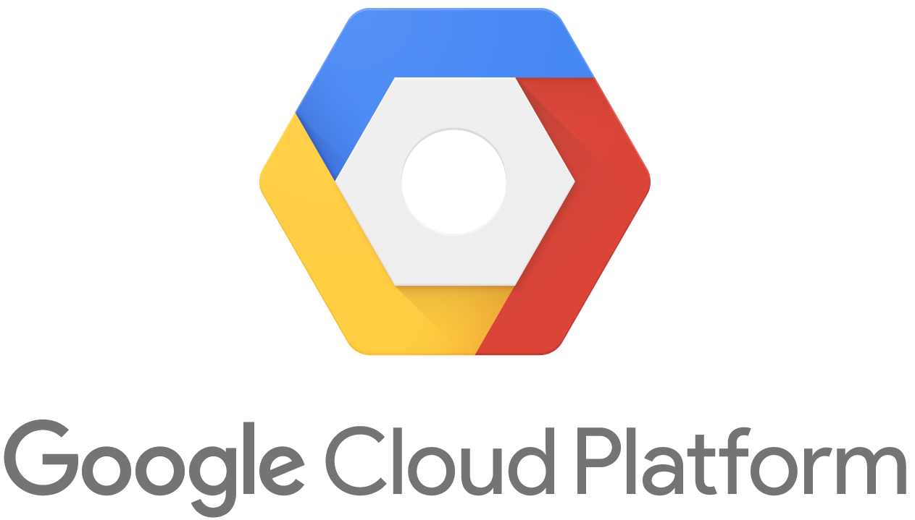

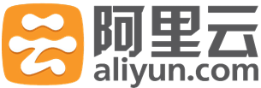
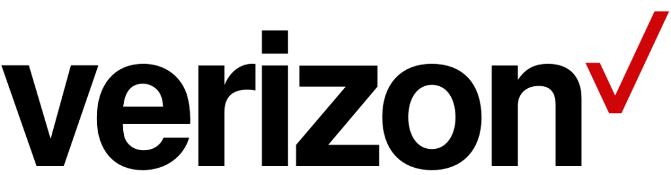


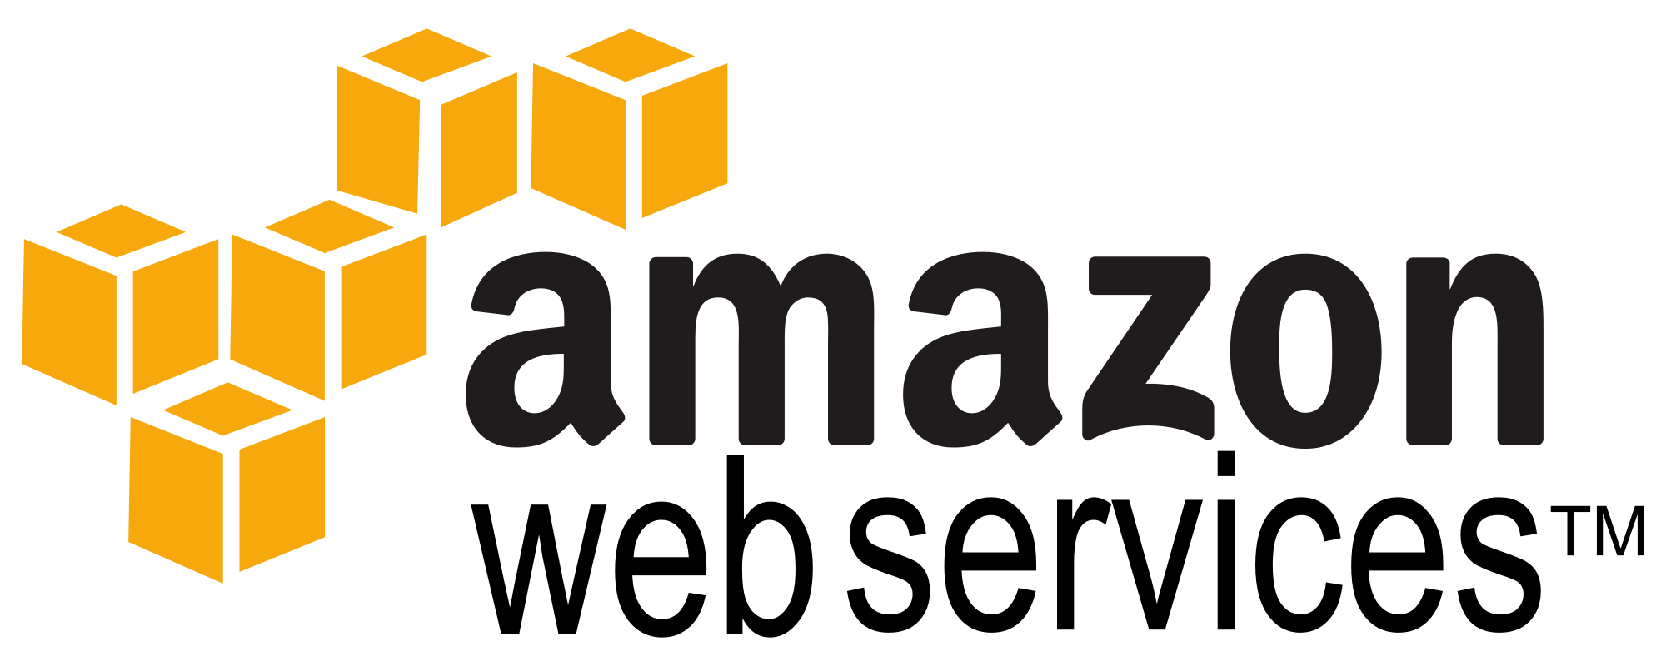

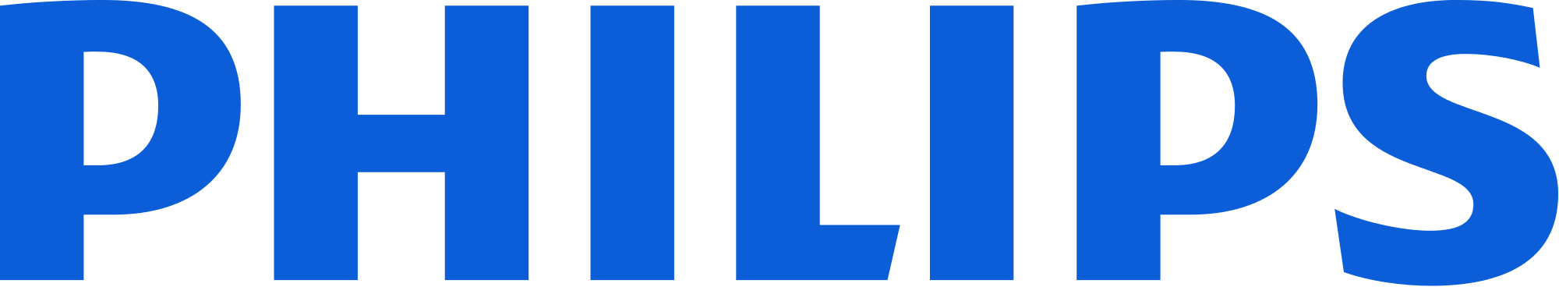

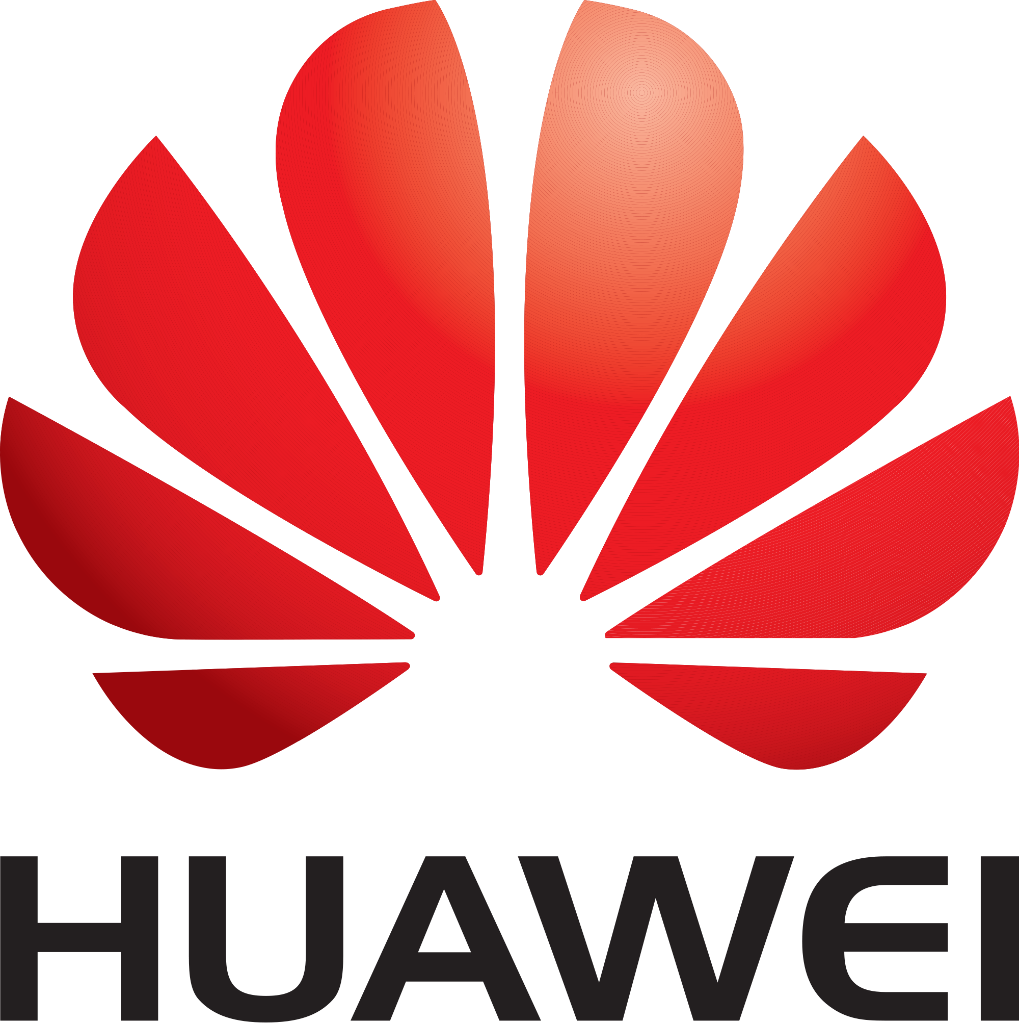

Outcome based economy through ecosystems
Enabled by a Platform of Platforms
Telco
Enterprise
Cloud
Health
Social
Industrial
Notes:
Companies must work together to meet the needs of customers. The other advantage an ecosystem provides is speed. Since digital markets evolve at a much faster rate than physical industries, being part of an ecosystem allows participating companies to specialize in their core competencies and work together to quickly adapt to changes in external environments.

Slide 7
The transition from app to Platform
IoT is an iterative process that starts with an initial use case that is then rapidly adapted.
Faster deployment and iteration result in better applications, more accurate analytics, better outcomes.
ENABLING AGILITY AND SCALE OF APPLICATIONS
THE IoT APPLICATION
THE PLATFORM CORE
3,500 msg/sec
6,000 msg/sec
DEVICES
APPLICATIONS
PLATFORM GROWS
10s Models
1000s Models
PLATFORM
HARVESTS
MODELS
1 Env
AWS
3 Env
AWS
DATA
CLOUD
PLATFORM ACCELERATES
PLATFORM ACCELERATES DEVELOPMENT
Agility to rapidly develop and evolve use case.
Scale number of devices, volumes of data, analytical models.
PLATFORM GROWS NEW USE CASES
Agility to harvest, discover, and reuse IoT components.
Scale horizontal components to scale across verticals.
Notes:
The Challenge with Platform
Scale is not about devices, models, virtual machines—this is app scale.
IoT is about outcomes. These are aligned to verticals. The platform is horizontal.
But you make money vertically. How do you make money with a platform? How do you manage and add new use cases?
The role of the platform: Accelerate new use cases
One hallmark of a mature ecosystem is the presence and wide acceptance of anchor software platforms, which connect and align all parties to achieve desired outcome by providing rules, structures and incentives. A platform can collect and analyse data from all participants, including customers and ensure that outcomes commitments are
met. In time, the top-tier platforms will comprise extended networks of innovators, including software developers, start-ups, customers, partners, suppliers and competitors turned “co-opetitors,” which collectively amplify the value creation opportunities for all participants, and solve problems and apportion liability if one or more parts of the
system fail.

Slide 8
The platform journey
Autonomous
Pull Economy
Outcome-based
Economy
New Products,
Services and
Business Models
Operational
Efficiency
Strategy & Governance
From
APPLICATIONS to
services
ecosystems
economy
Architecture
From
inventorized to
rationalized
federated
Platform of platforms
Development process
From
standardized to
configured
automated
Self-adapting
User Community
From
documented to
Transition App to Platform
Self-service
Community Managed
across ecosystem
Optimization
From
Measured to
predictive
prescriptive
Continuous
Platform Maturity
Notes:
Many of us started with initial IoT apps, that need to evolve and move towards outcome based, and pull economy
Agile DevOps for IoT: Implementation of IoT is not a one-shot deal, but an iterative process that starts with a set of applications and data complete enough to capture the initial use case and is then rapidly adapted. It allows for faster deployment and iteration cycles that result in better applications and more accurate analytics, better decision making.
Operational Efficiency
New products – e.g., Philips Healthcare
Outcome based – Patient Readmittance
Autonomous Pull - Self-acting ecosystem

Slide 9
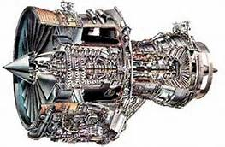
Strategy & Governance
Strategy & Governance
From
APPLICATIONS to
services
ecosystems
economy
New Products,
Services and
Business Models
Outcome-based
Economy
Operational
Efficiency
Autonomous
Pull Economy
Differentiation
Example
Product Value
“Higher reliability engine that burns less fuel”
Product outcome
“Pay for engine reliability. Assumes entire risk of time-on-wing and shop visits.”
Business outcome
“Fleet optimization to reduce equipment failures and minimize delays.”
Digital Economy
“Optimizing transport across long distances.”
Focus
Product Centric
Product Vision & Champion
Cross-functional Team
Platform Centric
Cross LOB Buy-in
Services > Product
Ecosystem Centric
Cross Partner Buy-in
Competitors-to-Cooperators
Economy Centric
Cross Industry ecosystem
Smart contracts
Transition App to Platform
Major shift: Addressing the “why behind the buy”
Notes:
Product companies have traditionally built their reputations by providing high-quality products at competitive prices, helping retail or commercial customers meet their needs more efficiently or effectively: aircraft that carry more passengers but burn less fuel; tractors that plant hectares of farmland faster; and light bulbs that last longer but consume less energy. In recent years, pressure has been mounting for manufacturers to look downstream to uncover new value creation opportunities by helping customers use their products to meet specific outcomes, such as optimizing transportation of people across long distances, increasing crop yield and providing lighting only when it is needed.
For example, agricultural companies now have the data necessary to calculate how many bushels of wheat can be produced on a given piece of farmland with a particular
mix of seed, fertilizer, water, soil chemistry and weather conditions. By combining analytics software with connected tractors, tillers and planters, they can apply the precise mix of seed and fertilizer to maximize crop yield at harvest.
Digital lighting is one industry leading this transition to ecosystems. For example, Philips has developed smart LED bulbs and wireless switches powered by kinetic energy, and is now creating an ecosystem of partners to provide a wide variety of digital lighting solutions. It has partnered with design studios WertelOberfell and Strand+Hvass to co-create 3D-printed luminaires, with carpet manufacturer Desso to develop light-transmitting carpets and with AliCloud, a Chinese cloud services and wireless service provider, to support smart lighting control systems. Meanwhile, industry consortiums, such as the Connected Lighting Alliance, are bringing together lighting, electronics and controls companies to promote open standards and global growth for interoperable wireless lighting solutions
For example, target outcomes might relate to the operations or maintenance of a product (e.g. reliability), or to the savings generated from the use of a product or piece of equipment. In general, product outcomes are fairly straightforward because they typically involve only the product supplier and user. For example, Rolls-Royce’s TotalCare provides a suite of predictive maintenance and repair services for its jet engines, including monitoring engine health, and modifying engines to increase reliability and durability. Customers pay for product reliability. As the product-service provider, Rolls-Royce assumes the entire risk of time-on-wing and shop visit cost.
Business outcomes, on the other hand, are quantitative measures that address the why behind the buy. One example of business outcomes is from Taleris America LLC. Unlike Rolls-Royce’s TotalCare service, which focuses on the uptime of one product (e.g. Rolls-Royce jet engines), Taleris tackles the larger issue of airline delays and cancellations caused by equipment failures. To accomplish this goal, it focuses on airline fleet optimization far beyond the operational condition of a specific piece of equipment. By servicing the entire fleet, Taleris can impact overall maintenance schedules. This systemic approach means less disruption, lower costs, better spare-parts inventory management and more satisfied traveler.
Similarly, a building management company can deliver a defined level of energy savings through sensors, controls and software to analyse the data on when and where people work, and thus optimize the lighting and temperature levels required to support them.
Ongoing improvements in sensor technologies – including miniaturization, performance, cost and energy consumption – are making intelligent products more accessible. These sensors are increasingly being installed in industrial equipment, such as GE’s latest locomotives, which are equipped with more than 250 sensors that measure 150,000 data points per minute.
As this level of digital infrastructure develops, companies will be able to take advantage of growing data streams to apply powerful analytics for insights that can enhance existing services, enrich customer experiences and create alternative revenue streams, not only through new products but also through entirely new business models. With the Industrial Internet, manufacturers are already using new software capabilities to improve operational efficiency through predictive maintenance, and achieving
results such as savings on scheduled repairs (12%), reduced maintenance costs (nearly 30%) and fewer Industrial Internet of Things breakdowns (almost 70%).
For example, ThyssenKrupp AG, which makes and maintains elevators in buildings around the globe, uses networked sensors for its predictive maintenance system designed to reduce down time and unnecessary trips by service personnel for elevator repair. Data from the sensors travels to the cloud, where analytics software identifies anomalies to determine what problems need immediate attention versus those that can wait for scheduled maintenance.
Similarly, product companies increasingly rely on software to differentiate their products and customer experiences. For example, automotive supplier ZF Friedrichshafen AG’s intelligent transmission system continuously monitors and analyses a commercial driver’s behaviour, along with topographical data, to signal vehicle transmissions when to shift gears. As a result, truck transmissions last longer and use less fuel

Slide 10


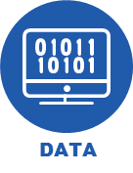
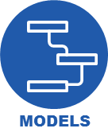

architecture
Architecture
From
inventorized to
rationalized
federated
Platform of platforms
PLATFORM MANAGER
ACCESS
LAYERS
Web Apps
Mobile Apps
Business Intelligence
Adhoc Analysis
RAPID VISUALIZATION DEVELOPMENT FRAMEWORK augments BI tools to create analytics applications
DATA VIRTUALIZATION presents a single logical access interface to all data stores
ANALYTICS LIFECYCLE MANAGEMENT
manages configuring, launching, and monitoring analytics models
DEVICE MANAGEMENT
is vendor agnostic
CLOUD MANAGEMENT
is deployable across cloud providers
API MANAGER
Platform Admin UI
Developer Portal /Catalog
INDUSTRY
ENABLERS
EGRESS GATEWAY ADAPTERS
Customer Subscription Relationship Manager
Mediation
Service Assurance
Configuration / Monitoring
External Gateway
Device Inventory
Software Manager
Legacy Data Gateway
External to Platform
Device Manager
Device Manager
Business Rules Manager
Notification Hub
INGRESS GATEWAY ADAPTERS
STREAMING LEG
DATA
MANAGER
FEDERATED SECURITY
Data Service Layer (API)
RTU
HTTPS
TCP/IP
Virtualized Data Access
(PrestoDB)
Intel Gateway
Device Comm. Manager
Device Comm. Manager
Storage Manager
Post-Process Event Router
IAM
Device Agent
HA NoSQL
Warehouse
Active Directory / Customer ID
RDBMS
Data Lake
INGRESS GATEWAY ADAPTERS
BATCH LEG
ANALYTICS
LEGEND
Staging
(SFTP, HDFS)
Kinesis
Analytics Layer (SAS, R)
Platform Configure
Batch Data Ingest
Spark
Platform Build
Stream Processing
Pre
Processor
Batch Processing
Post Processing
Client-specific Build
ETL Orchestration
3rd party Integration
Notes:
Components in an IoT application
There will be heterogeneity – how do we decouple the interfaces

Slide 11
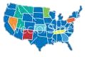
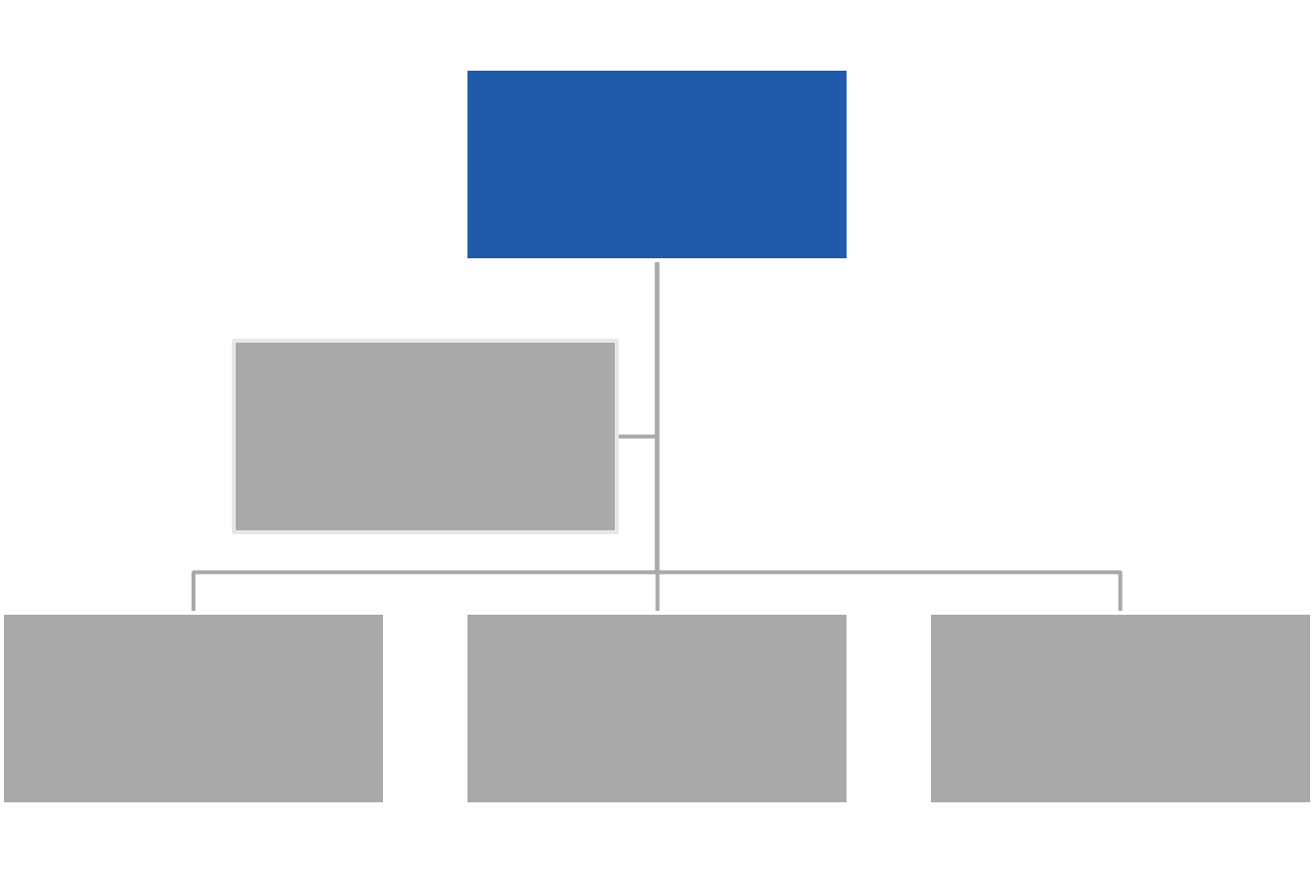
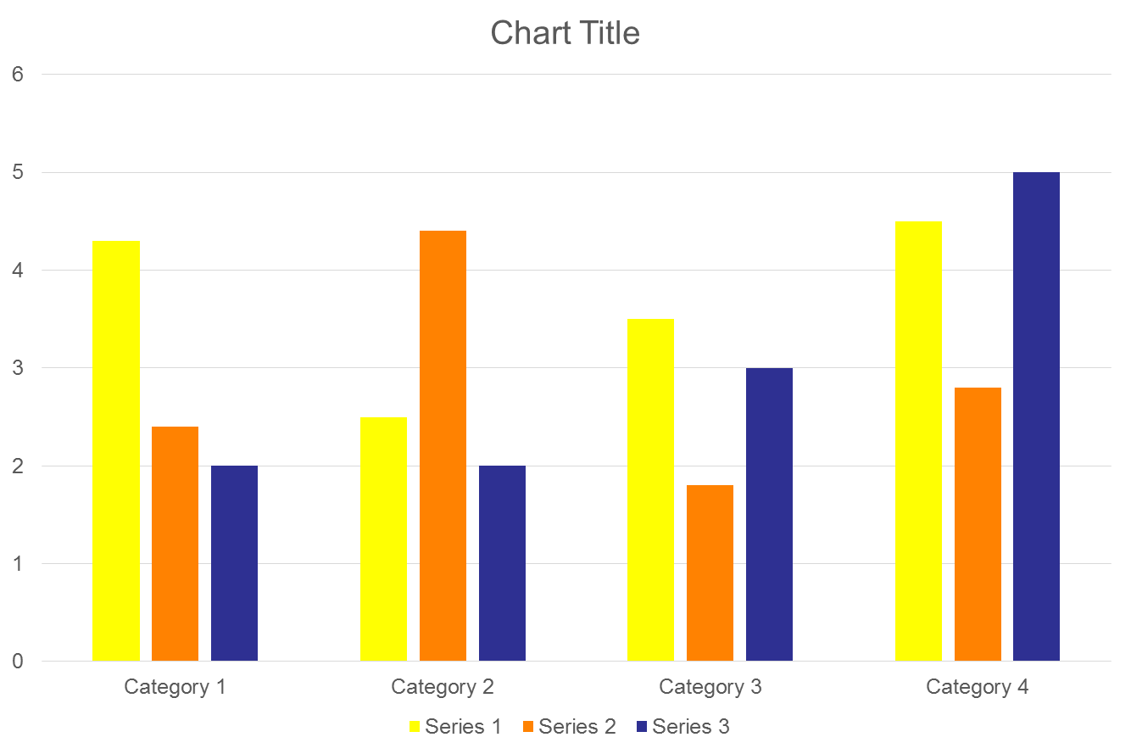
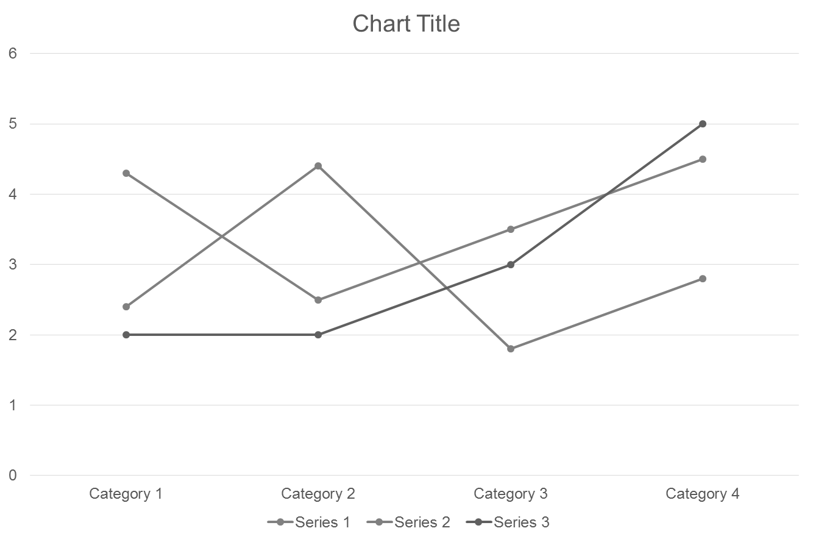






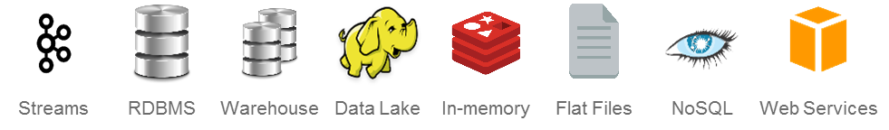
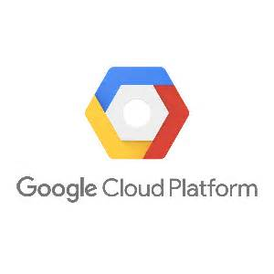
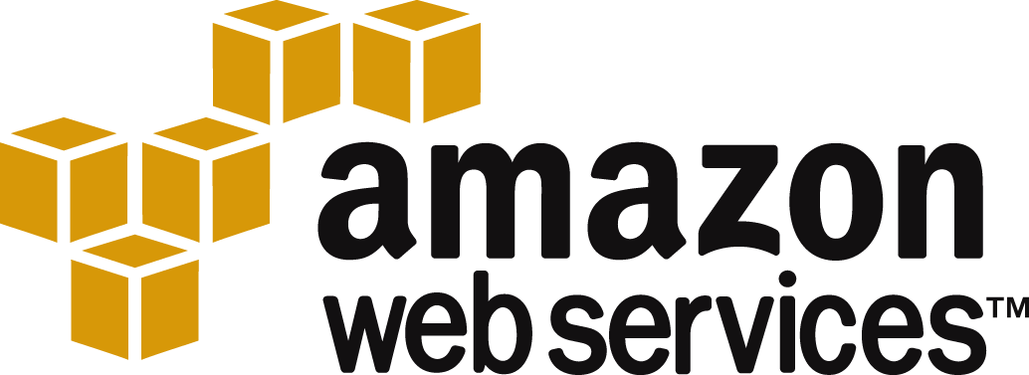
Development process
Development process
From
standardized to
configured
automated
Self-adapting
Harvest and reuse application components
HTML, CSS, Javascript
SPAs, React.js, Angular.js, Backbone.js, etc
Geospatial
Hierarchical
Network
Tabular
Time Series
APPLICATIONS
Compose expert-created models
ML/AI
Data Science
Engineering
Operations
Business
MODELS
Utilize existing and 3rd party data
Enterprise
Big Data
Social
3rd Party Weather
DATA
Utilize existing and 3rd party devices
Hi-Def CCTV
Phone
Network
Vehicles
OT
DEVICES
Utilize many cloud engines
On Prem
CLOUD
Notes:
3G: 0.5-1.5Mbps (Average)
4G LTE: 5-12Mbps (Verizon)
Satellite: $1000 / GB (Iridium Pilot)
Data generated by high-def CCTV camera: 5–10Mb/s (1080p @ 30fps)

Slide 12

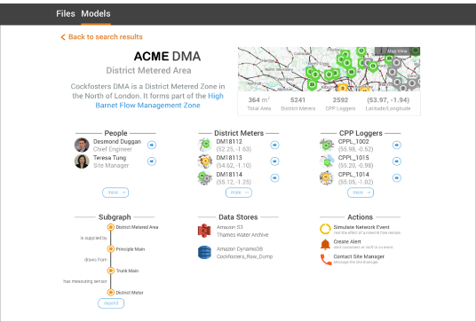
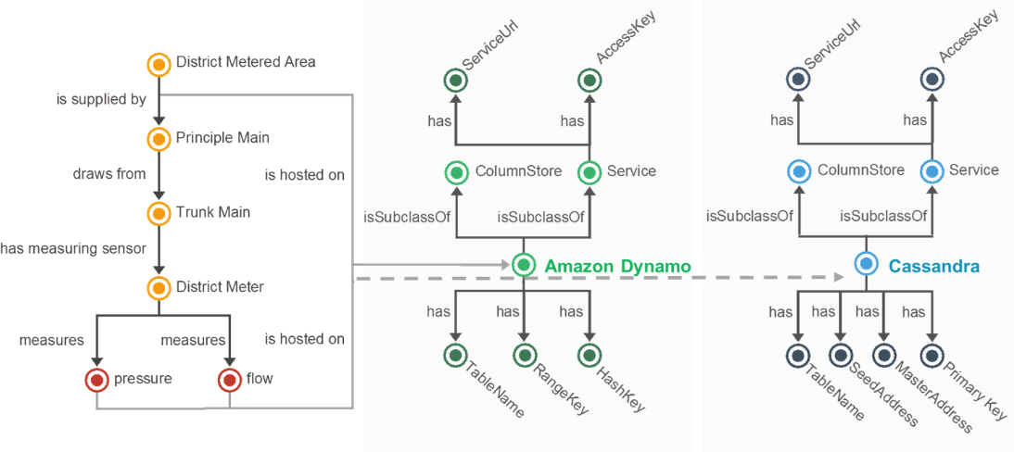
User community
User Community
From
documented to
Self-service
Community Managed
across ecosystem
PUTTING THE “INTERNET” IN IoT
Domain Knowledge Graph
Smart Water
System Metadata
Notes:
Development with an IoT platform acceleration through casting of application
A How-To Cast Platform Components into a Domain
Example: Infrastructure
Interoperable (Cast-able) – Create and Onboard datastore types: Cassandra and Dynamo
Capture (How to Cast)
Capture: How to access and use the datastore types
Configure (Do it!)
- Set how it relates to the domain

Slide 13
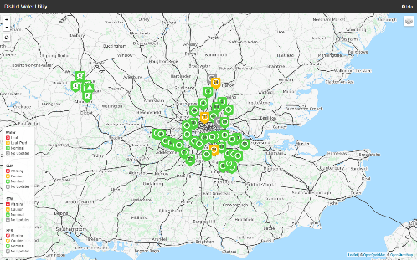

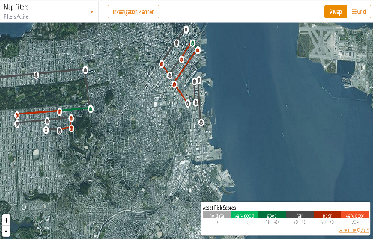






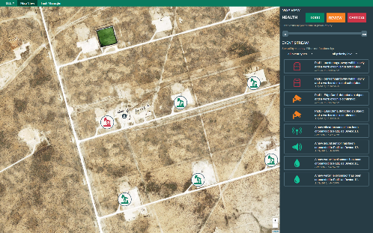
optimization
Optimization
From
Measured to
predictive
prescriptive
Continuous
SCALE THE IoT PLATFORM
WITH NEW APPLICATIONS
SCALE NEW APPLICATIONS
WITH AN IoT PLATFORM
THE PLATFORM CORE CAPABILITIES
1
Reuse
SMART WATER
12 weeks
Initial real-time streaming
Base set of components
Applications
Harvest
Devices
2
Reuse
SMART GRID
8 weeks
Leverage existing base
Contribute new components
Data
Harvest
Models
3
Reuse
OIL & GAS
2 weeks
Main focus on domain specific
Heavy reuse of components
Cloud
Harvest
Notes:
Many organizations can build the first applications
How to evolve?
How to reuse across applications, across domains?
How to operate?
But how do we manage when the number of applications scales?
How do we justify a long running platform? Versus an application?

Slide 14

The platform journey
Strategy & Governance
Optimization
Continuous Demand Sensing
Business Operating Model
Organization Structure
User Community
Architecture
Development Standards
Ways of Working
Tools & Standards
Operations
May be 3rd Party
Development Process
DevOps for Apps, Models, Data
Notes:
Initial Apps + Business Case + Initial Technologies
Ongoing Business Model and Identification of Organization Structure
Organization Structure + Tools & Standards (may be 3rd party)
Development Standards and Ways of Working
Continuous Demand Sensing and End-to-End automation

Slide 15
Questions?

