Slide 1
Serverless Architecture on AWS
Our Experiences
Christopher Phillips, Stanley Black & Decker

Slide 2
Christopher Phillips
Technical Backend Lead at Stanley Black and Decker
7+ years of development experience
Delivered production systems in Node, Erlang, Java
Experienced with distributed, highly available, fault tolerant systems
Serverless deployments since September 2015
Notes:
Talk about self, SBD

Slide 3
Purpose

Slide 4


Slide 5
Summarize the infrastructure we’ve used, the ways we’ve used it, and the lessons we’ve learned, to give you a decent working set of what is useful in going Serverless.
Notes:
Basically, given you know how to set up rest endpoints in lambda, how do you leverage other AWS services to deliver a complete, -useful- solution

Slide 6
Assumptions

Slide 7


Slide 8
You have a sense of humor (or at least will indulge me).

Slide 9
You have a sense of humor (or at least will indulge me).
You are involved in technical software decisions.

Slide 10
You have a sense of humor (or at least will indulge me).
You are involved in technical software decisions.
You use, plan to use, or are considering using the Cloud (specifically AWS).

Slide 11
You have a sense of humor (or at least will indulge me).
You are involved in technical software decisions.
You use, plan to use, or are considering using the Cloud (specifically AWS).
You have some inkling of what Serverless is.

Slide 12
But just in case…

Slide 13
Recap

Slide 14


Slide 15


AWS as VM farm
Application Servers
Database Servers
Elastic Load Balancing
Auto Scaling group
Auto Scaling group
Availability Zone #1
Notes:
The cloud is just running your application on other people’s servers

Slide 16







VMs with AWS Hosted Services
Amazon
Route 53
CloudFront
distribution
web app
server
root volume
logs
Elastic Load Balancing
EC2 instance
security group
data volume
Amazon EBS
snapshot
Amazon S3
bucket
Auto Scaling group
Amazon
RDS
VPC subnet
Availability Zone #1

Slide 17


Serverless (AWS)
Amazon
Route 53
CloudFront
distribution
logs
Amazon API Gateway
AWS
Lambda
Amazon S3
bucket
Amazon
RDS
VPC subnet
Availability Zone #1

Slide 18
Pros
Cons
Costs are more visible
Complexity is hidden
Stateless
Scales trivially
Secure
Costs are more visible
Complexity is hidden.
Stateless can seem harder to reason about
Latency issues (cold start)
Immature tooling
Vendor lock-in (to some degree)
Notes:
Pros –
Simpler – no OS or hardware to manage or orchestrate
Stateless – No implicit state stored in memory to trip you up
Scales trivially – Both in performance and cost. Use a lot, pay a lot; use little, pay little. Predictable
Secure – At least, reduces your attack surface; you don’t have to worry about securing servers.
Cons –
Costs – Savings are hard to quantify (sysops and the like), but cost is very visible.
Stateless etc – This runs counter to how most systems are initially built. You have to be conscious of state to be distributed, but there is no way to punt on these decisions
Cold start – Very surmountable; run a pre-warming function. Still, if not done, you’ll see the latency (and might anyway on the occasional aberrant call)
Tooling – There are some, and others can be cobbled together, but it’s in no way mature.
Lock-in – Obviously, you’re tied to your cloud provider. However, you can at least ensure your code is portable by decoupling it properly.

Slide 19
So Serverless is just replacing REST APIs with API endpoints that call stateless functions.

Slide 20
So Serverless is just replacing REST APIs with API endpoints that call stateless functions.
Right?

Slide 21
So Serverless is just replacing REST APIs with API endpoints that call stateless functions.
Right?
Of course not.

Slide 22
Real Applications™ Are Serious Business ™

Slide 23


Slide 24
Real Applications:
Maintain explicit state
Notes:
Meaning data storage. We have to be very intentional about what we store, because anything we aren’t intentional about storing will not persist between function invocations (with caveats).

Slide 25
Real Applications:
Maintain explicit state
Transition and communicate about state
Notes:
As in, outside of just your REST response. Asynchronously communicate with clients (other than the one invoking a REST response), and to other services on the backend, outside of the context of your REST request.

Slide 26
Real Applications:
Maintain explicit state
Transition and communicate about state
Have access controls

Slide 27
Real Applications:
Maintain explicit state
Transition and communicate about state
Have access controls
Support CI/CD mechanisms

Slide 28
Real Applications:
Maintain explicit state
Transition and communicate about state
Have access controls
Support CI/CD mechanisms
Are monitored

Slide 29
Real Applications:
Maintain explicit state
Transition and communicate about state
Have access controls
Support CI/CD mechanisms
Are monitored
Ideally don’t suffer from noticeable latency

Slide 30
Real Applications:
Maintain explicit state
Transition and communicate about state
Have access controls
Support CI/CD mechanisms
Are monitored
Ideally don’t suffer from noticeable latency
Rely on indirection to provide agility
Notes:
So all in all, this is a list of criteria I thought of to try and determine what else a backend has to do beyond just be a REST API.

Slide 31
Real Applications:
Maintain explicit state
Transition and communicate about state
Have access controls
Support CI/CD mechanisms
Are monitored
Ideally don’t suffer from noticeable latency
Rely on indirection to provide agility

Slide 32
Explicit State

Slide 33


Slide 34
Definition Time!
Notes:
‘Explicit state is state whose lifetime extends over more than one procedure call without being present in the procedure’s arguments’.

Slide 35
Serverless has no shared disk or memory between function invocations (with caveats)

Slide 36
Everything you have learned about distributed storage applies to basic storage in Serverless.
Notes:
Don’t know anything about distributed storage? Learn it. The CAP theorem applies regardless of what you know.
AWS provides a few solutions. Here are the most common.

Slide 37
S3
Pros
Cons
Extremely Cheap
No provisioning required
Trivial to replicate across regions
Version controlled
Very durable, with SLA
Can trigger off of updates
File system-like (no queries)
Eventually consistent
Notes:
You’d use this for a website/webapp anyway, but it can also be used for backend storage.
Strongly consistent when PUTting new objects

Slide 38
DynamoDB
Pros
Cons
Infinitely scalable
Queryable
Can trigger off of updates.
Expensive
Requires explicit throughput provisioning
NoSQL model dictates denormalization and all that entails
Eventually consistent
Notes:
Strong read consistency available, as well as optimistic locking

Slide 39
RDS
Pros
Cons
ACID transactions
Queryable
Familiar
Provisions according to hardware; downtime to scale up.
Limited ways to scale out (read replicas).
Questionable distribution story.
Requires you managing the DB
Should be in a VPC, which has some limitations you need to be aware of.
Complexity when it comes to connection handling.
Notes:
The other two are HTTP access; this is standard MySQL/PostGRES/etc protocols
When I talk about complexity, I mean, do you persist the connection across function invocations? If not, you take a performance hit when the function is reused; if you do, you have to worry about it timing out and being closed by the DB, as well as some race conditions at high load that might cause other function invocations to starve of connections.
We’ll get into the VPC issues later
So now that we’ve talked about storing data externally, let’s talk about storing it internal to the function

Slide 40
Be wary of disk and memory persistence between function invocations.
Notes:
Using the reused function’s memory/disk has some uses, but is very likely to trip you up.
* Loading costly to compute/retrieve secrets
Danger, which we’ve hit, of destructive operations on persisted memory structures.
* Danger in inability to unload functions

Slide 41
Summary
Push state to the datastore; don’t rely on memory/disk between function invocations.
The datastore is necessarily distributed; treat it as such
S3 is cheap, low complexity, but the most restrictive model
DynamoDB is expensive, requires adaptive provisioning, and is eventually consistent.
RDS is familiar, moderately expensive, moderately complex, and changes in provisioning require downtime.
There is no one size fits all; evaluate your use case.

Slide 42
Real Applications
Maintain explicit state
Transition and communicate about state
Have access controls
Support CI/CD mechanisms
Are monitored
Ideally don’t suffer from noticeable latency
Rely on indirection to provide agility

Slide 43
Messaging
&
Responding

Slide 44


Slide 45
What if I need some backend processing apart from REST calls?
Notes:
I don’t want to just hold a user connection open while I do stuff the user doesn’t care about

Slide 46
SQS
Event based triggers
Schedule based triggers
Kinesis
SWF
Lambda Step functions
Notes:
SQS – Simple Queue Service, allows for a basic message queue. Details later.
Event based triggers – What we’ve largely used. S3 and Dynamo predominantly, but they can be triggered off of others (Cloudwatch alarms for instance).
Kinesis – Data stream; haven’t used it at large, but am aware of it.
Simple Workflow Service – Not really touching on; this is AWS’ more enterprise-y solution for building an entire workflow. We don’t really use it
Step Functions – SWF lite, almost; a way to define a series of lambda functions into a single callable chain, output of one step -> input to the next. Supports parallel execution, but
currently not dynamic, which is limiting.
The first three are ways to offload work from the lambda backing the REST call. The second two are ways to define more complex tasks. I’m not going to go too deeply into the second two

Slide 47
Fundamentally all these services (and others) trigger lambdas based on various events.

Slide 48
But with some caveats!
Notes:
Let’s start with queues

Slide 49
Default SQS queues don’t preserve message order. But they’re probably what you want if you need a queue for later processing.
Notes:
They do, however, guarantee at least once delivery. HOWEVER, ensure idempotency, in the event a message arrives more than once

Slide 50
SQS also provides FIFO queues, but extremely limited availability.
Notes:
Only available in Ohio and Oregon right now
Automatically deduplicate messages over a five minute window. Meaning if the same message arrives again within 5 minutes, it’ll cull it for you. This allows a kind of exactly once delivery to the queue; it can not guarantee exactly once processing however. You still probably want idempotency.
Costs are different between standard and FIFO queues.
FIFO queues are not as compatible as standard queues, and throughput IS limited.

Slide 51
Event based triggers are what they sound like.
Notes:
A lambda that triggers in response to a particular event. These events are things that happen in other AWS services. For instance, every time you create a file in S3, trigger a lambda. Very similar to database triggers (and in fact you can trigger these from Dynamo. Not, currently, from RDS). This is technically how the API Gateway calls lambdas, too.

Slide 52
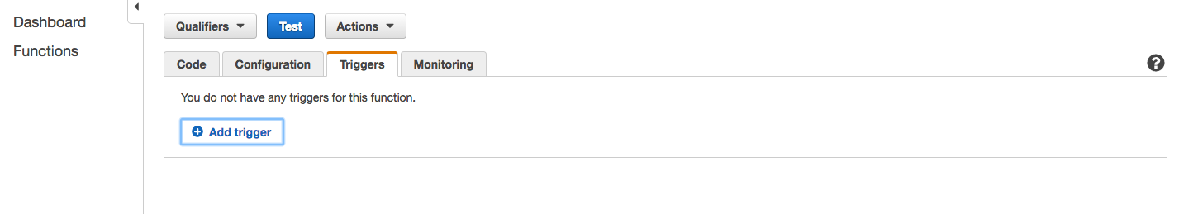
Notes:
Add triggers from the lambda, not the other way around –except- in the API Gateway use case

Slide 53
Scheduled events can be triggered with Cloudwatch

Slide 54
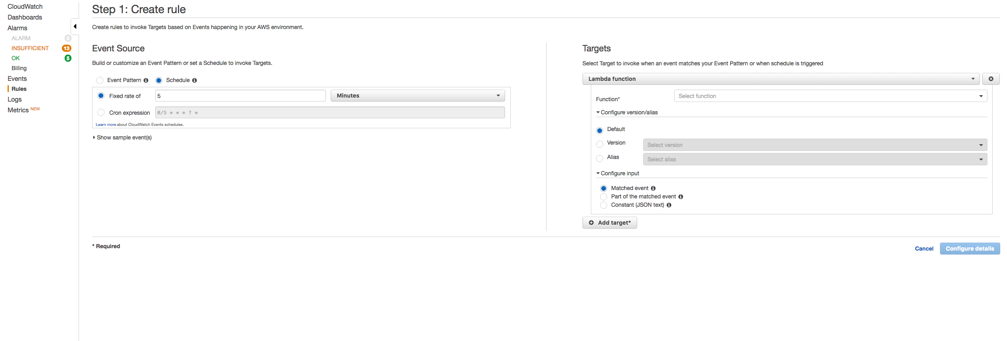
Notes:
Every event in the backend is either externally caused, internally (infrastructure) caused, or time caused.

Slide 55
You can invoke lambdas directly with the SDK, as well as execute SWF workflows or Lambda Step Functions.
Notes:
Be aware of timeouts, however, if you have a lambda invoke another lambda, as timeouts can compound. The other two give you no opportunity to block until a response comes back (they returned immediately).

Slide 56
What happens when things fail?
Notes:
Specifically, what happens when my code fails? A bug, bad data, a service is unavailable, etc?

Slide 57
Lambdas behave differently depending on whether they’re called synchronously, asynchronously, or from a streaming service.

Slide 58
Lambdas called synchronously will simply return a failure.
Lambdas called asynchronously (from other AWS services) will automatically be queued up and retried a couple times and can be sent to a dead letter queue if retries are used up.
Lambdas called from a streaming service will be retried, in order, until success or expiration.
Notes:
Synchronous – Mention these are mostly client service, and can be retried. API Gateway, Cognito, Echo, and Lex
Async - S3, SNS, SES, Cloudformations, Cloudwatch
Streams – Dynamo, Kinesis

Slide 59
So that’s a quick overview of backend infrastructure.
What about client pushes?

Slide 60
Pushes to phones, triggered from lambdas, are no different from a traditional server environment.
Notes:
Typical to what you expect, have a token, post to APNS or GCM with it.

Slide 61
Pushes to web clients, however, are. They have no canonical AWS solution (as of writing)

Slide 62
But there is a way.

Slide 63
AWS IoT effectively gives you pub/sub capabilities via WebSockets (MQTT over Websocket)
https://github.com/lostcolony/examples/blob/master/deviceless_ws.js
Notes:
Note that this example does not use temporary credentials; just add sessionToken into the device initializer JSON if you are.
This is expensive, but robust. And it may not actually be needed, because…

Slide 64
Consider Polling.

Slide 65
No, seriously. Frequent updates may be cheaper to pick up via batching and polling.
Consider Polling.

Slide 66
If AWS IoT is too expensive, and polling won’t work…you may actually need server based infrastructure.

Slide 67


Slide 68
However, this feature has been lodged with AWS.
Notes:
That is, we’ve asked for AWS to separate out this websocket connectivity either into its own service, or into a separate pricing strategy, as the IoT pricing is heavy, and assumes thing shadow updates, rules engine executions, plus certificate checking; when just leveraging a websocket to publish a message out, most of that lays unused.

Slide 69
Summary
Events can trigger lambdas from many other services, and are configured as part of the lambda.
API Gateway is just a particular use case of this.
Events can be synchronous, in which case failure requires you to retry, asynchronous, in which case it will automatically be retried, or streaming, in which case it will retry until expiry, blocking all other events from processing.
AWS IoT provides a way to have Serverless websockets, but it’s not priced as competitively as it might otherwise be (bulk discounts available though).
Use queues as appropriate; maintain idempotency.

Slide 70
Real Applications
Maintain explicit state
Transition and communicate about state
Have access controls
Support CI/CD mechanisms
Are monitored
Ideally don’t suffer from noticeable latency
Rely on indirection to provide agility

Slide 71
Access Control

Slide 72
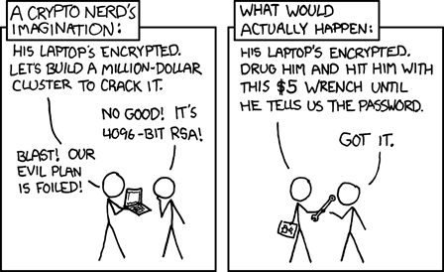

Slide 73
AWS has IAM for access control.
(Identity Access Management).
Notes:
Describe in brief

Slide 74
AWS also has Cognito as an identity service.

Slide 75
You don’t need to use Cognito for identification, but it’s actually pretty simple to get started.

Slide 76
Create a federated identity pool. For its role(s), assign the relevant policy permissions.
Notes:
You can hook up a user pool to your federated identity pool if you want to manage users within Amazon; most of our use cases entail users signing in through some other portal however. Either way, you can start here and extend later.

Slide 77
Amazon|Facebook|Google
Log the user in to the service using their API, to get an openID token.
Call getCredentialsForIdentity with the appropriate login provider.

Slide 78
Custom Identity Provider
Create an endpoint that validates user credentials appropriately.
On successful validation, create a token with getOpenIdTokenForDeveloperIdentity. Return this to the client.
On the client, call getCredentialsForIdentity. Use the login provider “cognito-identity.amazonaws.com”
Notes:
At this point you have temporary AWS credentials, that have a decided upon policy applied to them.

Slide 79



2. getOpenIdTokenForDeveloperIdentity
AWS
Lambda
Amazon
Cognito
3. getCredentialsForIdentity
1. API call
Amazon API Gateway
temporary security credential
OpenId
Token

Slide 80
You can also call sts:assumeRole* variants to generate temporary credentials, and to further restrict policies.

Slide 81

1. Set up a role in your application account that has a trusted principal of the Cognito bucket in your authentication account.
3. Client calls sts:assumeRoleWithWebIdentity with a role belonging in a second account. Get credentials for that account.
2. Client calls custom API in authentication account for OpenID token
Notes:
This opens up a really cool ability to retrieve OpenId tokens from one account, and use them to authenticate with another.

Slide 82
Every AWS service can be accessed with these credentials using AWS Signature Version 4
Notes:
Use a library for this. Ideally, use the aws-sdk.

Slide 83
You can restrict access to your APIs this way, too, but not via the SDK. Use a third party signing library rather than reimplement Sig4
Notes:
Budget time for this. Even with a library getting it working right can be time consuming.
I’ve seen three different teams work on getting their API’s authenticated in this way. All three took a day or two.
This gets especially complex when using CloudFront, DNS, and HTTPS. I.e., a production environment. Set it up early in DEV.

Slide 84
AWS does not currently have user controlled rate limiting to prevent malicious users from DDoSing you.
Notes:
They’re working on this as part of the WAF, which is part of…

Slide 85
However, stick a CloudFront in front of your API Gateway, and you can enable a Web Application Firewall.
Notes:
If you enable Cloudfront, and take advantage of the WAF, you can restrict by IP. You can not currently rate limit, however; it’s either an IP is banned or allowed.

Slide 86
There is also AWS Shield. This works with the WAF on Cloudfront (and Route 53 at the DNS level)
Notes:
This mitigates DDoS.
Basic level included for all accounts.
Premium unlocks additional features.
Haven’t played with this yet.
A feature request have been lodged to also apply for IoT, Websocket based communication, to limit publishes.

Slide 87
Most usage billed services AWS provides include access limits. Production workloads may need these raised.
Notes:
I.e., you can only have so many concurrent function executions in Lambda

Slide 88
Some can be automatically raised via code. Most can’t.
Notes:
DynamoDB, for instance, can have its throughput automatically raised via lambdas tied to high watermark events. It’s obvious what can or can’t; if raising it requires a service ticket, you can’t do it automatically.
Be aware of the ramifications if you modify your resource access via code. It could lead to huge spikes in the event of a DDoS.

Slide 89
In general, you still have to have the monitoring and support a traditional solution requires.
Notes:
We will, of course, be getting to this. But first…

Slide 90
Summary
IAM is mostly respected by every service. Learn it.
Cognito is an identity provider built to return an OpenID token
With a Cognito token, or custom code, you can retrieve temporary access credentials to AWS that can be used for most services.
The AWS SDK makes this easy for everything but API Gateway.
For API Gateway, use a Signature 4 library
DDoS prevention is there, but limited. AWS is actively improving this.
Be aware of usage limitations. Raise as appropriate.

Slide 91
Real Applications
Maintain explicit state
Transition and communicate about state
Have access controls
Support CI/CD mechanisms
Are monitored
Ideally don’t suffer from noticeable latency
Rely on indirection to provide agility

Slide 92
Automation

Slide 93


Slide 94



Slide 95
Infrastructure doesn’t change that much. Code does.
Notes:
I suggest separate strategies for handling these.
For code, find a framework that allows you to spin up and deploy lambdas (and their associated IAM roles, etc).

Slide 96
Serverless - https://serverless.com/
Apex - http://apex.run/
Sparta - http://gosparta.io/
Zappa - https://github.com/Miserlou/Zappa
Chalice - https://github.com/awslabs/chalice
Notes:
I use Serverless, as it bundles both Lambda and API Gateway, has Node and Python as first class citizens, and seems the most mature. It also has some plugins to allow you to test the API Gateway portion locally, creating an ExpressJS server based on your config.
Apex is focused specifically on lambdas, not the API Gateway. It has some neat capabilities within that.
Sparta is Serverless for Golang.
Zappa is Serverless for Python. It includes a lambda pre-warming option as simple config, which is nice.
Chalice is interesting; it’s not ready for prod, but as you can see from the URL, it’s the solution in this space being built by AWS itself.

Slide 97
Because these are CLI tools, you can leverage existing CI/CD tools fairly easily, but direct plugins are few.
Notes:
It’s all command line stuff, so easy to assemble, but nothing really out of the box.

Slide 98
These tools do NOT address spinning up additional infrastructure.
Notes:
Your S3 buckets, Dynamo tables, etc.

Slide 99
For this, use Cloudformations (or your preferred tool of choice)
Notes:
For managing changes and carrying them across your environments. This is also a really good place to dedicate DevOps resources.

Slide 100
Versioning of both lambdas, and API Gateway stages, is supported, but fiddly.
Notes:
You should be using source control anyway; keep note of what commit is deployed
Note that most frameworks won’t prune old endpoints/funtions.
That said, you can use this to keep an older API in place. You need to be careful though; unless you hooked up the API Gateway to a specific published version of a lambda, it will default to using the latest. If you wish to persist an older API, first version the lambda, and then reference it when hooking up the API Gateway. Your SDK may do this automatically for you, but be sure to test it out before relying on it. Better is to always maintain backwards compatibility with your APIs, or deprecating with forced version updates. This is no different than you already do with server-ful APIs.

Slide 101
If you maintain config in separate files, consider uploading them to an encrypted S3 bucket.
Notes:
But that said…

Slide 102
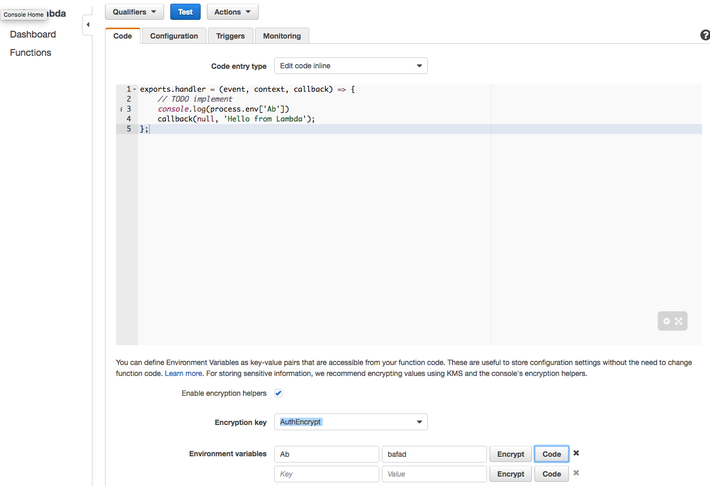
Notes:
AWS has added the ability to include environment variables for your lambdas as of November. There’s two ways of doing this.
The first, pictured here, is to use an encryption helper to store the values encrypted, and then decrypt them in code via KMS. This is a pain, and requires you to select your own key.

Slide 103
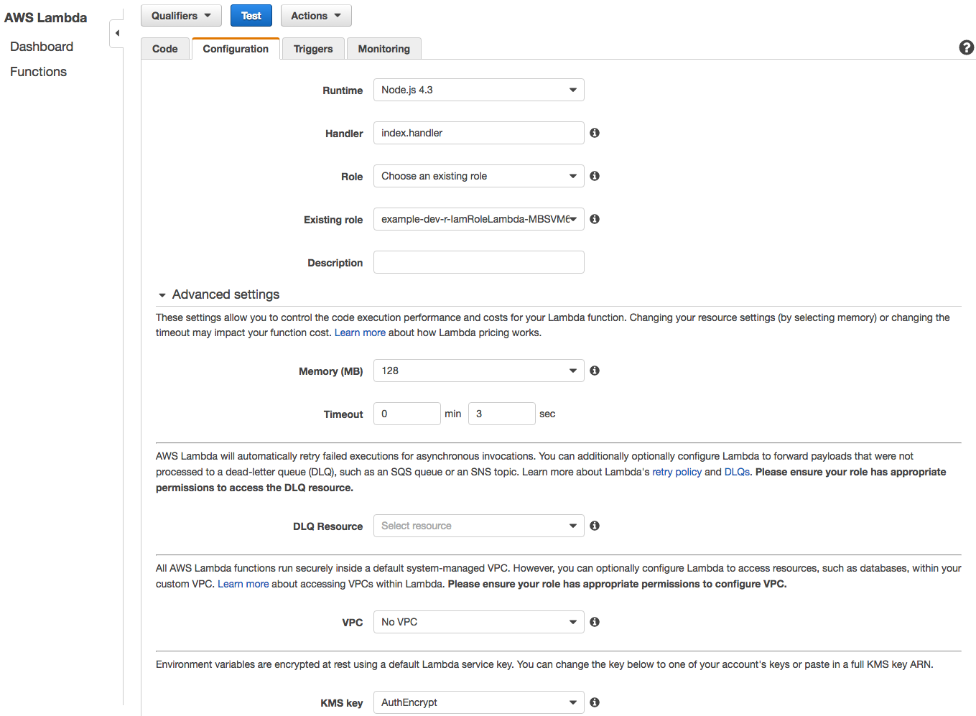
Notes:
The second, pictured here, is to set the key as part of your advanced configuration; this will encrypt them only at rest, and pass them to your function decrypted. For this, you can also use the default AWS key, to avoid being charged.

Slide 104
We’ve had success allowing devs access to a dev AWS account, which has AWS Config enabled.
Notes:
Devs can make changes to infrastructure by hand as they need while developing.
When it comes time for a stage push, DevOps can go to AWS Config and see what has changed; from that (and speaking with the devs) they can build a Cloudformation.

Slide 105
Summary
Use a framework for deploying lambda + API Gateway changes
Use Cloudformations for infrastructure.
There are multiple ways of handling config. Figure out what fits your deployment and security needs best.
Have separate accounts for each environment.
We’ve found a lot of success in allowing devs to make infrastructure changes freely in a dev account, and only on success worrying about the resulting Cloudformations, for deploying to stage, prod, etc.

Slide 106
Real Applications
Maintain explicit state
Transition and communicate about state
Have access controls
Support CI/CD mechanisms
Are monitored
Ideally don’t suffer from noticeable latency
Rely on indirection to provide agility

Slide 107
Monitoring

Slide 108
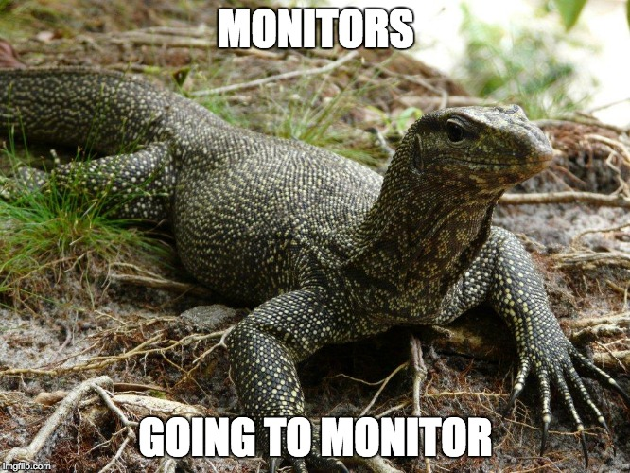

Slide 109


Slide 110
Unsurprisingly, with Serverless, both logging and alerting change.

Slide 111
Lambda logs go directly into Cloudwatch, but they are not easily followable, as they’re per function container.
Notes:
Functions get reused, created, and deleted, at unpredictable times, and so two invocations might be in the same log, or different, and no way to tell which one except by timestamp
That said, the API Gateway does tag logs per invocation, as of early March, so that helps.

Slide 112
Happily, Cloudwatch has pretty decent search and metrics tools.
Notes:
I actually use these a lot; however, we’ve spent time integrating Cloudwatch logs into other products, too. There are a lot of possible integrations. But even just using the provided tooling…

Slide 113
You can set up alarms for these metrics, to post to an SNS queue (and then send out SMS messages, or emails).
Notes:
For instance, alert me any time my APIs return an HTTP status code of 500.
However, we’ve not had a great experience with these. Turns out, most of our prod errors are due to users, timeouts (which your client should be handling), etc.
We’ve talked about sending these errors into a lambda that then does more digging into the logs, and determines whether to actually inform us, but what we’ve actually ended up doing is just raising the alarm threshold for these issues.

Slide 114
Following up with asynchronous lambdas. If they fail too many times, what happens?

Slide 115
Well, they’re retried (as mentioned before), but otherwise nothing by default.
But…

Slide 116
Dead letter queues!

Slide 117


Slide 118
You can hook a dead letter queue to your function, to send to an SNS topic or SQS queue.
Notes:
Do this as part of the function definition of the lambda itself.

Slide 119
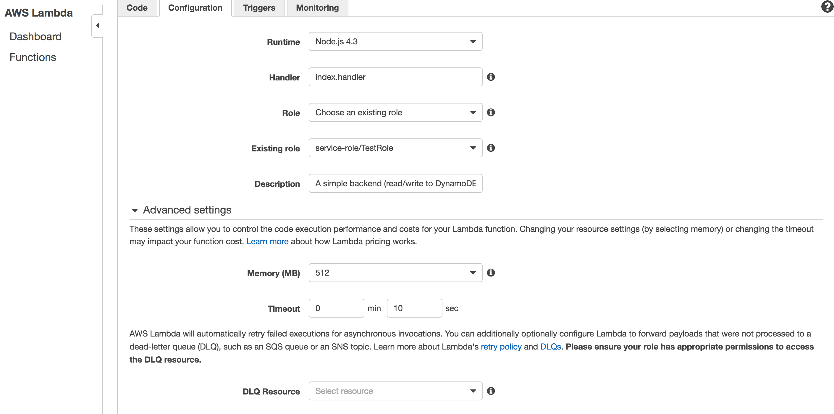
Notes:
From SNS you can email yourself, or stick them on an SQS queue for later processing, or whatever. You can also have them go directly onto SQS, though that’s more limited (SNS can trigger a lambda, or have both a queue and an email distribution list subscribed to the notifications).

Slide 120
So lambda logs go to Cloudwatch. What about knowing (for instance), when I’m running out of throughput for my Dynamo tables?

Slide 121
Metrics metrics metrics!
Notes:
I mentioned these before. Cloudwatch metrics can be accessed directly by lambdas. Like I said before about Dynamo, utilization is too high? Automatically raise it! Once it drops, lower it again.
CloudWatch.getMetricStatistics or CloudWatch.describeAlarms (where state value is ALARM)

Slide 122
Track changes to your infrastructure. Cloudtrail does this if you enable it, and it, too, can post to Cloudwatch.
Notes:
AWS Config is also helpful here.

Slide 123
Cloudwatch logs can be copied to S3 buckets, as input for other tools, processes, etc.
Notes:
In short, everything ties into Cloudwatch. Hence the name.

Slide 124
Summary
All your logs are belong to Cloudwatch
Cloudwatch tracks a lot of technical metrics for you.
Dead letter queues for your async lambdas that fail too hard. SNS can just email it to you.
Cloudwatch can manually drop logs into S3 buckets, or automatically stream them to a Kinesis stream.
Those logs can in turn trigger lambdas!
Or just be processed by an AWS aware tool of your choice.

Slide 125
Real Applications
Maintain explicit state
Transition and communicate about state
Have access controls
Support CI/CD mechanisms
Are monitored
Ideally don’t suffer from noticeable latency
Rely on indirection to provide agility

Slide 126
Latency

Slide 127


Slide 128
Latency is not a problem. User experience is.
Notes:
Figure out where users expect latency, and where they will notice it. Consider signing in to a mobile app. This can take a while, even on the order of a few seconds, and it’s ~okay~. Obviously though, page layouts, images, etc, have to happen fast.

Slide 129
Use Cloudfront.
Notes:
Cloudfront can cache your website, yes, but it can also serve as a cache for the GETs on your APIs. Further though, it also enables WAF (web application firewall), supports more TLS options for connecting compared with the API Gateway, and until recently was the only way to integrate the certificate manager to provide HTTPS for custom domains.

Slide 130
In general, any production facing endpoints should have a Cloudfront instance in front of them, even if you’re not caching.

Slide 131
Be careful of caching error codes.
Notes:
This may seem obvious, but, we were bitten by this. You need to explicitly tell Cloudfront if you don’t want to cache errors, by setting a custom error response for the HTTP code, and setting a minimum TTL.

Slide 132
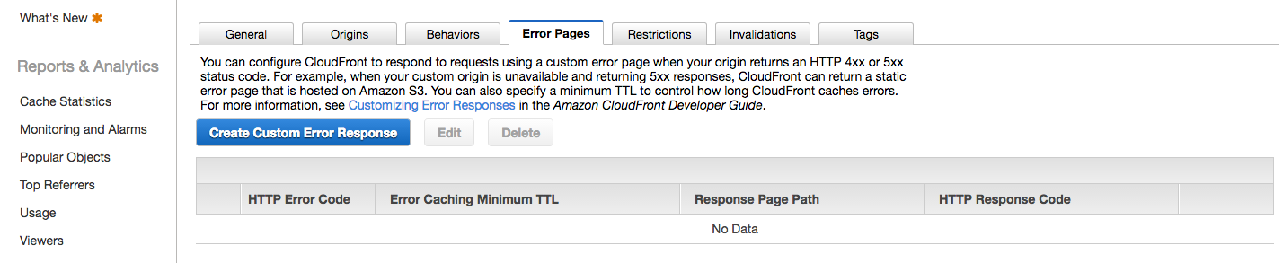
Notes:
This may seem obvious, but, we were bitten by this. You need to explicitly tell Cloudfront if you don’t want to cache errors, by setting a custom error response for the HTTP code, and setting a minimum TTL.

Slide 133
The API Gateway also has a separate caching mechanism. It’s not really worth it.
Notes:
I say this with caveats, of course. It’s far more limited, but the pricing model is different. If you don’t want anything Cloudfront offers –except- caching, and the pricing is better, it might be worth it. But by default I’d say use Cloudfront

Slide 134
Your lambdas take time to spin up. Take that into account.
Notes:
This may not be an issue if you plan for it. If it is, you can prewarm them. Set up the lambda to take a specially crafted payload, that instructs it to do nothing. Then set up a scheduled event that invokes one lambda, that in turn invokes all of the lambdas you need to stay warm. Code them to handle that with a no-op. Note that you can invoke lambdas directly in this way via the SDK; this is cheaper than calling them via HTTP through the API Gateway. You don’t want separate events for each lambda because there is a limit to the number of scheduled events per environment that you can have.

Slide 135
Lambdas cold starting in a VPC take EVEN LONGER, and have additional considerations around ENIs.
Notes:
On the order of 10+ seconds. Again, take this into account. You definitely want to be considering warming functions.
ENI = Elastic Network Interface
350 is limit.
New one per container.
Can raise this by contacting support.
Make sure max(lambda count, eni count) is supported by DB, connectionwise.

Slide 136
Rethink your API design.
Notes:
Good REST APIs break apart resources upon semantically separate nouns. “user”, vs “project”, say.. But if you have predictable access patterns that can be combined in a single API call, consider doing that as well. Why? Because you can save on cost, with no negative affect on performance. One call to the API Gateway, one lambda, to execute two DB requests in parallel, will charge you only once for the API Gateway and lambda. As always, your mileage may vary; profile it.

Slide 137
Summary
Worry about latency only when you have to.
Cloudfront all the things (APIs).
Be aware that HTTP errors are by default cached.
Prewarm functions if you need to.
Consider optimizing your API for fewer calls rather than separation of concerns if cost is a factor (with a solid framework this should not affect your library code, just your glue)

Slide 138
Real Applications
Maintain explicit state
Transition and communicate about state
Have access controls
Support CI/CD mechanisms
Are monitored
Ideally don’t suffer from noticeable latency
Rely on indirection to provide agility

Slide 139
Indirection

Slide 140


Slide 141
Route 53 + Certificate Manager
Notes:
Touch on cheap domains, free certs if using Cloudfront (only available to be used in Cloudfront, API Gateway, or ELB). Automatically rotate. No access to private key

Slide 142
Rely on standard ports
Notes:
Cloudfront and the API Gateway only support ports 80 and 443 for incoming connections. I mention this mostly for those people who want to slowly evolve toward Serverless. Make sure your clients assume default ports, so you can slap the API Gatewa in place.

Slide 143
Use DNS for indirection even within VPCs, and use it for cross regional failover and scale out.
Notes:
AWS supports various routing policies; of most interest is latency based routing.

Slide 144
Write your lambdas as libraries, and isolate the handler code.
Notes:
Meaning…

Slide 145
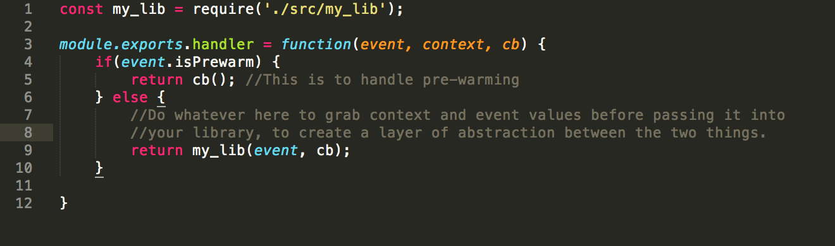

Slide 146
Summary
Write your lambdas as libraries, with glue.
AWS has great DNS and certificate utilities, that play very nicely with Serverless.
If you plan to migrate to Serverless, rely on standard ports.

Slide 147
And that’s basically it. The AWS docs are good, the services work, we’re pretty happy with our serverless solutions.
Notes:
Hopefully you feel sufficiently informed to evaluate a serverless solution for your own business problems.

Slide 148
Questions?

