Slide 1
The Need for Speed: Benchmarking DL Workloads
Greg Diamos, Sharan Narang
Sept 26, 2016

Slide 2
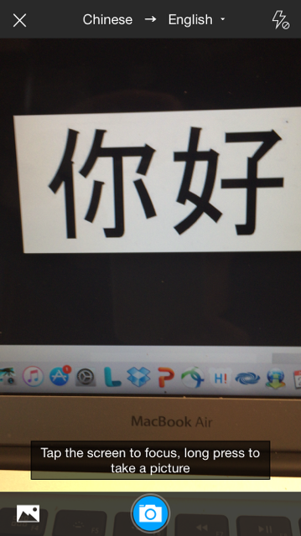
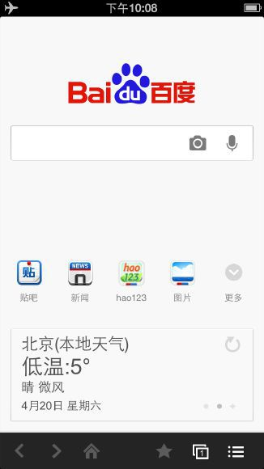
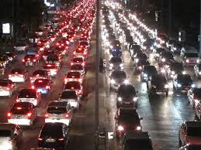
What can AI do for us?
Help us communicate with devices
Find what we are looking for
Help us communicate with each other
Drive us to work

Slide 3
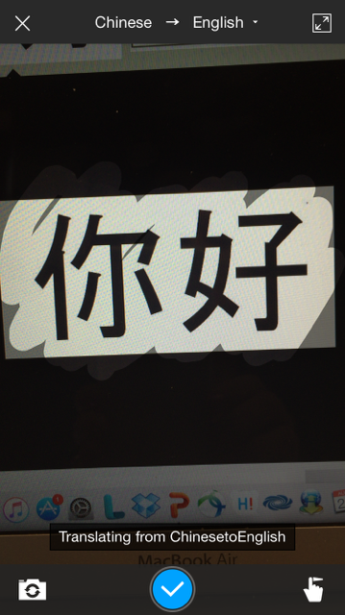
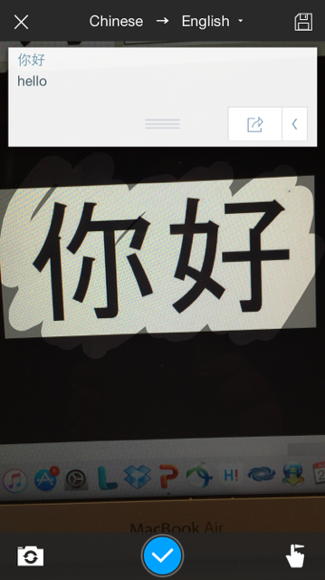
OCR Based Translation App Baidu IDL
hello

Slide 4
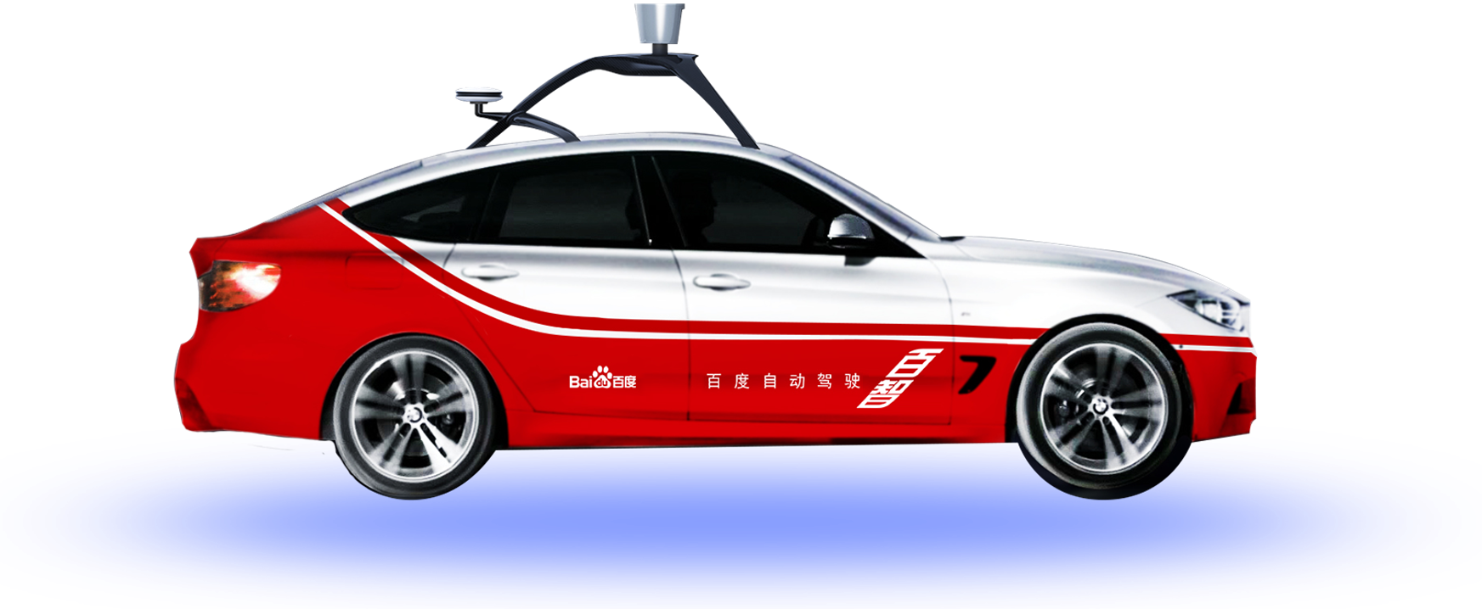
Self Driving Car Baidu ADU

Slide 5
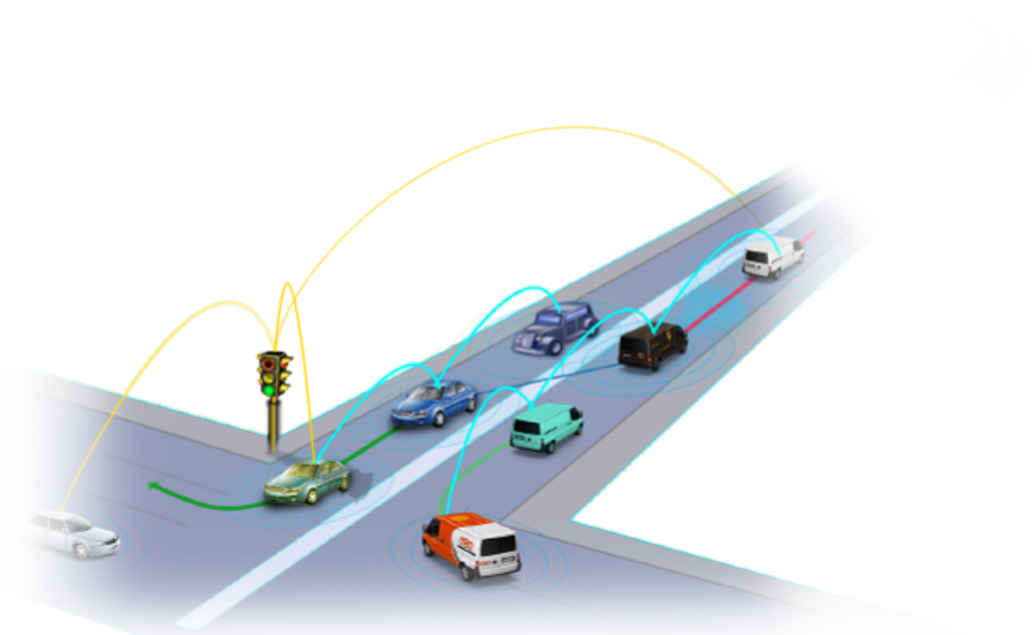
Self Driving Car Baidu ADU
Safer
Efficient
Economical
Goal: Saving 3000+ lives from road traffic death per day

Slide 6
Natural User Interfaces Goal
Make interacting with devices as natural as interacting with humans.

Slide 7
Natural User Interfaces Challenges
Speech Recognition
Emotional Recognition
Dialog Systems
Speech Synthesis

Slide 8
Speech Recognition Baidu SVAIL
English

Slide 9
Why Deep Learning?

Slide 10
Key Tenets of Deep Learning
1. Large amount of data

Slide 11
How Large is our Data?
Data
Notes:
Analogy to real world problem.

Slide 12
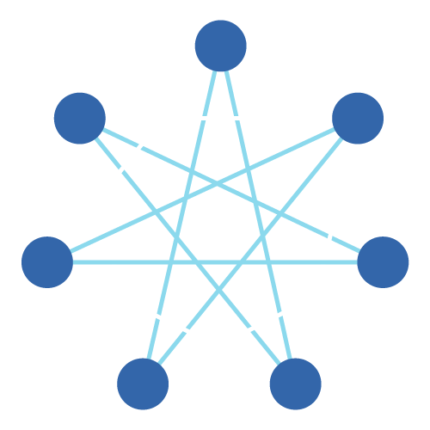
Key Tenets of Deep Learning
1. Large amount of data
2. Large and complex models
(that have diverse operations)

Slide 13
Fully Connected Layer
Models
Matrix Multiply
Multiple
Inputs
Multiple Outputs

Slide 14
Convolutional Layers
Models
Several small dot products over multiple dimensions
Filter
Filter
Input
Output

Slide 15
Recurrent Layers
Models
Smaller matrix multiplications repeating over time
Outputs
Inputs
Time

Slide 16
Key Tenets of Deep Learning
1. Large amount of data
2. Large and complex models
(that have diverse operations)

Slide 17
How do we train deep learning models?
Deep Learning Frameworks & Libraries
Training Hardware

Slide 18
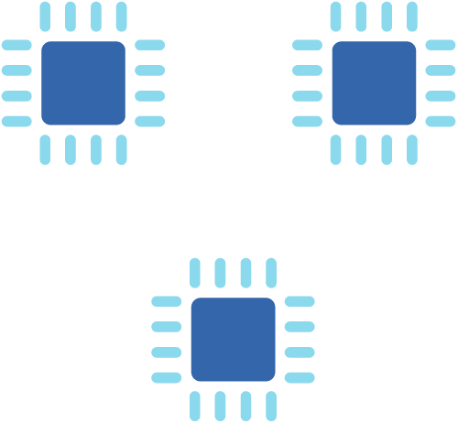
Multiple Processors

Slide 19
To summarize so far
Large data
Large and complex models
Frameworks & Libraries
Training Hardware

Slide 20
Training Many Large Models Quickly
We need to complete the cycle fast to explore many ideas.
Idea
Results
Code

Slide 21
All this complexity slows things down significantly!

Slide 22
Need for Speed

Slide 23
DeepBench
First open source benchmarking tool to measure deep learning performance

Slide 24
What is DeepBench?
Benchmarking tool for neural network libraries and underlying hardware
Includes a curated list of deep learning operations and workloads that are important and widely used in the industry

Slide 25
Where does DeepBench fit in?
Deep Learning Frameworks
E.g. PaddlePaddle, TensorFlow
Neural Network Libraries
E.g. cuDNN, MKL
DeepBench
Hardware

Slide 26
Why DeepBench?
Set industry benchmarks on hardware and libraries to use for deep learning operations
Establish a set of operations and workloads as standards

Slide 27
DeepBench Results

Slide 28
Benchmarks – Matrix Multiply
Matrix Sizes | Time (milliseconds)
1760 x 1760 , 1760 x 128 | 0.17
2560 x 2560 , 2560 x 64 | 0.28
7680 x 2560 , 2560 x 64 | 0.42

Slide 29
Benchmarks - Convolutions
Input Size | Filter size | # of Filters | Time (milliseconds)
224 x 224 x 3 | 3 x 3 | 64 | 2.00
112 x 112 x 3 | 3 x 3 | 128 | 3.71
7 x 7 x 512 | 3 x 3 | 512 | 1.28

Slide 30
Community Involvement
Deep learning researchers can provide new operations and workloads that are specific to their application
Hardware vendors and startups can contribute results for these benchmarks using their hardware and libraries
https://github.com/baidu-research/DeepBench

Slide 31
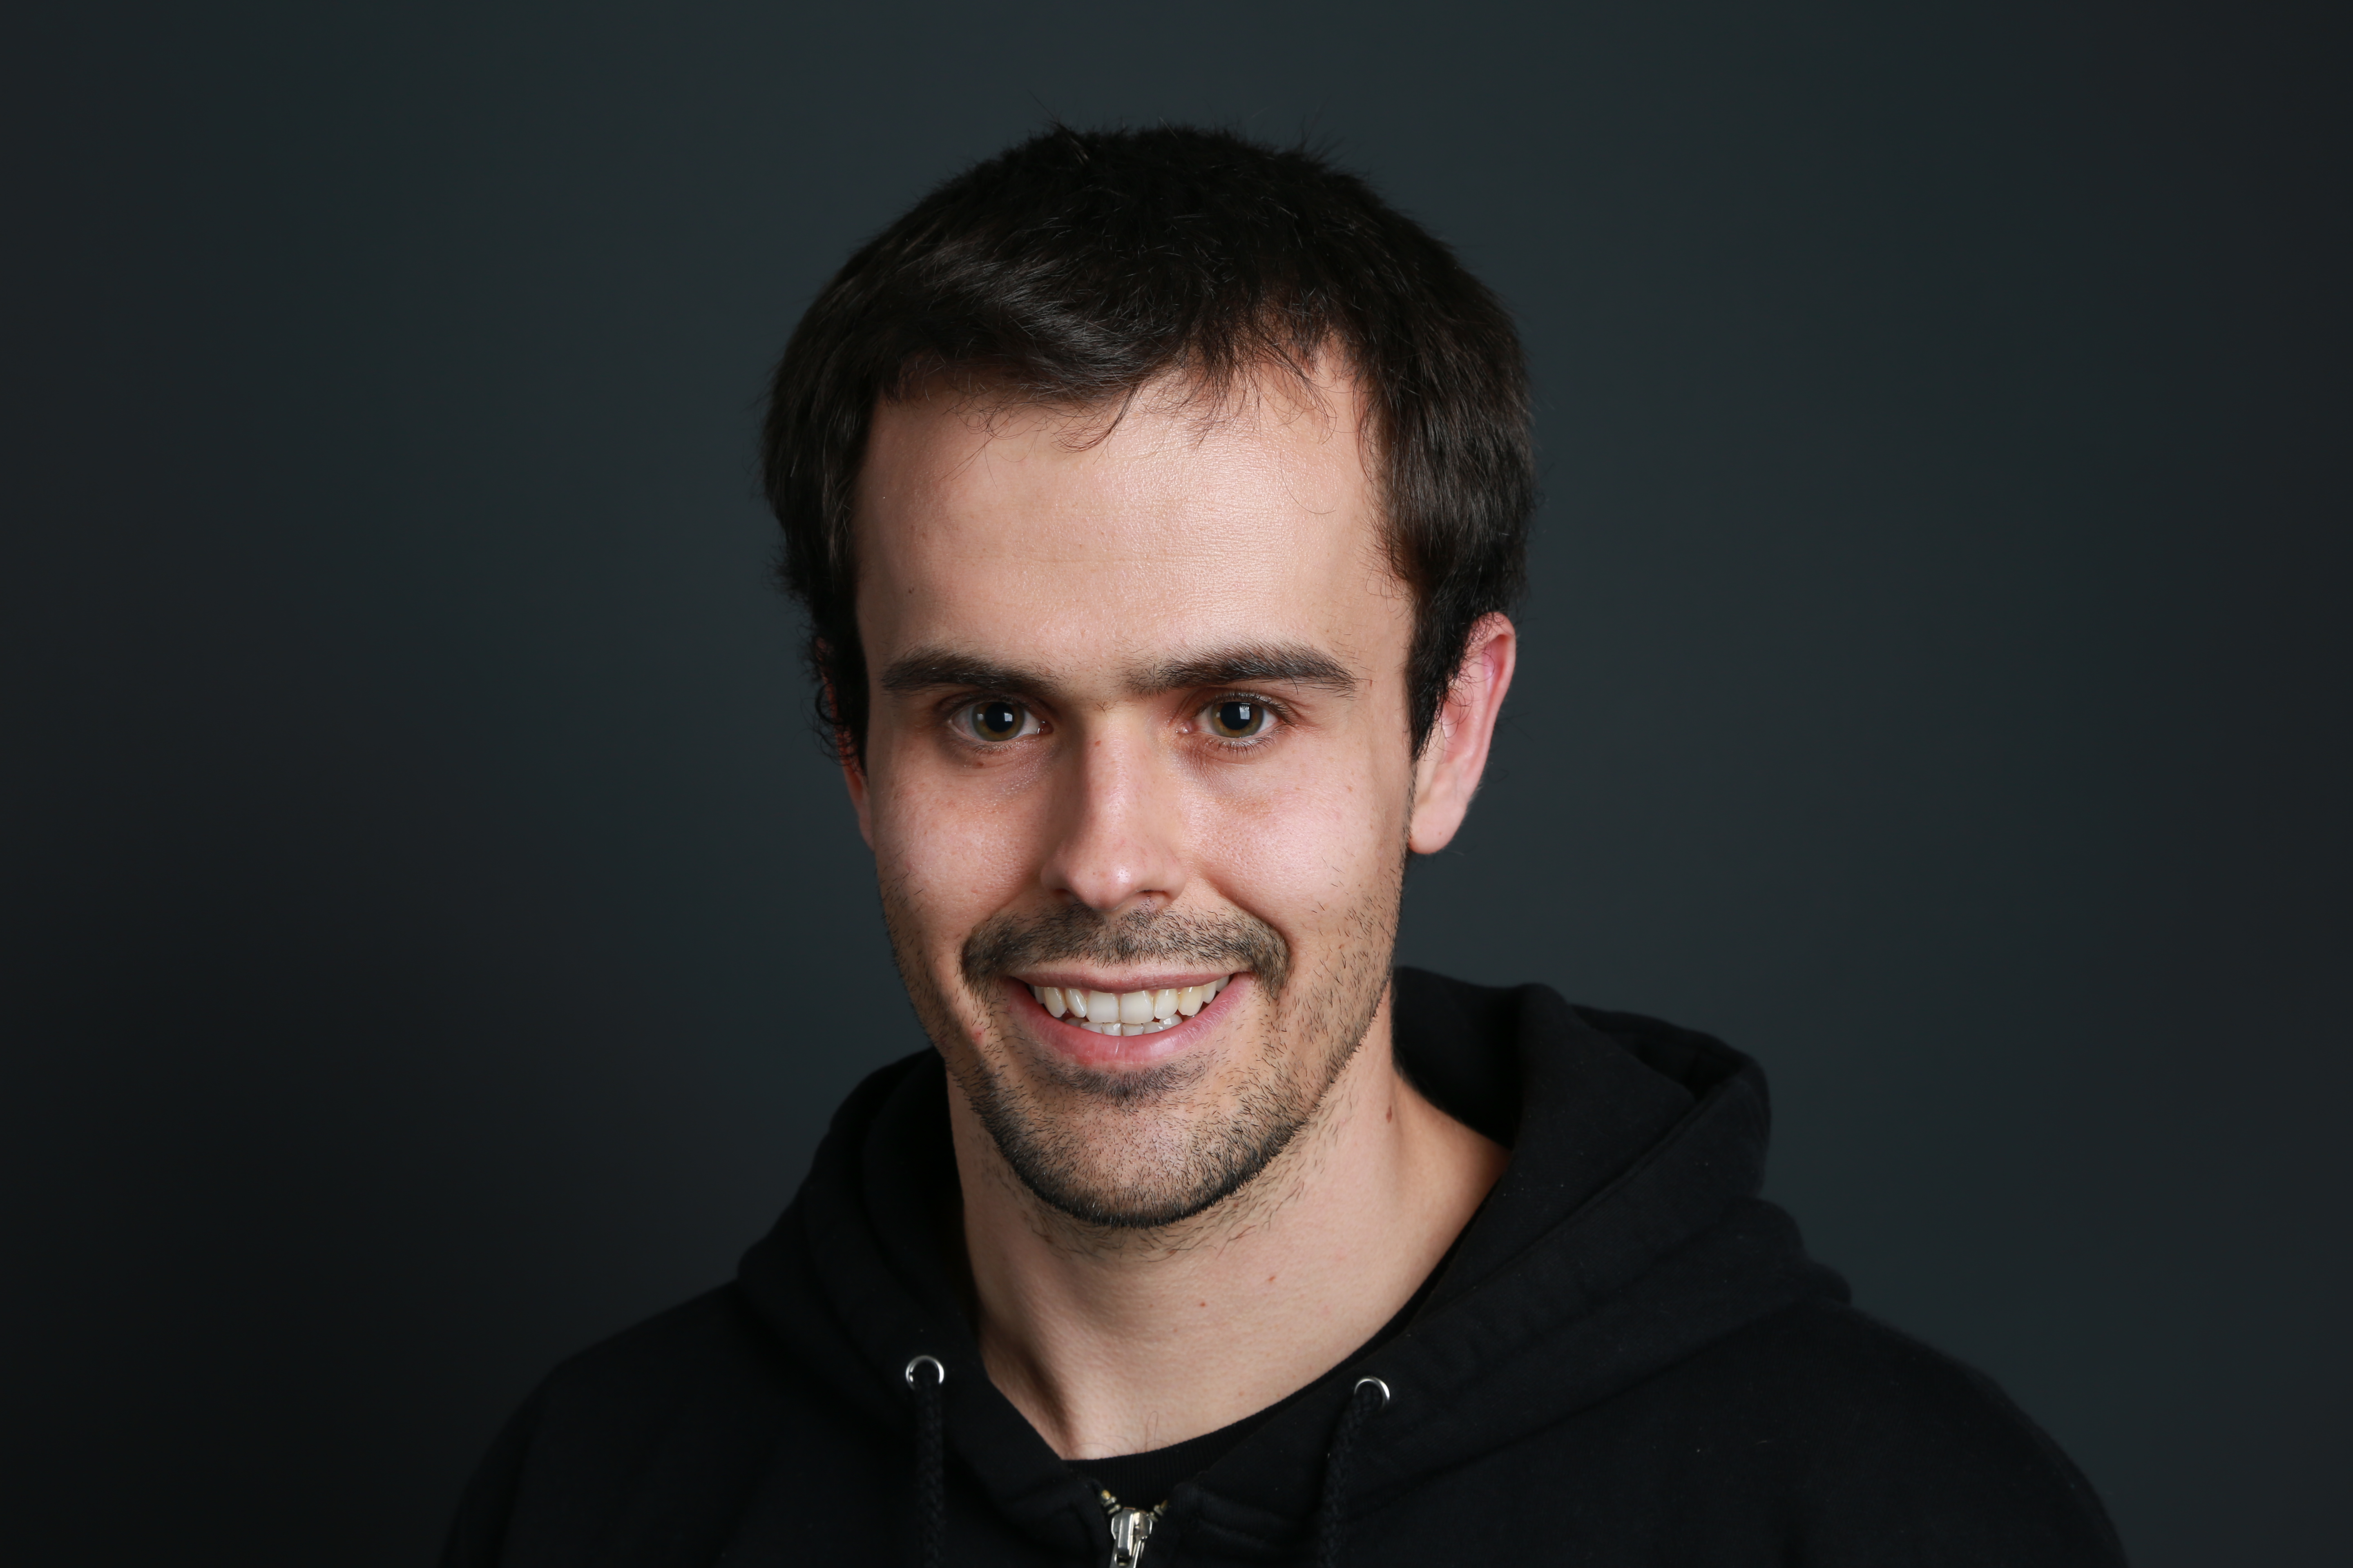
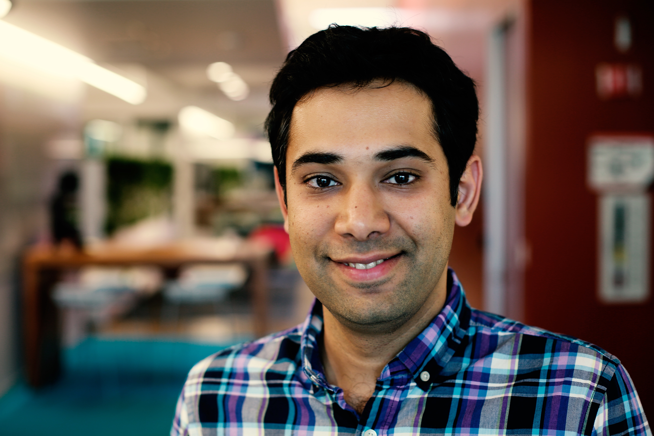
Greg Diamos gregdiamos@baidu.com Sharan Narang sharan@baidu.com http://research.baidu.com
Silicon Valley AI Lab

