Slide 1
Incremental Threat Modelling
Never try to boil an ocean

Slide 2
Who am I
Security consultant at NCC Group
Coming from software development and architecture
20 years as software engineer, architect, technical lead
Variety of consulting and testing work
From large financial organisations to start-ups
Favourite engagement type – threat modelling
Notes:
Alphabet soup: CREST TSA, CISSP. CSP when wearing my other hat.
So I’ve been at the intersection of agility and security for a while, and I have a strong interest in how to squeeze security activities into fast and iterative lifecycles that don’t have a set-up phase.
Helping teams to perform threat modelling, and teaching them to do it independently.
Often hear the following:
We cannot do threat modeling for each feature! We have half a day between iterations for planning activities at best.
The purpose of this talk is to demonstrate how it can be done, as simple as that.

Slide 3
Agenda
STRIDE – quick recap
Introducing our example
Incremental modelling walk-through
Sting in the tail
Conclusions
Q&A

Slide 4
Threat modelling
Reminder
Decompose architecture using DFDs
Search for threats using STRIDE
Rank or quantify – out of scope for today
Notes:
Threat modelling is a structured method for identifying weaknesses on architectural level.
Lots of free material from Microsoft, OWASP, anywhere
Books
Training

Slide 5
Data Flow Diagrams
External Entity | Process | Data Flow | Data Store | Trust Boundary
People Other systems | Logical component Service Process in memory | RPC Network traffic File I/O | Database File Queue/Stack | Process boundary Network boundary
Notes:
These diagrams are conceptually Data Flow Diagrams. Not state machines, not sequence diagrams. Don’t try to express “if-then-else” or “first-this-then-that”, because you can’t.
Of all the elements, trust boundaries are extremely important to get right – your most interesting threats will be on the data flows that cross trust boundaries. So I’ll be going on about them in our example.

Slide 6
STRIDE
Threat | Property | Definition
Spoofing | Authentication | Impersonating something or someone else
Tampering | Integrity | Modifying data or code
Repudiation | Non-repudiation | Claiming to have not performed an action
Information Disclosure | Confidentiality | Exposing information to non-authorised party
Denial of Service | Availability | Deny or degrade service
Elevation of Privilege | Authorization | Gain capabilities without proper authorisation

Slide 7
Introducing our example
Explain the existing architecture and the feature we are planning to add
Pretend that threat model for the existing part does not exist
Model new feature

Slide 8
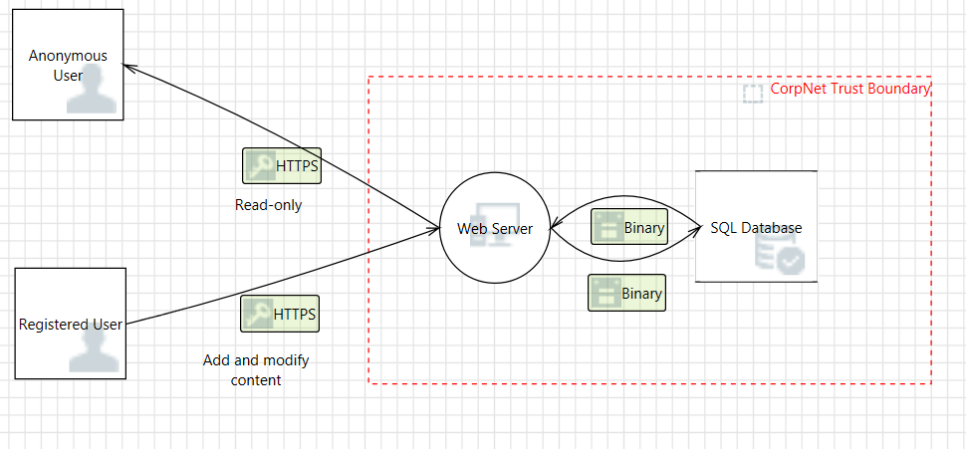
A very simple architecture
8
Notes:
As basic as it gets, the world is full of applications like that.
A new feature is proposed, business analytics.
Pretending we are in a planning meeting, this is what product owner says:
We are going to use a 3rd party reporting and analytics technology. They are going to host Data Warehouse (DWH) and reporting server on their infrastructure.
They will give us licences to use their web-based Analytics App, which can query the reporting server. The only thing we need to build in-house is an aggregator process,
which will get data from our database, aggregate it and upload it to the DWH on a regular basis (they provide API for automated upload).

Slide 9
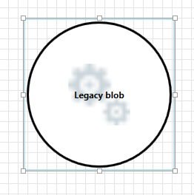
Now pretend to forget it
We are going to use a 3rd party reporting and analytics technology. They are going to host Data Warehouse (DWH) and reporting server on their infrastructure.
They will give us licences to use their web-based Analytics App, which can query the reporting server. The only thing we need to build in-house is an aggregator process,
which will get data from our database, aggregate it and upload it to the DWH on a regular basis (they provide API for automated upload).
9
Notes:
If we had a threat model for our existing architecture, we would just add new information to it. But we don’t. And assuming the real architecture is much more complex than our toy one, we don’t have time to do the full thing now. Our existing architecture is just a legacy blob.
So, we have a legacy blog to represent an existing architecture, and we have a story from product owner. Can’t say fairer than that, every team has at least that much at the planning meeting.
If you want to check how long the incremental modelling of this feature takes, you can start a stopwatch now.

Slide 10
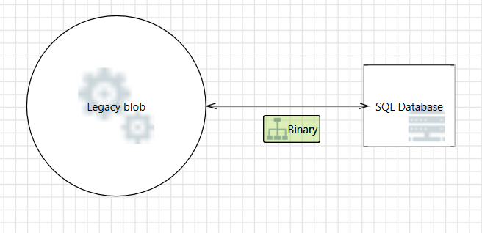
Step by step
We are going to use a 3rd party reporting and analytics technology. They are going to host Data Warehouse (DWH) and reporting server on their infrastructure.
They will give us licences to use their web-based Analytics App, which can query the reporting server. The only thing we need to build in-house is an aggregator process,
which will get data from our database, aggregate it and upload it to the DWH on a regular basis (they provide API for automated upload).
10
Notes:
First thing: identify which existing components are involved in the story.
Only database is involved, so that’s the only thing we want to show explicitly.
Do we need trust boundary between them? No, because we know the database only interacts with “internal” components, in the same trust boundary.
(Reminder: you don’t show firewall as trust boundary. Firewall is a mitigation to threats on data flows, not an element of the model).

Slide 11
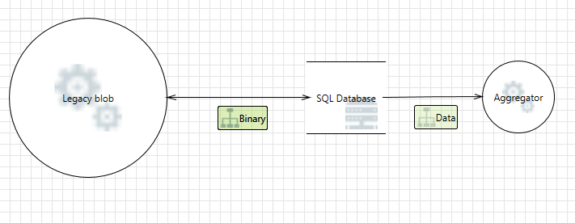
Step by step
We are going to use a 3rd party reporting and analytics technology. They are going to host Data Warehouse (DWH) and reporting server on their infrastructure.
They will give us licences to use their web-based Analytics App, which can query the reporting server. The only thing we need to build in-house is an aggregator process,
which will get data from our database, aggregate it and upload it to the DWH on a regular basis (they provide API for automated upload).
11
Notes:
Next step – identify what needs to be added.
New process that reads data from our database. You could choose to show the other direction (SQL select), or you could for simplicity concentrate on the idea that essentially it’s one-directional logic flow.
Needs trust boundary? Still no.

Slide 12
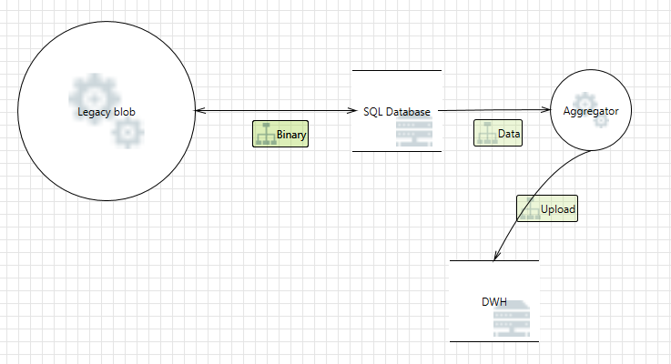
Step by step
We are going to use a 3rd party reporting and analytics technology. They are going to host Data Warehouse (DWH) and reporting server on their infrastructure.
They will give us licences to use their web-based Analytics App, which can query the reporting server. The only thing we need to build in-house is an aggregator process,
which will get data from our database, aggregate it and upload it to the DWH on a regular basis (they provide API for automated upload).
12
Notes:
Aggregator uploads data to DWH

Slide 13
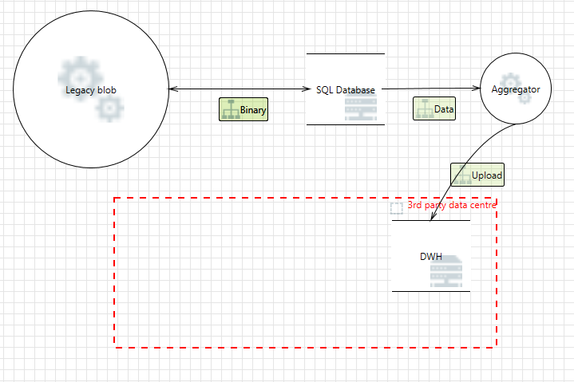
Step by step
We are going to use a 3rd party reporting and analytics technology. They are going to host Data Warehouse (DWH) and reporting server on their infrastructure.
They will give us licences to use their web-based Analytics App, which can query the reporting server. The only thing we need to build in-house is an aggregator process,
which will get data from our database, aggregate it and upload it to the DWH on a regular basis (they provide API for automated upload).
13
Notes:
Finally needs a trust boundary!

Slide 14
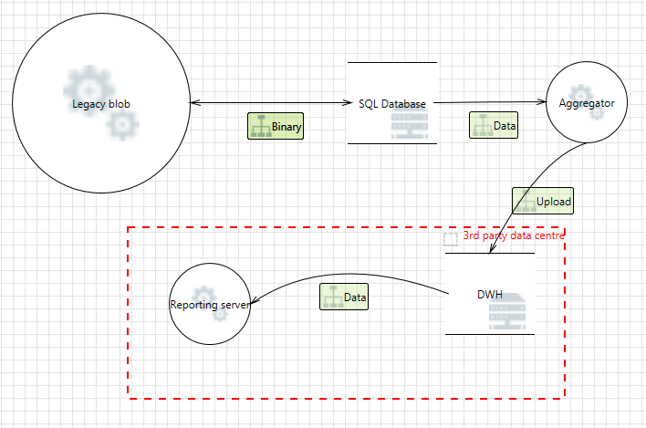
Step by step
We are going to use a 3rd party reporting and analytics technology. They are going to host Data Warehouse (DWH) and reporting server on their infrastructure.
They will give us licences to use their web-based Analytics App, which can query the reporting server. The only thing we need to build in-house is an aggregator process,
which will get data from our database, aggregate it and upload it to the DWH on a regular basis (they provide API for automated upload).
14
Notes:
Reporting server – within the same trust boundary

Slide 15
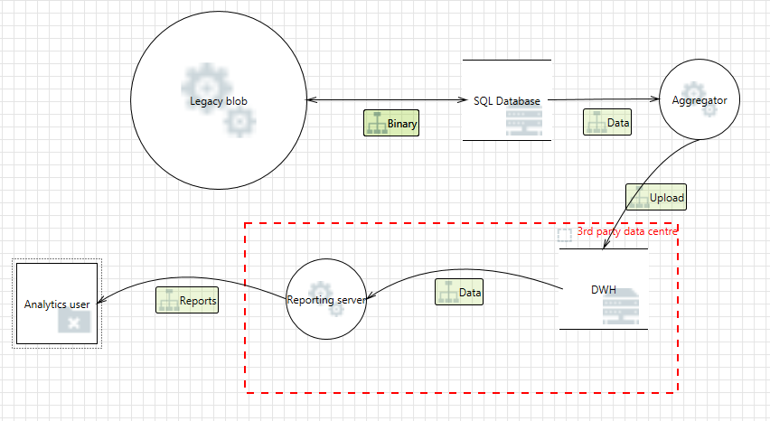
Last step
We are going to use a 3rd party reporting and analytics technology. They are going to host Data Warehouse (DWH) and reporting server on their infrastructure.
They will give us licences to use their web-based Analytics App, which can query the reporting server. The only thing we need to build in-house is an aggregator process,
which will get data from our database, aggregate it and upload it to the DWH on a regular basis (they provide API for automated upload).
15
Notes:
Analytics user – same trust zone as everything else? This is where we ask clarifying questions from product owner: will this user connect from anywhere, or does he have to be on our corporate network to use the app?

Slide 16
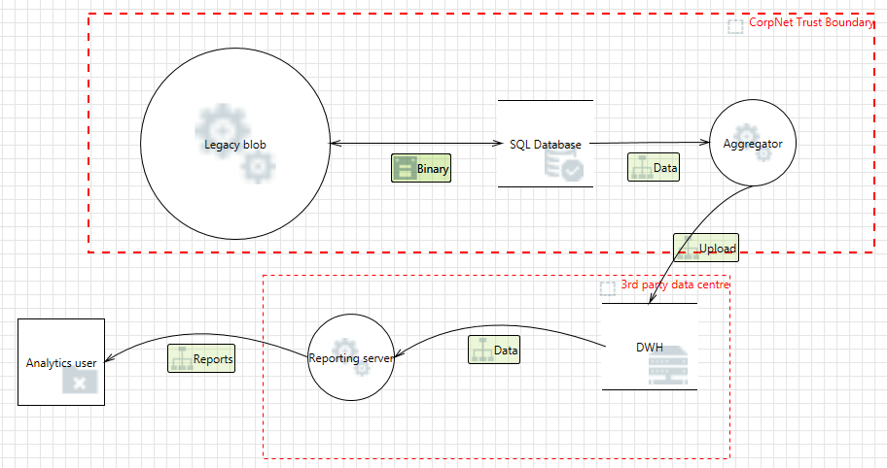
Last step
16
Notes:
If analytics user can connect from anywhere, we need another trust boundary – to separate our corporate infrastructure from the general internet.
Job done!
How do we know it’s job done when building DFDs? The rule of thumb is “everyone agrees the diagram tells the story”. So with incremental threat modeling we are actually in a better position that with the normal one, as we actually have an agreed story. Should be pretty easy to validate that we’ve covered all the aspects of this story.

Slide 17
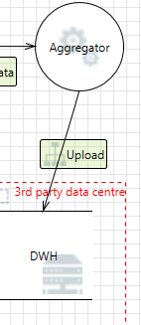
Relevant threats
Spoofing
Can attacker upload data on our behalf? How we authenticate the destination before uploading?
Tampering and Information Disclosure
Can attacker sniff the data or tamper with it?
Repudiation
Can DWH claim we didn’t send the data? Or sent above the quota?
Denial of service
Is there availability SLA for uploads?
Privacy
Can our aggregation be reverse engineered?
Do we need to notify the users that 3rd party is involved?
Notes:
You can use threat modelling tool which auto-generates threats around your diagram, or you can apply STRIDE on a whiteboard, either way it will be a limited, manageable set of threats with this feature.
Relevant threats will concentrate around new component Aggregator and new data flow Upload.
Not everything is covered by STRIDE, for example Privacy.

Slide 18
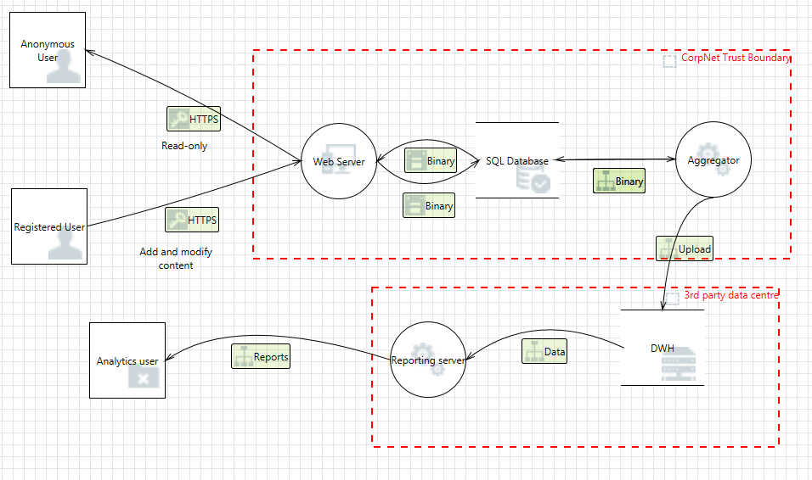
Irrelevant threats
Notes:
If we were using threat modeling from day 1 of building this application, all the existing threats would be known and mitigated or accepted at this point. But unfortunately we did not.
That will be one of the first times when the team does security focused design. It’s exciting!
People will bring up threats that belong to “Legacy blob”. Such as “Can registered user inject malicious content”? Can anonymous user bypass access controls and modify something?
Is our datacentre infrastructure secure, i.e. can attacker get directly to SQL database or Aggregator, bypassing web interface?
Can analytics user abuse licencing?
How to keep the activity time-boxed and focused?
Here I’m going to get a bit controversial. You’ll use two phrases a lot:
We are not making existing situation worse
Not our problem. Sounds horrible, right? Maybe rephrase as “We don’t have to analyse it right now”.

Slide 19
Irrelevant threats – how to make them go away
Can registered user inject malicious content?
We are not making it worse
Can anonymous user bypass access controls and modify something?
We are not making it worse
Is our datacentre infrastructure secure?
We are not making it worse (careful here!)
Can analytics user abuse licencing?
Not our problem, 3rd party problem
Notes:
#3 – if Aggregator is running under a different user privilege than DB server, or you need to punch another hole in firewall, then you are possibly making it worse.

Slide 20
Caveats
Not our problem
If the team’s task is not just to implement with a chosen provider, but to evaluate several providers.
We are not making it worse
If you come across something so catastrophic in the “Legacy blob”, that it’s an immediately obvious critical flaw.
Notes:
Every rule has an exception etc.
“Stop the production line” Andon cord, if you are familiar with Kaizen and Lean concept.

Slide 21
What if implementation deviates from design?
Aggregator is implemented as two processes: one to read and aggregate the data, the other for actual upload
Time pressure and we MUST have analytics in the release. Let’s create a user for this 3rd party so they pull data directly from our DB.
Notes:
I always recommend threat modelling as a whole team activity. Not just for architect or security lead.
When the team shares this mental model, it becomes very easy to spot the deviations that invalidate the model.
Also, threat modelling is not only for developers. Involve QA if you have in-house QA, or a cross-functional team. QA engineers will be able to derive test-cases from the threat model, they will be able to use it to validate requirements, it’s a great way to develop security-focused thinking in your testing function.
Telling people “start thinking like an attacker” is not helpful at all. This provides a structured way for deriving security-oriented test-cases.
Speaking of QA…

Slide 22
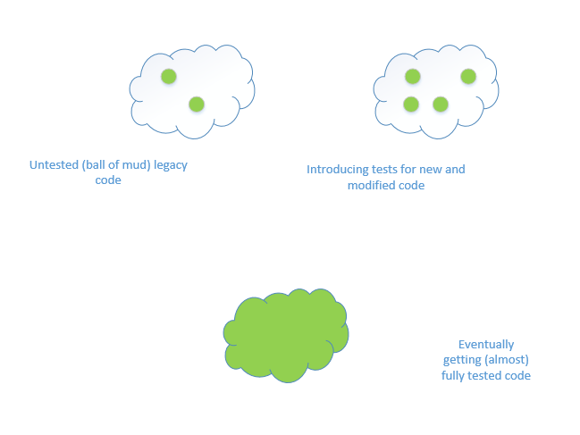
Looks familiar?
Notes:
If you’ve ever done software development, you must have seen a similar picture – how to deal with untested legacy systems.
Introduce tests around new and changed code. The thinking is: modifications introduce bugs, so moving parts are more important than what’s not changing.
From functionality point of view this reasoning is good – if we have a system that’s been doing the job for 5 years and no one is complaining, it can’t have many functional bugs in it on the workflows that matter.

Slide 23
This thinking does not work in security!
Examples:
NTVDM bug – found in 2010, introduced in 1993
Shellshock – found in 2014, introduced in 1989
Heartbleed – found in 2014, introduced in 2011
POODLE – found in 2014, existed since 1996
JASBUG – found in 2015, introduced in 2000
DROWN, Badlock, gotofail, etc.
Notes:
Deliberately picking “famous” vulnerabilities here. Famous as in they have their own name, some of them have own logo, theme music and what not. But the trend holds for non-famous vulnerabilities as well.
In security what you didn’t touch can harm you, what you didn’t even know you have can harm you.
Some of the above are code level vulnerabilities, some are design level. Some are infrastructure – if you have a forgotten web server somewhere in the corner that supports SSL v2, it’s influencing all the new and supposedly secured servers. That’s the essence of DROWN attack.
The attacker does not care if the particular execution flow is popular with normal users. If it’s there, and there is a vulnerability in it => exploit.

Slide 24
Eventually we need to see the whole picture
Reasons:
What we don’t know can harm us
The system is greater than the sum of its parts
Notes:
We’ve covered the first reason, so hopefully you are convinced
And the second reason – I don’t need to spend time elaborating it in the architecture conference

Slide 25
Why eventually is better than upfront
People have developed the necessary skills
Many subsystems will be already analysed
Easier to achieve management buy-in
Notes:
Hopefully you’ve caught and mitigated some spectacular threats by now, so getting time and resources to keep up the good work should be easier.

Slide 26
Conclusion
Incremental threat modelling can fit any time-box, without disturbing the regular development cadence.
You can build a model of the whole system in parallel, starting from day 1, or waiting for several cycles, whatever suits your situation.
As a shortcut, you can bring external resources to help with the initial model.
But for the best results in agile environment you have to involve the whole team.
Notes:
One of the best entry-level security activities that delivers an immediate return on investment.
If you don’t keep your model up to date, you miss on the 90% of its benefits. It’s just the most expensive piece of documentation you’ve ever had.
Use it to validate requirements
Use it to derive test-cases
Promote knowledge sharing in the team

Slide 27
Points of contact
Irene Michlin
Principal Security Consultant
M: +44 (0) 7972 333 148
E: irene.michlin@nccgroup.trust
T: @IreneMichlin

Slide 28
Locations
North America
Atlanta
Austin
Chicago
Kitchener
New York
San Francisco
Seattle
Sunnyvale
Europe
Manchester - Head Ofﬁce
Amsterdam
Basingstoke
Cambridge
Copenhagen
Cheltenham
Delft
Edinburgh
Glasgow
Leatherhead
Leeds
London
Luxembourg
Madrid
Malmö
Milton Keynes
Munich
Vilnius
Zurich
Australia
Sydney

