Slide 1
Support digital applications with a resilient, highly available and NRT Hadoop Backend
Santander UK

Slide 3
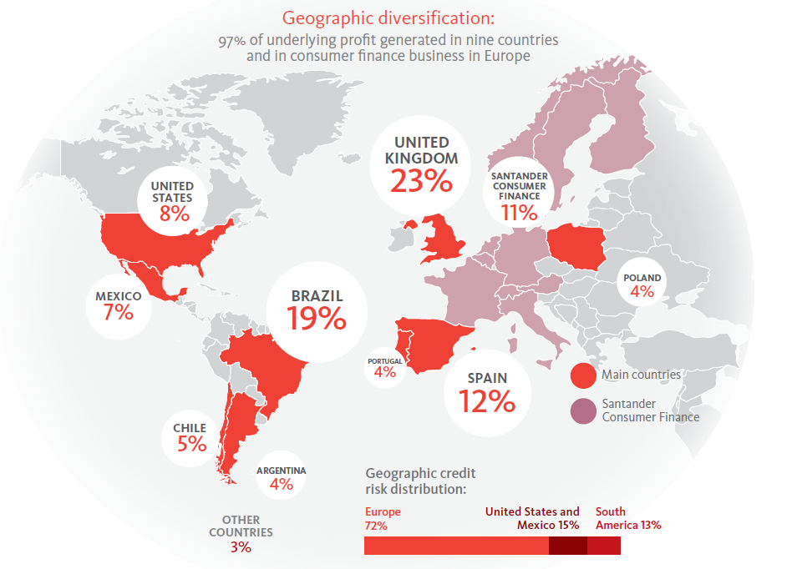

Slide 4
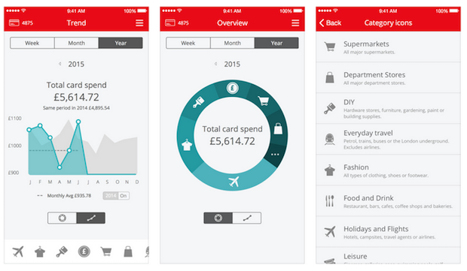
Spendlytics
Big data is more than MI
Notes:
Mention James, Ian and Rob

Slide 5
Architecture high level view
Quick look over the possible architecture
Online
Online
MQ
MQ
Mainframe
Analytics
Operational
Business Layer API
Data Layer API
Business Layer API
Data Layer API
HDFS
HDFS
HDFS
Middleware
Middleware
Batch Data
Batch Data
Batch Data
Data Sink
Landing
Data Sink
Staging
Enriched
DistCp
HDFS
HDFS
Hbase
Hbase
Analytics
Analytics
Data Certification
Data Certification

Slide 6
HA Description
Santander UK Big data platform
Overview
Node resilient.
Applications
APIs
Rack resilient.
Data Centre 1
Data Centre 2
Operational cluster
Operational cluster
Cluster resilient.
ACTIVE
ACTIVE
HDFS
Hbase
Kafka
…
HDFS
Hbase
Kafka
…
HDFS
Hbase
Kafka
…
HDFS
Hbase
Kafka
…
HDFS
Hbase
Kafka
…
HDFS
Hbase
Kafka
…
Data centre resilient.
Security through encryption of customer data, restricted views and Sentry.
Analytics cluster
Analytics cluster
ACTIVE
PASSIVE
HDFS
Hive
Impala
…
HDFS
Hive
Impala
…
HDFS
Hive
Impala
…
HDFS
Hive
Impala
…
HDFS
Hive
Impala
…
HDFS
Hive
Impala
…
Exploitation tools

Slide 7
HA Description - Flow
.
MQ Cluster
Manual fail over
DC1
DC2
Flume Agent
Kafka
Kafka
Flume Agent
Flume Agent
Flume Agent
Topic: RAW
KAFKA
Mirror Maker
Topic: RAW
Topic: Transformed
Topic: Transformed
Topic: Enriched
Topic: Enriched
HBASE
HBASE
HBASE
Replication
HDFS
HDFS
Manual fail over
BDR

Slide 8
HA Description - Flow
.
MQ Cluster
Manual fail over
DC1
DC2
Flume Agent
Kafka
Kafka
Flume Agent
Flume Agent
Flume Agent
Topic: RAW
KAFKA
Mirror Maker
Topic: RAW
Topic: Transformed
Topic: Transformed
Topic: Enriched
Topic: Enriched
HBASE
HBASE
HBASE
Replication
HDFS
HDFS
Manual fail over
BDR

Slide 9
HA Description
Middleware
DC1
DC2
Business Layer
WAS
WAS
WAS
WAS
WAS
WAS
WAS
WAS
Data Layer
With health check
WAS
WAS
WAS
WAS
WAS
WAS
WAS
WAS
Health check
Health check
Hbase
Region Server
Region Server
Region Server
Region Server
Region Server
Region Server

Slide 10
HA Description
Middleware
DC1
DC2
Business Layer
WAS
WAS
WAS
WAS
WAS
WAS
WAS
WAS
Data Layer
With health check
WAS
WAS
WAS
WAS
WAS
WAS
WAS
WAS
Health check
Health check
Hbase
Region Server
Region Server
Region Server
Region Server
Region Server
Region Server

Slide 11
HA Description
Middleware
DC1
DC2
Business Layer
WAS
WAS
WAS
WAS
WAS
WAS
WAS
WAS
Data Layer
With health check
WAS
WAS
WAS
WAS
WAS
WAS
WAS
WAS
Health check
Health check
Hbase
Region Server
Region Server
Region Server
Region Server
Region Server
Region Server

Slide 12
Design Challenges
Challenges
Hbase rowkey definition. Huge importance on this definition for low latency and correct access pattern
Avro format and the evolution of it. Different schemas needed
Search →Column Families
By adding more column families for search purposes not only increase size but also maintenance complexity
&
Data enrichment build under different moving parts, which is difficult to maintain. Unification of enrichment
RocksDB has been proven as a good cache DB to support lookups
Region Server load and bulkput vs Hfiles

Slide 13
Limitations / Problems we have overcome..
Limitations
Kerberos not integrated.
As the data in this cluster was only accessed via Microservice, no sentry was applied.
KMS
Data encryption postponed and not included in this release.
Bulk load created issues at certain benchmark (around 15mill), so load of bulk data in Hfiles.
Hfile
Manual Flume failover
Apache Phoenix Aggregation Functionality

Slide 14
Ongoing challenges
Ongoing Challenges
VS
OR
Q-Replicator → HA

Slide 15
Thanks a lot! Let’s hear your questions!!
QA
Nicolette Bullivant
Nicolette.bullivant@isbanuk.com
Jorge Pablo
jorge.pablofernandez@isbanuk.com

Slide 16
Isban Uk

