Slide 1
the case for
HTTPS everywhere

Slide 2
Emily Schechter
@emschec
Notes:
Hi everyone, my name is Emily Schechter. I’m the product manager for the Chrome security team, and today I’m going to talk about HTTPS.

Slide 3
the case for
HTTPS everywhere
Notes:
And specifically, I’m going to talk about why and how we try to convince people that HTTPS should be everywhere.
I'm going to start off with an imagination exercise. Imagine that you're on the security team for a company, and your company has some online website, probably not that hard to imagine. Let’s say your company is an online medical supply retailer. Your company has a website...

Slide 4
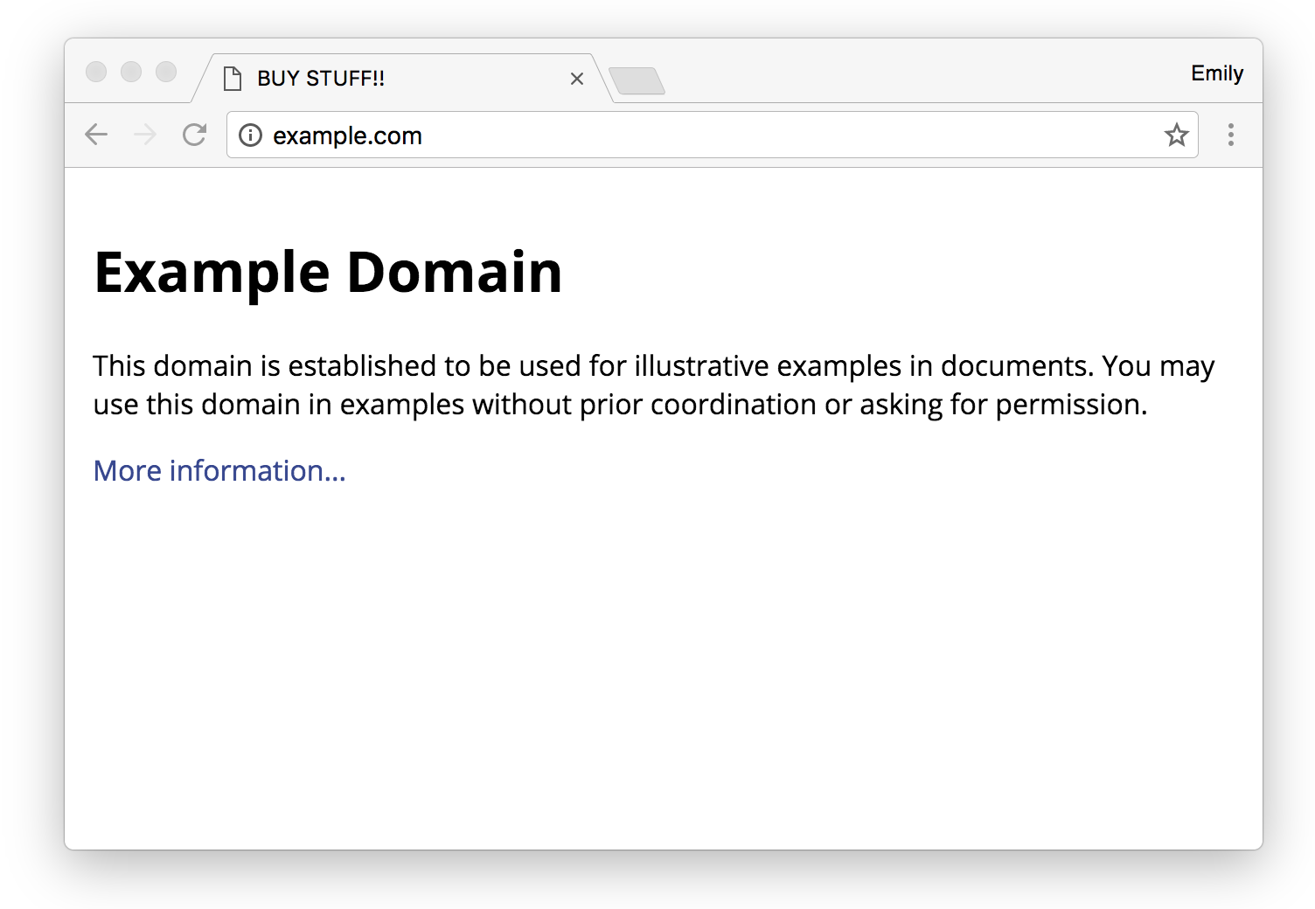
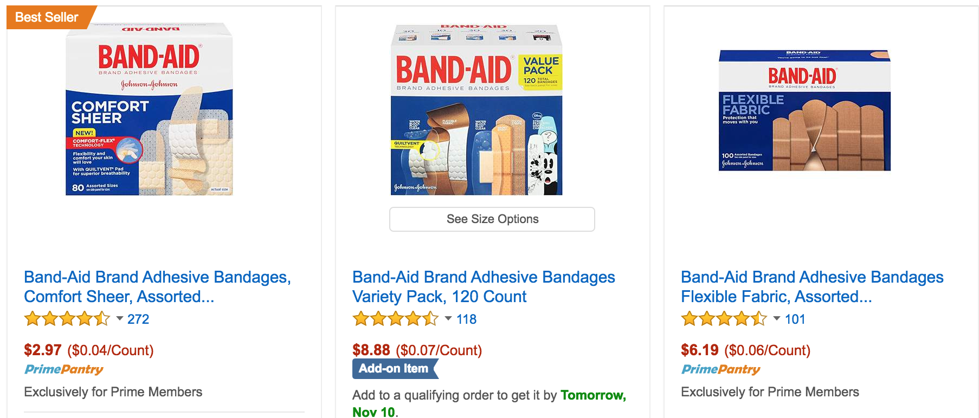
medical-stuff.example.com
Notes:
Your designers worked really hard to give you an interesting and unique UI, as you can see. And let’s say your site has HTTPS on the checkout page, but not on any of the main shopping pages.

Slide 5
medical-stuff.example.com
Notes:
So one day, your management sees some recent headline about security [CLICK], and they're pretty terrified, and they ask you, what more can we do for the security of our users and our website? And you tell them, like you've been telling them every year, that they should consider migrating your main site to HTTPS. And they say... welll..... We already have HTTPS on our checkout page. I don’t think we’ll need it for our main site.. And you grumble a little bit, then say, ok fine, and go back to your day job.

Slide 6
medical-stuff.example.com
Notes:
And a few weeks later, your management opens their morning news again and sees another security related headline [CLICK], and they're terrified, and they ask you, what more can we do for the security of our site? And you tell them again, that they should consider migrating your main site to HTTPS, because it will protect the privacy of your users, because your users deserve to have an experience where no one else can see what they're shopping for.
And your management says welllll... okay, I've looked into since the last time you asked, and it sounds like an ok idea, but it looks like it might be kind of expensive.... so, we might do it in a couple years, we'll put it on the roadmap, after we slim down the company, and start getting more profitable. And you know this means it will probably never happen.

Slide 7
Notes:
And so, you’re feeling pretty exasperated, and pretty upset, because you know if your site doesn’t have HTTPS, your users will continue typing in their passwords on your login page, and they’ll continue shopping for solutions for sensitive medical conditions, in a such a way that an attacker eavesdropping on the network can see all the data that they’re sending back and forth.

Slide 8
medical-stuff.example.com
Notes:
And you’re also feeling pretty upset, because your site’s front end developers are spending tons of money and time and energy crafting the perfect user experience, and your site could deliver that perfect user experience and have some ISP or a wifi provider, or some other intermediary on the network injecting obnoxious ads like this.
And isn't hypothetical -- we see major ISPs injecting ads or other content all the time.
And if this was your company site, you’d probably be pretty sad, right, because this interferes with that perfect user experience, and it might even trick your users into downloading and installing malware on their computers.

Slide 9
Notes:
And so, when your boss asked what you should do to improve the security of your site, you recommended HTTPS, because you want your site to be protected from this kind of snooping and tampering. And that’s what we get from HTTPS.
That’s what this green lock signifies, and we’re hoping to move towards a web, where this green lock is so ubiquitous, that we might not even need to show it at all, because it’s just the default that users have come to expect as the bare minimum in terms of security for any site on the web today.

Slide 10
$$$??
Performance?
Maintenance??
Notes:
HTTPS has been around for about 20 years, but for most of that time, adoption has been hindered by the challenges involved with HTTPS migrations. When you see this green lock, you might think [CLICK] that it represents a financial burden, or a performance cost.
And many of these associations really were true 5 or 10 years ago, but many of them are no longer true today. And that’s because people all over the world, and across the web ecosystem, have been interested in promoting a safe future for the web where HTTPS is everywhere.
And because of all of these changes,

Slide 11
we must change
the way we talk about HTTPS
Notes:
We must change the way we talk about HTTPS, and we must change the way we ask our management to prioritize HTTPS. And so what I’m going to do in this talk,

Slide 12
convince your boss!
step one: $$
step two: now!!
Notes:
is I’m going to teach you how to convince your management to migrate your company site to HTTPS, by explaining the business benefits of HTTPS, and i’m going to teach you how to convince them to prioritize this seemingly scary migration that they’ve been continually putting off, by explaining the urgency and the required planning involved with the migration. Along the way, I’ll do a bit of HTTPS mythbusting, separating fact from fiction, and use case studies of sites who have moved, to take a realistic look at what the actual challenges will be, and what should be left behind as an HTTPS myth.

Slide 13
convince your boss!
step one: $$
step two: now!!
Notes:
So, step one is all about money.

Slide 14
step one: $$
Notes:
We are no longer in a world where we constantly have to defend HTTPS for being too expensive.

Slide 15
step one: $$
there are business benefits
of migrating to HTTPS
Notes:
There are real business benefits to migrating to HTTPS.

Slide 16
step one: $$
Powerful features
Performance
Mythbust perceptions
Notes:
We are now in a world [click] where HTTPS unlocks features that measurably benefit site conversions. A world [click] where HTTPS is required for the best performance that the web offers. And we are now in a world [click] where there are ways to mitigate what were once real and unavoidable expenses of setting up HTTPS.
I’ll step through these three key points to building your business case for HTTPS.

Slide 17
step one: $$
Powerful features
Performance
Mythbust perceptions
Notes:
The first point is all about website features and functionality.

Slide 18
New features are built to require HTTPS
ServiceWorker
Web Push Notifications
Add to Home Screen
Credit Card Autofill
Payments API
Credential Management API (SmartLock)
Notes:
Chrome and other browsers have a mission to bring the web, and especially the mobile web, into the future. What this means is designing new functionality and new APIs to give websites superpowers that they never had before. And many of these new capabilities are simply too powerful for non-secure HTTP, so browsers are requiring HTTPS for these features to work.
ServiceWorkers allow web sites to work offline, push notifications can keep users coming back and engaged. Add to Home Screen allows sites to feel like installed apps, accessible form the home screen. Credit card autofill and the payments API make buying things online much easier, and the credential management API allows users to save passwords across devices and stay signed in. These new features all measurably benefit things like site conversions and user engagement, and these new features are all only accessible if your page is HTTPS. I’ll give you a couple case studies of sites that have seen measurable benefits with these features.

Slide 19
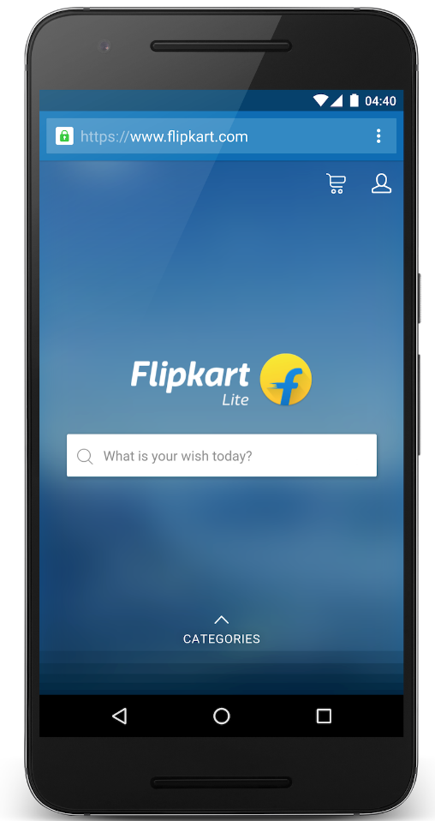
Flipkart.com
70% greater conversion rate
3x more time spent on site
40% higher re-engagement rate
3x lower data usage
Notes:
Flipkart, India’s largest e-commerce site, migrated to HTTPS in order to rebuild their mobile site using ServiceWorker, Push Notifications, and Add to Home Screen, and they have seen a 70% greater conversion rate and 3x more time spent on site with their new web app. That’s a lot.

Slide 20
Housing.com
38% more conversions
40% lower bounce rate
10% longer average session
30% faster page load
Notes:
Housing.com, one of India’s top startups, also migrated to HTTPS in to rebuild a mobile web app using ServiceWorker, Push Notifications, and Add to Home Screen. They saw a 38% increase in total conversions across browsers, with higher-value users, who spent 10% longer per session and returning more often.

Slide 21
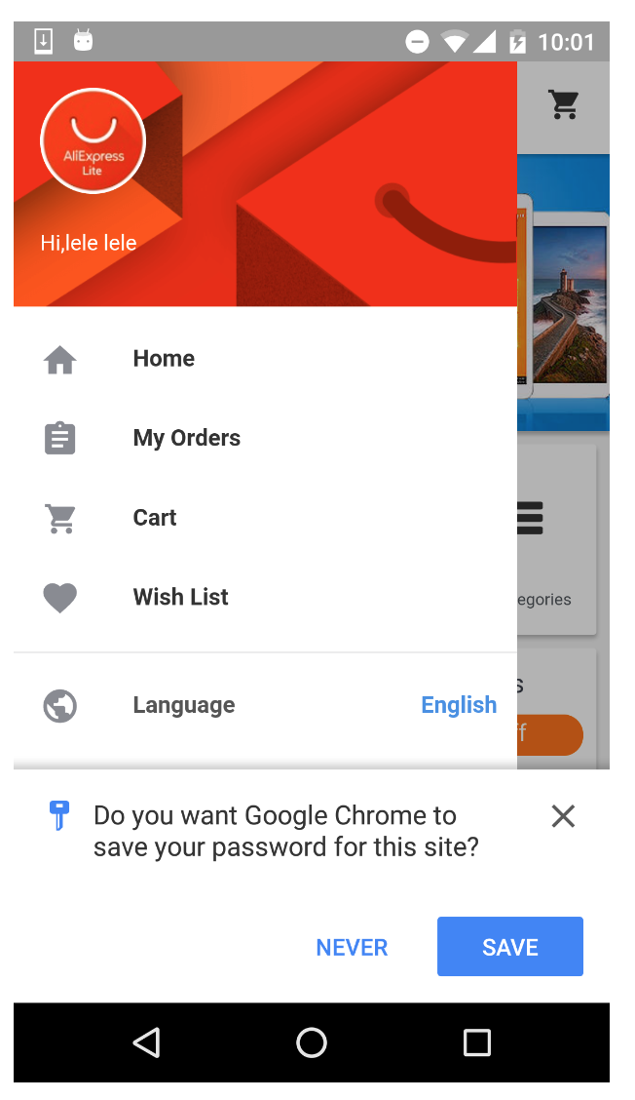
SmartLock for AliExpress
11% increase in conversions
95% of users saved credentials
85% drop in failures for web sign in
60% decrease in time to sign in
Notes:
AliExpress is a Chinese e-commerce site, who migrated their mobile website to HTTPS and started using the Credential Management API, which is called SmartLock, and since users are now signed-in across platforms, they saw an 11% increase in conversions from using this API.

Slide 22
Current features deprecated over non-HTTPS
Geolocation
getUserMedia()
Encrypted Media Extensions
AppCache
}
Only available over HTTPS in Chrome
}
Soon to be removed on HTTP
Notes:
Not only are these impactful new features being designed to require HTTPS, but Chrome and other browsers, are actually removing support from current APIs that are again too powerful to be used over non-secure HTTP.
So what does “too powerful” mean? Think about Geolocation, as an example. If a site knows where I am, it also knows where I live, where I work, where my doctor is, maybe where my kids go to school -- that’s a lot of information to know about me, right, and that’s information that I’m only trusting this site to know. We need HTTPS to guarantee that the site I think I’m giving this permission to, is the site it says it is, and to guarantee that no one else on the network, can see this data.

Slide 23
Current features deprecated over non-HTTPS
Geolocation
getUserMedia()
Encrypted Media Extensions
AppCache
}
Only available over HTTPS in Chrome
}
Soon to be removed on HTTP
Notes:
So there are a list of powerful features that have already been removed when accessed over non secure HTTP, like Geolocation, and there are a few more that are coming down the pipeline.
EME and AppCache specifically are coming up next. Non-secure usage of EME has actually already been removed from the spec. We don’t have specific public timelines for these removals yet, but they are coming up next. We’ll be sure to be responsible with announcing timelines and adding a notification in Chrome Dev Console before deprecations, but if you know that your HTTP site relies on any of these features, we encourage you to starting thinking about HTTPS now.

Slide 24
Key features of certain products, such as the location-finding feature within the Homepage, Travel News and Weather sites, would stop working if we didn’t enable HTTPS for those services.
BBC.co.uk Internet Blog (http://www.bbc.co.uk/blogs/internet/entries/f6f50d1f-a879-4999-bc6d-6634a71e2e60)
Notes:
The BBC quoted this deprecation of powerful functionality as one their main reasons for migrating to HTTPS, that key features of certain products would stop working if they didn’t enable HTTPS.

Slide 25
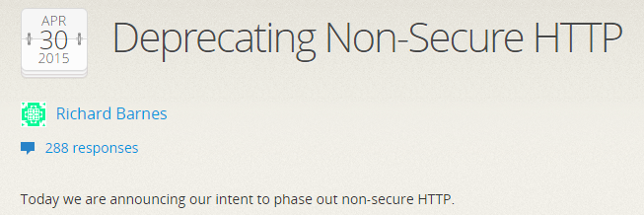
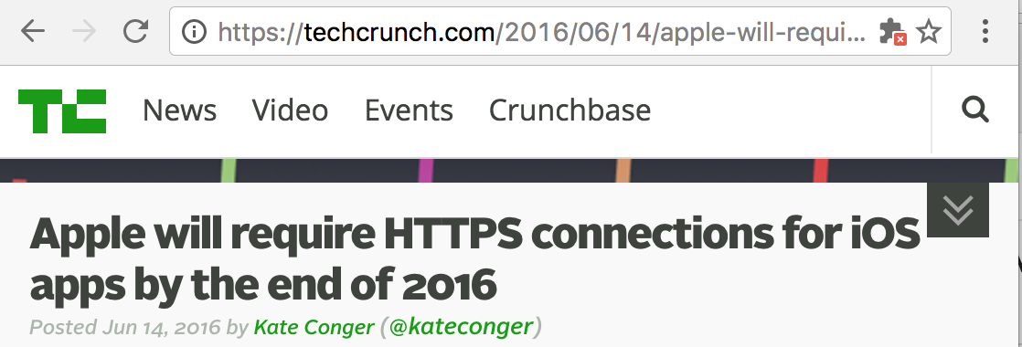
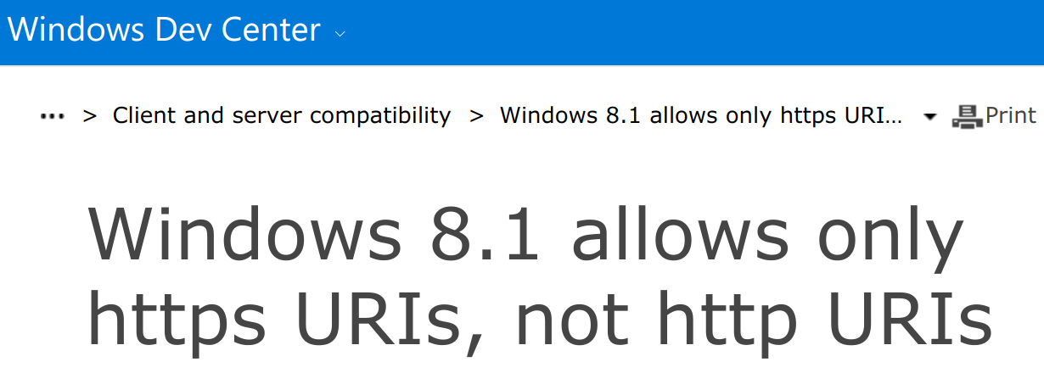
It’s not just Chrome!
Notes:
And of course, this is not just about Chrome. Across browsers and operating systems, we’ve seen announcements about tighter restrictions on non-secure HTTP to usher us into the world of HTTPS everywhere.

Slide 26
step one: $$
Powerful features
Performance
Mythbust perceptions
Notes:
So all of these new and existing powerful features, have proven their real business impact, and you can’t get any of it, if you’re not on HTTPS.

Slide 27
step one: $$
Powerful features
Performance
Mythbust perceptions
Notes:
Next, I’ll talk about performance. And when we talk about performance and HTTPS, we use to talk about it in a completely different way. People used to ask, but won’t HTTPS hurt the performance of my site? Won’t TLS require extra round trips, that will hurt how fast my site loads?

Slide 28
HTTPS is required for the best performance available on today’s web.
Notes:
It’s time to change the way we talk about HTTPS and performance. HTTPS is now required for the best performance available on the web.

Slide 29
HTTP/2
Service Workers
Brotli compression
TLS/1.3
istlsfastyet.com
Notes:
This is thanks to a number of performance enhancements become available when HTTPS is used; these improvements are limited to TLS-encrypted connections for very practical reasons, because intermediaries like proxies otherwise might corrupt traffic using them.

Slide 30
Raw TLS
“TLS accounts for
less than 1% of the CPU load,
less than 10KB of memory per connection
less than 2% of network overhead.”
Adam Langley, Google (2010)
Notes:
In terms of raw TLS performance costs, the good news is, modern hardware has made great improvements in recent years, and there are multiple ways to tune your TLS setup to optimize away remaining small costs. In 2010, when Google migrated Gmail to HTTPS, we saw a basically negligible performance overhead.

Slide 31
HTTP/2
“We activated HTTP/2... and saw an overall drop of ~250ms per pageview on supported devices.”
Weather.com
Notes:
HTTP/2, which requires HTTPS, blows this overhead out of the water by introducing compression of headers, and multiplexing of requests and responses. Weather.com turned on HTTP/2 after migrating to HTTPS and saw a significant performance improvement.

Slide 32
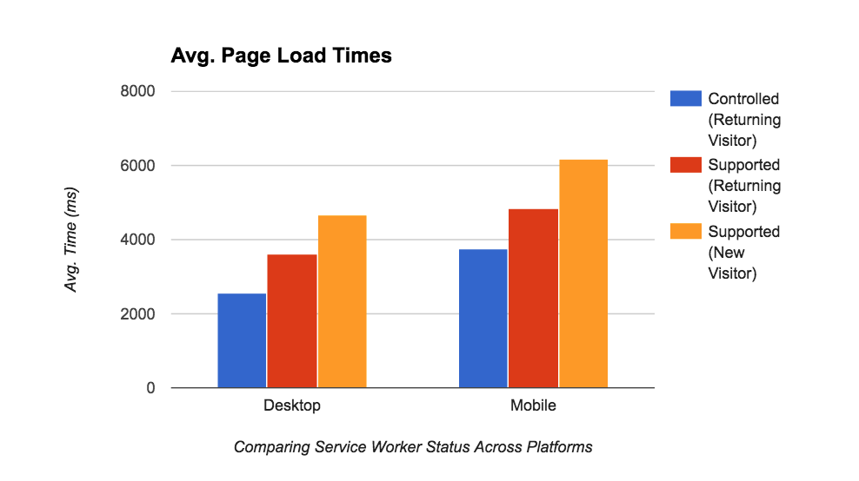
Service Worker
enable offline and respond to network requests using previously-cached content
Notes:
Service Workers, also only available over HTTPS, enable offline support and respond to network requests using previously cached content. This graph is actually from this year’s Google I/O Web App. When the app was using the Service Worker, shown here in blue, it had a much smaller page load time across platforms than when the site was not using the service worker.

Slide 33
step one: $$
Powerful features
Performance
Mythbust perceptions
Notes:
So HTTPS is actually required to achieve the best performance possible today.

Slide 34
step one: $$
Powerful features
Performance
Mythbust perceptions
Notes:
The last step is mythbusting perceptions. Since HTTPS has been around for so long, and since it honestly used to be pretty expensive to turn on HTTPS, it’s important to make sure that your management knows that HTTPS no longer actually has to cost you money. Here I’ll mention three ways that it’s traditionally been expensive, and those are certificate pricing, ads, and CDN expenses.

Slide 35
Notes:
To turn on HTTPS, you have to get a certificate from a Certificate Authority, and traditionally you had to buy one. But the good news is, this is no longer the case. Let’s Encrypt is a free and automated Certificate Authority that even provides command line tools to make renewing your certificates easy and automated. And sites like WordPress and Squarespace are using Let’s Encrypt to give free automatic certificates at scale to even custom domains.

Slide 36
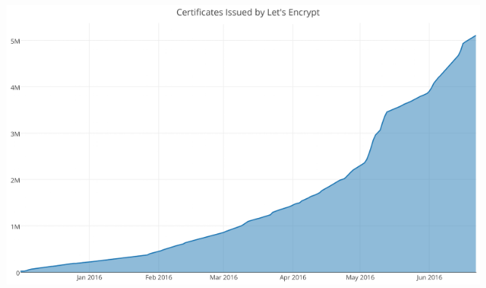
letsencrypt.org
Notes:
Let’s Encrypt has now issued over 5 million certificates, and they do have a crowdfunding campaign going on right now if you’re interested in donating to keep this graph going up and to the right. Besides Let’s Encrypt, there are now many other low-cost options that won’t break the bank for even more fancy types of certificates. So, spending money on certificates is really no longer a reason to not migrate to HTTPS.

Slide 37
ads!
Notes:
Another piece of the revenue story is ads, because historically sites were afraid of losing ad revenue when migrating to HTTPS, or afraid that their ad partners would refuse to support HTTPS. Ad support for HTTPS really was once a huge issue, but because of work done across the ads ecosystem, the situation is now much better.

Slide 38
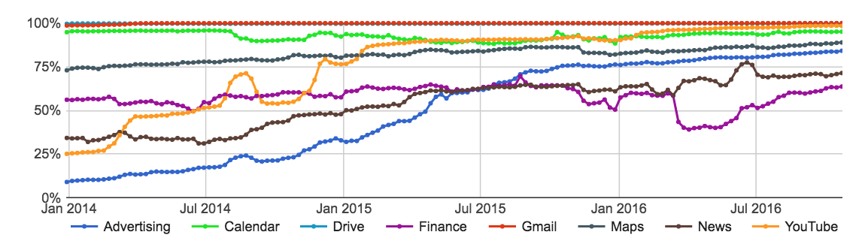
For most users, all ads that come from any Google source always support HTTPS, including AdWords, AdSense or DoubleClick Ad Exchange.
Notes:
In terms of Google ads specifically, for most users all ads that come from any Google source always support HTTPS, including AdWords, AdSense or DoubleClick Ad Exchange. This means there will be no change to the ads that appear on a site after migrating to HTTPS. The same ads compete in the auction, so switching your site to HTTPS will have no effect on the ads most users see, or on auction pressure.
Here is a graph of support for HTTPS at Google, broken down by Google products, and you can see the blue line, which represents HTTPS traffic to our ads servers, has significantly increased from 2014 to the current situation in 2016.
Keep in mind that for direct deals, such as those via DoubleClick for publishers, ads still have to be created to be HTTPS friendly.

Slide 39
“We saw no material impact to AdX revenue with the transition to SSL.”
Jason Tollestrup, Director of Programmatic Advertising for the Washington Post
Notes:
The Washington Post is a good case study here. They migrated to HTTPS and measured their ad revenue, and found that there was no material impact to their AdX revenue.

Slide 40
By the end of 2014, 80% of IAB member ad delivery systems supported HTTPS.
Notes:
Outside of Google, things are looking good too. The IAB said in a blog post that broad support for HTTPS on public servers is a best practice for the industry, and by the end of 2014 80% of member ad systems supported HTTPS.

Slide 41
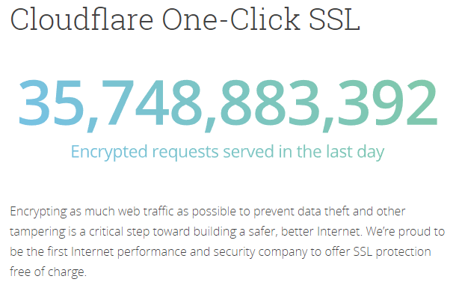
Content Delivery Networks
Notes:
Here’s another fun topic when we talk about the potential cost of HTTPS. CDNs. Sometimes, sites tell me that increased CDN pricing is keeping them from moving to HTTPS. It turns out that some CDNs are actually great partners in getting sites on HTTPS. For example, Cloudflare now has one-click and free SSL. Other CDNs will advertise bundled prices that make the cost of HTTPS seem much higher. If this is a problem for your site, as a best practice, it’s good to ask about TLS pricing specifically.

Slide 42
step one: $$
Powerful features
Performance
Mythbust perceptions
Notes:
As you’ve seen, HTTPS is required for new and existing powerful features and the fastest web performance, plus, many of the old perceptions about HTTPS being expensive are now myths. So with those 3 points, you’ve argued that HTTPS will actually bring business benefit to your site, besides the benefit of increased privacy and security for your users.

Slide 43
convince your boss!
step one: $$
step two: now!!
Notes:
But wait… there’s more… No business case is really quite as effective as one that also includes a ticking time bomb, an argument that sets a tone of such urgency, that your company will prioritize this HTTPS migration over the other millions of things that your company is doing.

Slide 44
step two: now!!
Don’t get left behind
Browser UI is coming!
Plan to avoid challenges
Notes:
So here are 3 points that set that tone of urgency.

Slide 45
step two: now!!
Don’t get left behind
Browser UI is coming!
Plan to avoid challenges
Notes:
The first is… don’t get left behind.

Slide 46
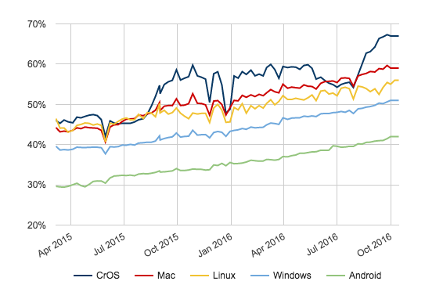
Chrome Page Loads over HTTPS
Notes:
Because it looks like everyone else is doing it. Firefox and Chrome have both released telemetry stats that show that more than 50% of desktop page loads are now over HTTPS. Chrome also just released time-based statistics that show that desktop users now spend more than two-thirds of their time on HTTPS sites. And all of these graphs show a strong upwards trajectory. So HTTPS everywhere is not some far-off future -- it’s the the new normal, and its happening now.

Slide 47
step two: now!!
Don’t get left behind
Browser UI is coming!
Plan to avoid challenges
Notes:
The second point really falls under the umbrella of “ticking time bomb”. And thats the Browser UI -- the indicator that browsers will show to accompany HTTP pages.

Slide 48
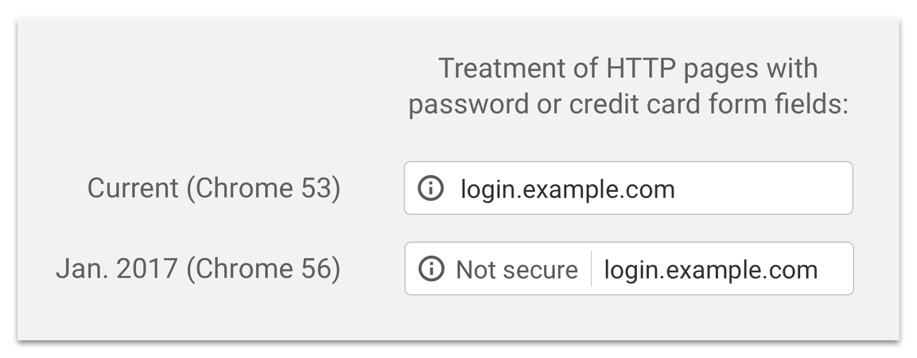
Chrome Canary flag: chrome://flags, flip #mark-non-secure-as
chrome://flags/#mark-non-secure-as
Notes:
Browsers want to ease users into the idea that HTTP is bad, without scaring or confusing the average web user.
This is the new UI treatment for *some* insecure http sites that we’ll be launching with Chrome 56 in January, specifically those that collect passwords or credit card information over insecure HTTP. This feature is still in development, so it’s subject to change, but you can try it in Chrome Canary today by flipping the flag shown here, and visiting any HTTP page with a login. We encourage you to try out your own site with this flag right now to see if your users will see omnibox warnings in January, and if they will, show this live demo to your boss, to hammer that last nail into the HTTP coffin.

Slide 49
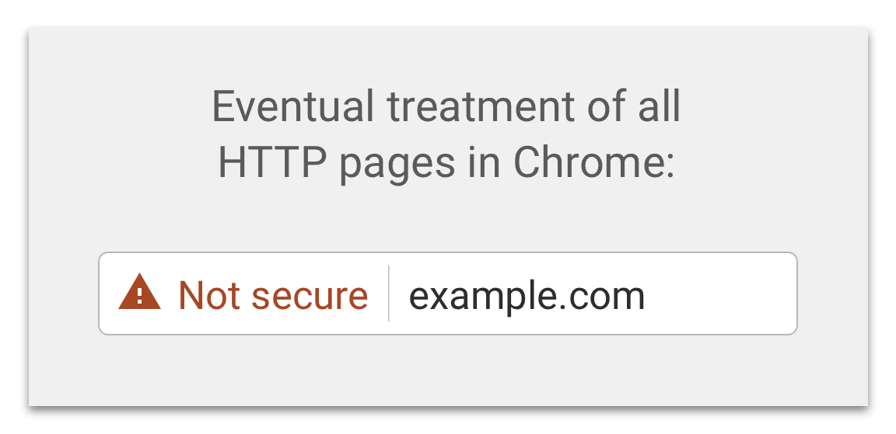
Not Secure Warning in Chrome - Future
Notes:
As HTTPS becomes more prevalent, we plan to continue to use more and more signals to know when it’s important to warn the user about the lack of connection security, to gradually transition to a world where Chrome is fully honest with users about what it means to not use HTTPS.

Slide 50
step two: now!!
Don’t get left behind
Browser UI is coming!
Plan to avoid challenges
Notes:
The last piece in your case for HTTPS migration urgency, is the cold truth about site migrations. An HTTPS migration is a full site migration, and like all major site changes, you can’t just turn it on and hope for the best. You need to plan to do it right. And if you start that now… you’ll avoid a lot of pain later.

Slide 51
SEO impact??
%&#)@)(#*!!
Notes:
As with all major site migrations, there are certain steps webmasters must take to ensure that search ranking transitions are smooth when moving to HTTPS. To help with this, we’ve posted two FAQs to help sites transition correctly, and will continue to improve our web fundamentals guidance. Careful planning and implementation is super important to avoid impact. I have the links to these resources in my speaker notes on this slide deck.

Slide 52
We were able to migrate Wayfair.com to HTTPS with no meaningful impact to Google rankings or Google organic search traffic. We are very pleased to say that all Wayfair sites are now fully HTTPS.
Brian Wood, Director of Marketing SEO at Wayfair
Notes:
We have seen many sites successfully transition with negligible effect on their search ranking and traffic. Wayfar.com, and online retailer, migrated to HTTPS in the last month and saw no meaningful impact to rankings or search traffic.

Slide 53
We successfully completed our move of CNET.com to HTTPS last month. Since then, there has been no change in our Google rankings or Google organic search traffic.
John Sherwood, Vice President of Engineering & Technology at CNET
Notes:
CNET also migrated very recently, and similarly saw no change in their rankings or trafffic.

Slide 54
oh nooooo,
MIXED CONTENT!
Notes:
And finally, mixed content is the problem of loading nonsecure HTTP content on an HTTPS site. And this is important, because non-secure subresources can actually compromise the security of a secure HTTPS site. So if you try to load insecure scripts or iFrames or other active content like that on an HTTPS site, browsers will actually block it, because that content is too powerful and would completely wipe out all the security of that HTTPS site.
Preventing mixed content is a real challenge for many sites in the migration process, especially for publishers, who often have lots of old news articles that link to old 3rd party images that aren’t available over HTTPS. We call images passive content, and browsers will allow them to load, so the site won’t be completely broken, but the green lock goes away.

Slide 55
Content-Security-Policy
Notes:
Fortunately, you can serve a Content Security Policy header to receive reports about mixed content. This header is basically a way for you to assert to the browser that all content should be loaded over HTTPS, and that you want to receive reports about any content that isn’t. And that allows you to go find and fixe mixed content on all your millions of pages. This means that you don’t have to rely on users to report broken behavior; you’ll be able to find and fix problems quickly as soon as they arise.

Slide 56
upgrade-insecure-requests
Notes:
You can also use the upgrade-insecure-requests CSP directive to ensure that any requests you overlook are seamlessly upgraded to HTTPS.

Slide 57
step two: now!!
Don’t get left behind
Browser UI is coming!
Plan to avoid challenges
Notes:
So between those Browser UI changes, and the required planning involved with an HTTPS migration, it’s pretty clear that sites cannot keep putting this off.

Slide 58
boss: convinced!
Notes:
Let’s come back to that conversation with your boss, where you once unsuccessfully argued for HTTPS. After proving real business benefit, and proving why this has to be done now, I hope your management will agree with me that it’s both important, and beneficial, for every page of every site on our powerful web today, to use HTTPS.

Slide 59
thanks!
office hours at 14:30
Emily Schechter
@emschec

