Slide 1
When One Data Center Is Not Enough:
Building Large-scale Stream Infrastructures Across Multiple Data Centers with Apache Kafka
Ewen Cheslack-Postava

Slide 2
Outline
Kafka overview
Common multi data center patterns
Future stuff

Slide 3

What’s Apache Kafka
Distributed, high throughput pub/sub system
Notes:
New theme.
Picture/logo

Slide 4



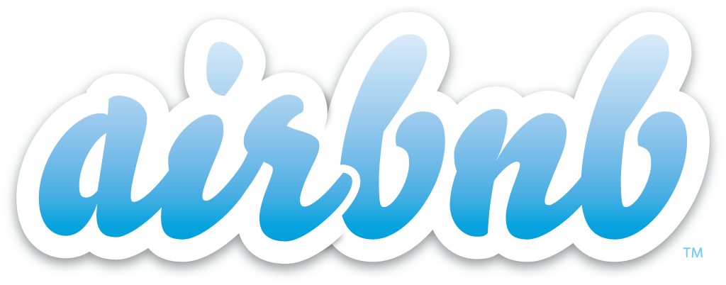












Kafka usage

Slide 5
Common use case
Large scale real time data integration

Slide 6
Other use cases
Scaling databases
Messaging
Stream processing
…

Slide 7
Why multiple data centers (DC)
Disaster recovery
Geo-localization
  Saving cross-DC bandwidth
  Security

Slide 8
What’s unique with Kafka multi DC
Consumers run continuously and have state (offsets)
Challenge: recovering the state during DC failover

Slide 9
Pattern #1: stretched cluster
Typically done on AWS in a single region
  Deploy Zookeeper and broker across 3 availability zones
Rely on intra-cluster replication to replica data across DCs
DC 1
DC 2
DC 3
producers
producers
producers
Kafka
consumers
consumers
consumers

Slide 10
On DC failure
Producer/consumer fail over to new DCs
  Existing data preserved by intra-cluster replication
  Consumer resumes from last committed offsets and will see same data
DC 1
DC 2
DC 3
producers
producers
Kafka
consumers
consumers

Slide 11
When DC comes back
Intra cluster replication auto re-replicates all missing data
When re-replication completes, switch producer/consumer back
DC 1
DC 2
DC 3
producers
producers
producers
Kafka
consumers
consumers
consumers

Slide 12
Be careful with replica assignment
Don’t want all replicas in same AZ
Rack-aware support in 0.10.0
  Configure brokers in same AZ with same broker.rack
Manual assignment pre 0.10.0

Slide 13
Stretched cluster NOT recommended across regions
Asymmetric network partitioning
Longer network latency => longer produce/consume time
Cross region bandwidth: no read affinity in Kafka
region 1
Kafka
ZK
region 2
region 3
Kafka
ZK
Kafka
ZK

Slide 14
Pattern #2: active/passive
Producers in active DC
Consumers in either active or passive DC
DC 1
producers
DC 2
Kafka
Kafka
Replication
consumers
consumers

Slide 15
Cross Datacenter Replication
Consumer & Producer: read from a source cluster and write to a target cluster
Per-key ordering preserved
Asynchronous: target always slightly behind
Offsets not preserved
  Source and target may not have same # partitions
  Retries for failed writes
Options:
  Confluent Multi-Datacenter Replication
  MirrorMaker

Slide 16
On active DC failure
Fail over producers/consumers to passive cluster
Challenge: which offset to resume consumption
  Offsets not identical across clusters
DC 1
producers
DC 2
Kafka
Kafka
Replication
consumers

Slide 17
Solutions for switching consumers
Resume from smallest offset
  Duplicates
Resume from largest offset
  May miss some messages (likely acceptable for real time consumers)
Set offset based on timestamp
  Current API hard to use and not precise
  Better and more precise API being worked on (KIP-33)
Preserve offsets during replication
  Harder to do
  No timeline yet

Slide 18
When DC comes back
Need to reverse replication
  Same challenge: determining the offsets
DC 1
producers
DC 2
Kafka
Kafka
Replication
consumers

Slide 19
Limitations
Reconfiguration of replication after failover
Resources in passive DC under utilized

Slide 20
Pattern #3: active/active
Local → aggregate replication to avoid cycles
Producers/consumers in both DCs
  Producers only write to local clusters
DC 1
producers
producers
DC 2
Kafka local
Kafka local
Replication
consumers
consumers
Kafka aggregate
Kafka aggregate
consumers
consumers

Slide 21
On DC failure
Same challenge on moving consumers on aggregate cluster
  Offsets in the 2 aggregate cluster not identical
DC 1
producers
producers
DC 2
Kafka local
Kafka local
Replication
consumers
consumers
Kafka aggregate
Kafka aggregate
consumers
consumers

Slide 22
When DC comes back
No need to reconfigure replication
DC 1
producers
producers
DC 2
Kafka local
Kafka local
Replication
consumers
consumers
Kafka aggregate
Kafka aggregate
consumers
consumers

Slide 23
An alternative
Challenge: reconfigure replication on failover, similar to active/passive
DC 1
producers
producers
DC 2
Kafka local
Kafka local
Replication
consumers
consumers
Kafka aggregate
Kafka aggregate
consumers
consumers

Slide 24
Another alternative: avoid aggregate clusters
Prefix topic names with DC tag
Configure replication to replicate remote topics only
Consumers need to subscribe to topics with both DC tags
DC 1
producers
producers
DC 2
Kafka
Kafka
Replication
consumers
consumers

Slide 25
Beyond 2 DCs
More DCs → better resource utilization
  With 2 DCs, each DC needs to provision 100% traffic
  With 3 DCs, each DC only needs to provision 50% traffic
Setting up replication with many DCs can be daunting
  Only set up aggregate clusters in 2-3

Slide 26
Comparison
 | Pros | Cons
Stretched | Better utilization of resources Easy failover for consumers | Still need cross region story
Active/passive | Needed for global ordering | Harder failover for consumers Reconfiguration during failover Resource under-utilization
Active/active | Better utilization of resources | Harder failover for consumers Extra aggregate clusters

Slide 27
Multi-DC beyond Kafka
Kafka often used together with other data stores
Need to make sure multi-DC strategy is consistent

Slide 28
Example application
Consumer reads from Kafka and computes 1-min count
Counts need to be stored in DB and available in every DC

Slide 29
Independent database per DC
Run same consumer concurrently in both DCs
  No consumer failover needed
DC 1
producers
producers
DC 2
Kafka local
Kafka local
Replication
DB
DB
Kafka aggregate
Kafka aggregate
consumer
consumer

Slide 30
Stretched database across DCs
Only run one consumer per DC at any given point of time
DC 1
producers
producers
DC 2
Kafka local
Kafka local
Replication
DB
DB
Kafka aggregate
Kafka aggregate
consumer
consumer
on failover

Slide 31
Future work
KIP-33: timestamp index
  Allow consumers to seek based on timestamp
Integration with Kafka Connect for data ingestion
Offset preservation

Slide 32
THANK YOU!
Ewen Cheslack-Postava | ewen@confluent.io | @ewencp
Learn more about Kafka at Strata + Hadoop World NY
  Securing Apache Kafka - Jun Rao, River Pavilion @ 2:05pm
  Ask Me Anything: Apache Kafka – Jun Rao & Ewen Cheslack-Postava, 1E09 @ 4:35pm
  Visit Confluent’s Booth (#758)
Kafka Training with Confluent University
  Kafka Developer and Operations Courses
  Visit www.confluent.io/training
Want more Kafka?
  Download Confluent Platform Enterprise at http://www.confluent.io/product
  Apache Kafka 0.10 upgrade documentation at http://docs.confluent.io/3.0.1/upgrade.html
  Kafka Summit recordings now available at http://kafka-summit.org/schedule/

