Slide 1
Securing Apache Kafka
Jun Rao
co-founder at Confluent, Inc

Slide 2
Outline
Kafka and security overview
Authentication
  Identify the principal (user) associated with a connection
Authorization
  What permission a principal has
Secure Zookeeper
Future stuff

Slide 3

What’s Apache Kafka
Distributed, high throughput pub/sub system
Notes:
New theme.
Picture/logo

Slide 4
















Kafka Usage

Slide 5
Security Overview
Support since 0.9.0
Access control on resources such as topics
  Enable sharing Kafka clusters
Wire encryption btw client and broker
  For cross data center mirroring

Slide 6
Authentication Overview
Authentication through SSL or SASL
Broker support multiple ports
  plain text (no wire encryption/authentication)
  SSL (for wire encryption/authentication)
  SASL (for SASL authentication)
  SSL + SASL (SSL for wire encryption, SASL for authentication)
Clients choose which port to use
  need to provide required credentials through configs

Slide 7
Why is SSL useful
1-way authentication
  Secure wire transfer through encryption
2-way authentication
  Broker knows the identity of client
Easy to get started
  Just involve client and server

Slide 8
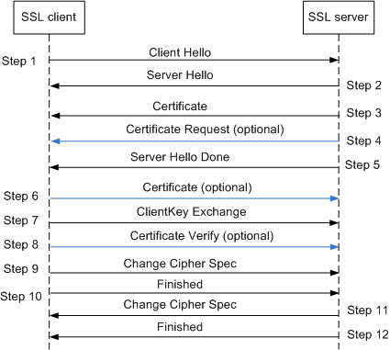
SSL handshake

Slide 9
Subsequent transfer over SSL
Data encrypted with agreed upon cipher suite
  Encryption overhead
  Losing zero-copy transfer in consumer

Slide 10
Performance impact with SSL
r3.xlarge
  4 core, 30GB ram, 80GB ssd, moderate network (~90MB/s)
Most overhead from encryption
 | throughput (MB/s) | CPU on client | CPU on broker
producer (plaintext) | 83 | 12% | 30%
producer (SSL) | 69 | 28% | 48%
consumer (plaintext) | 83 | 8% | 2%
consumer (SSL) | 69 | 27% | 24%

Slide 11
Preparing SSL
Generate certificate (X509) in broker key store
Generate certificate authority (CA) for signing
Sign broker certificate with CA
Import signed certificate and CA to broker key store
Import CA to client trust store
2-way authentication: generate client certificate in a similar way

Slide 12
Configuring SSL
No client code change; just configuration change.
Client/Broker
ssl.keystore.location = /var/private/ssl/kafka.server.keystore.jks
ssl.keystore.password = test1234
ssl.key.password = test1234
ssl.truststore.location = /var/private/ssl/kafka.server.truststore.jks
ssl.truststore.password = test1234
Broker
listeners = SSL://host.name:port
security.inter.broker.protocol = SSL
ssl.client.auth = required
Client
security.protocol = SSL

Slide 13
SSL Principal Name
By default, the distinguished name of the certificate
  CN=host1.company.com,OU=organization unit,O=organization,L=location,ST=state,C=country
Can be customized through principal.builder.class
  Has access to X509Certificate
  Make setting broker principal and application principal convenient

Slide 14
What is SASL
Simple Authentication and Security Layer
  Challenge/response protocols
  Server issues challenge and client sends response
  Continue until server is satisfied
Different mechanisms
  GSSAPI: Kerberos (supported since 0.9)
  Plain: cleartext username/password (supported since 0.10)
  Digest MD5

Slide 15
Why Kerberos
Secure single sign-on
  An organization may provide multiple services
  User just remember a single Kerberos password to use all services
More convenient when there are many users
Need Key Distribution Center (KDC)
  Each service/user need a Kerberos principal in KDC

Slide 16
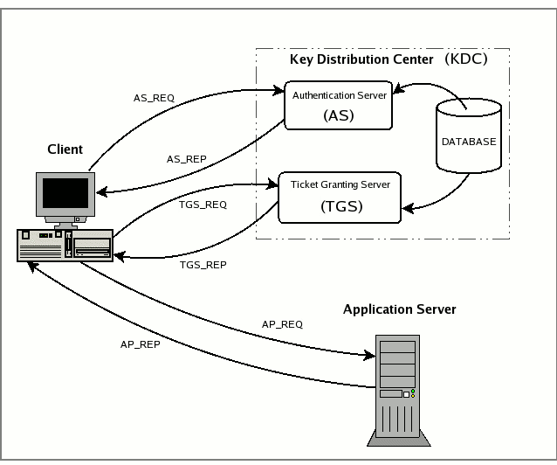
How Kerberos Works
Create service and client principal in KDC
Client authenticate with AS on startup
Client obtain service ticket from TGS
Client authenticate with service using service ticket

Slide 17
SASL handshake
Client
Broker
Connection
Mechanism list
Selected mechanism & sasl data
Evaluate and response
Sasl data
Client authenticated

Slide 18
Data transfer
SASL_PLAINTEXT
  No wire encryption
SASL_SSL
  Wire encryption over SSL

Slide 19
Preparing Kerberos
Create Kafka service principal in KDC
Create a keytab for Kafka principal
  Keytab includes principal and encrypted Kerberos password
  Allow authentication w/o typing password
Create an application principal for client KDC
Create a keytab for application principal

Slide 20
Configuring Kerberos
No client code change; just configuration change.
Broker JAAS file
Client JAAS file
KafkaServer {
com.sun.security.auth.module.Krb5LoginModule required
useKeyTab=true
storeKey=true
keyTab="/etc/security/keytabs/kafka_server.keytab"
principal="kafka/kafka1.hostname.com@EXAMPLE.COM";
};
KafkaClient {
com.sun.security.auth.module.Krb5LoginModule required
useKeyTab=true
storeKey=true
keyTab="/etc/security/keytabs/kafka_client.keytab"
principal="kafka-client-1@EXAMPLE.COM";
};
Broker JVM
ClientJVM
-Djava.security.auth.login.config=/etc/kafka/kafka_server_jaas.conf
-Djava.security.auth.login.config=/etc/kafka/kafka_client_jaas.conf
Broker config
Client config
security.inter.broker.protocol=SASL_PLAINTEXT(SASL_SSL)
sasl.kerberos.service.name=kafka
security.protocol=SASL_PLAINTEXT(SASL_SSL)
sasl.kerberos.service.name=kafka

Slide 21
Kerberos principal name
Kerberos principal
  Primary[/Instance]@REALM
  kafka/kafka1.hostname.com@EXAMPLE.COM
  kafka-client-1@EXAMPLE.COM
Primary extracted as the default principal name
Can customize principal name through sasl.kerberos.principal.to.local.rules

Slide 22
Supporting multiple SASL mechanisms
Broker can support multiple SASL mechanisms
  sasl.enabled.mechanisms=GSSAPI,PLAIN
  By default, only GSSAPI is enabled
Client only picks one SASL mechanism
  sasl.mechanism=PLAIN
  Defaults to GSSAPI

Slide 23
Authentication Caveat
Authentication (SSL or SASL) happens once during socket connection
  No re-authentication
If a certificate needs to be revoked, use authorization to remove permission

Slide 24
Authorization
Control which permission each authenticated principal has
Pluggable with a default implementation

Slide 25
ACL
Alice is Allowed to Read from topic T1 from Host1
Principal
Permission
Operation
Resource
Host
Alice
Allow
Read
Topic:T1
Host1

Slide 26
Operations and Resources
Operations
  Read, Write, Create, Describe, ClusterAction, All
Resources
  Topic, Cluster and ConsumerGroup
Operations | Resources
Read, Write, Describe (Read, Write implies Describe) | Topic
Read | ConsumerGroup
Create, ClusterAction (communication between controller and brokers) | Cluster

Slide 27
SimpleAclAuthorizer
Out of box authorizer implementation.
CLI tool for adding/removing acls
ACLs stored in zookeeper and propagated to brokers asynchronously
ACL cache in broker for better performance.

Slide 28
Authorizer Flow
Client
Broker
Authorizer
Zookeeper
configure
Read ACLs
Load Cache
Request
authorize
ACL match
Or Super User?
Allowed/Denied

Slide 29
Configure broker ACL
authorizer.class.name=kafka.security.auth.SimpleAclAuthorizer
Make Kafka principal super users
  Or grant ClusterAction and Read all topics to Kafka principal

Slide 30
Configure client ACL
Producer
  Grant Write on topic, Create on cluster (auto creation)
  Or use --producer option in CLI
  bin/kafka-acls --authorizer-properties zookeeper.connect=localhost:2181 \
  --add --allow-principal User:Bob --producer --topic t1
Consumer
  Grant Read on topic, Read on consumer group
  Or use --consumer option in CLI
  bin/kafka-acls --authorizer-properties zookeeper.connect=localhost:2181 \
  --add --allow-principal User:Bob --consumer --topic t1 --group group1

Slide 31
Secure Zookeeper
Zookeeper stores
  critical Kafka metadata
  ACLs
Need to prevent untrusted users from modifying

Slide 32
Zookeeper Security Integration
ZK supports authentication through SASL
  Kerberos or Digest MD5
Set zookeeper.set.acl to true on every broker
Configure ZK user through JAAS config file
  Each ZK path writable by creator, readable by all

Slide 33
Migrating from non-secure to secure Kafka
Configure brokers with multiple ports
  listeners=PLAINTEXT://host.name:port,SSL://host.name:port
Gradually migrate clients to secure port
When done
  Turn off PLAINTEXT port on brokers

Slide 34
Migrating from non-secure to secure Zookeeper
http://kafka.apache.org/documentation.html#zk_authz_migration

Slide 35
Future work
More SASL options: md5 digest
Performance improvement
Integrate with admin api
Delegation tokens

Slide 36
Thank you
Jun Rao | jun@confluent.io | @junrao
Meet Confluent in booth #758
Confluent University ~ Kafka training ~ confluent.io/training
Confluent services ~ confluent.io/services
Download Apache Kafka & Confluent Platform: confluent.io/download

