Slide 1
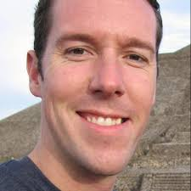
Brad Sarsfield
Principal Data Architect

Slide 2
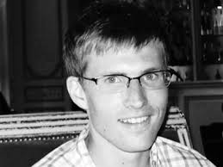
Evan Macmillan, Founder and CEO

Slide 3
Hanna Kang-Brown
censusspices.us

Slide 4
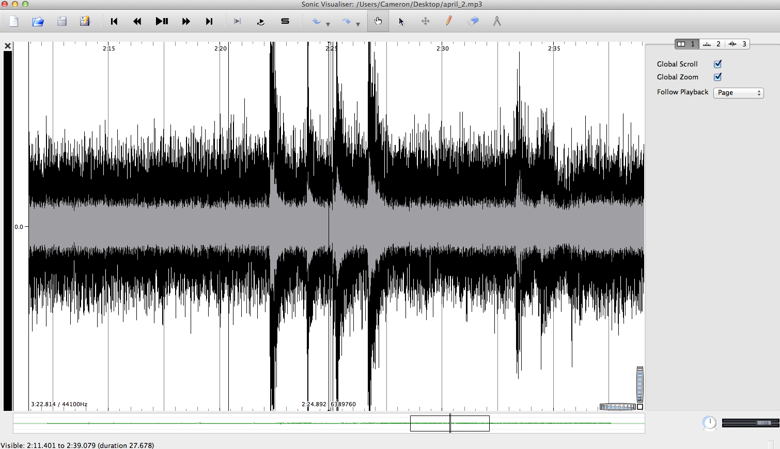
Cameron Turner
The Data Guild/Datorium
Moderator
cameron@thedataguild.com
@cturner50

