Slide 1
Fast Cars, Big Data
How Streaming Can Help Formula 1

Slide 2
Contact Information
Ted Dunning
Chief Applications Architect at MapR Technologies
Committer & PMC for Apache’s Drill, Zookeeper & others
VP of Incubator at Apache Foundation
Email tdunning@apache.org tdunning@maprtech.com
Twitter @ted_dunning
Hashtags today: #strataconf @mapr

Slide 3
Agenda
What’s the point of data in motorsports?
How can we play too?
KPI preserving generation
How the sim works
What works?
Live demo

Slide 4
How data plays in F1 motorsports

Slide 5
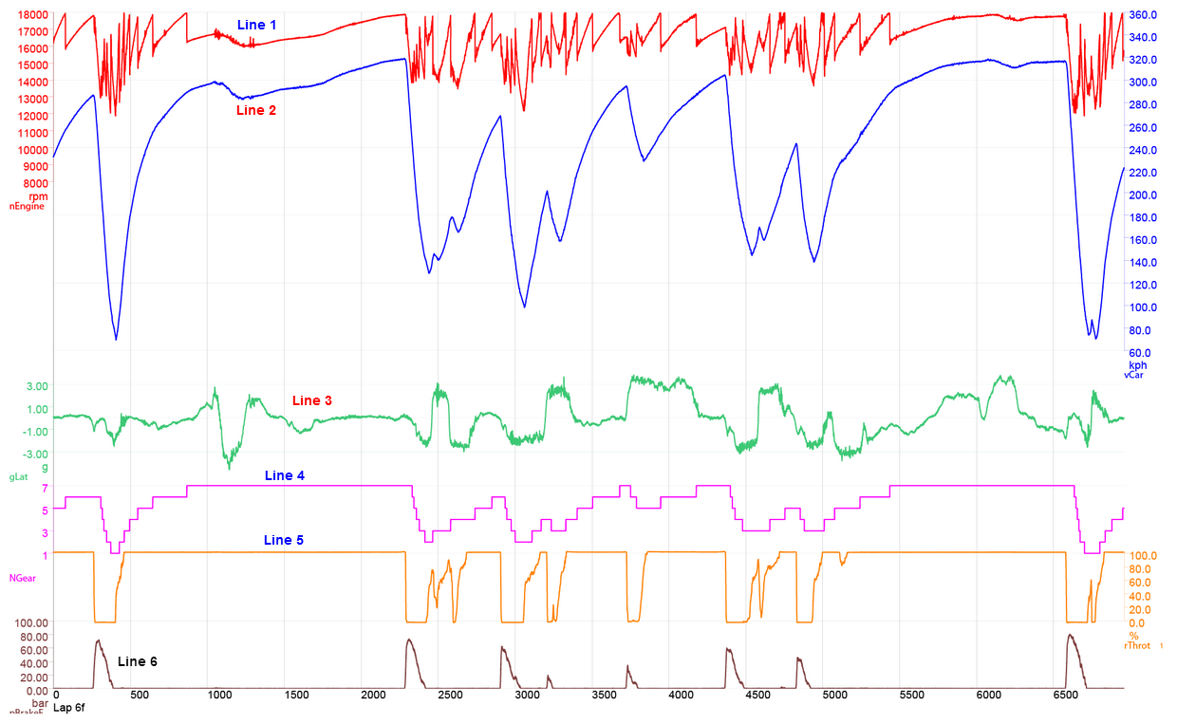
Data in Motorsports
http://f1framework.blogspot.de/2013/08/short-guide-to-f1-telemetry-spa-circuit.html

Slide 6
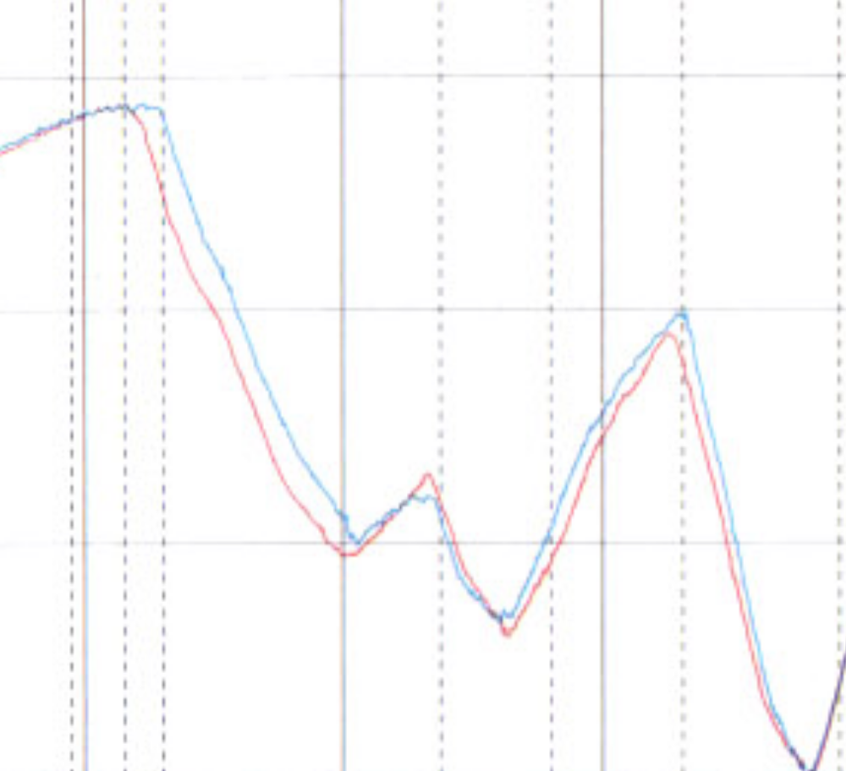
Blue driver carries more speed while slowing for curve
https://scarbsf1.wordpress.com/2011/08/18/telemetry-and-data-analysis-introduction/

Slide 7
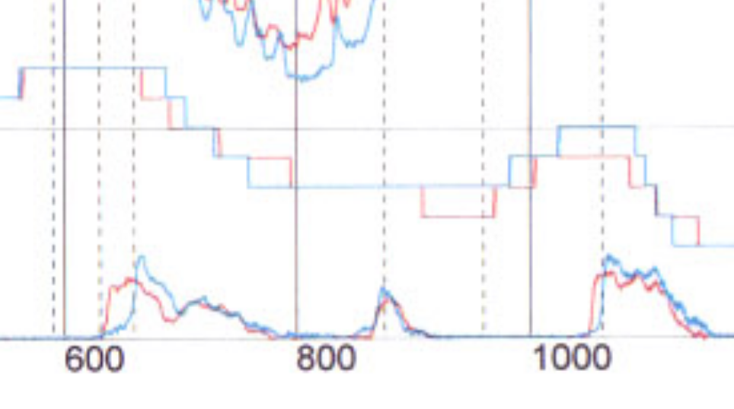
Difference is due to later and sharper braking

Slide 8
Real Analytics as Well as Visualization
Inputs
Predictive analysis of consumables and tires
Physical models of car + driver performance
  Tire wear slows lap times, lower fuel weight speeds lap times
Game theoretic analysis of competitors’ options
Monte Carlo analysis of likely weather conditions
Current GP points status
Outputs
Tactical options, outcome distributions

Slide 9
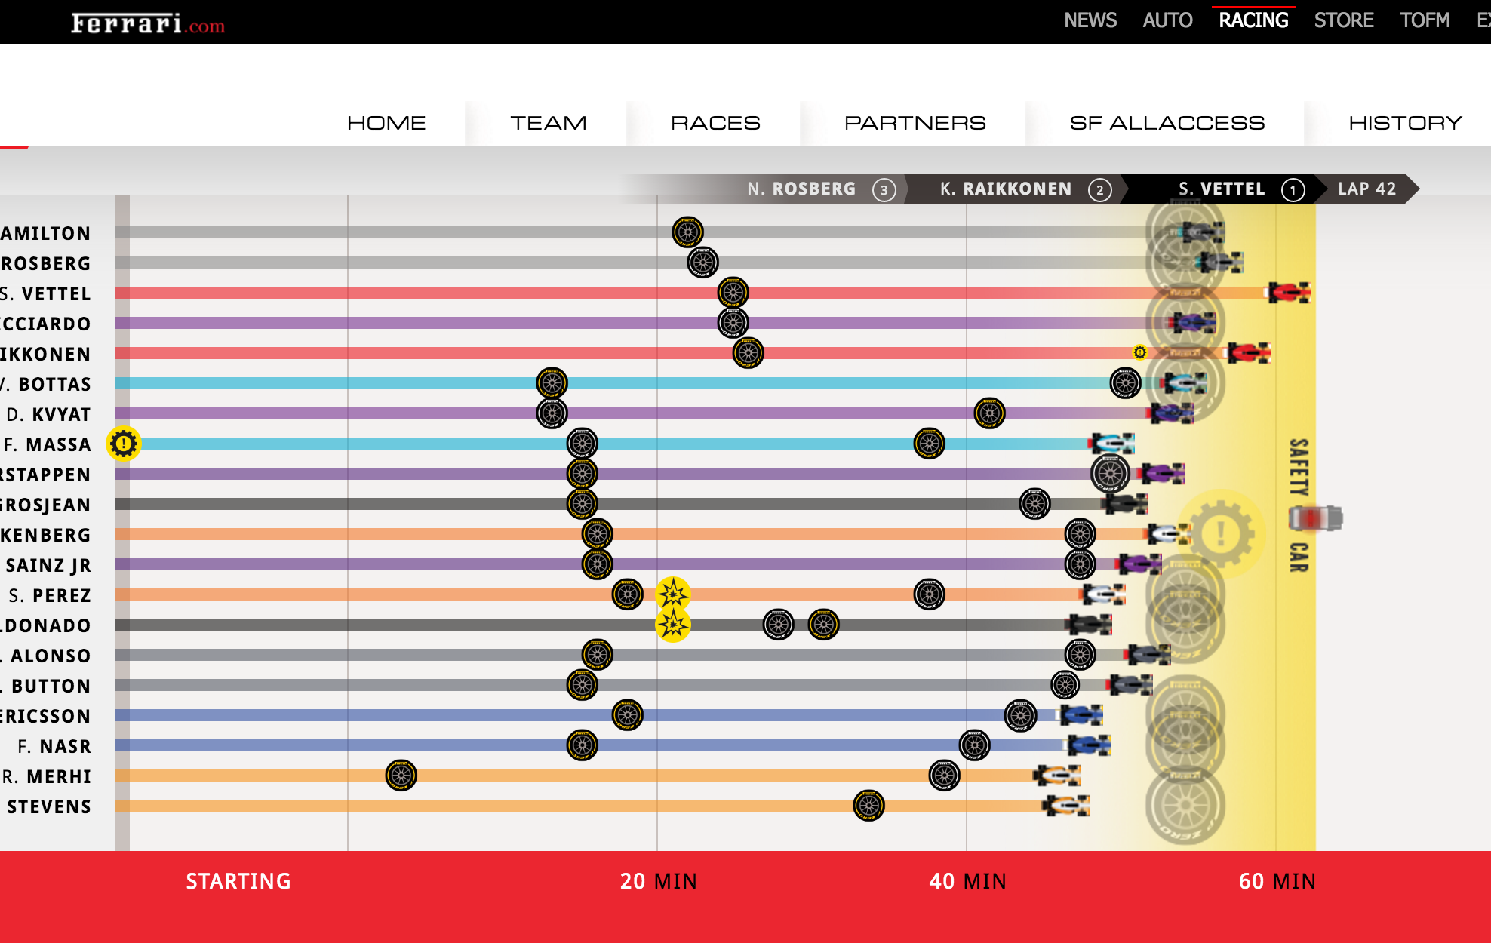
Data for Marketing as well
http://formula1.ferrari.com/en/inforacing-hungarian-gp-2015/

Slide 10
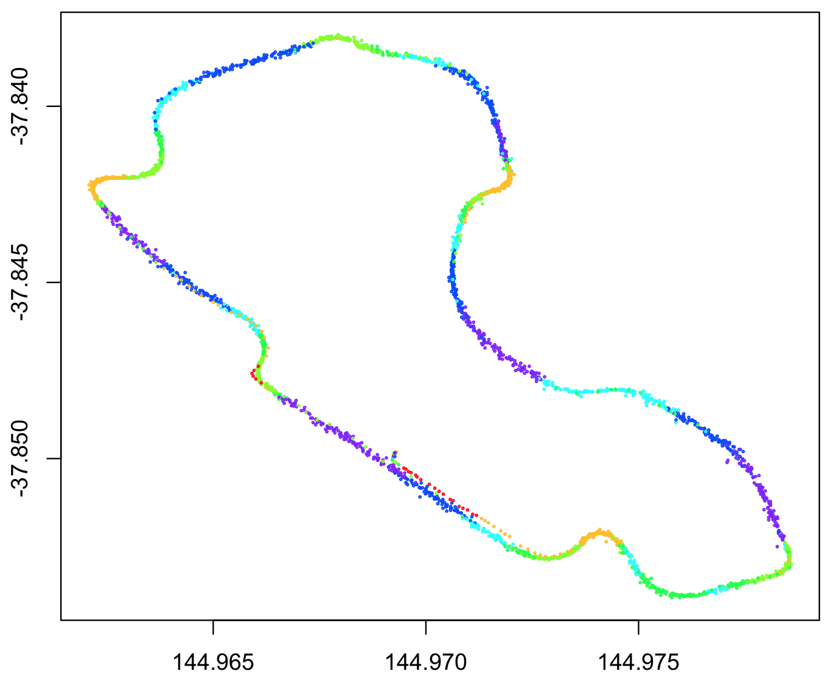
More Data = More Gearhead Engagement
Occasionally, somebody makes a tiny bit of data available like this data dump of Button’s ride in the Australian Gran Prix
Fans go nuts with this
http://bit.ly/f1-data-dump
http://bit.ly/f1-data-plotting-with-r

Slide 11
But it still doesn’t work ...

Slide 12
ENODATA !
Available data is definitely not good enough for more than an occasional blog post
Available data is intermittent, out of date and inconsistent
Except in special cases we can’t really build publicly available systems from scrounged data

Slide 13
The Unrealistic Nature of Real Data
Real data has several defects
  We can’t share it
  We can’t get it
  We can’t break it
  We can’t understand it
KPI preserving synthetic data has several virtues
  We can generate at any scale we like
  We can inject faults or oddities
  We have a god’s-eye view
  We have guarantees about practical fidelity

Slide 14
The Unrealistic Nature of Real Data
Real data has several defects
  We can’t share it (due to confidentiality)
  We can’t get it (too big, wrong scale, out of date)
  We can’t break it (injecting major real-world faults frowned upon)
  We can’t understand it (we don’t know what really happened)
KPI preserving synthetic data has several virtues
  We can generate at any scale we like
  We can inject faults or oddities
  We have a god’s-eye view
  We have guarantees about practical fidelity

Slide 15
KPI Matching Simulation
Parametric matching of key performance and failure signatures allows emulation of complex data properties
Matching on KPI’s and failure modes guarantees practical fidelity

Slide 16
If it breaks the same, it’s as good as the same

Slide 17
The Method
Pick realistic and important KPI’s and failure measures
  Sample rates, data volumes
  Plausible physics
  Plausible data semantics
  Your mileage may vary
Build emulation roughly based on real system
Tune data spec to match KPI’s using real models
Export data spec to alternative models
Re-tune data spec to match on alternative models

Slide 18
So how does that work?

Slide 19
So how does that work?
Especially for real-time data?

Slide 20
Production System Outline

Slide 21
Simplified Demo System Outline

Slide 22
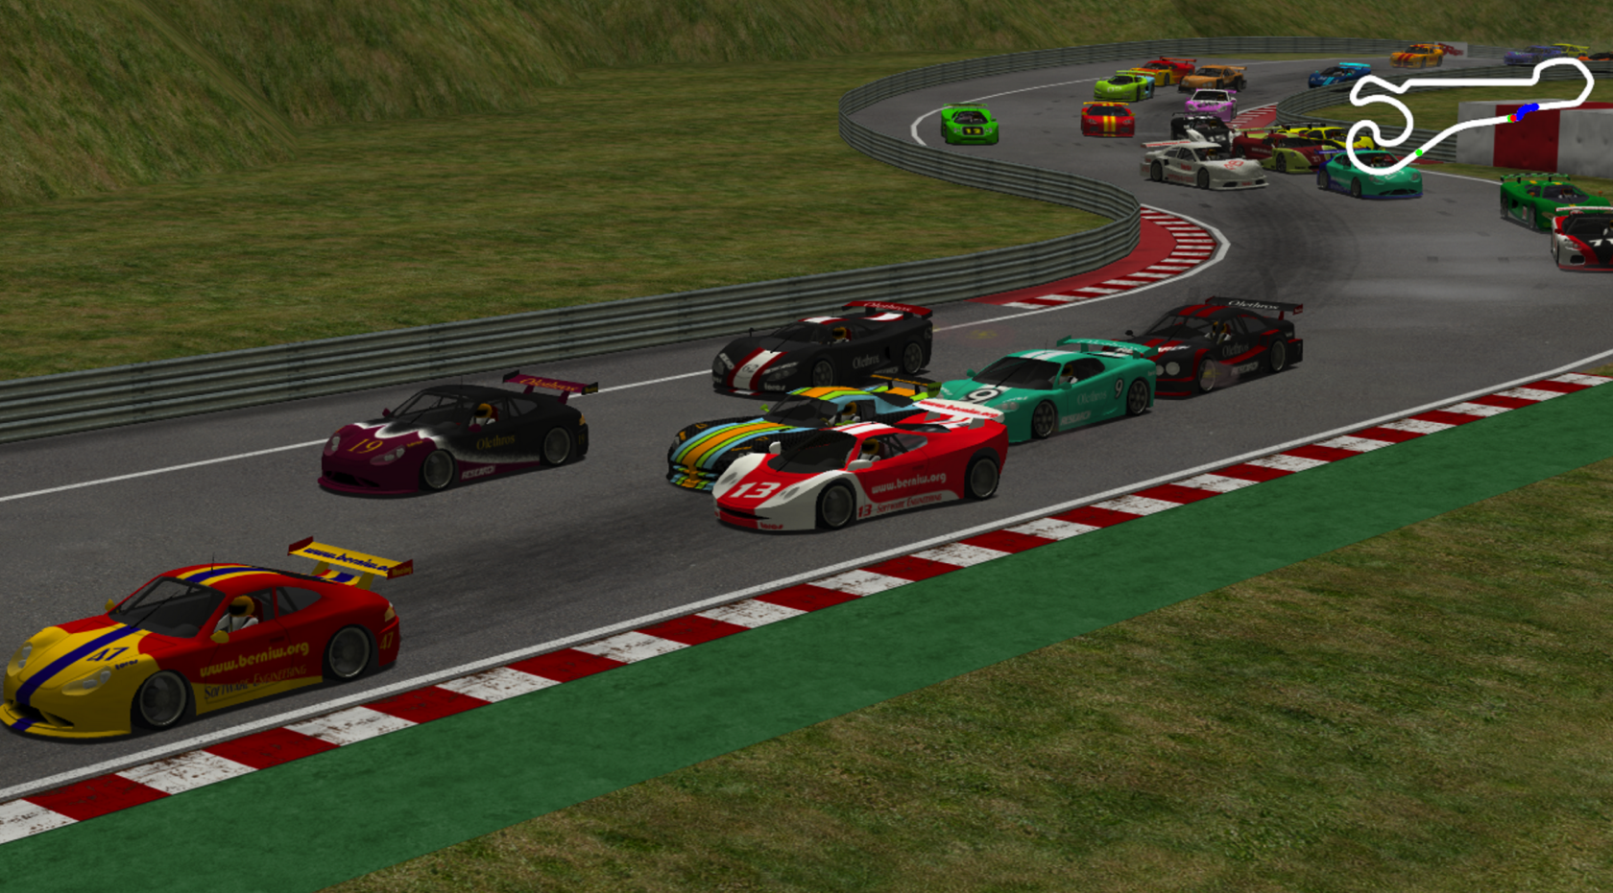
TORCS for Cars, Physics and Drivers
TORCS is a pseudo-physics based racing simulator with full graphics output and pluggable control modules.
TORCS is commonly used for AI research, but the control model can just as well collect data

Slide 23
What is the Point?
We would like to
  Prove out software architectures
  Test data pipelines and visualization systems
  Tune UI’s

Slide 24
What is the Point?
We would like to
  Prove out software architectures
  Test data pipelines and visualization systems
  Tune UI’s
  Play video games?

Slide 25
What is the Point?
We would like to
  Prove out software architectures
  Test data pipelines and visualization systems
  Tune UI’s
We also need to
  Simulate system failure scenarios
  Push limits for future usage

Slide 26
Current Status
It works, is available on github, ASL 2
Data collected is unrealistically limited, lacks
  Tire pressure, temperature x 4
  Brake usage, temperature x 8
  Engine monitoring is primitive (RPMs only, no KERS)
  Data rate is fixed, real data comes in at highly variable rates
  Real data has variable delays due to RF dropout + buffering
Data collected is in pure JSON
  Real data is columnar compressed blobs

Slide 27
Tables as Objects, Objects as Tables
List of objects
Column-wise form
Object containing lists
Row-wise form

Slide 28
Micro Columnar Formats
An entire table stored in columnar form can be a first-class value using these techniques
This is very powerful for in-lining one-to-many relations.

Slide 29
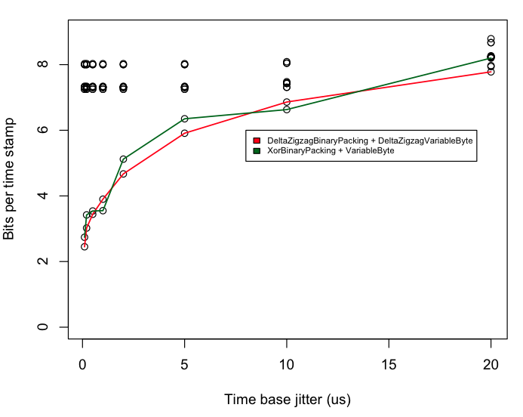
Compression Results
Samples are
64b time, 16 bit sample
Sample time at 10kHz
Sample time jitter makes it important to keep original time-stamp
How much overhead to retain time-stamp?

Slide 30
Sensor Data V1
{ "_id":"1.458141858E9/0.324",
"car" = "car1",
"timestamp":1458141858,
"racetime”:0.324,
"records":
[
{
"sensors":{
"Speed":3.588583,
"Distance":2003.023071,
"RPM":1896.575806
},
"racetime":0.324,
"timestamp":1458141858
},
{
"sensors":{
"Speed":6.755624,
"Distance":2004.084717,
"RPM":1673.264526
},
"racetime":0.556,
"timestamp":1458141858
},
3 main data points:
  Speed (m/s)
  RPM
  Distance (m)
Buffered

Slide 31
Sensor Data V2
{ "_id":"1.458141858E9/0.324",
"car" = "car1",
"timestamp":1458141858,
"racetime”:0.324,
"records":
[
{
"sensors":{
"Speed":3.588583,
"Distance":2003.023071,
"RPM":1896.575806,
"gear" : 2
},
"racetime":0.324,
"timestamp":1458141858
},
{
"sensors":{
"Speed":6.755624,
"Distance":2004.084717,
“RPM":1673.264526,
"gear" : 2
},
"racetime":0.556,
"timestamp":1458141858
},
3 main data points:
  Speed (m/s)
  RPM
  Distance (m)
  Throttle
  Gear
  …
Buffered

Slide 32
Let’s see it work!
(Murphy be praised)

Slide 33
Thank you for coming today!

Slide 34


Slide 35


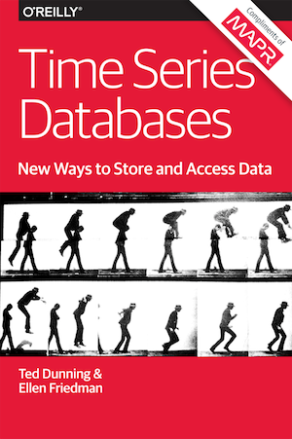

Short Books by Ted Dunning & Ellen Friedman
Published by O’Reilly in 2014 and 2015
For sale from Amazon or O’Reilly
Free e-books currently available courtesy of MapR
http://bit.ly/recommendation-ebook
http://bit.ly/ebook-anomaly
http://bit.ly/mapr-tsdb-ebook
http://bit.ly/ebook-real-world-hadoop

Slide 36

Streaming Architecture
by Ted Dunning and Ellen Friedman © 2016 (published by O’Reilly)
Free copies at book
signing tomorrow
morning before Tug’s
talk
http://bit.ly/mapr-ebook-streams

Slide 37
Thank You!

Slide 38





Q & A
Engage with us!
@mapr
maprtech
mapr-technologies
MapR
tdunning@maprtech.com
maprtech

