Slide 1
Data First Approach to Drive Real-Time Applications
Jack Norris
SVP Data and Applications
Notes:
First of all let’s start with Real-time..What exactly is real time
Slides from keynote
So the issue is how to bridge operational and analytics together
More recent analyst slides
Let’s go through some examples…
Now that we are on the same page lets define data first approach
It’s not worrying about the data and planning what you want to do so you get the data organized a particular way…that’s the old way
Define data first…data without considering the application and use…can serve both operations and analytics and both simultaneously…
How can that be…We need to do specifc operations
Lambda architecture
Converge it…
Many disparate operations..
Many applications..
Many workloads
Start with the data as events…
Look at streams
Stream development
What about the Data
Advantages of JSON
Drill
MapR-DB
OJAI
Benefits for Administrators
Focusing on Data first benefits both but primarily...
Microservices
Development streams
Administration benefits...
Wrap-up
--- What’s Data First Approach?
Development set up slides
Development process challenge is the intersection…
Examples of applications...
Use cases
Old way
Silos vs. Data first
Focusing on Data first benefits both but primarily...
Microservices
Development streams
Advantages for Developers
Advantages gor Administrators
Transformational applications
Wrap-up
Leading companies that are getting the most out of their data are not focusing on queries and data lakes, they are actively integrating analytics into their operations with a data-first application development approach. Real-time adjustments to improve revenues, reduce costs, or mitigate risk rely on applications that minimize latency and rely on a variety of data sources. This session reviews best practices by reviewing three use cases in Health care, Media and Financial Services to illustrate customer approaches to better develop, deploy, and dynamically update these applications; and how this data-first approach is fundamentally different from traditional applications.
Included in the discussion will be examples of how customers identified ways to simplify data streams in a publish-and-subscribe framework. For example, how focusing on a stream of electronic medical records, simplified the deployment of real-time applications for hospitals, clinics, and insurance companies.
The session will also detail how a data-first approach can lead to rapid deployment of additional real-time applications as well as centralize and simplify many data management and administration tasks.

Slide 2
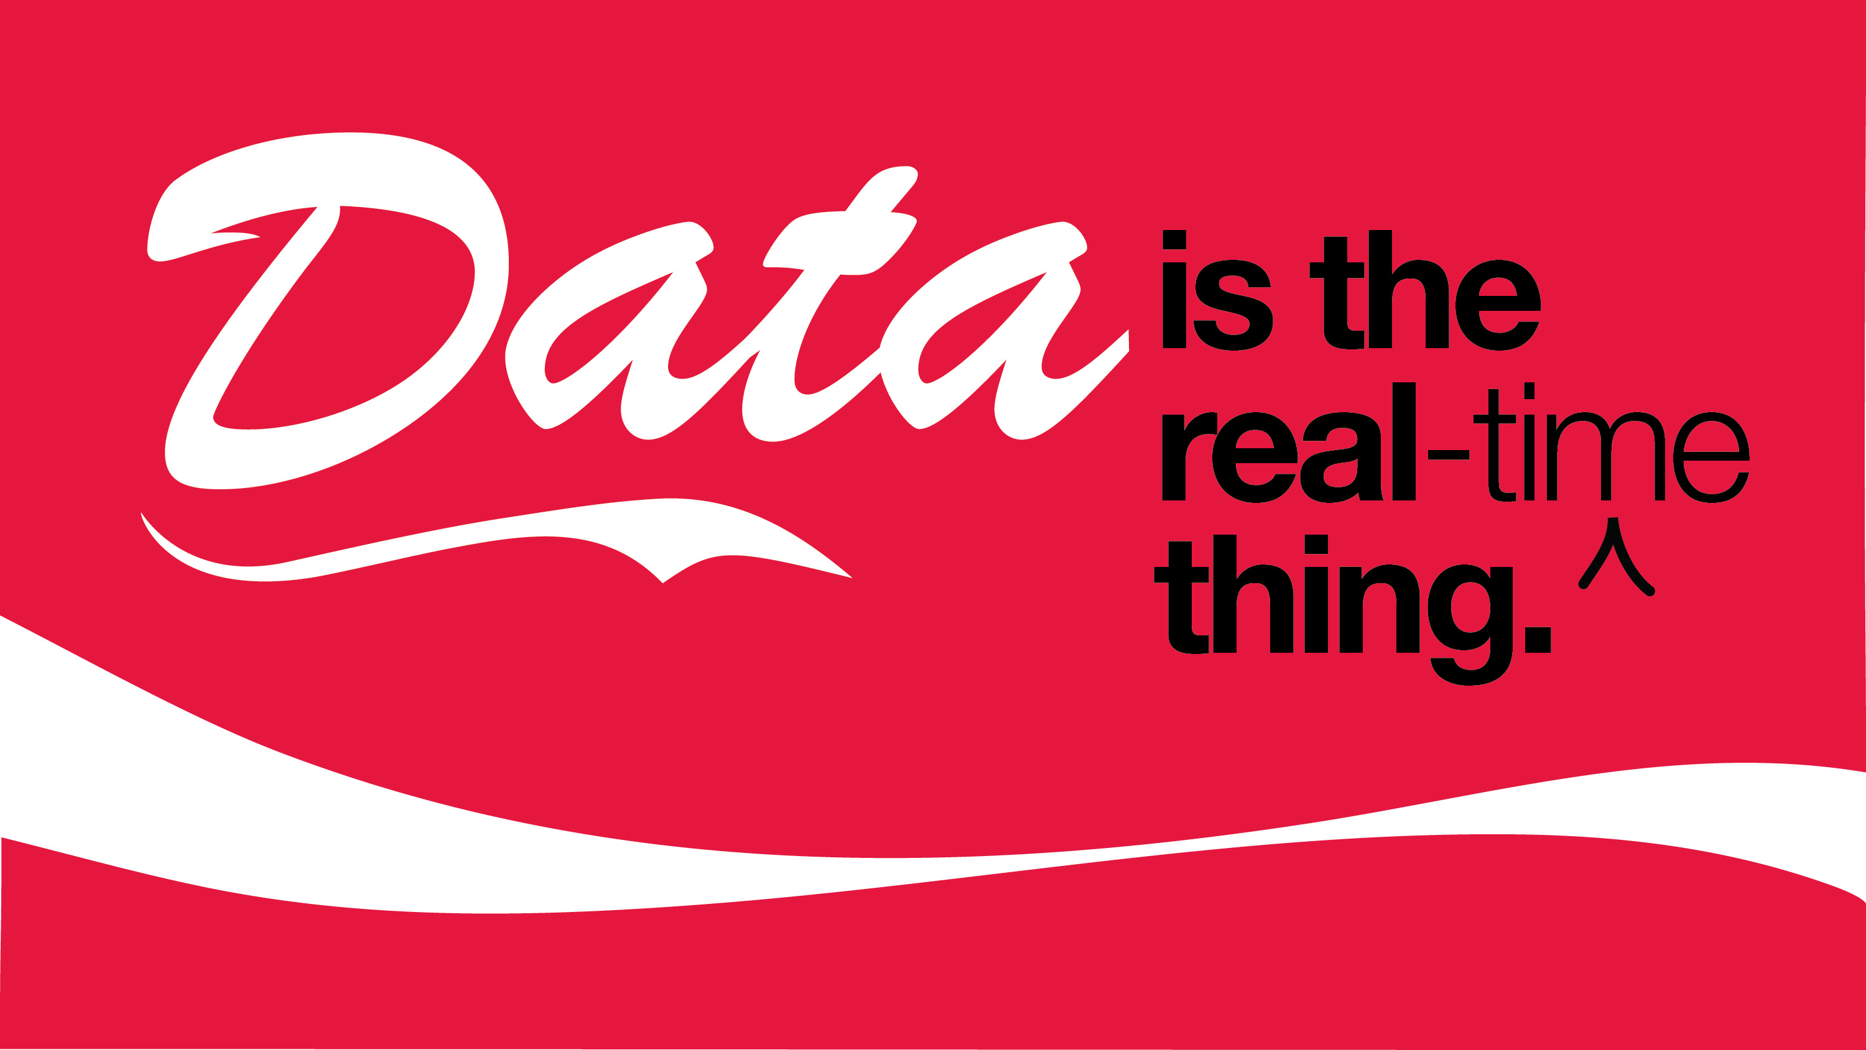
Data is the Real Thing
Notes:
Slide 2 – Data It’s the Real (caret time) Thing – Coke can graphic…
Real-time is at the core of transformational applications that perform analytics on operational data directly and in real time. Use cases from customers in retail, financial services and telcos will be cited to show how apps are architected to provide the required speed and flexibility to address multiple requirements, groups, and business functions -- and most importantly not just tolerate but embrace changes.

Slide 3

What is Real Time?
A Query response in less than 20 milliseconds?
Continuous data ingest
Database operation to support xyz
What if you found out that:
.20 response time on data that is one month old data
- continuous data ingest but batch analytics
--- database operations but 30 seconds of latency…

Slide 4
What is Real Time?
A Query response in less than 20 milliseconds?
  Data is one month old
Continuous data ingest
  Resulting analytics are performed at the end of each day
Database operation to support xyz
  Results in 30 seconds of latency

Slide 5
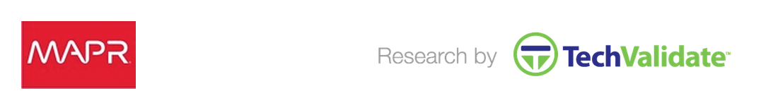
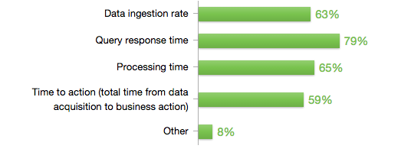

Which of the following are important factors for real-time Hadoop requirements?
Real time is required everywhere
Notes:
Which of the following are important factors for real-time Hadoop requirements?
Real time is across the whole cycle

Slide 6
Legacy Business Platforms
Operational Applications
Analytical Applications
Relational Database
J2EE
AppServer
Message
Bus
Analytic Database
ETL Tool
BI Tool
Specialized Storage
Specialized Storage
  IT must integrate all the products
  Inability to operationalize the insight rapidly
  Can’t deal with high speed data ingestion and processing
  Scale up architecture leads to high cost
Notes:
Application development is particularly difficult when it comes to bridging operational and analytical applications..IT must provide integration, but there are inherent barriers to integrating data, barriers that result in delays, downtime, and prevent real-time operations

Slide 7
Historical
Immediate
Analytical Applications
Operational Applications
Analysts
Creating BI Reports and KPIs on Data Warehouse
Developers Creating Database and Event Based Applications
Complete Access to Real-time and
Historical Data in One Platform
Notes:
A converged data platform not only supports analytic applications with greater selection of data and operations including machine learning, and supporting operational applications with high speed and scale it supports the intersection of applications to integrate analytics with operations and impact business as it happens….
One major difference with these applications is that they aren’t database applications, or file applications. Developers are free to use whatever is the best operation side by side...

Slide 8


Altitude Digital
Notes:
Companies are impacting their topline like Altitude Digital, one of the fastest growing video advertising marketplaces, with nearly seven billion transactions per day. Altitude Digital selects in real time the best video advertisement to play at the right time for the right person.

Slide 9


Event Driven Heath Care
Notes:
Baptist Healthcare is a $2B hospital chain headquartered in Florida. They are deploying an event-drven platform that could handle real-time patient data, medical history and improve patient care

Slide 10

Yield Management Optimization
Global
Semi-conductor
Company
Notes:
Companies are reducing costs like the Global semi-conductor manufacturer that is improving yield management by leveraging real-time machine sensors for vibrations, heat, etc. They are determining quality problems and correcting issues must faster with this real-time analysis.

Slide 11


National Oilwell Varco (NOV)
Notes:
National Oilwell Varco is a $23B multinational company based in Houston and is a leading worldwide provider of oil equipment, components and services.
NOV is using our platform to perform real-time analysis to optimize Oil and Gas drilling and production"

Slide 12

American Express
Managing Risk/Fraud
  Fraud protection on $1 trillion
  Decisions made in less than 2 milliseconds
Notes:
Security and fraud is another rich area for real-time applications. American Express leverages big data to identify potential fraud when an American Express Card is used anywhere in the world. Their platform protects $1 trillion in charge volume every year. Making decisions in less than 2 milliseconds, it supports approval of charges at the point of sale, with the least amount of disruption to customers.

Slide 13

Data First Approach
Data first approach is independent of application
  Storage is independent of whether it is used for operations or analytics
Allows flexibility
Provides agility
Traditional approach requires specialized storage formats, ETL, separation

Slide 14

Traditional Applications Dictate Data
This slide is not conceptual.. Maybe the shape of a glass (rounded at bottom)
The top says application
The bottom layer is data
ETL process with arrow pointing at it
Specialized schema with arrow pointing
Security with arrow….
Application
Data
ETL process
Specialized schema
Security
Notes:
Traditionally we’ve taken an application first approach.
You start with the application and determine what are the data requirements. Then you prepare the data into specialized schemas, or cubes to serve the application. The keys to success are understanding all the requirements so you can have the right data model. Extract Transform and Get the data loaded…..

Slide 15

Applications Dictate Data – Results in Silos
Notes:
This results in application silos…According to Gartner the major data management issue facing organizations is the proliferation of data silos….with the typical organization having to deal with hundreds of separate data silos.
Advances in technology….

Slide 16
Convergence

Slide 17
Before
Converged
Data
Analytics
Operations
Analytics
Data
Operations
Data
Complex
Slow
Multiple versions of the truth
Difficult governance
High TCO
Real-time data to action
For e-tailing, IOT, real-time fraud
Single data copy
Easy governance
Low TCO – scales horizontally
HTAP (Hybrid Transaction/Analytical Processing – Gartner Group 2015

Slide 18


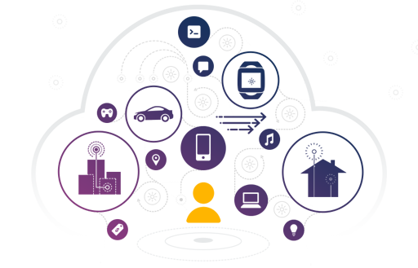


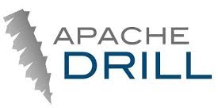

Open Source Analytics
(Hadoop, Spark)
Apps
Sources
Streaming Cluster
(TIBCO, IBM, Kafka)
Operational Cluster
(HBase, Cassandra)
Batch Loads
Enterprise
Storage
(system of record)
Streaming
Real-time
Notes:
Contrast this with the situation presented with all other approaches. You have data duplication, more management tasks to coordinate the flow, more latency as data is staged and transferred between systems and much more data risk as there are lack of reliability, protection and DR capabilities across these solutions.

Slide 19





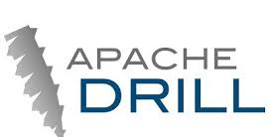















Newer Technologies and Patchwork of Data Silos
Apps
Data Architecture Optimization
Customer Experience
Security Investigation &
Event Management
Operational Intelligence
Managed Services & Custom Apps
Processing
Streaming
Batch
SQL
Data
MapR Converged Data Platform
Notes:
A converged platform provides an underlying data layer that replaces the patchwork of independent data silos. This layer supports all of the broad open source projects that provide a rich diversity of processing options, but it also integrates more generally across enterprise apps that require file, table, or stream access.

Slide 20






Design Goal: Common Data Services for All Applications
Apps
Data Architecture Optimization
Customer Experience
Security Investigation &
Event Management
Operational Intelligence
Managed Services & Custom Apps
MapR Converged Big Data Platform
Converged platform with the power of Hadoop, NoSQL database,
SQL, streaming, and Web-scale storage
Processing
Streaming
Batch
SQL
Data
MapR Converged Data Platform
MapR Converged Data Platform
Files
Tables
Documents
Streams
Enterprise HA/DR
Security
Real-time
Multi-tenancy
Multi-Datacenter
Management & Monitoring
Notes:
MapR uniquely provides a converged data platform which provide enterprise class performance, HA, DR, security, and real-time for mission critical apps as well as the multi-tenancy and cross data center capabilities required for large deployments.
.

Slide 21

Dimensions of Convergence
Data at Rest
Data in Motion
Open Source
Patented Innovations
Legacy
Next Generation
Batch
Real Time
Notes:
Data in Motion Data at Rest
Open source patented
Legacy Next Gen
Batch Realtime

Slide 22

The Power of Application Convergence
Applications on a Single Cluster
1
2-5
6-10
11-50
50+
Faster
time to value
Quicker
innovation
Easier
administration
4%
33%
22%
22%
18%
April 2015, MapR customers
Notes:
We’re already seeing leading companies move in this direction. In a study conducted by TechValidate they found that 18% of MapR customers in production had 50 or more applications running on a single cluster.
The fast organic growth of these different uses is a testament to a mature platform. The multi-tenancy features, security, workload management, and more….reduces the friction and delays associated with deploying new applications. And the benefits in terms of speed, efficiency and business impact are difficult to over estimate…

Slide 23

Convergence Simplifies Data Flows
Notes:
So what is the right approach.?
Start with the data… The promise of big data is to gather information into a centralized hub or data lake. And bring processing to it.

Slide 24
Event-Based Data Flows

Slide 25







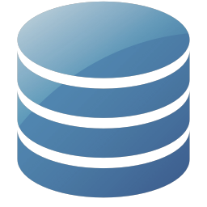

Big Data is Generated One Event at a Time
“time” : “6:01.103”,
“event” : “RETWEET”,
“location” :
“lat” : 40.712784,
“lon” : -74.005941
“time: “5:04.120”,
“severity” : “CRITICAL”,
“msg” : “Service down”
“card_num” : 1234, “merchant” : ”Apple”, “amount” : 50
Notes:
In fact we have a tendency to talk about Big Data when it is at rest and marvel at it’s volume and variety and forget that it was typically created one event at a time. Whether that’s social/mobile interaction, machine generated data, or transactions.
Harnessing these data flows and understanding the meaning and context are key building blocks for applications

Slide 26

Event-based Data Flows
etc…
web events
machine sensors
Mobile events
Biometrics
Notes:
The Second Key is event-based data flows
Examples of data flow…web events, machine sensors, biometric data etc…… Operational agility requires flowing data to be quickly analyzed and understood in context. Context that could benefit from understanding long term trends and patterns as well as leverage newly arriving data.
Data in motion is not fundamentally different from data at rest.

Slide 27

Event-based Data Drives Applications
Supply Chain Optimization
Ad optimization
Web
Personalized Offers
Failure
Alerts
Real-time Fraud Detection
Real-time application & network monitoring
Trending now
Notes:
Event based data drives applications.. Whether it’s collecting machine sensors to predict and prevent failures, or providing key offers to customers, or identifying and preventing fraud before it happens. All these use cases are enabled by event based data flows and a converged platform.

Slide 28

What’s a Stream again?
Events
Producers
Events_Topic
Consumers
A stream is an unbounded sequence of events carried from a set of producers to a set of consumers.
Producers and consumers don’t have to be aware of each other, instead they participate in shared topics. This is called publish/subscribe.
Notes:
What’s a Stream? Series of unbounded sequence of events carried from a set of producers to a set of consumers. The don’t have to be aware of each other they participate in shared topics.

Slide 29
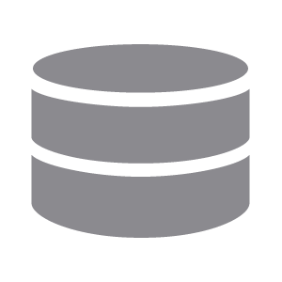







Examples of Producers & Consumers
Social Platforms
Sensors
Alerting Systems
Databases & Search Engines
Servers
(Logs, Metrics)
Mobile Apps
Stream Processing Frameworks
Dashboards
Other Apps & Microservices
Other Apps & Microservices
Notes:
Examples of producers include sensors, apps, servers, social platforms, even micro events themselves.
Consumers – alerting systems, databases, dashboards, or other apps and microservices

Slide 30


Streams vs Queues
Events are delivered in the order they are received, like a queue.
Unlike with a queue, events are persisted even after they’re delivered.
Notes:
There’s a difference between a stream and a queue.
Events are delivered in the order they are received like a queue. But unlike a queue events are persisted even after they’re delivered.

Slide 31


Streams Simplify Data Integration Pipelines
Batch Load
Batch Load
Filter
Aggregate by Minute
Join
Buffer & Save Hourly Files
Aggregate by minute
Join
Analytics & BI
Notes:
Streams can simplify data integration pipeline with a consumer filtering many producers topics aggregating and then joining the consolidated data.

Slide 32

Streams Enable Real-time Processing
Location analytics
Trending now
News feed
Ops dashboards
Failure alerts
Breach detection
Real-time fraud detection
Real-time offers
Push notifications
Notes:
Streams enable a range of real-time processing – from customer features and applications built around trending now, news feeds, location analytics to administrator applications that rely on…ops dashboards.. Breach detection...etc. to operational analytics that add intelligence to the business function – real-time fraud detecion, offers etc.

Slide 33
Producing & Consuming is Easy
producer = new KafkaProducer<>();
ProducerRecord<> event =
new ProducerRecord<>(“/MyStream:MyTopic”, “MyEvent”);
producer.send(event)
consumer = new KafkaConsumer<>();
consumer.subscribe(“/MyStream:MyTopic”);
while(true) {
ConsumerRecords<> events = consumer.poll(1000);
Iterator<> newEvents = records.iterator();
while(newEvents.hasNext()) {
System.out.println(newEvents.next().toString());
}
}
/MyStream:MyTopic
Notes:
No direct linking…read on available...

Slide 34
Flexible Communication Modes
P
P
P
Orders
Clicks
C
Consumer Group
C
C
C
One to One
Many to Many
Notes:
Bi Directional?

Slide 35
ANATOMY OF A TOPIC
Logical View
Topics are logs
Producers write to the head of the log
Partition 1
Consumers read at their own pace, each with a cursor
P
C1
C2
Partitions used for load balancing
P
C2b
Producers split events based on key
Partition N
Consumers belonging to same group divide partitions
Notes:
Security at stream level….ACEs on Streams....Finegrained by Topic?
Security slide on Streams...

Slide 36

Streams Enable Event-based Microservices
Sessionizer
Converted?
Clicks
Sessions
Conversions
Notes:
Finally streams enable event-based microservices…

Slide 37
Data First Development

Slide 38
How Are Microservices Used
Microservices that leverage file, database, and streaming services are more powerful and agile than a monolithic approach
A complex series of microservices can also be orchestrated with an underlying publish-and-subscribe framework
Integration data-in-motion and data-at-rest supports continuous and low latency processing.
Deep insights from accumulated data informs the rapid response to the latest events

Slide 39

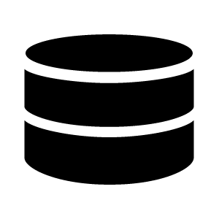

Microservices Leverage Databases/Files/Streams
Immediate access to operational (current) and analytical (historical) data in MapR
…
Microservices
Microservices
Microservices
…
Stream
Stream
Databases/files
Databases/files
Databases/files
MapR Converged Data Platform

Slide 40
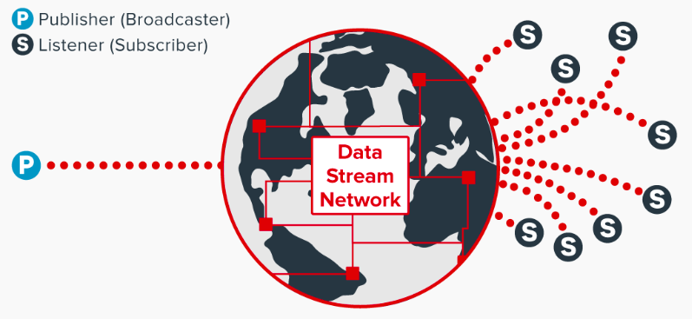
Converged Data Platform Support for Microservices
Bridge the gap between production and analytic environments
Drive automation, intelligence, and rapid response to better impact business as it happens.
Overcomes difficulty of data services:
  How it is shared, managed, protected, and delivered is a major constraint
  Data dependency for the successful creation and deployment of applications, particularly real-time and mission-critical applications.

Slide 41
Microservice Support Details
Integrated publish-and-subscribe framework to support event-driven applications.
  Ultra scale, low latency, utility grade reliable messaging system as foundation of microservice at the application level
  Combines global messaging service with processing services in the same physical nodes for greater efficiency and simplicity than alternative architectures
  Support for hybrid cloud microservices architectures with global message service, global data namespace, and service scale out capabilities.

Slide 42
Microservices Architecture
Processing
Services
Message Broker
Message Broker
Processing
Services
Notes:
Converged microservices – animation with message broker

Slide 43
Microservices Architecture
Streaming Data
Platform
Processing
Platform
Message Broker
Processing
Platform
Notes:
Until now, the architecture of a microservices application would rely on the use of multiple disparate platform for supporting the different processing and message passing services. These different platforms would often correspond to physically separate clusters. So messages traveling between services would have to hop between platforms or cluster, adding latency and complexity.

Slide 44
Converged Microservices Architecture
Converged
Message
And
Processing
Services
MapR Converged Data Platform
Notes:
Converged microservices

Slide 45
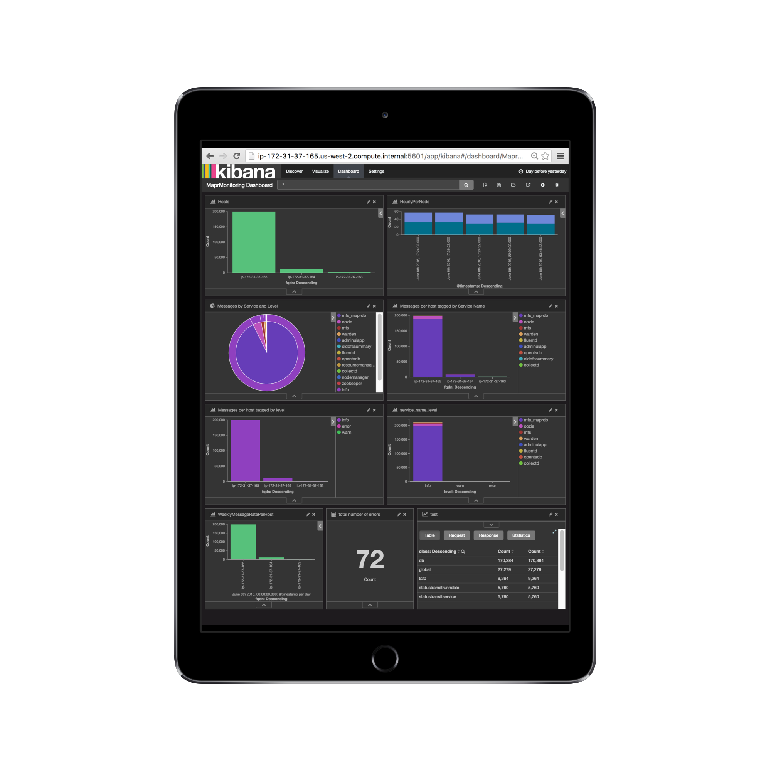
Microservice Support Details
Simplified Microservices Monitoring and Management
  Comprehensive monitoring of resource usage for a single pane of glass view
  Microservices specific volumes for application versioning, simplifying the development lifecycle and production deployment
  Support for containerized applications especially in Docker provide utilization and agility advantages
  Continuous high availability and distributed multi-data disaster recovery capabilities
  Unified security with access control expressions for stream access and analytics

Slide 46
Microservice Support Details
Support for Agile Microservices Application Development and Evolution
  Enterprise-grade messaging supports sharing data while maintaining logical and functional isolation of services. Ideal for machine learning model training and evaluation
  Natural infrastructure for service modification without disrupting production workflows
  Freedom for developers to combine file, database, document, and streaming analytics functionality

Slide 47
Microservices on Converged Data Platform
Immediate access to all operational and analytical data
  Integrated database, file, and streams access
  No unnecessary data silos that require data movement
  Unified administration/security for all big data
Data versioning to measure application enhancements
Single line of code to retrieve or persist data (as JSON)
Easy scale out and global replication
Extensible monitoring for complete visibility on cluster operations

Slide 48
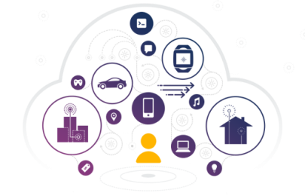
Versioning & A/B Testing
80%
A
10%
B
10%
C

Slide 49

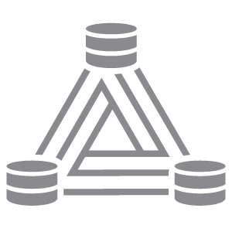
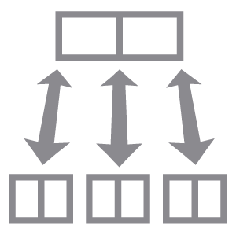

Converged Application Benefits
Consumers scale horizontally with partitions
  1:1 mapping between consumer and partition
  Enables predictable scaling as production needs grow
Data can be seamlessly replicated to another cluster
  Enables HA with zero code changes
Data is indexed dynamically according to receivers, senders
  Scales beyond the capabilities of Kafka
Snapshots can be taken to capture state
  Enables faster testing and deployment of applications
Notes:
blueprint for converged applications
event driven microservices

Slide 50
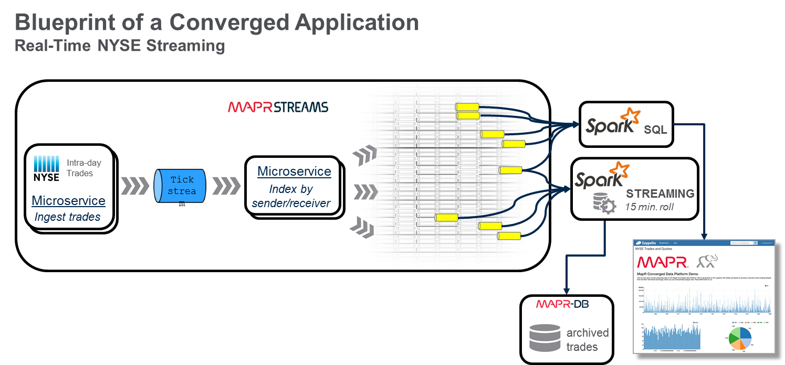

Slide 51
Converged Application Blueprint Details
Convergence of databases, files, and streams
Download location and specifics
  mapr.com/appblueprint
  Example application(s) with source,
  available for commercial use
  Architecture guides, including for
  microservices
  MapR-shared expertise
  Community-supported best practices
  (more to come)

Slide 52
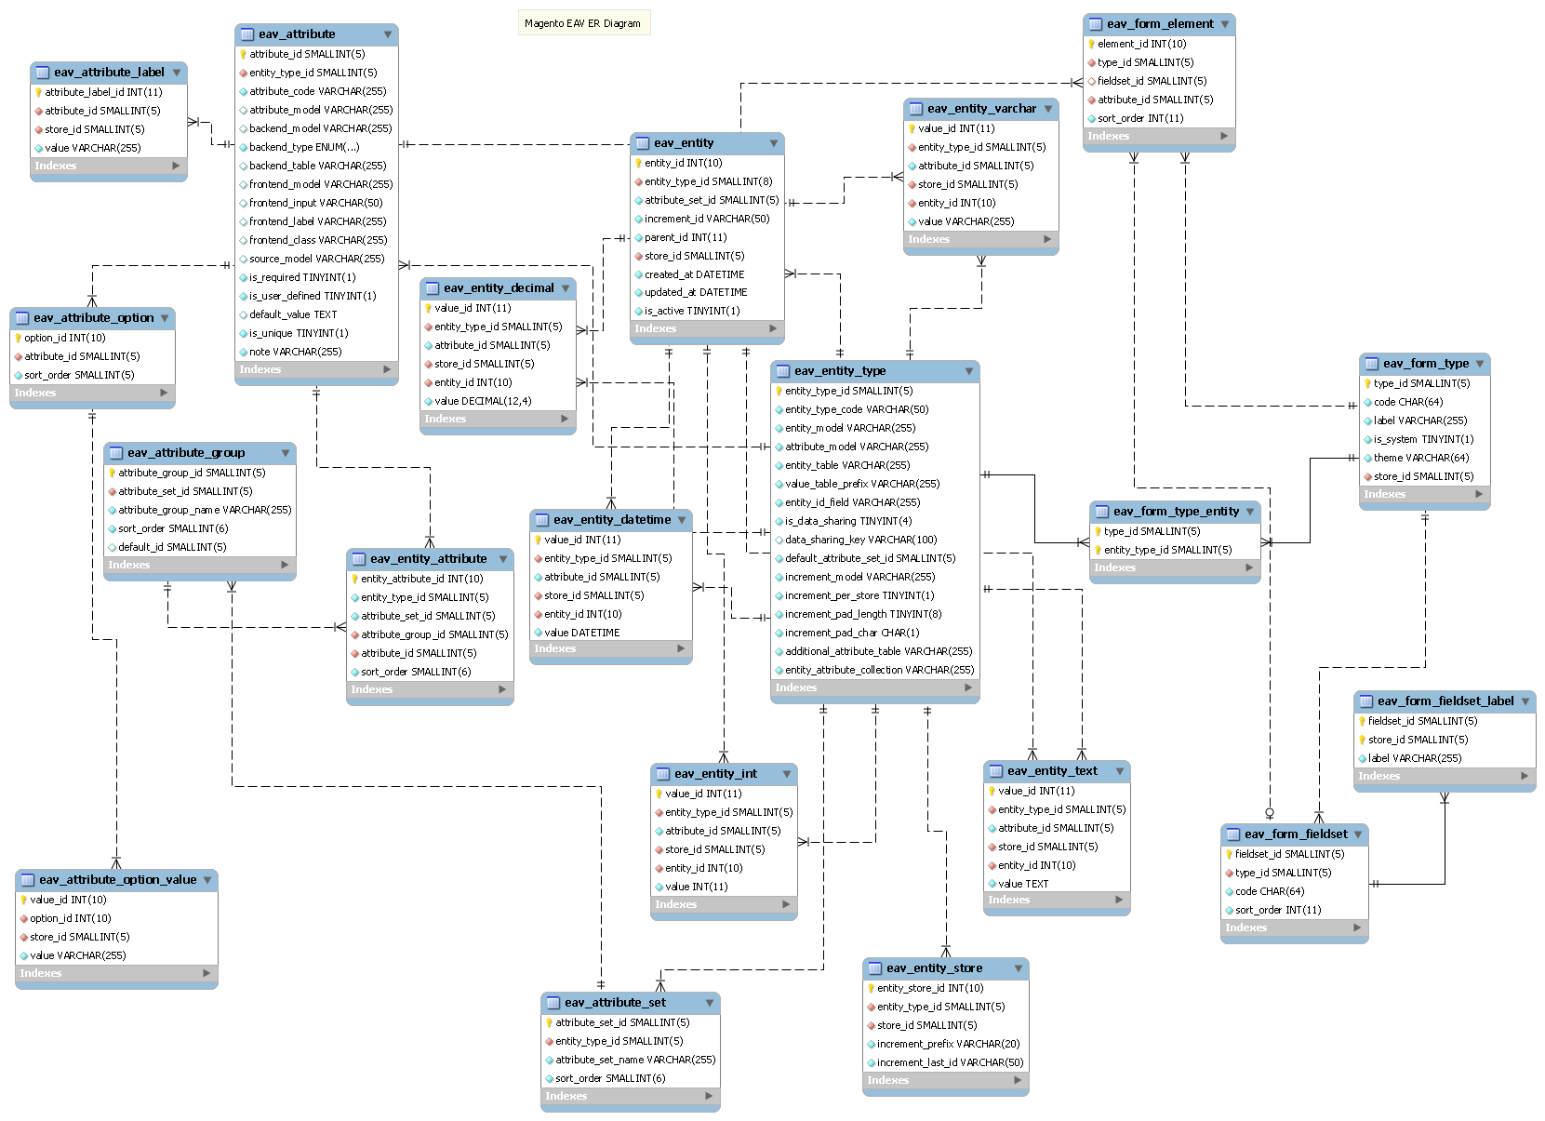
Product Catalog - RDBMS
SELECT * FROM (
SELECT
ce.sku,
ea.attribute_id,
ea.attribute_code,
CASE ea.backend_type
WHEN 'varchar' THEN ce_varchar.value
WHEN 'int' THEN ce_int.value
WHEN 'text' THEN ce_text.value
WHEN 'decimal' THEN ce_decimal.value
WHEN 'datetime' THEN ce_datetime.value
ELSE ea.backend_type
END AS value,
ea.is_required AS required
FROM catalog_product_entity AS ce
LEFT JOIN eav_attribute AS ea
ON ce.entity_type_id = ea.entity_type_id
LEFT JOIN catalog_product_entity_varchar AS ce_varchar
ON ce.entity_id = ce_varchar.entity_id
AND ea.attribute_id = ce_varchar.attribute_id
AND ea.backend_type = 'varchar'
LEFT JOIN catalog_product_entity_text AS ce_text
ON ce.entity_id = ce_text.entity_id
AND ea.attribute_id = ce_text.attribute_id
AND ea.backend_type = 'text'
LEFT JOIN catalog_product_entity_decimal AS ce_decimal
ON ce.entity_id = ce_decimal.entity_id
AND ea.attribute_id = ce_decimal.attribute_id
AND ea.backend_type = 'decimal'
LEFT JOIN catalog_product_entity_datetime AS ce_datetime
ON ce.entity_id = ce_datetime.entity_id
AND ea.attribute_id = ce_datetime.attribute_id
AND ea.backend_type = 'datetime'
WHERE ce.sku = ‘rp-prod132546’
) AS tab
WHERE tab.value != ’’;
“Entity Attribute Value” pattern
To get a single product
Notes:
The data is an important factor in operational agility. Let me give you example, say you are developing a product catalog for a web application. …
An application like this has to deal with a range of attributes that are unique to specific products.
how you describe a “ a bike”, a pedal, a jersey is very different..
One possible design in RDBMS is to use a EAV pattern, that gives flexibility, but each time you want to access a product (or create, update, delete…) you must create a complex query… in this example a 36 line query to get a single product.
It’s hard to write, maintain, and may have performance issues at scale

Slide 53
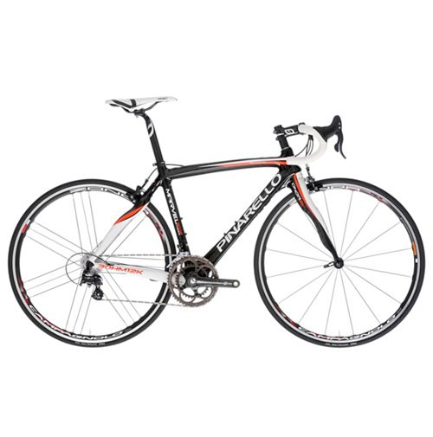


Agility for Developers with Native JSON
{
"_id" : "rp-prod132546",
"name" : "Marvel T2 Athena”,
"brand" : "Pinarello",
"category" : "bike",
"type" : "Road Bike”,
"price" : 2949.99,
"size" : "55cm",
"wheel_size" : "700c",
"frameset" : {
"frame" : "Carbon Toryaca",
"fork" : "Onda 2V C"
},
"groupset" : {
"chainset" : "Camp. Athena 50/34",
"brake" : "Camp."
},
"wheelset" : {
"wheels" : "Camp. Zonda",
"tyres" : "Vittoria Pro"
}
}
{
"_id" : "rp-prod106702",
"name" : " Ultegra SPD-SL 6800”,
"brand" : "Shimano",
"category" : "pedals",
"type" : "Components,
"price" : 112.99,
"features" : [
"Low profile design increases ...",
"Supplied with floating SH11 cleats",
"Weight: 260g (pair)"
]
}
{
"_id" : "rp-prod113104",
"name" : "Bianchi Pride Jersey SS15”,
"brand" : "Nalini",
"category" : "Jersey",
"type" : "Clothing,
"price" : 76.99,
"features" : [
"100% Polyester",
"3/4 hidden zip",
"3 rear pocket"
],
"color" : "black"
}
bike
pedal
jersey
Notes:
JSON documents have been embraced for their lightweight data interchange advantages.
Each individual document is a “self-describing document” that has specific attributes with embedded schema.. You have different details within each document. A document for a bike looks much different than on for a pedal or a jersey.

Slide 54
The Power of Application Convergence
{
"_id" : "rp-prod132546",
"name" : "Marvel T2 Athena”,
"brand" : "Pinarello",
"category" : "bike",
"type" : "Road Bike”,
"price" : 2949.99,
"size" : "55cm",
"wheel_size" : "700c",
"frameset" : {
"frame" : "Carbon Toryaca",
"fork" : "Onda 2V C"
},
"groupset" : {
"chainset" : "Camp. Athena 50/34",
"brake" : "Camp."
},
"wheelset" : {
"wheels" : "Camp. Zonda",
"tyres" : "Vittoria Pro"
}
}
products
.findById(“rp-prod132546”)
Store the product “as a business object”
To get a single product
Notes:
To get a single product requires a simple statement.
This is why JSON Documents have emerged as the defacto standard data interchange format for web applications.

Slide 55
Wrap Up
Real-time in context of the business
Convergence is key
The Importance of Event-based Dataflows
Microservices Drive Productivity
Data Interchange Formats

Slide 56


Free On-Demand Training
Hadoop, Spark, other Big Data Courseware
Separate tracks for
  Administrators
  Analysts
  Developers

Slide 57


Where Should I Start With Big Data?
Quick Start Solutions: Speeding Time-to-Value
Data Warehouse Optimization
and Analytics
Solution
Template
Real-Time Security Log Analytics
Recommendation Engine
Deployment
Architecture
Time Series Analytics
Knowledge
Transfer
Genome Sequencing
Notes:
Clearly state the value of this to the client – what does this bundle given them … turn-key up and running quickly …
Gives us a “toe in the water” offering for finding your first project
Let us help you take complexity of Hadoop and big data off the table.
Lost cost entry points that bring high value

Slide 58





Q & A
@norrisjack
maprtech
mapr-technologies
MapR
jnorris@mapr.com
maprtech

Slide 59
Backup

Slide 60
The Growing Complexity of Big Data Environments
Apps
Data Architecture Optimization
Customer Experience
Security Investigation &
Event Management
Operational Intelligence
Managed Services & Custom Apps
Hadoop & Spark cluster
Cassandra for event or content logging
Message middleware
Search
server
Classic data warehouse
Application
server
Document JSON DB
Notes:
Hadoop enables organizations to collect data into a centralized data lake. But the growing complexity of big data is resulting in the dividing of data into separate clusters. A separate cluster to handle ingestion, streaming analytics, database operations, and long term storage.
So when it’s time to get real there are 2 Key Areas to Focus upon…. Number 1 is Convergence…

