Slide 1
Running micro service environments is no free lunch
Dynatrace – Alois Mayr
B2W digital – Alexander Ramos

Slide 2
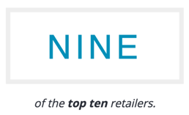
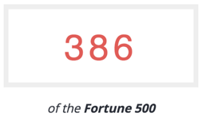
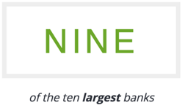
Notes:
We have a lot customers running classical monolith apps – on Java, .NET, PHP – yes even on the mainframe

Slide 3
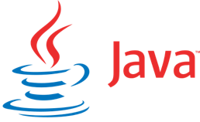
Enterprises often still run traditional monolithic applications
Notes:
We have a lot customers running classical monolith apps – on Java, .NET, PHP – yes even on the mainframe

Slide 4
Deliver value at the speed of business
 |  | 700 deployments / YEAR
 |  | 10 + deployments / DAY
 |  | 50 – 60 deployments / DAY
 |  | Every 11.6 SECONDS
Notes:
We see the need at most of them to change to a more rapid deployment model – just as we have heard over the years from companies like cars, etsy, amazon, …
Several companies changed their way they develop and deploy software over the years. Here are some examples (numbers from 2011 – 2014)
Cars: from 2 deployments to 700
Flicks: 10+ per Day
Etsy: lets every new employee on their first day of employment make a code change and push it through the pipeline in production: THAT’S the right approach towards required culture change
Amazon: every 11.6s
Remember: these are very small changes – which is also a key goal of continuous delivery. The smaller the change the easier it is to deploy, the less risk it has, the easier it is to test and the easier is it to take it out in case it has a problem.

Slide 5
Not only fast delivered but also delivering fast
Response Time
Conversions
+100ms
-1%
-1000ms
+2%
-1000ms
+10%
Notes:
But it is not only about delivering features faster – it is also about delivering fast features!
These stats come from here: http://nft.atcyber.com/infographics/infographic-the-importance-of-web-performance-20140913

Slide 6
Not only technical metrics count…
Notes:
Not only technical metrics count but also business metrics

Slide 7
…but also business metrics

Slide 8
Notes:
Learn from the best?…. E.g. all the cloud scale companies we know and from the well-known stories at Netflix etc.

Slide 10
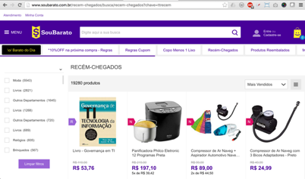
Biggest LatAm e-commerce company
R$ 10+ billion revenue (~ U$ 3 billion)
Americanas, Submarino
Shoptime, Soubarato
Rio de Janeiro and São Paulo, Brazil

Slide 11
Why are we doing micro services?

Slide 12
July 2014 The Night of Darkness

Slide 13
What exactly was broken?

Slide 14
We didn’t know fast enough
Something in the monolith!

Slide 15
Who’s involved in fixing it?
Ops had to act like heroes during incidents
Devs write bugfixes

Slide 16
What we have changed!

Slide 17
Notes:
Enterprises go new technologies.
Now lets hear from Alex – on their journey – where they started – where they struggled – where they are right now and where they are going

Slide 18
Change responsibilities!
Code business rules into micro services
Each dev team owns its micro services
You developed it, you operate it in production
Dev teams have on call rotation too
Ops keep the platform, the databases, and facilities (logging, authorization, etc)

Slide 19
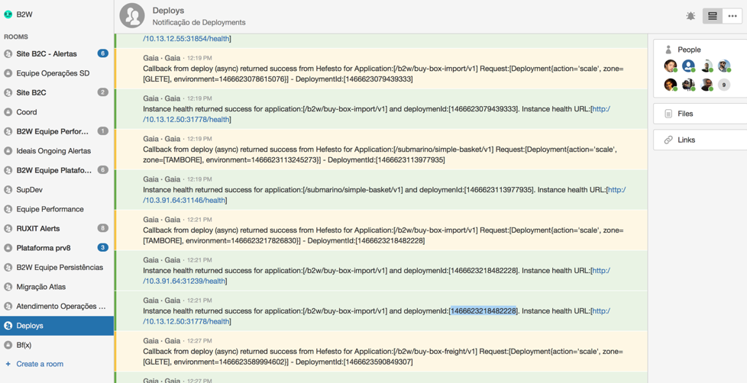
Change communication!
Unified chat room and alerting system
Transparency is key
More and Faster deployments (~50/day)
Notes:
everyone knows what has been deployed, when it will be deployed and every major incident

Slide 20
How we did it?

Slide 21
Empower your developers!
Devs need to be responsible for running services in production
Devs know the business domain
Devs know who should fix each service
Notes:
Dev teams know what, where and who fix a problem
Devs know where something is hanging/not working

Slide 22
From monolith to micro services
Monolith
Micro services
cart
freight
freight
cart
sku
inventory
inventory
sku

Slide 23
Dynatrace Ruxit service flow makes micro services visible

Slide 24
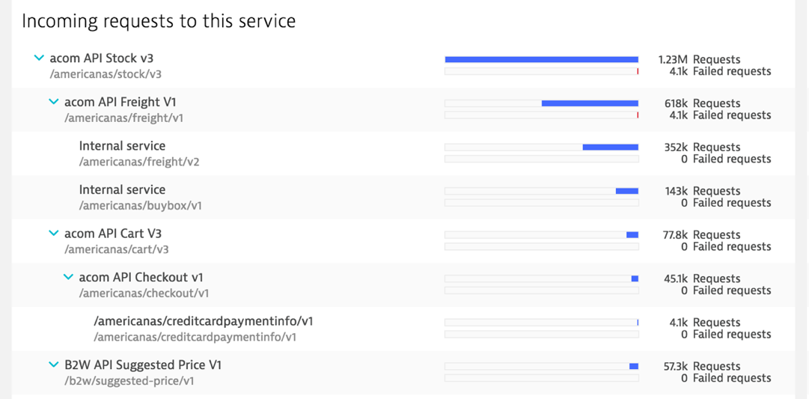
Dynatrace Ruxit service flow makes micro services visible

Slide 25
The Platform

Slide 26
One PaaS to run all micro services
CI / CD
Orchestration API
Marathon Framework
Run micro services
Auto-healing
Service discovery
Chronos Framework
Run batch jobs
Retry
Apache Mesos
server
server
server
server
server
server
server
server
server
server
server
server
Notes:
Where should we run it?
We don’t care. Let Mesos and Marathon distribute the workload.
What about batch jobs and crons?
Chronos does the job.
Just be sure to dockerize your batch job.

Slide 27
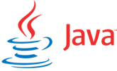
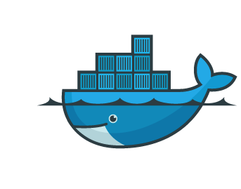
Which technology a micro service is built?
We don’t care!
Notes:
We don’t care.
Just dockerize it. And run it on the platform.

Slide 28
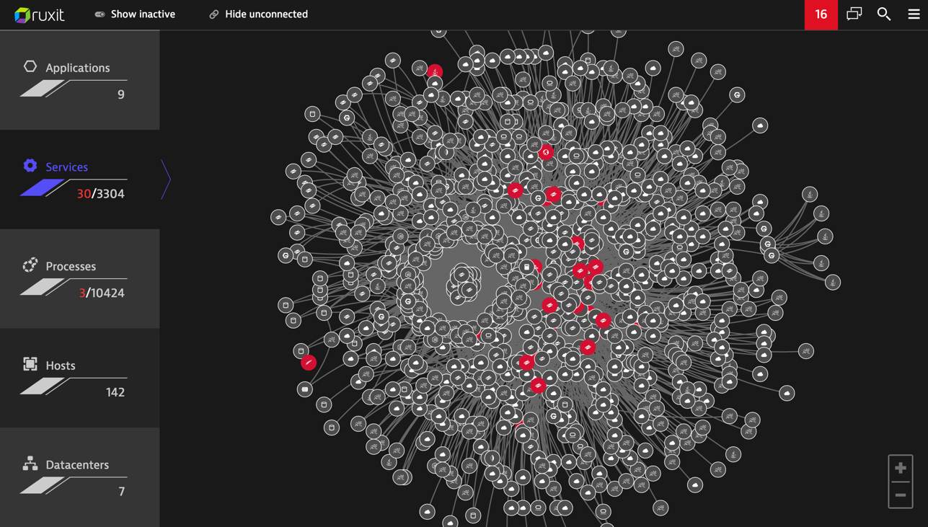

Slide 29
What have we learned?

Slide 30
#1 – From monolith to bad app
First services didn’t scale well
It’s all about resource sharing
File descriptors
Connection pools
Docker image sizes
If it needs local state, it is a bug

Slide 31
#2 – Legacy systems
Most of your bad apps are legacy systems
We keep legacy systems aside from Mesos
Do Ops teams own legacy systems?
99.99% of the time the answer is yes
So, don’t mess with them
Write as many monitors as possible
Ops team should invest some time in auto remediation
Don’t treat legacy systems like micro services

Slide 32
#3 – Multi datacenter PaaS
Datacenter A
Datacenter B
CI / CD
Orchestration API
Marathon Framework
Chronos Framework
Marathon Framework
Chronos Framework
(failover)
Apache Mesos
Apache Mesos
Don’t put all your eggs in one basket
server
server
server
server
server
server
server
server
server
server
Notes:
One Mesos cluster per DC
CI/CD should know nothing about DC’s
The orchestration layer knows each Marathon/Chronos cluster
Chronos should be used in failover fashion

Slide 33
#4 – Seriously, you need an API Gateway
Filters wrong
HTTP Methods (415)
HTTP Caching
policy (304)
Throttling (503)
Request/response
transforming
Cart
Api gateway
Freight
Edge traffic
Edge balancer
Api gateway
Sku
Api gateway
Inventory
Build micro service architecture with API Gateway
Notes:
Seriously, you need it!
Simplifies micro services development
Improved security (authentication, authorization goes here)
Protect your apps against bad requests
Throttling
Turns service discovery a little more complicated

Slide 34
#5 – Databases
Flexibility is overrated when talking about databases
Databases need state and overcommit
Keep your database clusters isolated per application
Right tool for the right problem (don’t throw everything on relational DB or on MongoDB)
Run databases out of Mesos cluster. It is not that hard
Manage state isolated on the PaaS

Slide 35
#6 – DevOps? Dev and Ops need to work closely together
Ops own the platform but not the services running on it
As long as Ops simplify Devs workflows, the job is good enough
If Devs don’t like what Ops are doing, Ops are doing it wrong
The platform’s sole purpose is to turn Devs life easier
Devs are the stars of the show
Devs should think like Ops and Ops should think like Devs
Notes:
New databases: should I hire specialists?
Data visualization (big data, or whatever) deserves a separate operation
Ops should always help dev decide what is the appropriate architectural pattern for any given situation

Slide 36
Black Friday?

Slide 37
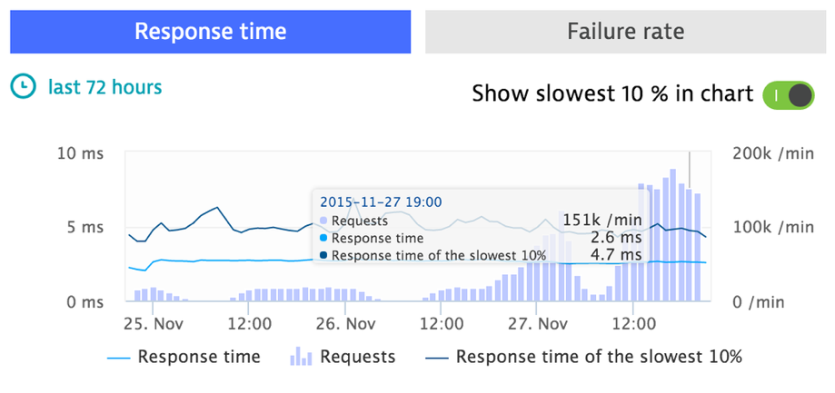
We survived Black Friday

Slide 38
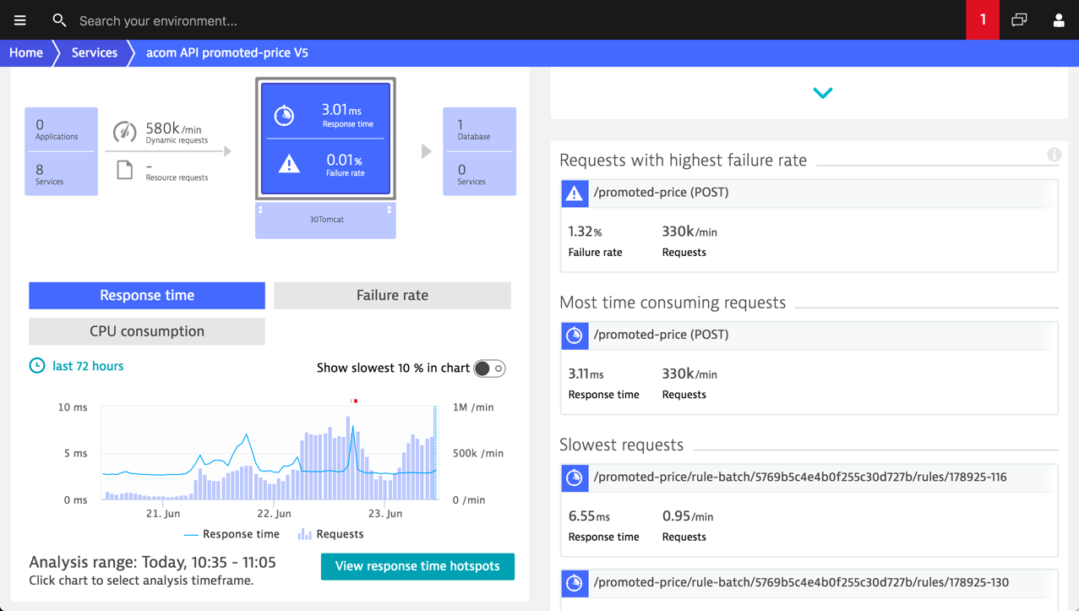

Slide 39
Thanks!
Questions?

