Slide 1
Monitoring the Microsoft Cloud The Geneva Monitoring System
Gabe Wishnie
(on behalf of the Geneva Monitoring Team)

Slide 2
Agenda
Brief intro to Geneva Monitoring System
Deep(er) dive into Geneva Metrics System (a.k.a. MDM)
Questions

Slide 3
Geneva Data Classification
Multi-Dimensional-Metric (MDM) & Health Service
Hot Path (TTD<60s)
Alerts
HOT PATH
ETW
Diagnostics Apps (< 5 min)
Monitoring Agent(MA)
Distributing Tracing
Diagnostics Compute Layer
Top N Error Service
API
Log Search/Indexing
f()
WARM PATH
Warm Path
Data Publish
External data
Data Collector and Scrubber
SQL Azure
Cold Path
COSMOS
COLD PATH
SQL

Slide 4
Wait, But I Really Want...
Hot Path, Warm Path, Cold Path

Slide 5
Scale Is Different For Everyone
Millions of clients producing data
Over 2 billion metrics received and aggregated per minute – after client aggregation!
Over 500 million unique time series aggregated per minute
Over 5 petabytes of logs ingested per day
Over 5 million metric requests per minute (dashboards/views and API)
Over 6 million alert combinations processed per minute
99% metric queries completed in <= 500ms

Slide 6
Focusing On Multidimensional Metrics (Geneva MDM)
A metric is a point-in-time measure of an activity occurring or entity state within a system
Examples:
TransactionProcessed, ResponseLatency, QueryReceived, QueueDepth
Dimensionality captures meta data about an activity or measure
Examples:
Locale, Market, Workflow, Flight, DataCenter
Metric aggregation is compression with statistical insight over time and the population
Request Latency is 867ms in market United States for Flight Alpha in datacenter Columbia.

Slide 7
(Some Of) The Hard Problems
Scale and data explosion
Data quality guarantees or lack thereof?
Contextual metadata
Expensive aggregation types
Crippled but available when under duress
Multitenancy (will not be covered)

Slide 8
Scale And Data Explosion
It doesn’t take a big service to generate a lot of metrics
100 metrics
10K users
5 regions
250 API calls
10 components
100 * 10000 * 5 * 250 * 10 = 12.5B different theoretical time series
Multiply by thousands of services

Slide 9
Scale And Data Explosion
A partitioned data funnel with client reduction
LatencyMs
{User:GabeW,
Region:WestUS,
Api:GetResponse,
Value:300}
Publishing Client
Publishing Client
Publishing Client
Publishing Client
Publishing Client
Publishing Client
Publishing Client
Aggregation
VIP
Frontend
Server
Frontend
Server
Frontend
Server
Frontend
Server
Frontend
Server
Micro Partitioned Batching/Aggregation
P1
P2
P3
Aggregator/Batcher
Aggregator/Batcher
Aggregator/Batcher
Partitioned Batching/Aggregation
P1
P2
P3
Store (Caching)
Store (Caching)
Store (Caching)
Store (Caching)
Store (Caching)
Aggregation/Data Durability & Paging
For query across multiple time series, double hashing is done first on metric name then full metric tuple

Slide 10
Scale And Data Explosion
Take advantage of the characteristics of time series metric data
Data is typically always moving forward in time
Delta-of-deltas encoding used for timestamps (T3-T2) - (T2-T1) -> 1 bit in most cases such as a minutely counter
Most metrics (modulo incidents) are relatively stable sample-over-sample
Delta encoding used for metric values (V1-V2) -> few bits depending on variance
Special case common scenarios
Many metrics are always 0 value – takes 1 bit only to store since sign is not needed
Many metrics may only emit one sample per period - do not store min/max since == sum
Long values are supported, most are much smaller
Fibonacci encoding used for metric delta values 1-bit for sign + Fib(Abs(∆))
Sum and Count encode to 5 bits for some data sets - 95% reduction - now multiple these savings by a billion active time series

Slide 11
Data Quality
Strict lossiness is the enemy of low latency
Avoid sustained outages – time marches on and so does client publication
Expect drops, capture it (and attempt to minimize it)
Publishing Client
Publishing Client
Publishing Client
Publishing Client
Publishing Client
Publishing Client
Publishing Client
VIP
Frontend
Server
Frontend
Server
Frontend
Server
Frontend
Server
Frontend
Server
Data can be sampled
Data can be dropped
Data can be throttled
Aggregator/Batcher
Aggregator/Batcher
Aggregator/Batcher
Store (Caching)
Store (Caching)
Store (Caching)
Store (Caching)
Store (Caching)

Slide 12
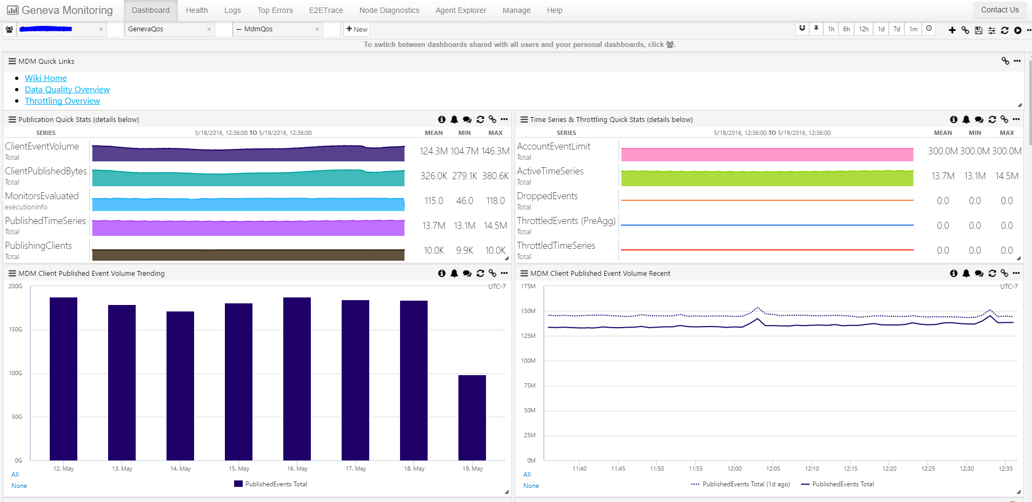
Data Quality

Slide 13
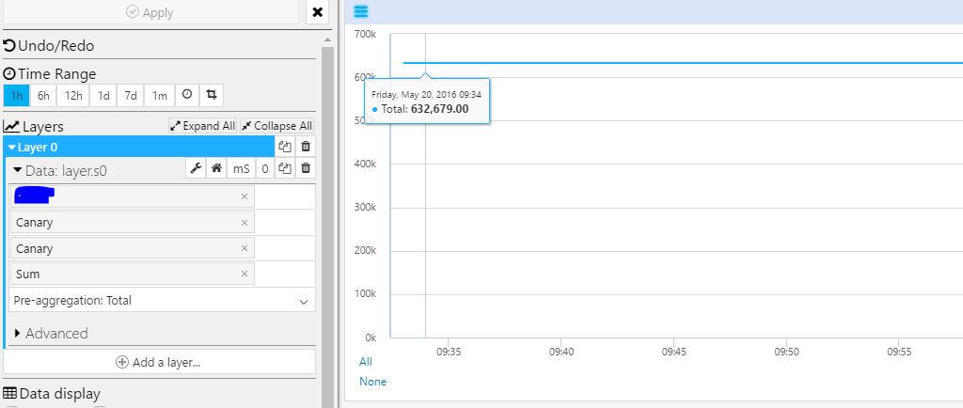
Data Quality
The mighty canary (a.k.a. heartbeat)
Used to get a steady state of active clients to an account
Measure E2E ingestion to understand latency at each layer

Slide 14
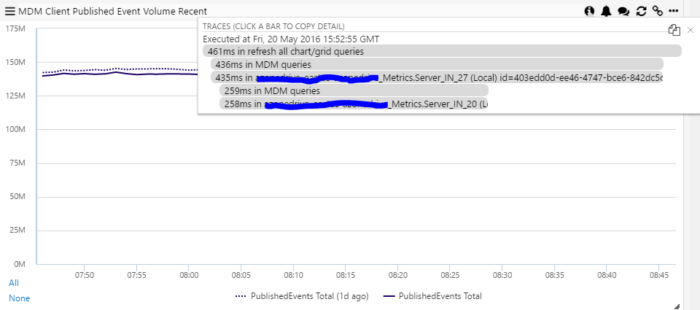
Data Quality
Same applies to query path

Slide 15
Contextual Metadata (a.k.a. Hinting)
When dimensions on a metric increases the sparseness of known combinations increases
Dimension values may only be generated for a period of time
Region
WestUS
EastUS
SouthCentralUS
CentralUS
EastUS2
VMID
{E2C914AA-33A0-44BF-A5F8-1568254E4ACB}
{A55FB923-1083-4AA5-9A77-0F34F280DC0A}
{316D98D8-8C03-409A-B6C0-3839ECF7E170}
{CFFC08A1-CB55-44C7-9E10-15F94E387256}
{A5DFE2F7-8D01-412D-808E-584771F7CD27}
{08274A3C-F7A0-4594-B3B5-09D8D9392F6C}
{A267B95E-C681-4CF0-9D00-7E33FD2D166D}
{B918EA85-6910-4FF8-96C9-5065B4F60A4C}
{9BA5CB05-73DA-43E7-8B01-DBF27DD01B2D}
{C47E5A84-973E-4CFA-B39C-87B0CA83E1C7}
{9923A171-DC3D-4B15-BC2F-2F7AC528712A}
{AEA776ED-D1A9-4C76-885F-E83B7DF5EFC2}
{D0A77F8B-9BCA-4ACD-BA4A-9CA7E690A6D7}
{6BC3ABBE-0697-455D-AD2C-440E78A80C51}

Slide 16
Contextual Metadata (a.k.a. Hinting)
Rather contextually filter based on previous selections (implies order matters)
Region
WestUS
EastUS
SouthCentralUS
CentralUS
EastUS2
VMID
{E2C914AA-33A0-44BF-A5F8-1568254E4ACB}
{08274A3C-F7A0-4594-B3B5-09D8D9392F6C}
{9923A171-DC3D-4B15-BC2F-2F7AC528712A}

Slide 17
Contextual Metadata (a.k.a. Hinting)
Partitioned, in-memory index of metric metadata
Aggregator/Batcher
Publish metadata
Hints
Hints
Hints
Hints
Query Service
Query metadata
Single metrics with 30M+ combinations
Over 360M+ combinations for single customer
Receive 2500+ requests/min for single customer

Slide 18
Finding The Needle In The Haystack
Humans cannot process millions of metrics
Show me the top/bottom N with a filter
Show me the top/bottom N with a filter but pivot to another metric
Alerts to identify problematic series
Utilize Service Fabric Actors
Frontend
Server
QueryCoordinator Actor
Based on query criteria get candidate series
and split into jobs to distribute
QueryWorker Actor1
QueryWorker Actor2
QueryWorker ActorN
Process assigned job and reduce based
on query criteria – provide reduced set back

Slide 19
Expensive Aggregation Types
Standard Sum/Min/Max/Count (Average/Rate) are relatively cheap to aggregate, store and query
Percentiles and distinct count are expensive to aggregate, store and query
Distinct count
HyperLogLog utilized to get statistical approximation
Sketch is constructed on client and merged throughout aggregation pipeline
Precompute common query window (i.e. 1m) for efficiency
Compute on the fly for arbitrary windows
Percentiles
True collection, user defined bin intervals and automatic binning of varying technique
Currently precompute common set (50th, 90th, etc) at 1m window
Adding support to maintain histogram for arbitrary %ile and window size

Slide 20
Available Under Duress
Big data is not new – many solutions exist for various scenarios
Monitoring systems are critical when the world is burning
Careful dependency evaluation and isolation
Do we use storage? What if it is down?
Do we use DNS? What if it is down?
Do we use SLB VIPs? What if it is down?
Do we use a ticketing service for auth? You get the picture…
Core services monitor themselves using Geneva – watch for circular dependencies and decide what functionality will go down with the ship and what will serve as the life boat
For us, it is MDM and watchdogs/runners

Slide 21
Where Might You Find MDM?
Initially targeted as internal monitoring solution and beginning to expand to our customers
Investing in serving as backend for Azure Insights metric pipeline
Application Insights utilizing for metric pipeline

Slide 22
We’re Hiring
Passionate about low latency big data problems?
Enjoy working on large distributed systems?
Want to enable monitoring of some of the largest services in the world?
Let’s talk!

Slide 23
Questions?

