Slide 1
Measuring Ad Blocker’s impact on
Site Performance
Karan Kumar
Technical Lead Performance Engineering
June 21, 2016

Slide 2
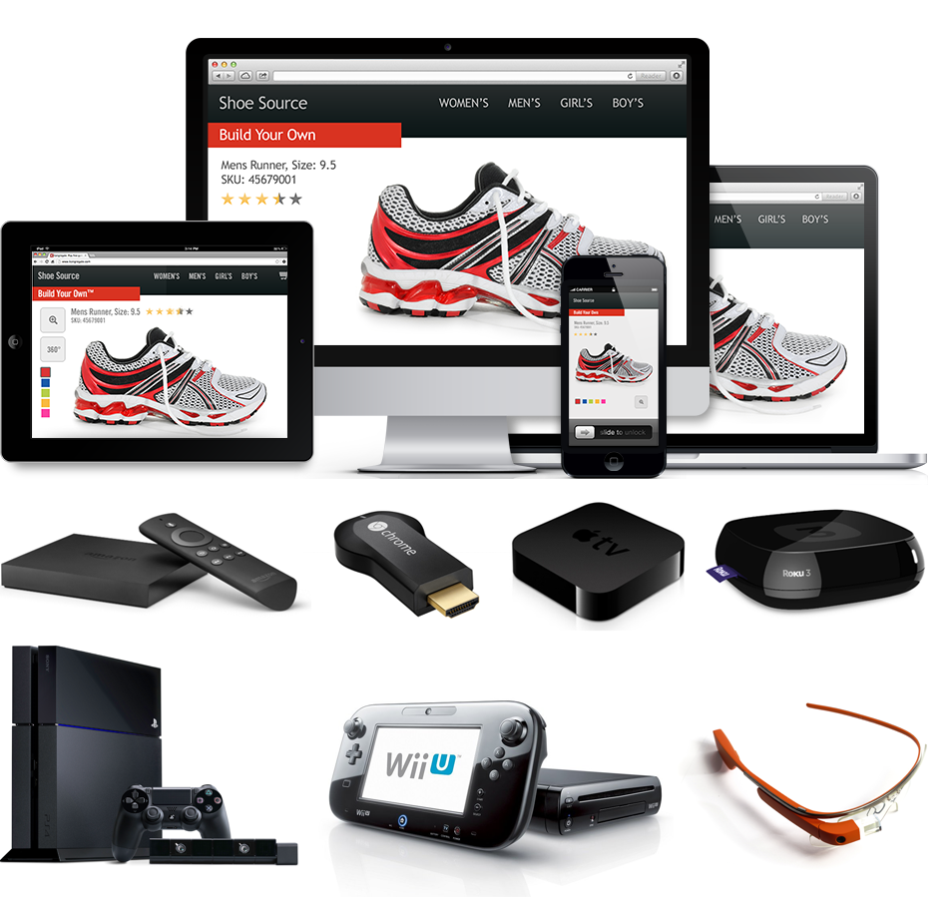
Web Performance
Latency (ms)
Devices
Format/capability diversity
Networks
Sophisticated Apps
Visual, personalized, complex
Notes:
User end point diversity
Webserver stack
Network
Application
----
Conversions
More and more of this complexity is moving towards the user end point and thus factors impacting application performance on user end point become important

Slide 3
Popular browser extensions
> 500 million downloads
> 200M + active users
100M + active users
Adblock Plus blog, 9th May 2016
http://i.imgur.com/IG8oVar.png
https://chrome.google.com/webstore/category/popular
Notes:
Source:
https://malwaretips.com/threads/22-billion-in-advertising-revenue-will-be-lost-through-adblockers.49452/

Slide 4
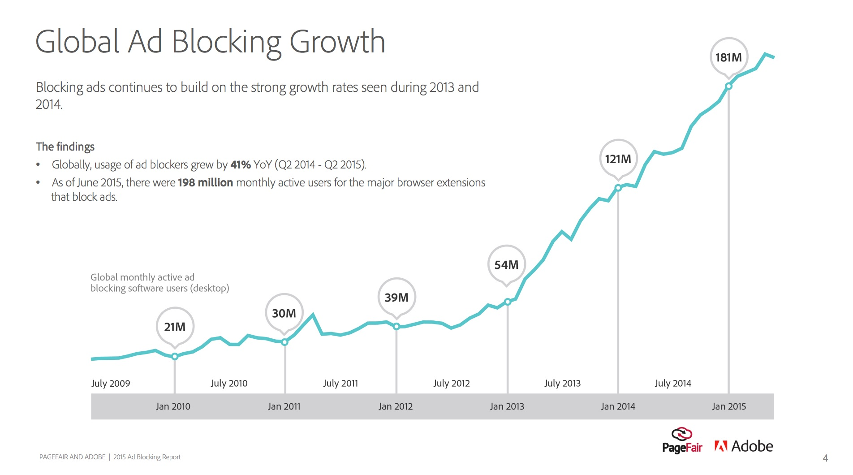
Source: https://downloads.pagefair.com/wp-content/uploads/2016/05/2015_report-the_cost_of_ad_blocking.pdf

Slide 5
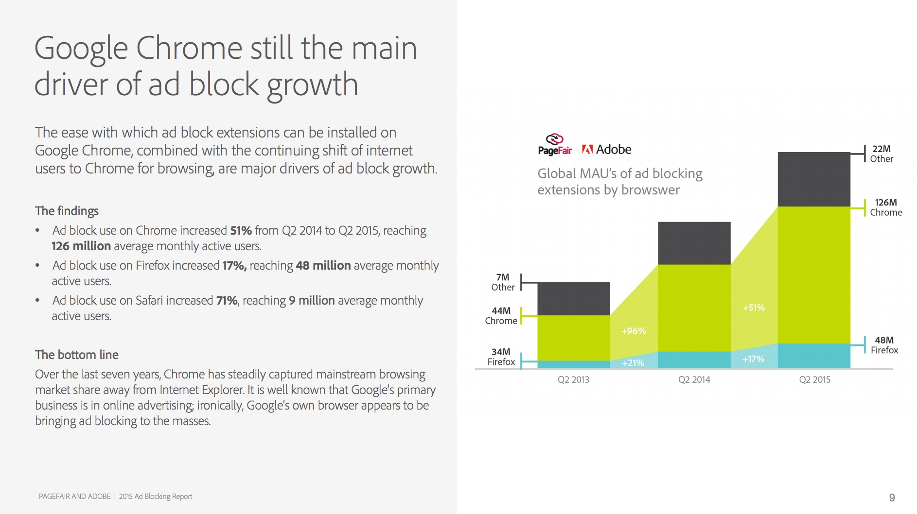
Source: https://downloads.pagefair.com/wp-content/uploads/2016/05/2015_report-the_cost_of_ad_blocking.pdf
Notes:
Source: https://downloads.pagefair.com/wp-content/uploads/2016/05/2015_report-the_cost_of_ad_blocking.pdf

Slide 6
BROWSER =
EXTENSION =

Slide 7
Bird's-eye view
Filter lists
Content
Ads
Source: http://adforads.com/category_images/website.jpg
https://www.digitalmusicnews.com/wp-content/uploads/2015/11/adblocklogo.png
http://findicons.com/files/icons/1579/devine/256/list.png
Notes:
Browser will make a GET request, and html page is served, browser beings to parse the page, and create DOM (document Object model), fires other requests on the page ( blocks rendering)
Intercept network requests before sending it out from browser
Pass through its filter list and either allow or block it
Source: http://adforads.com/category_images/website.jpg
https://www.digitalmusicnews.com/wp-content/uploads/2015/11/adblocklogo.png
http://findicons.com/files/icons/1579/devine/256/list.png
Website Content filtering
Mainly browser based extensions
Filter list
Chrome Extension overview https://developer.chrome.com/extensions/overview
Content scripts https://developer.chrome.com/extensions/content_scripts
https://en.wikipedia.org/wiki/Adblock_Plus

Slide 8
Performance Impact ?
Notes:
https://twitter.com/inspiredlabs/status/743037699561492480

Slide 9
Performance Impact
Source: https://twitter.com/inspiredlabs/status/743037699561492480
Notes:
https://twitter.com/inspiredlabs/status/743037699561492480

Slide 10
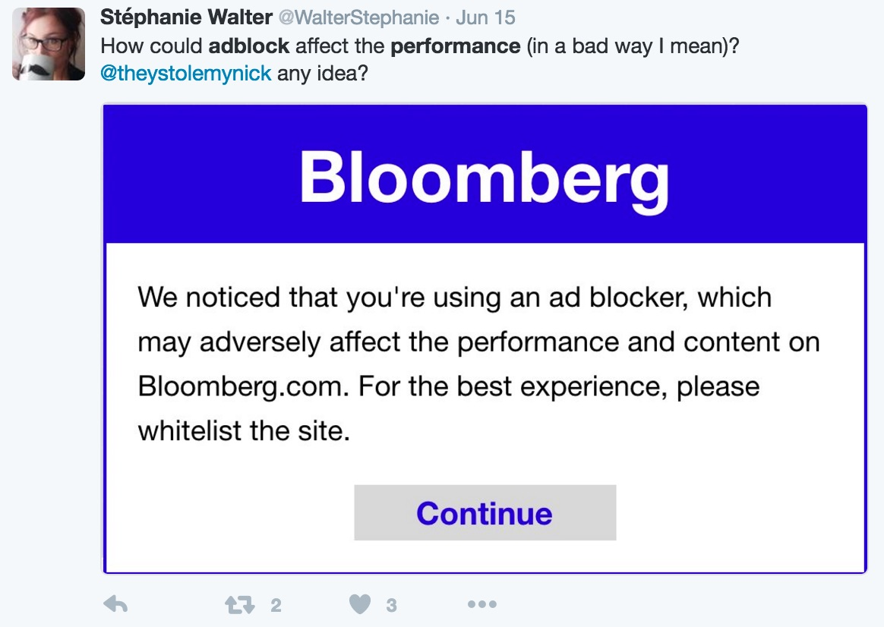
Performance Impact
Source: https://twitter.com/WalterStephanie/status/742979562049548289

Slide 11
Performance Impact
“”The results: For a number of websites that contained mobile ads with a lot of data, web page data sizes decreased significantly and load times accelerated enormously with ad blockers turned on.””
NY Times Oct 1st 2015
Source: http://www.nytimes.com/2015/10/01/technology/personaltech/ad-blockers-mobile-iphone-browsers.html?_r=1
Notes:
Nytimes study

Slide 12
Performance Impact
“Above All Else, Ad Blocking is a User Experience Problem”
Rigor: 21th June 2016
Source: http://rigor.com/blog/2016/06/ad-blocking-above-all-else

Slide 13
Notes:
But lets take a pause here for a minute, what we were hearing was
Adblockers could imporve user experience
They could make the page load faster
They could reduce battery usage
Adblocks are a UX problem
How could I produce the same set of results on my end
Spectrum of tools
Running locally
No standard way of measuring/quantifying

Slide 14
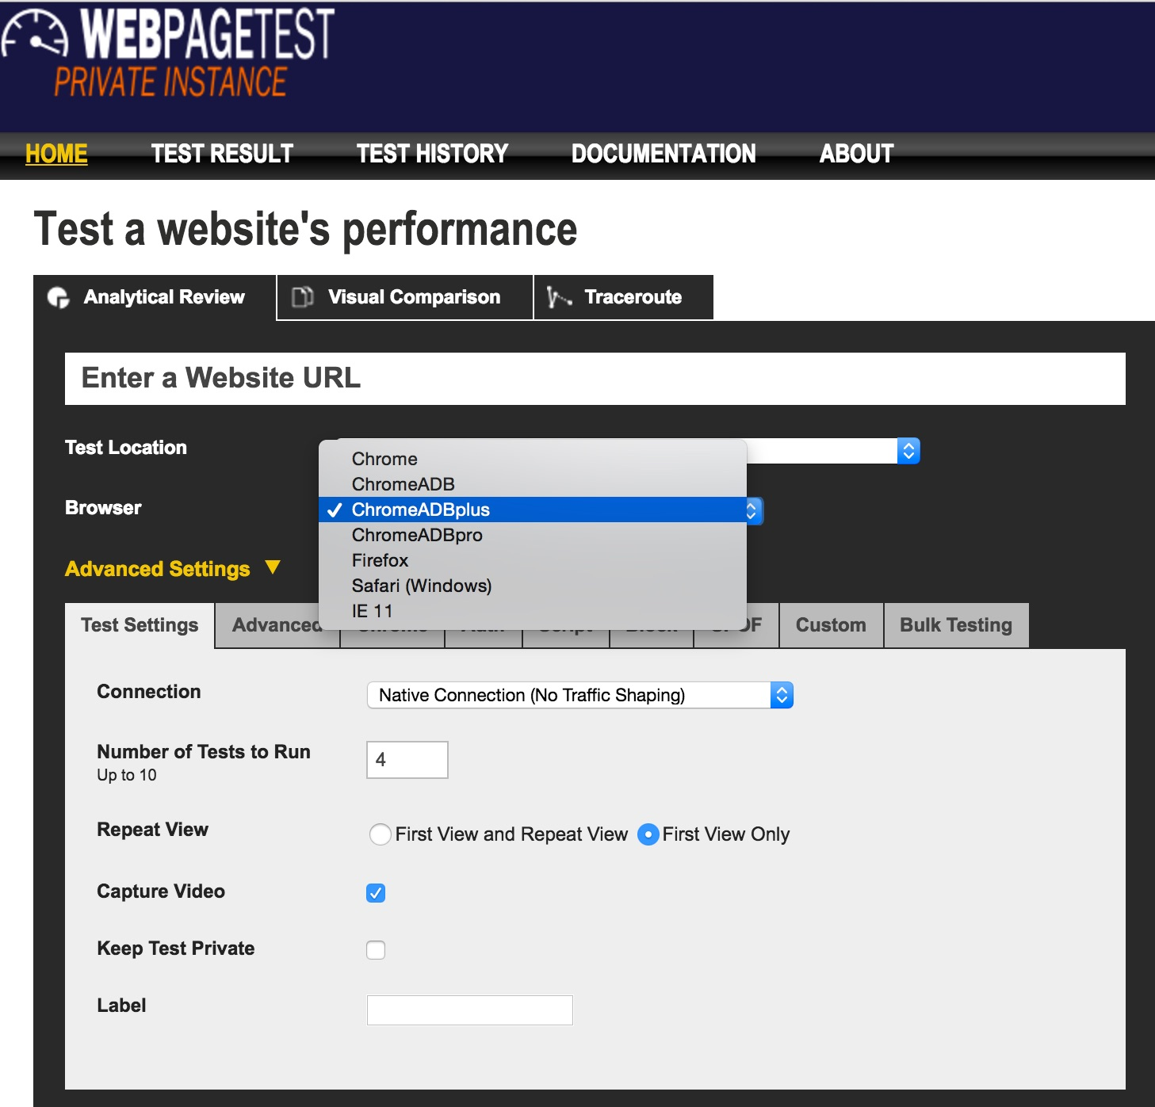
Extend WebPagetest
Easy to extend WebPagetest
Detailed Step-by-Step instructions
Side-by-Side comparison
Multivariate tests

Slide 15
Experimental Setup
Private WebPagetest instance
WebPagetest replay
Record live website and playback
Reduce outliers (time of day, network, DNS, server load etc.)
Normalize the results
Cable connection
Chrome 51 Browser on Windows
Vs.
Notes:
Private: https://sites.google.com/a/webpagetest.org/docs/private-instances
WPR: https://sites.google.com/a/webpagetest.org/docs/private-instances/web-page-replay

Slide 16
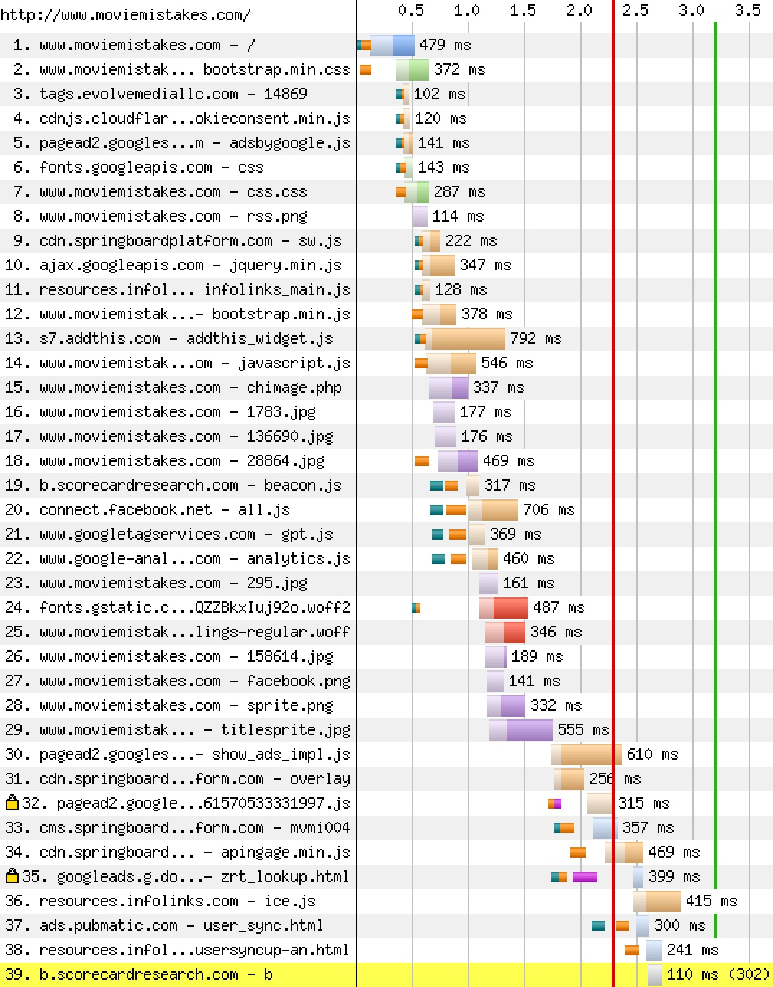
Example 1: moviemistakes.com
Notes:
Removing ad scripts in critical rendering path
Total 14 scripts, 8 in Critical rendering path
ChromeABP
http://www.webpagetest.org/results.php?test=160621_WM_05da47db5ac1447f4a1dc0fd7d9ec883
Chrome
http://www.webpagetest.org/results.php?test=160621_DJ_1bfc7b372d1dd4e31f812748f28573ae
Side-by-side
http://www.webpagetest.org/video/compare.php?tests=160621_DJ_1bfc7b372d1dd4e31f812748f28573ae
-r%3A7-l%3AWithout%2C160621_WM_05da47db5ac1447f4a1dc0fd7d9ec883
-r%3A4-l%3AAdblock&thumbSize=200&ival=100&end=doc

Slide 17
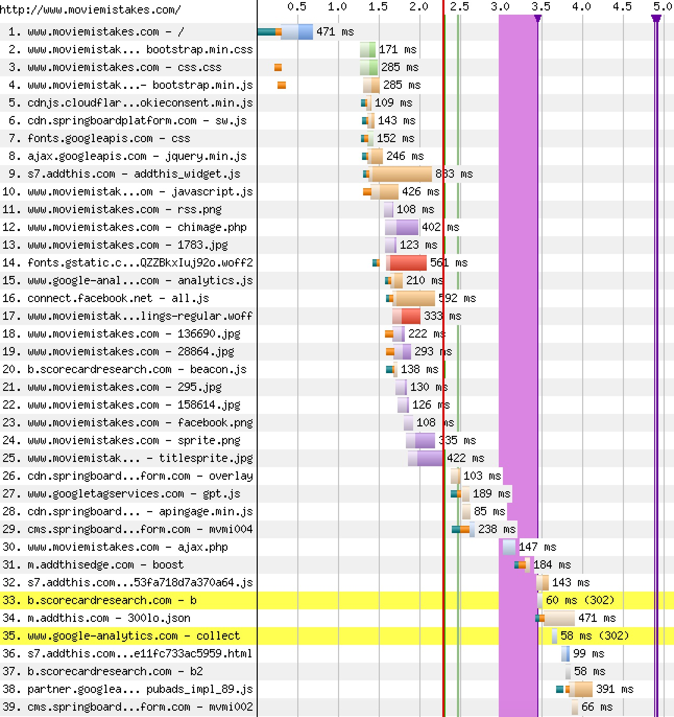
Example 1: moviemistakes.com
Notes:
Removing ad scripts in critical rendering path
Total 14 scripts, 8 in Critical rendering path
ChromeABP
http://www.webpagetest.org/results.php?test=160621_WM_05da47db5ac1447f4a1dc0fd7d9ec883
Chrome
http://www.webpagetest.org/results.php?test=160621_DJ_1bfc7b372d1dd4e31f812748f28573ae
Side-by-side
http://www.webpagetest.org/video/compare.php?tests=160621_DJ_1bfc7b372d1dd4e31f812748f28573ae
-r%3A7-l%3AWithout%2C160621_WM_05da47db5ac1447f4a1dc0fd7d9ec883
-r%3A4-l%3AAdblock&thumbSize=200&ival=100&end=doc

Slide 18
Example 1: moviemistakes.com
Notes:
ChromeABP
http://www.webpagetest.org/results.php?test=160621_WM_05da47db5ac1447f4a1dc0fd7d9ec883
Chrome
http://www.webpagetest.org/results.php?test=160621_DJ_1bfc7b372d1dd4e31f812748f28573ae
Side-by-side
http://www.webpagetest.org/video/compare.php?tests=160621_DJ_1bfc7b372d1dd4e31f812748f28573ae
-r%3A7-l%3AWithout%2C160621_WM_05da47db5ac1447f4a1dc0fd7d9ec883
-r%3A4-l%3AAdblock&thumbSize=200&ival=100&end=doc

Slide 19
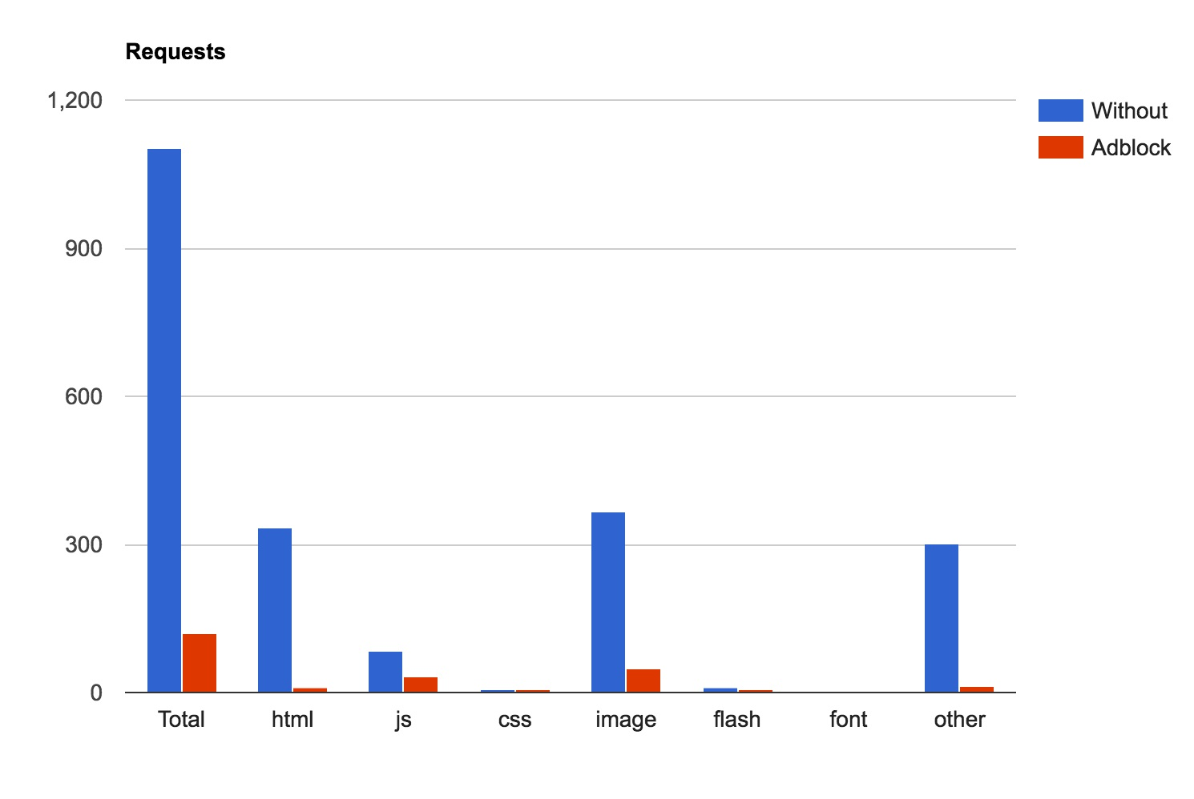
Example 1: moviemistakes.com
Notes:
ChromeABP
http://www.webpagetest.org/results.php?test=160621_WM_05da47db5ac1447f4a1dc0fd7d9ec883
Chrome
http://www.webpagetest.org/results.php?test=160621_DJ_1bfc7b372d1dd4e31f812748f28573ae
Side-by-side
http://www.webpagetest.org/video/compare.php?tests=160621_DJ_1bfc7b372d1dd4e31f812748f28573ae
-r%3A7-l%3AWithout%2C160621_WM_05da47db5ac1447f4a1dc0fd7d9ec883
-r%3A4-l%3AAdblock&thumbSize=200&ival=100&end=doc

Slide 20
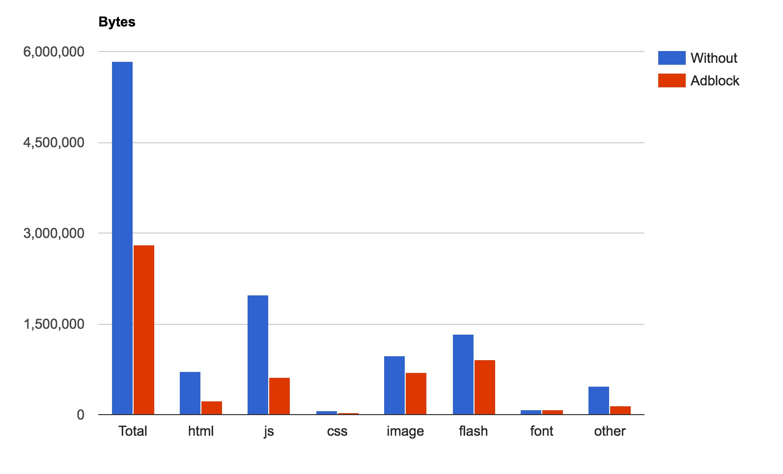
Example 1: moviemistakes.com
Notes:
ChromeABP
http://www.webpagetest.org/results.php?test=160621_WM_05da47db5ac1447f4a1dc0fd7d9ec883
Chrome
http://www.webpagetest.org/results.php?test=160621_DJ_1bfc7b372d1dd4e31f812748f28573ae
Side-by-side
http://www.webpagetest.org/video/compare.php?tests=160621_DJ_1bfc7b372d1dd4e31f812748f28573ae
-r%3A7-l%3AWithout%2C160621_WM_05da47db5ac1447f4a1dc0fd7d9ec883
-r%3A4-l%3AAdblock&thumbSize=200&ival=100&end=doc

Slide 21
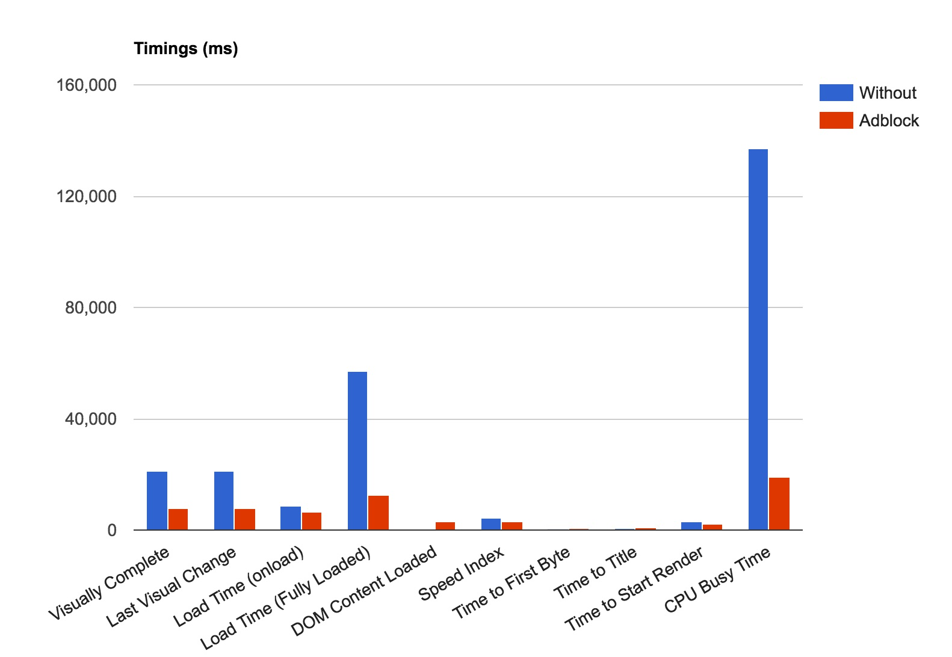
Example 1: moviemistakes.com
Notes:
ChromeABP
http://www.webpagetest.org/results.php?test=160621_WM_05da47db5ac1447f4a1dc0fd7d9ec883
Chrome
http://www.webpagetest.org/results.php?test=160621_DJ_1bfc7b372d1dd4e31f812748f28573ae
Side-by-side
http://www.webpagetest.org/video/compare.php?tests=160621_DJ_1bfc7b372d1dd4e31f812748f28573ae
-r%3A7-l%3AWithout%2C160621_WM_05da47db5ac1447f4a1dc0fd7d9ec883
-r%3A4-l%3AAdblock&thumbSize=200&ival=100&end=doc

Slide 22
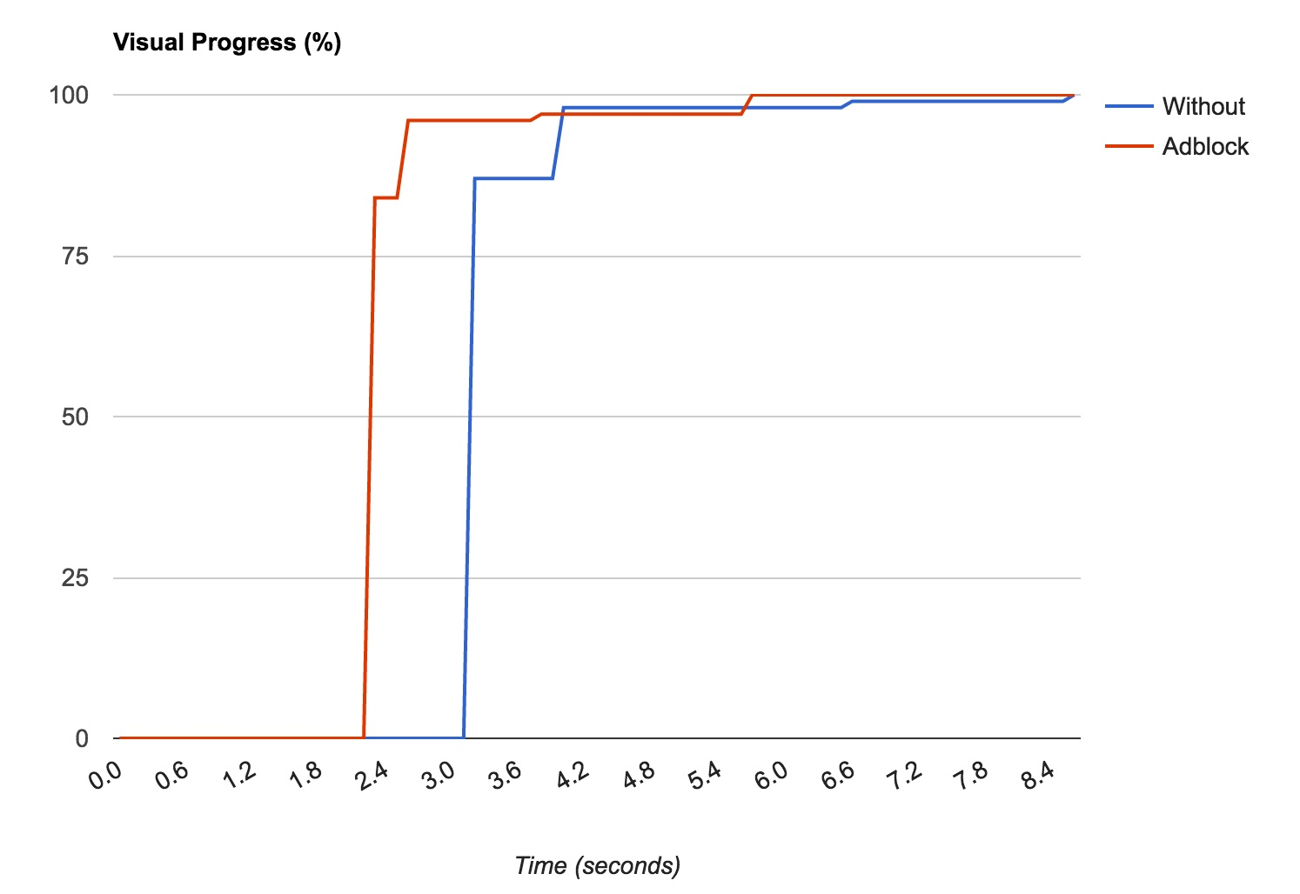
Example 1: moviemistakes.com
Notes:
ChromeABP
http://www.webpagetest.org/results.php?test=160621_WM_05da47db5ac1447f4a1dc0fd7d9ec883
Chrome
http://www.webpagetest.org/results.php?test=160621_DJ_1bfc7b372d1dd4e31f812748f28573ae
Side-by-side
http://www.webpagetest.org/video/compare.php?tests=160621_DJ_1bfc7b372d1dd4e31f812748f28573ae
-r%3A7-l%3AWithout%2C160621_WM_05da47db5ac1447f4a1dc0fd7d9ec883
-r%3A4-l%3AAdblock&thumbSize=200&ival=100&end=doc

Slide 23
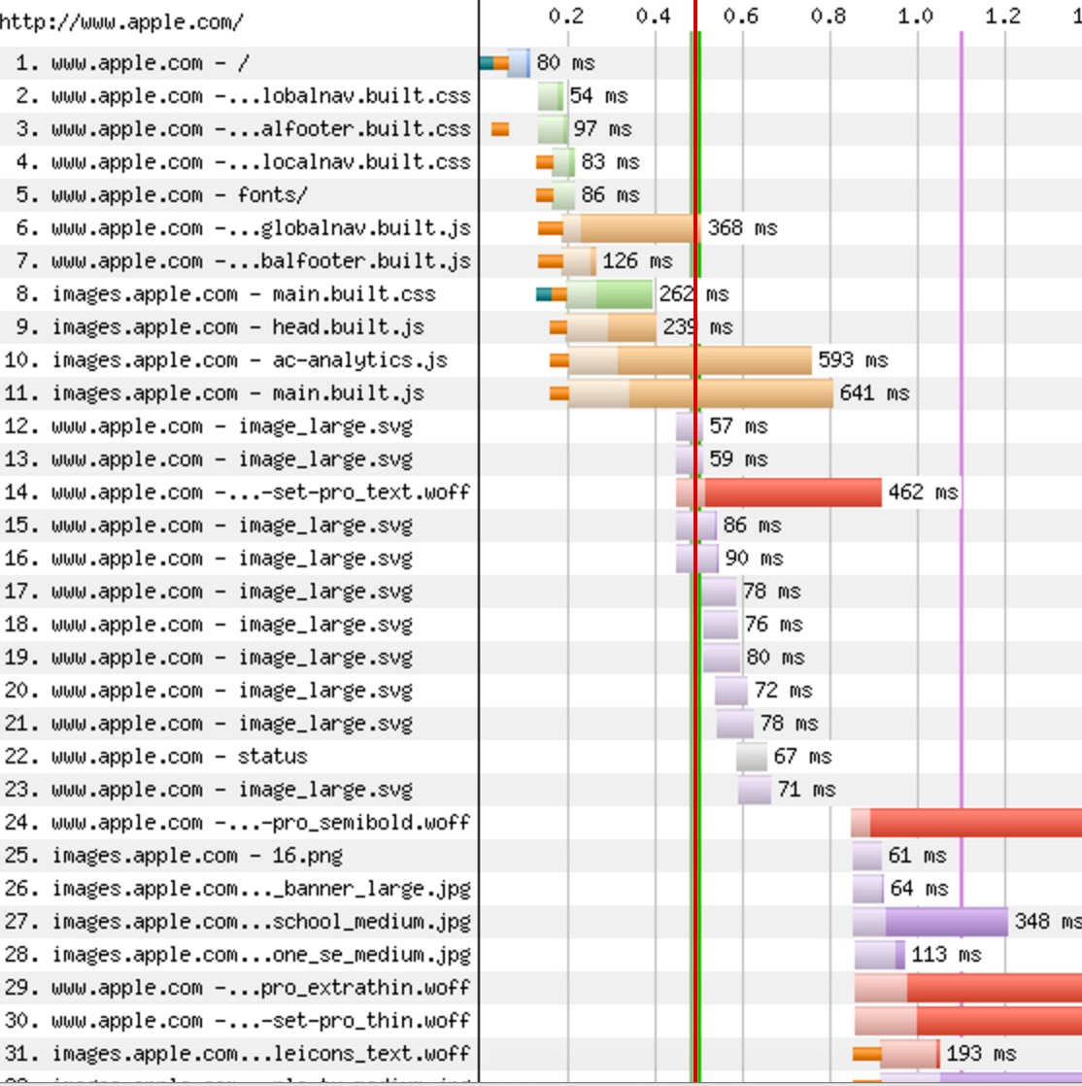
Example 2: apple.com
Notes:
Apple:
Chrome
http://www.webpagetest.org/results.php?test=160621_2W_bb24ff0d3af3d923b53f6d62b85ed05b
ChromeAbp
http://www.webpagetest.org/results.php?test=160621_H9_2c137987b59f4e60a46771ef5d65a6a8
http://www.webpagetest.org/video/compare.php?tests=160621_2W_bb24ff0d3af3d923b53f6d62b85ed05b
-r:3-l:Without%2C160621_H9_2c137987b59f4e60a46771ef5d65a6a8-r:5-l:Adblock

Slide 24
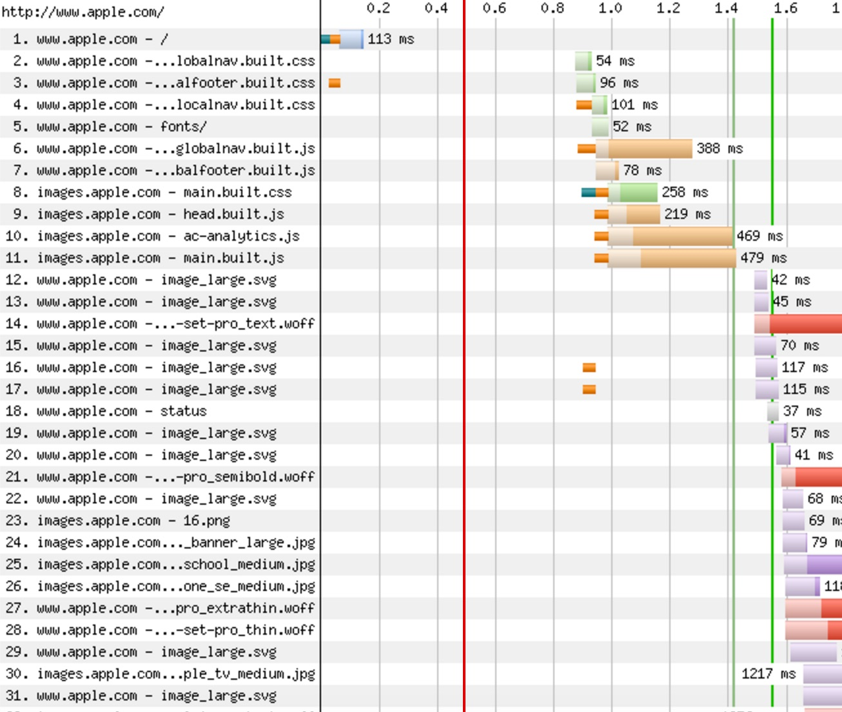
Example 2: apple.com
No requests were blocked
Notes:
Apple:
Chrome
http://www.webpagetest.org/results.php?test=160621_2W_bb24ff0d3af3d923b53f6d62b85ed05b
ChromeAbp
http://www.webpagetest.org/results.php?test=160621_H9_2c137987b59f4e60a46771ef5d65a6a8
http://www.webpagetest.org/video/compare.php?tests=160621_2W_bb24ff0d3af3d923b53f6d62b85ed05b
-r:3-l:Without%2C160621_H9_2c137987b59f4e60a46771ef5d65a6a8-r:5-l:Adblock

Slide 25
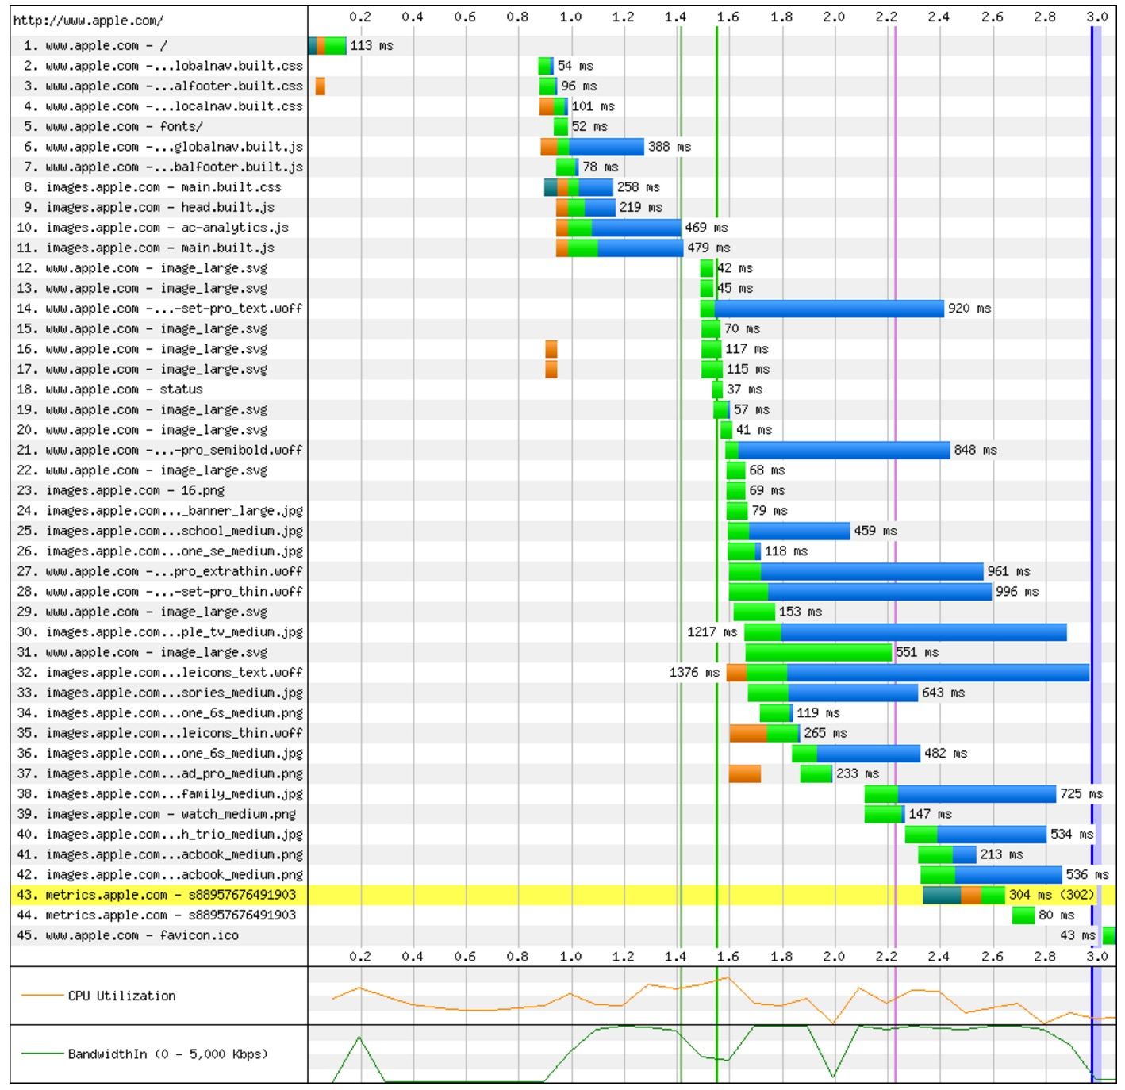
Example 2: apple.com
Notes:
Apple:
Chrome
http://www.webpagetest.org/results.php?test=160621_2W_bb24ff0d3af3d923b53f6d62b85ed05b
ChromeAbp
http://www.webpagetest.org/results.php?test=160621_H9_2c137987b59f4e60a46771ef5d65a6a8
http://www.webpagetest.org/video/compare.php?tests=160621_2W_bb24ff0d3af3d923b53f6d62b85ed05b
-r:3-l:Without%2C160621_H9_2c137987b59f4e60a46771ef5d65a6a8-r:5-l:Adblock

Slide 26
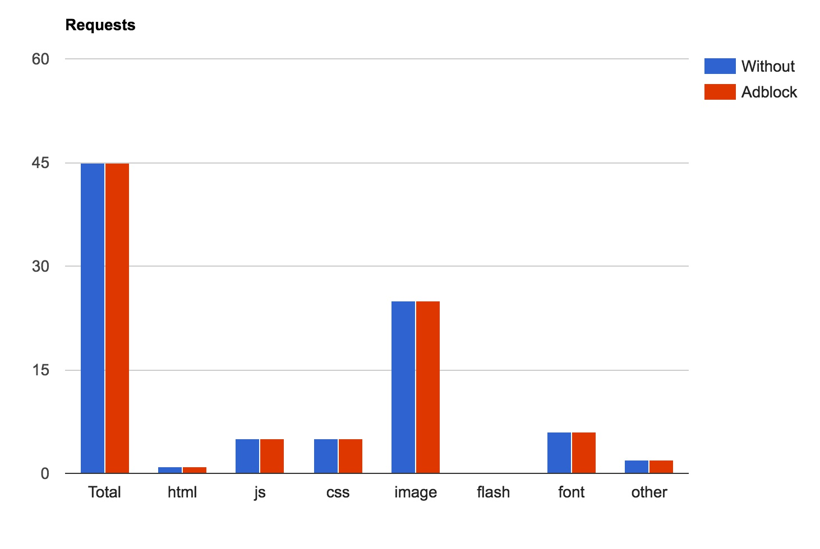
Example 2: apple.com
Notes:
Apple:
Chrome
http://www.webpagetest.org/results.php?test=160621_2W_bb24ff0d3af3d923b53f6d62b85ed05b
ChromeAbp
http://www.webpagetest.org/results.php?test=160621_H9_2c137987b59f4e60a46771ef5d65a6a8
http://www.webpagetest.org/video/compare.php?tests=160621_2W_bb24ff0d3af3d923b53f6d62b85ed05b
-r:3-l:Without%2C160621_H9_2c137987b59f4e60a46771ef5d65a6a8-r:5-l:Adblock

Slide 27
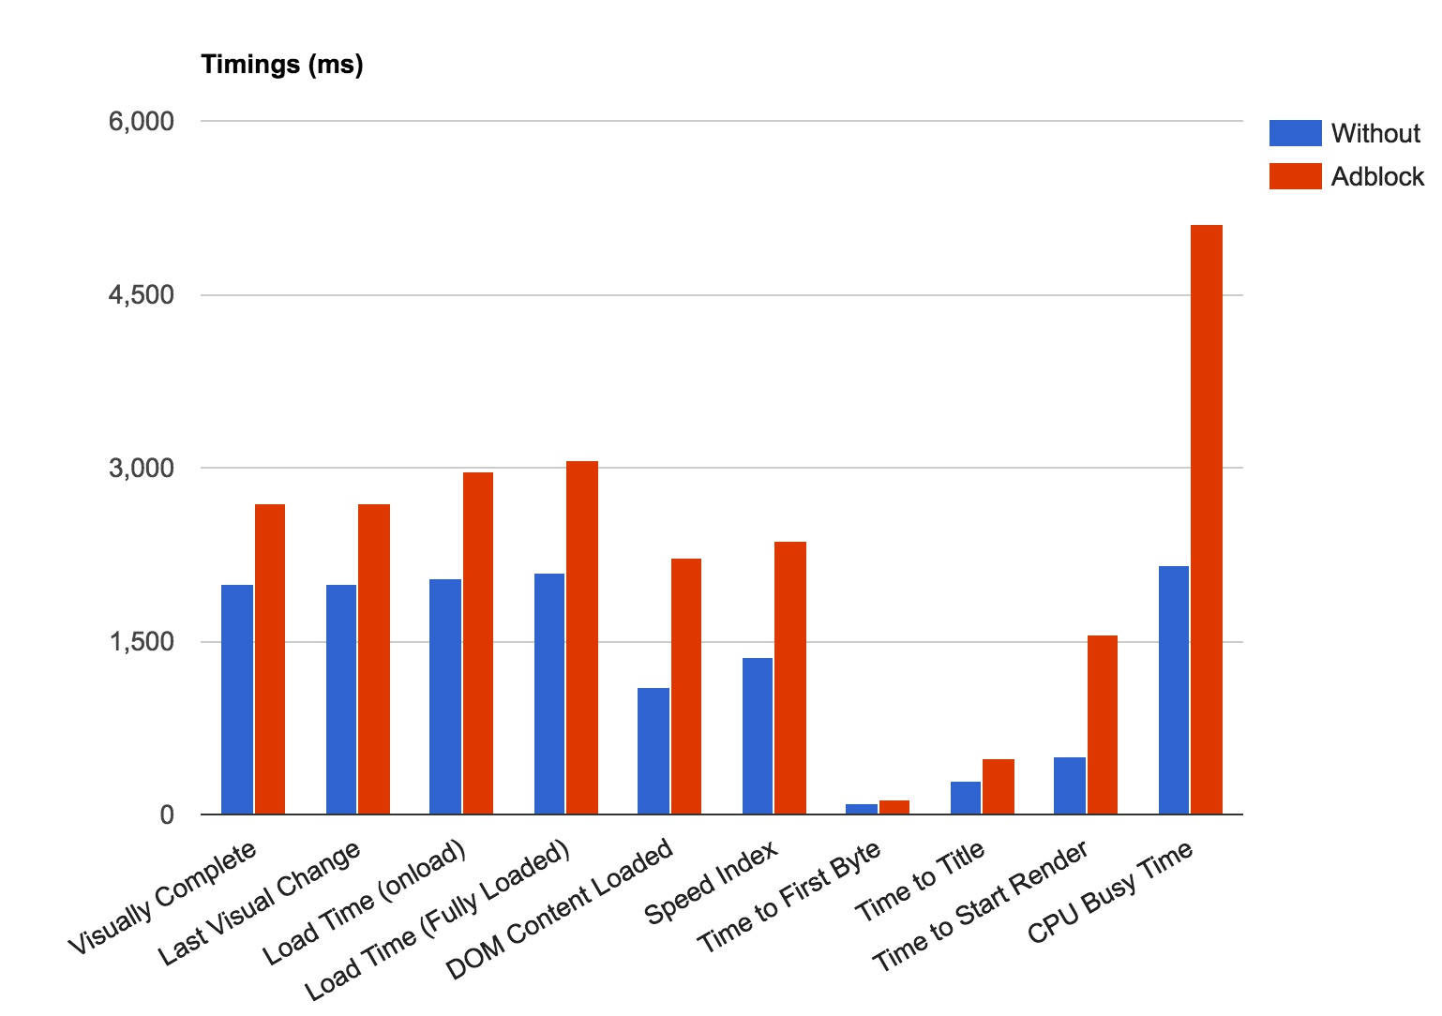
Example 2: apple.com
Notes:
Apple:
Chrome
http://www.webpagetest.org/results.php?test=160621_2W_bb24ff0d3af3d923b53f6d62b85ed05b
ChromeAbp
http://www.webpagetest.org/results.php?test=160621_H9_2c137987b59f4e60a46771ef5d65a6a8
http://www.webpagetest.org/video/compare.php?tests=160621_2W_bb24ff0d3af3d923b53f6d62b85ed05b
-r:3-l:Without%2C160621_H9_2c137987b59f4e60a46771ef5d65a6a8-r:5-l:Adblock

Slide 28
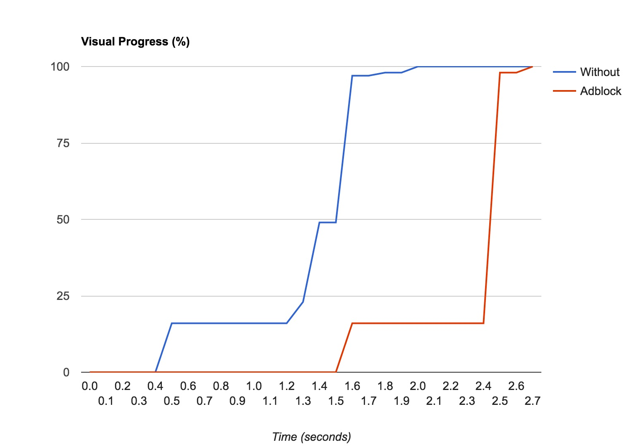
Example 2: apple.com
Notes:
Apple:
Chrome
http://www.webpagetest.org/results.php?test=160621_2W_bb24ff0d3af3d923b53f6d62b85ed05b
ChromeAbp
http://www.webpagetest.org/results.php?test=160621_H9_2c137987b59f4e60a46771ef5d65a6a8
http://www.webpagetest.org/video/compare.php?tests=160621_2W_bb24ff0d3af3d923b53f6d62b85ed05b
-r:3-l:Without%2C160621_H9_2c137987b59f4e60a46771ef5d65a6a8-r:5-l:Adblock

Slide 29
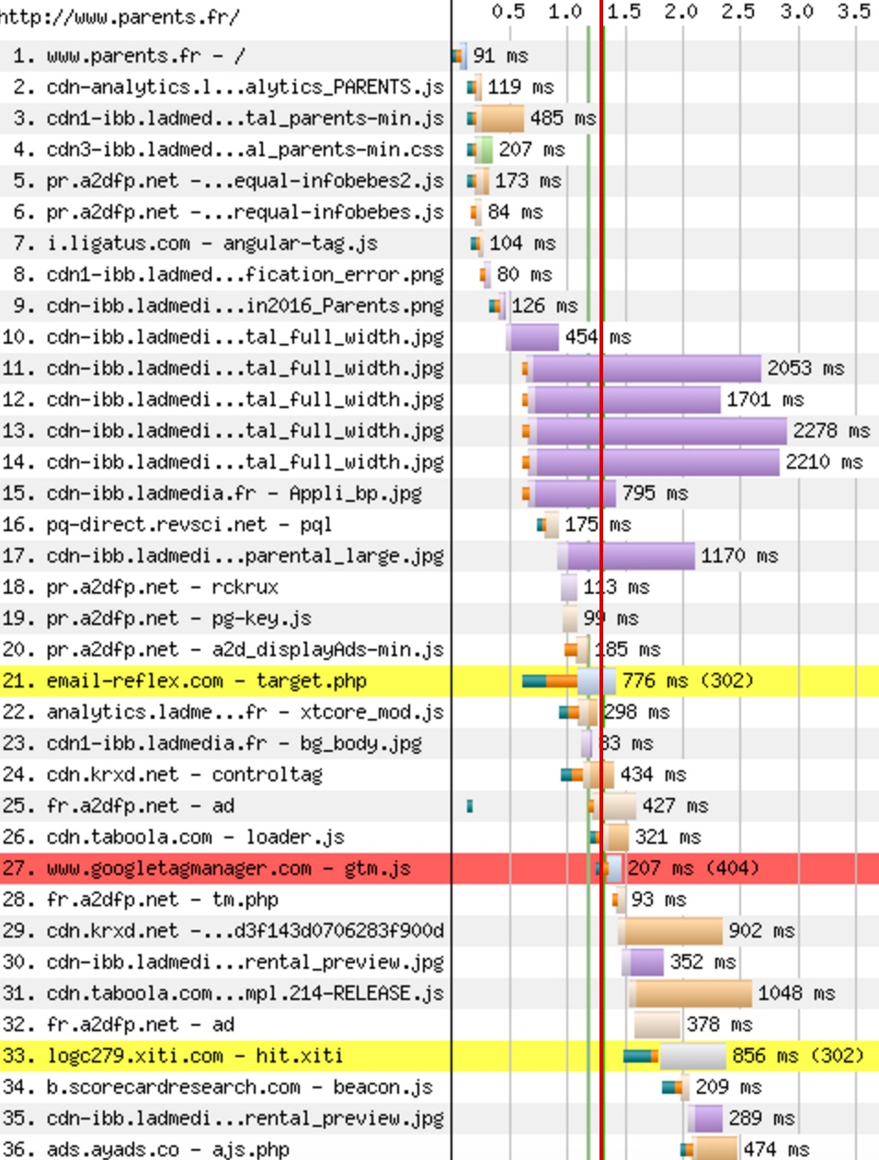
Example 3: parents.fr
Notes:
Chrome
http://www.webpagetest.org/results.php?test=160621_HC_47319296a3159b6aa6d0a2c8e2f44b73
ChromeABP
http://www.webpagetest.org/results.php?test=160621_EH_e1e9e14ce93cdd1b4e63da6a4ae89999

Slide 30
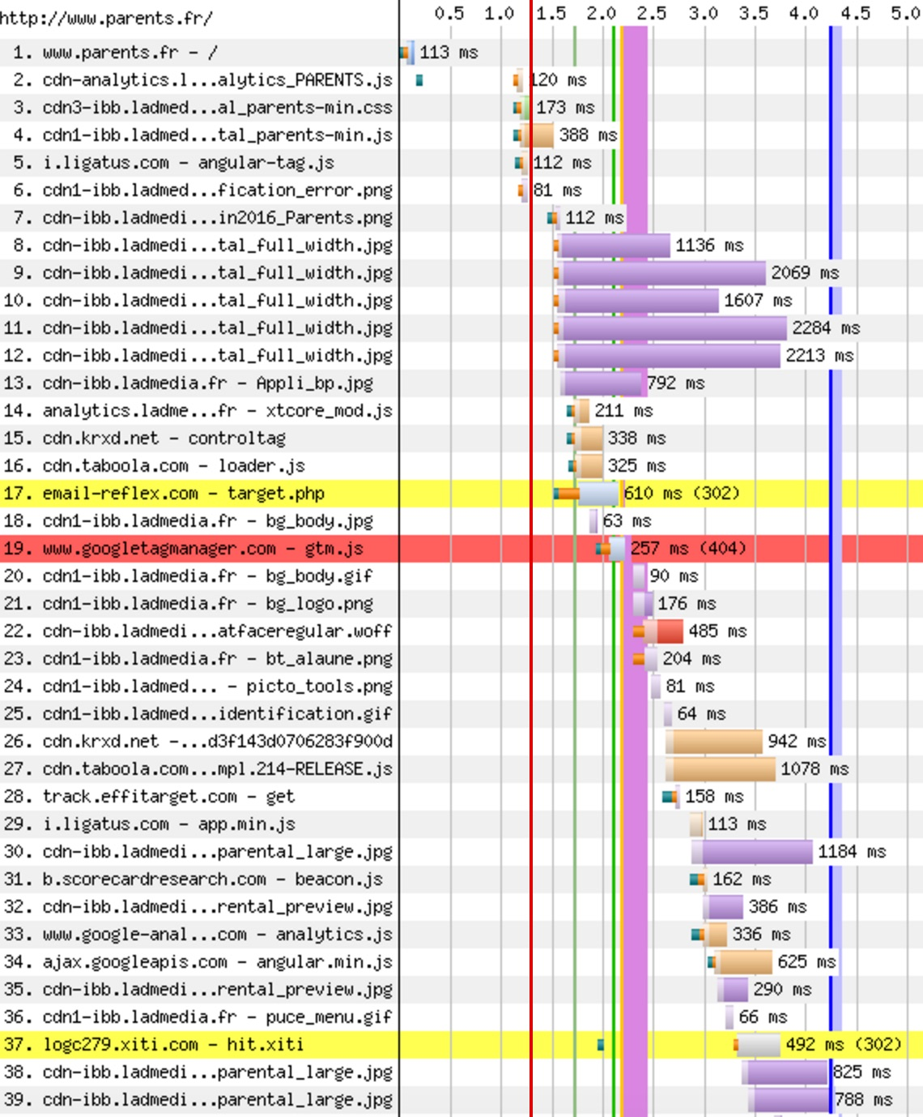
Example 3: parents.fr
Notes:
Chrome
http://www.webpagetest.org/results.php?test=160621_HC_47319296a3159b6aa6d0a2c8e2f44b73
ChromeABP
http://www.webpagetest.org/results.php?test=160621_EH_e1e9e14ce93cdd1b4e63da6a4ae89999

Slide 31
Example 3: parents.fr
Notes:
Chrome
http://www.webpagetest.org/results.php?test=160621_HC_47319296a3159b6aa6d0a2c8e2f44b73
ChromeABP
http://www.webpagetest.org/results.php?test=160621_EH_e1e9e14ce93cdd1b4e63da6a4ae89999

Slide 32
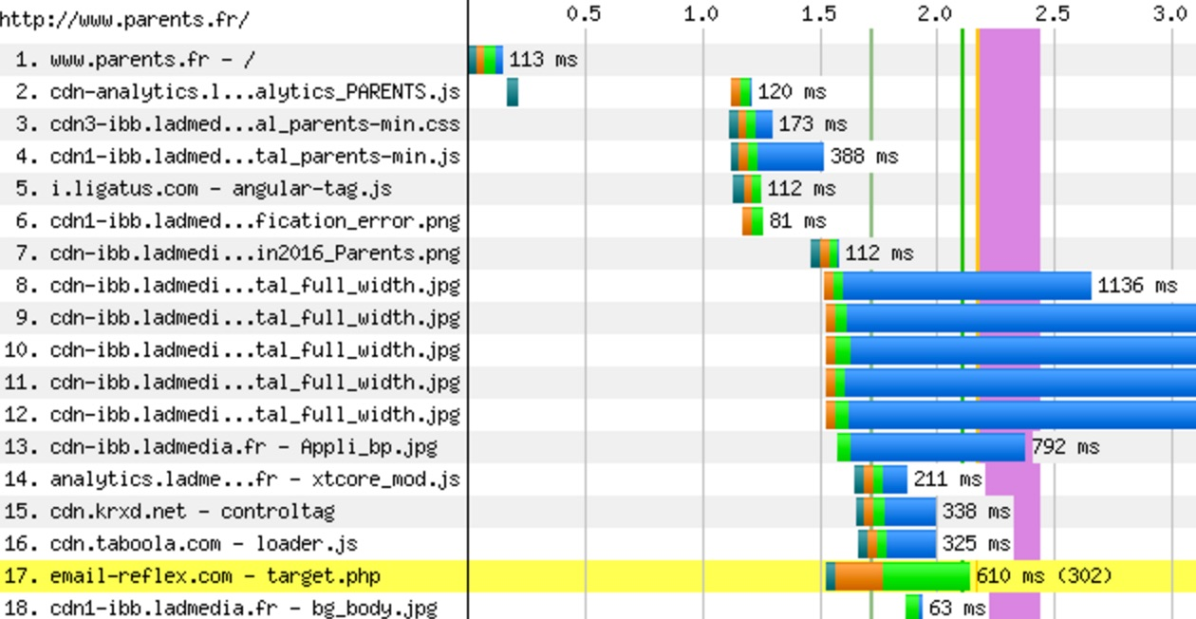
Example 3: parents.fr
Notes:
Chrome
http://www.webpagetest.org/results.php?test=160621_HC_47319296a3159b6aa6d0a2c8e2f44b73
ChromeABP
http://www.webpagetest.org/results.php?test=160621_EH_e1e9e14ce93cdd1b4e63da6a4ae89999

Slide 33
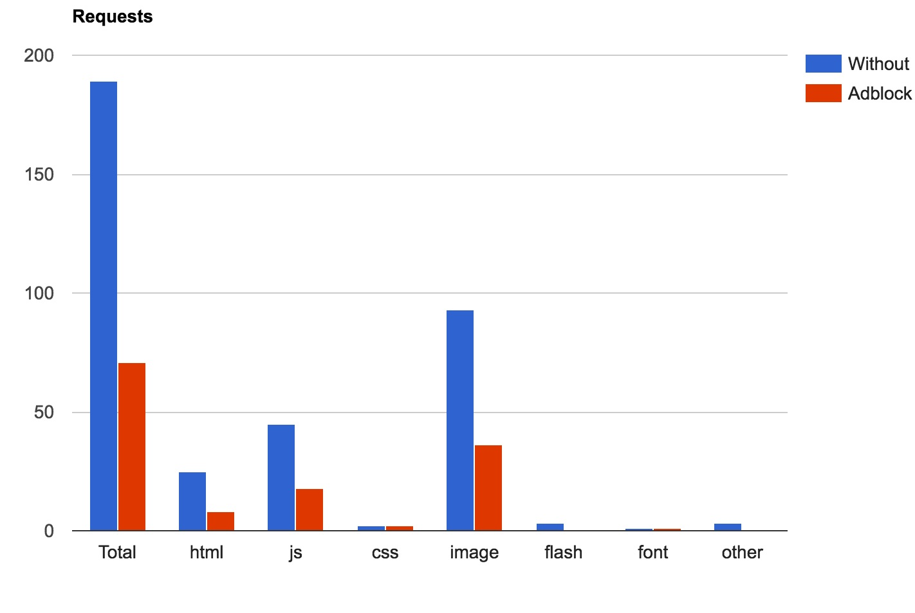
Example 3: parents.fr
Notes:
Chrome
http://www.webpagetest.org/results.php?test=160621_HC_47319296a3159b6aa6d0a2c8e2f44b73
ChromeABP
http://www.webpagetest.org/results.php?test=160621_EH_e1e9e14ce93cdd1b4e63da6a4ae89999

Slide 34
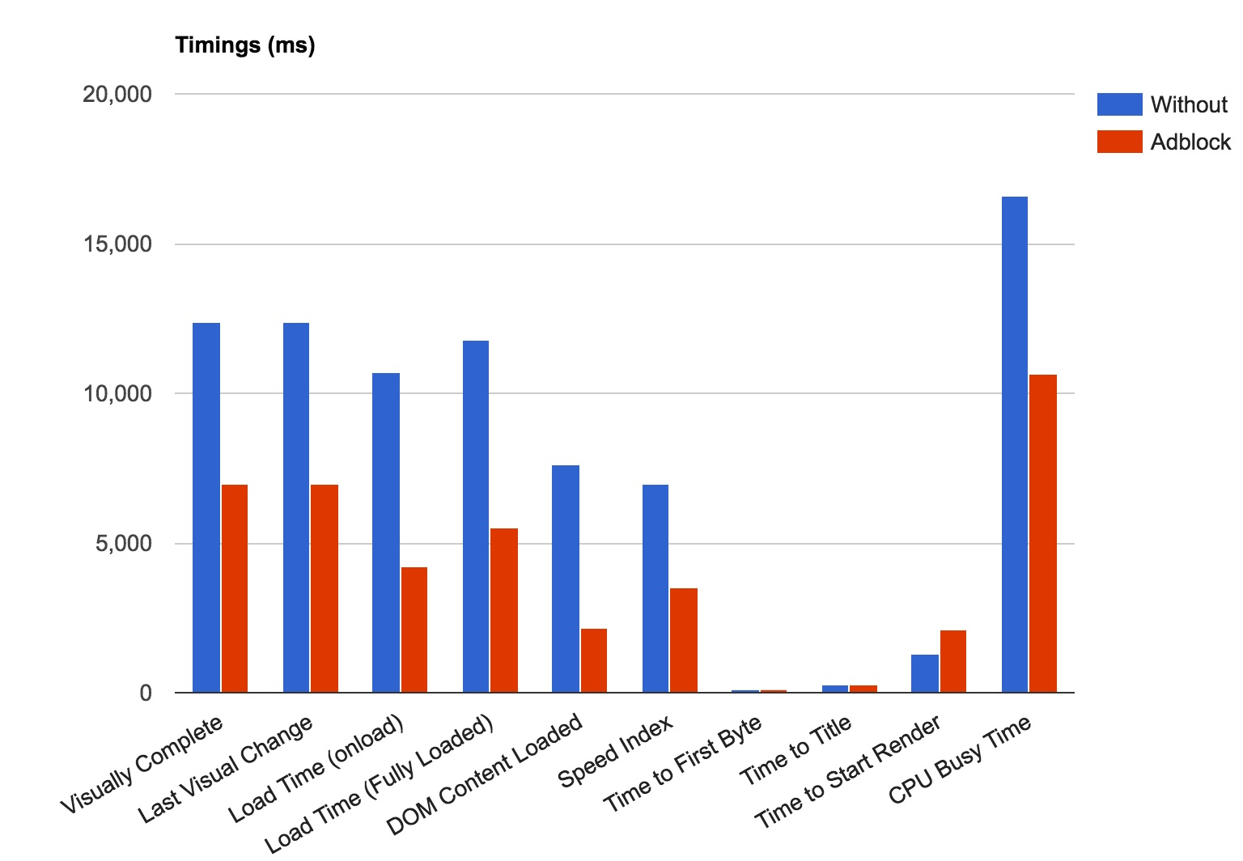
Example 3: parents.fr
Notes:
Chrome
http://www.webpagetest.org/results.php?test=160621_HC_47319296a3159b6aa6d0a2c8e2f44b73
ChromeABP
http://www.webpagetest.org/results.php?test=160621_EH_e1e9e14ce93cdd1b4e63da6a4ae89999

Slide 35
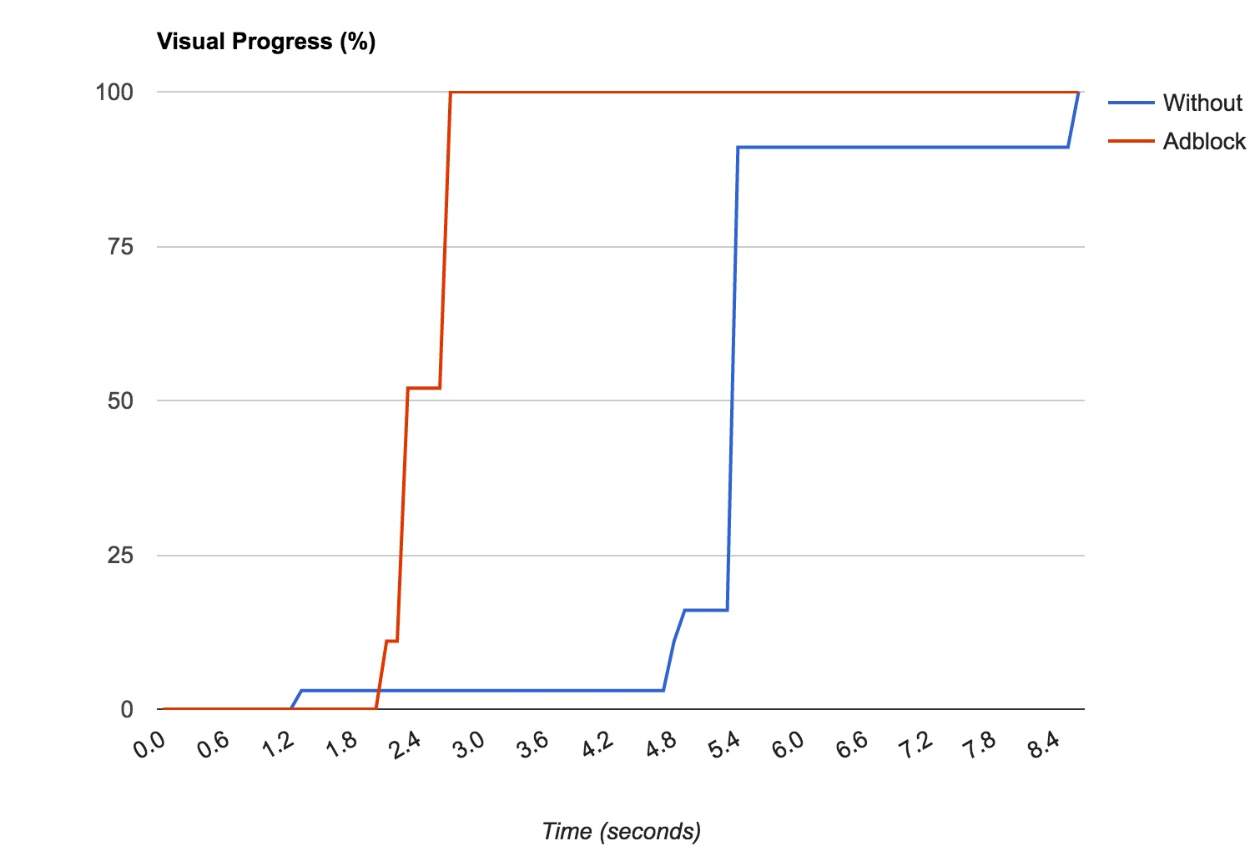
Example 3: parents.fr
Notes:
Chrome
http://www.webpagetest.org/results.php?test=160621_HC_47319296a3159b6aa6d0a2c8e2f44b73
ChromeABP
http://www.webpagetest.org/results.php?test=160621_EH_e1e9e14ce93cdd1b4e63da6a4ae89999

Slide 36
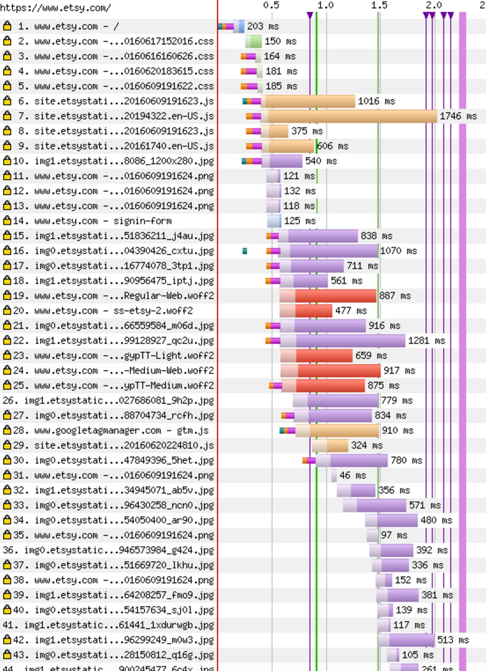
Example 4: etsy.com
Notes:
Chrome
http://www.webpagetest.org/results.php?test=160621_HV_fce26e59494634f74ed9105d2aa6de98
ChromeABP
http://www.webpagetest.org/results.php?test=160621_FW_4673432e8fdb152544a0ea03009d4c99
Comparison
http://www.webpagetest.org/video/compare.php?tests=160621_HV_fce26e59494634f74ed9105d2aa6de98
-r%3A8-l%3AWithout%2C160621_FW_4673432e8fdb152544a0ea03009d4c99
-r%3A6-l%3AAdblock&thumbSize=200&ival=500&end=doc

Slide 37
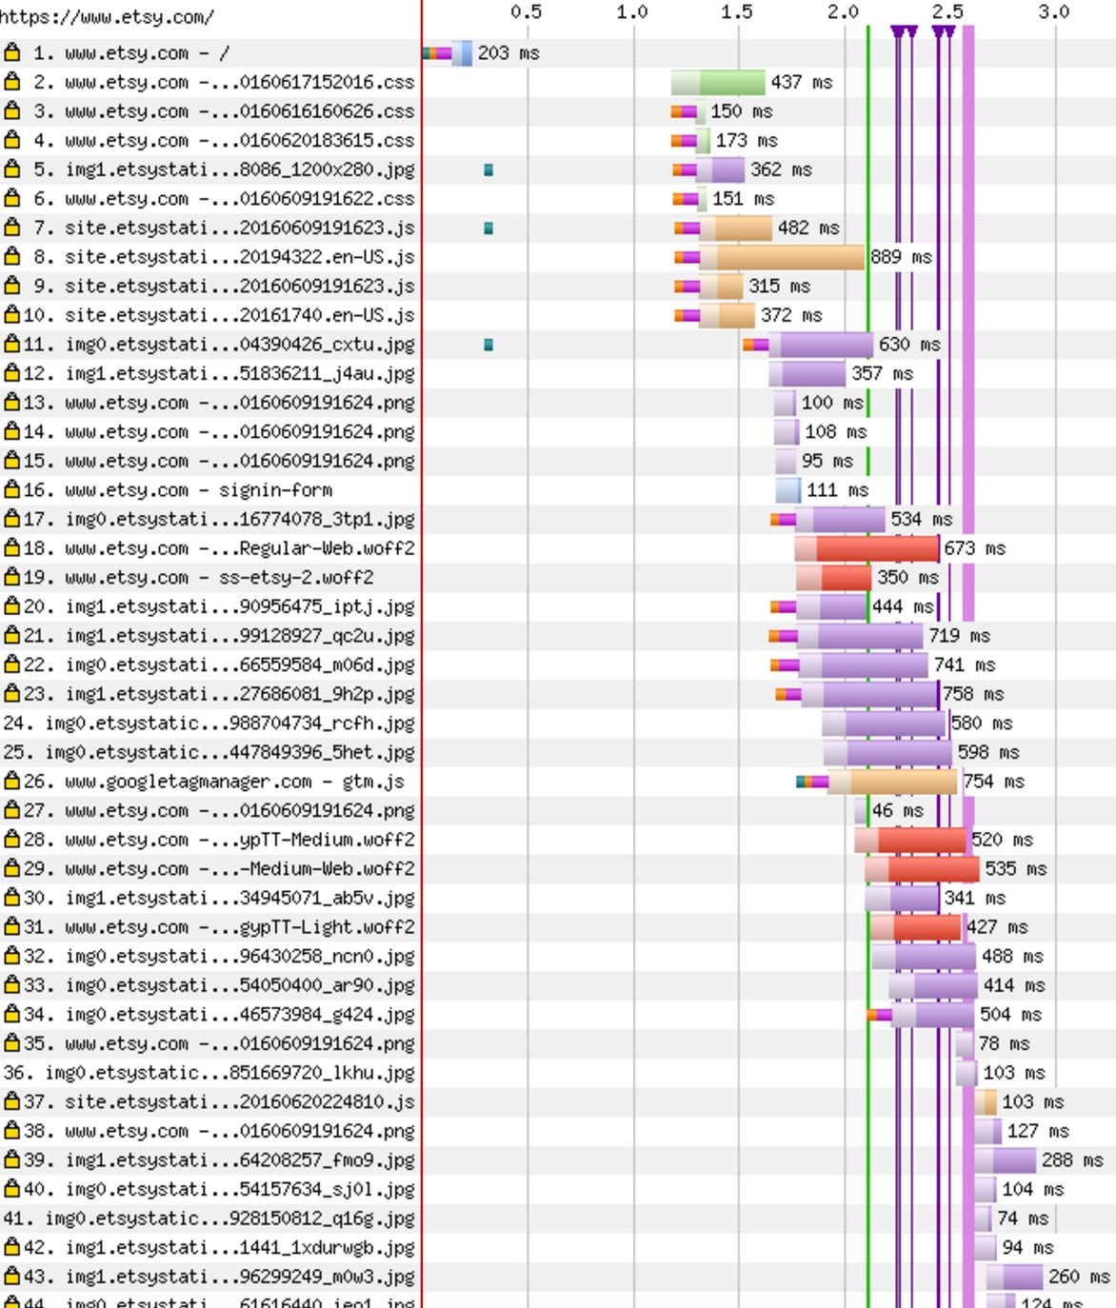
Example 4: etsy.com
Notes:
Chrome
http://www.webpagetest.org/results.php?test=160621_HV_fce26e59494634f74ed9105d2aa6de98
ChromeABP
http://www.webpagetest.org/results.php?test=160621_FW_4673432e8fdb152544a0ea03009d4c99
Comparison
http://www.webpagetest.org/video/compare.php?tests=160621_HV_fce26e59494634f74ed9105d2aa6de98
-r%3A8-l%3AWithout%2C160621_FW_4673432e8fdb152544a0ea03009d4c99
-r%3A6-l%3AAdblock&thumbSize=200&ival=500&end=doc

Slide 38
Example 4: etsy.com
Notes:
Chrome
http://www.webpagetest.org/results.php?test=160621_HV_fce26e59494634f74ed9105d2aa6de98
ChromeABP
http://www.webpagetest.org/results.php?test=160621_FW_4673432e8fdb152544a0ea03009d4c99
Comparison
http://www.webpagetest.org/video/compare.php?tests=160621_HV_fce26e59494634f74ed9105d2aa6de98
-r%3A8-l%3AWithout%2C160621_FW_4673432e8fdb152544a0ea03009d4c99
-r%3A6-l%3AAdblock&thumbSize=200&ival=500&end=doc

Slide 39
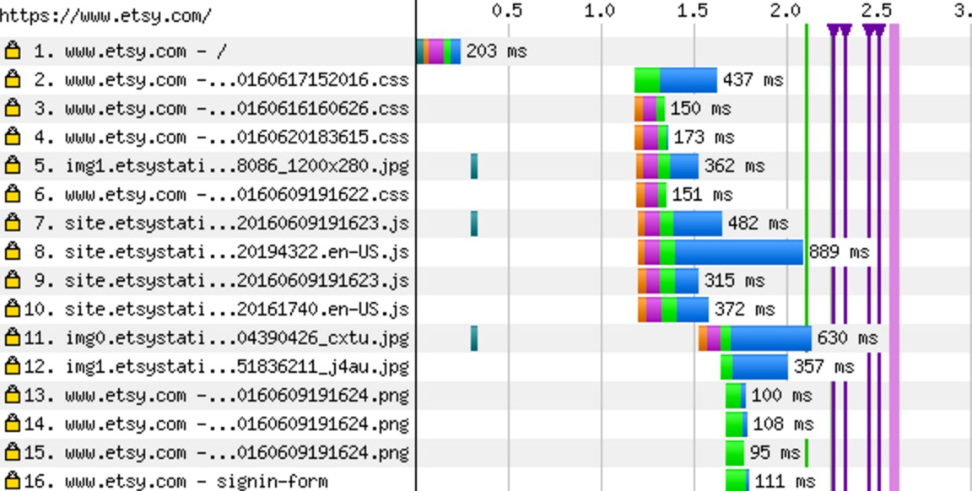
Example 4: etsy.com
Notes:
Chrome
http://www.webpagetest.org/results.php?test=160621_HV_fce26e59494634f74ed9105d2aa6de98
ChromeABP
http://www.webpagetest.org/results.php?test=160621_FW_4673432e8fdb152544a0ea03009d4c99
Comparison
http://www.webpagetest.org/video/compare.php?tests=160621_HV_fce26e59494634f74ed9105d2aa6de98
-r%3A8-l%3AWithout%2C160621_FW_4673432e8fdb152544a0ea03009d4c99
-r%3A6-l%3AAdblock&thumbSize=200&ival=500&end=doc

Slide 40
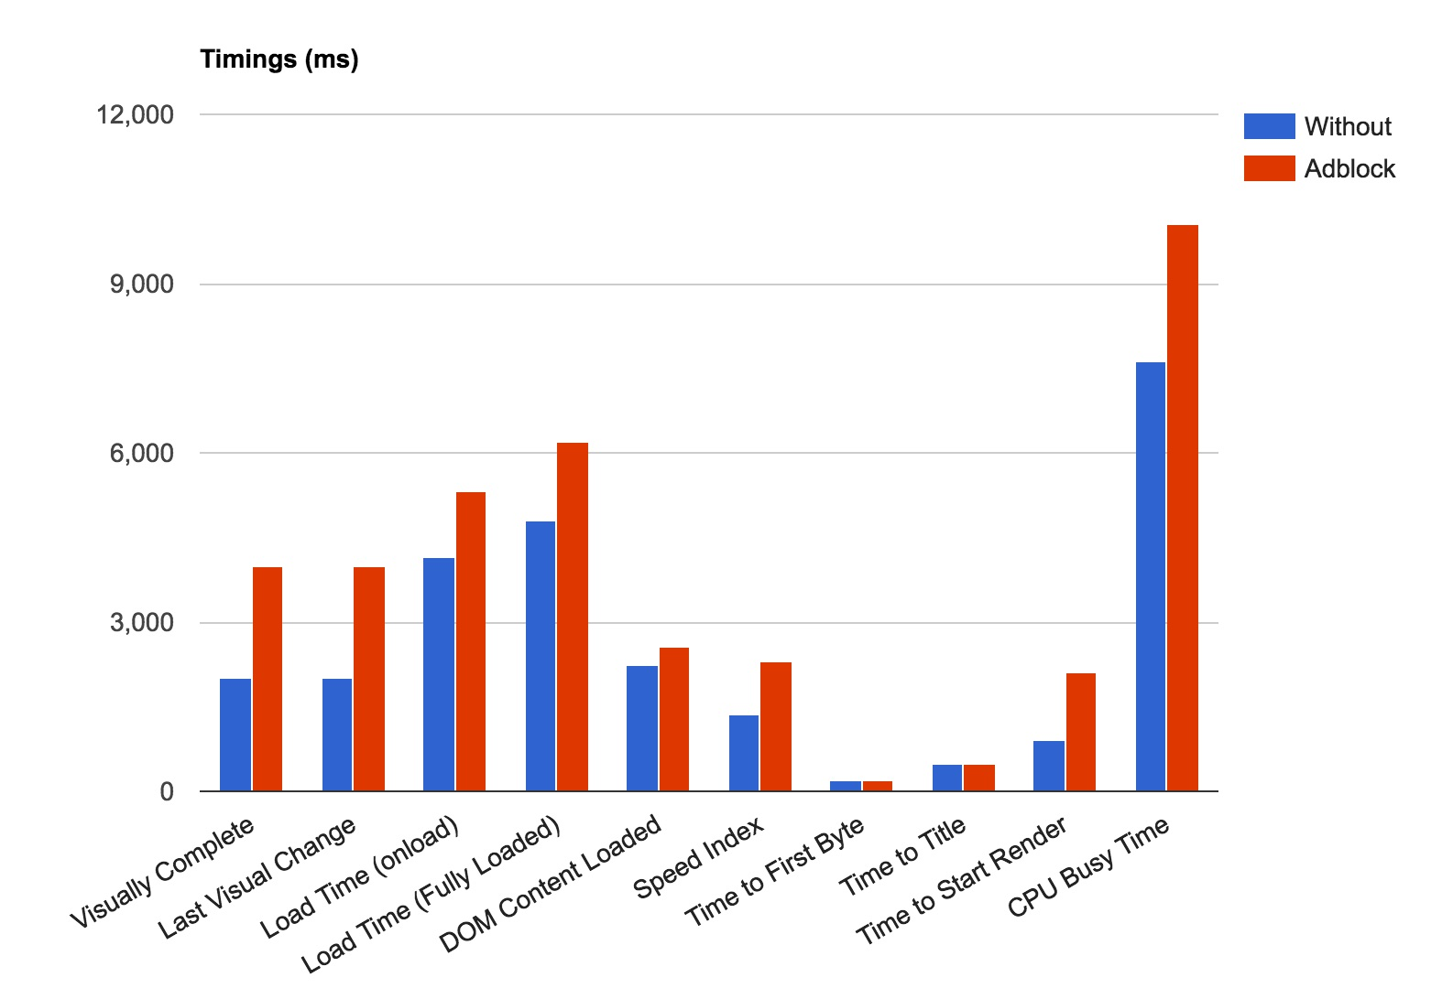
Example 4: etsy.com
Notes:
Chrome
http://www.webpagetest.org/results.php?test=160621_HV_fce26e59494634f74ed9105d2aa6de98
ChromeABP
http://www.webpagetest.org/results.php?test=160621_FW_4673432e8fdb152544a0ea03009d4c99
Comparison
http://www.webpagetest.org/video/compare.php?tests=160621_HV_fce26e59494634f74ed9105d2aa6de98
-r%3A8-l%3AWithout%2C160621_FW_4673432e8fdb152544a0ea03009d4c99
-r%3A6-l%3AAdblock&thumbSize=200&ival=500&end=doc

Slide 41
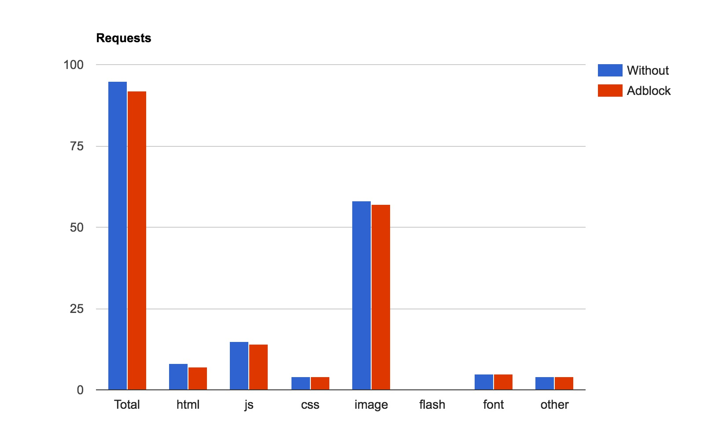
Example 4: etsy.com
Notes:
Chrome
http://www.webpagetest.org/results.php?test=160621_HV_fce26e59494634f74ed9105d2aa6de98
ChromeABP
http://www.webpagetest.org/results.php?test=160621_FW_4673432e8fdb152544a0ea03009d4c99
Comparison
http://www.webpagetest.org/video/compare.php?tests=160621_HV_fce26e59494634f74ed9105d2aa6de98
-r%3A8-l%3AWithout%2C160621_FW_4673432e8fdb152544a0ea03009d4c99
-r%3A6-l%3AAdblock&thumbSize=200&ival=500&end=doc

Slide 42
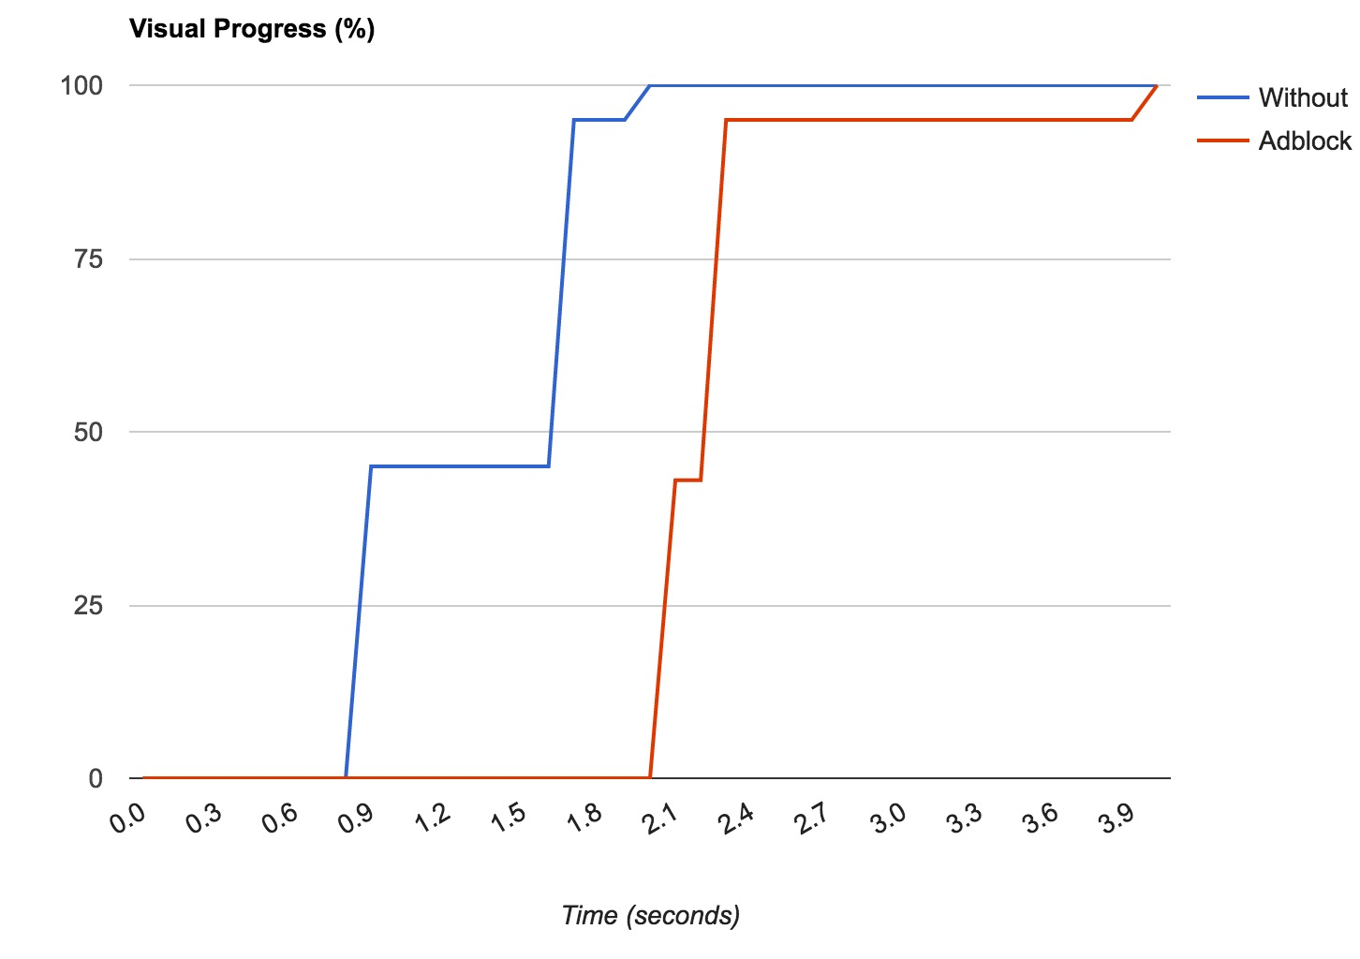
Example 4: etsy.com
Notes:
Chrome
http://www.webpagetest.org/results.php?test=160621_HV_fce26e59494634f74ed9105d2aa6de98
ChromeABP
http://www.webpagetest.org/results.php?test=160621_FW_4673432e8fdb152544a0ea03009d4c99
Comparison
http://www.webpagetest.org/video/compare.php?tests=160621_HV_fce26e59494634f74ed9105d2aa6de98
-r%3A8-l%3AWithout%2C160621_FW_4673432e8fdb152544a0ea03009d4c99
-r%3A6-l%3AAdblock&thumbSize=200&ival=500&end=doc

Slide 43
Summary of examples
Moviemistakes.com
Better Speed Index, Start Render
Parents.fr
Better Speed Index, Worse Start Render
Apple.com
Worse Speed Index, Start Render
Etsy.com
Worse Speed Index, Start Render
Higher Time To First Byte

Slide 44
More Experiments
2016 Internet Retailer 150 Homepages
2016 Top 100 Media Sites

Slide 45
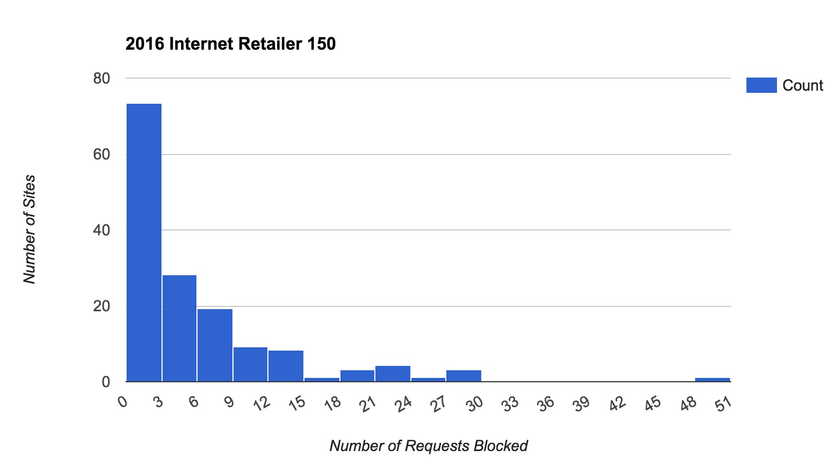
2016 Internet Retailer 150 Homepages

Slide 46
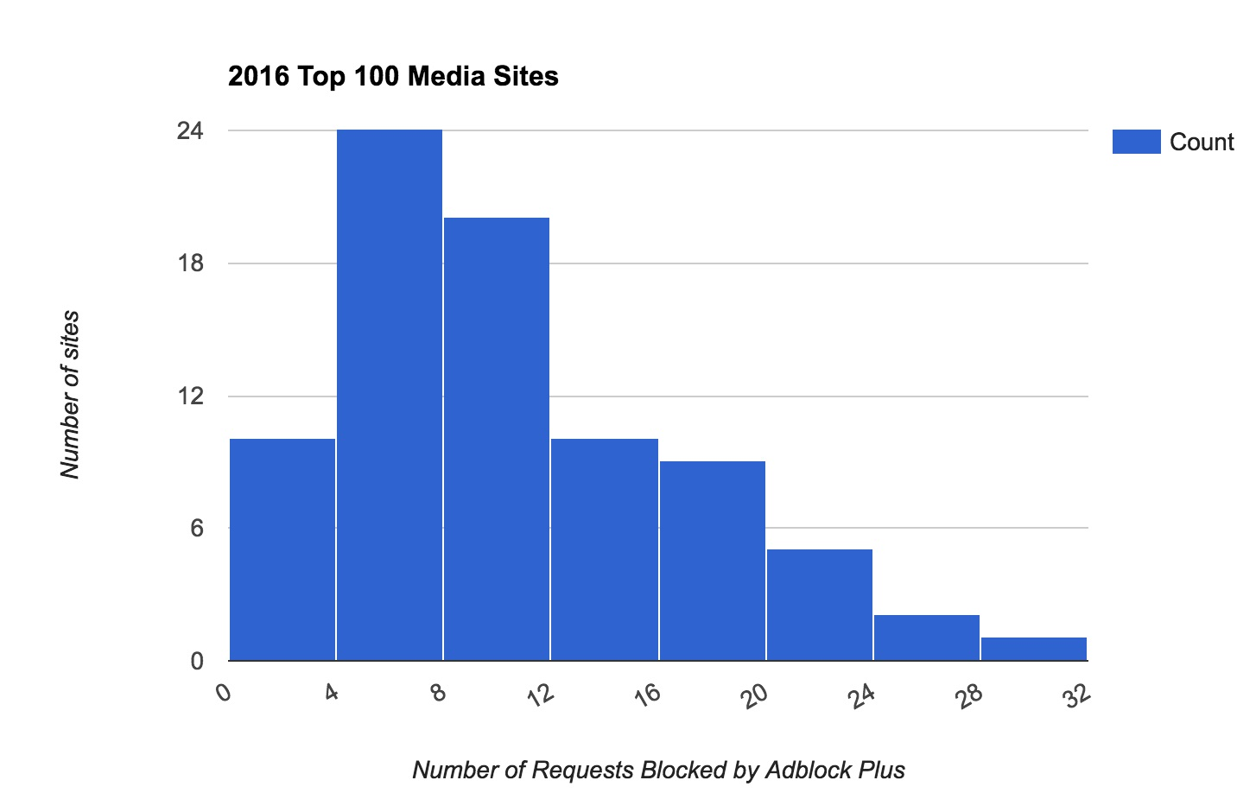
2016 Top 100 Media Sites

Slide 47
Observations
CPU cycles for blocking content
Varies by industry
Huge filter list
Blocked list
580 KB (~1.9 MB)
Allowed list
422 KB (~1.9 MB)
User experience could be worse

Slide 48
Takeaways
Overheads of Ad blocker's
Benefit from blocking content
performance != universal
Invest in tooling
Measure it

Slide 49
Karan Kumar
kkumar@instartlogic.com
@kkumar86
https://www.linkedin.com/in/kkumar86
BOOTH @ 215

Slide 50
View Blocked Content
Without Adblocker
Adblocker
Notes:
http://www.webpagetest.org/results.php?test=160621_Z5_4641ee9b85c479c9d393f6e7ecb6938f
http://www.webpagetest.org/results.php?test=160621_31_4b99f83538843f8eec280525998722a4

