Slide 1
Debugging
Front-end Performance
Tim Kadlec (@tkadlec) & Pat Meenan (@patmeenan)
June 20-21, 2016 at Velocity Conference (#velocityconf)

Slide 2
TLS

Slide 3
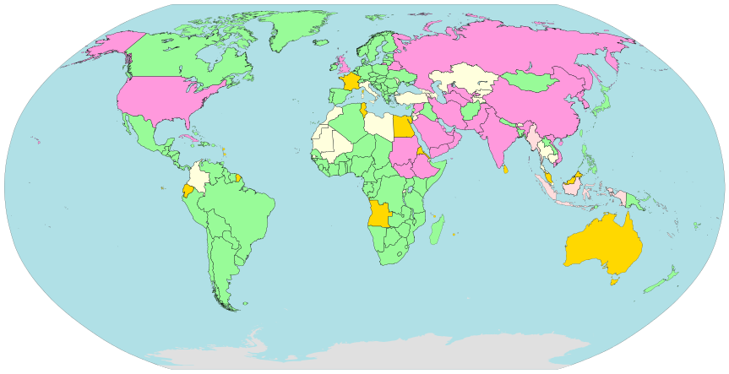
https://en.wikipedia.org/wiki/Internet_censorship_and_surveillance_by_country

Slide 4
http://www.bidnessetc.com/39369-verizon-communications-inc-tracking-supercookie-under-review-by-fcc/

Slide 5
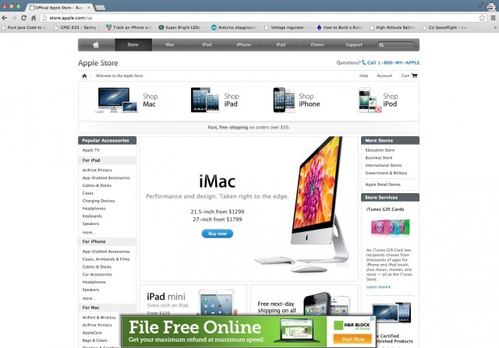
http://arstechnica.com/tech-policy/2013/04/how-a-banner-ad-for-hs-ok/

Slide 6
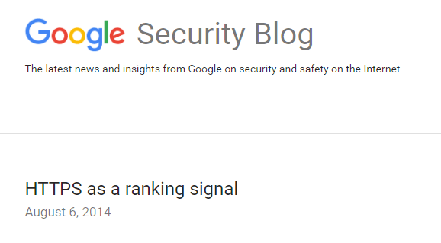
https://security.googleblog.com/2014/08/https-as-ranking-signal_6.html

Slide 7
https://www.chromium.org/Home/chromium-security/marking-http-as-non-secure

Slide 8
Requiring HTTPS For…
Service Workers
HTTP/2
Geo Location
All new “powerful” web features
Chrome and Firefox

Slide 9
https://www.igvita.com/
@igrigorik
https://hpbn.co/

Slide 11
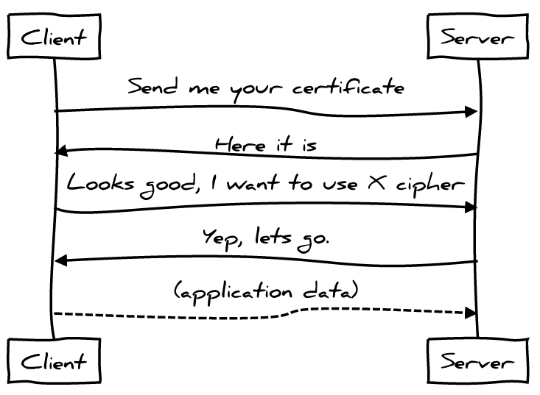
TLS handshake 101
Certificate verification
(asymmetric crypto)
2 RTTs
Symmetric key negotiation
encrypted app data

Slide 12
1 RTT HandSHAKE

Slide 13
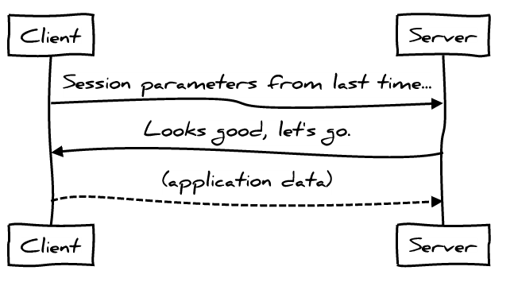
TLS resumption 101
Re-use negotiated parameters for the symmetric cipher
Eliminates asymmetric crypto on the server via reuse of previously used parameters
Eliminates full roundtrip, allowing 1-RTT connection establishment

Slide 14
TLS resumption
Session identifiers
Server assigns session ID
Server caches parameters
Client sends session ID
Session is “resumed”
Session tickets
Server encrypts parameters
Server sets opaque ticket
Client sends opaque ticket
Server decrypts ticket and resumes session
Shared state is on the server
Shared state is on the client

Slide 15
A few things to think about…
Session identifiers
Require a shared cache between servers for best results
Sessions must be expired and rotated in a secure manner
Session tickets
Require a shared ticket encryption key
Shared encryption key must be rotated in a secure manner
Perfect Forward Secrecy (PFS)
“Session ticket keys have to be distributed to all the frontend machines, without being written to any kind of persistent storage, and frequently rotated.”
https://www.imperialviolet.org/2011/11/22/forwardsecret.html

Slide 16
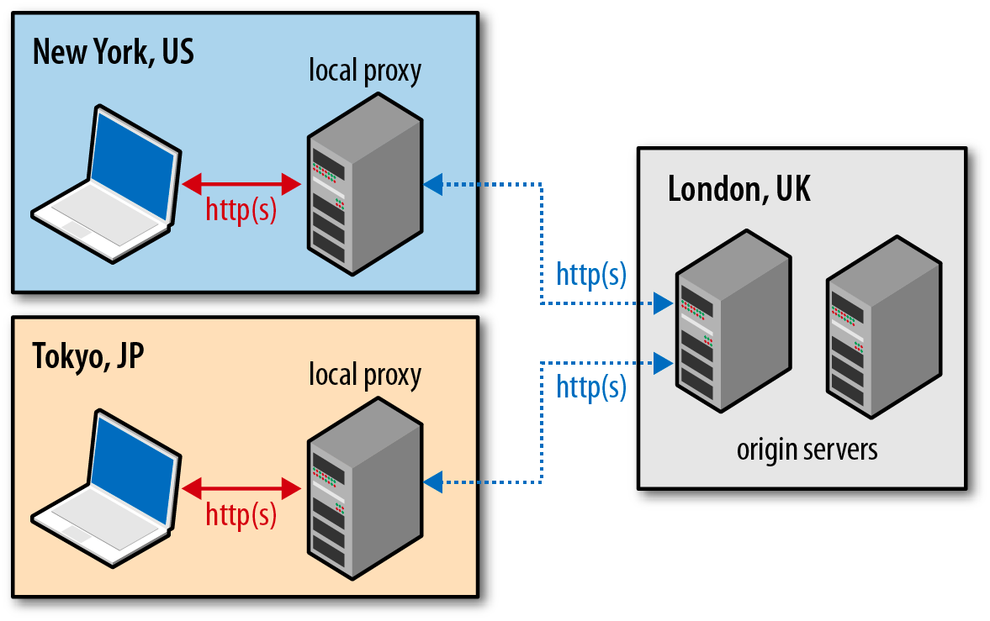
Terminate TLS at the CDN edge...
CDNs are not just for static content. Edge termination can significantly reduce TCP and TLS handshake costs!
RTT with origin
*Before you hand over the keys to your kingdom, make your your CDN has their TLS stack optimized! You may be surprised...
RTT with CDN edge

Slide 17
Online Certificate Status Protocol (OCSP)
Has this certificate been revoked?
Stop the world and query the OCSP server
DNS lookup
TCP connect
Wait for server response
What if the OCSP check times out, gets blocked, etc? See “Revocation still doesn’t work.”

Slide 18
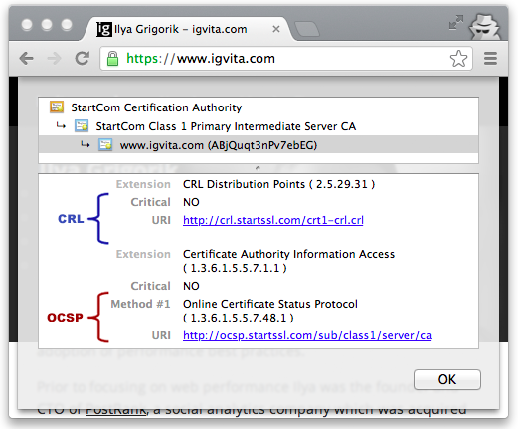
Eliminating OCSP latency
Chrome blocks on EV certs only
Other browsers may block on all (FF)
Use OCSP stapling!
Server retrieves the OCSP response
Server “staples” response to certificate
Client verifies stapled response
OCSP endpoint

Slide 19
TLS handshake with stapled OCSP response...
$> openssl s_client -connect example.com:443 -tls1 -tlsextdebug -status
OCSP Response Data:
OCSP Response Status: successful (0x0)
Response Type: Basic OCSP Response
Version: 1 (0x0)
Responder Id: C = IL, O = StartCom Ltd., CN = StartCom Class 1 Server OCSP Signer
Produced At: Feb 18 17:53:53 2014 GMT
Responses:
Certificate ID:
Hash Algorithm: sha1
Issuer Name Hash: 6568874F40750F016A3475625E1F5C93E5A26D58
Issuer Key Hash: EB4234D098B0AB9FF41B6B08F7CC642EEF0E2C45
Serial Number: 0B60D5
Cert Status: good
Stapled OCSP means no blocking!
OCSP stapling increases certificate size! Is this a problem for your site? Better check.

Slide 20
How many RTTs does your certificate incur?
3+ RTT TLS handshake due to 2 RTT cert?
Average certificate chain depth: 2-3 certificates
Average certificate size: ~1~1.5KB
Plus OCSP response…
Many cert chains overflow the old TCP (4 packet) CWND
Upgrade your servers to use IW10!

Slide 21
Check your server, you may be surprised...
nginx <1.5.6, HAProxy <1.5-dev22 incur extra RTT, even w/ IW10!
Capture a tcpdump of your handshake and check the exchange
Some servers will pause on “large certificates” until they get an ACK for the first 4KB of the certificate (doh!)

Slide 22
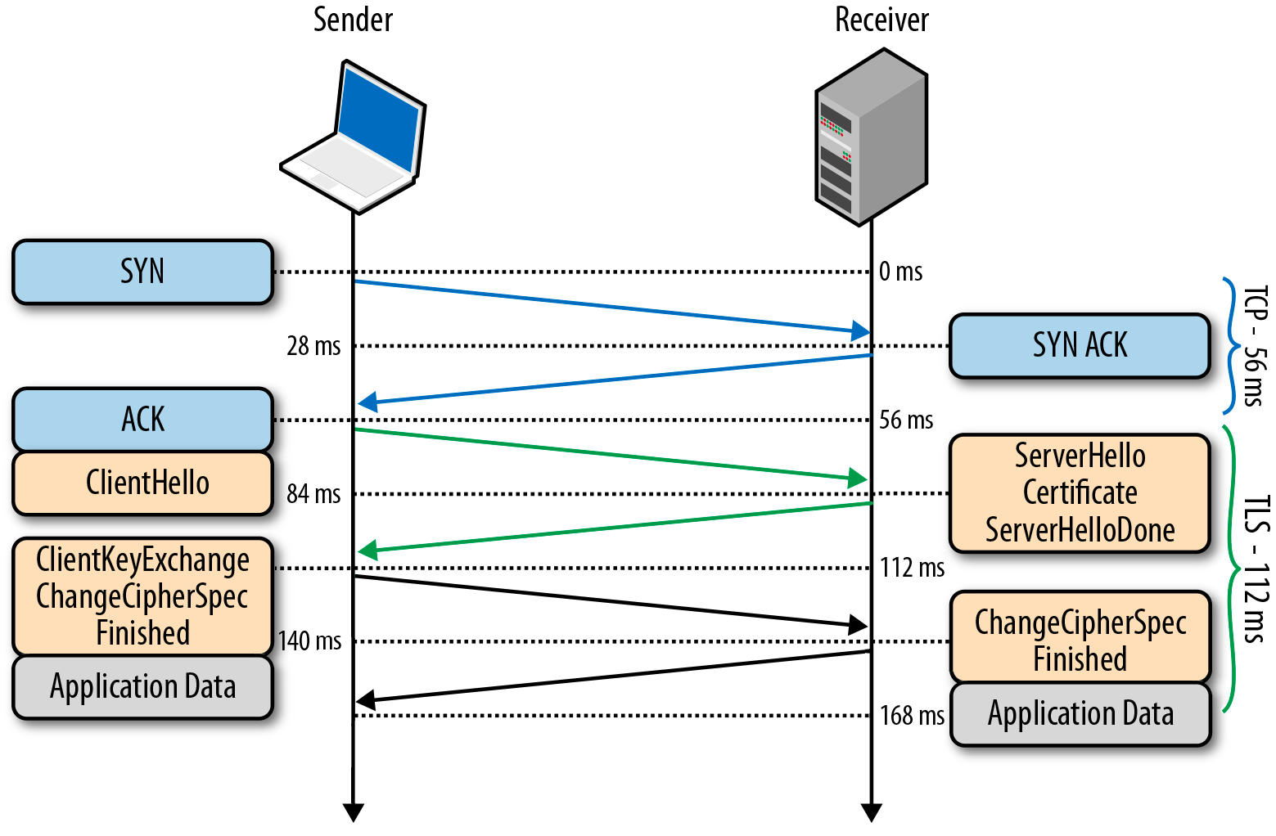
1-RTT non-resumed handshake with TLS False Start
Client sends application data immediately after “Finished”.
Eliminates 1RTT
No protocol changes...
Only timing is affected
In practice…
Some servers break (ugh)
Hence, opt-in behavior...

Slide 23
Deploying False Start...
Chrome and Firefox
Chrome and Firefox
ALPN advertisement - e.g. “http/1.1”
Forward secrecy ciphersuite - e.g. ECDHE
Safari
Forward secrecy ciphersuite
Internet Explorer
Blacklist + timeout
If handshake fails, retry without False Start
TL;DR: enable ALPN advertisement and forward secrecy to get 1RTT handshakes.

Slide 24
Ingredients for a 1-RTT TLS experience…
False Start = 1-RTT handshake for new visitors
New users have to perform public-key crypto handshake
Session resumption = 1-RTT handshake for returning visitors
Plus, we can skip public-key crypto by reusing previous parameters
OCSP Stapling
No OCSP blocking to verify certificate status
False Start + Session Resumption + OCSP stapling
1-RTT handshake for new and returning visitors
Returning visitors can skip the public-key crypto

Slide 25
What’s wrong with this picture?
300ms RTT, 1.5Mbps...
It’s a 2-RTT handshake… we know better!
At least there is no OSCP overhead!
It’s a 2-RTT time to first byte!
Large records are buffered, which delays processing!

Slide 26
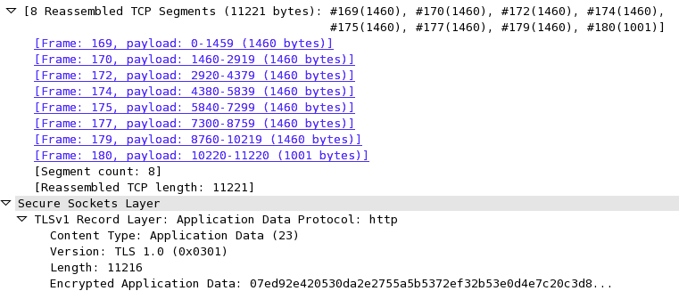
TLS record size + latency gotchas...
This record is split across 8 TCP packets
TLS allows up to 16KB of application per record
New connection + 16KB record = CWND overflow and an extra RTT
Lost or delayed packet delays processing of entire record

Slide 27
Optimizing record size…
Google servers implement dynamic record sizing
New connections start with 1400 byte records (aka, single MTU)
After ~1MB is sent, switch to 16K records
After ~1s of inactivity, reset to 1400 byte records
Most servers don’t optimize this case at all...
HAProxy recently landed dynamic sizing patch - yay!
Nginx landed ssl_buffer_size: static override - better, but meh...
Cloudflare released patch for Nginx dynamic record sizing
TL;DR: there is no “perfect record size”. Adjust dynamically.

Slide 28
Quick sanity check... theory is great, but does this all work in practice?

Slide 29
Tuning Nginx TLS Time To First Byte (TTTFB)
Pre 1.5.7: bug for 4KB+ certs, resulting in 3RTT+ handshakes
1.7.1 added ssl_buffer_size: 4KB record size remove an RTT
1.7.1 with NPN and forward secrecy → 1RTT handshake
https://www.igvita.com/2013/12/16/optimizing-nginx-tls-time-to-first-byte/

Slide 30
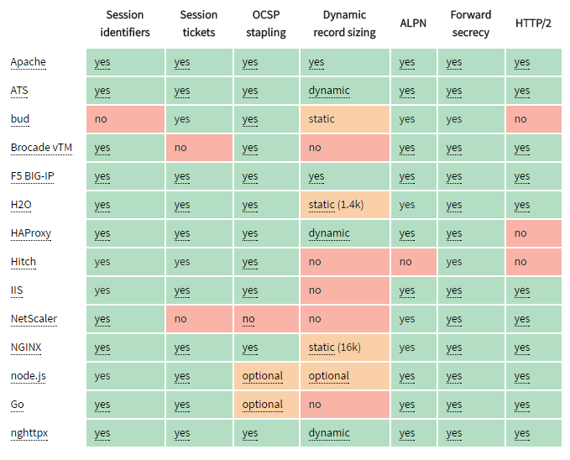
https://istlsfastyet.com/#server-performance

Slide 31
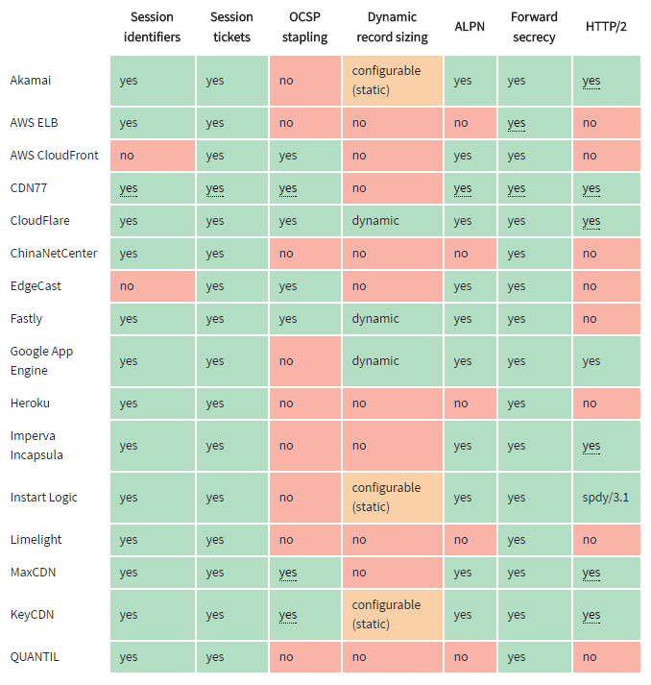
https://istlsfastyet.com/#cdn-paas

Slide 32
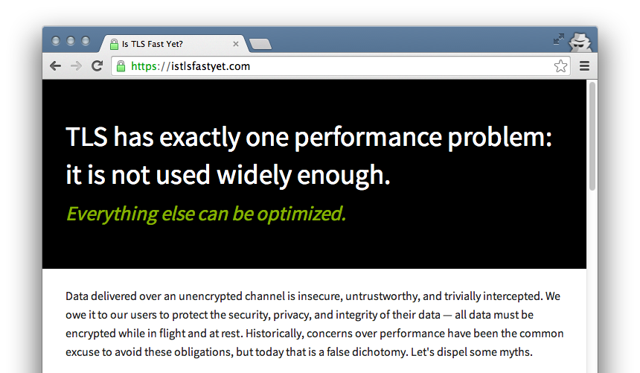
isTLSfastyet.com

Slide 33
More HTTPS Debugging

Slide 34
CSP Violation Reports
HTTP Response header
Content-Security-Policy-Report-Only:
default-src https:;
report-uri http://reportcollector.example.com/collector.cgi

Slide 35
Strict Transport Security - HSTS
Server response header
Strict-Transport-Security: max-age=15768000; includeSubDomains; preload
Chrome/Firefox preload list

Slide 36
Key Pinning - HPKP
Reducing/Reporting MITM attacks
Server response header
Public-Key-Pins:
report-uri=https://example.net/pkp-report
Doesn’t apply to “local trust anchors” ☹
Chrome, Firefox, Opera

Slide 37
Thank You!
Tim Kadlec (@tkadlec) & Pat Meenan (@patmeenan)
June 20-21, 2016 at Velocity Conference (#velocityconf)
Icons courtesy of The Noun Project

