Slide 1
20% blissful, 80% ignorance.

Slide 2
Notes:
Lets say you like strawberries

Slide 3
Strawberries
Time
Notes:
This is a good thing as everyone is talking about how more strawberries are now available than have ever been available before.

Slide 4
Notes:
Also, studies have shown that strawberries are good for your health

Slide 5
Notes:
and more and more strawberry handling technologies are available all the time.

Slide 6
Notes:
The government is even making it’s own strawberries available

Slide 7
Notes:
Strawberries are brilliant

Slide 8
You don’t have any strawberries!
Notes:
You don’t have any strawberries

Slide 9
Notes:
<pause>
So now what do we do?

Slide 10
Strawberry Strategy!
Notes:
What we need is a strawberry strategy!

Slide 11
Notes:
Lets say you like strawberries

Slide 12
Notes:
Regardless of where you get them, if you don’t store them property they rot.
And after you spent your hard earned cash on getting here as well.

Slide 13
Notes:
<pause>
So now what do we do?

Slide 14
0
Notes:
So you learn to make Jam.

Slide 15
Notes:
Then you start a new relationship and your new partner decides it’s healthier to eat fruit salad.
New fruit, new techniques, new investment.

Slide 16
Notes:
<pause>
So now what do we do?

Slide 17
=
Notes:
You have probably already guessed; Strawberries equal data
In both cases, there are people who will tell you it is easy to get hold of.
In both cases, this is not true.
What a glib analogy. Fun, but that’s not why I am here.

Slide 18
Why?
Notes:
Why am I here?

Slide 19
Notes:
I believe that data is important.
I believe data has huge potential values

Slide 20
Notes:
And I am pissed off because people keep saying it is easy.

Slide 21
Who?
Notes:
Who am I talking to? 50% people who feel the pain. 20% people who want to understand. 30% of people who will be upset and disagree with me.

Slide 22
Notes:
Poorly set expectations lead to the trough of despair.

Slide 23
DATA HAS FAILED
Notes:
And people coming out with rubbish like this

Slide 24
What for?
Notes:
In society and business, this value is very real. Data helps people, like in the Humanitarian data exchange or the typhoid studies in soho. In business it teaches you about your business and makes your decisions better. In business you will want 1 of three things.

Slide 25
Better
Customer
Understanding
Actionable
Insightful
Reports
Automated
Decision
Making
Notes:
Chances are you want one of these three things
And you want to achieve it through the use of data.
Chances are you have tried to get it before and failed.

Slide 26
Report
You
Have
Report
You
Want
Notes:
Chances are also, you have tried to make a change in an existing data system
And it was much more expensive or took longer than you expected.
Isn’t change always harder than you expected?

Slide 27
Notes:
Even more likely is that your data team is overworked, have long lead times and keep asking for more money for new tools or people. They also probably seem strangely stressed and angry.
2am 7 days a week is not healthy.

Slide 28
Boring, Horrible,
Grunt-work
Notes:
Boring, horrible, grunt work.
That most people ignore this.
They sweep it under the carpet and pretend getting what they want is easy.
Strong section, why I am doing. Who am I speaking to? People who work with data, and it hurts. People like me who are really trying to make the data work. There will also be the people who are frustrated with their data department. There will also be the people who disagree with me. Fine, lets have a conversation.
Why? Because I think this work is where a huge amount of time, money and stress is wasted.
So what does a business want?

Slide 29
La,
La,
La,
Not Listening!
Notes:
It’s because you are not making data a first class citizen and are ignoring the real work that goes into the data driven thing you want. For the long term.
Making data a first class citizen means truly putting data at the heart of your organisation, thinking about data first over application. Making data a truly strategic asset.

Slide 30
DataOps
Is what you should focus on
Notes:
DataOps is what you should focus on, it’s not glamourous, it’s not easy, it’s not pretty but it is the root of all the things that you want. This is not data science, this is not data engineering. I suppose Google would call it Data Reliability Engineering.

Slide 31
DataOps Is:
Landscaping
Politics
Empathy
4. Authentication
5. Acquisition
6. Processing
7. Quality
8. Monitoring
9. Debugging
10. Hard
Notes:
No matter how automated you think everything is. No matter how quietly it hums in your business. This is going on. And as soon as you want anything new or any kind of change, this is definitely going to be the most important thing in your life. Whether you think so now or not.
All of these lead to the delivery of what you want.

Slide 32
‘Implicitly, the daily upkeep of data-driven processes become second-nature as aspects of data stewardship, provenance, integration, and even modelling simply become due diligence for everyone’s job’
https://analyticsweek.com/content/the-blueprint-for-becoming-data-driven-data-quality/
Notes:
Great example from Analytics Week. They are talking about what I called ‘Data Ops’

Slide 33
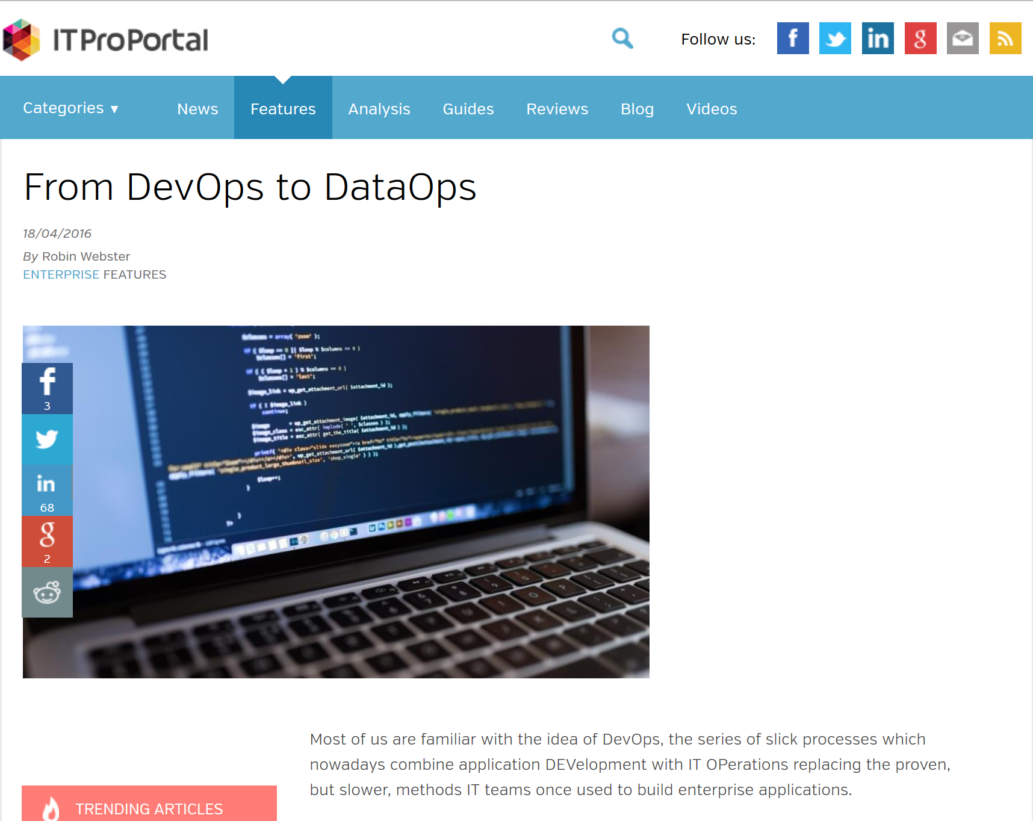
‘We believe there are four layers to the DataOps process, which in most cases means four skillsets. Information Consumers, Business Analysts, Platform Operations, Infrastructure Operations’
http://www.itproportal.com/2016/04/18/from-devops-to-dataops/
Notes:
IT Pro Portal from April

Slide 34
ETL
Data Governance
Notes:
Wait a second, side note, this sounds like ETL in part and Data Governance?
That’s because, in part, it is. ETL, extract, transform, load being the general process for getting data from one system to another. Data Governance being the control framework surrounding a data system. Both these things feel all-too-enterprisey and unsexy. So many good people don’t know what they are or ignore them.

Slide 35
Harsh
realities

Slide 36
1 >
30billion
Notes:
The first entry in your system costs more than the next 30 billion.
We have the tools for processing petabytes of data. Great. But we still have to do all the work to make them dance. That work is cost.

Slide 37
6250p/hour
£500 per day
18p/hour
£4.32 per day

Slide 38
Notes:
Your data supplier doesn’t care about you.
And they will do things that make your life difficult. No matter how much funding, how big, or how clever they are their user experience will suck.

Slide 39
{
"dataset": {
"name": "Some data",
"column_names": [
"Date",
"Open",
"High",
"Low",
"Close",
"Volume"
],
"frequency": "daily",
"type": "Time Series",
"premium": false,
"data": [
[
"2016-02-18",
38.65,
39.1,
38.4,
39,
6588471
]
]
}
}
Document & Tabular paradigm
Mixed type array.
Notes:
Here is an example of some open data provided by a company who exists to tidy it up.
The site this comes from, which will remain nameless, is really good. I like it and would encourage people to use it.
It’s tick data and contains a multivariate time series.
However, it has some issues:
Even in a JSON doc thinks about things in a table.
And the actual data, well it’s a mixed type array. Which assumes a certain kind of programming language.
Dynamically typed like Javascript or Python.
Parsing this is harder than it should be. You have to know a lot about the data before you use it.
The point here is not that they didn’t give a damn.
It’s that they gave the wrong damn. Assumptions ruled.

Slide 40
‘Fields containing a line-break, double-quote, and/or commas should be quoted. (If they are not, the file will likely be impossible to process correctly ).’
2014-10-01,”€10,100.50”,6.5%,€12.50
2014-10-01,””€10,100.50,6.5 ”%”,€12.50
Notes:
Standards: often completely ignored. Take this CSV example

Slide 41
06000000320120702162004002401 000392 0100000000000000000000000
06000000520120702012000002801 000394 1100000000000000000000000
06000002320120702012000003401 000392 1100000000000000000000000
06000002320120702012216001701 000892 1100000000000000000000000
06000004020120702032005007201 000392 0010000000000000000000000
06000005020120702012005002301 000392 1000000000000000000000000
06000006120120702012000002901 000396 1100000000000000000000000
0600000942012070201200800271120003742012070220011000000000000000000000000
0600000942012070201220500091120003742012070220191000000000000000000000000
06000011220120702012011000101 000362 0100000000000000000000000
06000011220120702012016000201 000362 0100000000000000000000000
06000011620120702012027003201 000362 1000000000000000000000000
06000011620120702012201002601 000362 1000000000000000000000000
0600001212012070201220800231120451562012070222051100000000000000000000000
06000015520120702012012001401 000874 1010000000000000000000000
06000015520120702012026000401 000874 0110000000000000000000000
06000018220120702012202004201 000382 1100000000000000000000000
06000020820120702012013000101 000884 1100000000000000000000000
06000022420120702012200003301 000386 1100000000000000000000000
06000025720120702032218000301 000312 0101000000000000000000000
06000026620120702012213001701 000432 1000000000000000000000000
06000028320120702012020000401 044064 1100000000000000000000000
06000028320120702012202003201 000434 1100000000000000000000000
0600002982012070201222100321120004342012070219291100000000000000000000000
06000032120120702012002007201 000314 1100000000000000000000000
06000033120120702012016001601 000942 110100000000000000000000
06000034320120702012209001801 045154 1000000000000000000000000
06000035920120702012000002801 000444 1000000000000000000000000
06000036620120702012000002801 000322 1100000000000000000000000
06000036920120702012205003201 000446 1100000000000000000000000
06000037620120702012225001201 000432 1100000000000000000000000
06000039420120702012215000101 000326 1000000000000000000000000
0600003942012070201221600110520003262012062922411000000000000000000000000
06000040120120702012202001801 000324 1000000000000000000000000
06000042820120702012003002601 000342 1000000000000000000000000
06000042820120702012203001701 000342 1000000000000000000000000
06000043620120702012027008601 000344 1100000000000000000000000
06000043920120702012216000201 000352 0100000000000000000000000
06000043920120702012218000701 000852 0100000000000000000000000
06000043920120702012225001201 000352 0100000000000000000000000
06000044820120702162222000601 000344 1100000000000000000000000
06000045420120702012000002901 000342 1000000000000000000000000
06000047420120702012000002901 000354 0100000000000000000000000
06000048720120702012217000301 000352 1000000000000000000000000
06000050920120702012200003101 000402 1100000000000000000000000

Slide 42
Notes:
Data is not software.
Applications are where data goes to die

Slide 43
A. Data within your organisation
*
B. Data useful to an application
∩
B A
*Definitely not a moon
Notes:
Data, correctly managed, outlives the applications you currently use to work with it.

Slide 44
+
!=
Notes:
DevOps is not DataOps
Different skills, different focus.
Knowing SQL doesn’t mean you understand data. Knowing Pandas doesn’t mean you understand what the business needs.

Slide 45
Soc.
Med.
Web based insights portal & API give different values.
Profile stats only available when post made.
Spred
cell
Print areas affect the way cell ranges are handled.
Colour is very hard to use programmatically.
Web
alytics
Segments based on regex.
User change segments, data looks the same to code.

Slide 46
Notes:
There isn’t one database for everything. Yes, for a particular application at a particular time one database can server your needs. But if you are truly making data a first class citizen and utilise data successfully over the long time…
You must embrace polyglot persistence and understand what it takes to move data around and change it for specific purposes. Chances are, you are doing this already.
So ETL will be a fact of life. You will need to move data around.
Your solution will not be simple, make peace with that.

Slide 47
Real-time
Networks
Different Needs
Transactions
Analytics
Applications
Images
Notes:
Different systems, different data types, different needs require different tools. Just because you have a hammer…

Slide 48
>
Notes:
In my view, ETL is the biggest challenge you will face, no matter what you call it.
There are two kinds of people I have met. Those who do ETL and understand how much of a pain in the arse it is. And those who don’t know their pain in the arse is called ETL.

Slide 49
A. The data that you want
B. Things you control
Notes:
This one is fairly obvious. Data comes from the place that you don’t control.

Slide 50
Unintentional
Lies
Notes:
DataOps is hard because of the unintentional lies we all tell and we all hear and believe. We believe them because we want them to be true. Here is a few I have met – naming no names. Have you said any of these things?

Slide 51
“We have the data!”
LIE!
Notes:
My example for this is, naming no names, is in the television business. A service a love, traditional and online. When they built their online presence they tagged it to the hilt. Great. Lots of data there. Can the team studying user behaviour use that data? No. It’s in a different department, somewhere else.

Slide 52
You don’t have the data,
until you have the data.
Notes:
You don’t have the data until you have the data. This means, in your domain, that you can look at, process and work with. Someone else telling you they have it is not the same thing. I have met some people working on this. Looking to improve customer analytics in a bank. They are focusing on the politics part of data ops. Negotiating contracts of access early in the process, so once they have accessed the data once, they can get it again.

Slide 53
“Instant cloud BI platform!”
LIE!
Notes:
This one is just sales and marketing rubbish. There are several companies out there offering a magic button for data, especially in the BI space. They often have a huge amount of funding and have spent a load of it on capturing the buzz word space that the data illiterate will fall for.

Slide 54
Look at the developer documentation, there is always hard work needed.
Notes:
Take a moment to look at the developer documentation. You will soon see that the real business is consulting, not software. One site, the first three boxes in ‘Logical Data Modelling’ documentation were warnings (in red) about how hard LDM is. How it is not a common skill. And how by changing the LDM all the dashboards will break. So, as long as you have a team who can handle the DataOps and not break everything, it will be ‘instant’ right? Remember those overworked, stressed and angry people who keep asking for more budget? Even after you purchased this ‘instant’ cloud solution? Into which you have now poured more budget for consult?

Slide 55
“You just put the data in!”
LIE!
Notes:
The word ‘just’ in this sentence means ‘You have to get the data, understand it, manipulate it, quality control it, understand the loading mechanism, understand the terms and conditions, understand the data model and it’s restriction, connect systems, monitor and correct errors’. You know, ‘just’ means DataOps.

Slide 56
You have to put the data in,
and that is most of the work.
Notes:
Take a large, modern, relational database. If it’s one you buy, then only 30% of the cost you pay will be the database licence. The rest will be split between consulting and ETL. Even if the database is available to download and build ‘free’, open source for example. Even if that database is Hadoop or Spark. There is 70% cost in money or time you have to deal with.

Slide 57
“Data is now easy!”
LIE!
Notes:
I was shocked to hear at a meetup. A ‘data scientist’ was giving a presentation and these words came out of their mouth. Just before they went on to describe getting stolen data from Tor, setting up Redshift, poking the data in there, then analysing it using ML in python.

Slide 58
Selling data is now easy
Notes:
And this sales, this lie is inhibiting the value that data can provide.
People are ended up disappointed and not liking data.
You are making the problem.
Lets take “Data is the new oil”. Liquid gold right? Who ever said Oil was easy?
Oil is one of the dirtiest, hardest jobs there is.
It’s not data’s fault, it’s people’s fault.

Slide 59
Data is hard, really.
Notes:
They have mislabelled ‘possible’ and ‘we worked hard to get here’ as ‘easy’. It’s the common fallacy of success. It’s a misrepresentation. On the flip side, I have met a company who have built a business around Redshift and the fact that it needs careful management. They make good money because the reality is, it’s not easy. Data is hard. It’s a horrible mess for most business who are not highly specialists. You will need help, time, money and experience. Experience takes time. A startup, making data a first class citizen from the start is in a very different postion from an established company who wants to start using data more.

Slide 60
Notes:
Lets say you like strawberries

Slide 61
What can we do about it?

Slide 62
Awareness
Acceptance
Desire
Action
Notes:
Going back to why I am here today, I am pissed off that we still have these problems and good people, time and money is being wasted. Expectations are being mismanaged and people are disappointed. Data is brilliant, we can do wonderful things with it. But we won’t unless we deal with the DataOps.
Don’t wait to have the pain, go and hunt out the source of your pain. I know you will find the things I have talked about if you look. When you find it, you can then work out how to change it. But just hiding from it wont’ help.
You can’t take meaningful action until you have increased your awareness and accepted that you have a problem. So many businesses start with the ‘we must do more with data’ motivation and entirely miss how they are using data now and what a small first step might look like. Wasted time, wasted money.

Slide 63
Success?
Notes:
What did I hope to achieve today?

Slide 64
Just one person…
Notes:
I just want one person to feel understood
Just one person has realised why their colleague is stressed and working late all the time.
Maybe just one person will stop saying ‘Data is easy’.

Slide 65
@codebeard
phil@datashaka.com
http://datashaka.com
Making data for analytics easier.

