Slide 1
Rethinking security from the ground up with a microservices mindset
OSCON 2016
Andy Randall | CEO, Tigera | @andrew_randall
May 17, 2016

Slide 2
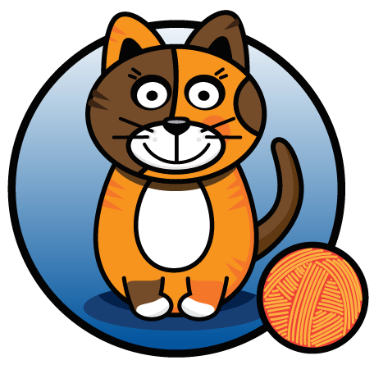
Introductions

Slide 3
Notes:
I’d like to begin by reminding you of something you already know: which is that networks matter.
The application you want to build doesn’t fit on a single machine. Computers have gotten faster, but our ambitions have outstripped what a single host can handle. In previous generations of web application architectures, the network was the thing that allowed you to reach your users.

Slide 4
Notes:
Now it is integrally involved in the composition of the application itself.
So, container networking is important.

Slide 5
Notes:
We now come to our final act, Act III: Attacks.
Monday, November 24th, 2014. Just a little over a year ago, Sony Pictures Entertainment employees logged in to their computers in the morning and what they saw was this.
I’m quoting Fortune.com here: “Before Sony’s IT staff could pull the plug, the hackers’ malware had leaped from machine to machine throughout the lot and across continents, wiping out half of Sony’s global network. It erased everything stored on 3,262 of the company’s 6,797 personal computers and 837 of its 1,555 servers.”
Now, although the initial messages like these didn’t say so, we now believe the “who” and “why” of this story are North Korea and the Sony Pictures film The Interview, whose plot involved the assassination of North Koreas sitting political leader, Kim Jong-un.
The broader lesson from this story in “how.” How were the attackers able to cause so much distruction?

Slide 6
…For more than two months Sony’s hackers roamed freely, identifying what they wanted to steal. This was possible because the studio, with few exceptions, didn’t segregate or provide extra security for even its most precious secrets. In effect, once the invaders made it past the network gates they could go anywhere they wanted because Sony hadn’t locked any doors.
Notes:
Well, here’s how.
Emphasis my own: “once the invaders made it past network gates they could go anywehere.”
Sony Pictures built defenses along the perimeter of their network.
And this isn’t the only example: every month it seems there’s a new one: Target, Home Depot, eBay, Anthem, …

Slide 8
DMZ

Slide 9
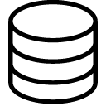
Generalizing to the n-tier DMZ (where n usually = 3)
Notes:
Outer tier – the web
Middle tier – business logic
Inner tier – data
This has become synonymous as the way we build our networks.
Real security for the data – these are the crown jewels.
Getting more militiarised as we go down

Slide 10
Fast forward to the present
Notes:
So, fast forward to the present. What does the architecture look like? Well, application specific machines are now replaced with racks of general purpose servers. Commodity Hardware. Easily interchangeable. Centralized monitoring. Multiply redundant.
And, on top of this physical infrastructure I deploy virtualized application services. And then I set up my virtual network on top of the physical network and… SURPRISE!, it’s the same architecture!
One of my colleagues was relating a recent story where he was building an application for a big enterprise, law enforcement. They consider themselves pretty progressive, pretty “with-it” when it comes to technology. Fully virtualized compute and storage and when it came to think about deployment, their ops manager handed him a form…

Slide 11
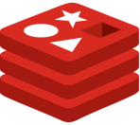
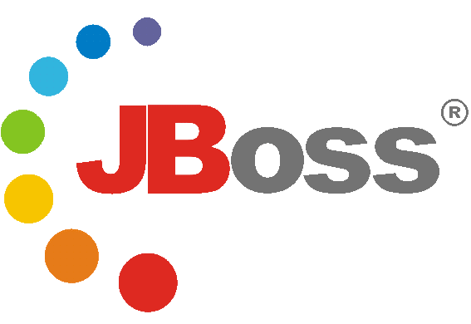
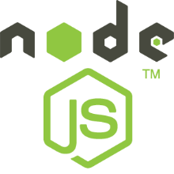
Increased complexity
Notes:
… and asks me to fill in all their services. Which ones need access from the Internet?, those go in the Web tier. Which ones access data?, those are in the Data tier. Anything else? App tier! Web can’t access Data directly. Why? There are design rules!
At the time, he had seven services that made up my app; not micro-services. It took a bit, but he could fill-in all the ports and IPs that he needed him to open on the firewalls. Until he forgot one and the application couldn’t connect. Raise a ticket! 2 days later, firewalls updated and I’m back in business. Then, a few weeks later, I wanted to add a new service: raise a ticket!
Oh, you want to stand up a second application stack in this environment? Maybe a third? So this is where we are today before you even add micro-services into the mix. Before long your developers are going to have 10 Pythons chasing 30 gophers, and they’re going to want to change it every week, then every other day, then every day and then every push.
And this is the first part of the challenge with micro-services. Developers want to push change at a faster and faster rate. So, do put your foot down and “you have to go through security to modify the network, start early.” If you do, congratulations, now you’re the bottleneck to innovation in your software company. Or, do you open wide the gates?

Slide 12
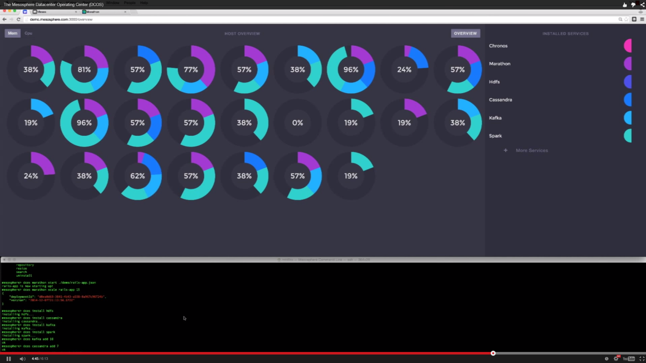
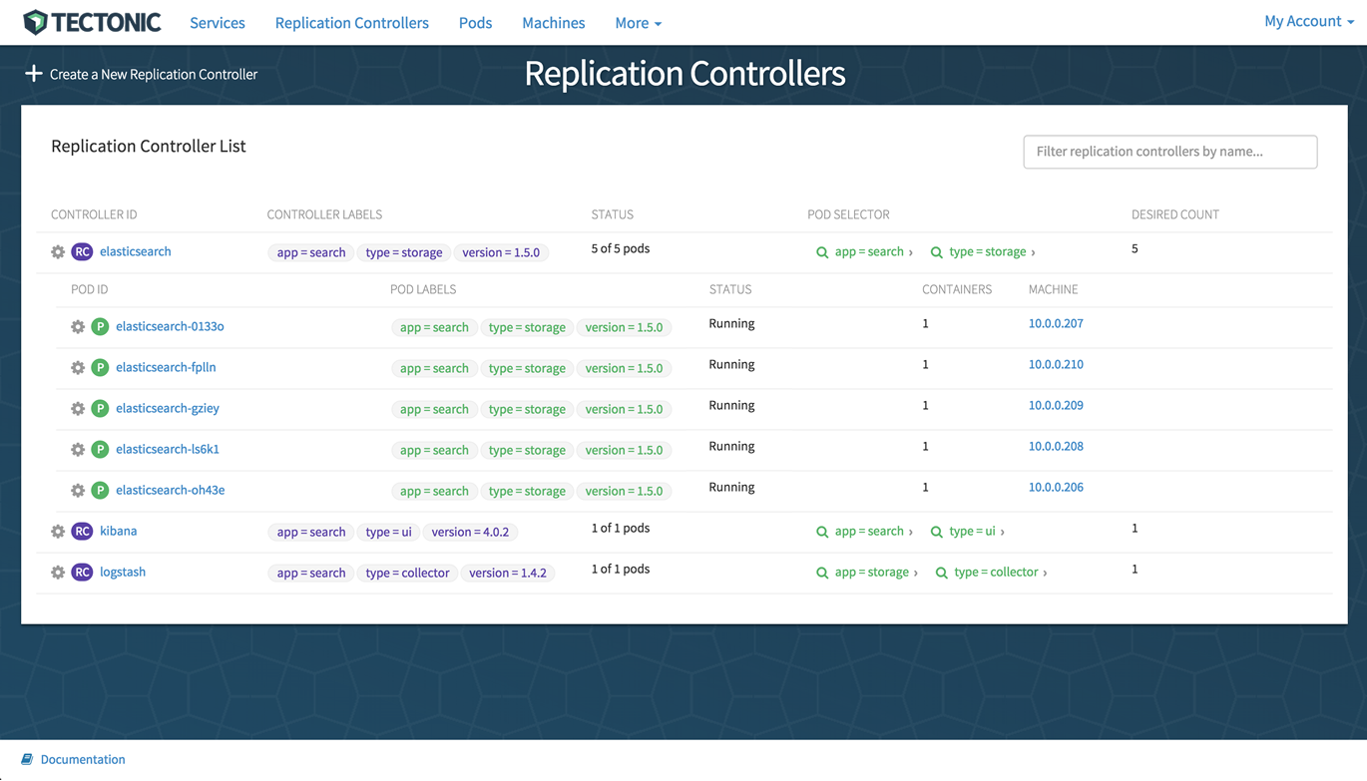
Resource Fungibility
Notes:
Let’s think about the second issue with micro-services from the standpoint of network security. You’ve probably heard of Tectonic: CoreOS + Kubernetes, and Mesosphere. What they have in common is the vision of a datacenter operating system---an environment that takes care of the detail that your application is distributed across hundreds or thousands of servers. You can call this property of modern datacenter architectures fungibility. Each host is mutually interchangeable with any other. That means that any service instantiated in your should be able to be deployed on any host, and you should be able to scale any service across your whole data center.
[back one slide] This is not fungible. I’ve divided my datacenter into zones and I’m dependent on the firewalls to enforce security.

Slide 13
Virtualize the n-tier model with layer 2 overlays + virtual firewalls?
Virtual L2 network
Virtual L2 network
Virtual L2 network

Slide 14
Tear down the walls?
Notes:
Do you double down on virtualization, build 3 virtual L2 zones connected by virtual firewalls and somehow scale your virtual network resources as the services in them scale?
Or, do you tear down the walls at the zoo and let the animals roam together?
So, that’s the problem. Things are moving fast and will move faster, and people want the datacenter to present fungible resources, they want to autoscale their applications and have service instances deployed by scheduler which pack things for maximum utilization of the expensive hardware it takes to run a datacenter.

Slide 15
The opportunity?
Notes:
But it’s not all bad news for micro-services from the perspective of network security. Micro-service have a really useful property: they are compartmentalized.
Building applications this way naturally forces you to break down large, monolithic applications into constituent parts and isolate them. That means that if one gets compromised, your attacker gets only a small amount of information, and only a small amount of power to subvert the rest of your system.
They’re also, by definition, small! The goal is for each service to do one thing and do it well. This makes it much easier to analyze an application from a security perspective. Each service does something simple and probably only needs to talk to a few different things.

Slide 16
The opportunity?
Notes:
So, this is the dream: break the application up into compartments that are easy to understand and easy to analyze, and then isolate them. Containers give you isolation within the host OS, and what I’m talking to you about is network isolation.
Now, of course, we can’t have a functioning application if the containers are completely isolated: they need to communicate, but only over a few specific ports to specific destinations.
This is a tough nut to crack. Firewall every instance of every micro-service, opening just the ports it needs to communicate over and to just the specific addresses it needs. So now, attackers need to do more than just breach your castle walls---make them fight tooth and nail room by room, container by container. Every service instance exposes just the minimum surface.

Slide 17
The Distributed Firewall
eth0
eth0
192.168.1.2
192.168.1.5
10.0.0.1
Network
Fabric
10.0.0.2
eth0
Routing
eth0
eth0
Routing
eth0
192.168.1.4
192.168.1.6
eth0
eth0
192.168.1.7
192.168.1.3
Notes:
This is a fundamental assumption in Kubernetes, it’s getting added to Mesosphere. You can use Project Calico to do this on either or whatever container orchestrator you want. If Calico doesn’t fit your use case look at Weave, look at Flannel, they support this too.
The problem of resource fungibility, that containers need to run anywhere in the data center means that the firewall needs to be closely coupled to the service instance. It needs to be where the container is and needs to live and die with the service. In Calico, each container has a virtual Ethernet interface that connects to the main network namespace and we turn on kernel routing to route packets in and out of containers. To properly isolate each service, we need to instantiate a per-instance firewall right here. In the container host Linux kernel, tied to the particular virtual interface for that instance.
The scale of containers and rate of change means that this needs to be automated. You can’t provision these manually based on opening tickets.

Slide 18
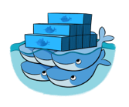
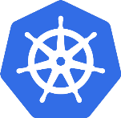
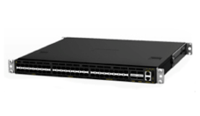
Project Calico architecture
Developer intent from orchestrator
eth0
iptables
192.168.1.2
Felix
Routes
eth0
192.168.1.4
Route
Reflector
eth0
BGP
192.168.1.7
Kernel
Route as native IP without L2 overlays
Notes:
Brief interlude on Calico architecture
Let’s take a closer look at how this works. Here I’ve focused on just one container host. In the Linux kernel we have routing information and iptables to control the firewalls. There is a Calico agent, named Felix, loaded on each compute host, and it programs local routes and sets up iptables.
In order to program the firewall, it needs to know the policy for each container, and the IP addresses of the services that container needs to talk to. To store all that state consistently, and distribute it to all the container hosts, we use an etcd cluster. Each Felix watches etcd for changes, as services are created, destroyed and rescaled.
Where does that information come from? Well, it comes from the orchestrator or data center operating system. This could be Docker Swarm, or Clocker, or Mesosphere, or Kubernetes, or whatever. We just need a Calico plug-in that takes that state about the services and writes it to etcd.
I don’t want to spend too much time on the routing side of Calico in this talk, but I’ll just say that Calico is pure IP without any encapsulation or overlays. So, we need to distribute the routing information to all of the container hosts. Felix only programs the routes to local containers---we use a BGP client to distribute this to the rest of the cluster. You could use etcd for that too, but BGP is a good choice because it’s an open, standard protocol that router jockeys are used to. It also means that you can connect up to your data center infrastructure directly: any routers in your fabric or the edge routers that connect your data center to the Internet or your organization’s network. If anyone wants to talk in depth about that, find me later.

Slide 19
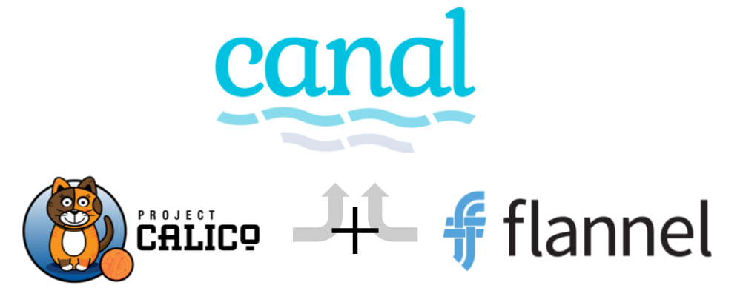
Where this is headed…
De facto industry standard for policy-driven networking for cloud native applications
Flat routed IP networking with fine-grained policy
Broad set of overlay options

