Slide 1
Building a fundable open source company
May 18, 2016

Slide 2
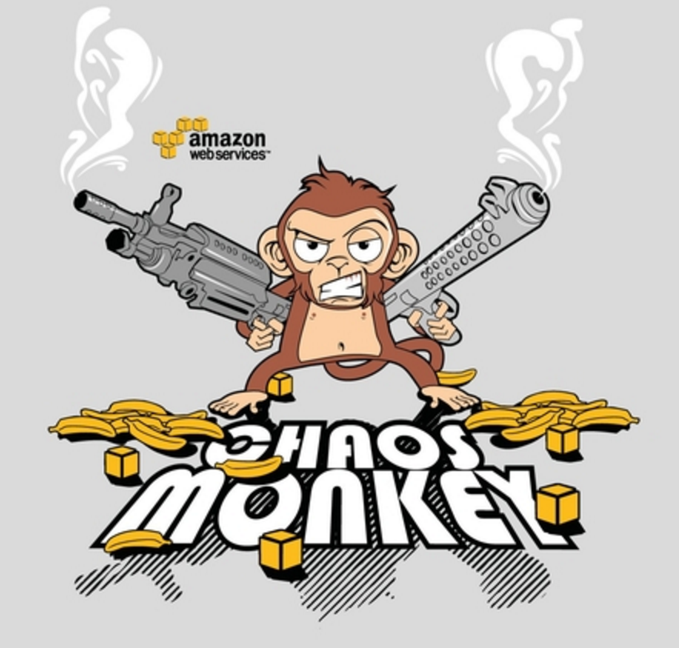
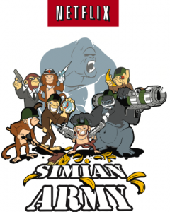
About me
Partner @ Scale Venture Partners
Operations & Cloud Engineering @ Netflix
Founder CTOWorks
Engineering / Products @ Startups
Engineering @ Siebel Systems / Oracle Corp
UC Berkeley CS / Wharton MBA (Finance & Marketing)

Slide 3
About Scale Venture Partners
>$1B total under management
Early 2016, ScaleVP V, L.P., $335M
Funding early-in-revenue enterprise software
SaaS, Cloud Infrastructure and Security
Agari, Box, Chef, CircleCI, CloudHealth, Datastax, Demandbase, Docusign, Hubspot, PubNub, RingCentral and Threat Stack

Slide 4
Why Open Source
Do good
Make money
Fame & Glory
Notes:
There are lots of different ways to directly make money from open source, and a few indirect ones as well. You could make a compelling argument that developing and contributing to open source projects, if done well, is likely to increase your changes of getting hired and earning a higher salary. The direct ways to make money from open source involve starting a company and figuring out how to get a subset of your users to pay you
Purposefully want to stay out of the philosophy of open source and focus on how to build a company that sells a product or service to generate revenues

Slide 5
Building a company
Two roads diverged in a yellow wood
Notes:
Bootstrap - get to CFBE quickly
Not mutually exclusive. Atlassian is a great example. Founded in 2002 and the founders bootstrapped the company with $10,000 on a credit card. In 2010, they raised $60M from Accel and 5 years later in 2015 went public at a $5.9B valuation
Each has pros and cons. Bootstrapped companies grow slower because it typically takes capital to invest into growth

Slide 6
VC-backed companies are more likely to go public, more likely to be acquired and less likely to fail
Hellmann, Thomas, Puri, Manju, and Da Rin, Marco. "A Survey of Venture Capital Research." (2011)
Notes:
Using over twenty-five years of data from the Census Bureau, Puri and Zarutskie (2011) find that relative to the non-VC control group, VC-backed companies are more likely to go public, more likely to be acquired and less likely to fail. This basic pattern has generally been found in various subsamples over time.

Slide 7
Venture 101
https://en.wikipedia.org/wiki/Venture_capital

Slide 8
Notes:
So the first step in getting your company funded is to understand how you will make money. Let’s start by looking at the biggest successes in the enterprise of open source software. I would submit that there have been three projects that have fundamentally changed the way software is built and delivered and introduced open source to the world. These are Linux, Apache, and mySQL

Slide 9
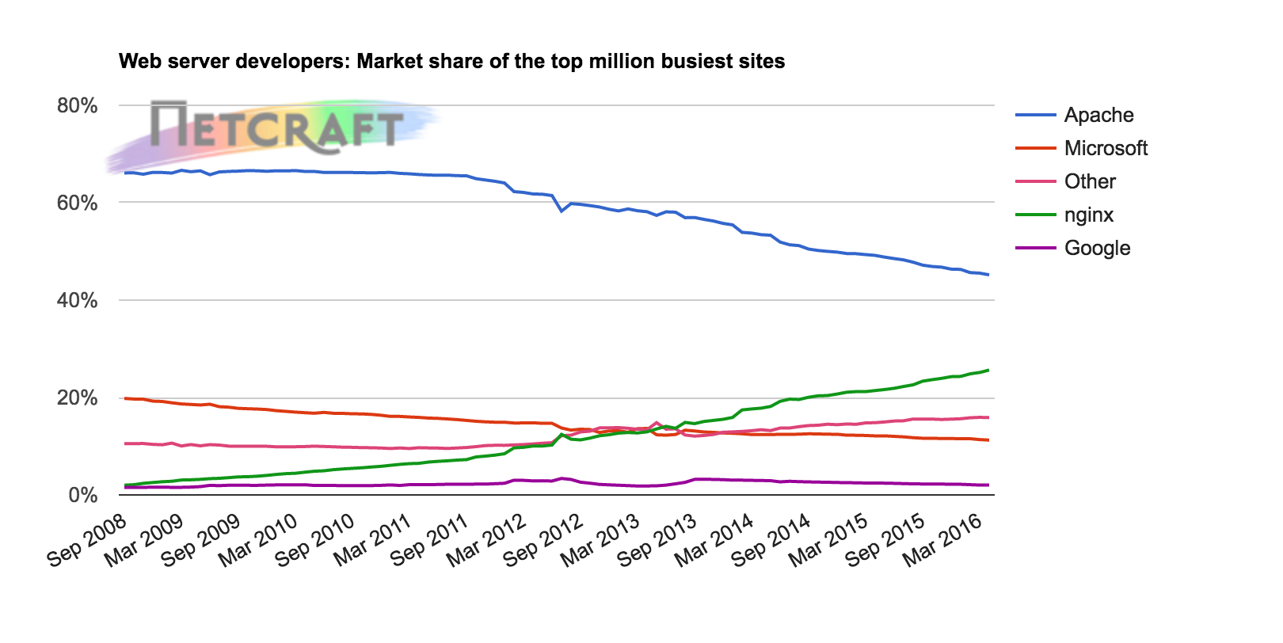
Nginx gaining on Apache
Netcraft April 2016 Web Server Survey (http://news.netcraft.com/archives/2016/04/21/april-2016-web-server-survey.html)
Notes:
Apache remains a community project under the Apache Software Foundation, though its dominance is being threatened by nginx, which does have a commercial entity behind it and we’ll talk about how it makes money later on

Slide 10
Red Hat
Notes:
Red Hat was created to provide enterprise support for Linux in 1993 and went public in 1999. Today, it has revenues $2B per year and it worth north of $13B. It’s by far the biggest company created from an open source project.

Slide 11
MySQL
Notes:
MySQL also had a large financial outcome. It was founded in 1995, sold to Sun in 2008 for $1B to headlines line this one and was later picked up by Oracle in $7.4B when it acquired Sun 2010

Slide 12
First OSS Business Model
Support & Services
Notes:
In the case of Linux and Red Hat, many CIOs needed that assurance of a viable business to be on the other end of support calls before they were willing to put their mission-critical applications on a new operating system. They needed someone to say “this is going to work and you can call us to fix it if it doesn’t”. Then there was indemnification.
Lot of problems with this business model today (1) software matures, linux example (2) more & more becoming software companies

Slide 13
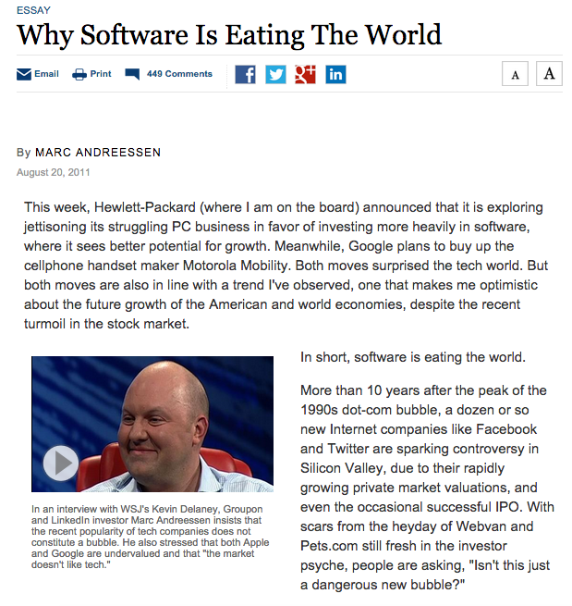
Notes:
Every company is turning into a software company as software extends beyond the online and becomes pervasive in every part of our physical world. We can already see this happening with companies like Nike, Capital One and JPMC, and GE building large in-house software development organizations in what were historically non-software companies. The result is that there’s a higher ability to consume open source software without the need for an insurance blanket from another entity to provide support and services

Slide 14
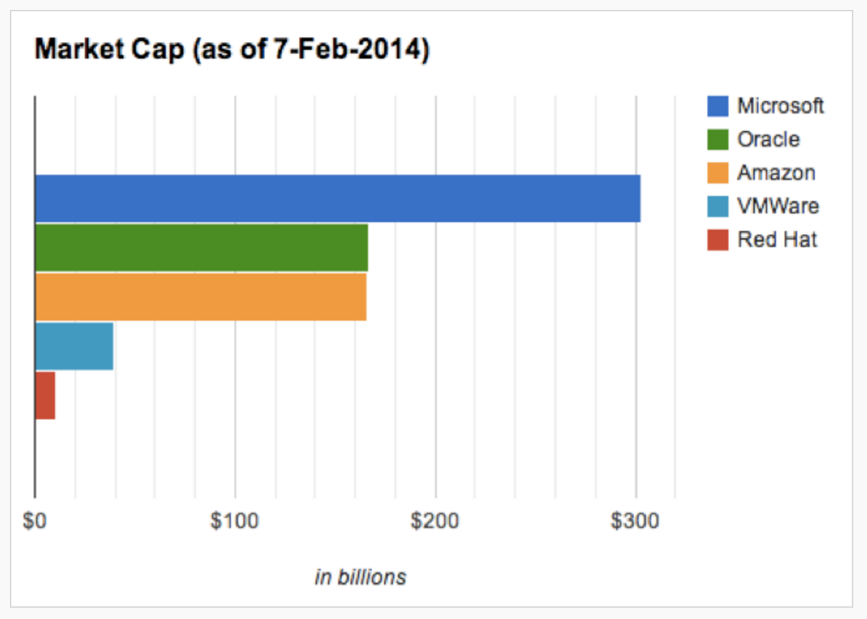
Service Model is Dead
http://techcrunch.com/2014/02/13/please-dont-tell-me-you-want-to-be-the-next-red-hat/
Notes:
3rd reason, is that it’s difficult for this business model to capture enough value to sustain ongoing innovation

Slide 15
What’s Next
Notes:
So if the support and service model won’t work, what comes next? What are viable business models for open source today?

Slide 16
Community
Notes:
One reason that open source has been so quick to takeoff is that every project that gains critical mass develops a core asset that is its community. It’s the strength of the community that tends to determine the eventual success of the project. The challenge in attempting to monetize open source is that you must thread the needle of providing enough value to the community for it to continue to thrive while attempting to extract some of that value through pricing. The field is littered with failed attempts at doing this. A number of business models have emerged since the original support and service model.

Slide 17
Open Core
“Is open source a crappy business? Very true. We didn’t realize this when we started out, but eventually we realized that you have to sell something that is just your own.”
Marten Mickos
Former CEO, MySQL
Notes:
The first and by far most popular one is the open core model. The open core model involves developing a substantial portion of the project as free and open-source software and building a community around that. Other features are then built as proprietary software that typically cater to more of the enterprise use cases.
Carve out functionality that those with higher willingness to pay will want. Examples LDAP integration and more broadly integration into common enterprise systems, security, management, provisioning, monitoring, availability

Slide 18
Open Core - Examples
Open Source Project
Hadoop
Cassandra
Docker
Nginx
Metasploit
Artifactory
Commercial Product
Cloudera Enterprise
Datastax Enterprise
Docker Datacenter
Nginx Plus
Rapid7 Metaspoit Pro
JFrog Artifactory Pro
Notes:
Here are a few examples of open core projects. Hadoop as the open-source project and Cloudera as the commercial entity. There are different dimensions for segregating free vs commercial offerings and these include security, management, monitoring. Offering an on-premises version of the software is another way of charging in an open core model.
Pause on Docker. Good example of the challenges and tradeoff of the open core model.

Slide 19
The Modern Application Stack
Old World
New World
DEVICES
Apps
Mobile
Web
IoT
WEB SERVER
API
Security
Authentication
APP SERVER
Constellation of Microservices
SQL
NoSQL
Big Data
Mobile DB
DATABASE
Notes:
Old – monoliths
New – microservers, increased willingness to consume external services
result is developer services trend

Slide 20
Software-as-a-Service (SaaS)
Notes:
The SaaS model is becoming more and more popular with micro services. Outsourcing the undifferentiated heavy lifting is a common theme these days, made popular by Amazon. Twilio was the first service I can remember that developers wanted to outsource. Who wants to build communications infrastructure? Since teams were already used to relying on other internal teams for abstracting away services, why not outsource that function when it not part of your core IP.

Slide 21
SaaS - Examples
Open Source Project
Drupal / Wordpress
Fluentd
Spark
Hadoop
Docker
Artifactory
Commercial Service
Automattic, Acquia, Pantheon
Treasure Data
Databricks
Amazon EMR, Qubole, Altiscale
Docker Cloud, Docker Hub
JFrog Artifactory SaaS

Slide 22
OSS-powered services
Notes:
Related but different usage of open source…
Reason for going the open source route is...don’t represent differentiated IP. Instead undifferentiated infrastructure
At Netflix...Cassandra 0.7, AWS in 2009/2010
Necessities, strong desire to put out in the community to (1) reduce chance we end up alone, railroad to town (2) reduce ongoing tax and maintenance
Other benefits – code quality
Wouldn’t call these open source companies...product they sell isn’t OSS. OSS here is a component rather than product itself

Slide 23
The next OSS business model
<Your business model here>

Slide 24
Beyond the Business Model
Market
Competitive Advantage
Notes:
Market: re there clearly identifyable users and buyer for the product, and do they have a willingness to pay. Is the market sufficiently big (# buyers x average selling price)
Comp: what is unique about what you are doing and why hasn’t it been done before? What alternatives exists to solve the same problem for your buyers? Will there be any barriers to prevent others from copying you?

Slide 25
Summary
Many reasons to open source and a few ways to monetize
If you want to raise venture funding, find a business model that works
Open Core and SaaS are most prevalent today. Yours could be next
Don’t forget about the market and competition

Slide 26
Q & A
Questions?
You can reach me at
ariel@scalevp.com
www.linkedin.com/in/atseitlin
@atseitlin

