Slide 1
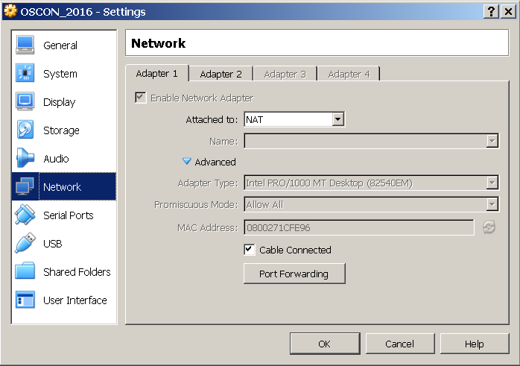
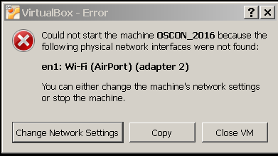
Setup
Connect to open wifi network - id = OSCON, no password.
Need virtualbox installed - Windows and OS/X versions available from server at http://172.16.0.20 and on Patriot flash drives.
Copy OSCON_2016.ova onto your disk from USB drives and follow instructions in Labs doc. Also some orange devices that have it installed.
May see an error for networking. Click Change Network Settings, then OK.

Slide 2
Creating a Deployment Pipeline with Jenkins
Brent Laster

Slide 3
About me
Senior Manager, R&D at SAS in Cary, NC
Part-time trainer
Git, Gerrit, Gradle, Jenkins
Author - NFJS magazine, Professional Git book (fall)
Brent.Laster@sas.com
LinkedIn: https://www.linkedin.com/in/brentlaster
Twitter: @BrentCLaster
Email: training@nclasters.org

Slide 4
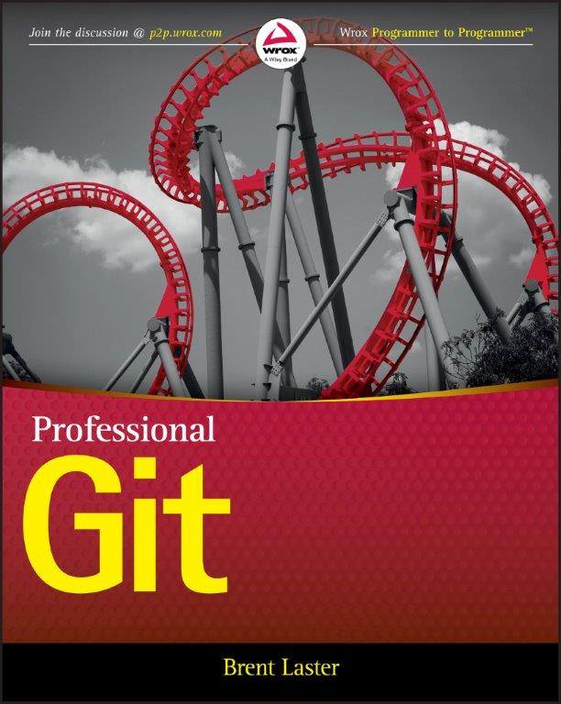
Professional Git - due fall, 2016

Slide 5
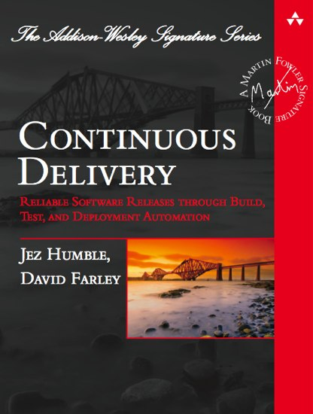
Continuous Delivery Book

Slide 6
Extremely Strange…
“An extremely strange, but common, feature of many software projects is that for long periods of time during the development process the application is not in a working state. In fact, most software developed by large teams spends a significant proportion of its development time in an unusable state.”

Slide 7
Continuous Delivery - Overall Goals
Deliver useful, working software to users as quickly as possible
Low cycle time
Get to users sooner
Verify changes quickly
High quality
Supported by frequent, automated releases
Repeatable
Discipline vs. art
Frequency means deltas between releases is small – reduces risk
Faster feedback

Slide 8
Continuous Delivery in Practice
Theme is automation of software production process
Combines 3 core practices/disciplines
Continuous Integration
Continuous Testing
Continuous Deployment (if desired)
Includes Configuration Management

Slide 9
Continuous Delivery - Benefits
Less risk
Less stress
Quicker ROI
Improved response to business needs/challenges
Improved quality
Fail-fast
Higher confidence

Slide 10
Deployment Pipeline
“… an automated implementation of your application’s build, deploy, test, and release process.
Every change made to configuration, source code, environment or data triggers a new instance of the pipeline.
Change motivates production of binaries and then a series of tests are done to prove it is releasable.
Levels of testing provide successive levels of confidence.

Slide 11
Deployment Pipeline Stages
Review Stage
Review
Commit Stage
Compile and Unit Tests
Integration Tests
Source Code Analysis
Assembly and Packaging
Publish
Artifacts
Acceptance Stage
UAT
Production
Promote/ Retrieve
Artifacts
Deploy for Functional Testing
Functional Tests
User Acceptance Tests
Deploy to Production

Slide 12
Approach
Model steps in pipeline as Jenkins build jobs
Successful jobs kick off other jobs
Some Linux-specific implementations
Using Jenkins wherever possible
Using free versions of products
Light treatment of each area
Selected set of technologies

Slide 13
Disclaimers
Focus is on process rather than underlying code
Some end point steps (Functional tests) omitted for brevity
Multiple ways to implement a pipeline
This is not a Java programming workshop
Bias is for free versions rather than paid versions
Bias is for Jenkins integration over other methods
Not Jenkins 2.0

Slide 14
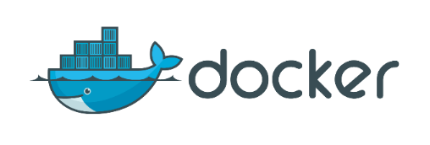
Technologies used
Jenkins - workflow management
Git - source management
Gerrit - code review and verification builds
Gradle - build engine and automation
Sonar - code analysis and metrics
Jacoco - code coverage
Artifactory - binary artifact storage and management
Docker - container and image creation

Slide 15
Plugins used (additional)

Slide 16
About Jenkins – What is it?
Open-source framework for Continuous Integration
Monitors execution of repeated jobs; examples: cron jobs or builds
Generally used for:
Building/testing software projects continuously
Monitoring executions of externally-run jobs, such as cron jobs
Created by Kohsuke Kawaguchi
Formerly known as Hudson
Over 1000 plug-ins

Slide 17
Where to get more information
Jenkins home page
http://jenkins-ci.org
Jenkins wiki
https://wiki.jenkins-ci.org
Free Jenkins book
Jenkins – the definitive guide – by John Ferguson Smart

Slide 18
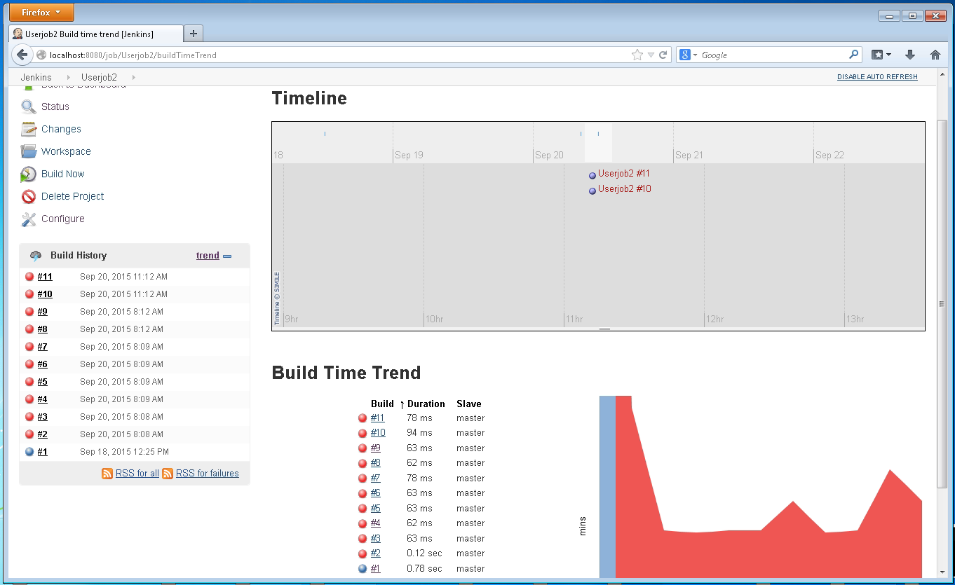
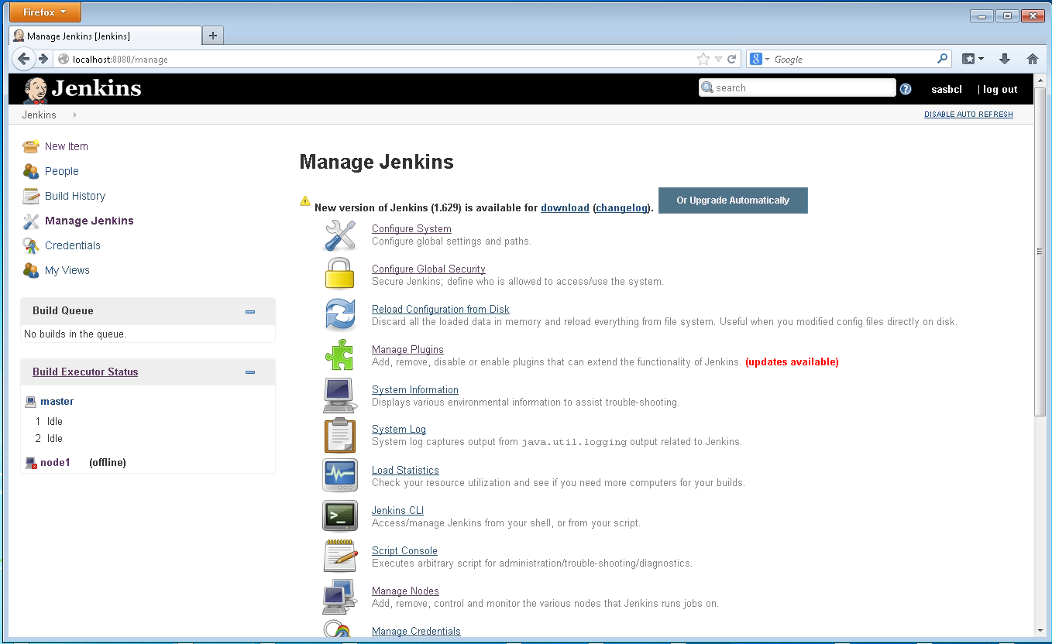
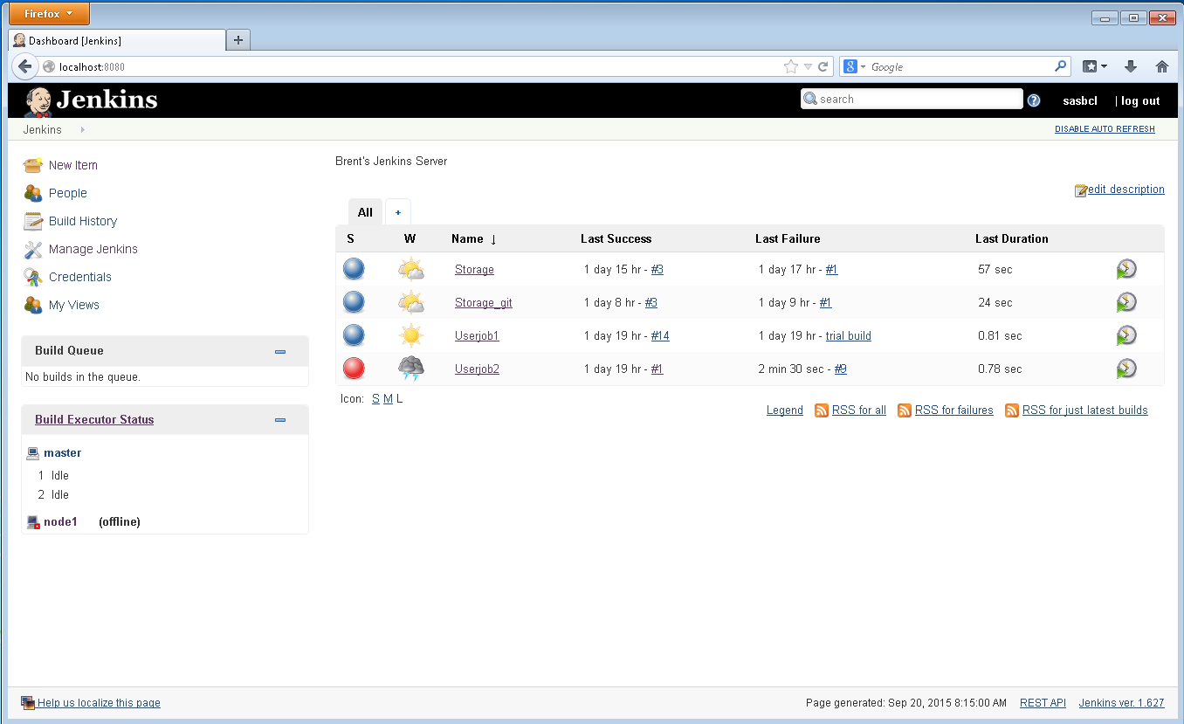
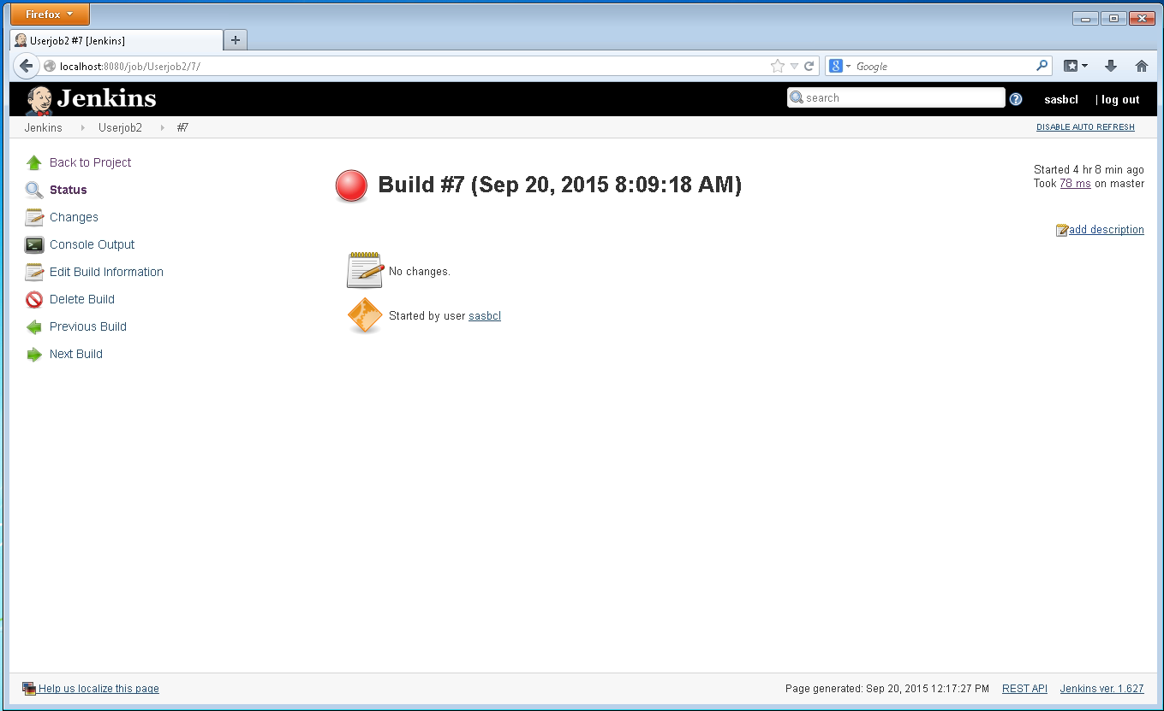
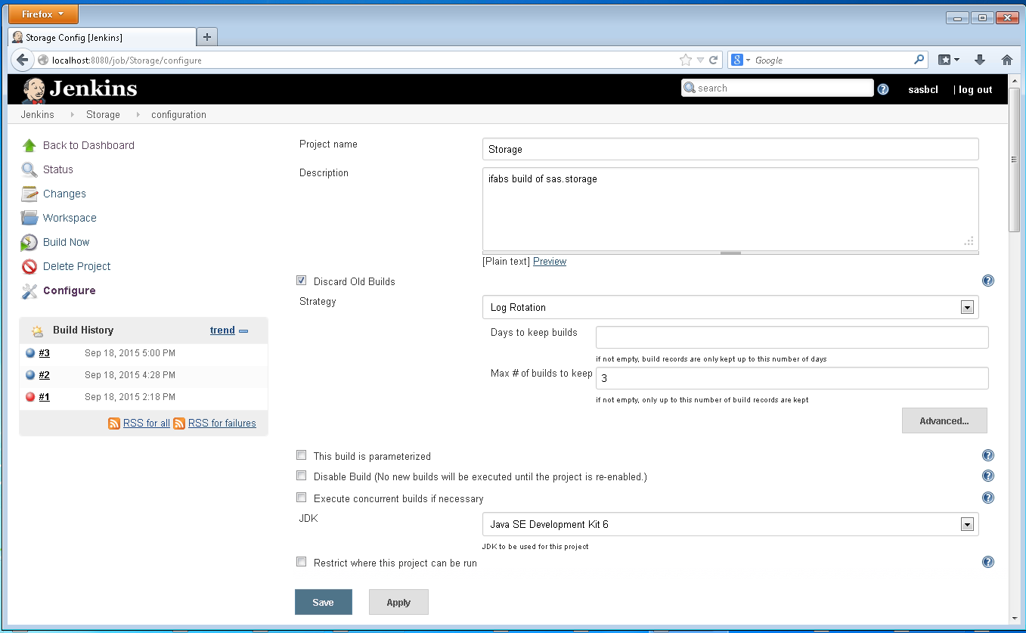
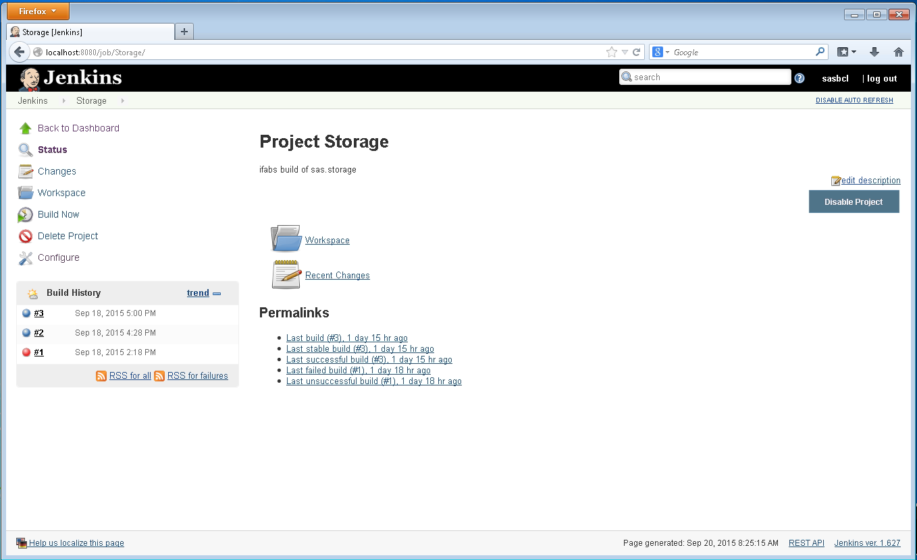
The Jenkins “Object Model”
Jenkins Dashboard
(Latest Build Jobs Statuses)
Build Job
Build Job
Global Management
Configuration
Configuration
Analysis/Trends
Analysis/Trends
Overall configuration
Build History
Build History
Plug-in management
Status
Output
Invocation
Status
Output
Invocation
Status
Output
Invocation
Status
Output
Invocation
Node management
More...

Slide 19
Jenkins Hierarchy
Basic Jenkins Hierarchy is:
Dashboard
Individual project
Individual build results for a project
Each one may have subsections
Examples:
build project may have configure and trend information
build results have status and console output
Supporting pieces
Jenkins global configuration (Manage Jenkins)

Slide 20
Survey of Jenkins – Dashboard

Slide 21
Interfacing with Jenkins Settings
Values are not remembered until saved
Names are important to have
Avoid using spaces in paths
Values are only committed by clicking Save or Apply button at bottom

Slide 22
Jenkins Master
Standard (default) operation mode of Jenkins
Serves all http requests and has access to config, etc.
Can always still do builds/handle jobs
Over time, more jobs can put a load on the master in terms of system resources
Options:
Upgrade master
Set up slave nodes
Master is also limited to its local environment

Slide 23
Jenkins Slave
A system that is setup to offload projects from the master
After setup, distribution of tasks can be one of two ways
A project is allowed to “roam” between slaves
Can specify a particular slave for a project (useful if slave implements a separate, needed environment such as different OS)
Slaves run under a different, minimal interface
Jenkins slave agent
No need to install Jenkins on other systems
Can be started multiple ways
Users access results still via accessing master

Slide 24
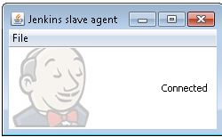
Slave Node Properties and Jobs

Slide 25
Lab 1 - Creating a Jenkins Slave Node

Slide 26
Jenkins - Restricting where a job can run
Points job to particular slave node
Uses slave node’s label
Above “Advanced Project Options”

Slide 27
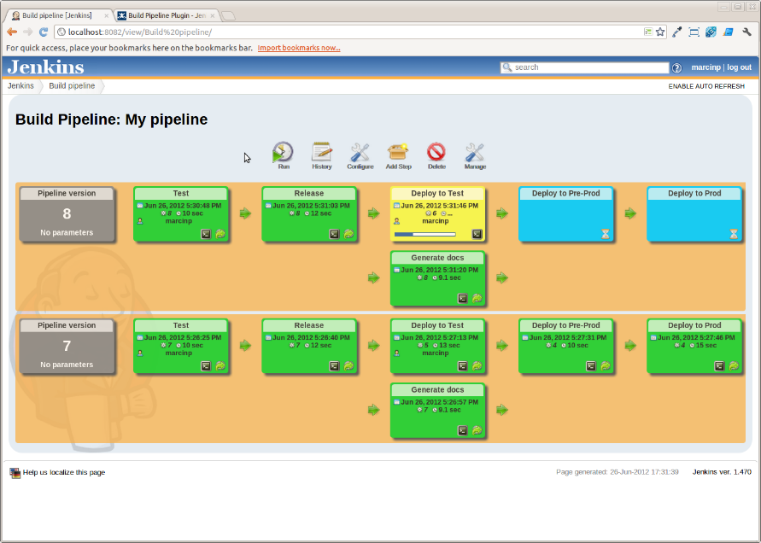
Technology – Build Pipeline Plugin (https://wiki.jenkins-ci.org/display/JENKINS/Build+Pipeline+Plugin)
Allows for forming a chain of Jenkins jobs based on their upstream/downstream dependencies.
Allows for defining a Jenkins view of the change.
Allows for defining manual triggers for jobs that need intervention prior to execution – i.e approval process.
Can see history of pipeline runs, current status and version of each job.

Slide 28
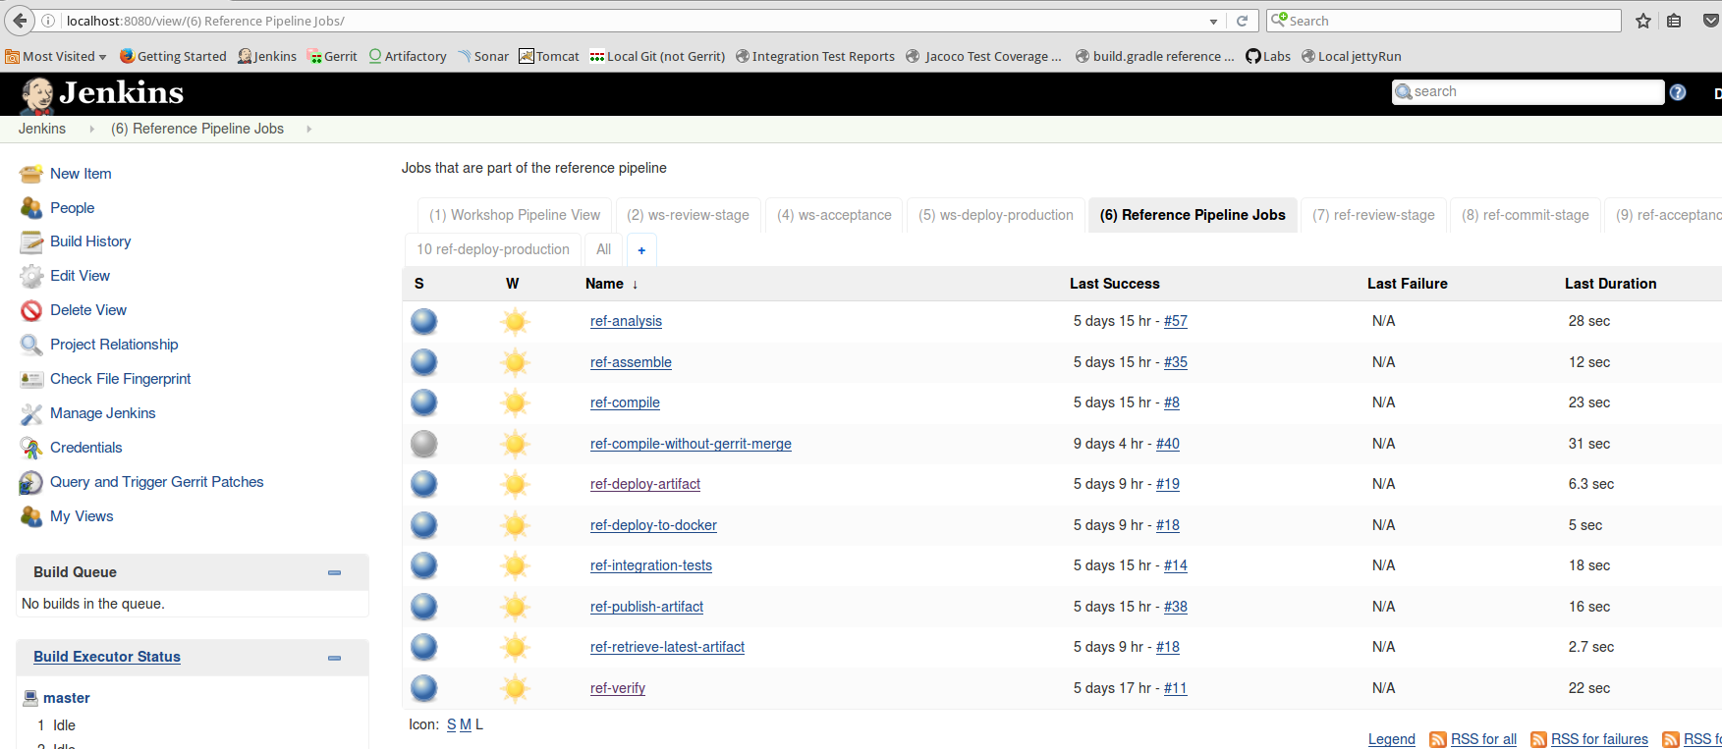
The Reference Pipeline Jobs
Reference model
Job configuration already done - no workspace
One run of each job (except ref-compile-without-gerrit-merge)

Slide 29
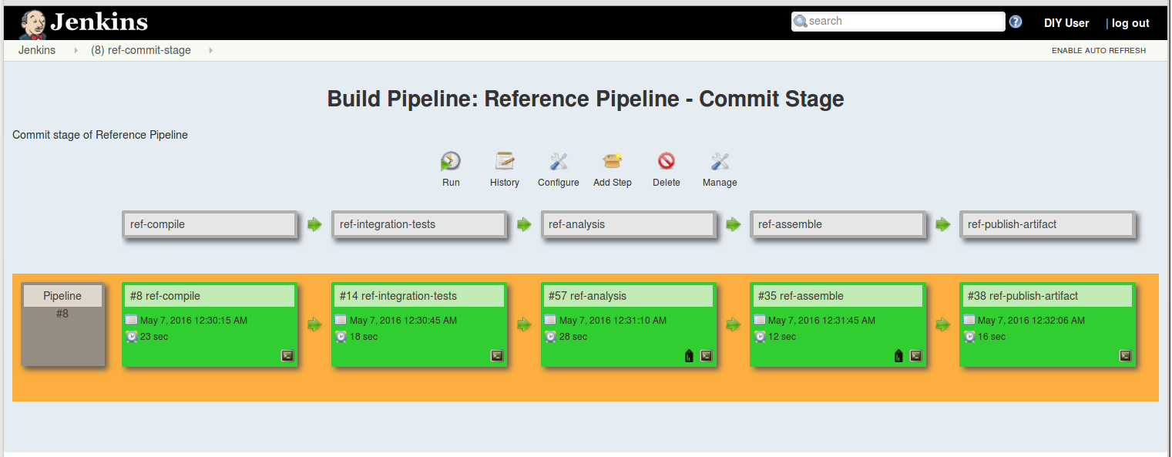
The Reference Pipeline Views
Contains fully implemented views
Shows one run of stage
Configure can be used to see setup

Slide 30
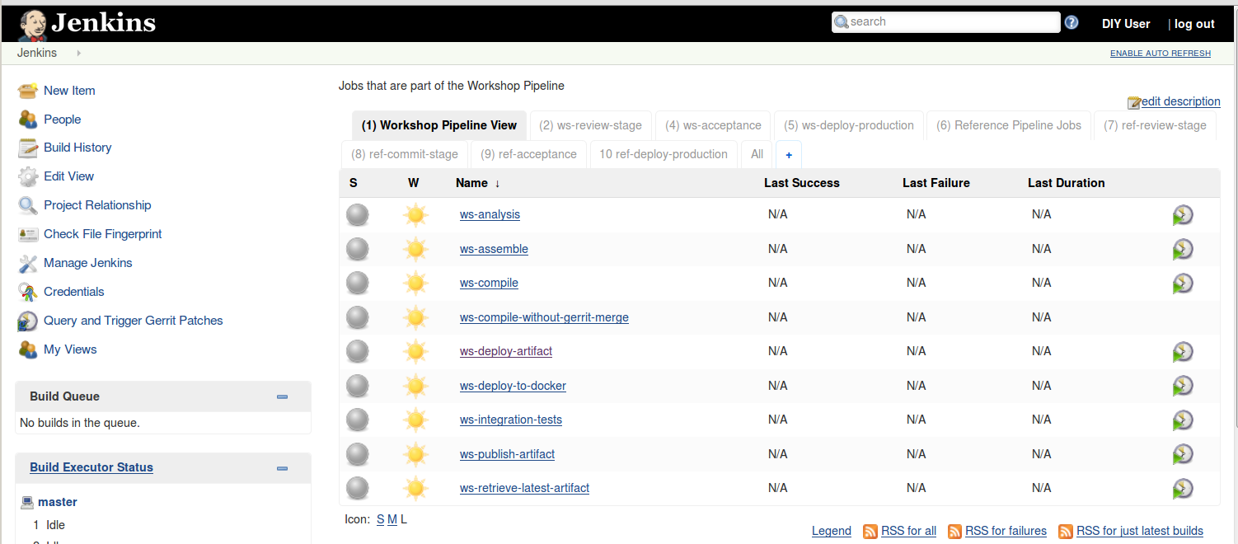
Workshop Pipeline Jobs
Jobs to use in the workshop
Some parts filled in, but some configuration needs to be done for most
Not run yet

Slide 31
Workshop Pipeline Views
May not have any views since jobs haven’t been run
May have ref job in them
Will be filled in as we go through labs

Slide 32
What is Git?
Distributed Version Control System
Open source
Available for multiple platforms
Roots in source control efforts for Linux Kernel
Primary developer – Linus Torvalds
Been around since 2005

Slide 33
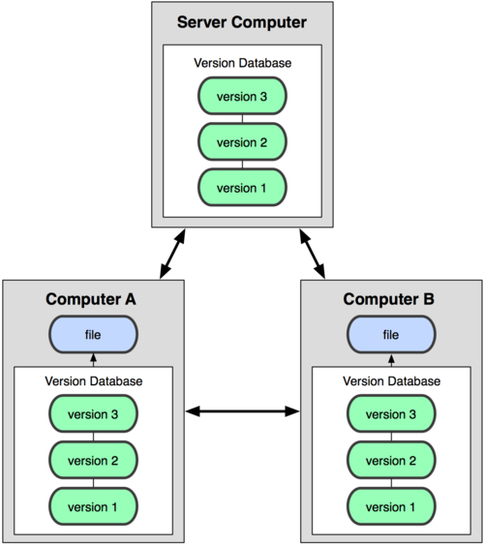
Centralized vs. Distributed VCS
Remote Repository
Disconnected Development
Local Repository

Slide 34
Git in One Picture
Server
Public
Remote Repository
Fetch
Push
Clone
Prod
Local Repository
Pul
l
Checkout
Commit
Test
Staging Area
Add
Dev
Working Directory
Local Machine

Slide 35
What is Gerrit?
User interface to Git
Web-based code review system
Facilitates on-line code reviews
Only for projects using Git as SCM
Allows developer to suggest a code change
After review, changes can be updated with a new set of changes
When changes are accepted, they are applied to code base stored in Git via Gerrit

Slide 36
How does it work?
Gerrit implements a wrapper around Git
Intercepts pushes to a remote Git repository (it’s own)
Push to a special path (ref specification) to initiate a code review – refs/for/<branch>
Pushes to this ref specification tell Gerrit to create a new review or update an existing one
Unique identifier on a commit (change-id) allows Gerrit to determine if a change is a new push or an update to an existing review

Slide 37
Gerrit in One Picture
Remote Repository
Server
Gerrit Project
Public
Code Validation
Access Layer
Push
Clone
Prod
Local Repository
Pul
l
Checkout
Commit
Test
Staging Area
Add
Dev
Working Directory
Local Machine

Slide 38
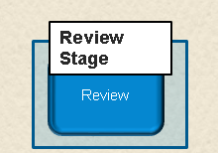
Review Stage
Local build and test
Push to Gerrit for verification build
Patchset created (new revision)
Code Review (manual)
Other checks/validations if defined
On successfully passing all checks, Gerrit attempts to merge it into remote Git repository
If successful
Change merged
Kicks off Commit stage (compile job)

Slide 39
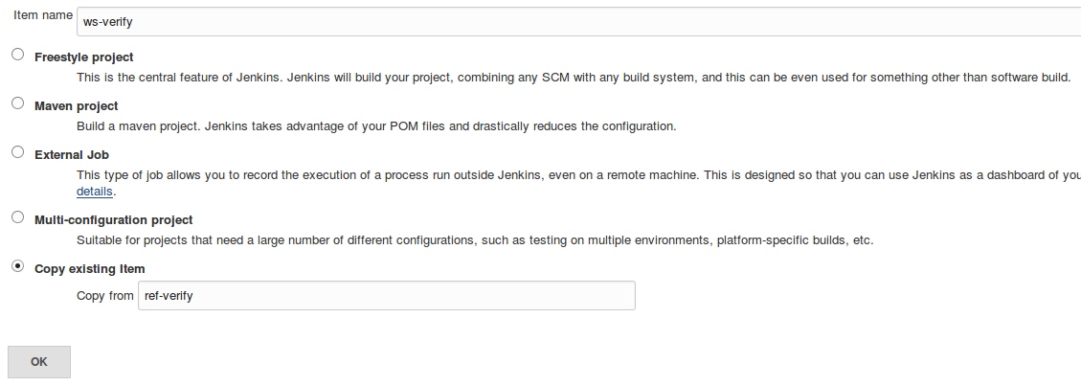
Creating a New Item in Jenkins from an Existing One

Slide 40
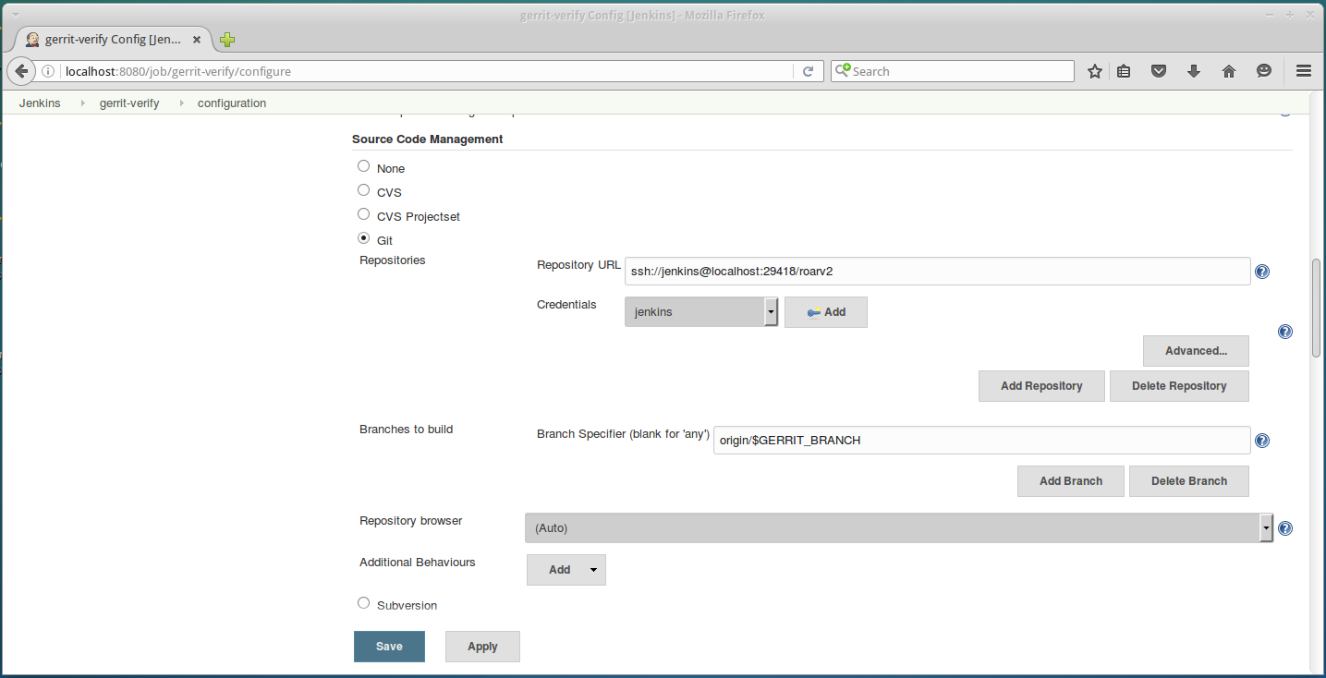
Verify SCM Setup

Slide 41
Verify Typical Gradle setup

Slide 42
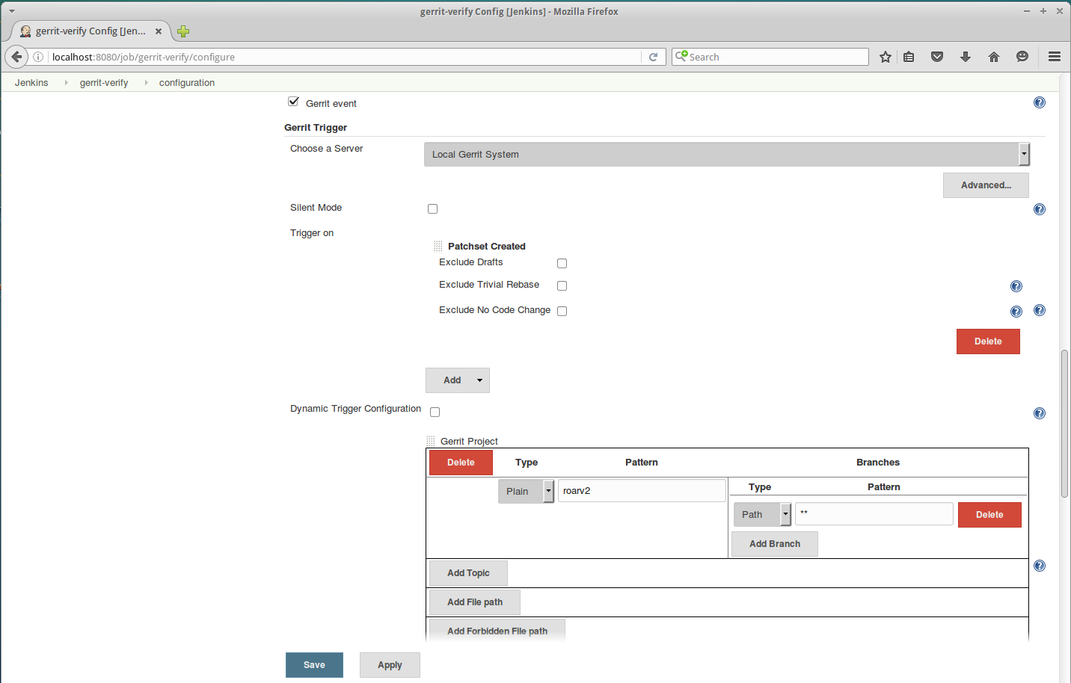
Verify - Gerrit Build Trigger

Slide 43
Lab 2 - Setting up the Review phase

Slide 44
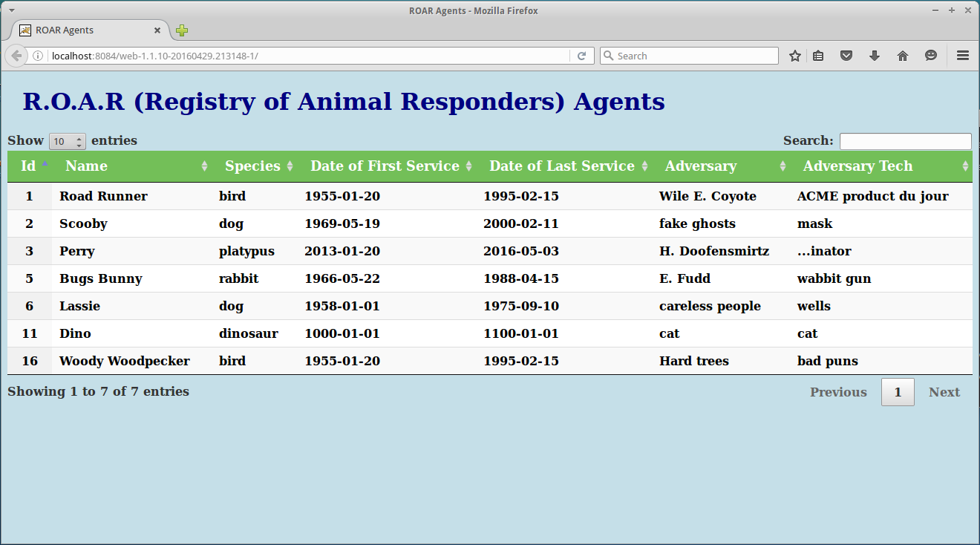
Sample Webapp

Slide 45
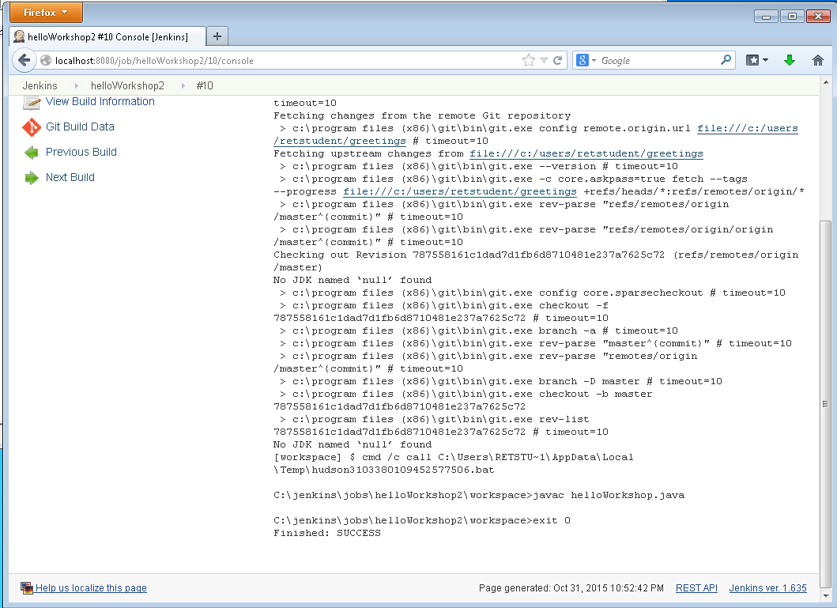
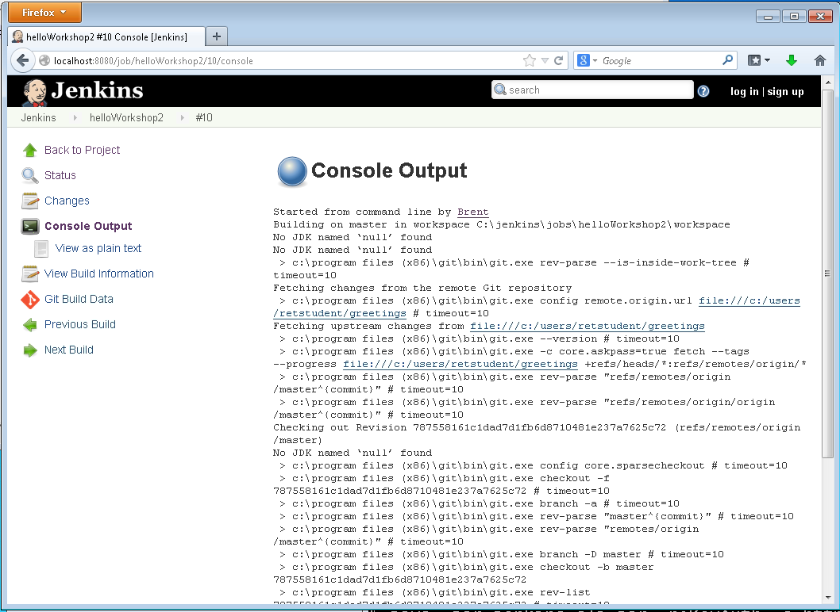
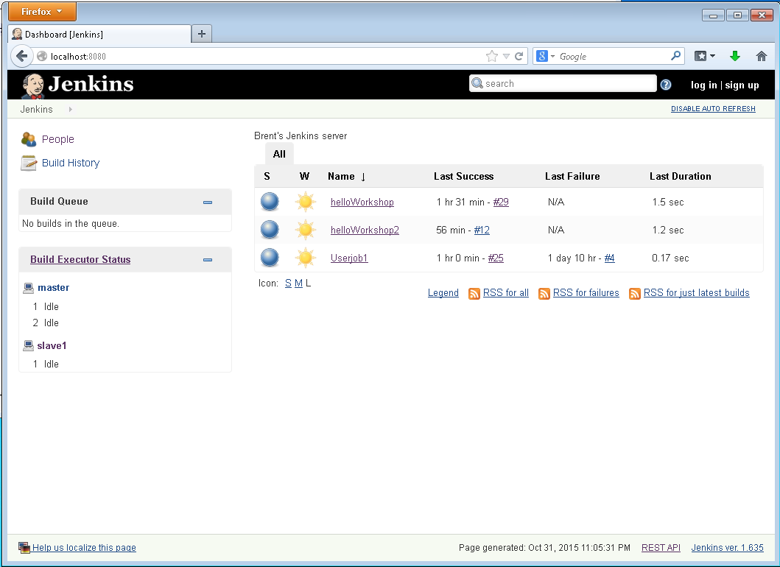
How Polling Works
Source
Management
System
(CVS, Git, etc.)
Jenkins polls (watches) for changes in source control system.
User pushes a change.
Jenkins detects change and gets latest code.
Jenkins runs a new build.

Slide 46
How Jenkins connects to Gerrit

Slide 47
Workflow for Verify Phase
Edit file and make a change
Build locally and validate
gradle build
gradle jettyRun
Configure Git username (email is usually set, but already done here to match Gerrit)
git config --global user.name “First Last
“Stage” the change in Git
git add <filepath>
Commit the change to Git’s Local Repo
git commit -m “<message>”
Push the change to the Gerrit holding area
git push origin HEAD:refs/for/master

Slide 48
Workflow for Verify Phase - cont.
Gerrit “captures” change
Jenkins is added as a “reviewer” of the code
Jenkins detects change, gets code, and does a test build
Build completes
Jenkins reports back success or failure to Gerrit
Success +1
Failure -1

Slide 49
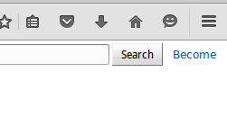
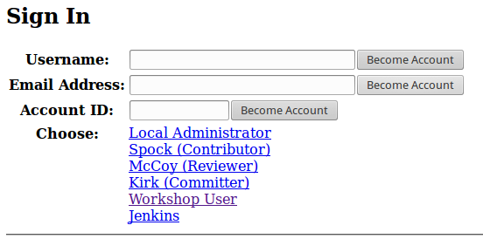
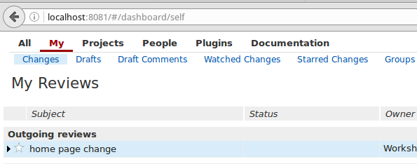
Logging into Gerrit
Running on localhost:8081
Setup in “debug mode” to “Become” any preconfigured user
Preconfigured users (via SSH keys)
Local Administrator
Workshop User
(Also Jenkins)

Slide 50
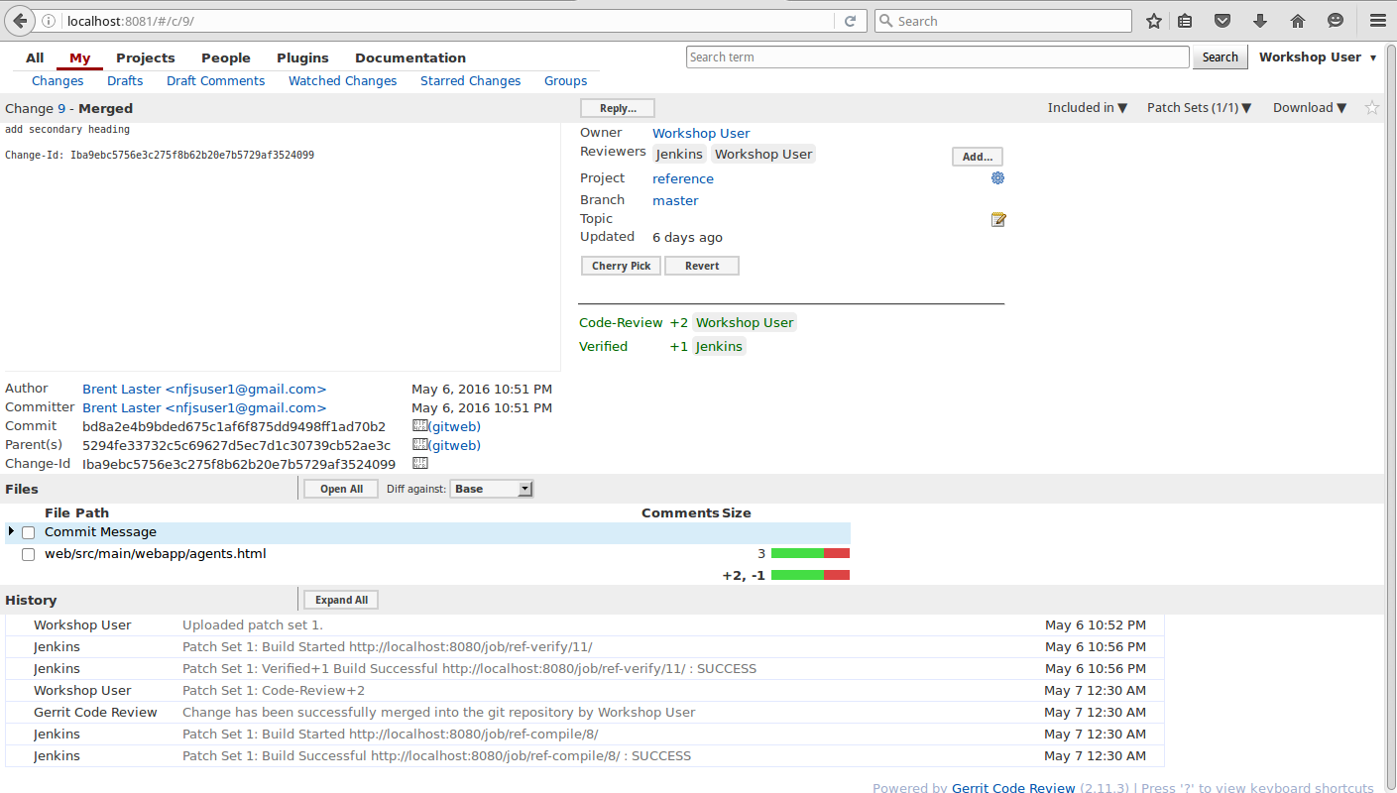
Gerrit Change Screen

Slide 51
Lab 3 - Pushing to Gerrit for Review

Slide 52
Triggering the Compile step
Gerrit
Patchset created
Change has been pushed to Gerrit for review
Not merged into underlying Git remote repository yet
Waiting on successful verification build and manual indication that code review is good
Change merged
Verification and review have passed
Code was able to be successfully merged into repo
Jenkins compile job keys off of Gerrit Change merged event
Without Gerrit
Jenkins compile job usually polls for changes in remote repository
When it sees one, it starts the compile and rest of pipeline
Alternate lab at end - compile-without-gerrit-merge job (disabled)

Slide 53
Why Gradle?
General Purpose Build Automation System
Middle ground between ANT and Maven
ANT – maximum flexibility, no conventions, no dependency management (offset by Ivy)
Maven – strong standards, good dependency management, hard to customize, not flexible
Offers useful “built-in” conventions, but also offers ease of extension
Useful for developing build standards
Rich, descriptive language (DSL – Groovy) – Java core
Built-in support for Groovy, Java, Scala, OSGI, Web

Slide 54
Why Gradle?
Multiple dependency management models
Transitive – can declare only the top-level dependencies and interface with Maven or Ivy
Manual – can manage by hand
Toolkit for domain-specific build standards
Offers useful features – upstream builds, builds that ignore non-significant changes, etc.

Slide 55
Gradle Build Script Basics
Two basic concepts – projects and tasks
Project
Every Gradle build is made up of one or more projects
A project is some component of software that can be built (examples: library JAR, web app, zip assembled from jars of other projects)
May represent something to be done, rather than something to be built. (examples: deploying app to staging area or production)
Task
Represents some atomic piece of work which a build performs (examples: compiling classes, creating a jar, generating javadoc, publishing archives to a repository)
List of actions to be performed
May include configuration

Slide 56
Gradle Command Line
invoke Gradle via gradle [option(s)] [task(s)]
Useful options
-h --help – show basic help info
-b –build-file – specify a non-default build file (not build.gradle)
-d –debug – log in debug mode
--daemon – use the gradle daemon to run builds – start it if needed
-i --info – set log level to info
-q –quiet – log errors only
--profile – profiles build execution time and generates a report
Other
properties - Emits all the properties of the build’s Project object. The Project object is an object representing the structure and state of the current build.
tasks - Emits a list of all tasks available in the current build file. Note that plug-ins may introduce tasks of their own, so this list may be longer than the tasks you have defined.

Slide 57
Gradle Structure
Gradle Build
Project (Deploy to production)
Project (Create webapp)
Project (Create jar)
Task
(Action: Compile files)
Task
(Action Prduce Javadoc)
Task
(Action: Publiish archives)
Property
Property
Property

Slide 58
Anatomy of a Task
def destDirs = new File('target3/results')
task createTarget(type: DefaultTask) {
doLast {
destDirs.mkdirs()
}
}
task createTarget << {
destDirs.mkdirs()
}
KEYWORD
TASK NAME
TYPE SPECIFICATION
API
ACTION
=
SHORTHAND FOR DefaultTask AND doLast

Slide 59
Plugins in Gradle
At its core, Gradle provides very little automation
Most automation, advanced functionality is via plugins
Example benefits of plugins
Promotes reuse
Encapsulates imperative logic (allows build scripts to be declarative)
More modular approach
Example actions of plugins
Extend Gradle DSL (“the model”)
Configure the project based on conventions (i.e. add tasks or sensible defaults)
Apply configuration/standards
Examples additions from plugins
tasks
domain objects
conventions
extension of existing objects

Slide 60
Java plugin – expected default layout
Directory | Meaning
src/main/java | Production Java source
src/main/resources | Production resources
src/test/java | Test Java source
src/test/resources | Test resources
src/sourceSet/java | Java source for the given source set
src/sourceSet/resources | Resources for the given source set

Slide 61
Java plugin – lifecycle tasks
Task name | Depends on | Type | Description
assemble | All archive tasks in the project, including jar. Some plugins add additional archive tasks to the project. | Task | Assembles all the archives in the project.
check | All verification tasks in the project, including test. Some plugins add additional verification tasks to the project. | Task | Performs all verification tasks in the project.
build | check and assemble | Task | Performs a full build of the project.
buildNeeded | build and build tasks in all project lib dependencies of the testRuntime configuration. | Task | Performs a full build of the project and all projects it depends on.
buildDependents | build and build tasks in all projects with a project lib dependency on this project in a testRuntime configuration. | Task | Performs a full build of the project and all projects which depend on it.
buildConfigurationName | The tasks which produce the artifacts in configuration ConfigurationName. | Task | Assembles the artifacts in the specified configuration. The task is added by the Base plugin which is implicitly applied by the Java plugin.
uploadConfigurationName | The tasks which uploads the artifacts in configuration ConfigurationName. | Upload | Assembles and uploads the artifacts in the specified configuration. The task is added by the Base plugin which is implicitly applied by the Java plugin.

Slide 62
Example Gradle Build File Conventions
build task order
:compileJava
:compileGroovy
:processResources
:classes
:war
:assemble
:compileTestJava
:compileTestGroovy
:processTestResources
:testClasses
:test
:check
:build
Includes all the Java tasks
apply plugin:’groovy’
apply plugin:’war’
respositories {
mavenCentral()
}
dependencies {
compile ‘javax.servlet:servlet-api:2.5’
testCompile “junit:junit:4.9”
}
Makes new tasks available
repository

Slide 63
Publishing
Plugins usually define what needs to be published
Need to tell Gradle where to publish artifacts
Done by attaching a repository to uploadArchives task
Note: Can define an artifact using an archive task
artifacts {
archives someFile (or jar)
}
uploadArchives {
repositories {
ivy {
credentials {
username = “name”
password = “pass”
}
url = ‘http://intranet/IUOCustom’
}
}
}

Slide 64
What is Artifactory?
Binary repository manager
We have source control for our source
Artifactory provides version control for binary artifacts (jars, wars, etc.)
Why use it?
If you rebuild from source each time, that can introduce change and failure for consumers.
By having a versioned copy of a (tested) artifact, everyone knows what they are getting.
Having multiple versions stored and versioned clearly allows different consumers to use different versions (i.e. current, last release, etc.)
Integrates with CI servers (such as Jenkins) so that if build is clean, automatically gets published with metadata about build
Allows virtual repositories which can aggregate multiple well-known or internal repositories

Slide 65
Artifactory - Artifacts

Slide 66
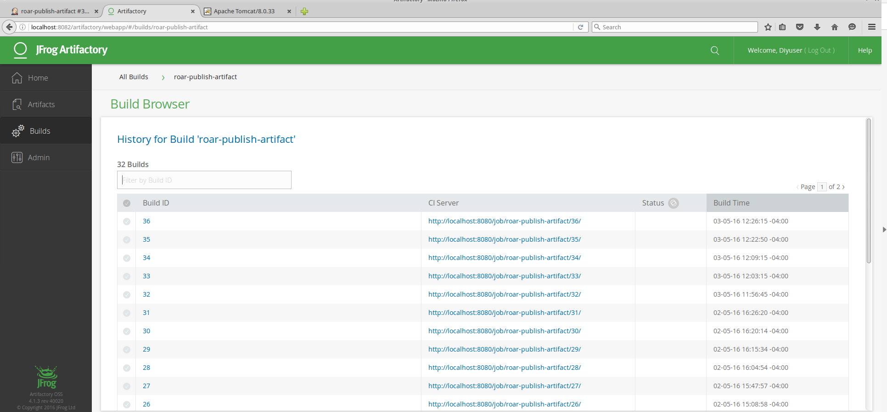
Arifactory - Builds

Slide 67
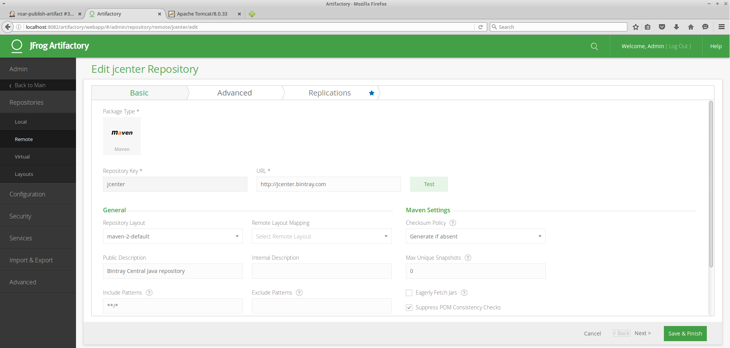
Artifactory - Editing/Defining Repositories

Slide 68
Artifactory - Virtual Repository

Slide 69
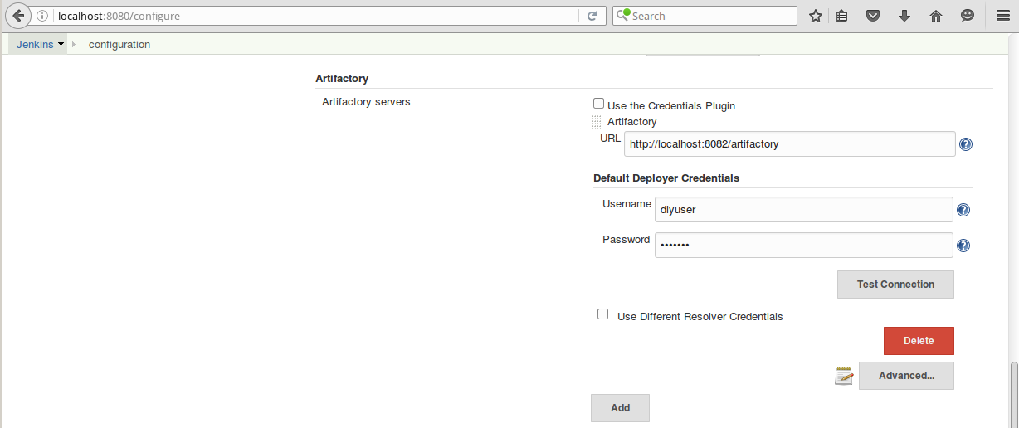
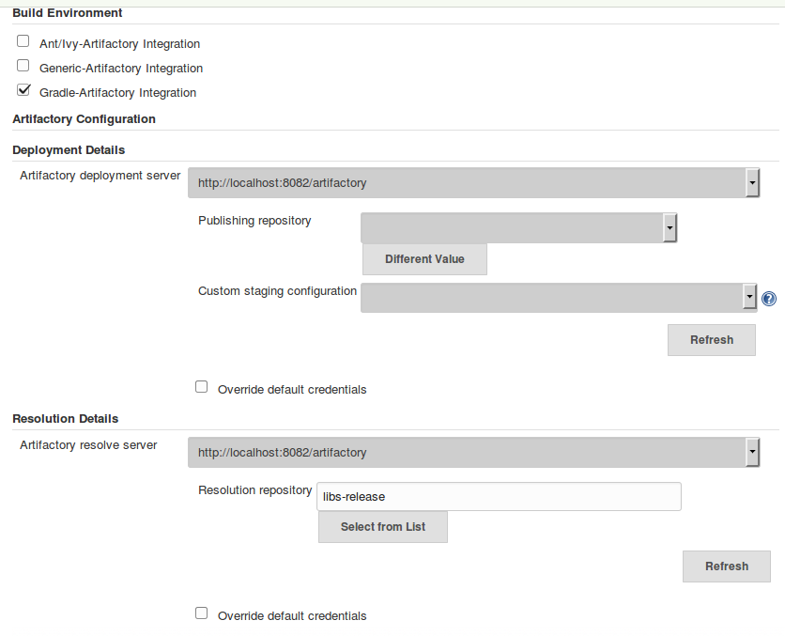
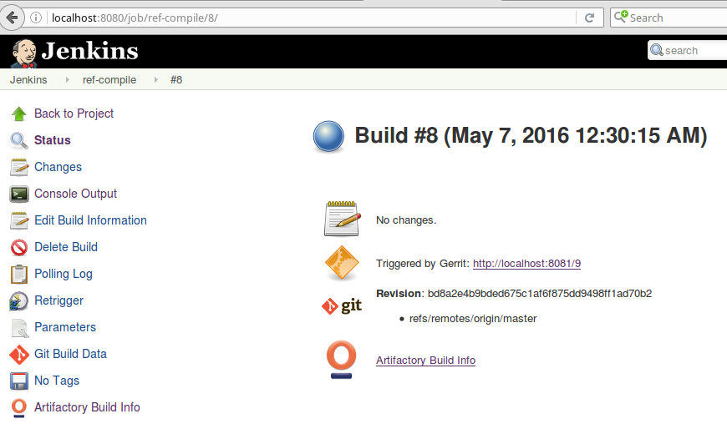
Jenkins Integration with Artifactory
Global (Manage Jenkins) Job (configuration)
Run (job output) - links to build browser in
Artifactory

Slide 70
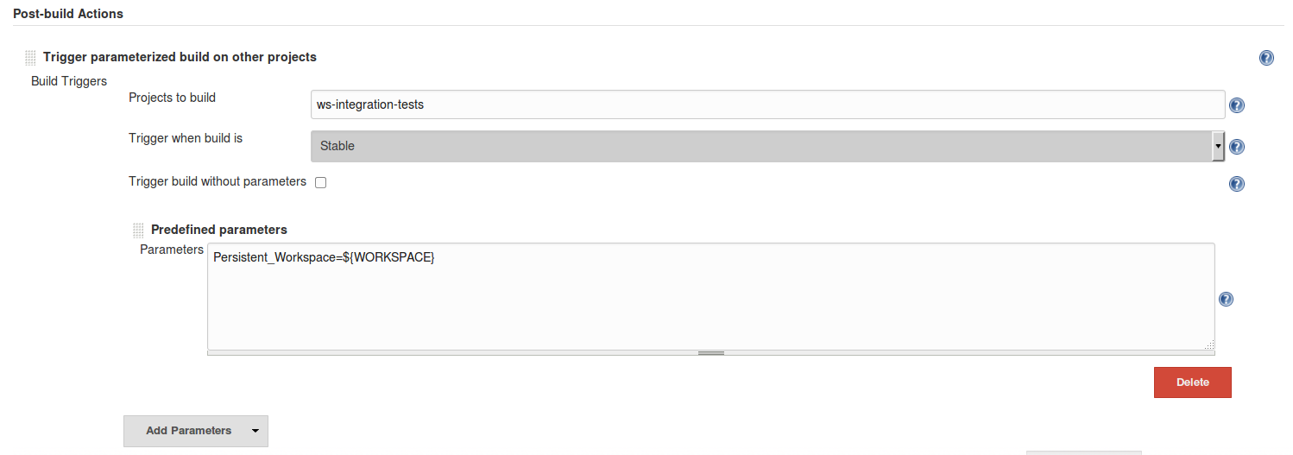
Passing Workspace to Next Job
Uses Parameterized Jobs Plugin
Set environment variable to current workspace in job
Use environment variable as workspace in next job

Slide 71
Lab 4 - Setting up the Compile Job
Compile and Unit Tests

Slide 72
Integration Testing
Gradle java plugin has built-in conventions for tests
We leverage this for our unit tests
In order to separate out testing for integration tests (and functional tests) we need to define new groupings for these types of tests in the build.gradle file
We do that using Gradle sourcesets

Slide 73
Gradle Source Sets
Source set - a collection of source files that are compiled and executed together
Used to group together files with a particular meaning in a project without having to create another project
In Java plugin, two included source sets
main (default for tasks below – assumed if <SourceSet> omitted)
test
Plugin adds 3 tasks for source sets
compile<SourceSet>Java
process<SourceSet>Resources
<SourceSet>Classes
Source sets also provide properties such as
allSource – combination of resource and Java properties
java.srcDirs – directories with Java source files

Slide 74
Source Sets (continued)
Can define your own source sets via sourceSets property of the project
sourceSets {
externApi
}
Get 3 new tasks: externApiClasses, compileExternApiJava, and processExternApiResources
Custom configuration (also how you would define structure for new ones)
sourceSets {
main {
java {
srcDir ‘src/java’
}
resources {
srcDir ‘resources/java’
}
}

Slide 75
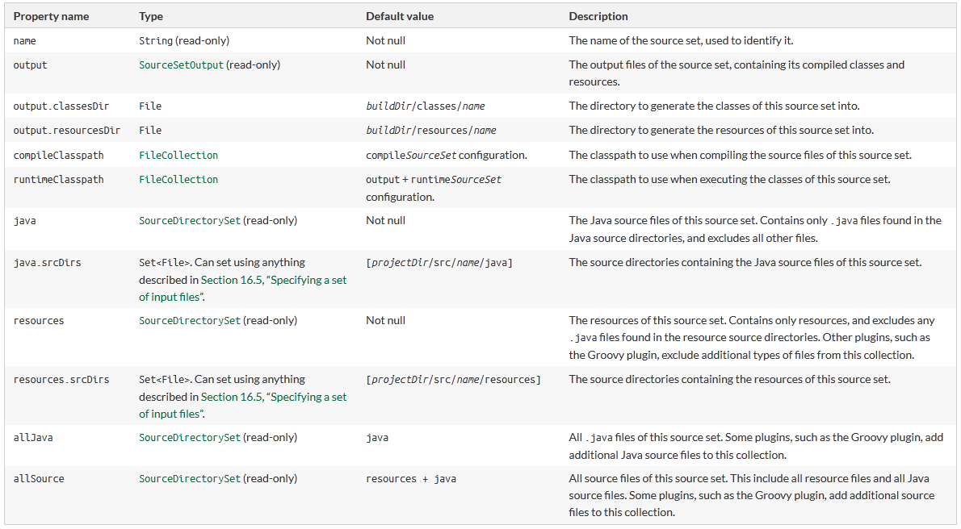
Source Set Properties

Slide 76
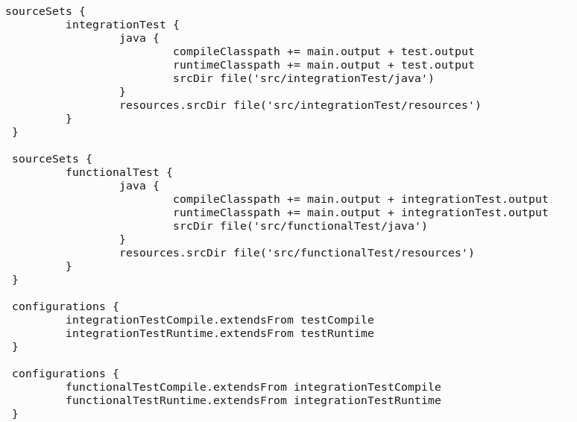
Source Sets for Integration and Functional Tests
build.gradle

Slide 77
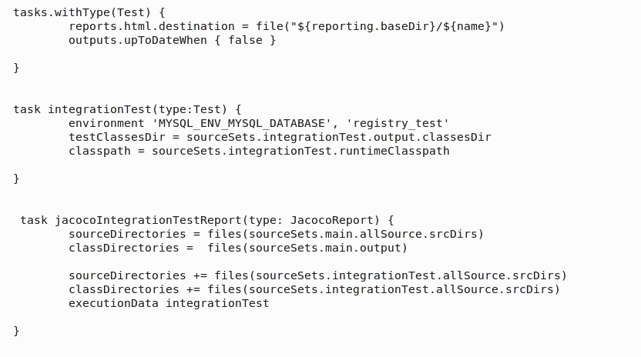
Related Tasks

Slide 78
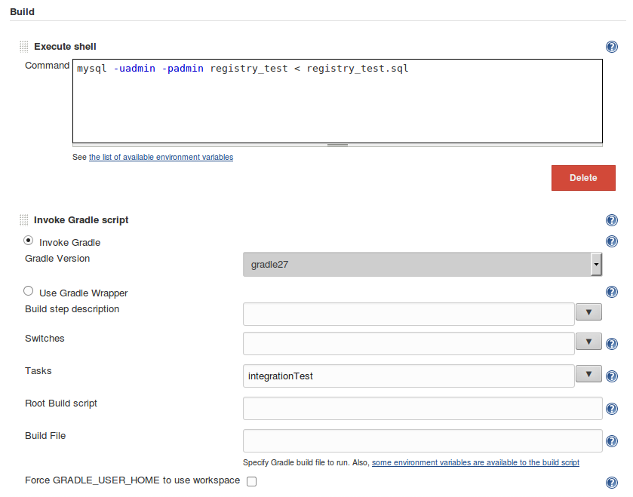
Integration Testing Job

Slide 79
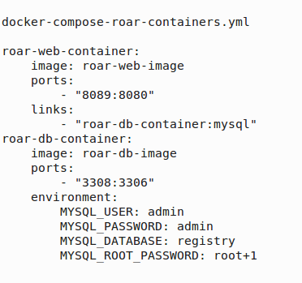
Controlling which database to use

Slide 80
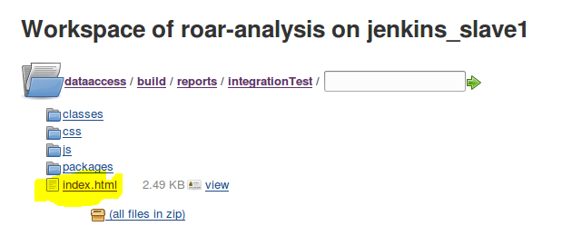
Example Integration Test Output

Slide 81
Technology – SonarQube (sonarsource.org)
Open platform for helping manage code quality in 7 areas:
Architecture and Design
Comments
Coding rules
Potential bugs
Duplications
Unit tests
Complexity
Allows configuration of rules, alerts, thresholds, exclusions, etc.
Extensible via plugins
Example site: http://nemo.sonarqube.org

Slide 82
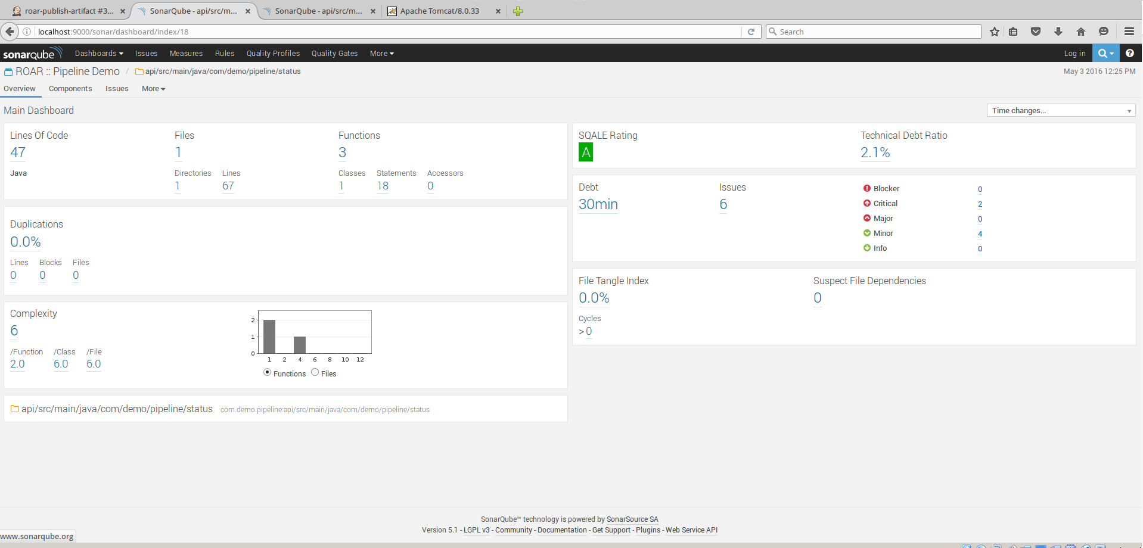
Sonar - drilling in
http://localhost:9000/sonar

Slide 83
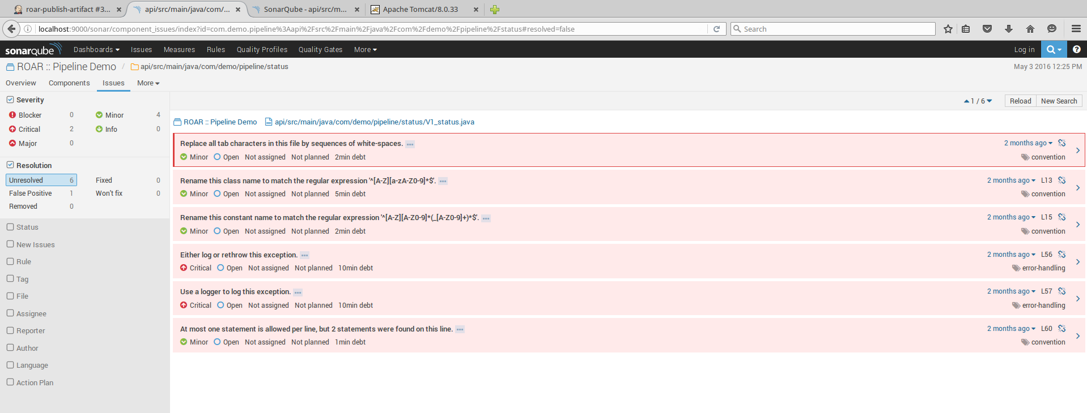
Sonar - looking at issues

Slide 84
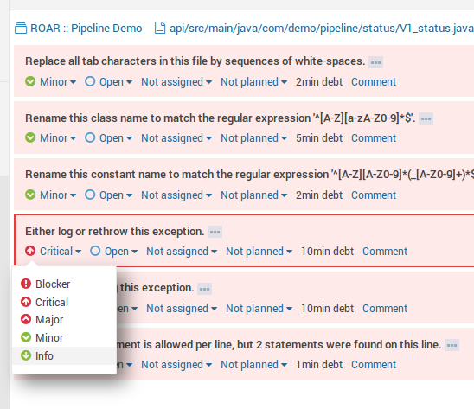
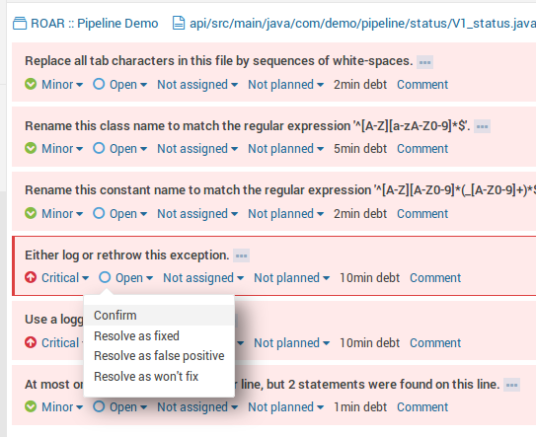
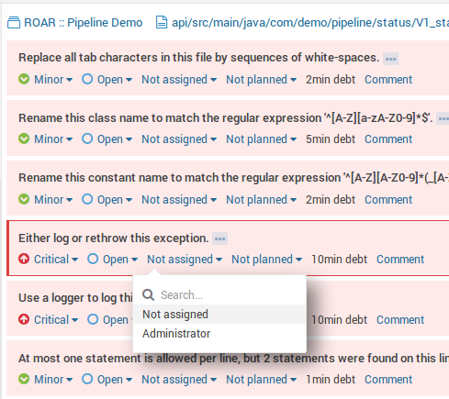
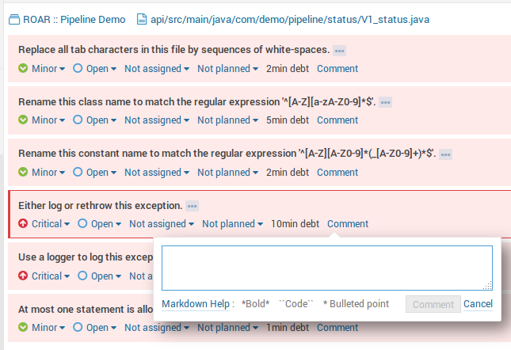
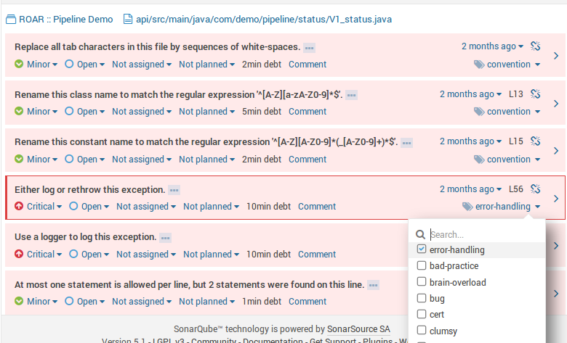
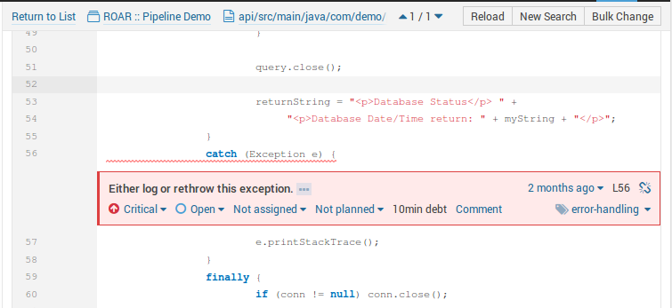
Sonar - responses

Slide 85
Sonar - Quality Profiles

Slide 86
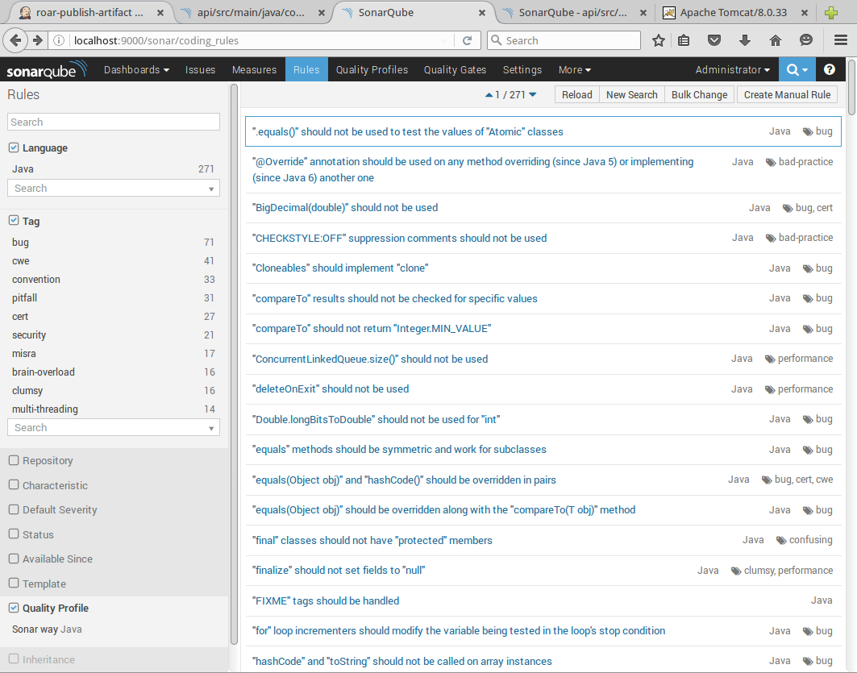
Sonar - rules

Slide 87
Sonar - quality gates

Slide 88
Sonar Reporting - Integration with Jenkins Pass/Fail

Slide 89
Jacoco (Java Code Coverage)
Derived from instrumenting Java class files
Instruction coverage - info about how much code has been executed
Branch coverage - if/switch statements; counts total number of branches in a method; figures out number of executed or missed branches
Cyclomatic Complexity - minimum number of paths that can gernerate all possible paths through a method (McCabe 1996). Can suggest number of unit tests to completely cover a piece of code.
Lines (requires debug info, default in gradle), methods, classes

Slide 90
How to interpret Jacoco Syntax Markings
For source lines with executable code
Fully covered code - green
Partially covered code - yellow
Haven’t been executed - red
Diamonds on left are for decision lines
All branches executed- green
Part of branches executed - yellow
No branches execute - red

Slide 91
Jacoco Integration with Jenkins

Slide 92
Lab 5 - Setting up the Analysis Job
Integration Tests
Source Code Analysis

Slide 93
Semantic Versioning
Format - Major.Minor.Patch-<label>
Increment Major version for incompatible API changes.
Increment Minor version for adding functionality in a backwards-compatible manner.
Increment Patch version for backwards-compatible bug fixes.
Labels for pre-release or build metadata can be added as an extension to the version number (in “<label>”).

Slide 94
Passing Properties to Gradle
Normally, can pass properties via -P
Not supported directly via Jenkins integration
Create values in properties files to simply passing from Jenkins parameters to gradle.properties

Slide 95
Assemble Job - assemble task

Slide 96
Lab 6 - Setting up the Assemble Job
Assembly and Packaging

Slide 97
Publishing Artifacts to Artifactory
Similar to how we used Artifactory before, but add a repository to publish to, and set switches to publish

Slide 98
Web Subproject - with POM generation

Slide 99
How Jenkins/Artifactory integration works

Slide 100
Build info in Artifactory

Slide 101
War deployed to Artifactory

Slide 102
Lab 7 - Setting up the Publish Artifact Job
Publish
Artifacts

Slide 103
Jenkins Views
Allow for filtering list of jobs based on various criteria
Default view is “All”
Typical use as “List View”
Include specific jobs
Or use regular expression
Select which columns to see
Build pipeline plugin adds additional functionality
Pipeline view
Add view by clicking on “+” at end of row.

Slide 104
Setting up Commit Stage Pipeline View

Slide 105
Lab 8 - Setting up the Commit Stage of the Pipeline
Commit Stage
Compile and Unit Tests
Integration Tests
Source Code Analysis
Assembly and Packaging
Publish
Artifacts

Slide 106
Quick Review - Local

Slide 107
Quick Review - Gerrit / Jenkins

Slide 108
Quick Review - Gerrit

Slide 109
Next Steps
1
3
2
3
1
2

Slide 110
Lab 9 - Running a change through the Commit Stage
Commit Stage
Compile and Unit Tests
Integration Tests
Source Code Analysis
Assembly and Packaging
Publish
Artifacts

Slide 111
Setting up the Acceptance Stage
Two jobs
Retrieve latest artifact
May not be what you always want to do
Artifactory Pro has this built-in
We will use shell scripting to accomplish this
Deploy to Docker
Isolated, portable environment good for testing
Shell steps will run docker steps
No setup in labs

Slide 112
Getting the latest (highest number) artifact
Jenkins Build Step
cleanup
path =
http://localhost:8082/artifactory/libs-snapshot-local/com/demo/pipeline/web
version =1.1.3-SNAPSHOT

Slide 113
Passing Artifacts between Jobs

Slide 114
What is Docker?
(Marketing) From docker.com
An open platform for distributed applications for developers and sysadmins.
Open source project to ship any app as a lightweight container
(Technical)
Thin wrapper around Linux Container technology
Leverages 3 functionalities from Linux to provide isolated environment in the OS
union filesystem - data
namespaces - visibility (pid)
cgroups - control groups (resources)
Provides restful interface for service
Provides description format for containers
Provides API for orchestration

Slide 115
How Docker differs from a VM
A VM requires a Hypervison and a Guest OS to create isolation; Docker uses Linux container technologies to run processes in separate spaces on the same OS
Because it doesn’t require the Hypervisor and a Guest OS, Docker is:
Faster to startup
More portable (can run an image unchanged in multiple environments)
VM
Appl N
Appl N+1
Appl 2
Runtime
Runtime
Runtime
Guest OS
Guest OS
Guest OS
Docker
Docker
Appl N
Appl N+1
Appl 2
Hypervisor
Runtime
Runtime
Host OS
Host OS
Server
Server

Slide 116
Docker Flows
Docker images are stored in a registry
A Dockerfile describes how to create a new image
docker build creates the new image
docker run starts up a container with an image
A docker compose file describes how to create containers and link multiple ones together
docker-compose executes a compose file and runs the unit
Registry
Host System
OS
-{
Image 1
Compose.yml
IMAGE A…..
IMAGE B….
LINK…
Container 1
Docker
Dockerfile
FROM …..
COPY….
RUN…
Image A
Image 2
Container 2
Image B
Image 3
Image 4
Image A

Slide 117
Creating the docker database image
Local Machine
Docker
> docker pull mysql
Docker Hub
> sudo docker build -t ref-db-image -f Dockerfile_roar_db_image .
docker-entrypoint-initdb.d (directory)
Image 1
FROM mysql:5.5.45
COPY docker-entrypoint-initdb.d /docker-entrypoint-initdb.d/
ENTRYPOINT ["/entrypoint.sh
CMD mysql
Dockerfile_roar_db_image
Image 2
Temp image
tomcat image
tomcat image
Temp image
mysql image
Temp image
mysql image
ref-db-image
mysql image

Slide 118
Creating the web image
Local Machine
Docker
> docker pull tomcat
Docker Hub
> sudo docker build -t ref-web-image -build-arg warFile=web*.war -f Dockerfile_roar_web_image .
web-*.war (webapp)
Image 1
FROM tomcat:7.0.65-jre7
ARG warFile
COPY $warFile $CATALINA_HOME/webapps/roar.war
CMD catalina.sh run
Dockerfile_roar_web_image
Image 2
tomcat image
tomcat image
Temp image
tomcat image
Temp image
mysql image
mysql image
ref-web-image
ref-db-image
mysql image

Slide 119
Composing the combined images and containers
Local Machine
Docker
Docker Hub
> docker-compose -f docker-compose-roar-containers.yml up -d
Image 1
roar-web-container:
image: roar-web-image
ports:
- "8089:8080"
links:
- "roar-db-container:mysql"
roar-db-container:
image: roar-db-image
ports:
- "3308:3306"
environment:
MYSQL_USER: admin
MYSQL_PASSWORD: admin
MYSQL_DATABASE: registry
MYSQL_ROOT_PASSWORD: root+1
docker-compose-roar-containers.yml
roar-web-container
Image 2
ref-web-image
roar-web-image
roar-web-image
tomcat image
tomcat image
tomcat image
Link
tomcat image
mysql image
mysql image
roar-db-image
roar-db-container
roar-db-image
mysql image

Slide 120
Lab 10 - Creating the job to retrieve the latest artifact and running the acceptance stage
Acceptance Stage
Promote/ Retrieve
Artifacts
Deploy for Functional Testing
Functional Tests

Slide 121
Passing Artifacts between Jobs

Slide 122
Retrieve Artifact and Deploy to Production
Uses Copy Artifact and Deploy to Container plugins

Slide 123
Deploy to Production Stage
http://localhost:8084/workshop

Slide 124
Lab 11 - Running the job to deploy the latest artifact to “production”
Production
Deploy to Production

Slide 125
That’s all - thanks!

