Slide 1
Self-service, interactive analytics at petabyte scale in capital markets regulation in the cloud
Scott Donaldson, Senior Director, FINRA
Matt Cardillo, Senior Director, FINRA

Slide 2
WHO IS FINRA?
Regulate 99% Equities and 70% of Options activity in the U.S.
Up to 75B market events/day
Reconstruct the market containing several trillion events
Detect & Investigate
Identify market manipulations, insider trading, and fraud
Ensure rule compliance
Enforce & Discipline
Fine and bar broker dealers
Refer matters to the SEC and other authorities

Slide 3
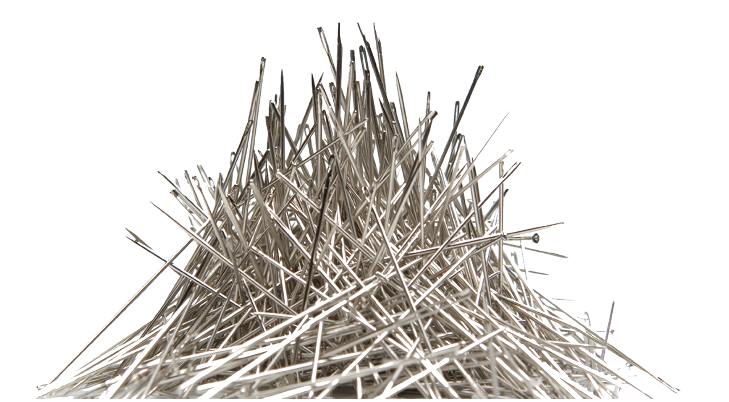
WHAT WE DO
Front Running
Insider Trading
Best Execution
Washed Sales
Short Sales
Layering
Spoofing
Order Protection
Fraud
Compliance
Compliance

Slide 4
OUR VIEW ON SELF SERVICE ANALYTICS
User Classification
General business user
Power Users
Data Scientists
Data Centric Tools in the Line of Business
Specialized
Templated
Exploratory
Embedded
Emphasize & Increase Data Literacy
Encourage innovation & sharing
Crowd sourced learning
IT hones the analytic to operate at scale

Slide 5
CREATE A DIALOGUE WITH THE DATA
Citizen analytics
Facilitate data exploration
Focus on ease of use
Easily share and collaborate
Minimize intermediaries between users and the data lake
Enable users without having to understand underlying technologies and infrastructure
Self Service with guard rails
Safeguard information with high degree of security and least privileges access
Users need to understand the semantics of the data

Slide 6
SECURITY IS OUR #1 PRIORITY
Virtual Private Cloud (VPC)
Encryption
Required to have encryption of all data at-rest and in-transit
Transparent Server Side Encryption for non-PCI/PII
KMS encryption for PCI/PII
Local disk encryption
Encrypt ephemeral storage on all nodes
LUKS with random, memory only key via custom bootstrap action
It is OK to lose the server and lose the data – S3 is our source of truth

Slide 7
SECURITY IS MORE THAN JUST ENCRYPTION
Security must be designed in from the beginning
Separation of duties
Dev, QC, Prod and DR accounts all separated
Use least privileges & no catch all rules
DevOps: Automate everything
Infrastructure as code
Requires a culture shift and retraining of development teams
Access rules
Data classification controls strictness of rules
Centralized monitoring for total transparency

Slide 9
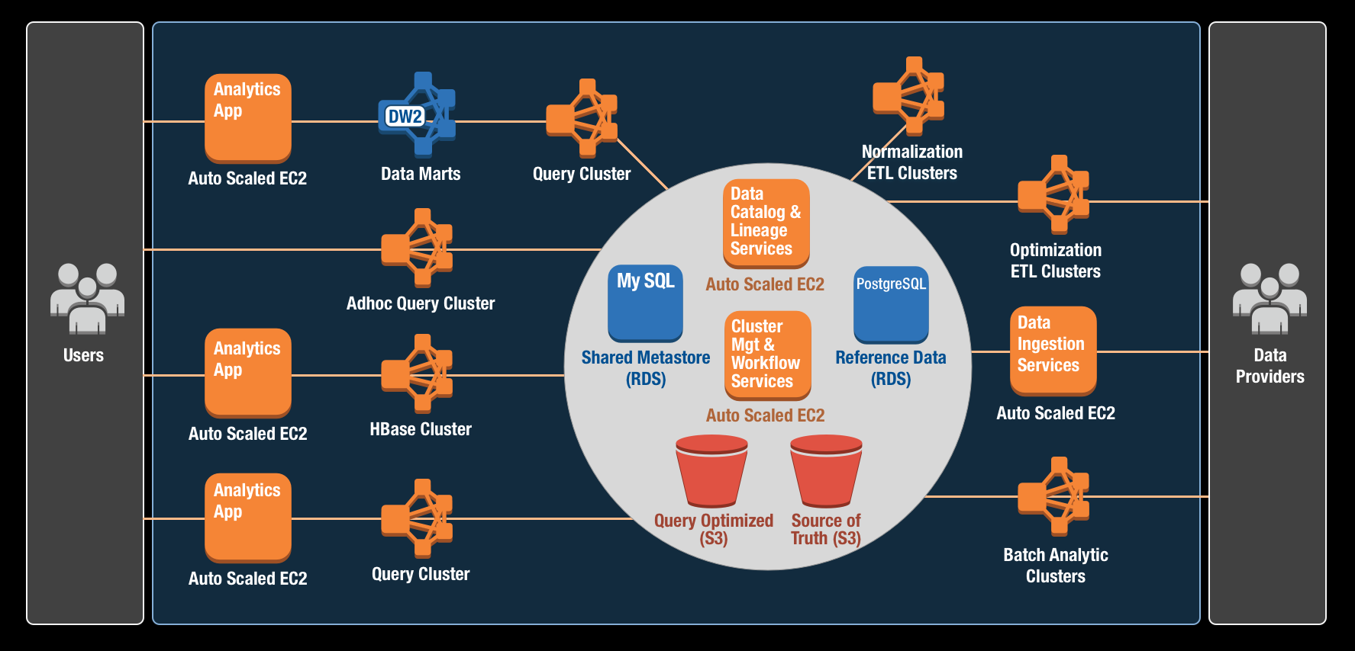
OUR CLOUD ARCHITECTURE

Slide 10
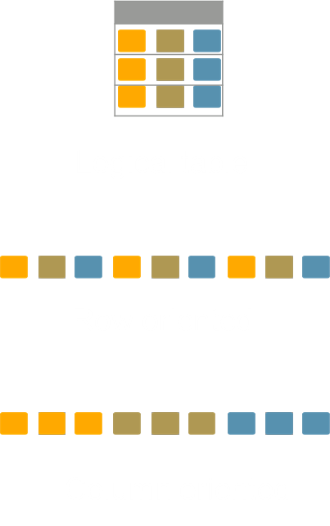
DATA BY DESIGN
Focus on use cases
Multiple copies often necessary
Organize your data for defined usage scenario
Experiment to determine optimal file size
Avoid small files
Separate storage from compute
Shutdown your cluster when not in use
Share data among multiple clusters
Fault tolerance and disaster recovery
Hybrid approach may be necessary
Columnar with the full row embedded using schema on read

Slide 11
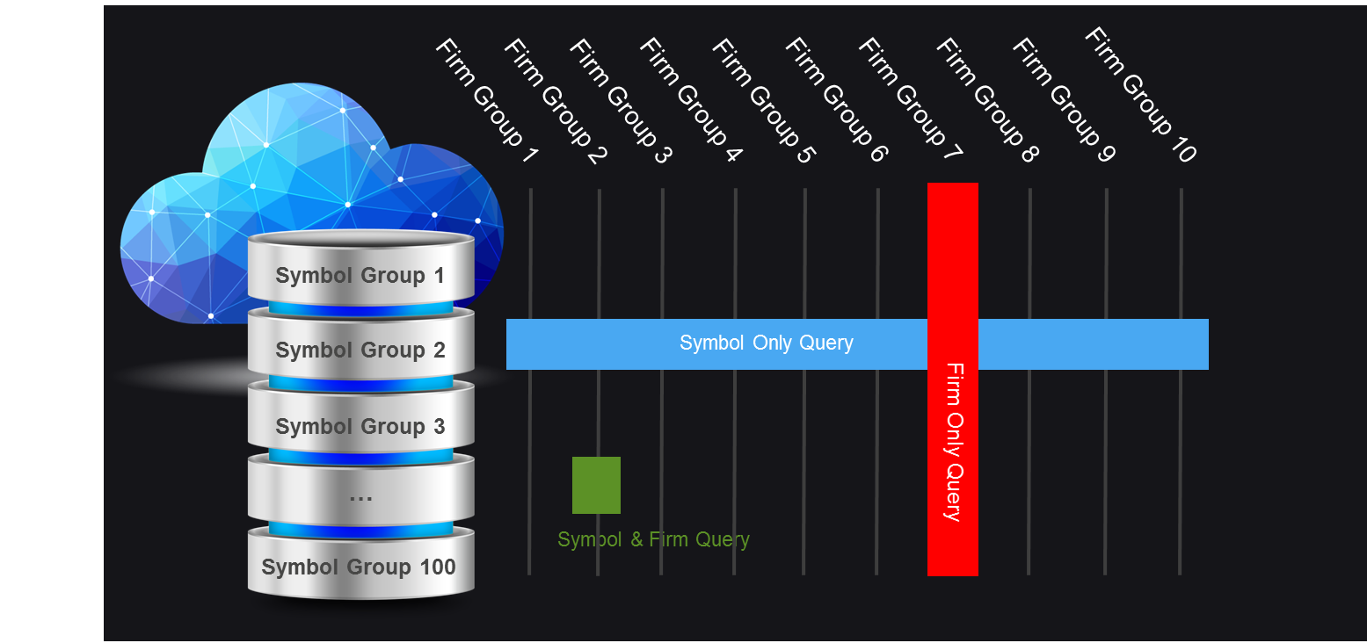
EXAMPLE PARTITION STRATEGY

Slide 12
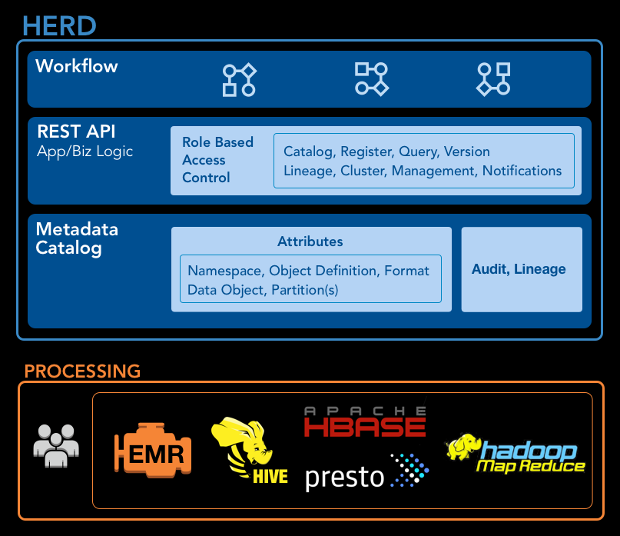
CENTRALIZE YOUR DATA MANAGEMENT
Herd
FINRA’s open source data manager
http://finraos.github.io/herd/
Platform Services
Unified catalog
Schemas
Versions
Encryption Type
Storage policies
Workflow and Cluster Management
Manage EMR clusters
Task Orchestration with Activiti, EMR Steps and Oozie
Lineage and Usage
Track publishers, consumers, and job lineage

Slide 13
SCALED REUSE WITH A SHARED METASTORE
Consider creating a shared hive metastore service
Offload metastore hydration of tables and partitions from cluster creation
Tables with millions of partitions can take hours to initialize
Transient clusters initialize faster
Avoid duplicative effort by dev teams
Register new tables and partitions as the data arrives via notifications
Separate metastore instances are needed for Hive 0.13, Hive 1.0 and Presto
Benefits:
Bring your own compute
Separation of concerns for different workloads
Optimize cluster configuration for the workload
Avoid compromises as you would in a shared database/appliance
Fault tolerance & DR with Multi-AZ RDS

Slide 14
RIGHT SIZE YOUR CLUSTER
Transient use cases: Batch and Progressive analytics
Size cluster based on run times and pricing structure
Use Spot and Fixed Duration pricing when you have flexible SLA
Always-On use case: Interactive analytics
Size Core nodes based on HDFS needs (statistics, logging, etc)
Reserve Master and Core nodes
Resize # of Task nodes as needed
Keep Core to Task ration of 1:5 to avoid bottlenecks
Use Spot and Fixed Duration pricing on Task nodes to manage costs

Slide 15
ELASTICITY METRICS
Node distribution for October 22nd

Slide 17
AD HOC QUERY EXAMPLE
Instantaneous access to the data lake
Easy data discovery
Shared metastore updated automatically from Data Management of all new table & partitions
Right tools for the right queries
Presto for interactive data slices
Hive (M/R and Tez) for complex queries and transforms
Share common DDL and ORC files between Hive and Presto
Separate concerns through separate clusters
Data is always available
No load/unload operations

Slide 18
EXPLORATORY ANALYTICS EXAMPLE
Audit Trail Information
Filtering, Summarization, Pivoting
Going beyond desktop tools

Slide 19
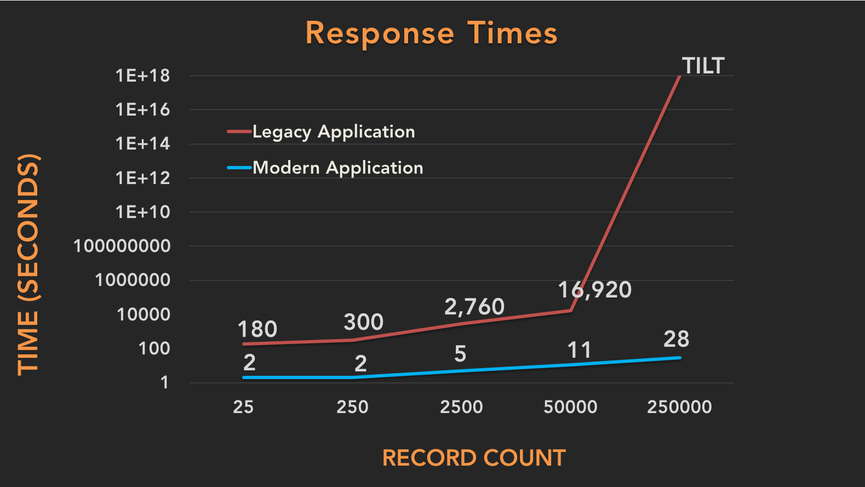
SPECIALIZED ANALYTICS EXAMPLE
Market Reconstruction
Pre-computed Order Lifecycles
3+ trillion nodes & 600 billion edges
Hbase schema on-read solution

Slide 20
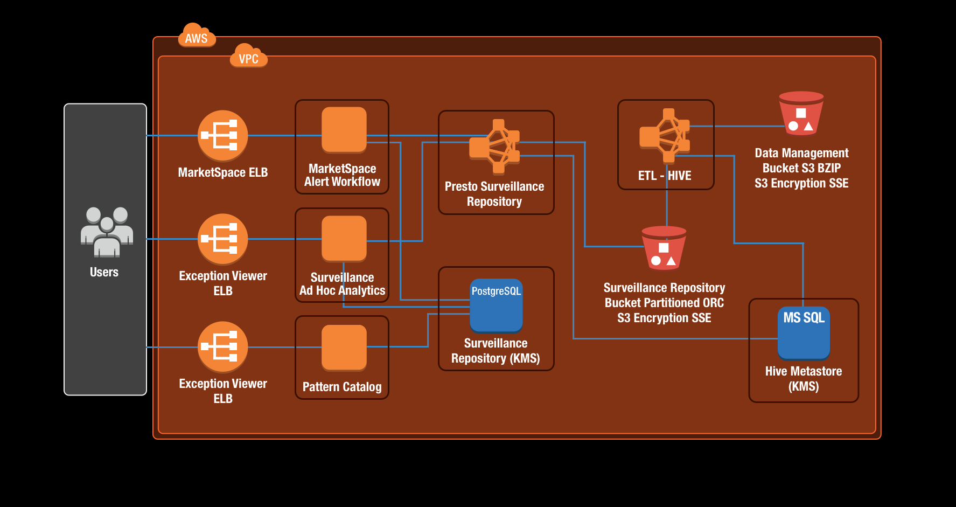
EMBEDDED ANALYTICS EXAMPLE
Embed scalable analytics into the workflow application
Provide richer Ad Hoc tools for analysis
Integrated with Surveillance Catalog

Slide 21
THE IMPACT
Removed obstacles
“Before data analysis of this magnitude required intervention from the technology team.”
Lowered the cost of curiosity
“Analysts are able to quickly obtain a full picture of what happens to an order over time, helping to inform decision making as to whether a rule violation has occurred.”
Optimize batch and interactive workloads without compromise
Elasticity allows us to process years of data in days rather than months while saving money
Increased teams’ delivery velocity

Slide 22
TAKEAWAYS
Provide the right tools to the right class of user
Empower exploration and sharing
Stay central and avoid silos
Emphasize and increase data literacy
Don’t forget about the UX
Collect and analyze metadata, then adapt
IT needs to collaborate as a partner

Slide 23
ABOUT THE PRESENTERS
Scott Donaldson
Senior Director, FINRA
Data Analytics and Surveillance Systems
Scott.Donaldson@finra.org
https://www.linkedin.com/in/scottdonaldson
Matt Cardillo
Senior Director, FINRA
Data Analytics
Matt.Cardillo@finra.org
https://www.linkedin.com/in/matt-cardillo-3977552

Slide 24
QUESTIONS?
Learn more at http://technology.finra.org/
FIRNA Technology is hiring
http://technology.finra.org/careers.html

