Slide 1
NETFLIX’S BIG LEAP
FROM
ORACLE TO C*
ROOPA TANGIRALA
Engineering Manager
Netflix
Notes:
Lot of questions on how Netflix migrated Want to share the story so that you all can take away from our journey and do your own big leaps !

Slide 2
WHO AM I?
Engineering Manager @ Netflix
Twitter - @roopatangirala
Email roopa.tangirala@gmail.com
Linkedin - https://www.linkedin.com/pub/roopa-tangirala/3/960/2b
Notes:
Joined Netflix back in 2007 when it was primarily DVD by mail and am honored to see the transition into Streaming Company with lot of original content..In the background, we transformed from being in DC and moving 100% cloud. My team provides cassandra, elastic search , dynomite and rdbms as a service and manage the infrastructure, be it upgrades, active active, new features .

Slide 3
OVERVIEW
Brief History
Set up
Migration Strategy
Migration Challenges
Example of Real use cases
Lessons learnt

Slide 4
1997
Notes:
2007 Netflix shipped its billionth DVD!

Slide 5
DATACENTER
Notes:
Own datacenter with core Ops team doing operations for managing the infrastructure. Lot of planning for additional hardware for the subscriber growth and spikes related to events like Oscars, were people flock to the netflix website and add movies which won oscar or contenting for the same in their queues.

Slide 6
BACKEND
Notes:
Backend for transactional datasets, this does not include the reporting or the Business analytics part of it.

Slide 7
ORACLE DATAMODEL LIMITATIONS
Notes:
RDBMS not flexible enough to handle modern day applications, which are a mixture of structured, semi-structured and unstructured data. WHILE Oracle handles structured data well it lacks dynamic datamodel which is important for high traffic modern applications.

Slide 8
NO HORIZONTAL SCALING
Notes:
Oracle scales up , master slave design limits both its scalability and performance for online applications, the failure of Oracle to add more capacity online in an elastic fashion without impacting the applications is a major drawback. IBM power 7 , 32 dual core 64 bit multiprocessors, 750GB RAM, TB’s storage allocated via SVC MCS cluster which is 8G4 cluster with 4GB/sec interface running with RAID 10 configurations.

Slide 9
LICENSE COST

Slide 10
EVERY TWO WEEKS!!
Notes:
Website went down every two weeks to include changes to PLSQL procedures, packages, schema changes and other backend database changes. Was ok for DVD since the shipping could happen after the site was back up but not acceptable for streaming service.

Slide 11
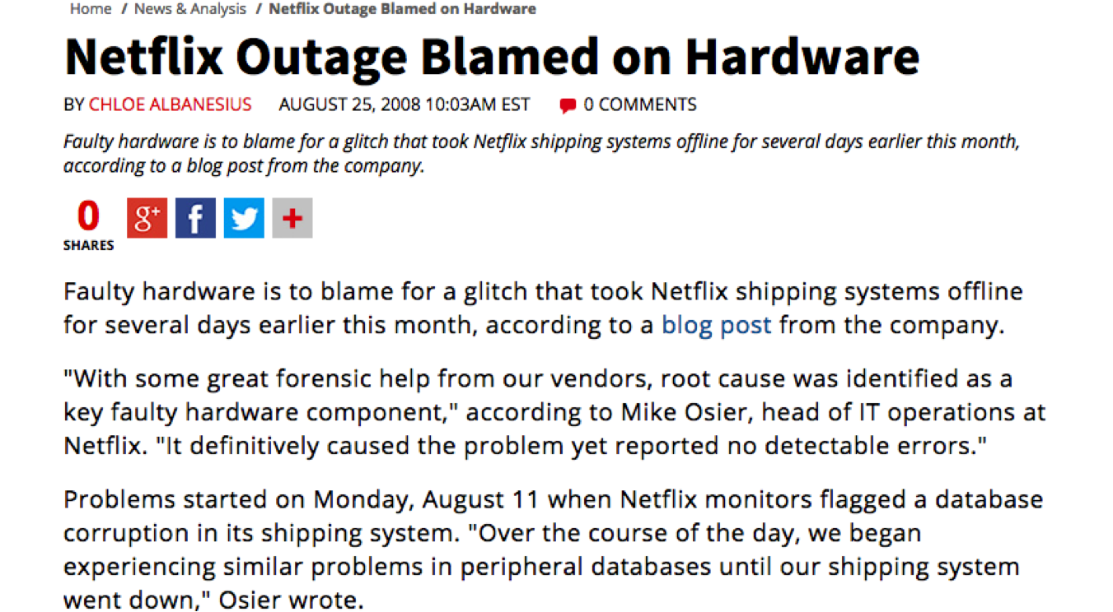
2008
Notes:
This was the ugly outage and changed the way we think about infrastructure , reliability and availability.

Slide 12
MOVE TO CLOUD
Notes:
1. Re-architect – question everything including keeping our own DC
2. Letting AWS focus on DC allows our engineers to focus on building and improving our business
3. Ideal for horizontal scaling architecture – even if we are not able to predict the customer growth
4. Cloud computing is the future.

Slide 13
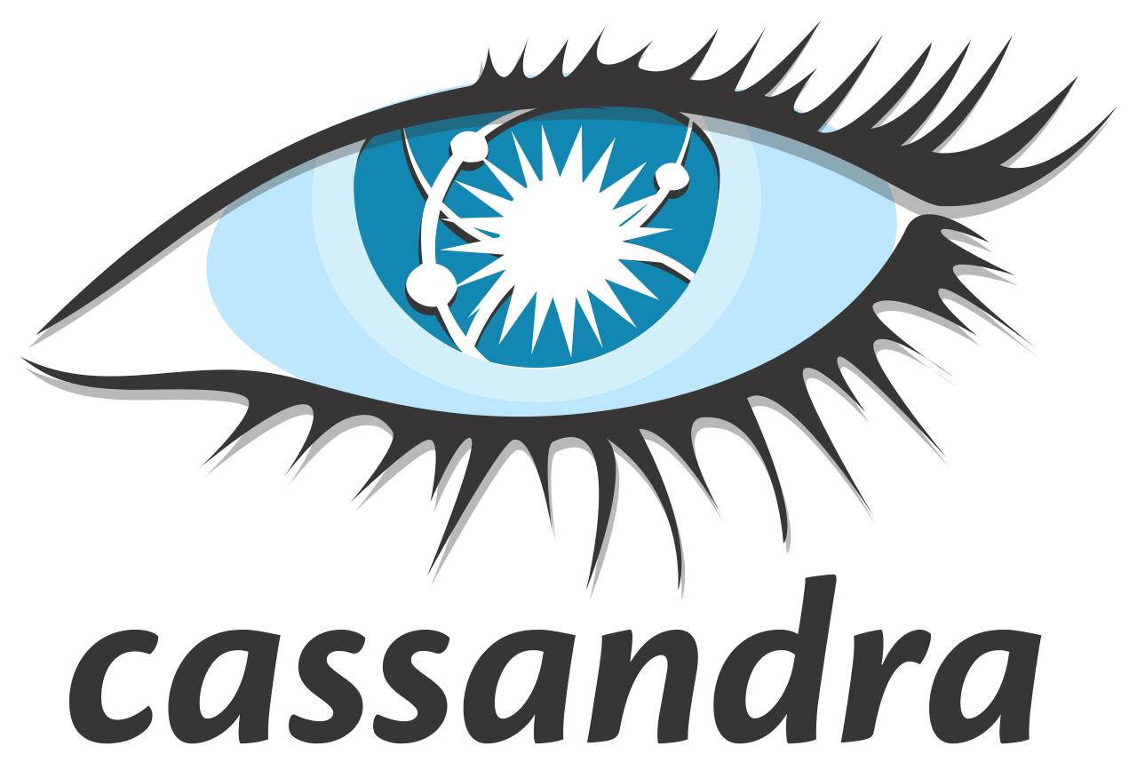
REQUIREMENTS
HIGHLY AVAILABLE
MULTI DATACENTER SUPPORT
PREDICTABLE PERFORMANCE AT SCALE

Slide 14
WHY C* ?
Massively scalable architecture
Multi-datacenter, multi-directional replication
Linear scale performance
Transparent fault detection and recovery
Flexible, dynamic schema data
Guaranteed data safety
Tunable data consistency

Slide 15
BACKEND NOW

Slide 16
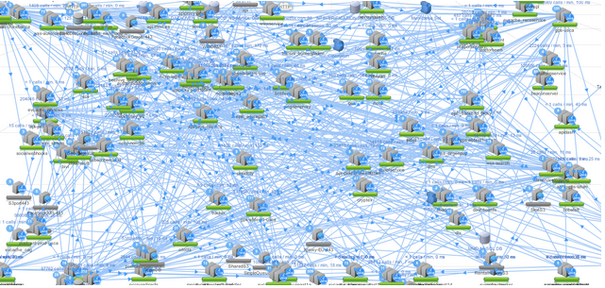
MICRO SERVICES
Horizontal, Homogenous, Commoditized

Slide 17
DOWNTIME

Slide 18
ALMOST DAILY PUSHES
Notes:
Pushes daily with each micro service doing daily pushes at their own pace and convenience without impacting other services.

Slide 19
GLOBAL CLOUD
Notes:
Dataset replicated in all three regions with 3 copies in each region. All apps local to the region and connect to clusters in the local region

Slide 20
GLOBAL PRESSENCE

Slide 22
MIGRATION STRATEGY

Slide 23
BABY STEPS
Notes:
Baby steps is critical to learn from the first pioneers and have other apps follow through. First page to go to cloud was jobs.netflix.com..so, start small and migrate it to cloud.

Slide 24
NEW FEATURES FIRST TO CLOUD
Notes:
Any new app which is coming along or a new product functionality, try to start in cloud. There also you will get to revamp from the lessons learnt and apply those in future critical migrations.

Slide 25
DATA MODEL REVIEW
ORACLE
CASSANDRA
DB/Schema
Table
Row
value
column
name
keyspace
column family
Row
name
value
timestamp
column
➔
Notes:
Rdbms backgroud
Keyspace -> DB
CF -> Table
Row groups columns
Each column is a triplet
Column naming is not necessary/could be different. Column comparator specifies the sorting.. No need to stick to certain rules
Name -> sorted
Timestamp -> conflict resolution

Slide 26
SCHEMALESS DESIGN
Row-oriented
Number of columns/Names can differ
xyz
name
Paul
zip
95123
abc
name
Adam
zip
94538
sex
Male
cde
name
XYZ
Notes:
Rows are indexed
Columns are sorted based on comparator you specify, so use it to your benefit
Keep column names short as they are repeated Column size = 15 bytes + size of name + size of value
Don’t store empty columns if there is no need – schema free design

Slide 27
UNDERSTAND WRITE PATH
client
Commit log (Disk)
Memtable (memory)
Flush
sstable
sstable
sstable
Notes:
Commit log for durability – sequential write
Memtable – no disk access (no reads or seeks)
Sstables written sequentially to the disk
Optimizing clusers for write heavy patterns,- we have disabled commit log for some very high write clusters where data can be regenerated. Tuning memtable settings to match the flush rate is also important.

Slide 28
UNDERSTAND READ PATH
memtable
client
sstable
sstable
sstable
Row cache/key cache
Notes:
2 digest query/ 1 complete data response. The optimization is only on the bandwidth
Number of replicas contacted depend on the consistency level specified
Hinted handoff, read repair, antientropy node repair
Read – with local_one for most clusters, good enough

Slide 29
LOGIC IN APPLICATION
Stored procedures
Functions
Triggers
Referential integrity constraints

Slide 30
CONSISTENCY CHECKER
DATACENTER AWS
ORACLE
C*
FORKLIFT
WRITES
WRITES
READS
DUAL WRITES
READS
APP

Slide 31
MAIN APPROACH
DUAL WRITES
FORKLIFT OLD DATASET
CONSISTENCY CHECKER
MIGRATE READS TO C* FIRST
SWITCH OFF WRITES TO DC

Slide 32
ORACLE SEQUENCE
USE UUID for Unique keys
Distributed Sequence Generator for Ordering
C* counters – not so much

Slide 33
Heavy Transactional Use Case
RDBMS

Slide 34
CHALLENGES

Slide 35
SECURITY
Notes:
Client to node encryption, authentication based on user/password, object permissions introduced in cassandra 1.2.. Before that we could not move SOX data to cassandra.

Slide 36
DENORMALIZE
DENORMALIZE
DENORMALIZE
DENORMALIZE
DENORMALIZE
Notes:
Coming from relational backgrounds many developers had to wrap their heads around designing schemas and think to denormalize and get rid of the 3rd normal form of design in rdbms. Storage is cheap, its ok even if the data is duplicated.

Slide 37
Roman Riding
Notes:
The guy looks happy, but he is not,,,it a lot of focus and hard work to make roman riding work..

Slide 38
Model Around Queries

Slide 39
Engineering Effort
Notes:
Huge engineering effort with various teams working on their services and doing migrations some in DC and some in cloud, managing the uptime , pushing new product features.

Slide 40
Know limitations
Notes:
Very important to know which use cases cassandra is not a good fit for.Never try to stick with one type of database since others are on it. Knowing cassandra is not good for transactional use case, use cases where there are lot of ahoc queries which keep changing ?

Slide 41
SOURCE OF TRUTHF TRUTH
Notes:
When to shift the change the source of truth is important…confidence in consistency checker and match the records at the source and destination.

Slide 42
REAL EXAMPLES

Slide 43
API
High concurrency
Range scans
~1MB of data
Caused heap issues at Cassandra level
Very high read latency
Notes:
API servers autoscale or new push, they need to read majority of rows in scripts column family

Slide 44
Range scan replaced with inverted index
client
1
active_Scripts_idx
Idx_1
/tvui/{ui}/pathEvaluator
1,2
/odp/{ui}/pathEvaluator
2
/odp/{ui}/pathEvaluator
2
/odp/{ui}/pathEvaluator
2
2
scripts
/tvui/{ui}/pathEvaluator_1
allocation
0000
active
false
Scripts_1
Text data
/odp/{ui}/pathEvaluator_2
allocation
0000
active
false
Scripts_1
Text data
/xbox/{ui}/pathEvaluator_1
allocation
0000
active
false
Scripts_1
Text data
Notes:
Simple but powerful concept – based on premise that rows are indexed and point looks are faster
Create another column family and store list of all required rowid’s for faster lookup

Slide 45
Inverted Index considerations
Column name can be used a row key placeholder
Hotspots!!
Sharding
Notes:
Wide row can reside only on one node.. And that can create hot spots
Sharding – application logic / buckets

Slide 46
VIEWING HISTORY
Notes:
Each customer id we have a row in cassandra
Keep appending columns as and when customer generates viewing history

Slide 47
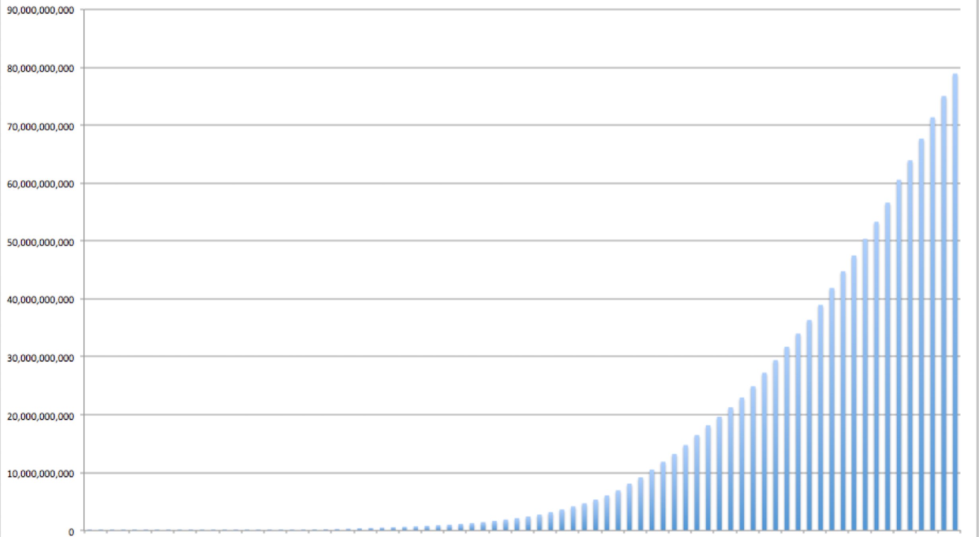
Growth of Viewing History

Slide 48
Problem
Growth Pattern: “Hockey-stick”
Retention Policy: Retain forever
Access Pattern: Retrieve all for a customer
Scaling and performance challenges as the data grows

Slide 49
Goals
Small Storage Footprint
Consistent Read/Write Performance
Infinite Scalability

Slide 50
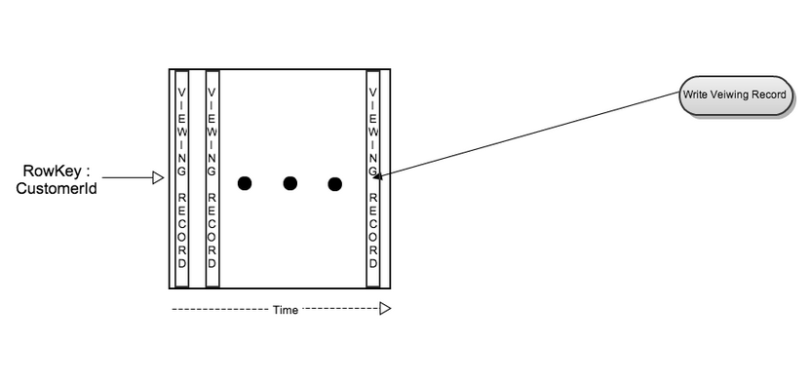
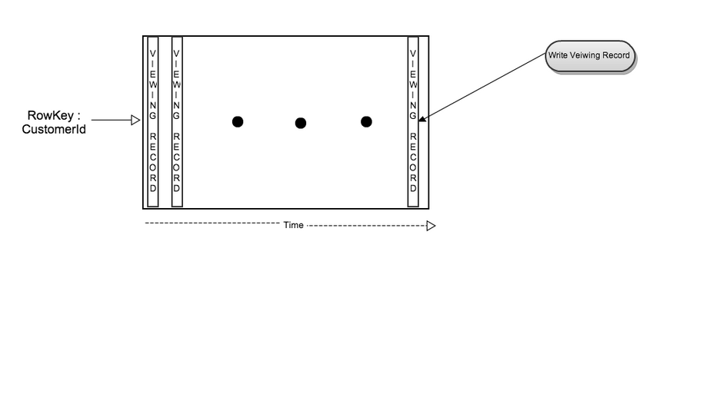
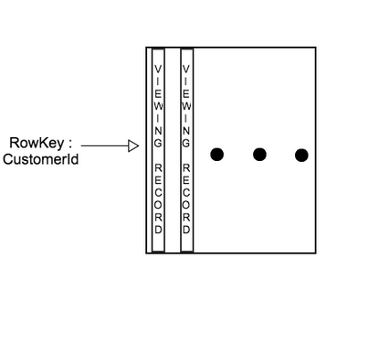
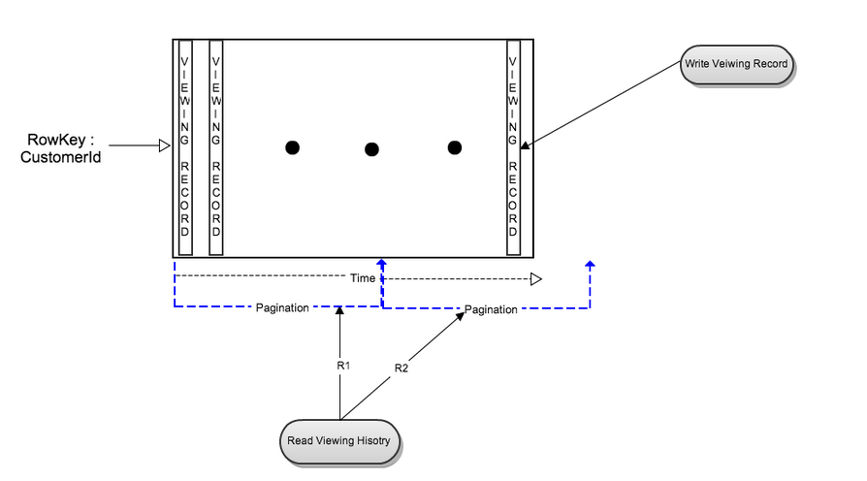
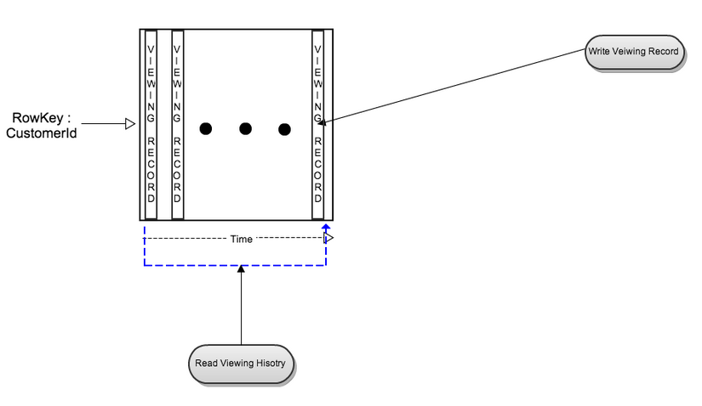
Old Data Model
Notes:
Viewing history for one customer is stored in one wide row with row key CustomerID in cassandra.
Write
One viewing record is inserted as a new column when a customer starts playing a movie (aka Open a stream).
Viewing record is updated after customer pauses or stops related playback.
Read
Read whole row at once to retrieve all viewing records for one customer.
This is efficient initially when number of records per customer is small.
Read whole row via pagination for large viewing history
read latency increases as number of viewing records increases

Slide 51
Old Data Model - Pros
Simple Wide Rows
No additional processing
Fast Write
Fast Read for Majority

Slide 52
Old Data Model - Cons
Read latency increases as number of viewing records increases
Cassandra Internal
Number of SSTables
Compaction
Read Repair
Lesson learned : Wide Row Limitation

Slide 53
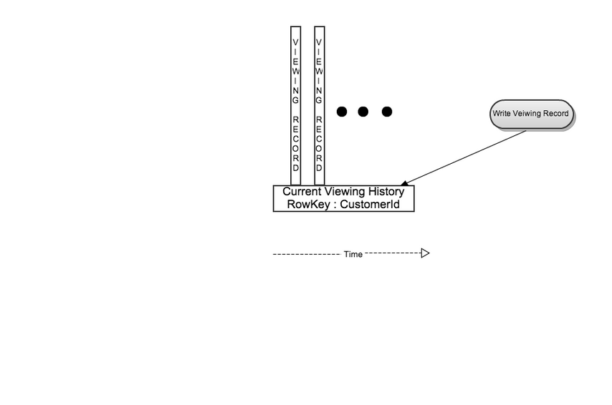
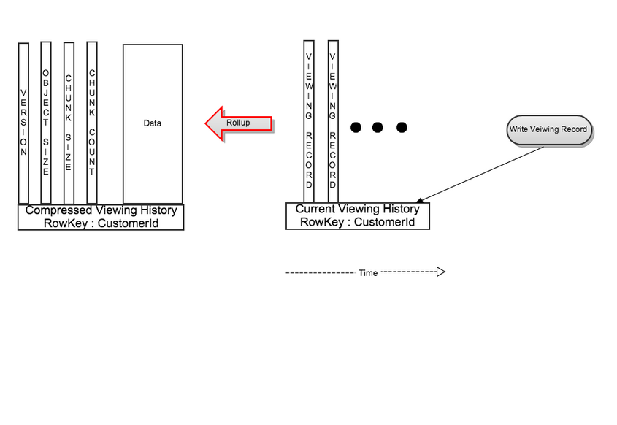
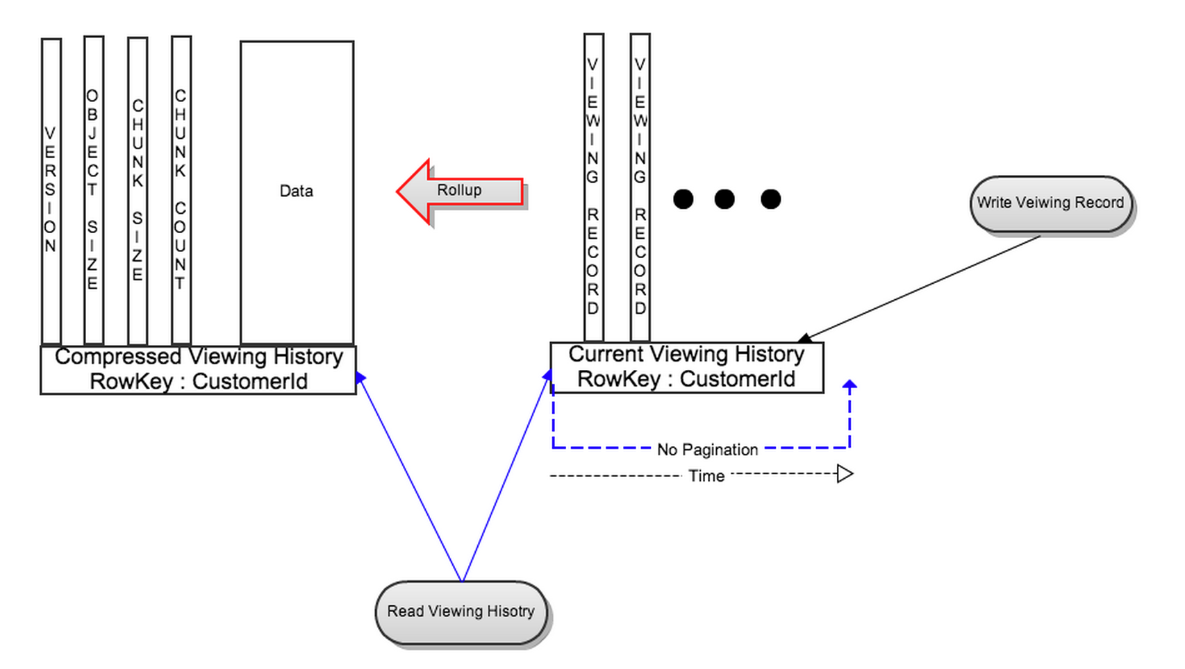
New Data Model cont’d

Slide 54
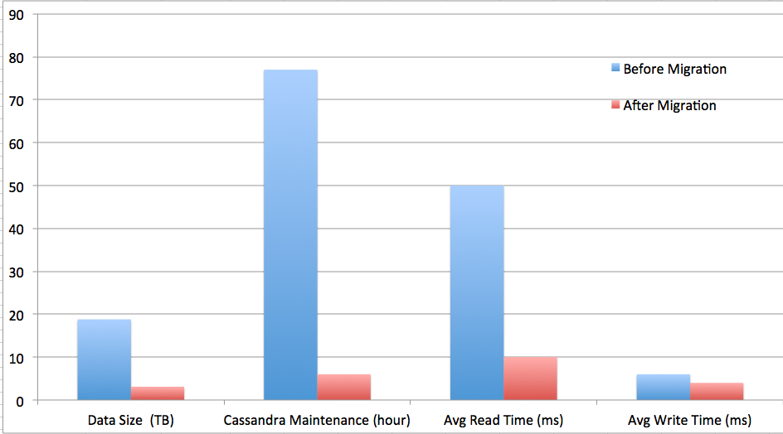
RESULTS

Slide 55
Think Data Archival
Data stores grow exponentially
Have a process in place to archive data
Moving to a separate column family
Moving to a separate cluster (non SSD)
Setting right expectations w.r.t latencies with historical data
Cassandra TTL’s
Notes:
We don’t have linear growth
TTL fascinating feature… coming from oracle background

Slide 56
Cinematch Rating Service
First Model
Second Model
12345
345
4
545
2
545
1
545
4
545
5
4355
45
2
66
2
67
4
12345
Movie_id
BLOB
4355
Movie_id
BLOB

Slide 57
WHAT WORKED?
12345
343
674
Name
3
5
BLOB
4355
443
4542
242
Name
4
2
5
BLOB

Slide 58
BLOB vs COLUMN/VALUE
Try out column/value approach first and hopefully it satisfies avg/95/99th
Column value pro’s:
Write payload can be smaller
Query by specific columns
Read path does not require reading the entire row
Blob considerations
Read percentage is very high (90’s)
Read latencies are very important
All the data is read most of the time

Slide 59
LESSONS LEARNT
Get the model right
Baby Steps
Huge Engineering effort
Think Compression
Performance test
DB just for Data

Slide 60
QUESTIONS?

