Slide 1
How to build a successful Data Lake
Alex Gorelik
Founder and CEO, Waterline Data

Slide 2
Alex Gorelik
Founder and CEO, Waterline Data
3rd start up: Acta (SAP), Exeros (IBM), Waterline
25 years of building data related technology (Sybase, IBM, Informatica)
5 years of hands on IT consulting (BAE, Unilever, IBM, Jysk, Stanford Hospital, Kaiser, etc.)
Last 5 years focused on Big Data (Waterline, Informatica, Menlo Ventures, IBM)
IBM Distinguished Engineer
BS CS Columbia, MS CS Stanford

Slide 3
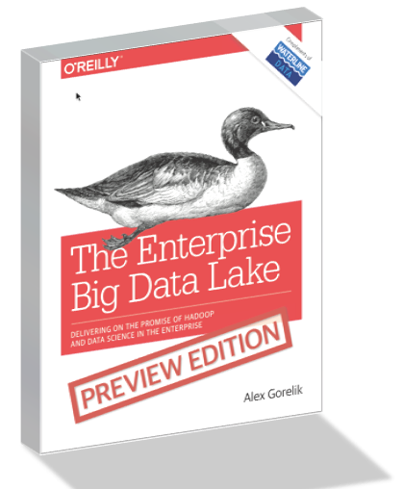
Visit Booth 640 (Waterline Data)
and enter to win a signed copy of The Enterprise Big Data Lake to be published this year by O’Reilly Media
For a free two-chapter preview, go to http://go.waterlinedata.com/stratasj

Slide 4
Data Lake Powers Data Driven Decision Making

Slide 5
Business value
Data Lake
Data Puddles
Data Warehouse Off-loading
Data Swamp
Enterprise Impact
Limited Scope and Value
Cost Savings
No Value
Value

Slide 6
Data Swamps
Raw data
Can’t find or use data
Can’t allow access without protecting sensitive data

Slide 7
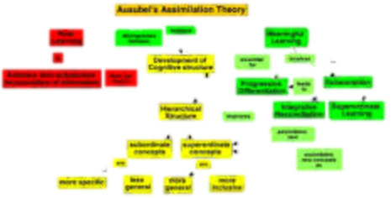
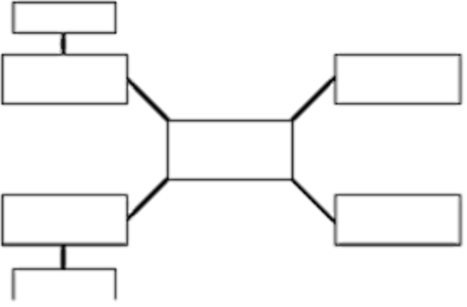
Data Warehouse Off-loading: Cost Savings
It takes IT 3 months of data architecture and ETL work to add new data to the Data Lake.
I prefer DW – it’s more predictable
I can’t get the original data


Slide 8
Data Puddles: Limited Scope and Value
Low variety of data and low adoption
Focused use case (e.g., Fraud detection)
Fully automated programs (e.g., ETL Off-loading)
Small user community (e.g., Data science sand box)
Strong technical skill set requirement

Slide 9
What Makes a Successful Data Lake?
+
+
Right Platform
Right Data
Right Interface

Slide 10
Right Platform: Hadoop
Volume - Massively scalable
Variety - Schema on read
Future Proof – Modular – same data can be used by many different projects and technologies
Platform cost – extremely attractive cost structure

Slide 11
Right Data Challenges: Most Data is Lost, so can’t Analyze it Later
Data Exhaust
Only a Small Portion of Data is Saved in Enterprises Today in Data Warehouses

Slide 12
Right Data: Save Raw Data Now to Analyze Later
Don’t know now what data will be needed later
Save as much data as possible now to analyze later
Save raw data, so can be treated correctly for each use case

Slide 13
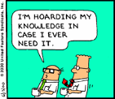
Right Data Challenges: Data silos and data hoarding
Departments hoard and protect their data and do not share it with the rest of the enterprise
Frictionless ingestion does not depend on data owners

Slide 14
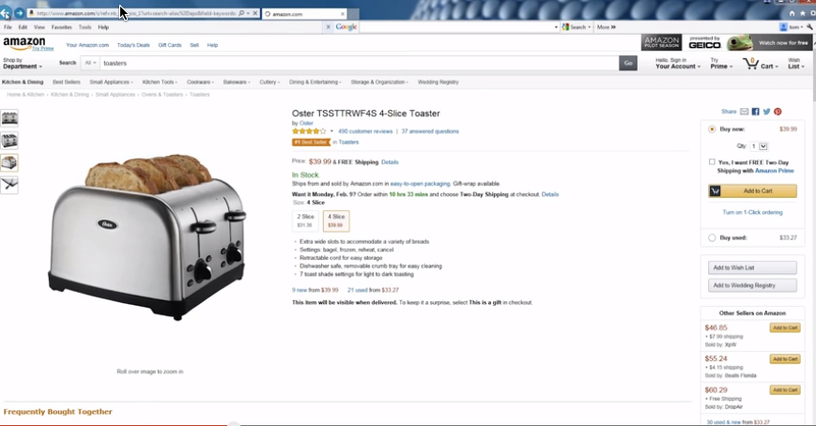
Right Interface: Key to Broad Adoption
Data marketplace for data self-service
Providing data at the right level of expertise

Slide 15
Providing Data at the Right Level of Expertise
Clean, trusted, prepared data
Raw data
Data Scientists
Business Analyst

Slide 16
Roadmap to Data Lake Success
Organize the lake
Set up for Self-Service
Open the lake to the users

Slide 17
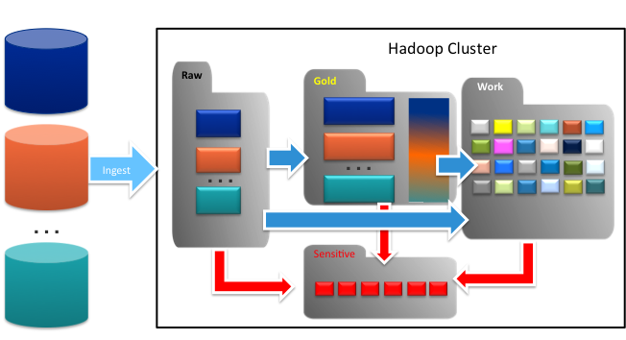
Organize Data Lake into Zones
Organize the lake

Slide 18
Multi-modal IT – Different Governance Levels for Different Zones
Minimal Governance
Make sure there is no sensitive data
Heavy governance
Restricted access
Raw/Landing
Sensitive
Data Stewards
Data Engineers
Data Scientists
Work
Gold/Curated
Business Analysts
Minimal Governance
Make sure there is no sensitive data
Heavy Governance
Trusted, curated data
Lineage, Data Quality
Data Scientists
Multi-modal IT with different governance levels in different zones

Slide 19
Business Analyst Self-Service Workflow
Set up for Self-Service
Find and Understand
Prep
Analyze
Provision

Slide 20
Finding and Understanding Data
Find and Understand
Crowd-source metadata and automate creation of a catalog
Institutionalize tribal knowledge
Automate discovery to cover all data sets
Establish Trust
Curated annotated data sets
Lineage
Data quality
Governance

Slide 21
Accessing and Provisioning Data
Provision
Cannot give all access to all users
Must protect PII data and Sensitive business information
Top down approach
Find and de-identify all sensitive data
Provide access to every user for every dataset as needed
Agile/Self-Service Approach
Create a metadata only catalog
When users request access, data is de-identified and provisioned

Slide 22
Provide data marketplace interface to find, understand and provision data

Slide 23
Data Prep
Prep
Prepare data for analytics
Clean data
Remove or fix bad data
Fill in missing values
Convert to common units of measure
Shape data
Combine (join, concatenate)
Resolve entities (e.g., create a single customer record from multiple records or sources)
Transform (aggregate, filter, bucketize, convert codes to names, etc.)
Blend data - harmonize data from multiple sources to a common schema/model
Tooling
Emerging space with many great dedicated data wrangling tools
Some capabilities in BI/Visualization tools
SQL and scripting languages for the more technical analysts

Slide 24
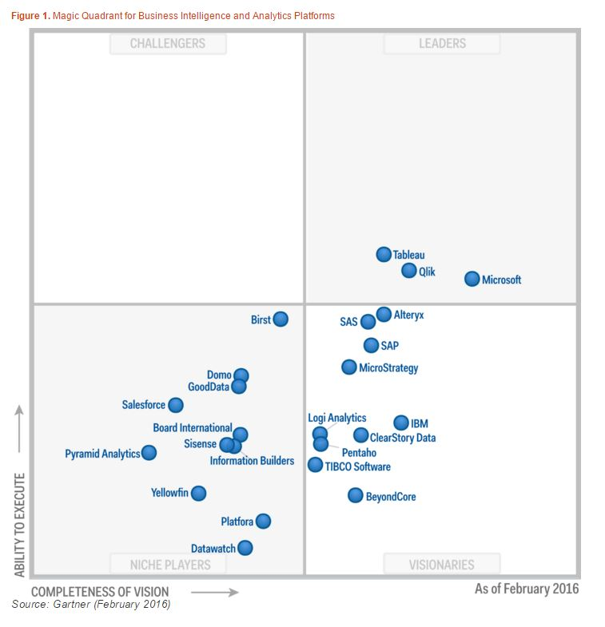
Data Analysis
Analyze
Many wonderful self-service BI and Visualization tools
Mature space with many established and innovative vendors
Magic Quadrant for Business Intelligence and Analytics Platforms
04 February 2016 | ID:G00275847
Analyst(s): Josh Parenteau, Rita L. Sallam, Cindi Howson, Joao Tapadinhas, Kurt Schlegel, Thomas W. Oestreich

Slide 25
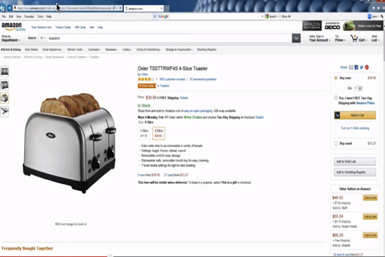
Successful Data Lake
+
+
Right Platform
Right Data
Right Interface

Slide 26
Q&A

Slide 27
Visit Booth 640 (Waterline Data)
and enter to win a signed copy of The Enterprise Big Data Lake to be published this year by O’Reilly Media
For a free two-chapter preview, go to http://go.waterlinedata.com/stratasj

Slide 28
Thank you

