Slide 1
Can you afford to drop ACID?
Understanding real-world SQL requirements in the big data era

Slide 2
Getting to Know Emma McGrattan
I’ve worked with data since before it was “Big”.
Upon “retirement” I dream of opening a bar/bistro in Dublin, Amsterdam or Paris.
I once won an open mic comedy night and would love to do stand-up.
I was born and raised in Ireland but became an American Citizen in 2011.
I would rather walk 150ft to my car to get my phone to control my lights and thermostats and avoid doing it the old fashioned way.
I’ve almost drowned five times.
I joined Mensa at age 12.
I once announced on-stage at Comdex that I’d like to be a pornographer – I meant to say “photographer” – honestly I did!

Slide 3
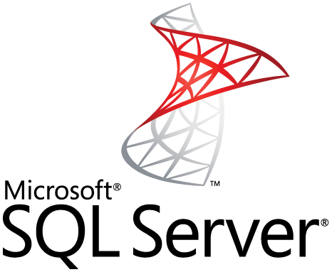
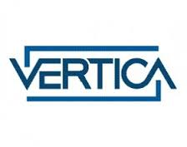
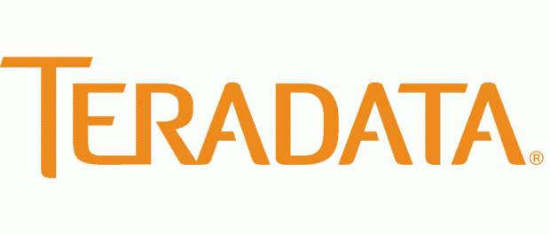
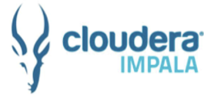
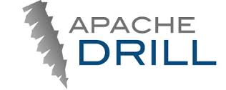
The SQL in Hadoop Landscape
Industrial
Strength
Traditional Enterprise Data
Warehouse
MATRIX
VECTOR in HADOOP
Modern, Super Scaling
Columnar Analytic Engine
Enterprise Readiness
Production
Ready
Ported Traditional RDBMS
SQL Query Engines
Immature
None
Connected
Native
Hadoop Integration

Slide 4
Does ACID Matter?

Slide 5
What is ACID?
Atomicity - Units of work within a database can be specified as transactions; where a transaction may be comprised of one or more SQL statements. Either the entire unit of work within a transaction succeeds or none of it does.
Consistency - transactions always take the database from one consistent state to another. If a transaction violates the databases consistency rules, then the entire transaction is rolled back.
Isolation - transactions are securely and independently processed in parallel without interfering with each other.
Durability – Once a transaction is committed, it will persist event in the face of catastrophic failure.
Notes:
ACID is an acronym for Atomicity Consistency Isolation and Durability. Let’s take each of these in turn and explain how Vector in Hadoop satisfies it:
Atomicity: Units of work within Vector in Hadoop can be specified as transactions, where a transaction may be comprised of one or more SQL statements. Either the entire unit of work within a transaction succeeds or none of it does. Take as an example transferring funds from your checking account to your savings account; you only want to debit your checking account if the money is credited to your savings account. This is an atomic operation - either it all happens, or none of it does. Typically a transaction is started with the BEGIN TRANSACTION SQL statement and ends with the COMMIT keyword, but Vector in Hadoop also supports autocommit.
Consistency: Vector in Hadoop ensures that the database remains in a consistent state before the start of the transaction and after the transaction is over. If, for whatever reason, a transaction is executed that violates the database’s consistency rules, the entire transaction will be rolled back and the database will be restored to a state consistent with those rules. On the other hand, if a transaction successfully executes, it will take the database from one state that is consistent with the rules to another state that is also consistent with the rules. Any DML that is not a data append will be stored in an optimized in-memory structure called the Positional Delta Tree (PDT). Vector in Hadoop supports multi-version read consistency. Committed data in PDTs is efficiently merged with data read from disk to answer queries. Any data that is committed to PDTs is also written to the write ahead log file and persisted on disk for recovery purposes before the commit completes.
Isolation: Vector in Hadoop ensures that transactions are securely and independently processed at the same time without interfering with each other. Vector in Hadoop uses a snapshot isolation transaction isolation model with optimistic concurrency control.
Durability: In Vector in Hadoop details of all transactions are written to a write ahead transaction log file. If the system crashes before the data has been written to the permanent database files, when the system is restarted committed transactions will be replayed and uncommitted transactions are undone or rolled back as part of the recovery process.

Slide 6
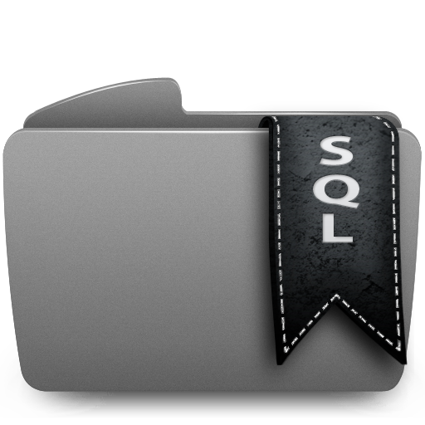
Real-World SQL in Hadoop Requirements
FAST
ENTERPRISE-GRADE
OPEN
Highly Performant – run existing apps faster and grow data without sacrificing performance
Full ANSI SQL 2003 support – leverage existing SQL skills and standard BI tools and apps
Hadoop distribution agnostic - avoid vendor lock-in and provide customer flexibility across distributions
High Concurrency – allow simultaneous users and tasks to run without long wait times
Fully ACID compliant – prevent inaccurate results by bringing transactional integrity to Hadoop
Collaborative architecture – minimize risk by leveraging existing tools and benefitting from cross-industry innovations
Mature, proven planner and fast optimizer – maximize usage of nodes, CPU, memory and cache with highly intelligent query execution plans
Update Capability – provide ability to update data in Hadoop without impacting query performance
Open Data Formats – query native Hadoop file formats and allow API access to our own block format
Native in-Hadoop YARN – optimize usage of low-cost Hadoop infrastructure by automatically managing cluster resources across applications
Native DBMS Security – sleep well with enterprise class authentication, user and role-based security, data protection, query auditing, query alarms and encryption
Cloud – get started quickly with flexible deployment options on premise or across multiple cloud infrastructures
Notes:
Only Actian provides this complete set of enterprise grade features. We know how important your data is. That’s why we’ve created the most battle-tested, industrial-grade SQL in Hadoop capabilities on the market.
[Important to call out why each of these exists in the first place and then how it applies to Hadoop]
Full ANSI SQL 92 support – You can take any of your off shelf tools and use them without compromising any functionatlity because of the full SQL 92. We also have analytic extensions – cubes, rolling set, upserts, etc. All of this allows you to do analytics on your Hadoop data with existing SQL skills.
Fully ACID compliant - we understand transactions. And we understand that you need to be able to rely on your results. If you run a report at 8am for your boss and he asks you to run again at 10, you need to have the same results. One mistake destroys your credibility. Have you ever bought a ticket through expedia and you see there’s one seat left? IF three people are looking at the same ticket, Expedia has to ensure that only one person gets it, even if all three click purchase at the same time. That’s ACID compliance. And no Hive doesn’t have this. Hive doesn’t even allow multiple, concurrent transactions executing at the same time.
Hadoop distribution agnostic – The last thing you want is to be locked into a specific vendor. We work with several companies who switch Hadoop distros or are trying out different flavors, maybe have some Cloudera and Some Hortonworks. We work with any of them, giving you the power to choose.
Update capability – we support individual updates inserts deletes concurrently without impacting performance. This is tremendously valuable because while everybody can do inserts, only Actian has the ability to randomly access data in the DB and update that or insert a value. If you’re running that same report for your boss and you realize that you had one of your data points listed in the wrong currency, for example. You want to be able to go back and fix that individual record without having to redo the entire query.
Highest concurrency – this is important because you’re likely going to have more than one user hitting the DB at the same time. So you need to be able to support not just simultaneous users, but simultaneous tasks (so one person running multiple tasks), without affecting performance.
Highly performant – this is what Actian is known for and every time we have a new release, our performance gap only increases as we extend our lead. In today’s world, where decisions have a small window of opportunity, performance is key.
Native DBMS security – because of Actian’s decades of investment and experience in the database world, we know security. We know that your job is on the line without it and a company’s reputation is at stake as well. It’s all too common to receive an email from Target, BestBuy or whoever is next, explaining that there has been a security breach and accounts may be at risk. This is one of the reasons why many have shied away from Hadoop because the lack of security makes it too risky . But we’ve addressed this with user and role based security and data level protection and encryption. We understand what it means to secure data, and can even give you the ability to know when someone is attempting to access something they shouldn’t.
Optimizer – We have literally hundreds of development years in query optimization. What does this mean? It means it makes you smarter. It can figure out if you’re joining a number of tables, what’s the best way to join them. It means unlike other offerings YOU can be in control.
YARN – I wouldn’t even talk to a vendor that’s not YARN compliant. It’s a key factor in managing resources efficiently. But we are doing some clever things with YARN beyond the basics. YARN not designed for long running processes. Essentially it’s impossible to grow and shrink resources on the fly, but we’ve enabled this with a requirement to dynamically set priority of the workload. We can identify data node failure and dynamically reconfigure cluster and we do intelligent block replica placement. All of this again goes back to giving you more power.
Collaborative architecture – We are able to ingest data from other sources. We have external table support, ingest data from other Hadoop formats.
Open APIs- there’s open source and openness, and while we may not be open source (which is for good reason, because vector processing is hands down the fastest way to process data), we are open. By allowing access to our block format, Other Hadoop projects in the ecosystem can benefit from that.
Both individually with each of these features and perhaps more importantly, collectively, no one else can claim this.
Some specifics:
BI Tools.
Skills Sets.
Standards
Openess.
Scale
Cost

Slide 7
Real World Use Case Re-Platforming ~30 Risk Applications off of Oracle to Actian
Requirement
Actual
Loading
2 billions risk data points in 6 hours (~100k/sec)
1 hour 40 min (333k/sec)
Full Day
Aggregation
6 sec on 5 node cluster; 2 sec on 10 node cluster
30 seconds
Hierarchy dimension on 1 million data points in <15 sec
Filtered
Aggregation
Sub second response time
Large Data
Volumes
Store 80 days (160 billion rows) of data
Store 100 days (200 billion rows) with linear scaling
Horizontal
Scalability
Up to 10 billion rows per day
Text book scalability as nodes added to cluster
Drill Up/
Drill Down
< 2 sec
< 1 sec

Slide 8
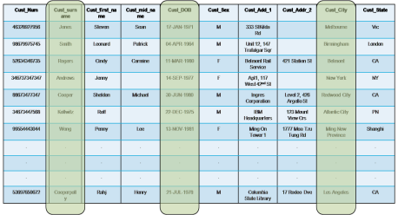
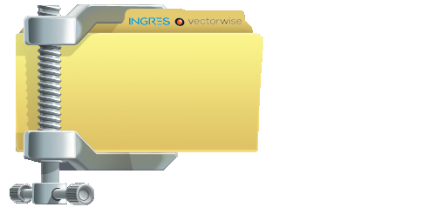
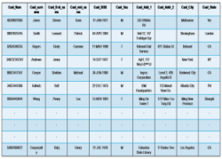
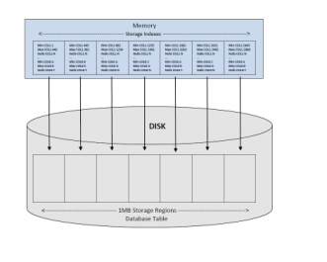
Actian Vector in Hadoop Execution Engine: A Look Under the Covers
1. Vector Processing
3. Second Gen Column Store
Single Instruction Multiple Data
Limit I/O
Efficient real time updates & deletes Updates don’t impact performance
2. Exploiting Chip Cache
4. Smarter Compression
Millions
DISK
Maximize throughput
Vectorized decompression
RAM
150-250
Time / Cycles to Process
CHIP
5. Storage Indexes
2-20
40-400MB
2-3GB
10GB
Quickly identify candidate data blocks
Minimize I/O
Data Processed
Process data on chip – not in RAM
6. Multi-core Parallelism
…
Maximize system resource utilization
Designed for concurrency and scale
Notes:
1: We use vectorized processing to exploit modern CPU architecture. We execute one operation at a time on a vector of data, which allows for tight inner code loops without branching. This way, we can use SIMD instructions and, because of the lack of branching, make sure the CPU pipelines are not thrashed.
A vector is typically 1024 rows of a single column, so it’s a manageable amount of data while the overhead per row is still negligible.
2: A vector will fit in the CPU cache together with the code for a particular operation, so all execution is in-cache.
3: To feed this engine with enough data, we’re also applying the vectorized paradigm to the storage subsystem. First of all, we’re using a column store, so only relevant columns are read from disk. Data is stored in blocks of typically 512MB and a single block contains only data from a single column (there are exceptions). Blocks of different columns can be interleaved per block, but typically more than one block of the same column is grouped.
To keep the stable storage fast and defragmented, we use in-memory overlays to store updates to the data. These overlays are automatically flushed to stable storage when needed.
4: The blocks are stored compressed on-disk. We’ve got a number of lightweight compression algorithms and the most efficient one is chosen per block, depending on the data characteristics. The decompression takes place per vector and can be done in the CPU cache, which neatly ties in with our in-cache execution.
We have a buffer manager that predicts what blocks are needed when and makes sure no blocks that will be used in the near future are evicted from the buffer cache.
5: We have min-max indexes on the disk blocks, so when data is not completely random we can narrow down the ranges of blocks we need to read from disk, per column.
All in all, the execution engine is able to do about 1.5GB/s per core, and high-end I/O subsystems are able to keep up with this.

Slide 9
Leverage Existing Ecosystem & Investments
Vector in Hadoop
Data Integration
Business Intelligence & Analysis
JDBC 4.2 ODBC 3.5

