Slide 1
Interactive Data Analytics with Spark on Tachyon in Baidu
Bin Fan (Tachyon Nexus)
binfan@tachyonnexus.com
Xiang Wen (Baidu)
wenxiang@baidu.com
Dec 02 2015 @ Strata + Hadoop World, Singapore

Slide 2
Who Are We?
Bin Fan
Tachyon Project Contributor
Software Engineer at Tachyon Nexus
Xiang Wen
From Baidu Big Data Department
Senior Software Engineer at Baidu

Slide 3

Team consists of Tachyon creators, top contributors
Series A ($7.5 million) from Andreessen Horowitz
Committed to Tachyon Open Source Project
www.tachyonnexus.com

Slide 4
Agenda
Tachyon Basics & New Features
Motivation
Building an interactive data service
  Spark + Tachyon
Future Works

Slide 5
History of Tachyon
Started at UC Berkeley AMPLab
  From summer 2012
Open sourced
  April 2013 (two and half years ago)
  Apache License 2.0
  Latest Release: Version 0.8.2 (November 2015)

Slide 6
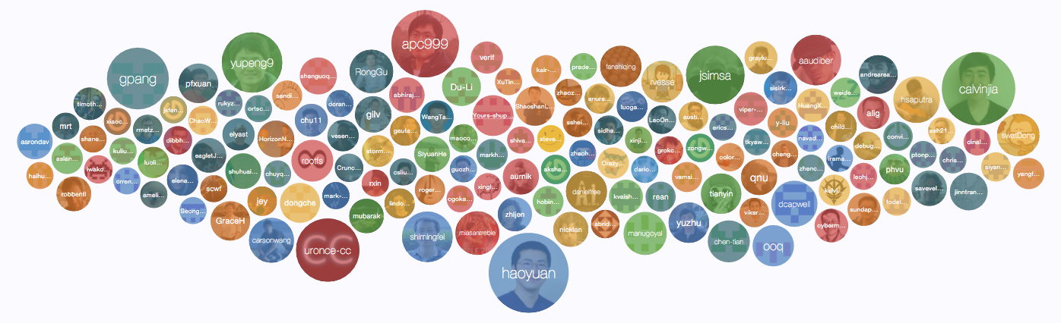
One of the Fastest Growing
Big Data Open Source Project
http://tachyon-project.org/community/
> 170 Contributors (v0.8)
3x increment over the last year

Slide 7




















One of the Fastest Growing
Big Data Open Source Project
> 50 Organizations

Slide 8
What is
An Open Source
Memory-Centric
Distributed Storage System

Slide 9











Tachyon Stack

Slide 10
Why Use Tachyon?
Memory-speed data sharing
across jobs and frameworks
Data survive in memory after computation crashes
Spark Job
crash
Hadoop MR Job
Spark mem
YARN
Off-heap storage, no GC
HDFS
disk
Tachyon
in-memory
block 1
block 2
block 3
Data
block 4
HDFS / Amazon S3

Slide 11

Enable Faster Innovation in Storage Layer

Slide 12
What if
data size exceeds
memory capacity?

Slide 13



Tiered Storage: Tachyon Manages More Than DRAM
Faster
MEM
SSD
HDD
Higher
Capacity

Slide 14
Configurable Storage Tiers
MEM only
MEM + HDD
SSD only

Slide 15
Pluggable Data Management Policy
Promote hot data to upper tier
Evict stale data to lower tier

Slide 16


Pin Data in Memory

Slide 17
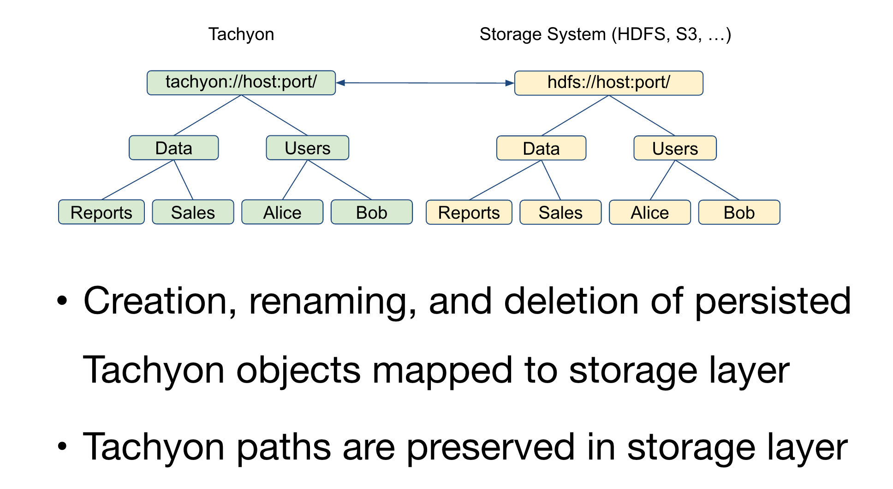
Transparent Naming

Slide 18
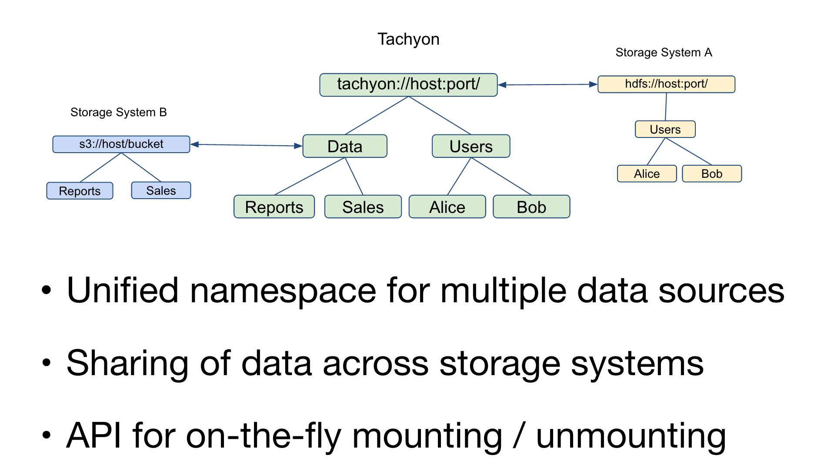
Unified Namespace Across Under Storage Systems

Slide 19
More Features
Remote Write Support
Easy deployment with Mesos and YARN
Initial Security Support
One Command Cluster Deployment
Metrics Reporting for Clients, Workers, and Master

Slide 20









Rich Choice of Under Storage Supports

Slide 21

How Easy to Use Tachyon in
  scala> val file = sc.textFile(“hdfs://foo”)
  scala> val file = sc.textFile(“tachyon://foo”)

Slide 22
Use Case: a SAAS Company
Framework: Impala
Under Storage: S3
Storage Media: MEM + SSD
15x Performance Improvement

Slide 23
Use Case: a Biotechnology Company
Framework: Spark & MapReduce
Under Storage: GlusterFS
Storage Media: MEM and SSD

Slide 24
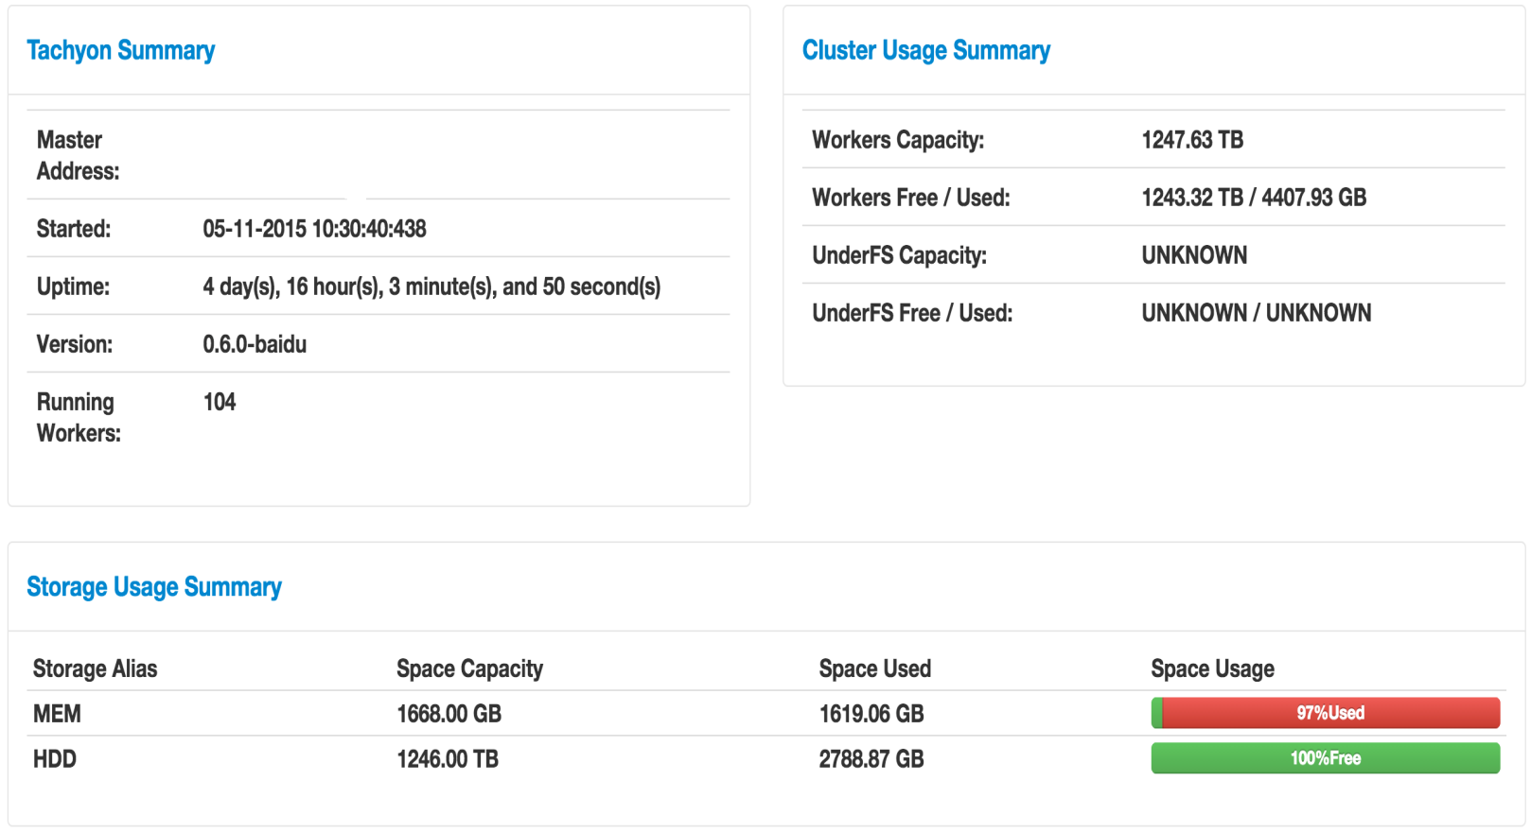
When Tachyon Meets Baidu
  30X Acceleration of our Big Data Analytics Workload
  ~ 100 nodes in deployment, > 1 PB storage space

Slide 25
Agenda
Tachyon Basics & New Features
Motivation
Building an interactive data service
  Spark + Tachyon
Future Works

Slide 26





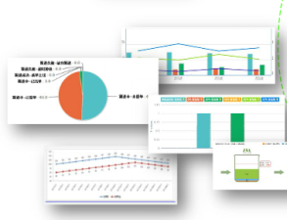

Background
Data Warehouse
Hours or Days
Hours
Logs
Online Data Services
Notes:
Logs -> Data Warehouse
Transfer from online services to HDFS
ETL, By Hive or MapReduce
Take hours or even days
Data Warehouse -> Data Mart
Usually several steps
Typically Hive
Take hours on each step
Data Mart -> Online Data Services
End of the long journey
Water drop from ocean

Slide 27
Frustrated data explorers
Example:
  John is a PM and he needs to keep track of the top user actions for a new feature
  Based on the top actions of the day, he will perform additional analysis
  But John is very frustrated that each query takes tens of minutes to finish

Slide 28

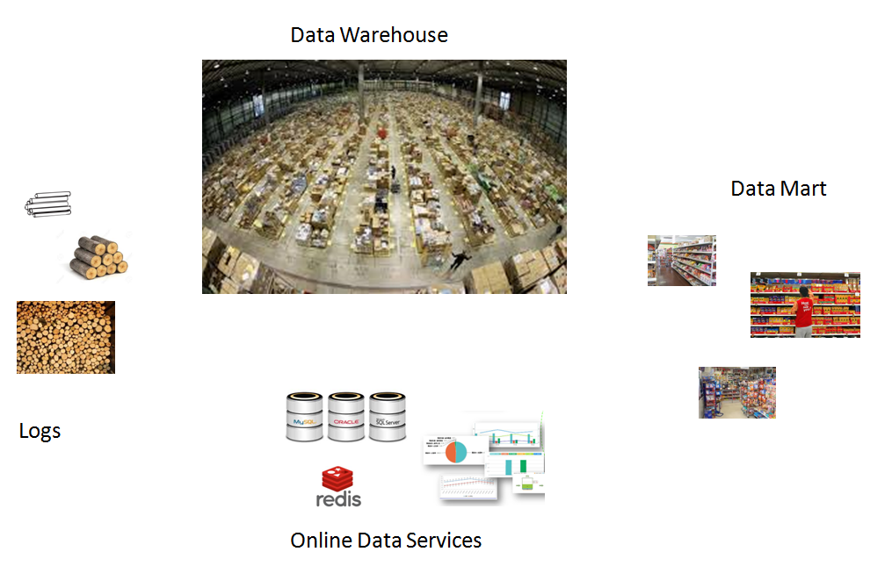
A dedicated service for data exploring
  Manages PBs of data
  Most queries within one minute

Slide 29
User Scenario
Have first try
select some_action, count(*)
from event_table
where event_day=‘20151123’
group by user_action
Web Site
Client
Magi
Try another way
select some_action, event_hour, count(*)
from event_table
where event_day=‘20151123’
group by user_action, event_hour
Pingo Service
Not as expected!
See what happens in original log
Structured Logs
Data
Warehouse
Data
Marts
select *
from event_log
where event_day=‘20151123’ and event_hour=’01’
limit 10

Slide 30
Agenda
Tachyon Basics & New Features
Motivation
Building an interactive data service
  Spark + Tachyon
Future Works

Slide 31
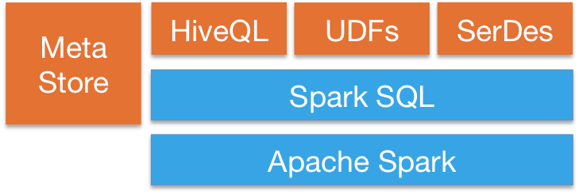

Choose Spark as compute solution
Service Gate
Service Gate
4X Improvement but not good enough!
Hive
Map Reduce
Compute Center
Data Center
Data Warehouse
BFS

Slide 32
Choose Tachyon as storage solution
Compute Center
Read from remote data center: ~ 100 ~ 150 seconds
Read from Tachyon cluster local node: 10 ~ 15 sec
Read from Tachyon machine local node: ~ 5 sec
Spark Task
Spark Task
Spark mem
Spark mem
HDFS
disk
Tachyon
in-memory
block 1
block 1
block 2
block 3
block 3
block 4
block 4
Tachyon Brings 30X Speed-up !
Data Center
Baidu File System (BFS)

Slide 33
Overall Performance
Setup:
Use MR to query 6 TB of data
Use Spark to query 6 TB of data
Use Spark + Tachyon to query 6 TB of data
Results:
Spark + Tachyon achieves 50-fold speedup compared to MR

Slide 34





Architecture
Operation
Manager
View
Manager
Ask & Profile
Run Query
Scheduler
Build Cache
SparkContext
Cache
Data Warehouse

Slide 35
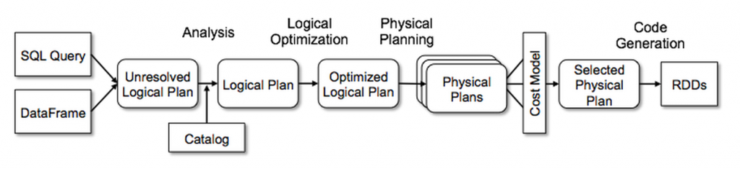
Catalyst helps to be ‘transparent’
lookupRelation
CacheableRelation
HiveTableScan
withUncachedPartitions
Union
HiveTableScan
withCachedPartitions
Tachyon
HDFS

Slide 36
Cache Policy
Prefetch
  Fetch the views daily in advance when system is idle
  The views fetched are based on the pattern of the past query history profiling, e.g. 3 months query logs
On Demand caches
  Fetch the views at runtime when system is serving regular queries.
  Using machine learning to generate policy file monthly for views/tables
  When a query is accessing some views, and parts of views match our pre-generated policy, those views will be cached at that time.

Slide 37
Hot Query: Cache Hit
Query UI
Operation Manager
View Manager
Cache Meta
Spark
HDFS
Tachyon

Slide 38
Cold Query: Cache Miss
Query UI
Operation Manager
View Manager
Cache Meta
Spark
HDFS
Tachyon

Slide 39
Daily Stats with Cache
Daily
  Table
    Queries: 100 – 300
    Hit Rate: ~40%
  Partition
    Queries: 80K – 120K
    Hit Rate: ~40 – 50%
Performance with Cache
  avg 2 - 3 time faster than without Cache

Slide 40
Agenda
Tachyon Basics & New Features
Motivation
Building an interactive data service
  Spark + Tachyon
Future Works

Slide 41
Improve Caching System
As Extended Meta Service
  Improve legacy schema/input-format
  Load block meta into cache layer
  Index / Materialized View
Cost Based Caching/Optimizing
  Better performance, hit rate & execution
  Lower storage needs for cache layer
Notes:
http:///
http://calcite.apache.org/

Slide 42
More User Scenario
If John is data scientist
  Need a way to construct dataset conveniently
  Usually have many tries with same dataset
An interactive system should help a lot
  Spark is an ideal solution

Slide 43
Hardware assisted big data infrastructure
Hardware
  GPU
  FPGA
Applications
  Accelerate common SQL and ML operators
  TableScan && InputFormat && Serde
Lower down the cost
  10 dollars for big data
  1 more dollar for interactive big data
Notes:
exploit

Slide 44
Q&A

