Slide 1
Advanced, Programmable Cloud-based GSLB to Optimize Performance and Availability
Terry Bernstein
Senior Product Manager
Verisign Managed DNS Service
Notes:
Key quotes/talking points:
Our dynamic traffic management solution provides a cloud-based global load balancing option for customers, delivering faster deployment, lower capex, improved resiliency from DDoS attacks, and an ability to scale the solution as your needs grow.
We built dynamic traffic management based on the input of our customers who are looking for ways to apply an increasing amount of data to their network management decisions. With Dynamic Traffic Management, customers options to use data for traffic routing are limited virtually only by their imagination.

Slide 2
Agenda
Verisign
Global Server Load Balancing
Dynamic Traffic Management Overview & Examples

Slide 3
Powered By Verisign
Protect and provide 100% uninterrupted DNS availability for .com and .net for more than 18 years
Operate two of the Internet’s 13 root servers
Worldwide constellation of 76 Internet Resolution Sites
Enable more than $800 billion of global B2C e-commerce annually
Reliable, secure & available critical Internet infrastructure processing 111 billion DNS queries daily
Entrusted with the domains that define the Internet – more than 130 million domain names
Develop innovative technologies reflected in hundreds of industry-leading patents

Slide 4
The Benefits of Global Traffic Management
Organizations want to direct Internet traffic among multiple sites, clouds, or CDNs to:
Improve Availability
Increase Capacity
Enhance Performance
Reduce Costs
Differentiate Services
Provide alternate locations in the event of a failure, or during routine maintenance
Split traffic among multiple locations to handle peak loads
Direct users to the closest or fastest service for the best experience
Direct traffic to the least expensive location, based on service or networking costs
Direct traffic based on either the physical location or IP network to provide unique services
Notes:
An important part of the story behind our solution is the fact that we built this based on demands from our existing customers who are constantly looking at new and better ways to manage Internet traffic
Some of the specific benefits customers get through better traffic management include <run through list>
These requests drove us to introduce a standard set of traffic management capabilities around our Managed DNS services <last year> and now we’ve created a whole capability through Dynamic Traffic Management that gives the customer virtually limitless opportunities to apply data to traffic routing decisions

Slide 5
Benefits of Traffic Management in the Cloud
Speed and Agility Enable Fast and Easy Deployment
Elastic Capacity
Ideal for Cloud Platform or CDN Balancing
Enhanced Security and Availability
DDoS attack resilient with a redundant and high-capacity infrastructure
Does not require in-house expertise, extensive planning, or hardware/software installations
Truly global GLB solution that keeps traffic in the cloud for faster performance
No Capex and typically lower Opex
Vastly deployed cloud-based infrastructure allows companies to scale capacity up or down
Cost Savings
Notes:
Much of what we’ve covered so far are the common benefits and drivers of improved traffic management
One very important aspect of our traffic management solution is that it’s deployed in the cloud
Often when we discuss traffic management requirements with our customers, they bring up some of the limitations they face with on-prem solutions sitting in their data center
So, what we’re launching here is a cloud-based GLB solution. Some of its benefits include . . .

Slide 6
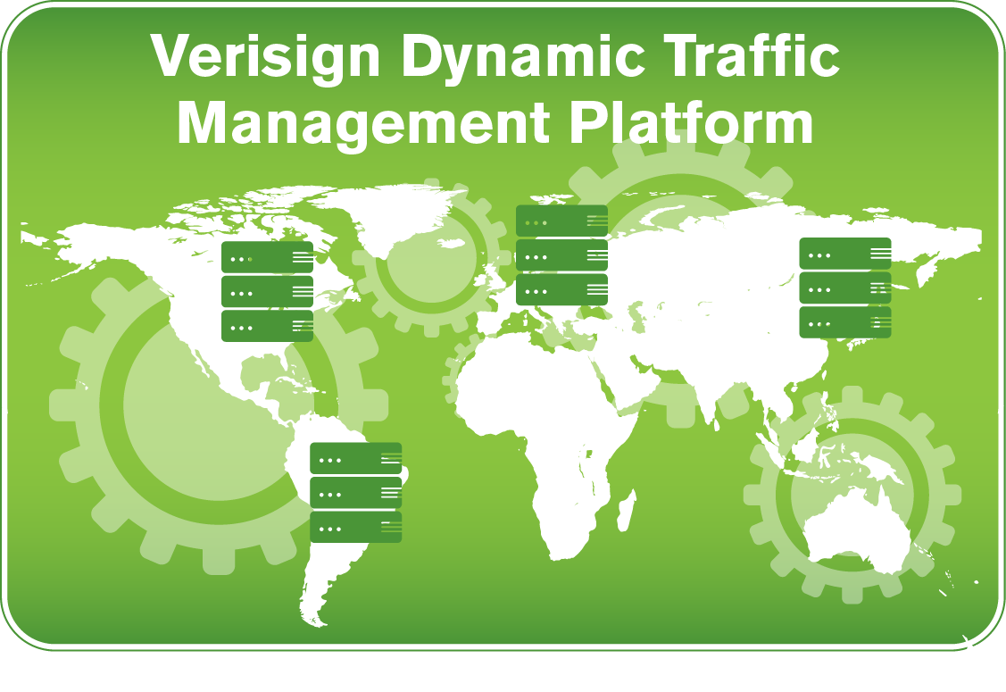
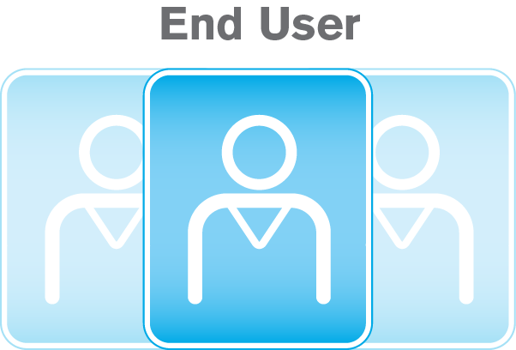
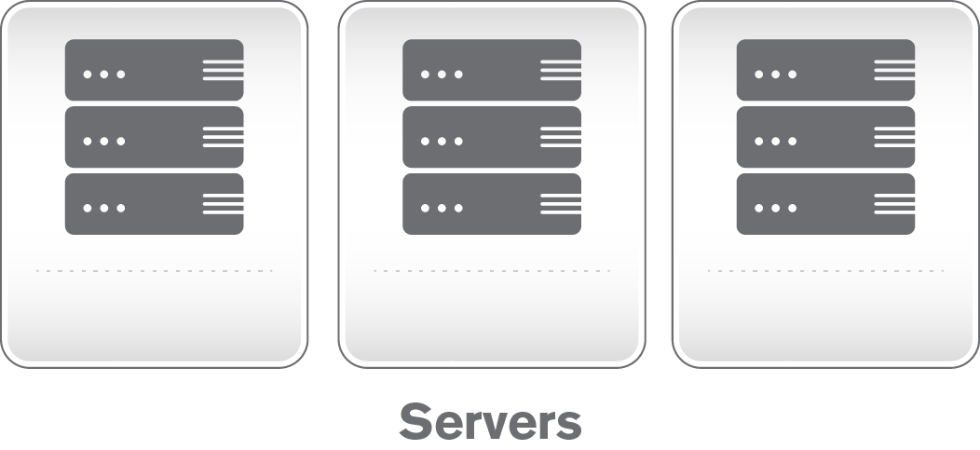
Recursive
Server
DC 1
DC 2
AWS
SERVICE INSTANCES
Verisign Dynamic Traffic Management puts the power at your fingertips to dynamically improve Website service availability and performance utilizing rules-based scripts with virtually unlimited options for customization.

Slide 7
Split DNS based on Source IP
Single Internal IP
if innetwork(“209.112.113.0/24”) = true then
return “internal”
else
return “public”
end
Multiple Internal IPs
local internalips=buildTbl(getacctval(“ip_list”)
-- ip_list: “192.0.2.0/24, 198.51.100.0/24”
if (innetwork(internalips) == true) then
return "internal"
else
return “public"
end
local function buildTbl(inputstr)
local t={} ; local i=1
for str in string.gmatch(inputstr, "([^,]+)") do
t[i] = str ; I = I +1
end
return t
end
General Public
Recursive IP?
Company Recursive → Internal Server
Else→ Public DC
Employee
Recursive
Server
Public DC
Internal Servers

Slide 8
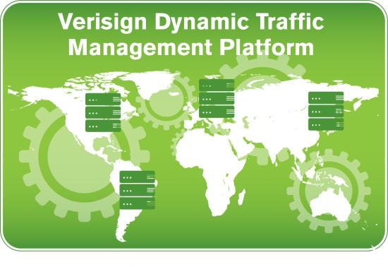
Backup for Hardware-based DNS Load Balancers
Manual Failover
local GTMstat = getacctval(“GTM_active")
if GTMstat == "active" then
return “GTM_CNAME"
else return “Verisign_CNAME"
end
Automated Failover
local gtmhealth = getacctval( "system+example.com+gtmcheck.example.com.+A+209.112.113.33")
if gtmhealth=="F" then
return “Verisign_CNAME"
else return “GTM_CNAME"
End
“F”: Health check probe failed
“S”: Health check probe success
www.example.com?
www.example.com?
Recursive
Server
A: 1.1.1.2
A: 3.3.3.3
CNAME: svc1.gtm.example.com
CNAME: svc1.vrsn.example.com
A: 3.3.3.3
svc1.gtm.example.com?
GSLB Appliance
A: 1.1.1.2
DC 1
1.1.1.2
DC 2
3.3.3.3

Slide 9
Choose the “Best” CDN
local geoView = getview(“MyGeoView")
if geoView == "AsiaPac" then return “CDN_C" end
if geoView == "Americas" then geoIndex = 1 end
if geoView == "EuropeMiddleEast" then geoIndex = 2 end
local A_Cost = tonumber(getacctval("cost_CDN_A"))
local E_Cost = tonumber(getacctval("cost_CDN_E"))
local A_TblPerf = buildTbl(getacctval("perf_CDN_A"))
local A_Perf = tonumber(A_TblPerf[geoIndex])
local E_TblPerf = buildTbl(getacctval("perf_CDN_E"))
local E_Perf = tonumber(E_TblPerf[geoIndex])
if A_Cost <= E_Cost then CheaperCDN = "CDN_A"
else CheaperCDN = "CDN_E“ end
if A_Perf <= E_Perf then FasterCDN = "CDN_A"
else FasterCDN = "CDN_E“ end
local time = gettime()
if time.hour >= 9 and time.hour < 17 then return FasterCDN
else return CheaperCDN
Parameter | Value
Cost_CDN_A | 10
Cost_CDN_E | 6
Perf_CDN_A | 99,75
Perf_CDN_E | 90, 80
CDN A
Perf=95
CDN E
Perf=60
CDN C
AsiaPac: CDN C
RoW:
Peak hours: Fastest CDN
Off hours: Cheapest CDN

Slide 10
Dynamic Traffic Management Details
LUA Scripting Functions
Parameters
Getacctval
Geolocation
GetGeo
GetView
IP / ASN
Getip
Getresolverip
GetASN
GetResolverASN
GetRequestDetails
InNetwork
Miscellaneous
GetRandom
GetSticky
GetVariants
Note
SOAP API
Parameters
addUserParameters
getUserParameters
deleteUserParameters
Resource Records
createTrafficManagement
getTrafficManagement
updateTrafficManagement
deleteTrafficManagement

Slide 11
Summary: Traffic Management from Verisign
Enhanced availability and performance, lower TCO, fast and easy deployment, elastic capacity
Dynamic / Flexible
DDoS Resilience
Trusted
Proven
Cloud
Enables unique enterprise traffic management requirements through scripted customization and API
Provides resilience to even the largest DNS-based DDoS attacks
From a trusted provider of critical Internet and security infrastructure services with an unmatched record DNS uptime
Built upon the technology and expertise that Verisign has developed to manage .com and .net with operational accuracy and stability for more than 18 years
Truly global load balancing provides enhanced user experience by reducing latency
Global Infrastructure
Notes:
No other cloud DNS provider has this ability to use dynamically updated information for global traffic management

