Slide 1
Requirements for Secure, Multi-Tenant Hadoop
IT’S MUCH MORE THAN YARN
Anant Chintamaneni

Slide 2
About Me
Products at BlueData
@AnantCman
Former Head of Hadoop Products & Analytics at Pivotal
Launched Hadoop-based analytics system at Merced Systems (now NICE Systems)

Slide 3
Talk Track
Hadoop ecosystem & typical data architecture
Road to multi-tenancy in the enterprise
Deep dive on the requirements for multi-tenancy
On-premises options and considerations
Customer examples & scenarios
Q&A

Slide 4
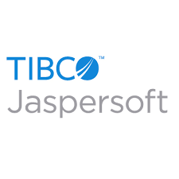
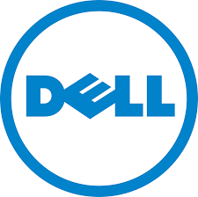
Hadoop Ecosystem
Search, BI, ETL, M/L
Data Pipelines
BI/ETL/Analytics
noSQL
Databases
Analytics Databases
Spark
Data Platforms
Hadoop MapReduce & HDFS
Data Ingestion
Virtualization
& Cloud
BIG DATA
INFRASTRUCTURE
Hardware
& Storage
It is much more than Hadoop / YARN

Slide 5
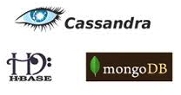
Typical Enterprise Data Architecture
Data Sources
Ingestion
Batch
Service
Speed
Example: Kafka + Hadoop + Spark + noSQL + SQL

Slide 6
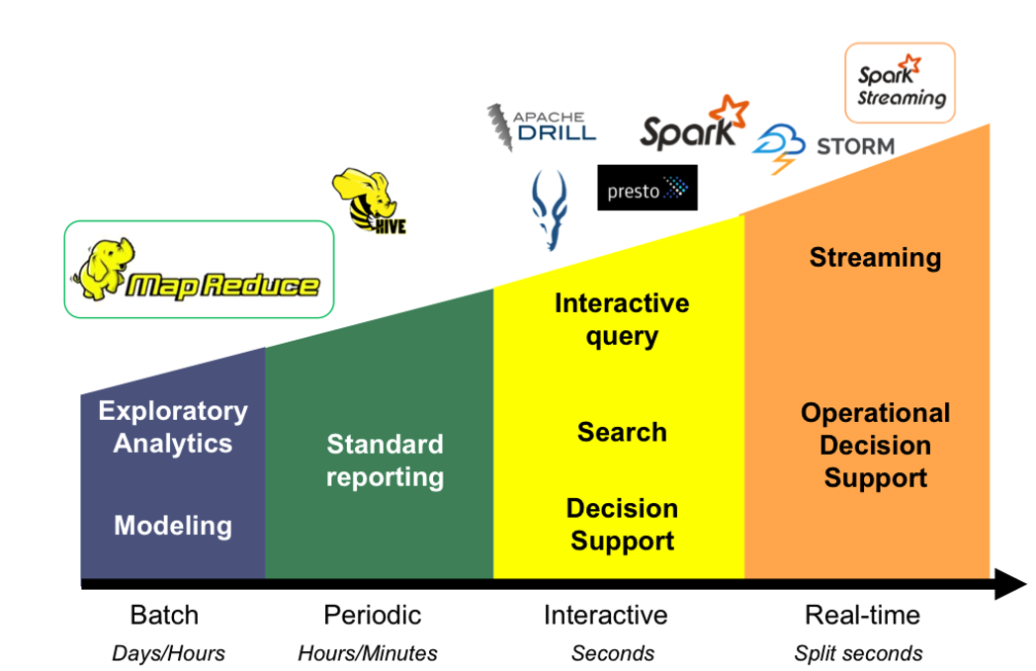
Road to Multi-Tenancy
Multi-purpose platform + multi-functional use cases demand multi-tenant architecture

Slide 7
Road to Multi-Tenancy – Status Quo
Marketing
R&D
Manufacturing
Log Analysis
INFRASTRUCTURE & CLUSTER SPRAWLS
360 customer view
Predictive maintenance
2.2
2.4
(M/L node)
2.2
(BI node Prod)
<30%
INFRASTRUCTURE UTILIZATION
Prod
Dev
Pre-Prod
LOCAL
ADMINS
LOCAL
ADMINS
IT
2.6
(BI node test)
2.5
Dev
MANAGEMENT
COMPLEXITY
Test
DUPLICATION
OF DATA
Notes:
Here is a quick visual of what we’ve seen at one of our customers
Line of business started a 360 view of customer in the Marketing group and built out a Hadoop environment. Independently, the product R&D team created their own Hadoop cluster around log analysis, the support team created their own cluster with a newer, different version of Hadoop and so did the Manufacturing group to the point where they managed to get to a pre-prod stage
At this point, some sort of a centralized group (IT) is usually pulled into help rationalize the efforts and look at the big picture. And then all issues become quite apparent.
Significant amount of data duplication and loss of visibility; management complexity due to the different clusters, versions and expectations. And not to mention the infrastructure sprawl and utilization issues.
If you are starting your Hadoop journey, especially in medium or large enterprises, this is what your environemnt coud look like if it isn’t aleady some variant of this.

Slide 8
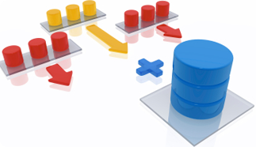
Haven’t We Seen This Pattern Before
But Hadoop is not a database…..it’s a distributed platform & ecosystem (remember!)

Slide 9
Multi-Tenancy – The story So Far..
HADOOP VENDOR # 1
Multi-tenancy in Hadoop refers to a set of features that enable multiple groups from within the same organisation to share the common set of resources in a cluster without negatively impacting service-levels, violating security constraints, or even revealing the existence of each other, all via policy rather than physical separation.
HADOOP VENDOR # 2
Multi-tenancy is the ability of a single instance of software to serve multiple tenants. A tenant is a group of users that have the same view of the system. Hadoop, as an enterprise data hub, naturally demands multi-tenancy. Creating different instances of Hadoop for various users or functions is not acceptable as it makes it harder to share data across departments and creates silos.

Slide 10
Breaking it Down
REQUIREMENTS
Shared, common resources
Single instance of software
Policy based security & isolation
Sharing data without duplication
HADOOP VENDOR POINT OF VIEW
Implement single Hadoop cluster
Deploy single version/distribution of Hadoop
Use Hadoop specific capabilities (e.g. YARN)
Use single storage system (i.e. HDFS on disks)

Slide 11
So the Recommendation Is ….
Multiple Clusters
➔
Single Cluster
2.2
Mktg Prod
2.x
2.6
2.4
Mfg
R&D
Mktg Prod
Mktg Test
R&D
Mktg Test
Mfg
2.2
Common set of resources
Multiple instances
Different data sets with duplication
Common set of resources
Single instance of software (just pick one!)
Single data repository

Slide 12
Game Over, Right ?

Slide 13
Does This Work for You?
Does your organization allow development on production Hadoop cluster?
Do you test/evaluate new versions on your production Hadoop cluster?
Are your different lines of business OK with one release cycle?
Is your organization OK to have one and only one centralized storage system?

Slide 14
For Most Enterprises …

Slide 15
Enterprise Realities
Operational
Models (e.g. Dev/Test, Specialized workloads)
Agility – evaluate new Hadoop ecosystem products
Data Center
Infrastructure
Security & Regulations
Business flexibility & independence
Data integration & mgmt
Multiple Hadoop Clusters
Centralized Management
Notes:
And to spice up the mix, there are some critical real world considerations that can’t be ignored as you consider your journey.
First, multiple Hadoop clusters is a reality but that doesn’t have to mean that these clusters each need to have dedicated hardware.
Secondly, Big Data can no longer be implemented as islands separate from your core data center infrastructure. Security and data governance considerations
So you land up in a place where there the business realities demand a multiple hadoop environments, yet at the same time requiring centralized management.

Slide 16
Comprehensive Multi-Tenancy
Multiple lines of business (i.e. tenants)
Multiple distribution/application versions concurrently (e.g. Dev/Test & Prod)
Multiple concurrent jobs across and/or within tenants
Multiple application workloads of different types (Hadoop, On-Hadoop, Non-Hadoop)
Security isolation between tenants (compute processing and data)
Multiple service level guarantees by tenant and/or application workload
On a shared, centrally managed infrastructure
Notes:
But before we go deeper, lets define the requirements for multi-tenancy.
Tenancy is about supporting business requirements, not technical requirements, i.e. lines of business, groups of users who use Big Data to create business value. They care about a friction less experience to work with big data.
The ability to support multiple versions concurrently is critical – use cases and workloads demand features
You might think concurrent submission of jobs in a cluster and/or across clusters is a given. But there are environments out there where getting access to a cluster is like waiting for a bathroom in a gas station (in the words of a anonymous real Hadoop users)
Security is a whole topic in itself. One of the core tenets of multi-tenancy is the ability to separate compute and data across tenants. In other words, having strict isolation between compute across tenants as well having the ability to strictly isolate data across tenants. As such, this type of requirements demand the separation of Hadoop compute and storage.

Slide 17
Multi-Tenancy Architecture
Marketing
R&D
Manufacturing
Multiple lines of business/user groups
Multiple use cases
360 customer view
Log Analysis
Predictive maintenance
Compute Isolation
Compute Isolation
Multiple ecosystem products (incl. non-Hadoop; BI/ETL tools)
Compute isolation between tenants
Prod
Dev/Test
POC
Prod
Dev/Test
Multiple environments per tenant
2.2
2.6
2.6
2.5
2.7
Multiple versions and/or distributions
Shared, Centrally Managed Compute Infrastructure
Data isolation
Data isolation
Data isolation by tenant (incl. ability to physically isolate storage)
Data/Storage
Marketing
R&D
Manufacturing
Notes:
So here is the solution architecture that multi-tenancy demands.
Starting point of a Shared Centrally managed infrastructure – collection of servers with the ability to carve out storage for each tenant.
Having compute isolation such than each tenant can have multiple Hadoop (or non-Hadoop) clusters and services that meets their business objectives

Slide 18
Multi-Tenancy Benefits
Better Infrastructure Utilization
Quicker & Easier to Spin Up/Down environments for Each Tenant
Separation of Compute & Storage for Scaling & Isolation
Operational Efficiencies
Utilize all available capacity via pooled resources
Dynamically provision compute on demand
Decoupling to ensure storage & compute match demand
It’s all about agility & cost efficiency

Slide 19
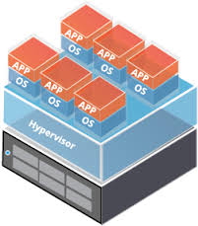
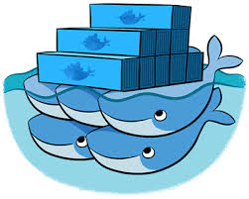
On-Premises Options
YARN-based Hadoop cluster (physical or virtual
Virtual machines on common, physical infrastructure
Docker containers on common, physical or virtual infrastructure
Mesos on physical or virtual to run multiple frameworks
Notes:
There are several ways to accomplish this architecture. By no means intended to be comprehensive, these are some of the on-premises options that are discussed.
Single YARN cluster which translates to creating a multi-tenant hadoop cluster – few considerations here include ability to support multiple versions of Hadoop on the same cluster and/or the enterprise realities of requiring multiple Hadoop clusters
Virtualized or containerized Hadoop is clear candidate given how well virtualization, a proven technology has served the datacenter for running diverse range of a enterprise workloads on a shared, common infrastructure. Done right, companies have proven virtual machines and containers have proven to not only perform better than bare metal hadoop for many workloads but also offer a level of elasticity and server utilization not possible with traditional physical deployments. This said, implementation of Big Data on VMs matters. Using VMs like physical machines and deploying Hadoop including HDFS
Mesos, an open source project that aims to be a data center operating system is another candidate. It can run Hadoop albeit requires the resource scheduler to be modified which does create few considerations. You are pretty much on your own since Hadoop distributions leverage YARN and don’t have support for Mesos.
Lastly, there is a new project by the name Myriad which is aiming to bring YARN based Hadoop clusters to run on mesos. This project is still incubating and will likely take several years to mature

Slide 20
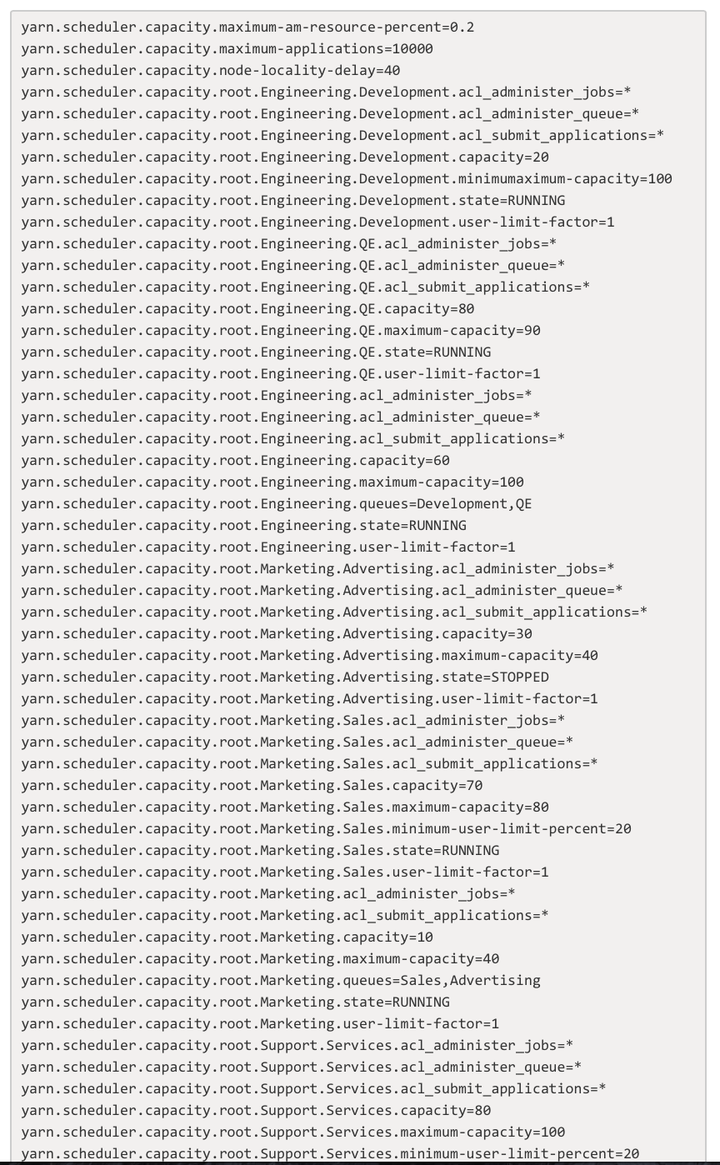
YARN
Highlights
Key Hadoop 2.0 enabler to run multiple compute services on a single cluster simultaneously
Complex, yet sophisticated scheduler schemes e.g. Capacity scheduler
YARN support varies by Hadoop platform provider
Considerations
Designed for one cluster, not across multiple clusters
Scheduler, not a resource manager for Hadoop only
Admin overhead with complex config’s for queues
SQL, noSQL and BI tool resources are not managed
Spark memory consumption poses issues for YARN

Slide 21
YARN
Multiple lines of business (i.e. tenants)
✕ Multiple distribution/application versions concurrently (e.g. Dev/Test & Prod)
Multiple concurrent jobs across and/or within tenants
Multiple application workloads of different types (Hadoop and non-Hadoop)
Security isolation between tenants (compute processing and data)
Multiple service level guarantees by tenant and/or application workload
Single Hadoop Cluster = Multi-tenant infrastructure

Slide 22
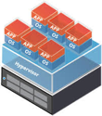
Virtual Machines
Highlights
Proven platform for running multiple workloads on common, physical infrastructure
Deploy Hadoop and non-Hadoop with ultimate flexibility e.g. multiple Hadoop clusters with elasticity
Enforce compute, memory & storage quotas by tenant and/or sub-tenants
Leverage YARN for individual cluster resource management
Considerations
HDFS implementation matters – HDFS on VMDK vs. not
Vanilla virtualization I/O subsystem not optimized for Big Data
Guest OS (VM) needs management (e.g. security patches)

Slide 23
Containers
Highlights
Hyper lightweight OS virtualization (no Guest OS)
Rapid adoption by enterprises for web/mobile app packaging
Deploy Hadoop/non-Hadoop (e.g. multiple Hadoop clusters) with elasticity
Packaging and deployment is elegant (e.g. Docker file)
Leverage YARN for cluster resource management
Considerations
Container management is emerging – focused on web apps
Big Data brings unique networking, storage and security requirements; Significant DIY even with open source tech
Still a developer toolkit, management layers still emerging

Slide 24
Mesos
Highlights
Positioned as Data Center OS – used by Twitter
Higher order resource mgmt framework compared to YARN
Supports Hadoop*, Spark* and noSQL platforms
Considerations
Distributed platforms will need to be modified (e.g. Hadoop, Spark) to use Mesos
Focus shifting to public cloud & container management
DIY platform with limited documentation
Demonstrated support is for Hadoop MRv1;
Project Myriad (incubating) runs Hadoop YARN clusters on Mesos

Slide 25
VMs, Containers, & Mesos
Multiple lines of business (i.e. tenants)
Multiple distribution/application versions concurrently (e.g. Dev/Test & Prod)
Multiple concurrent jobs across and/or within tenants
Multiple application workloads of different types (Hadoop and non-Hadoop)
Security isolation between tenants (compute & data): let’s discuss; implementation matters
Multiple service level guarantees by tenant and/or application workload

Slide 26
Customer Data Points
No | Customer | From | To
1 | Predictive Ad Tech | Two 1000+ node clusters (open source Hadoop) Spark on YARN causes QoS issues | Multi-tenant infrastructure to manage QoS for different groups/jobs (work in progress)
2 | Fortune 100 Media & Telco | Started with single Hadoop YARN cluster Post-production complexity (Dev/Test, external user groups) | Virtualized infrastructure to create multi-tenant Hadoop Self-service Hadoop cluster(s) for each tenant incl. different versions.
3 | Fortune 100 Retail | 100+ node cluster Resource mgmt for bursty, seasonal ad-hoc workloads | Offloaded ad-hoc jobs to virtualized, multi-tenant infrastructure User groups run I/O throttled jobs against production HDFS data

Slide 27
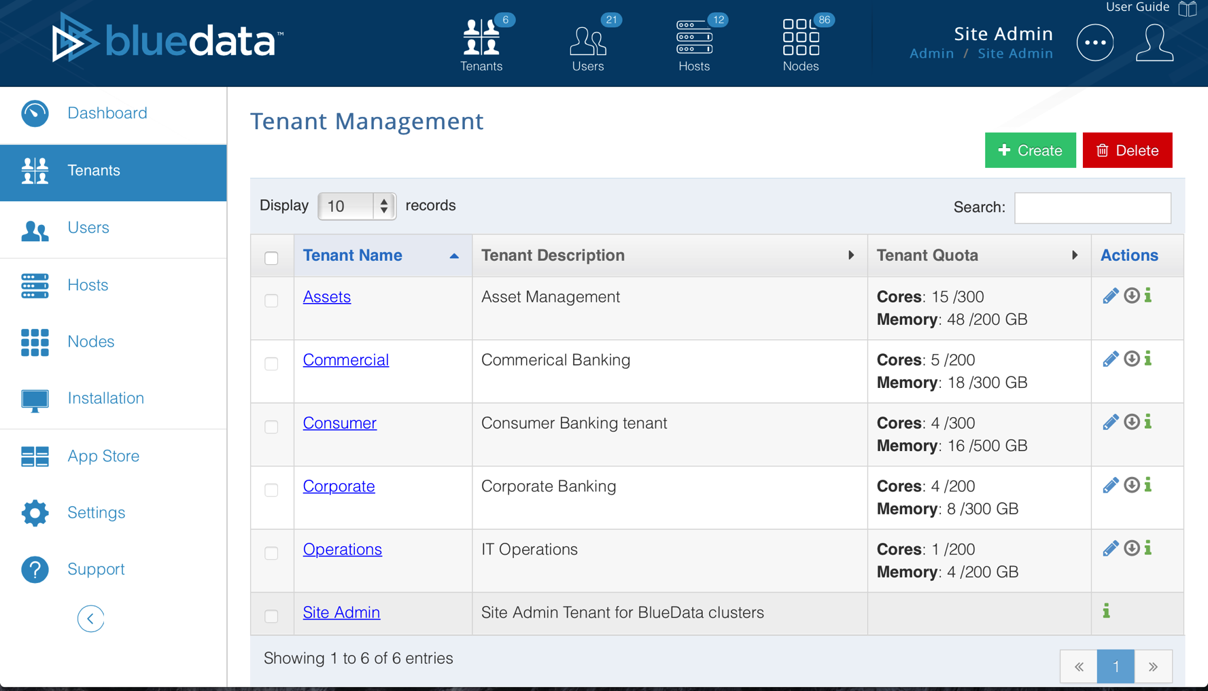
Multiple Tenants & Role Based Access Control

Slide 28
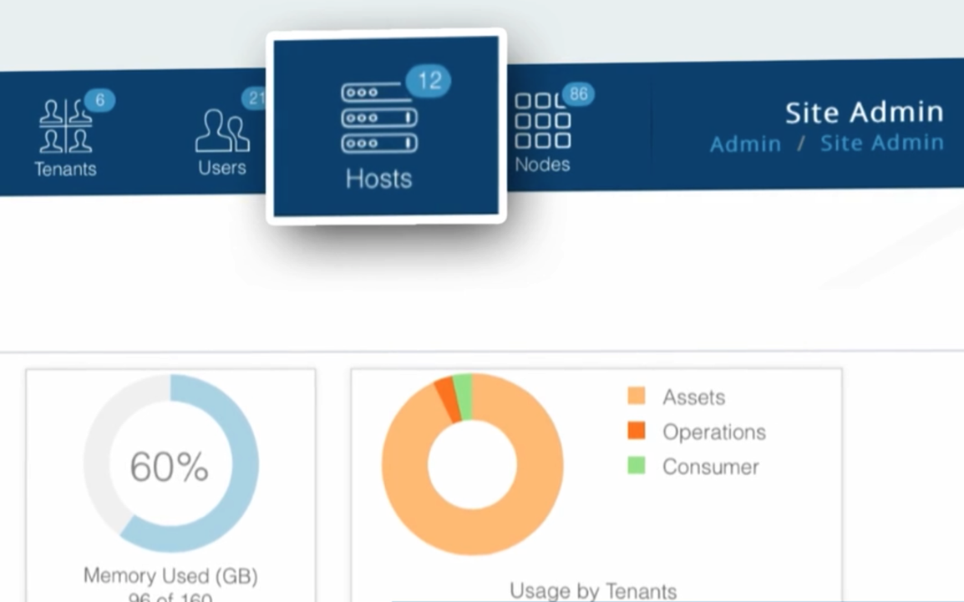
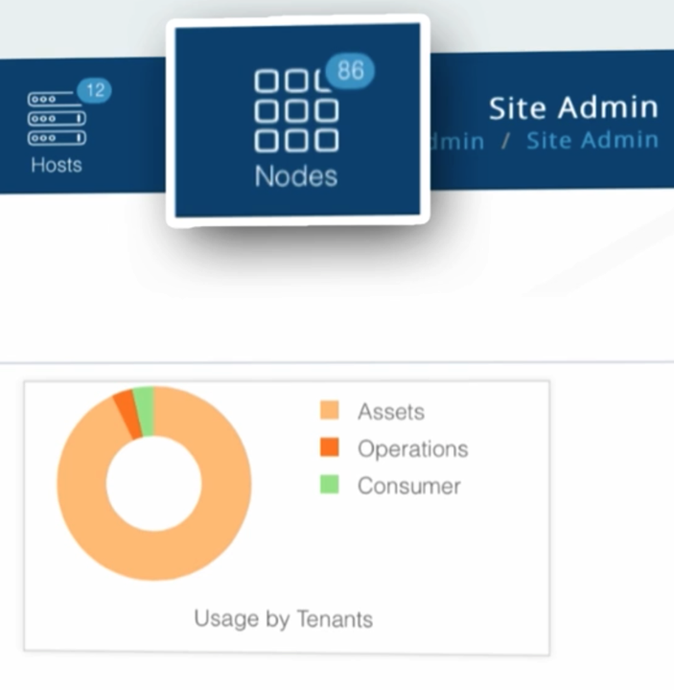
Common Infrastructure & Containers
Shared pool of resources (e.g. servers)
Containers as Hadoop/Spark nodes

Slide 29
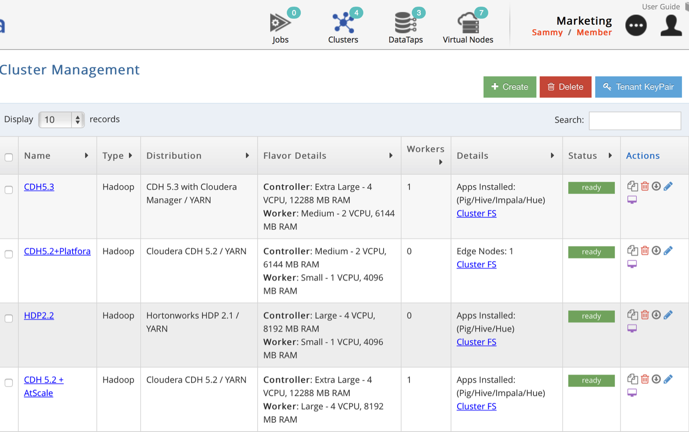
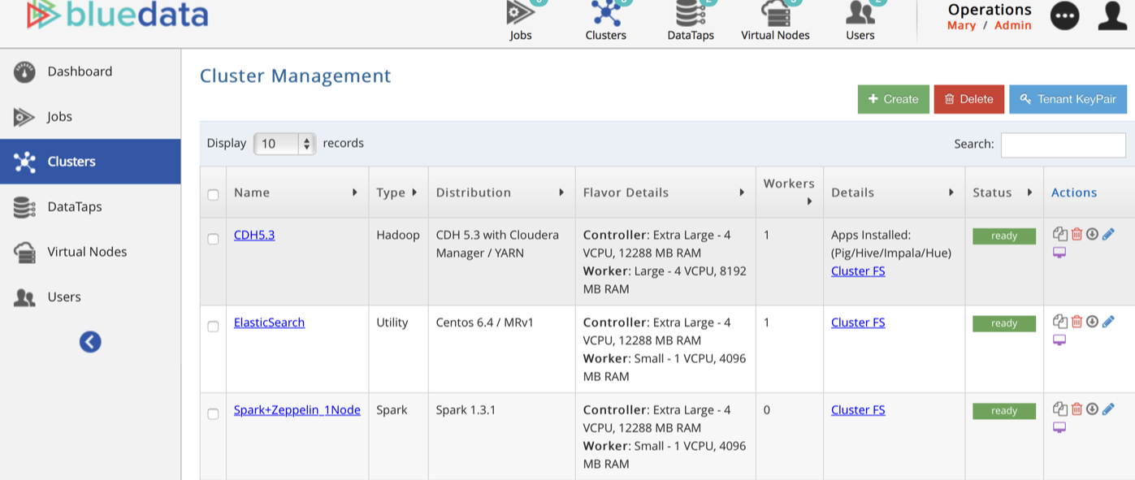
Tenants with Multiple ‘Containerized’ Clusters
Compute Isolation

Slide 30
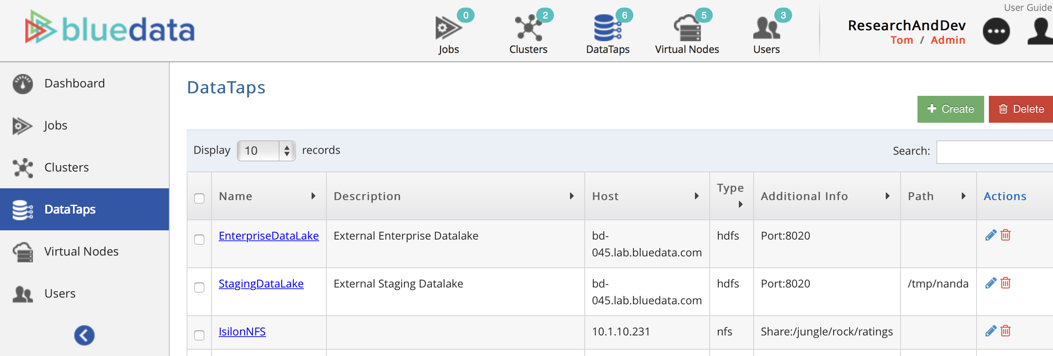
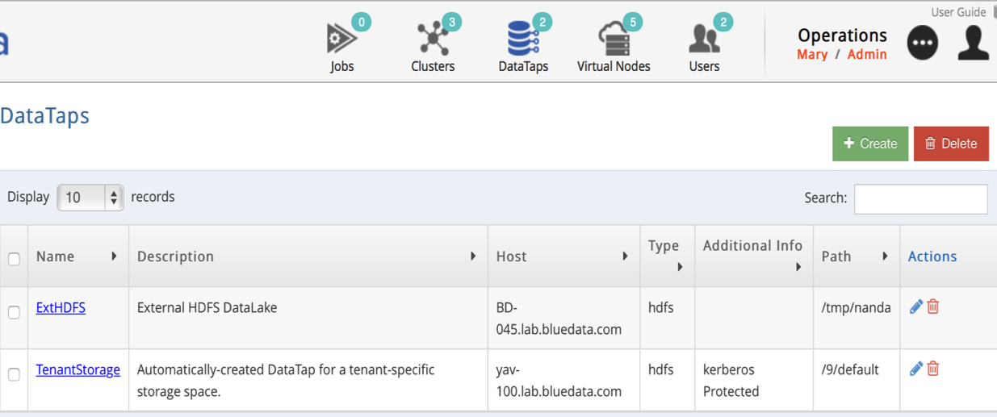
Storage Isolation between Tenants
Storage Isolation

Slide 31
Takeaways
Hadoop ecosystem and complexity increasing
The adoption journey: from single to multi-workload
Versatility and complexity requires balancing act
Multi-Tenant Hadoop Infrastructure

Slide 32
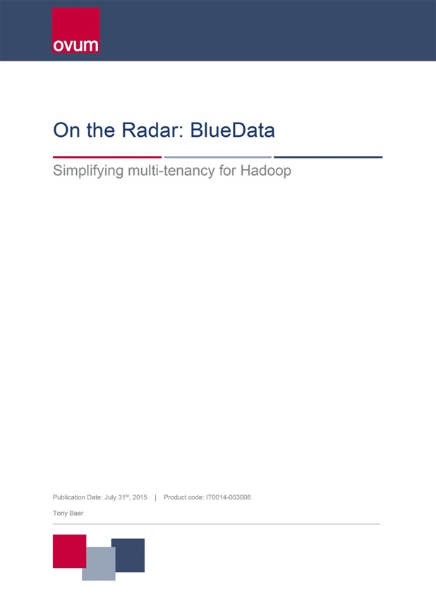
Thank You
For more information:
Visit the BlueData booth (#637)
www.bluedata.com
www.bluedata.com/free
< Free Download

