Slide 1
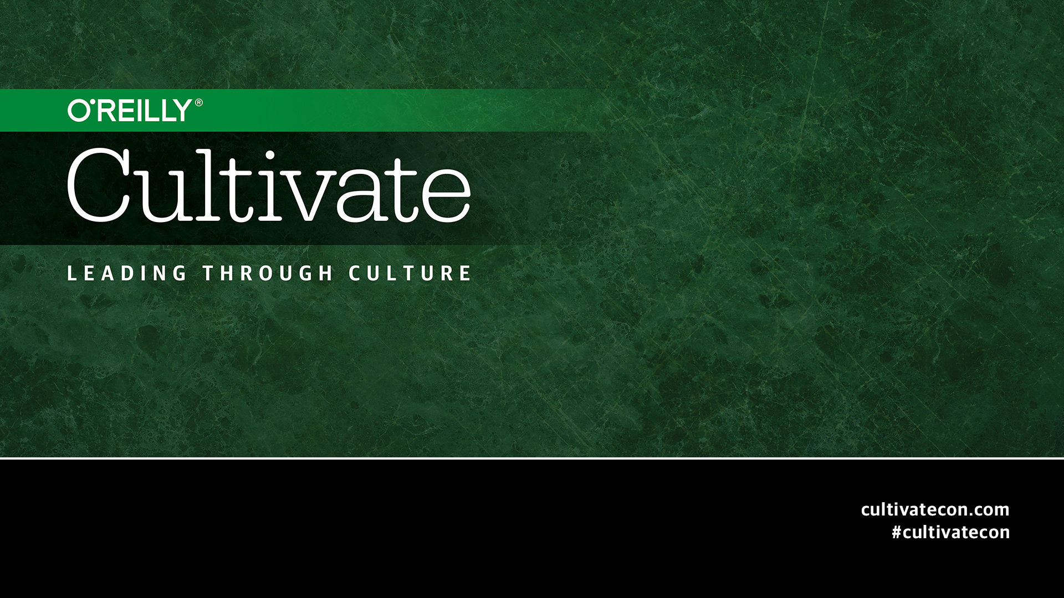

Slide 2
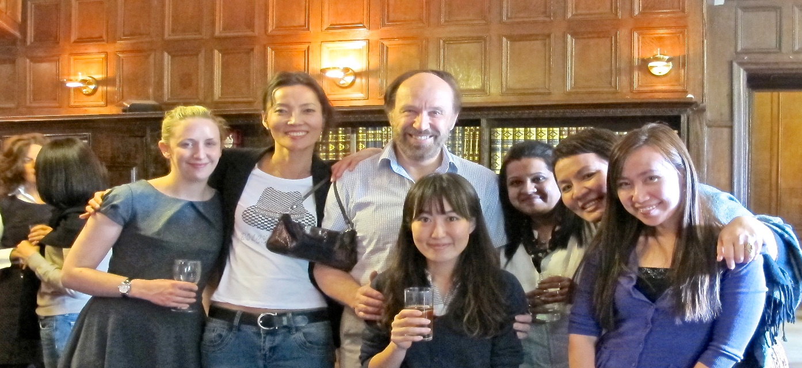
Corporations and Culture: Why does this Matter?
Mary Yoko Brannen, President CLIA Consulting; Jarislowsky East Asia (Japan) Chair and Professor of International Business, University of Victoria/ INSEAD
Email: maryyoko@uvic.ca; maryyoko@me.com
Tweet: @MaryYokoBrannen

Slide 3
Agenda
What is culture—getting beyond treating it with a shrug
Why it matters,
  It’s tacit and taken for granted → lost opportunity or, at worst, a liability
  It directly effects knowledge-appropriation
  It determines strategic agility
What’s needed? Ethnographic Thinking
Three examples
  Tesco plc
  Ciba Geigy / Alza Collaboration
  Nokia & Walt Disney Co
Three quick and easy tools for Ethnographic Thinking
  FSM: Flying Spaghetti Monster Observation Technique
  Knowledge-Appropriation Framework
  Framework for Assessing Strategic Agility through Corporate Language

Slide 4
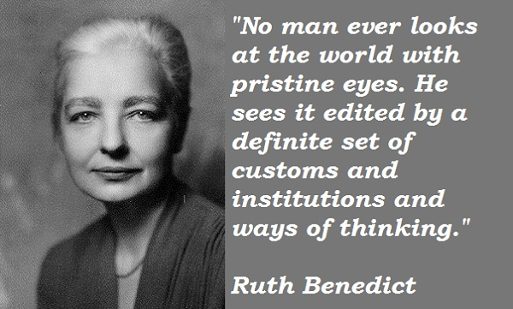
A cultural perspective: culture is learned behavior

Slide 5

Why culture is fundamental
Culture is the way groups of people syncronize behavior and social interaction
It provides the frame, or the lens, through which we view products, services and experiences
It is not just about national culture:
  Subcultures in multicultural countries (like US/Canada)
  Corporate cultures (like O’Reilly, Nokia, Microsoft…)
  Consumer “cultures” – or tribes – operate as subcultures
So, we can see it as a critical way of understanding the user experience

Slide 6
What is Culture?
1. A tacit system of learned H.E.L.P.
H abits
E xpectations
L anguage
P erspective
Source: Julia Gluesing Doctoral Dissertation
Notes:
First start with a definition of culture. One that cautions us to keep in mind that culture is Learned Help—Concepts and strategies – not recipe – but hope to get you thinking
About what works for a group of people and has worked for as long as they know—their guide regarding behavior and mental programming of thought patterns. “The way we do things around here”
Habits
Patterns of behavior and thought
Expectations
For ourselves and others, accepted norms
Language
Language (spoken & tacit), systems of shared meaning
Perspective
About work norms, assumptions regarding behavior

Slide 7
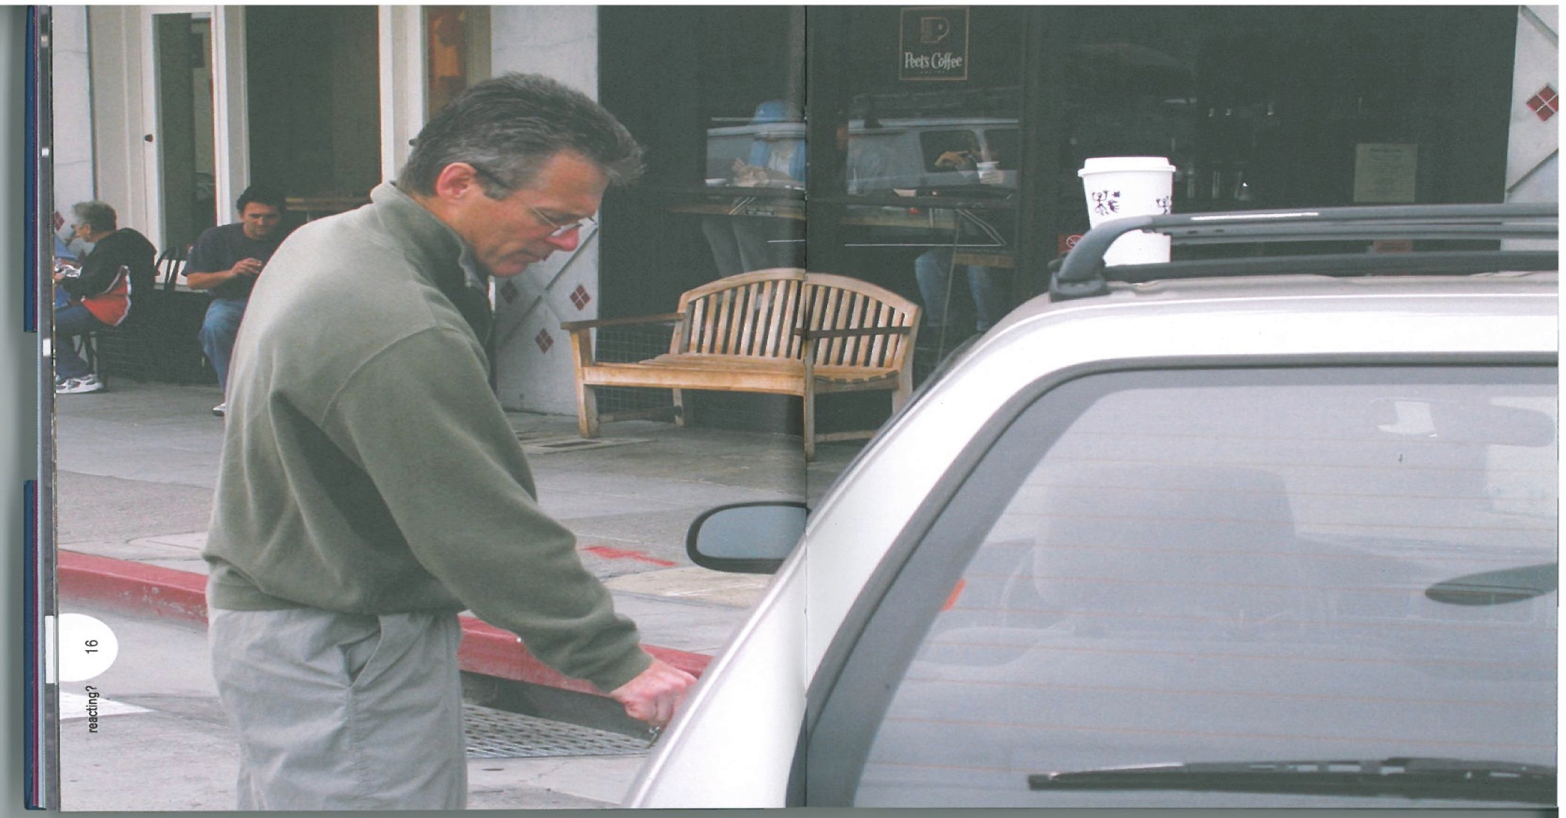
Perspective: who are YOU to say what’s happening?
Interpretation 1: “I put my coffee cup there while I was opening the door because my hands were full”
Interpretation 2: “I don’t know how it got there. It was sitting on the roof when I came out of the store”
Interpretation 3: “I put it there so you wouldn’t pay attention to me breaking into the car”

Slide 8
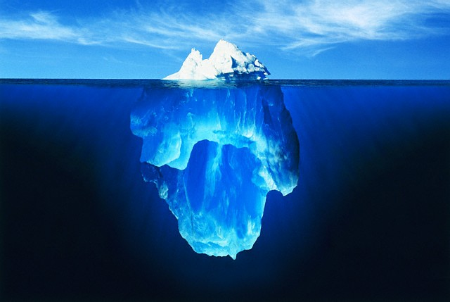
What is Culture: Beneath the Iceberg?
“Visible” Artefacts
differences in valuation
Values and Norms
unexpected outcomes
Hidden
Assumptions
positive windfall vs. negative result
Notes:
May get much more or less than expected.
Want to surface positive windfalls.
-Artifacts
On the surface, that can be ‘sensed’ easily
-Values
That can be or inferred, or articulated
- Assumptions
Hidden -- about humans and the environment, about human nature, human roles & relationships, reality, time, risk-taking…..

Slide 9
Death Valley
Warning Signs
Growing frustrations
Decreasing communications
Declining personal satisfaction
Lasting unresolved issues
Lack of socialisation
Personnel turnover
Open Symptoms
Cultural scapegoats
Breakdown of communication
Resignations
Enduring open conflicts
Pulling out of contracts
Requests for transfers back to parent partner organisation
Notes:
BUT, It doesn’t always work out this way. We have looked at alliances that have worked and others that have not been able to follow this trust-building path trajectory.
So, here are some warning signs and symptoms:

Slide 10
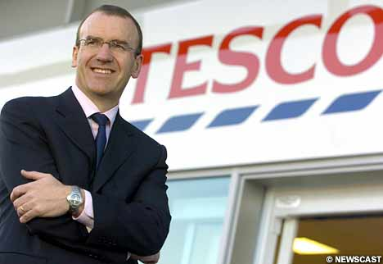
TESCO Plc
Terry TESCO—The TESCO WAY
Led transformation of TESCO – Pile it High, Sell it Cheap
→ 300X Profit growth in 6 year period.
2002 Knighted
Biggest private sector employer in UK
Operating in 12 countries (6 in Asia)
Terry Leahy, CEO 1997-2011

Slide 11

From ‘Tesco Way’ To the ‘Essence of Tesco’
UK sales fell by .5% in 2011
Profit up 12.9% WW
Philip Clarke, CEO 2011-2014

Slide 12
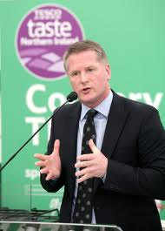

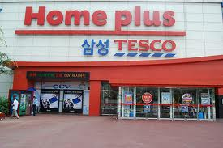

‘Essence of TESCO’ Project
What’s going on in Asia that we can learn from?
David Potts, CEO Asia 2011

Slide 13
Insider Ethnography for Strategic Renewal
Learning from Outside-In
Surface what’s taken-for-granted
Compare & contrast w/ home context
Meld Tesco’s values throughout its corporate footprint

Slide 14
Flying Spaghetti Monster Observation Technique
Tesco’s Essence
What’s Familiar?
What’s Surprising
What do I want to learn More about?
Customer at the heart
Leadership DNA
Opportunity to get on
Teamwork and collaboration
Work environment
Embracing change
It’s my business
Operational efficiency
Trusted brand
Respect for facts and insights

Slide 15
Ethnographic Thinking
We are not “objective” observers, but come with our own baggage
Users are not objects, but people and the owners of truth
As our understanding changes, so do our goals and our methods
Everything we see, hear, feel, touch or taste is data

Slide 16
2. Culture and Knowledge Appropriation
Existential Knowledge
“Quality” Japan, “Environment”Germany
Cultural assumptions (“kaizen”)
R&D approach
Standard Operating Practices
Customer Service Manuals
Consumer Behavior Reports
Practices and skills
Simple procedural routines
Technical blueprints
Patents
Scientific formulas
Complex
Impossible to move
Endemic Knowledge
Easier to move,
but easily misunderstood
Experiential Knowledge
Can be shared,
but only together
Explicit Knowledge
Simple
Easy to move and share
© Brannen, Doz, Santos 2007
Notes:
Knowledge is “messy” (tacit) and “sticky” (context-specific)

Slide 17
Alza and Ciba Geigy
Tacit
EXISTENTIAL
EXPERIENTIAL
Creativity
Vision for ADDS
Informal Culture
Entrepreneurial Spirit
Accounting and Finance Skills
WHAT ALZA HAD TO OFFER
Research Process Knowledge
Cross-functional
collaboration capability
Context
Free
Context
Bound
Commercialized products
Project management processes
WHAT CIBA-GEIGY HAD TO OFFER
How to bring new pharmaceutical products to markets
Funds
ENDEMIC
EXPLICIT
Explicit

Slide 18
3. Culture and Language
A system of signification used to convey meaning in a given cultural context.
In a given environment, language is a shorthand by which a community of people facilitate action
Language sets a course, determines an architecture that can either block or enhance strategic discourse across contexts.

Slide 19
The Language of Walt Disney Co.
Language-rich, context-poor strategizing
  Conceptual/theoretical representations
  Modelling of reality, ability to be playful
  Conscious thought experiments
  Risk of distance between reality and its representation
  Language as a tool for leadership (IBM) rhetoric of strategy
  How descriptive of context and reality is the language?
  Does language become a barrier to learning, innovation and adaptation (Cisco? easyGroup?)
  Huge risk of language limiting perception, language as blinder. Beware of Blind Action!
Notes:
Language in the global organisations
as problematic artefact of strategy, culture and identity
Language as a critical tool of strategic ethnography
challenges of analysis
Key difficulty of analysis of textual data
Mixed method approach possible
Growing sophistication of software for analysis of fieldnotes etc.
Atlas.ti 7
Dedoose
WORDij
LIWC

Slide 20
The Language of Nokia
Context-rich, language-poor strategizing
Shared substantive understanding, often tacit puzzle in the head
  Grown in/with the business, sense of history, timing…
  Constant on-going, immersed strategizing, intuitive processes
  Sense making and framing rooted in intimate experience of situations
  “Collective entrepreneur”, shared meanings, interpretations, emotions
  Adaptive evolving problem-solving.
  Underlying knowledge base is not codified, collectively known, and changes only incrementally? Innovation regimes and business models are not really challenged?(SAP? Accenture?)
  Run a huge risk of not being able to communicate outside of own context. Beware of being Lost in Translation!

Slide 21
ORGANIZATIONAL LANGUAGE AND STRATEGIC AGILITY
Hi
TRAPPED IN OWN JARGON
Locally agile
Constrained by business domain
Errors of Omission
Ex: Nokia
Risk: Paralysis
EFFECTIVE STRATEGIES
Aware of context/able to conceptualize
Ex: Amazon.com
Potential for clear action
Contextual
Specificity
Strategic Agility
DOOMED FROM THE START
-Conceptually flawed
-Contextually blind
Ex: Webvan
LOST IN TRANSLATION
Conceptually rich
Misinterpretations
Errors of Commission
Ex. Disney, easyGroup
Risk: Blind action
Lo
Conceptual Abstraction
Lo
Hi

Slide 22
Improving Contextual Awareness and Conceptual Richness
Effective strategies:
Strategically Agile
(Across contexts)
Contextual
Dependency
Bring in outsiders to help you
explicate your context and
competencies
Linguistically deconstruct your
business model
Dive into other contexts and
experience language limitations
Make use of partly overlapping
outsiders as linguistic translators
and bridgers
Hire or make use of people fluent
in the language(s) of receiving contexts
Surface taken-for-granted
meanings of corporate language
Co-opt each other’s language
Understand customer’s
experience in their own terms
Make use of bicultural bridges
fluent in each other’s context
Conceptual Abstraction

Slide 23
Why is ethnographic thinking needed?
Innovation needs to be more about customers’ needs than manufacturers’ needs
  Lack of true differentiation leads to commoditization
  Feature-based arms race confuses consumers … and impoverishes manufacturers
  The core challenge is to find original user insight
Competitive advantage comes from understanding individual and group behavior
  Products are part of an experience
  Experiences provide meaning to consumers
  Context and culture influence how the experience will be framed by users
Ethnography helps develop a deep understanding of experience
  Qualitative methods look for explanation of behavior and experience
  They are complementary to surveys and ‘big data’
  The emphasis is on seeing things from the user’s perspective

Slide 24
THANK YOU!
Questions and Discussion

