Slide 1
Architecting Web and Mobile Solutions to Meet Modern Customer Expectations
A Case Study @ Cigna
Brian Mitchell, Ph.D.
Enterprise Architecture
@DrBrianMitchell

Slide 2



Who Am I?
Architecture Leader
@ Cigna
Research Professor
@ Drexel University

Slide 3

Talk Outline
Part 1
object Part2{
def main(args : Array[String]) {
println("""
| Somewhat technical content
| on what we are doing and
| what we are exploring for
| the future.
""")
}
}
Where we were,
Where we are,
Where we are going
A “somewhat technical”
overview on how we are
getting there…

Slide 4
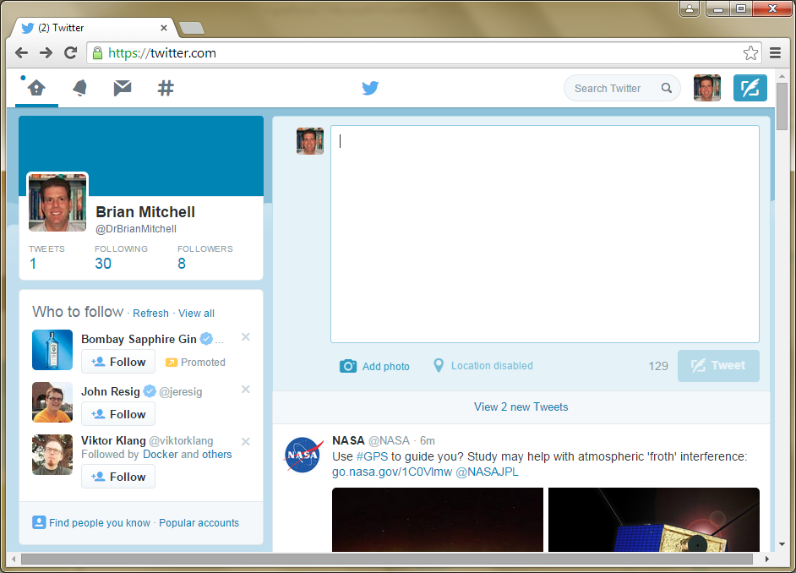
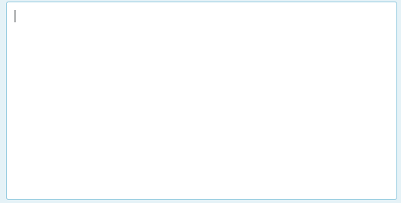





Recognizing #CignaThoughtLeaders
Clinical IT
RTDE

Slide 5

Let’s get started by
reviewing some vintage
slides

Slide 6

Our Starting Point (circa 2008)
Individual
Healthcare
Professional
Employer
Employee
Individual
Employee
HCP
Individual
Employer
myCIGNA
CIGNAforHCP
CIGNAAccess
TelDrug
OneView
CIGNA
Behavioral
Choicelinx
VieLife
MyCare
Allies
CIGNA
Voluntary
Your
CIGNA
Life
GreatWest
MSS
DSS
HSA/ FSA
PSS
ESS
CWR
Pharmacy
ACES
Vendor
Vendor
GreatWest
mycignaplans
SSO
CCF
EMT
CARS
Vendor
Vendor
Search
Search
Security
Security
Security
Security
Security
Security
Security
Security
Security
Content Management
Content Management
Content Management
Content Management
Content Management
Reporting
Reporting
Reporting
Search
Content Management
Reporting
Integration
Integration
Integration
Integration
Integration
Integration
CIGNA.com
HealthAdvisor
Itstimetofeelbetter
FUSE, NAIC, RRD, Careallies
CIGNAMedicare
CIGNASharedAdmin
MGM, CMG,
+ 80 other Content sites
Integration
Case Installation
Network
Enrollment
Medical Management
Data
Data
Data
Data
Data
Data
Data
Data
Data
Data
Data
Database
Database
Database
Powerstep
Medical
Dental
Data
Bluecard
Data
Data
Op. Financials
Data
Data
Data
Data
Data
Data
ECM
DocGen / Collateral Member
Data
Data
Data
Data
MHS
Data
Data
Data
Print
Data
Data
Hosting
Portal Server
Security
Application Server
Web Content Management
Cigna Datacenter
Portal 1
Web/HTTP
Java/J2EE
WCM
External Data Center
Portal 2
Web/HTTP2
.NET
Custom
Portal 3
LDAP
Vendor App
Contribute
SaaS Provider 1
Reporting
SaaS Provider 2
Integration Server
Search
IS1
IS2
Vendor
Database Search
Tool 1
Tool 2
SaaS Provider 3
IS3
IS4
Open Source
Custom

Slide 7
So how does this happen?

Slide 8

Meet our Lead Web Architect

Slide 9
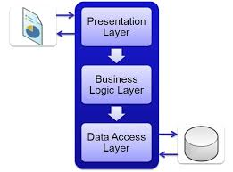
Time to Modernize !
Remember when you couldn’t play with the cool kids unless you separated concerns

Slide 10

Cigna moved to a layered “Portal” based architecture…
[note the only word changed on the slide was “responsive” – the term did not exist then - it was “personalization” prior]
Healthcare
Professional
Cigna
Employees
Technology Interactions
Trusted Partners and Client Sites
Customer
Client
Broker
App2App
Web
Mobile
Call
Web Services
B2B
Channels
Portals in the cloud,
Specialty Vendors, Practice Management Solutions, Consumer enrichment services
Constituent Interactions
Internal
Applications
Constituent Services
Constituent Content
Workbench
Self Service
Health Coaching
Reporting
Information
Marketing
Call
Analytics
Enrollment
Finance
Risk Assessment
Education
Training
Claims
….
Availability &
Performance
Services
Security
Services
Presentation Services
Authentication,
Authorization & SSO
Monitoring
Portal Server
Responsive
Web Content Management
Cloud Solution
[JSR Standard Portlets]
[Custom CSS for Web/Mobile]
[Authoring & Publication]
HTTP Proxy
Cache
Distributed Data
Grid
Platform Services
Federation
Search
Social Networking
Virtualization
SSO: Registration & Delegation
Personalization & Customization
Content Delivery
blog, wiki, forums.
SAML
Hypervisors
Syndication
Collaboration
Fine-Grained Externalized Access Control
SOA Endpoint
Virtualization
Service Bus
Customer Data Integration
Event Processing
Process Orchestration
Runtime Policy
Enforcement
Discover, Govern
Integration
App Server Clusters
Enterprise Services
XML Gateway
J2EE
Self-Service Transactions
Customer
Intelligence
Integrated
Constituent Data
Web Services
Portal Data
Enterprise Data
ETL
Data Grid
Cache
Portal
Repositories
MDM Hubs &
Indexes (Cache)
Books of Record
Transaction Stores
Info Factory
ECM
LDAP Security Stores (Internal/External)

Slide 11
…Success will be defined
as achieving a
user experience
that is
“Scary – 1”…

Slide 12

“OH NO…
THAT IPHONE IS COOL
WE NEED TO
ACCELERATE MOBILE!”
Mobile Enablement

Slide 13
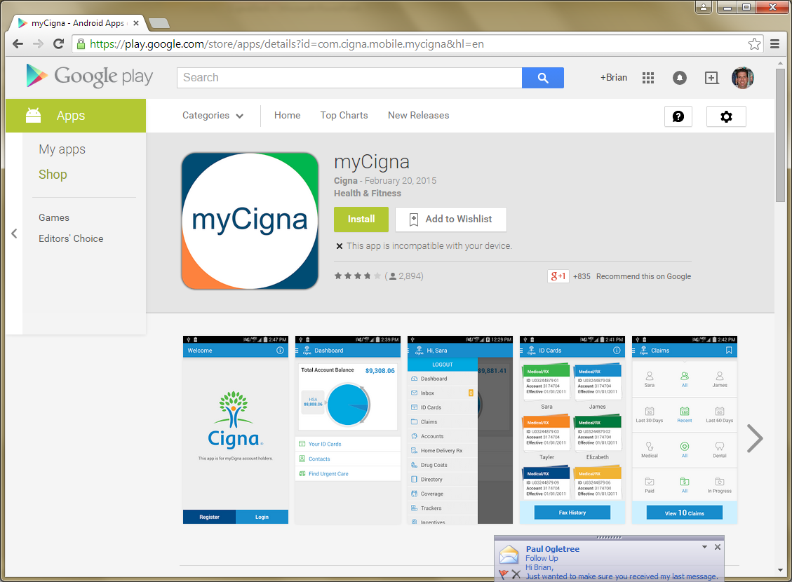
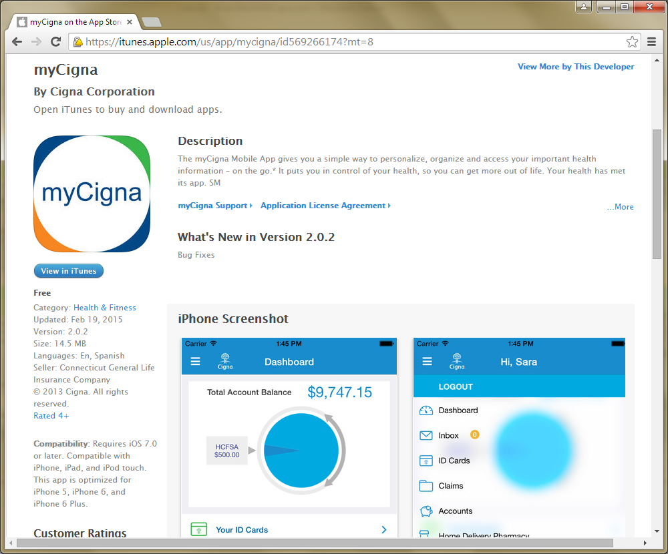
Approaching 1,000,000 Downloads

Slide 14
Our High Level Mobile Architecture
Customer
Mobile App
Android Application
iOS Application
Mobile Network
Mobile Endpoint (MSP Layer)
Mobile APIs
Mobile Enrichment Services
(Push, Cache)
Web Services
Mobile Specific Assets
Web Assets
Enterprise
Services
Integration
Fabric
EAI
Framework
Service Framework
API
Framework
Messaging
Framework
Platform Data
Data Grid
Cache
Online-Specific
Repositories
Legacy Data
Sources
Identity
Data
Profile
Data
Targeting
Rules
Content
Repository
Digital
Assets

Slide 15

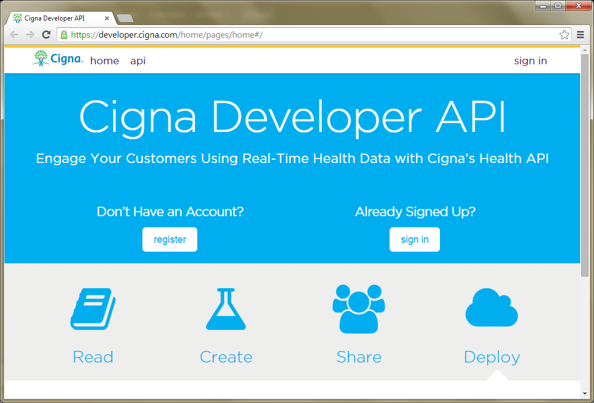
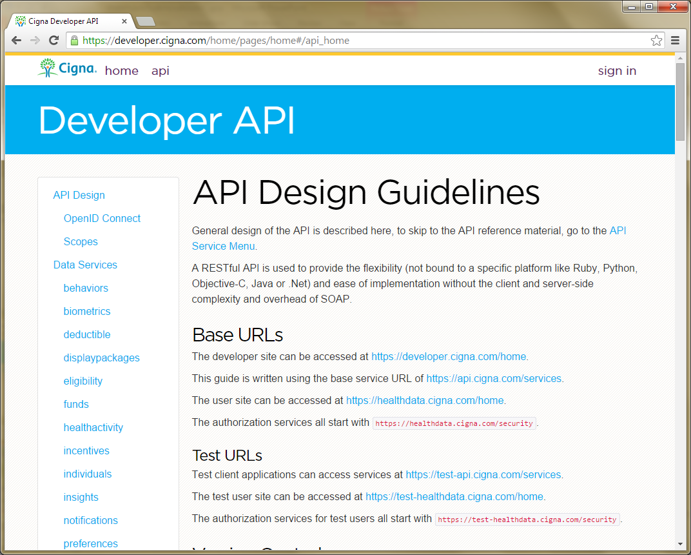



We also love our APIs
Publicly accessible at:
http://developer.cigna.com
We also have APIs for locating
a doctor, medical cost estimation,
and pharmacy cost estimation

Slide 16
Creating our web, mobile and API platforms over time has created a few architecture reuse challenges that we are addressing
Web &
Mobile Web
Architecture
Mobile
Architecture
Shared
Web & Mobile
Architecture
API
Architecture

Slide 17

Thank goodness, write-
once, deploy-everywhere.
Is this the solution?

Slide 18

HTML5 is probably part of
the solution, but its not
a silver bullet…
<HTML5/>
Figuring out the right balance while
preserving a great user experience
0% < HTML5 < 100%

Slide 19
A more sensible mix probably looks more like this:
Shared
Web & Mobile
Architecture
Web &
Mobile Web
Architecture
Mobile
Architecture
API
Architecture

Slide 20
Our Revisited Reference Architecture
Customer
Healthcare
Professional
Cigna
Employees
Client
Broker
Web
Mobile
Call
Web Services
B2B
Channels
Web & Responsive Web App
Native / Hybrid Mobile Apps
3rd Party Apps
Network (Internet & Mobile)
UX Framework
Mobile Framework
API Gateway
App Framework (Common Business Logic)
.
Business Objects
Business Objects
Business Objects
Other Cigna APIs and Services
APIs
Enterprise
Data
Sources
Customization &
Content
Personalization Services
Notification & Eventing
Security &
Registration
Other Cigna Apps
Platform Services
Warehouse
Identity
Entitlement
Targeting
Recommendation
Static
Content
App Data
Caching
Security
Search
Mobile
Enrichment
Dynamic
Content
Marts
Integration
Fabric
EAI
Framework
Service Framework
API
Framework
Messaging
Framework
Platform Data
ETL to Purpose built RDS and Web ODS
Data Grid
Cache
Online-Specific
Repositories
Legacy Data
Sources
Identity
Data
Profile
Data
Targeting
Rules
Content
Repository
Digital
Assets

Slide 21
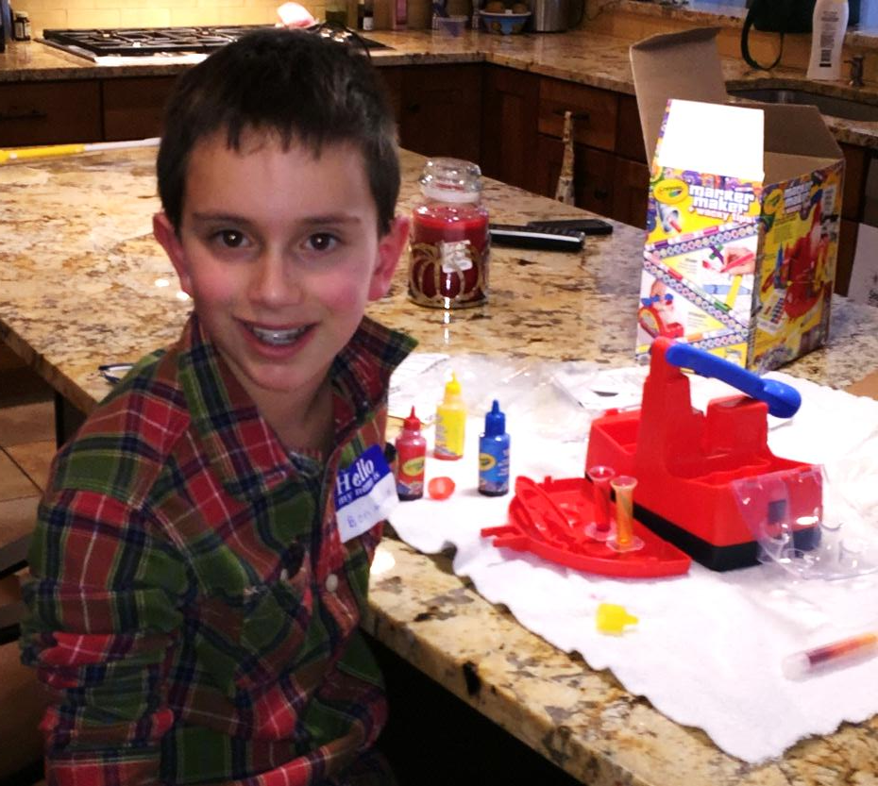

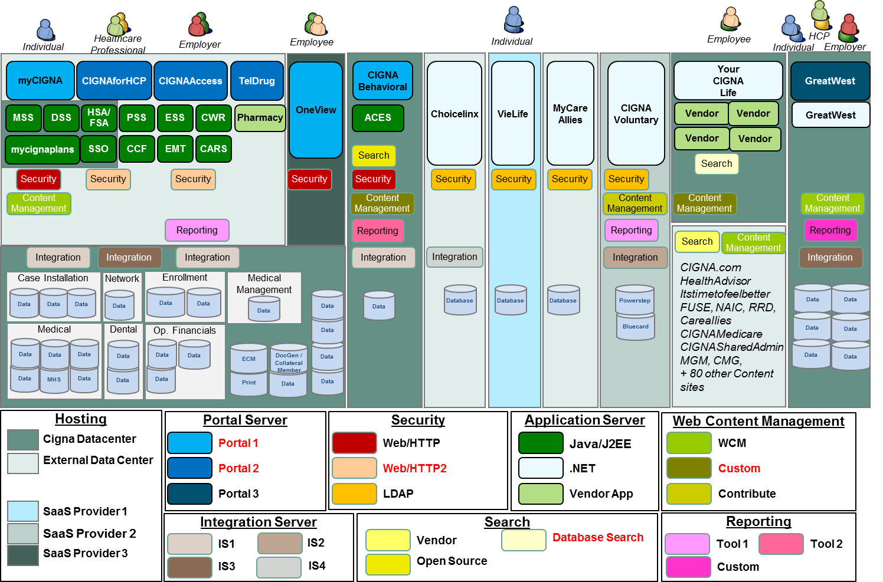
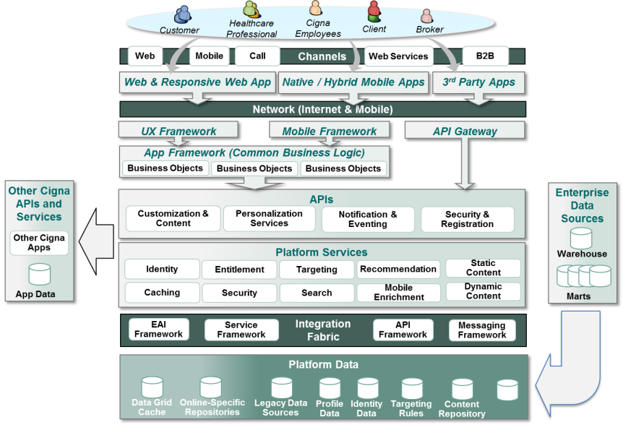
Looks like our Web Architect Picked Up Some New Skills
2007
2015

Slide 22

How are we doing this?
Warning: Some Technical
Content Ahead

Slide 23
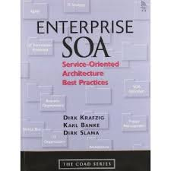



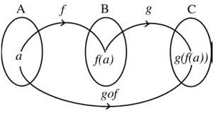

The nature of applications is changing, this is driving the refactoring of modern enterprise architectures
On the Front End:
On the Back End:
Refactoring our SOA Approach to…
New Application Architectures
Mobile
…Move from Course Grained “Big” SOAP
services to Composable RESTful Services
3rd Party Integration Requirements

Slide 24
Supporting diverse customer experience needs becomes a primary objective of our underlying solution architecture
Native & Hybrid
Solution Stack
Web & Mobile Web
I need to find a doctor!
What is this bill about?
I need a new ID card!
Am I eligible for this?
Customer-Initiated
Customer comes to Cigna to “do something”. Goal is to make it easy and fast for them to find what they want
You can save money
Take advantage of incentive
Enroll in this program
Cigna-Initiated
Cigna initiates outreach to customer. Goal is awareness, and to get the customer to “take action now”
Type of Experience
Take the HRA
Order Rx Refills Online
Product Enrollment
“Apps” – Task Oriented
We need the customer to complete a task – it has a beginning, a middle and an end.
Examples
The goal is to have the customer experience drive the technical architecture, and not the other way around

Slide 25



At the same time Front-end Architecture Changes are Driving Back-End Architecture Changes
Moving from a traditional Web architecture…
Browser
Server
Controller
Services
View
Model
App Rendered in Browser
To a modern “Client-Centric” architecture…
Browser
Server
App Runs in Browser
APIs
Services
Native
App Runs in Device

Slide 26

These new apps require
rethinking the integration
layer
Getting it correct is
essential for success!

Slide 27
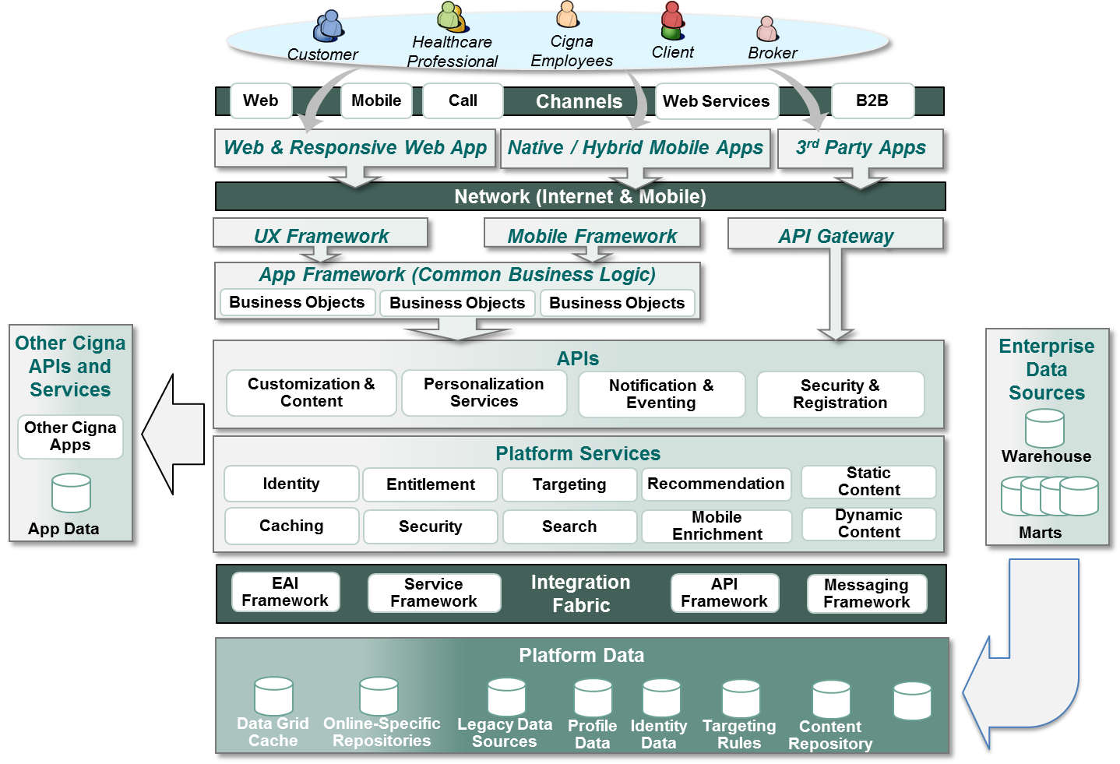
For us, that is here…

Slide 28
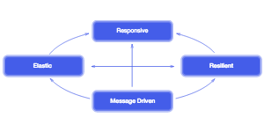
We also are interested in concepts inspired by the Reactive Community
the system responds timely
with consistent responsiveness
Responsive
responsiveness maintained
under varied workloads
responsiveness maintained
in the face of failure
Elastic
Resilient
Message Driven
component boundaries traversed
using asynchronous messages
http://www.reactivemanifesto.org/

Slide 29
Step 1 was to define an overall reference architecture that we could use to ground and educate the organization

Slide 30
This architecture promotes 5 key areas of focus
3
Enrich
1
Create
2
Compose
4
Manage &
Secure
5
Consume

Slide 31
To get started we needed to clearly define how we wanted our new REST services to be designed
1
Create

Slide 32
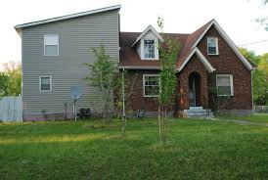
Does this belong here?
We like others have found SOAP abstractions make reuse difficult.
w/SOAP “Extension is via Addition”

Slide 33

REST = Reuse via Composition
Build higher level abstractions from granular reusable parts

Slide 34
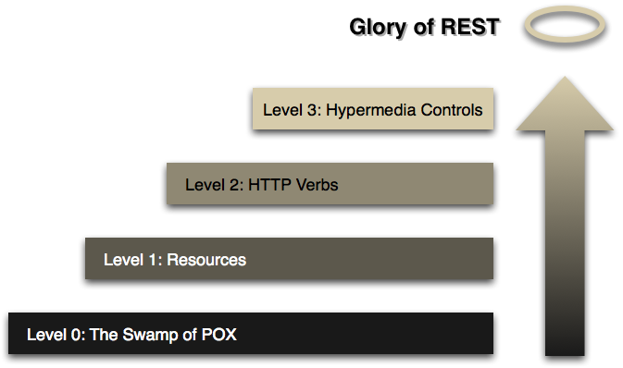
As typically happens – early adopters who dabbled in REST created services at Level 0 of the Richardson Maturity Model
Guidance was required to educate our development community on creating services at Level 2 and Level 3

Slide 35

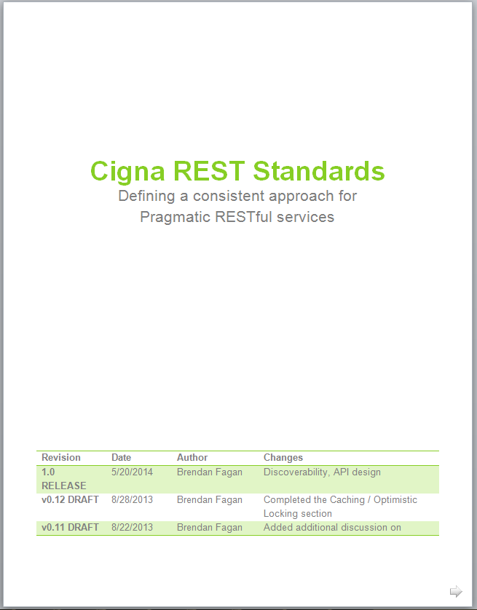





Our focus is on “Pragmatic” REST

Slide 36

Using Composition == Speedup Required
FROM
GOAL
TO
Client
Application
Client
Application
Contract-Oriented
SOAP Services
Resource-Oriented
REST Services
Server
Server
Performance Increase Target
Our new REST services run in 10-100ms
Our Traditional SOAP Services run about 500ms-3 seconds
[Note that we currently execute about 4.5 billion web service calls per year]

Slide 37
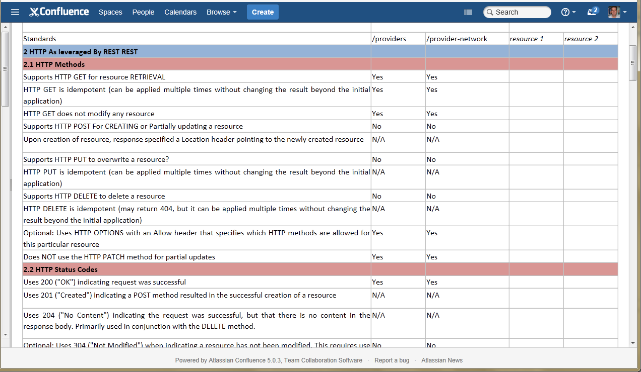
Education Required:
“REST in a Box” Workshop

Slide 38
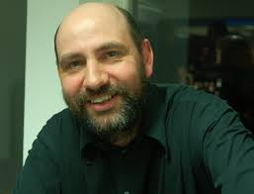
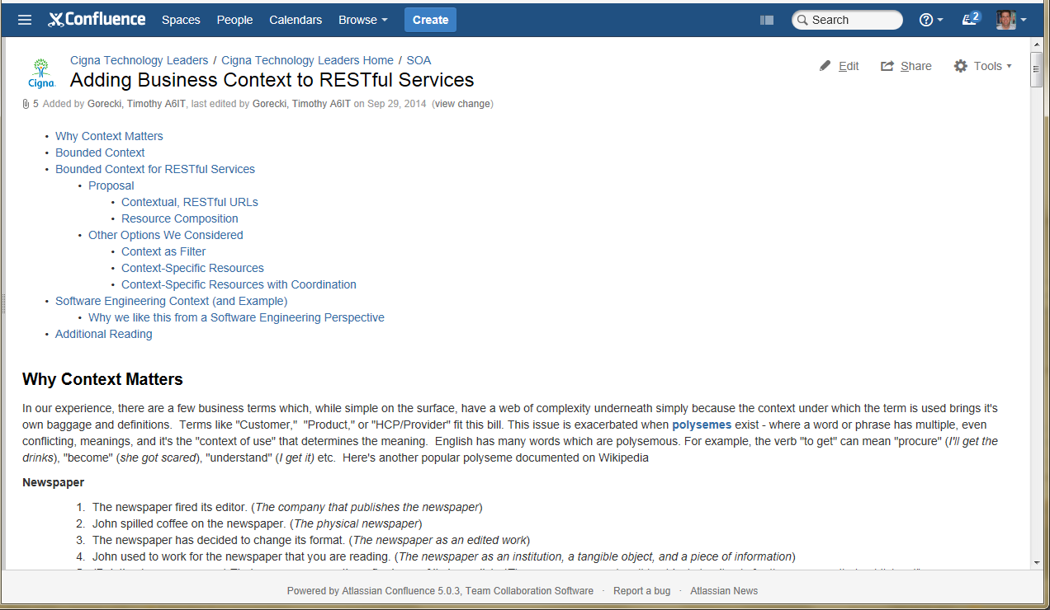

Inspiration from Thought Leaders: Business Context + REST
Martin Fowler
Eric Evans
We took concepts of Bounded Context from DDD and applied them to REST

Slide 39












The “Composition” Layer
✓
2
Compose
Options….
Use established EAI Frameworks? Use Functional Reactive Methods? Use Both?

Slide 40
Composition is required because we don’t want to…
Replace the problems associated with this (Course-Grained Services)…
SOAP
Request
SOAP Semantics are too abstract
Extension via contract addition
Large message sizes
Over time services become harder to call and there is a need to filter out response data based on what is needed
Client
Application
Server
SOAP
Response
With new problems associated with this (Granular Services)…
REST
Calls
REST Services are more granular
Promote composition over reuse
Problematic if the client is responsible for all of the composition
Need a solution to create higher-level abstractions from granular REST Services
Client
Application
Server

Slide 41




Example Composition – Getting a customer summary:
GET https://api.cigna.com/v1/customers/123/summary
FLOW: CustomerSummary
/customers/123?...
SPLIT
/orders/123?...
AGGREGATE
/bills/123?...
DEPLOY
EAI Server on JVM
Reactive Streams
At Cigna we currently are using both Spring Integration, Apache Camel and RxJava
in production

Slide 42
The API layer focuses on convenience, enrichment, and security for our modern apps
3
Enrich
4
Manage &
Secure

Slide 43
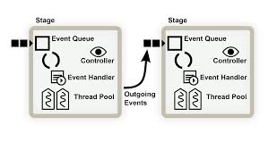
Although we are still in the Synchronous-One quadrant, we wanted to position the architecture for other reactive patterns
 | One | Many
Synchronous | Try[T] | Iterable[T]
Asynchronous | Future[T] | Observable[T]
Newer SOA patterns embrace asynchronous processing based on event handling and
messaging. They don’t use store-and-forward queues.

Slide 44
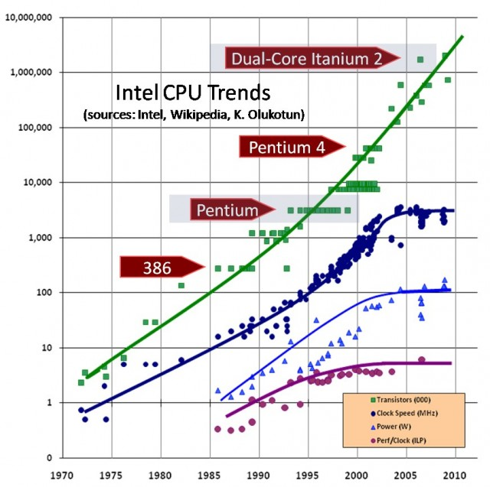
Asynchronous platforms will be critical for keeping up with the Moore’s law curve, we wanted a platform that moves us away from request/response (a.k.a. Servlet Container)
More Cores =
Harder Software
Around 2005 we started to see clock speed and performance of CPUs level off.
Performance is now increased by having multiple-cores on a chip, but this causes
complexity that our software needs to deal with…

Slide 45
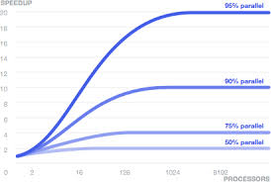
Amdahl’s law also comes into play when trying to determine the maximum speedup that can be achieved
This means to scale we also need to avoid parts of a system that need to be coordinated
across an async boundary (e.g., shared mutable state)

Slide 46
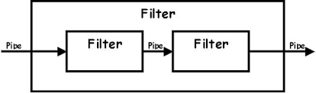
To enable asynchronous capabilities we wanted to ensure that our API platform was not layered on a container based on a pipe-and-filter architecture
HttpRequest
HttpResponse

Slide 47
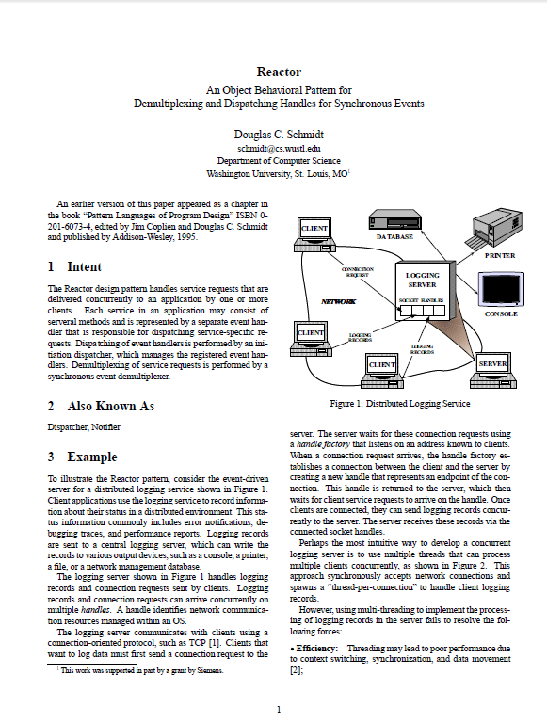
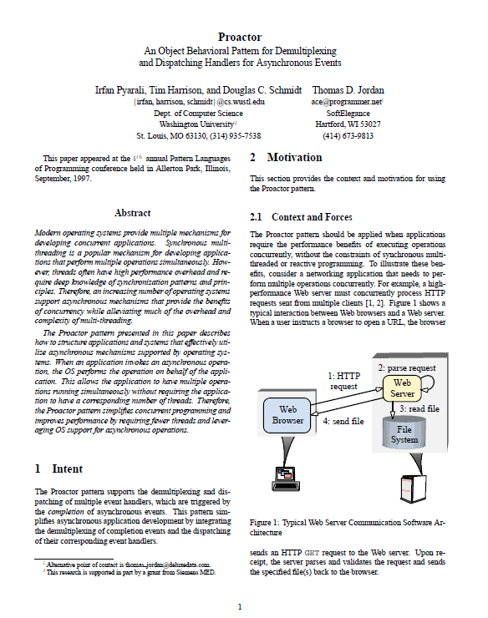
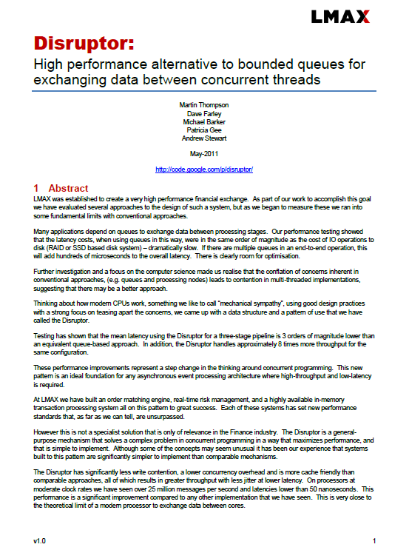
Newer asynchronous platforms are inspired by both old and new software engineering research
Reactor
Pattern (1995,1999)
Proactor
Pattern (1997)
LMAX Disruptor
Pattern (2011)
http://www.cs.wustl.edu/~schmidt/PDF/reactor-siemens.pdf
http://www.cs.wustl.edu/~schmidt/PDF/proactor.pdf
http://lmax-exchange.github.io/disruptor/files/Disruptor-1.0.pdf

Slide 48




We are still determining the platform(s) for our API layer but have been using the following…

Slide 49
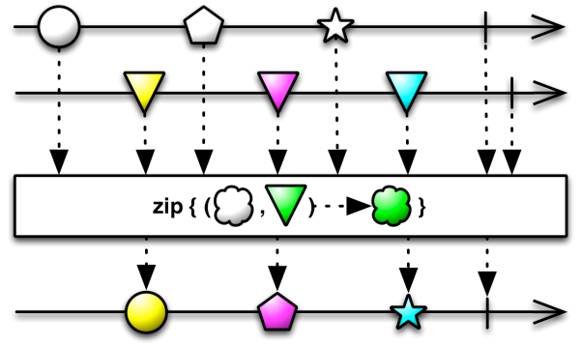
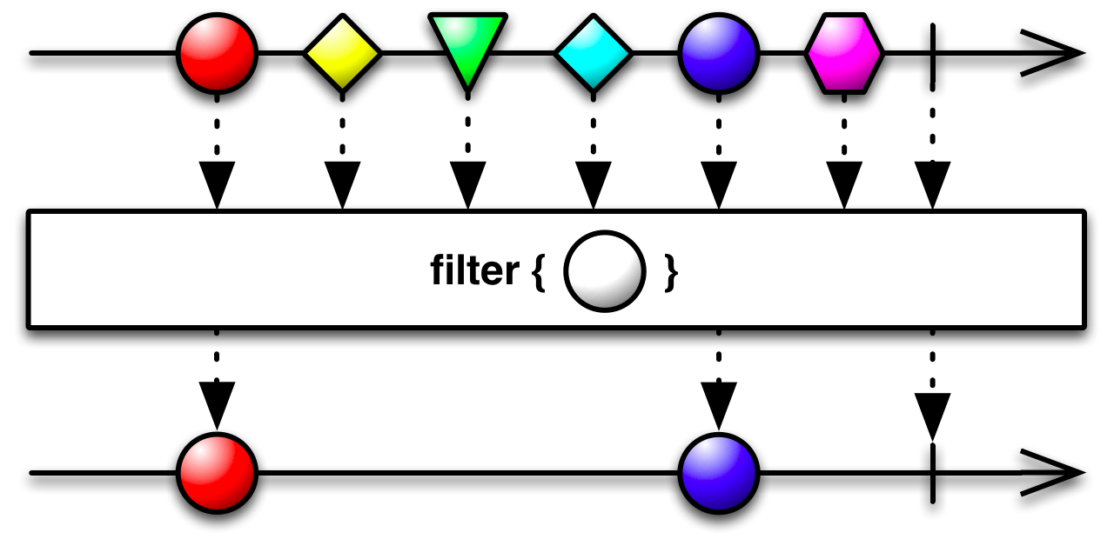
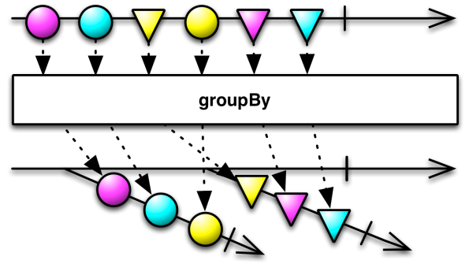
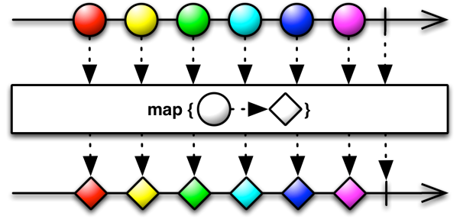
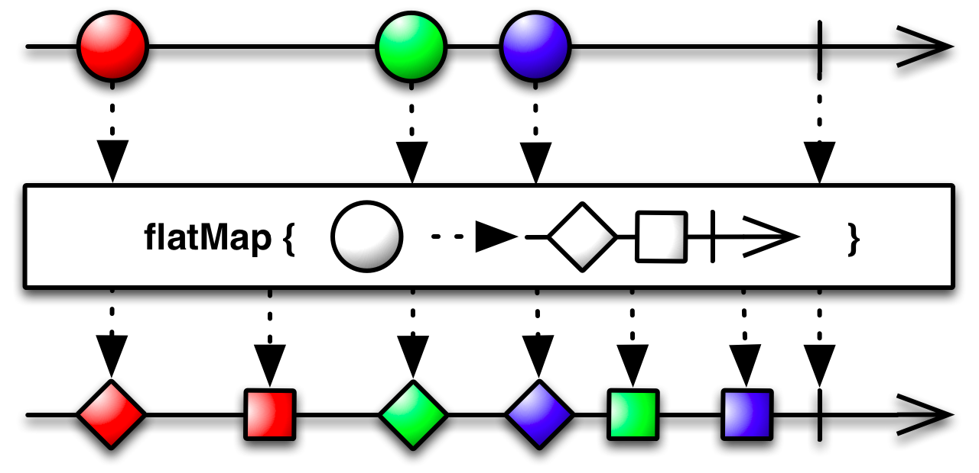
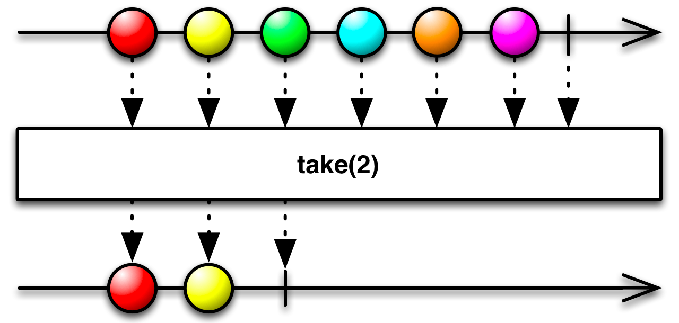
We just got started… but Functional Reactive Libraries Take Us to the Next Level
Asynchronous
Values
Events
Push
Functional Reactive
Lambdas
Closures
Pure Functions
Composable
http://reactivex.io/documentation/observable.html
Notes:
Functional Reactive Frameworks are based on extending the Observer pattern
from Object Oriented Programming, and Stream Processing from Functional Programming.
The goal is to build up a series of non-blocking actions by using functional operators and
combinators, and then execute by “materializing” or “subscribing”

Slide 50

Warning… I'm a Scala Geek…
and the only real way to see the power of functional reactive techniques is to look at code
Notes:
Functional Reactive Frameworks are based on extending the Observer pattern
from Object Oriented Programming, and Stream Processing from Functional Programming.
The goal is to build up a series of non-blocking actions by using functional operators and
combinators, and then execute by “materializing” or “subscribing”

Slide 51
Example: Getting a Customer Summary using Service Composition with Functional Reactive Techniques
def customerSummary(custId: Long) :Observable[Map[String,Any]] = {
customerService.getCustomer(custId).flatmap( cust => {
val orders: Observable[Map[String,List[Order]]] = orderService.
getOrders(cust.account_id).take(10) map (olist => Map( “orders” -> olist))
val bills: Observable[Map[ String,List[Bill]]] = billService.
getBills(cust.account_id).take(12) map (blist => Map( “bills” -> blist))
val theCust = Observable. just(Map(“customer” -> cust))
theCust ++ orders ++ bills
}
}
}
//Run It
def custSummaryService(name: String) = customerSumary( lookupCustId(name) ).
toBlocking.toList.reduce( _ ++ _)
GET /v1/customers/{name}/summary custSummaryService(name)
Note to better show the concept RESTFul services are wrapped in helper functions

Slide 52
Example: Getting a Customer Summary using Service Composition with Functional Reactive Techniques
def customerSummary(custId: Long) :Observable[Map[String,Any]] = {
customerService.getCustomer(custId).flatmap( cust => {
val orders: Observable[Map[String,List[Order]]] = orderService.
getOrders(cust.account_id).take(10) map (olist => Map( “orders” -> olist))
val bills: Observable[Map[ String,List[Bill]]] = billService.
getBills(cust.account_id).take(12) map (blist => Map( “bills” -> blist))
val theCust = Observable. just(Map(“customer” -> cust))
theCust ++ orders ++ bills
}
}
}
//Run It
def custSummaryService(name: String) = customerSumary( lookupCustId(name) ).
toBlocking.toList.reduce( _ ++ _)
STEP 1: Setup a Web Service REST Binding to map to a function
GET /v1/customers/{name}/summary custSummaryService(name)
Note to better show the concept RESTFul services are wrapped in helper functions

Slide 53
Example: Getting a Customer Summary using Service Composition with Functional Reactive Techniques
def customerSummary(custId: Long) :Observable[Map[String,Any]] = {
customerService.getCustomer(custId).flatmap( cust => {
val orders: Observable[Map[String,List[Order]]] = orderService.
getOrders(cust.account_id).take(10) map (olist => Map( “orders” -> olist))
val bills: Observable[Map[ String,List[Bill]]] = billService.
getBills(cust.account_id).take(12) map (blist => Map( “bills” -> blist))
val theCust = Observable. just(Map(“customer” -> customer))
theCust ++ orders ++ bills
}
}
}
//Run It
def custSummaryService(name: String) = customerSumary( lookupCustId(name) ).
toBlocking.toList.reduce( _ ++ _)
STEP 2: Stage a call to the Customer Web Service
How does it work?
Note that the getCustomer() function MUST return an Observable, the actual type is an Observable of a Customer object or Observable[Customer] – nothing happened yet
GET /v1/customers/{name}/summary custSummaryService(name)
Note to better show the concept RESTFul services are wrapped in helper functions

Slide 54
Example: Getting a Customer Summary using Service Composition with Functional Reactive Techniques
def customerSummary(custId: Long) :Observable[Map[String,Any]] = {
customerService.getCustomer(custId).flatmap( cust => {
val orders: Observable[Map[String,List[Order]]] = orderService.
getOrders(cust.account_id).take(10) map (olist => Map( “orders” -> olist))
val bills: Observable[Map[ String,List[Bill]]] = billService.
getBills(cust.account_id).take(12) map (blist => Map( “bills” -> blist))
val theCust = Observable. just(Map(“customer” -> cust))
theCust ++ orders ++ bills
}
}
}
//Run It
def custSummaryService(name: String) = customerSumary( lookupCustId(name) ).
toBlocking.toList.reduce( _ ++ _)
1
2
3
STEP 3: Use the “flatmap” operator to indicate that you are going to combine some things asynchronously, but need something to happen first. Specifically data for the last 10 orders, billing information for the past 12 bills, and customer profile data are to be obtained but the account number from the getCustomer service is a pre-requisite.
NOTE: (1), (2) and (3) ALL EXECUTE CONCURRENTLY – why?
THEY RETURN OBSERVABLES!
GET /v1/customers/{name}/summary custSummaryService(name)
Note to better show the concept RESTFul services are wrapped in helper functions

Slide 55
Example: Getting a Customer Summary using Service Composition with Functional Reactive Techniques
def customerSummary(custId: Long) :Observable[Map[String,Any]] = {
customerService.getCustomer(custId).flatmap( cust => {
val orders: Observable[Map[String,List[Order]]] = orderService.
getOrders(cust.account_id).take(10) map (olist => Map( “orders” -> olist))
val bills: Observable[Map[ String,List[Bill]]] = billService.
getBills(cust.account_id).take(12) map (blist => Map( “bills” -> blist))
val theCust = Observable. just(Map(“customer” -> cust))
theCust ++ orders ++ bills
}
}
}
//Run It
def custSummaryService(name: String) = customerSumary( lookupCustId(name) ).
toBlocking.toList.reduce( _ ++ _)
STEP 4: At this point we have 3 separate Map objects, we want to combine them to create an Observable of these three Map objects. This operation has the type of Observable[Map[String,Any]] , which aligns to the return type of the function.
NOTE: In Scala, the last executable statement in a scope is returned, the return keyword is not required
GET /v1/customers/{name}/summary custSummaryService(name)
Note to better show the concept RESTFul services are wrapped in helper functions

Slide 56
Example: Getting a Customer Summary using Service Composition with Functional Reactive Techniques
def customerSummary(custId: Long) :Observable[Map[String,Any]] = {
customerService.getCustomer(custId).flatmap( cust => {
val orders: Observable[Map[String,List[Order]]] = orderService.
getOrders(cust.account_id).take(10) map (olist => Map( “orders” -> olist))
val bills: Observable[Map[ String,List[Bill]]] = billService.
getBills(cust.account_id).take(12) map (blist => Map( “bills” -> blist))
val theCust = Observable. just(Map(“customer” -> cust))
theCust ++ orders ++ bills
}
}
}
//Run It
def custSummaryService(name: String) = customerSumary( lookupCustId(name) ).
toBlocking.toList.reduce( _ ++ _)
STEP 5: The cusomerSummary function is called but it returns an Observable. Nothing has happened yet! To extract the data we need to do a few functional transformations:
toBlocking: This function waits for the customerSummary service to execute
toList: Since the customerSummary service will return a stream of Map objects, this will create a List( OrderMap, BillMap, CustMap) object
reduce: This last operation will take a list of 3 Maps , each with a single key/value, and combine them into a single Map with three key/values.
Examples: val custData = customerSummary(lookupCustId("Mitchell"))
custData(“customer”).phoneNumber
custData(“bills”)(0).outstandingBalance
custData(“orders”)(0).orderDate
GET /v1/customers/{name}/summary custSummaryService(name)
Note to better show the concept RESTFul services are wrapped in helper functions

Slide 57
Example: Getting a Customer Summary using Service Composition with Functional Reactive Techniques
def customerSummary(custId: Long) :Observable[Map[String,Any]] = {
customerService.getCustomer(custId).flatmap( cust => {
val orders: Observable[Map[String,List[Order]]] = orderService.
getOrders(cust.account_id).take(10) map (olist => Map( “orders” -> olist))
val bills: Observable[Map[ String,List[Bill]]] = billService.
getBills(cust.account_id).take(12) map (blist => Map( “bills” -> blist))
val theCust = Observable. just(Map(“customer” -> cust))
theCust ++ orders ++ bills
}
}
}
//Run It
def custSummaryService(name: String) = customerSumary( lookupCustId(name) ).
subscribe( theObj => send(theObj))
STEP 5a: We can also do this fully asynchronously by calling subscribe() and then sending the individual Map's as they get resolved using Observables
GET /v1/customers/{name}/summary custSummaryService(name)
Note to better show the concept RESTFul services are wrapped in helper functions

Slide 58
Now how do we consume these APIs from a modern client?
5
Consume

Slide 59
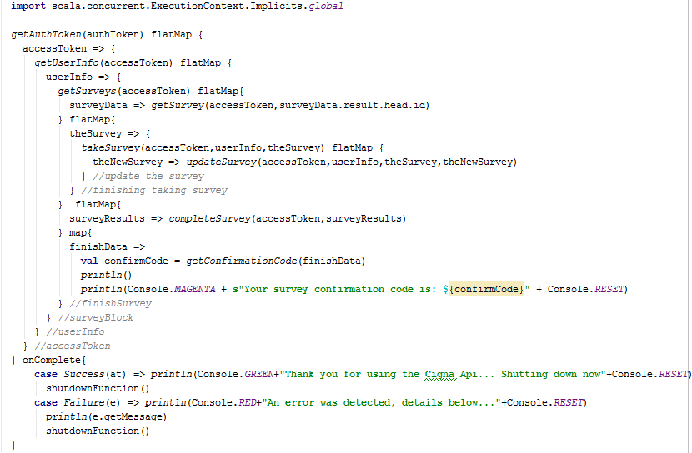
Example: From an internal code-a-thon –
Consuming services from a client asynchronously
Authenticate
Get User Information
Query Surveys
Pick a Survey
Take the Survey
Update the Survey
Complete Survey
Get Confirmation Code
Ensure that everything worked or handle failure condition
1
2
3
4
5
6
7
8
This solution is declarative versus imperative, while being fully non-blocking and immutable.
9

Slide 60
From a modern client perspective this architecture works very well on platforms that are optimized to integrate over REST
Browser
Server
App Runs in Browser
Gateway
APIs
Services
Native
App Runs in Device
REST Services Secured by oAuth and OpenID Connect

Slide 61
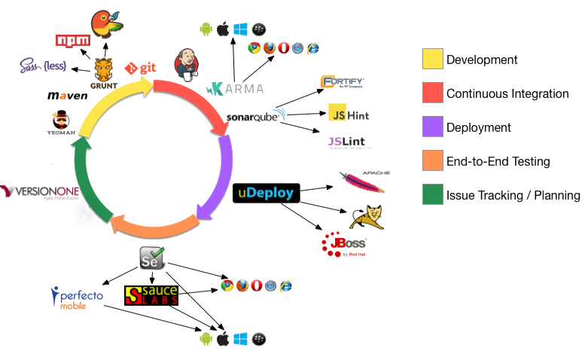

Supporting modern clients, especially SPAs, requires looking at the end-to-end lifecycle
Vendor Tool
Vendor Tool
Vendor Tool
Vendor Tool
Vendor Tool
Vendor Tool
Note that the client side development lifecycle heavily uses open source tooling. Due to Cigna policies I have redacted places where we are using commercial tools

Slide 62
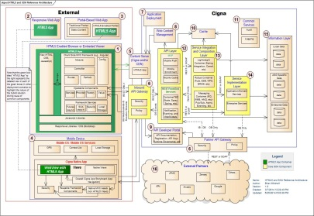
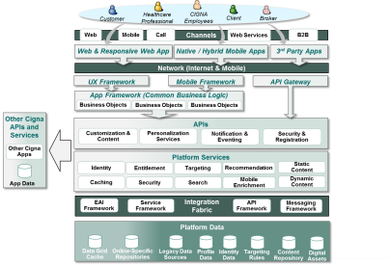
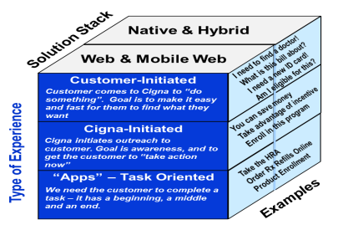







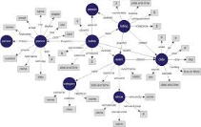





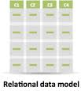


Wrapping Up! We have been working on many efforts to modernize our web and mobile solutions to scale using modern architecture approaches described in this talk.
+
+
+
SOA Strategy
NextGen Web &
Mobile Architecture
=
Improving the
Customer Experience
SOA Refresh
Project
Polyglot
Development
Polyglot
Persistence
Reactive:
Async, Eventing &
Notification
DevOps &
MicroServices

Slide 63
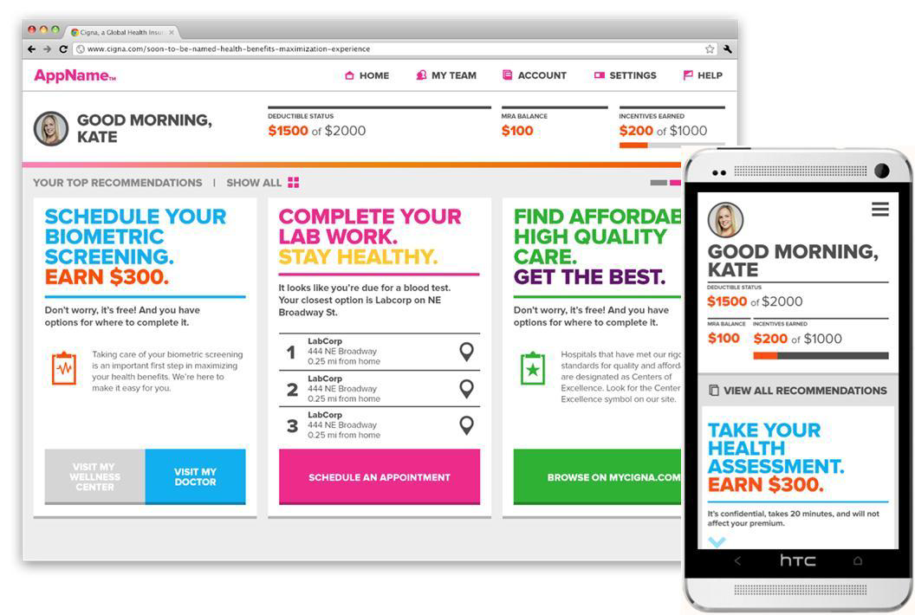
Example: Cigna Compass

Slide 64
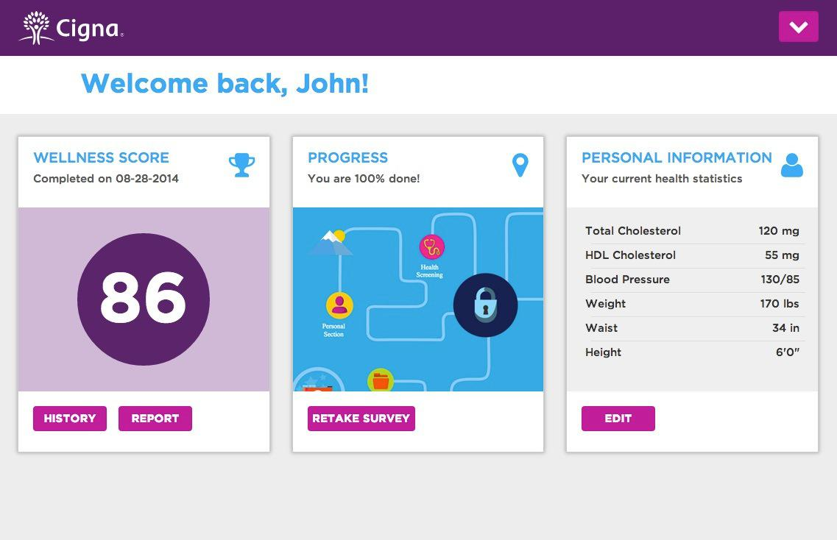
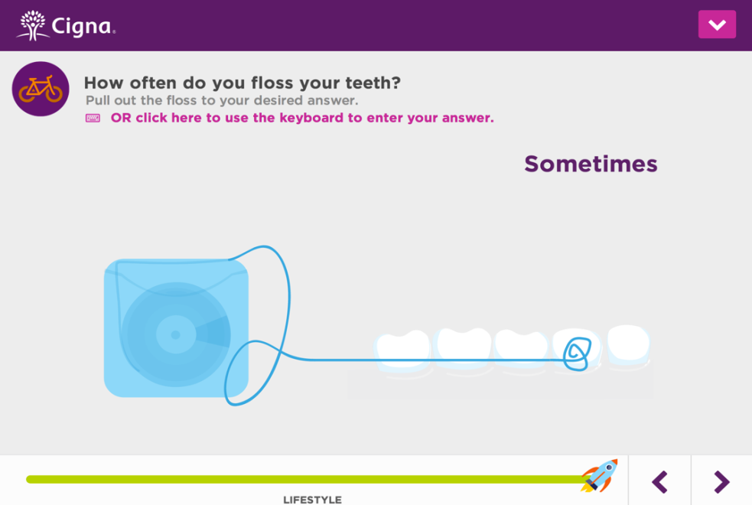
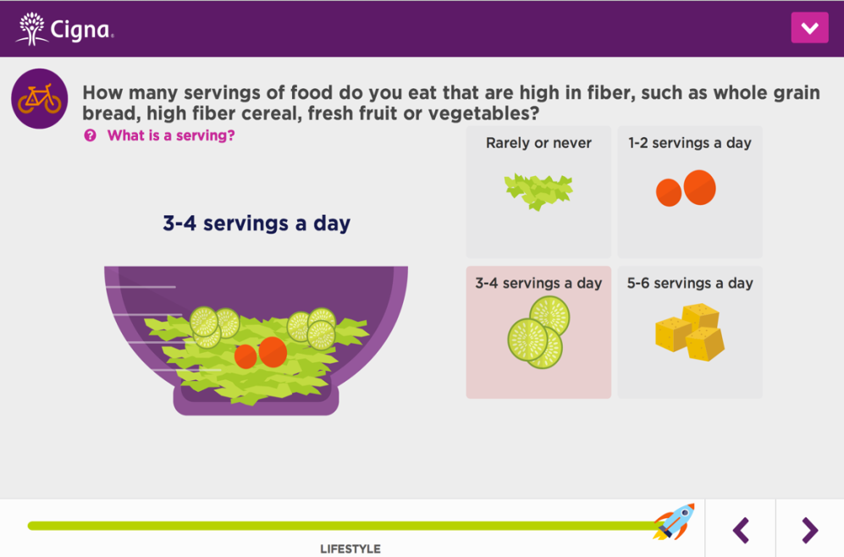
Example: Health Risk Assessment App

Slide 65
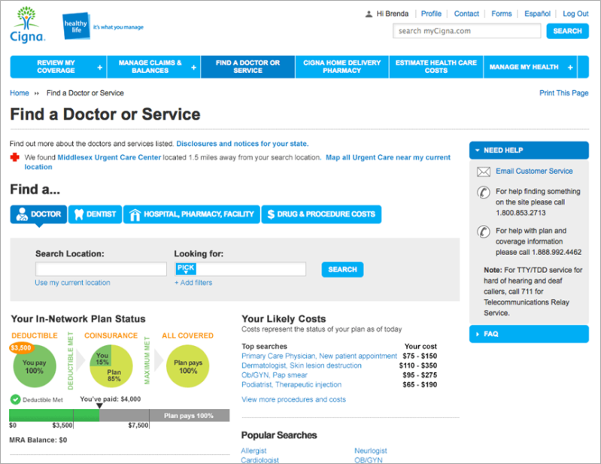
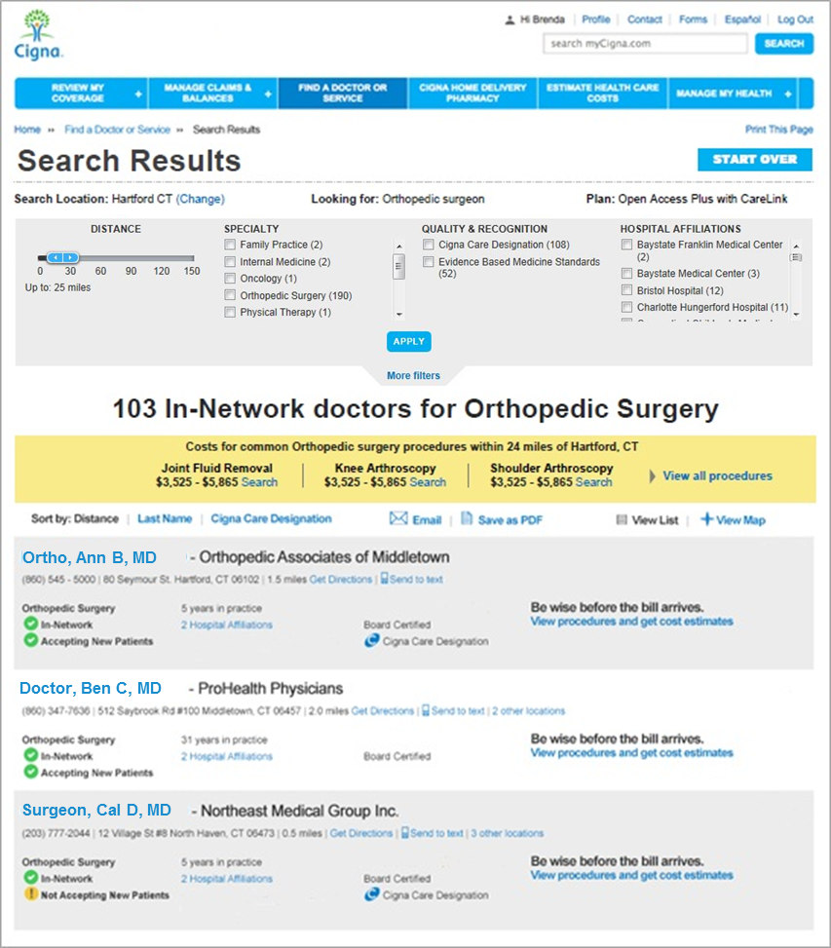
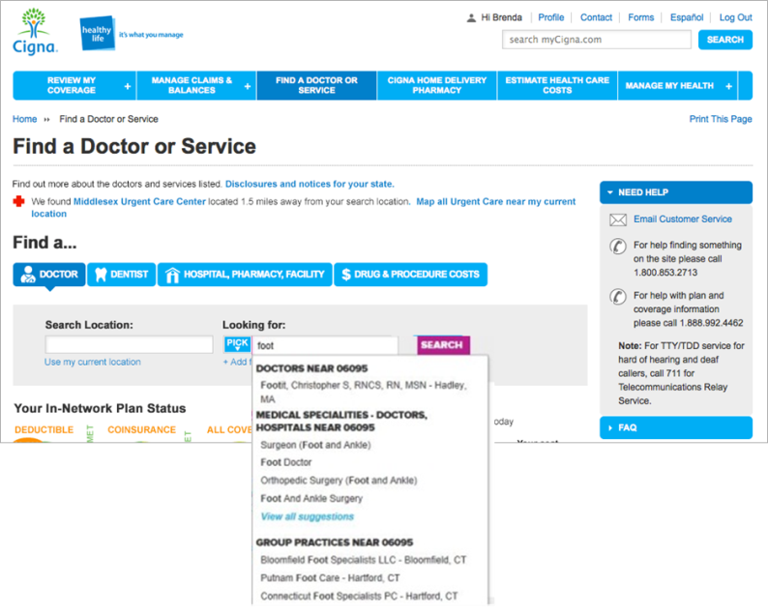
Example: Healthcare Professional Directory Tool

Slide 66
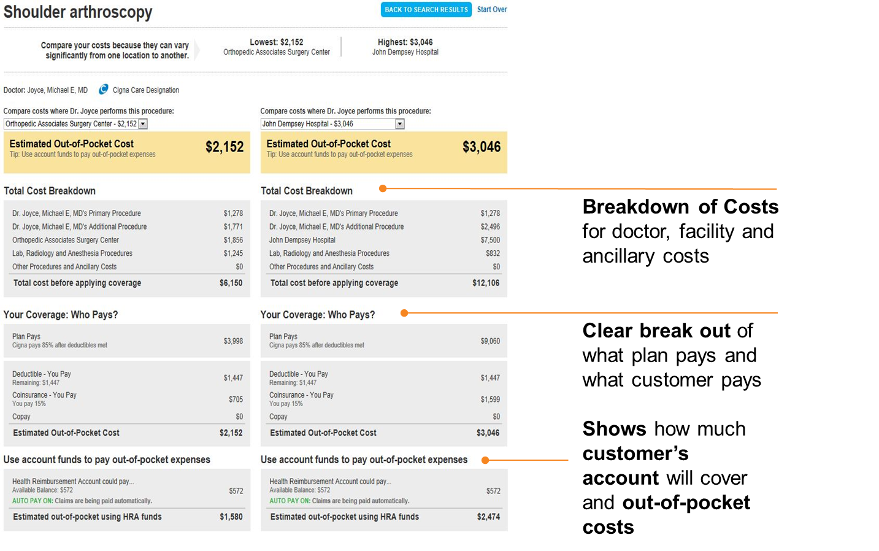
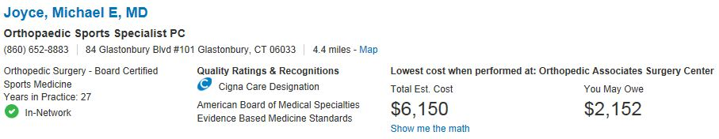
Example: Cost & Quality
Jeffrey, Elsa, MD

Slide 67

Lessons Learned
(mainly organizational challenges – debunking myths – managing change)
Time to get everybody aligned with the fact that SOA 1.0 is over (ESB as the center of the universe is so 2005)
Can't we just add another layer?
Challenges with breaking free of the verb-centric SOAP mindset (POX != REST)
Dogmatic RESTafrianism
Polyglot – I need to learn a new language?
Why can’t we stuff data into that RDMS (Not considering "best-fit persistence" )
Can't we at least keep the XML?
Async Really? We are not google
Threads, Immutability, Non-Blocking – doesn't the container do that?

Slide 68



Again, thanks to #CignaThoughtLeaders
E
A
Enterprise Architecture
Clinical IT
RTDE
Global Solutions Group
Questions?

