Slide 1
Notes:
Additional points: the new hardware is actually all about software

Slide 2
The New Hardware Movement
@JonBruner

Slide 3
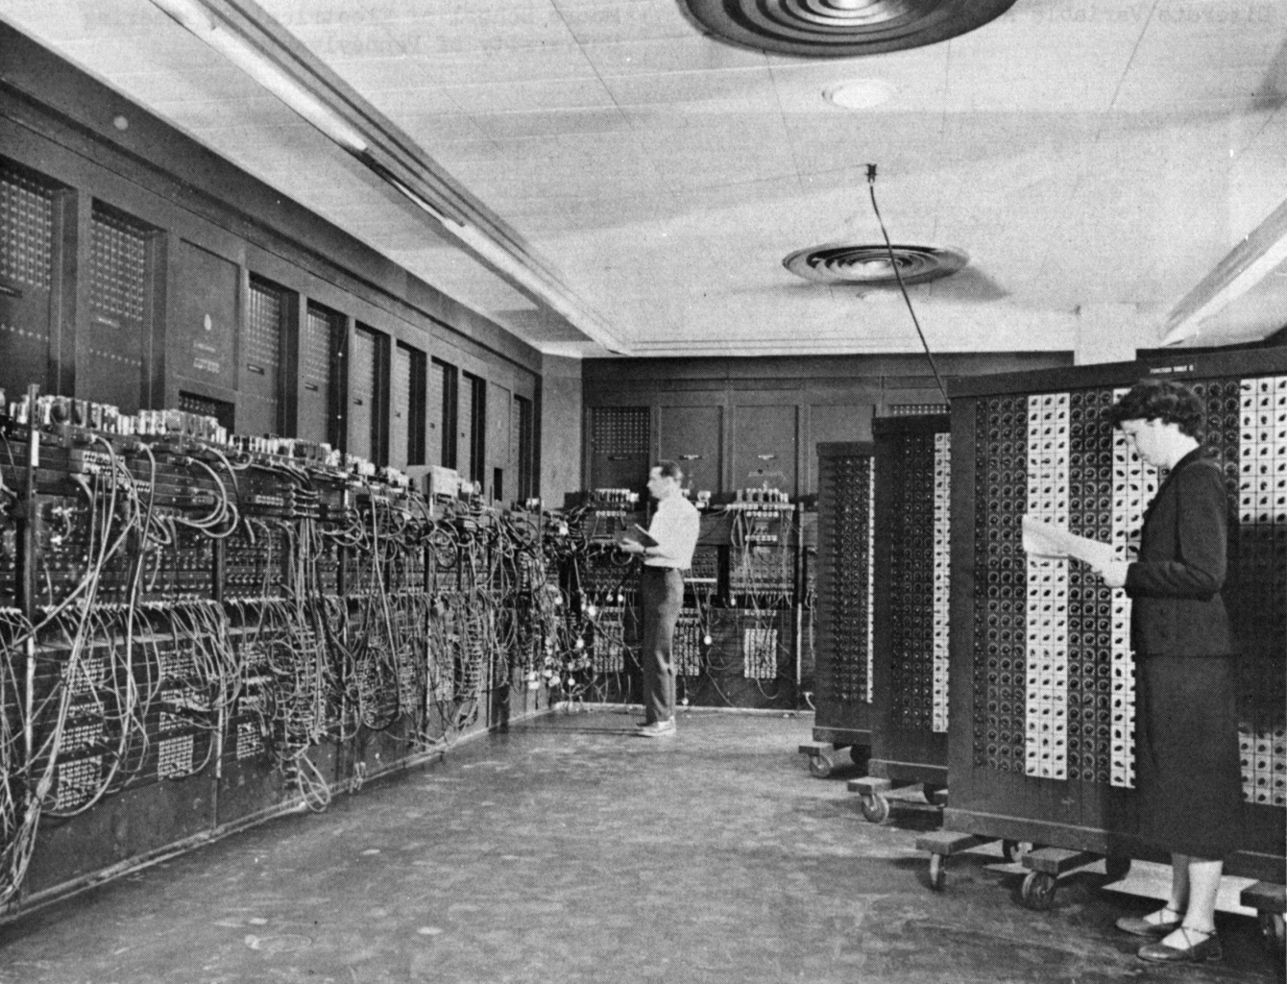
Notes:
ENIAC – Glen Beck and Betty Snyder – Wikipedia 1946

Slide 4
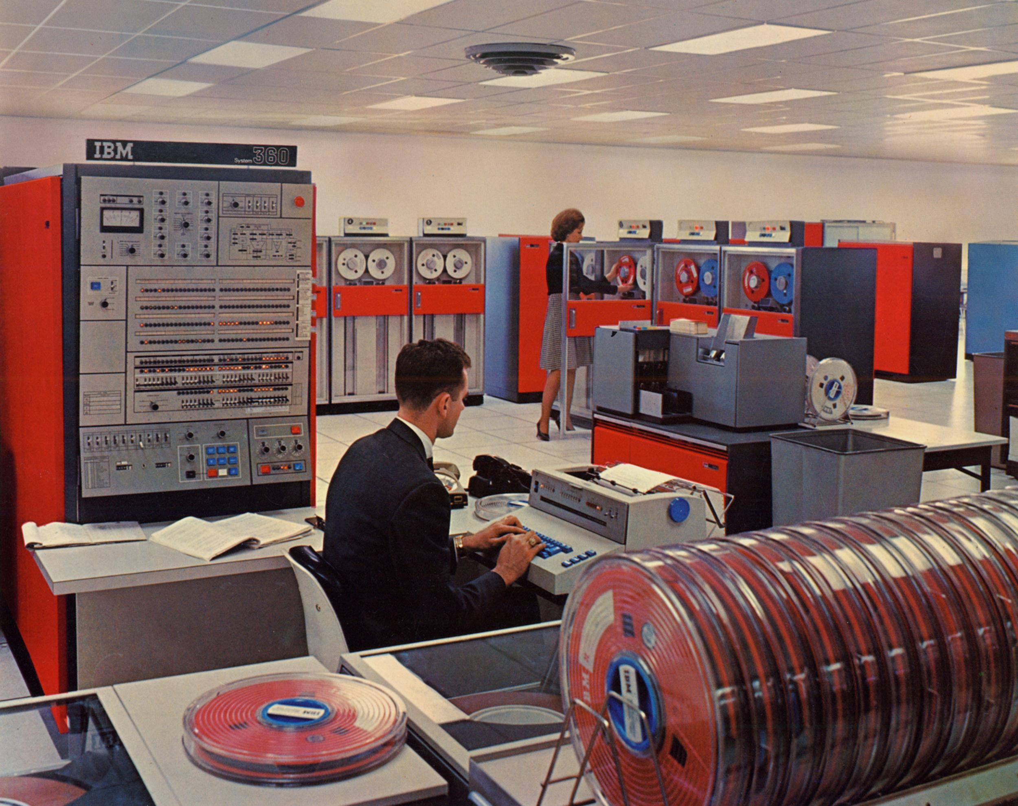

Slide 6
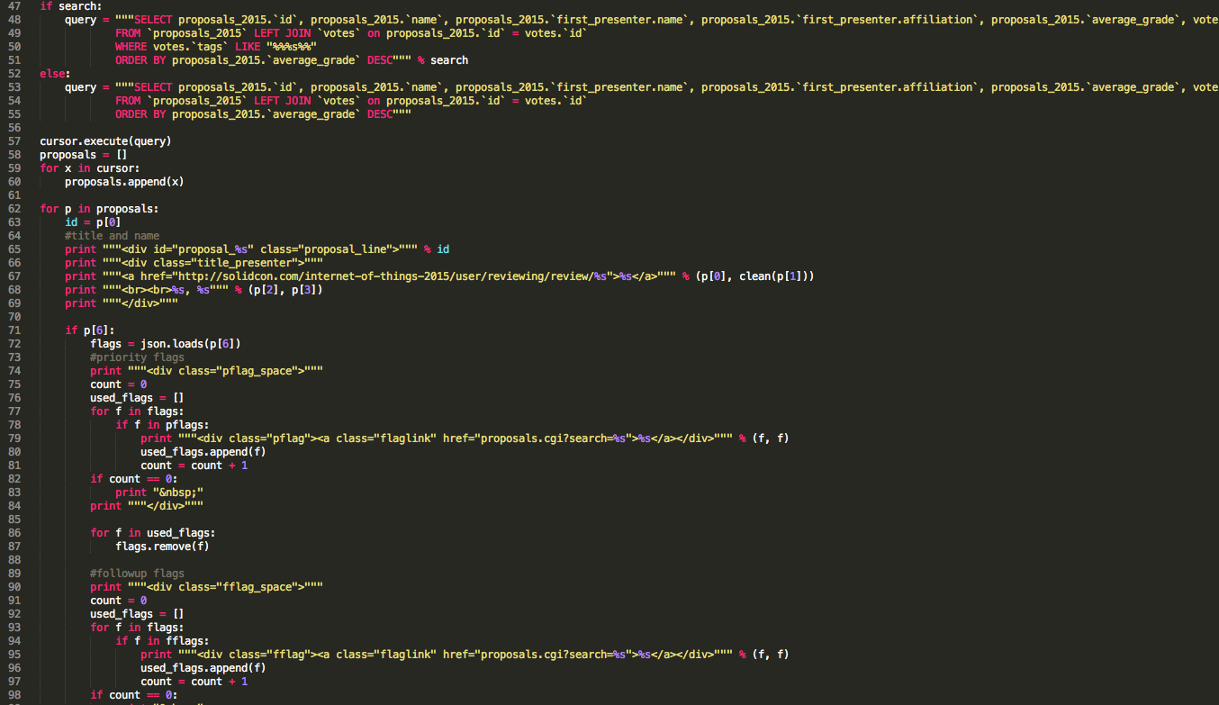

Slide 7
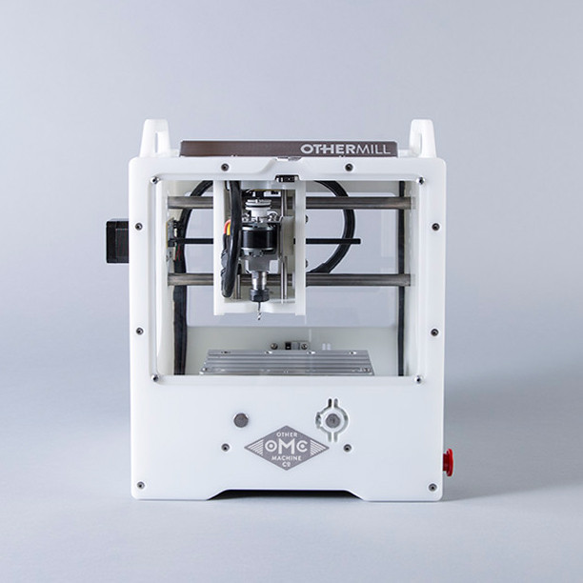
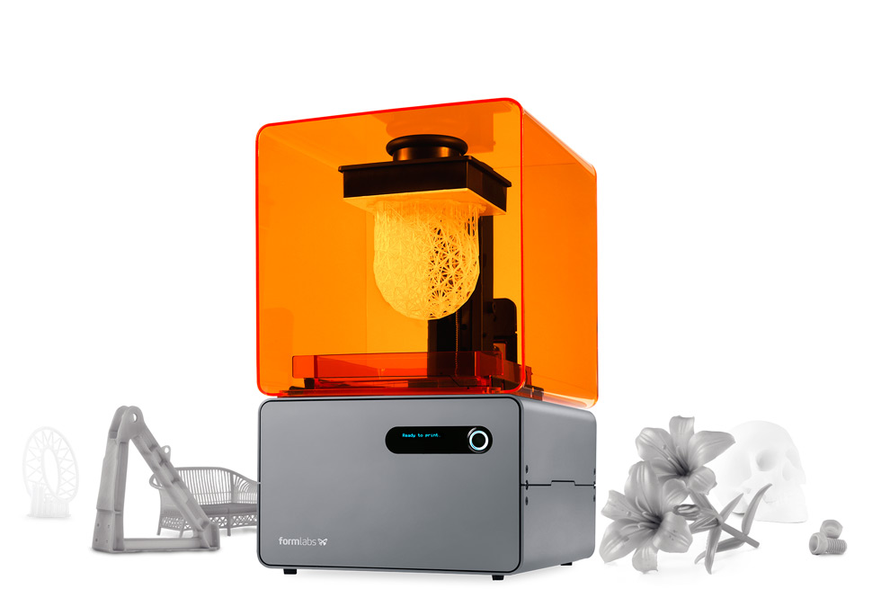
Design and Digital Prototyping
Notes:
We have all these cube-shaped machines that can do anything you want for not much money.

Slide 8
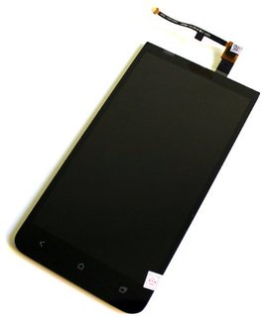
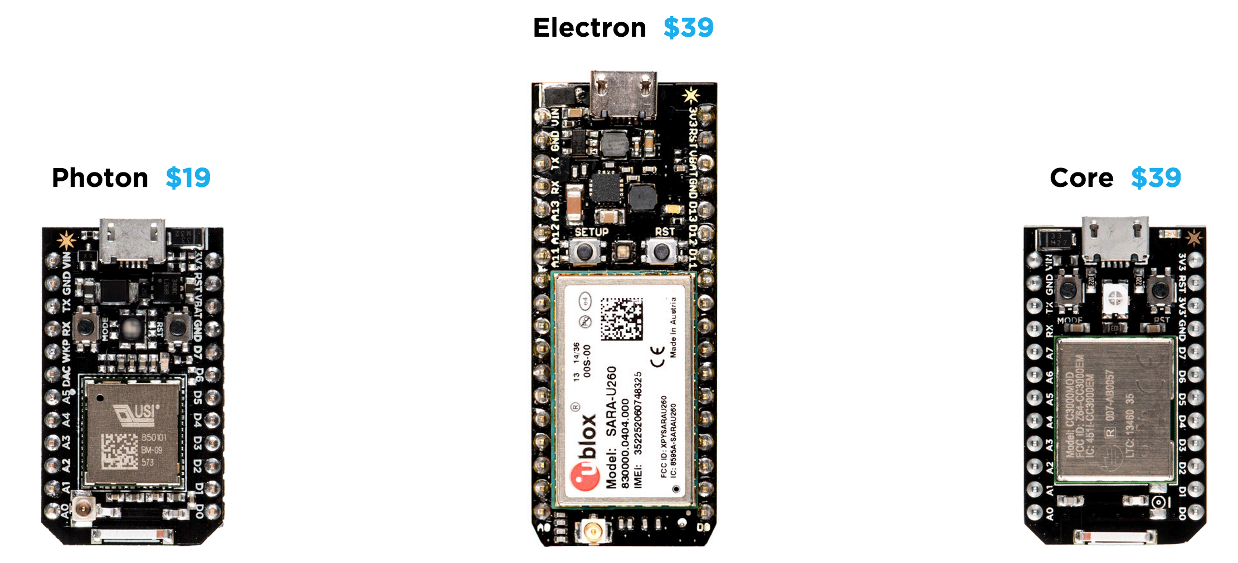
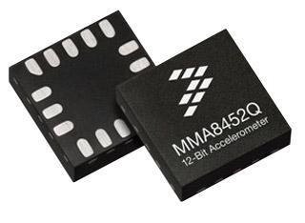
Components
Notes:
Modularity and cost! Many MEMS devices have fallen by an order of magnitude or more in the last 10 years. Small LCD panels like the ones used in inexpensive mobile phones have gotten 35% cheaper just in the last year. http://press.ihs.com/press-release/technology/smartphone-panel-prices-fall-panel-makers-focus-cost-reduction-ihs-says. Plus: Particle

Slide 9
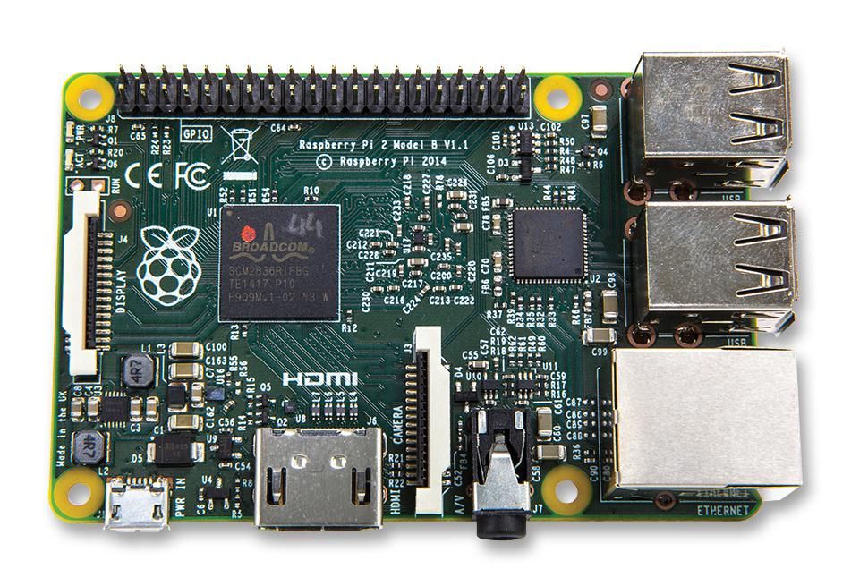
Processors and Programming

Slide 10
Fundraising and expertise

Slide 11
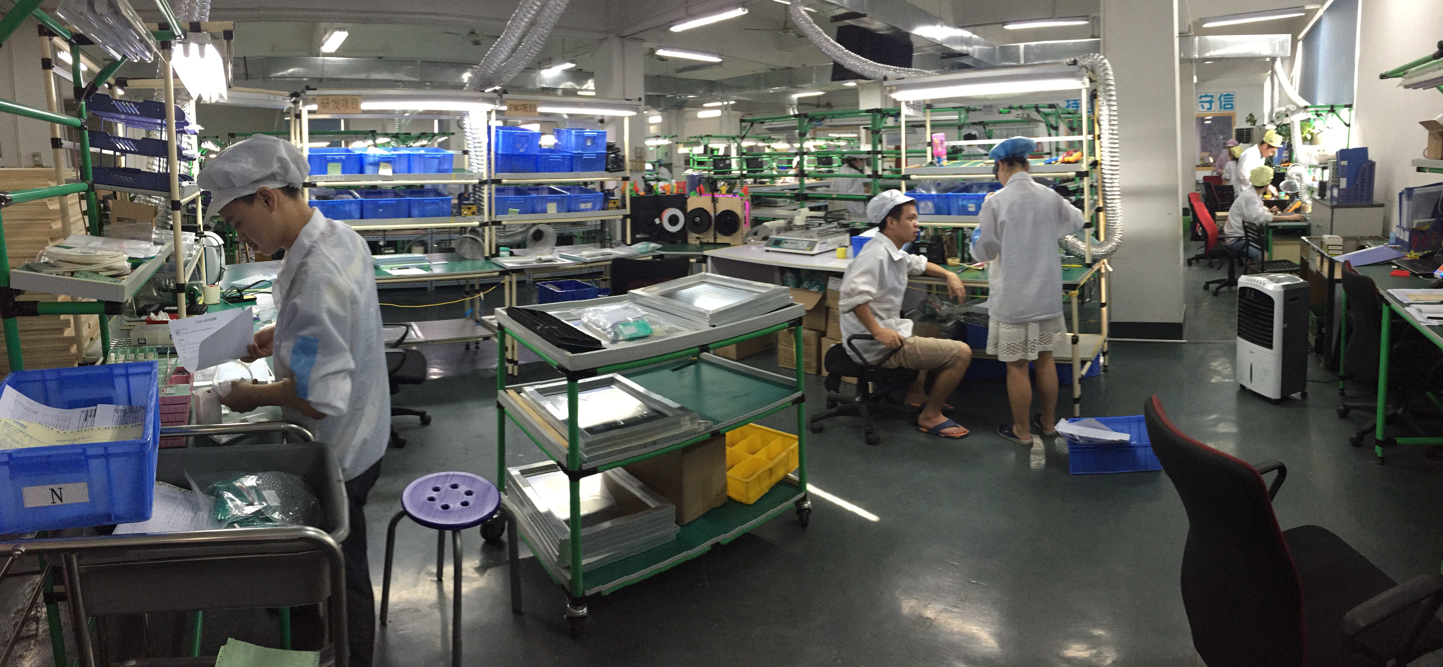
Manufacturing
Photo: David Cranor
Notes:
Shenzhen
PCH
Seeed
Also digital manufacturing:
ReFactory
Plethora
Tempo
Protomold

Slide 12
Marketing

Slide 14
“Mr. Frankel…began to suffer from the computer disease that anybody who works with computers now knows about,” [Richard] Feynman later explained.
“The trouble with computers is you play with them.”
—George Dyson, Turing’s Cathedral

Slide 15
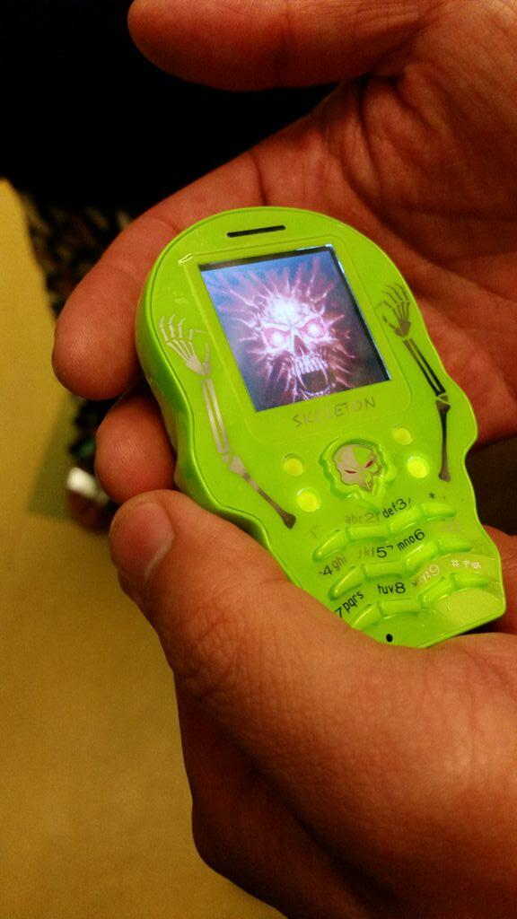
Photos: Rachel Kalmar

Slide 16
Notes:
In my view, the story of the new hardware movement begins with an earlier movement that’s strictly grounded in software.
Cloud makes ingestion, analysis, and storage incredibly cheap. Now you can keep and analyze any data, and capture data that used to be infeasible. Feeds into a long-time management mantra to instrument, measure, and optimize.
HBR October 2012
HBR November 2014

Slide 18
Every company is a “tech” company now.
Notes:
The scope of this hardware movement is such that software ideas, software mentalities, software approaches are no longer restricted to the virtual world. Grand unification of companies that deal with physical stuff and companies that deal with virtual stuff.

Slide 19
“Work on stuff that matters.”
—Tim O’Reilly
Notes:
Everyone is an engineer of his or her own world.

Slide 20
Thank you
@JonBruner

