Slide 1
Internet of Things (IoT) Cornerstones of Security
Brian Witten
June 25, 2015
© Symantec Corporation
Notes:
40 min talk, 5:25pm to 6:05pm (30min talk; 10 min Q&A)
Thank you for coming! In this last half hour of the conference,
I’ll not only be telling you True stories of
-- Hospitals breached by their medical devices
-- and steel factories damaged by cyber attacks
But I’ll also try to sketch a simpler path forward for Security.
Also, since credibility is important,
I should mention that we recently crossed a milestone and
… we’ve now protected more than a BILLION IoT Devices,
…actually 1.3 Billion (with a B) and counting as of March.
…embedding Security into industrial systems, consumer electronics
…smart meters, set top boxes, GSMA base stations, and more.

Slide 2
IoT will better our lives in countless ways.
Sampling from countless examples…
Digital Health
Connected Car
Digital Factory
Today
20 Billion Microcontrollers (MCU) Per Year
2020
20 Billion to 50 Billion CONNECTED Devices
© Symantec Corporation
Notes:
We’re doing this in part because we believe, like many of you
…smart connected “things” will better our lives in countless ways.
Many of our cars already stream satellite navigation,
…and some even have semi-autonomous control such as lane following.
Many of us already wear fitness bands,
…and we’ve seen pictures of a contact lens that can measure your blood glucose without pricking your finger
And in the Industrial Internet, 1% savings in areas like jet fuel, quickly translate to multi-billion dollar improvements.
Many people dismiss the projections of billions of devices, but fail to realize that the market already has billions of devices.
20 Billion “smart” (microcontroller based) devices already enter the market every year. What’s different as the clock rolls forward?
These devices are becoming (internet) connected as ubiquitous wireless access becomes pervasive –
- and it’s this “connectivity” that presents the opportunities for aggressors to wreak havoc with everyone’s systems
…as the Internet get’s physical and “tangible” all around us.

Slide 3
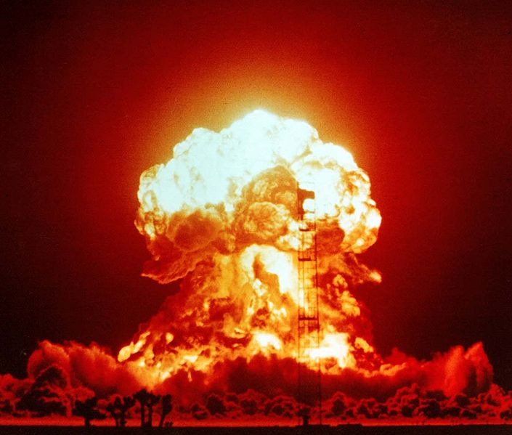
Why Care?
Pipeline
Explosions
Steel Mill
Blast Furnace
Cars Stolen
People Stalked
Hospitals Breached
via Medical Devices
Notes:
This slide isn’t about things that “could” happen, it’s about things that have happened,
…including (believe it or not) a three kiloton pipeline explosion, much older than the
…2014 realization that a 2008 pipeline (in Turkey) was caused by a cyber attack.
In December of 2014 the blast furnace of a steel mill was damaged by an attack
…that went through a gateway from “IT” networks to plant/production floor “operational” systems.
Earlier this month a security firm disclosed that Three hospitals had been
…breached through vulnerabilities in their medical devices.
…These devices ranged from MRI machines to Blood Gas Analyzers.
Another security professional saw an MRI machine crash from a simple port-scan.
…an MRI machine accessible from Guest Wifi, where anyone could’ve crashed the machine.
Many people have seen videos of the “backseat laptop” hitting the brakes on a moving car.
…More recently others demonstrated “hitting the brakes” via wireless attack, and
…some of the attack vectors work over the cell network for millions of cars.
It doesn’t take much imagination to imagine bad outcomes from thousands of cars
…suddenly hitting the brakes without warning during rush hour.
Still, fortunately we haven’t yet seen THOSE automotive attacks impacting average consumers.
INSTEAD, we’ve seen different automotive attacks. Specifically, mistakes in IoT security
…have led thieves to steal rashes of cars through weaknesses in keyless entry systems.
>>> Mistakes in IoT Security for Wearables have also enabled stalkers to track potential victims,
…and surprisingly such mistakes are not rare. Most fitness wearables accidentally enable such stalking.
These are just a few examples. I could spend an hour walking through countless examples like these,
…including stunning mistakes in security of home automation and home “security” systems that aren’t.
But I’m here to sketch a path forward.
I should say that all of these examples have links to supporting material in speaker notes of the slides, online for download,
…but regarding the older pipeline example mentioned earlier…
…in 1982 tampered pump/turbine control software caused a 3 kiloton explosion in the Trans-Siberian pipeline;
…and that was before we had billions of microcontrollers. I’m not sure we’ll ever have a 35 kiloton “nuclear” event, like the picture,
…but as the internet gets physical, and tangible, all around us, haven’t we come close enough? Let’s focus on a path forward.
http://www.symantec.com/connect/blogs/how-safe-your-quantified-self-tracking-monitoring-and-wearable-tech
http://www.symantec.com/connect/blogs/iot-smart-home-giving-away-keys-your-kingdom
http://blog.iiconsortium.org/2014/12/top-10-iot-security-mishaps-2014-.html
https://www.linkedin.com/pulse/could-hacker-steal-your-car-iot-security-gets-personal-brian-witten
symc.ly/1eTkjer
https://twitter.com/chriseng/status/610412829405941760
(1953 image, courtesy of US Government)
Federal Government of the United States - This image is available from the National Nuclear Security Administration Nevada Site Office Photo Library under number XX-34.
The BADGER explosion on April 18, 1953, as part of Operation Upshot-Knothole, at the Nevada Test Site.
https://en.wikipedia.org/wiki/National_Response_Scenario_Number_One#/media/File:Operation_Upshot-Knothole_-_Badger_001.jpg
This work is in the public domain in the United States because it is a work prepared by an officer or employee of the United States Government
as part of that person’s official duties under the terms of Title 17, Chapter 1, Section 105 of the US Code.

Slide 4
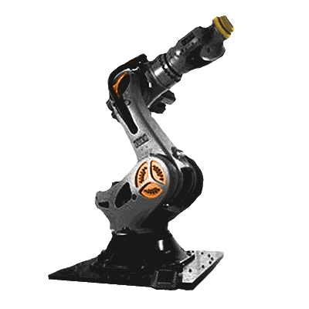
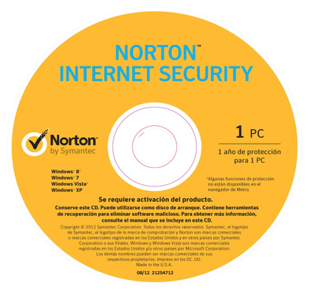
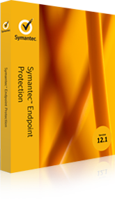
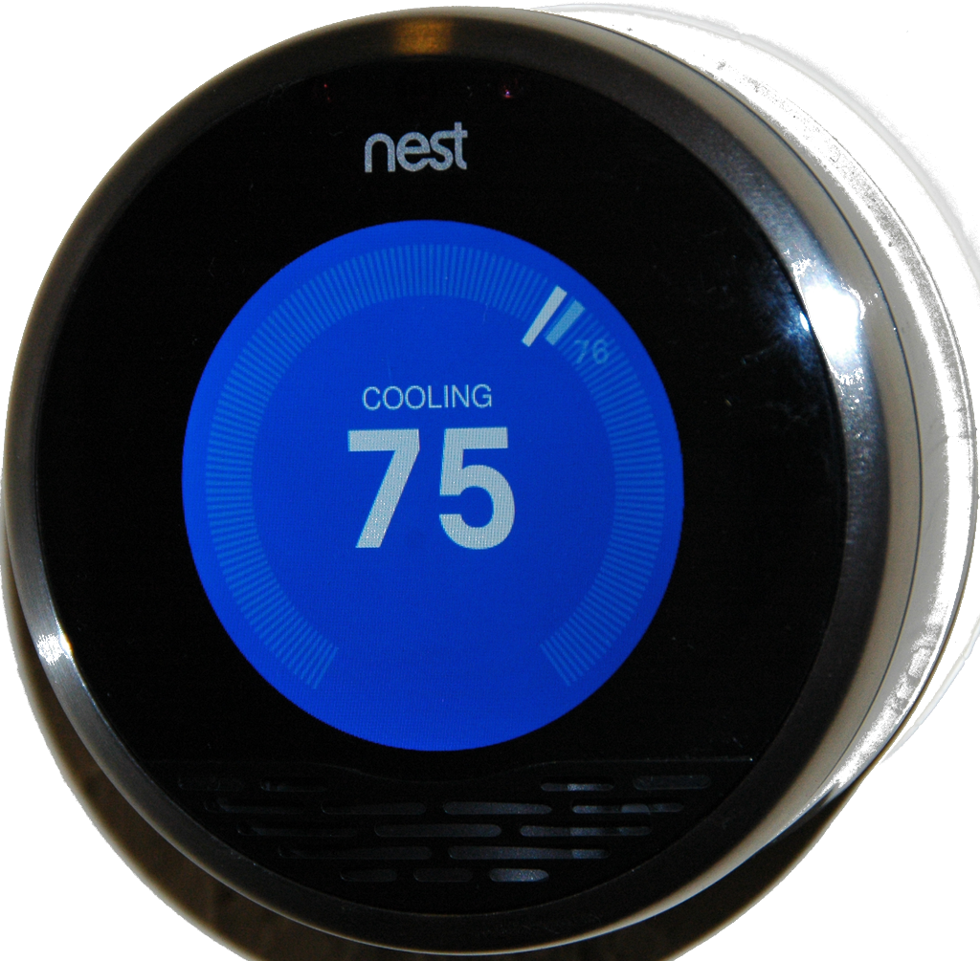
If basics like encryption and intrusions haven’t changed …what is the big difference?
Extrinsic Security
Add-On Security
Intrinsic Security
Security by Design
PC / Datacenter Era
Security “Bolted-On” to laptops, desktop PC, servers and IT networks long after manufacture
IoT / Cloud Era
Security must be “Built-In” to the devices and cloud services, not deferred to be added later
© Symantec Corporation
Notes:
Fortunately, many of the primitives in security remain the same, but before we dive into them, It’s important to note “what’s different.”
In PC/datacenter era, equipment vendors could “defer” security for someone to add later.
-- firewall and antivirus vendors were more than happy to “add” security later,
-- bolting such security onto corporate networks, laptops, desktops, servers and the like.
In the IoT era, the equipment vendor (and cloud providers) must integrate the security themselves…
-- this means that companies who could previously ignore security, can’t safely ignore it any longer
-- it also means that those of us in the security industry, need to make security easy to “embed” into countless products (and services)
Of course, … when these devices were “standalone,” who cared about security? …almost nobody.
However, as we connect them, the risks of course go off the charts.
…With with the ubiquity of mobile devices, and thumbnail sized 32GB SD cards,
…experts now rightly relegate the notion of (effective) “air gaps” to ancient myth.
Of course, strong separation of networks should be used whenever and wherever possible,
…but it’d be foolish to think adversaries won’t find toeholds on protected sides of such “gaps.”
We’ve literally seen pipelines explode and blast furnaces damaged from that kind of thinking.
…if your system does anything Valuable, or can misused to do harm in any way: it needs to be Secure By Design.
https://en.wikipedia.org/wiki/Nest_Labs#/media/File:Nest_front_official.png (public domain)
http://opensourceecology.org/wiki/File:Industrial_Robot.png (creative commons CC BY-SA4.0 license)
http://www.symantec.com/connect/blogs/mind-gap-are-air-gapped-systems-safe-breaches

Slide 5
What else is different?
IT |  | IoT
“Open” Easy to install | Openness | “Closed” Not open to new software after device leaves factory
“3” (Mostly UDP, TCP, IP) | Protocols | Thousands of Protocols (Hundreds in each vertical)
“5” (Mostly Windows, Linux, OSX, iOS, Android) | Operating Systems (OS) | Dozens (Heavily fragmented by vertical)
20k seat enterprise (Typical Enterprise) | Scale | 100M “things” (Typical Car Maker)
All verticals have same Hardware/OS supply chain | Fragmentation | Each verticals has different Hardware/OS supply chain
“2” X86 and x64 by Intel and AMD | Chipset Architectures | Many 8bit AVR,16bit MCU,32/64bit ARM,x86/64;12+vendors
© Symantec Corporation
Notes:
However, the guidelines for “secure by design” need to be given in a realistic context.
…IoT is very different from traditional “Information Technology,” “IT.”
Both use Open Source extensively these days,
…but IoT products often reach customers much more “closed”
…where modification of the device voids warranty.
Such warranties can be “pesky” things on a home thermostat…
But for capitalized smart _industrial_ systems worth hundreds of thousands of dollars,
…or constrained by FDA regulations (such as medical devices),
…”customers doing mods themselves” simply isn’t a realistic option.
…Security must be baked in by the vendors building and selling the devices.
Of course, the differences between IT and IoT don’t end there.
…IT rides mostly on three mid layer protocols.
…Industrial systems have thousands with their own frame formats, clocking mechanisms, and the like.
Operating Systems are similarly fragmented, but scale is the part that I really enjoy.
…A few of us have built consumer facing cloud based services that serve hundreds of millions of customers,
…and we know firsthand how radically different that is from an IT shop serving just tens or even hundreds of thousands of employees.
Further complicating the degree to which the hardware supply chains and architectures differ so radically
…from 8-bit, 8 MHz chips to 32 and even 64 bit GHz speed ARM chips embedded in some wearables;
…security capabilities of these devices vary dramatically, and so do their “hardware backed” security capabilities.
With all of these challenges, it’s no wonder that a Security Reference Architecture for simplifying those challenges has been slow in coming.

Slide 6
IoT Security Reference Architecture
Cornerstones of Security for the Internet of Things (IoT)
Manage Devices
Understand Your System
Cloud/Data Center
Cloud/Data Center
Gateway
Gateway
Devices
& Sensors
Devices
& Sensors
Protect the Device
Protect the Communications
© Symantec Corporation

Slide 7
Protecting Communications
Embedded Software
Protect the Communications
Operating Systems
Required: Authentication
Helpful, but not always required: Encryption
Increasingly Common: Sign data “object” on capture
to avoid burden of decrypt/re-encrypt for every link/hop
Devices
& Sensors
Hardware
Advantages of Professional
Certificate Authorities
What’s needed?
Crypto Libraries
For Authentication
And/Or Encryption:
Several good open-source and commercial options
(Newer “ECC” runs 10x faster than older RSA)
Revoking Expired / Stolen Credentials
Easier to Enroll IoT Devices
Certificates:
Because of the risks & limits of self-signed “certs,”
more than a Billion IoT devices embed certficates
chained to a world class Certificate Authority (CA)
Easier factory provisioning
World class physical security protecting
your roots of trust & private keys
Roots of Trust:
Will your devices talk to devices outside your control?
IoT “Roots of Trust” can help decide which to trust.
Scalable, time-proven infrastructure & processes
© Symantec Corporation
Notes:
For the same level of security, “elliptic curve crypto” (aka ECC) runs ten times faster than traditional RSA crypto.
Standards supported by Professional Certificate Authorities (CA):
Revocation:
-- OCSP: Online Certificate Status Protocol
-- CRL: Certificate Revocation List
Enrollment:
-- EST: Enrollment over Secure Transport
-- SCEP: Simple Certificate Enrollment Protocol

Slide 8
Elliptic Curve Cryptography (ECC) Digital Signature Algorithm (DSA) Performance Results on Arduino Devices Ranging from 8 Mhz to 84 Mhz
ATmega256RFR2 (16Mhz)
Extremely “limited” devices
can’t do meaningful security
Reality
Myth
ECDSA (fast) | secp256r1 | secp256k1
ECDSA sign time (ms): | 2386 | 1773
ECDSA verify time (ms): | 2650 | 1800
Code size (bytes): | 22594 | 22826
Even 8bit, 8Mhz, 32k flash (2k SRAM) devices can
can do ECC 256, effectively strong as RSA-2048,
with ECC implementations under 7k flash
ATmega328 (8 Mhz) with nano-ECC
Copyright © 2014, Kenneth Mackay
All rights reserved. Redistribution and use in source and binary forms, with or without modification, are permitted provided that the following conditions are met: * Redistributions of source code must retain the above copyright notice, this list of conditions and the following disclaimer. * Redistributions in binary form must reproduce the above copyright notice, this list of conditions and the following disclaimer in the documentation and/or other materials provided with the distribution. THIS SOFTWARE IS PROVIDED BY THE COPYRIGHT HOLDERS AND CONTRIBUTORS "AS IS" AND ANY EXPRESS OR IMPLIED WARRANTIES, INCLUDING, BUT NOT LIMITED TO, THE IMPLIED WARRANTIES OF MERCHANTABILITY AND FITNESS FOR A PARTICULAR PURPOSE ARE DISCLAIMED. IN NO EVENT SHALL THE COPYRIGHT HOLDER OR CONTRIBUTORS BE LIABLE FOR ANY DIRECT, INDIRECT, INCIDENTAL, SPECIAL, EXEMPLARY, OR CONSEQUENTIAL DAMAGES (INCLUDING, BUT NOT LIMITED TO, PROCUREMENT OF SUBSTITUTE GOODS OR SERVICES; LOSS OF USE, DATA, OR PROFITS; OR BUSINESS INTERRUPTION) HOWEVER CAUSED AND ON ANY THEORY OF LIABILITY, WHETHER IN CONTRACT, STRICT LIABILITY, OR TORT (INCLUDING NEGLIGENCE OR OTHERWISE) ARISING IN ANY WAY OUT OF THE USE OF THIS SOFTWARE, EVEN IF ADVISED OF THE POSSIBILITY OF SUCH DAMAGE.
ECDSA (256) signing: | 20,520 ms ~ 14 Milijoules
ECDSA (256) verification: | 24,198 ms ~ 16 Millijoules
ECDSA (small) | secp256r1 | secp256k1
ECDSA sign time (ms): | 4998 | 4904
ECDSA verify time (ms): | 5700 | 5220
Code size (bytes): | 6980 | 5080
ARM M3 (84 Mhz) with kmackay “fast” micro-ECC
ECDSA (256) signing: | 114 ms ~ 57 Millijoules
ECDSA (256) verification: | 142 ms ~ 70 Millijoules
(Experiments by Ming Pei & Jason Baker)
Note: “fast” is under 23 Millijoules to verify
© Symantec Corporation
Notes:
Note: AA batteries commonly store 9,000 Joules each
…AA battery could sign hourly messages every day for two decades, using nearly but less than 30% of the battery.
From datasheets and other publicly available material:
ATmega256RFR2 is 4.7 mA (TRX off) @ 1.8v x 2.650seconds = 22.8 mJ
ATmega328 is 0.2mA @ 3.3v x 24.2 seconds = 16 milli-Joules
ARM Cortex-M3 (84 Mhz) Atmel SAM3X8E, 150 milliAmps x 3.3 volts x 142 ms
Specific ARM M3: Arduino Due
…ARM cortex M0+ looks to be roughly 10x more battery efficient (from published DMIPS & uWatt per Mhz)
For Micro-ECC Results on ATmega256RFR2:
Copyright (c) 2014, Kenneth MacKay All rights reserved. Redistribution and use in source and binary forms, with or without modification, are permitted provided that the following conditions are met: * Redistributions of source code must retain the above copyright notice, this list of conditions and the following disclaimer. * Redistributions in binary form must reproduce the above copyright notice, this list of conditions and the following disclaimer in the documentation and/or other materials provided with the distribution. THIS SOFTWARE IS PROVIDED BY THE COPYRIGHT HOLDERS AND CONTRIBUTORS "AS IS" AND ANY EXPRESS OR IMPLIED WARRANTIES, INCLUDING, BUT NOT LIMITED TO, THE IMPLIED WARRANTIES OF MERCHANTABILITY AND FITNESS FOR A PARTICULAR PURPOSE ARE DISCLAIMED. IN NO EVENT SHALL THE COPYRIGHT HOLDER OR CONTRIBUTORS BE LIABLE FOR ANY DIRECT, INDIRECT, INCIDENTAL, SPECIAL, EXEMPLARY, OR CONSEQUENTIAL DAMAGES (INCLUDING, BUT NOT LIMITED TO, PROCUREMENT OF SUBSTITUTE GOODS OR SERVICES; LOSS OF USE, DATA, OR PROFITS; OR BUSINESS INTERRUPTION) HOWEVER CAUSED AND ON ANY THEORY OF LIABILITY, WHETHER IN CONTRACT, STRICT LIABILITY, OR TORT (INCLUDING NEGLIGENCE OR OTHERWISE) ARISING IN ANY WAY OUT OF THE USE OF THIS SOFTWARE, EVEN IF ADVISED OF THE POSSIBILITY OF SUCH DAMAGE.

Slide 9
Protecting the Device
Fundamentals of IoT Device Security
Never run unsigned code.
Never trust unsigned configuration data.
Never trust unsigned data. (Period.)
Run host-based security on each device.
Code Signing:
Protect the Code that Drives IoT
Always sign settings & data if persisted locally!
Effective Host Based Security
Must continue to provide security even when disconnected from
any servers and/or cloud based services.
Should lock the system down against suspicious behavior.
Should prevent malicious data on all network interfaces.
Should tightly fit each unique target system, leveraging a mix of
policy based, behavior based, content based, and reputation based
protections engineered to provide best fit for the unique system.
Should be updated whenever the host gets new functionality.
Wherever possible, collect security telemetry on device health,
including hardware backed attestation of configuration.
G. Settings
Persistent Storage
(if present)
D. Primary App
D. Primary App
F. Network Monitor
G. Settings
E. OpenSSL
F. Network Monitor
E. OpenSSL
D. Primary App
F. Network Monitor
C. Operating System
C. Operating System
E. OpenSSL
B. Network Stack
B. Network Stack
B. Network Stack
A. Device Drivers
A. Device Drivers
A. Device Drivers
Platform & binaries can be signed monolithically or individually.
© Symantec Corporation
Notes:
Never run unsigned code.
This includes need for secure boot.
Also, any higher level code must be signed, either separately or
as part of a monolithic whole “image” with or without an OS.
Leverage “hardware backed” secure boot wherever possible.
Never trust unsigned configuration data.
Weak configurations are exploited just as easily as vulnerable code.
Tampered configurations are exploited even more easily.
Never trust unsigned data.
Sign all data at time of capture.
Compute is only as clean as the inputs.
Garbage in, garbage out. Tampering inputs tampers behavior.

Slide 10
IoT Security Reference Architecture
Cornerstones of Security for the Internet of Things (IoT)
Manage Devices
Understand Your System
Safely & Effectively Managing IoT
Effective Host Based Protection for IoT
A Strong Trust Model for IoT
Protect the Code that Drives IoT
Protect the Device
Protect the Communications
© Symantec Corporation

Slide 11
IoT Security: Safely & Effectively Managing IoT Devices
Why update devices?
Industrial Systems
19 years on average
…
3 days
Average Time Between Vulnerability Discovery (Linux)
Manual Patching? More than 2,000 times? Ridiculous.
Updates must be done Over The Air (OTA)
Devices must build-in OTA update capabilities, from the beginning.
Updates Must Be Granular
Good Management: Not Just Updates
Telemetry & Normal Control
Software Inventory & Updates
Configuration Changes
New Functionality & Patches
Security Telemetry & Content
Diagnostics & Remediation
Network Access Control (NAC) Credentials/Permissions, Policies
2,000 x
=
200 x
=
Monolithic Updates Kill Batteries
© Symantec Corporation
Notes:
All devices ship with vulnerabilities
-- Industrial devices average 19 years in the field
-- Physically touching each device can be incredibly expensive,
-- especially if it involves a fleet of trucks to reach each device.
If we take industrial systems running Linux as an example, we’re on pace to discover more than 2,000 vulnerabilities over the next 19 years. (For context, in 1991, roughly 24 years ago, Linus Torvalds began what became the Linux kernel. 19 years is a long time for any system.)
For smaller systems, these are more readily reverse engineered so that vulnerabilities can be discovered yet more quickly.
Even with state of the art “code obfuscation” to slow the reverse engineering, such systems can be reverse engineered in weeks.
That’s still a few hundred patch cycles over the course of an industrial system’s lifetime. Perhaps more importantly, if the vulnerabilities aren’t being Publicly discovered and disclosed, then that just means that the adversaries are (very privately/quietly) finding them to use, and perhaps using them, not telling anyone.
Such management frameworks can be used many ways:
Collect software inventory, security telemetry, general telemetry
Push security updates, new functionality, configuration changes
Remote diagnostics and remediation
Managing Network Access Control (NAC) credentials, permissions, and security policies in general
Public domain images from:
http://www.clker.com/clipart-rip-tombstone.html
http://www.clker.com/clipart-145760.html
http://cliparts.co/clipart/3346476

Slide 12
Understanding Your System
IoT Security Analytics for Advanced Threats
No matter how well you do everything else, some threats will still get past even the best defenses.
Whether you’re protecting a manufacturing plant, CAN bus, power generation, or pipeline, detecting such threats requires strong understanding of what your network “should” be doing.
Fortunately, machine learning (ML) in big data analytics can distill models of “normal” operations to be run in compact Single Board Computers (SBC) for detecting anomalies.
In fact, some ML techniques can even do the “learning” in resource constrained gateways and small Single Board Computers (SBC). Others leverage telemetry from millions of gateways and devices.
Such IoT Security Analytics are crucial in finding advanced threats.
© Symantec Corporation

Slide 13
Knowing What To Trust
Managing Your Risk in Interfaces to “Other” Systems
Security Service Providers
Other Systems
Regarding the other system,
Is it safe to connect?
How do devices “know what to trust?”
How will your cloud? It helps to know
the safety/risk in connecting to other
devices/systems before connecting…
Reputation Services
Security Status Protocols
Your System
© Symantec Corporation
Notes:
IP-Reputation Services (Device Reputation Services)
Security Status Protocols:
-- OCSP
-- …plus other protocols coming 8^)

Slide 14
IoT Security Reference Architecture
Cornerstones of Security for the Internet of Things (IoT)
Manage Devices
Understand Your System
Know What To Trust
IoT Security Analytics for Advanced Threats
Safely & Effectively Managing IoT
Effective Host Based Protection for IoT
A Strong Trust Model for IoT
Protect the Code that Drives IoT
Protect the Device
Protect the Communications
© Symantec Corporation

Slide 15
IoT Security Reference Architecture
Cornerstones of Security for the Internet of Things (IoT)
Manage Devices
Understand Your System
Know What To Trust
Coming Soon
Coming Soon
Coming Soon
IoT Security Analytics for Advanced Threats
Safely & Effectively Managing IoT
Embedded Security for
Critical Systems
Released 2015, many top tier
Industrial and Automotive
customers already signed.
Effective Host Based Protection for IoT
A Strong Trust Model for IoT
IoT Roots of Trust
Released 2015, many top tier
Chipmakers and Crypto
partners already signed.
1.3 B IoT Devices Embed Symantec Device Certificates
Protect the Code that Drives IoT
Symantec Code Signing Services
Backed by an industry leading Certificate Authority
Protect the Device
Protect the Communications
© Symantec Corporation

Slide 16
Brian Witten
For more reading…
“How safe is your quantified self”
“Insecurity in the Internet of Things”
https://www.linkedin.com/in/bwitten
bwitten@symantec.com
www.symantec.com/iot
© Symantec Corporation

Slide 17
…
Medical Devices
Industrial Controls
Automotive Systems
Consumer Electronics
Teller Machines
…
Embeds Security in

Slide 19
Appendix

Slide 20
IoT security cornerstones
Manage Devices
Understand Your System
Protect the Device
Protect the Communications
© Symantec Corporation

