Slide 1
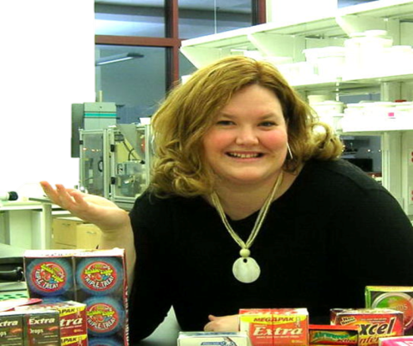
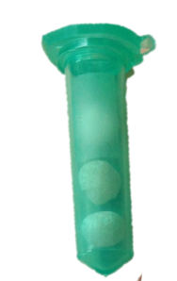
How We TASTE ‘A Brain Teaser’
Gwendolyn Graff
Creativity Fellow

Slide 2
Flavor Experience
Several factors create the flavor experience
Relative Effect on Flavor Experience
Flavor Experience
=
Taste

Slide 3
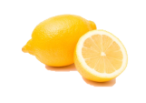
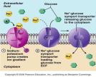
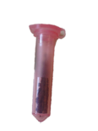
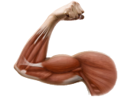
5 Tastes
¹Sweet
¹Sweet
²Sour
²Sour
³Salty
³Salty
⁴Bitter
⁴Bitter
⁵Umami
⁵Umami

Slide 4
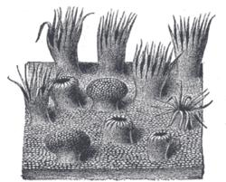
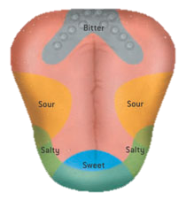
Tongue

Slide 5
Taste Buds

Slide 6
Papillae

Slide 7
Flavor Experience
Several factors create the flavor experience
Relative Effect on Flavor Experience
Flavor Experience
=
Taste
Sweet
Sour
Salt
Bitter
Umami

Slide 8
Cranial Nerves

Slide 9
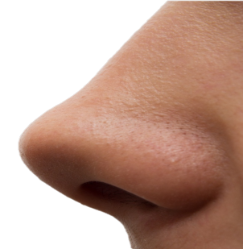
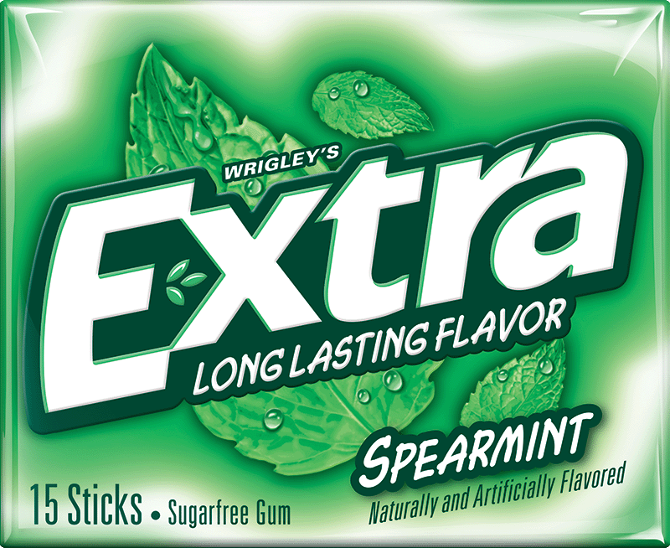
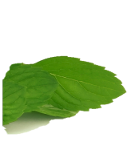
What does it taste like?

Slide 10
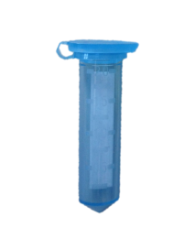
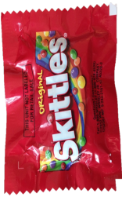
Flavor Experience
Several factors create the flavor experience
Relative Effect on Flavor Experience
Flavor Experience
=
Taste
+
Aroma
Sweet
Sour
Salt
Bitter
Umami
Mints
Fruits
Herbals

Slide 11
Cranial Nerves

Slide 12
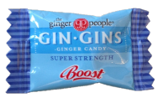
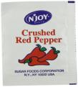
Flavor Experience
Several factors create the flavor experience
Relative Effect on Flavor Experience
Flavor Experience
=
Taste
+
Aroma
+
Trig.
Sweet
Sour
Salt
Bitter
Umami
Mints
Fruits
Herbals
Tingle
Warming
Cooling

Slide 13
Cranial Nerves

Slide 14
Flavor Experience
Several factors create the flavor experience
Relative Effect on Flavor Experience
Flavor Experience
=
Taste
+
Aroma
+
Trig.
+
Color
+
Texture
Sweet
Sour
Salt
Bitter
Umami
Mints
Fruits
Herbals
Tingle
Warming
Cooling

Slide 15
Cranial Nerves

Slide 16
Cranial Nerves

Slide 17
Cranial Nerves

Slide 18
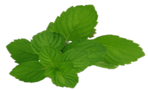
Flavor Experience
Several factors create the flavor experience
Relative Effect on Flavor Experience
Flavor Experience
=
Taste
+
Aroma
+
Trig.
+
Color
+
Texture
Sweet
Sour
Salt
Bitter
Umami
Mints
Fruits
Herbals
Tingle
Warming
Cooling

