Slide 1

Velocity
“Performance Engineering:
We the people have spoken”
Todd DeCapua
@AppPerfEng

Slide 2
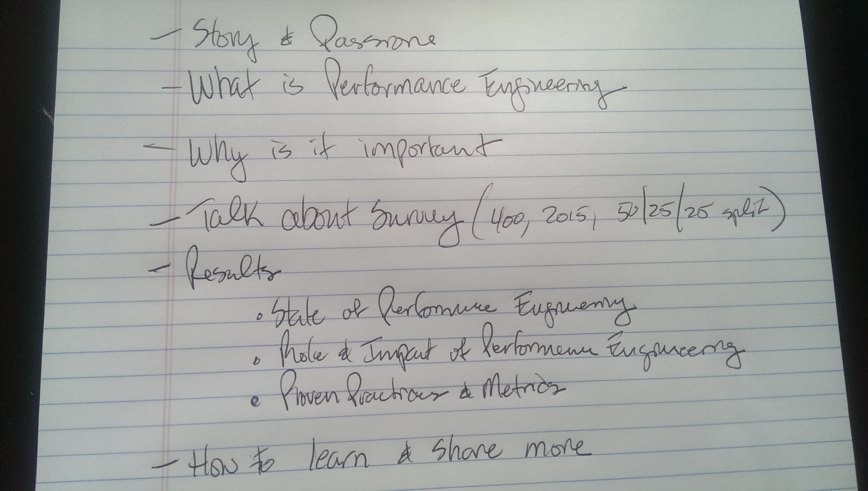

Slide 3

What is Performance Engineering
Continuous
Built-in
Predictive

Slide 4

Why is Performance Engineering important
Brand
Revenue
Customer
Competitive

Slide 5
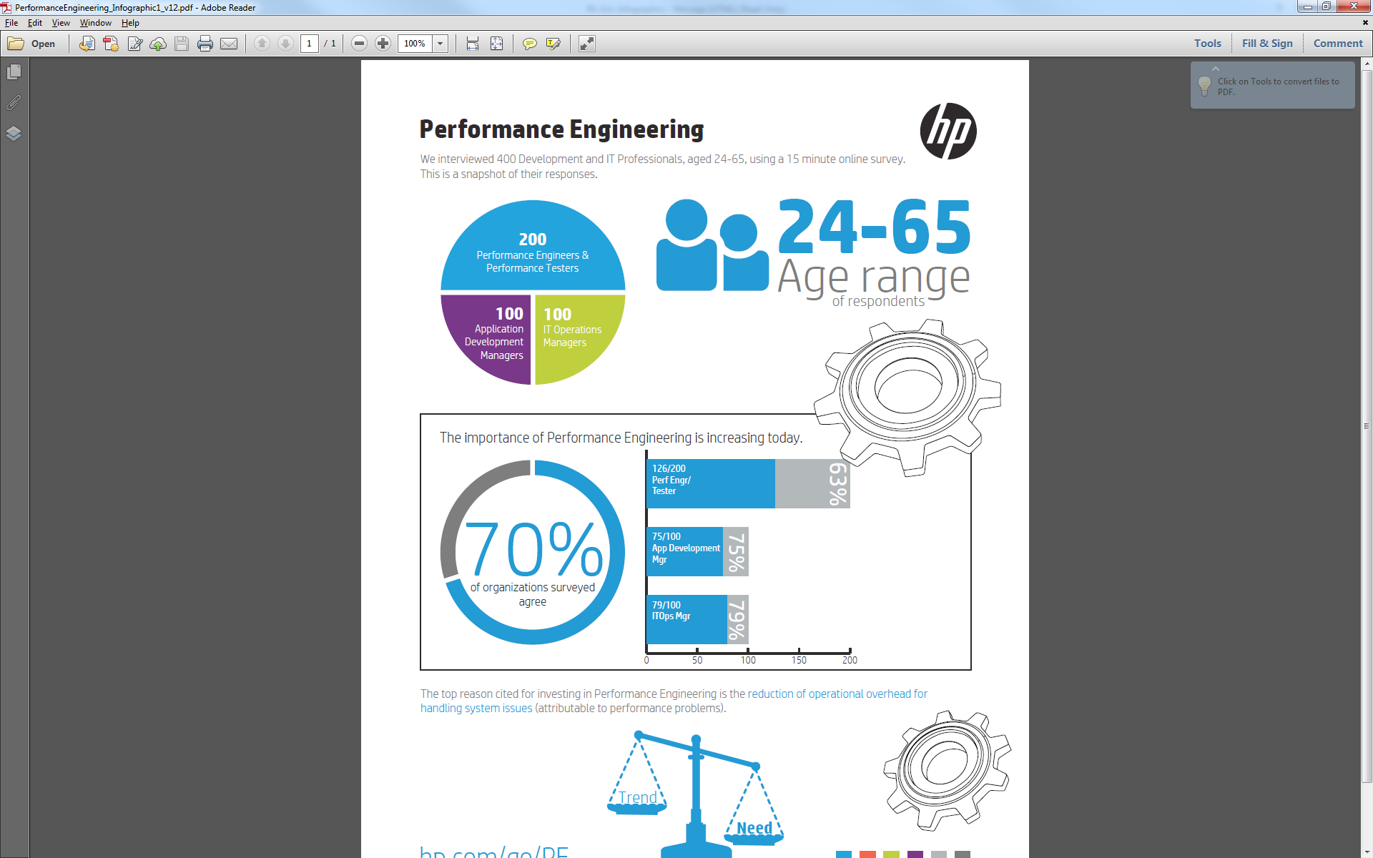
We the people have spoken
-Overview-
2015
US
400
Split
  50% PT or PE
  25% VP Apps
  25% VP Opps
A Lot of results
Some key themes and trends

Slide 6
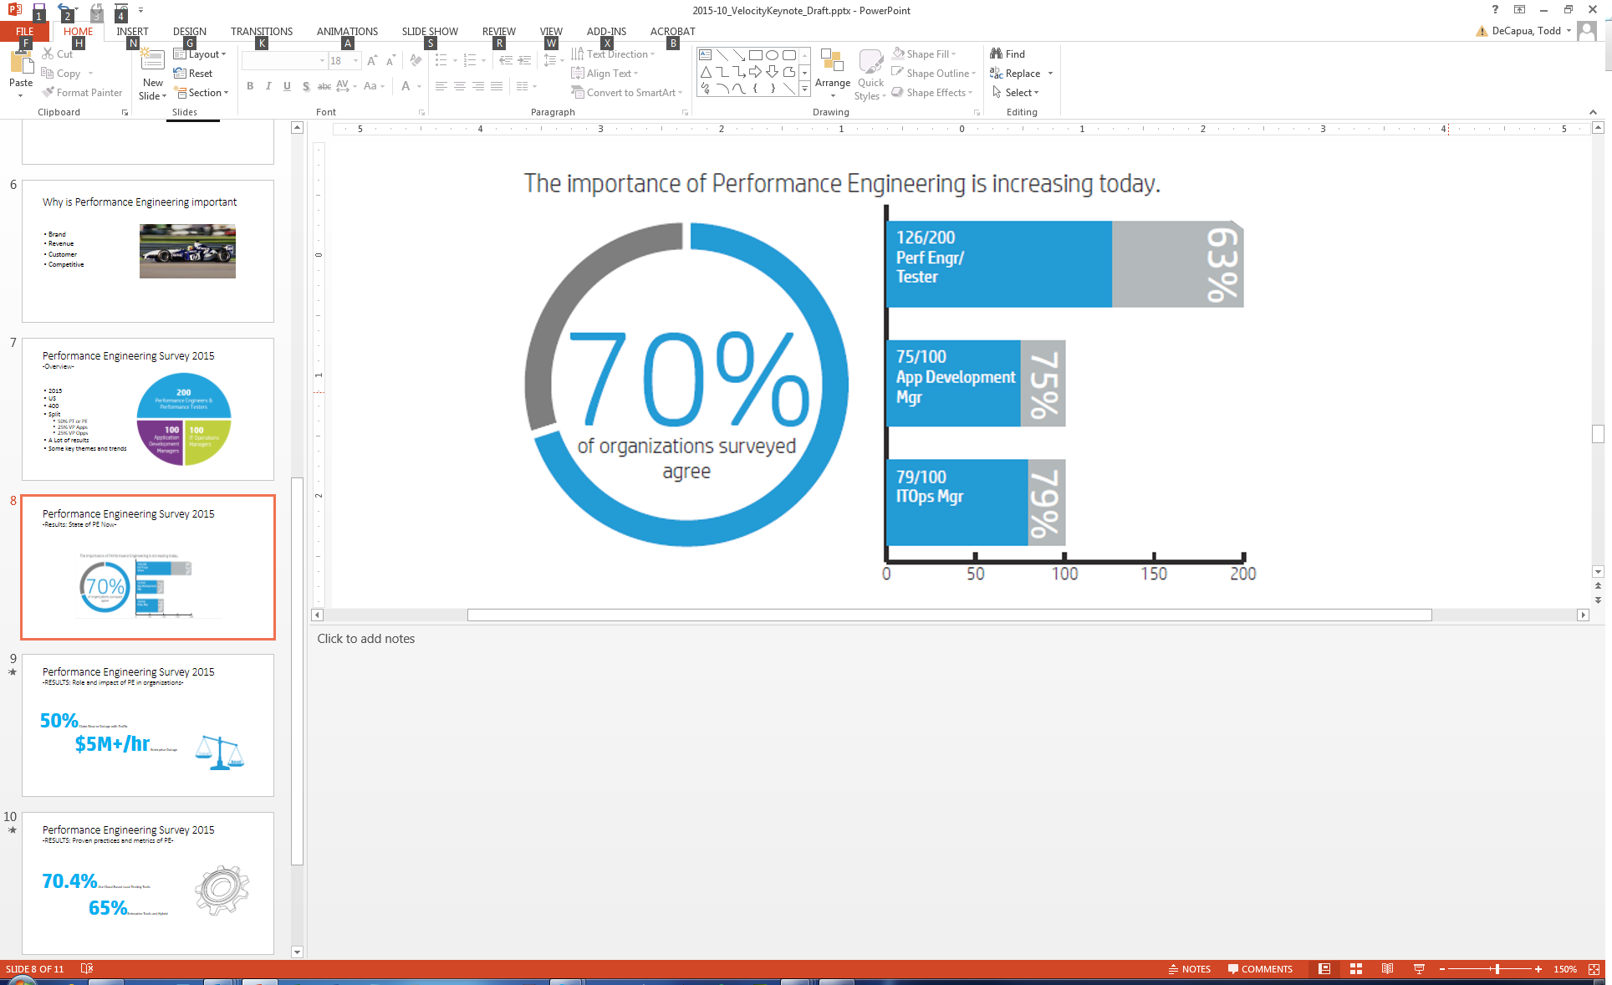
We the people have spoken
-Results: State of PE Now-
Notes:
How this number affect the way that I work and deliver apps?

Slide 7
We the people have spoken
-RESULTS: Role and impact of PE in organizations-
50%
$5M+/hr
Notes:
50% of the respondents claimed with traffic, their applications suffer significant Slowness or Outages.
Respondents told us an Enterprise Outage costs them $5M+ per hour.
How that impact my job?

Slide 8

We the people have spoken
-RESULTS: Proven practices and metrics of PE-
>70%
65%
Notes:
>70% said they use cloud based load testing tools
65% said they use Enterprise Tools and Hybrid
What do I do with this numbers?

Slide 9

We the people have spoken
So What?
Not a fantasy
The future is now
Design for speed
The people have spoken
WE the people
Do something about it
Notes:
Only for those who do not watch live

Slide 10


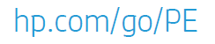

We the people have spoken
-How to start, and Learn more-
Survey Summary: Performance Engineering 2015
Book: Performance Engineering proven practices
bit.ly/RunTestNow
hp.com/go/PE
TechBeacon.com
@AppPerfEng
bit.ly/RunTestNow

