Slide 1
Todd Conklin
PreAccident Podcast

Slide 2
Human Performance Highly Reliable Organizations
Todd Conklin PhD
Human Performance Improvement/ HRO
Toddconklin@gmail.com

Slide 3
Never
take a sleeping pill
And a laxative
at the same time.
In any order…
Conklin

Slide 4
Resilient Systems are not an outcome to be achieved.
Resilient Systems are a method by which you design, manage and perform work.
Conklin

Slide 5
Reliability is not the absence of Failure.
Reliability is the presence of Defenses.
Capacity.
Conklin

Slide 6
Systems are as reliable as they need to be,
Without being too reliable, in order to be productive.
Conklin

Slide 7
Until They’re NOT..

Slide 8
Human Performance
“ To understand failure…we must first understand our reaction to failure.”
— Sidney Dekker
Conklin

Slide 9
A Great Shift in Operational Learning
Traditional Ops Learning
Learning
Find
Blame
Learn
Fix
Learn
Soak
Fix
Improve
Conklin

Slide 10
3
Pre-Accident Investigations, Conklin 2013
Parts of an Event
Conklin

Slide 11
Events are the result of many contextual factors that helped create the conditions that allowed (or will allow) the failure to succeed.
Conklin

Slide 12
Worker’s Don’t Cause Failures.
Worker’s Trigger Latent Conditions That Lie Dormant In Organizations
Waiting for This Specific Moment In Time.

Slide 13
We desire seductively unambiguous information about an event.
Conklin

Slide 14
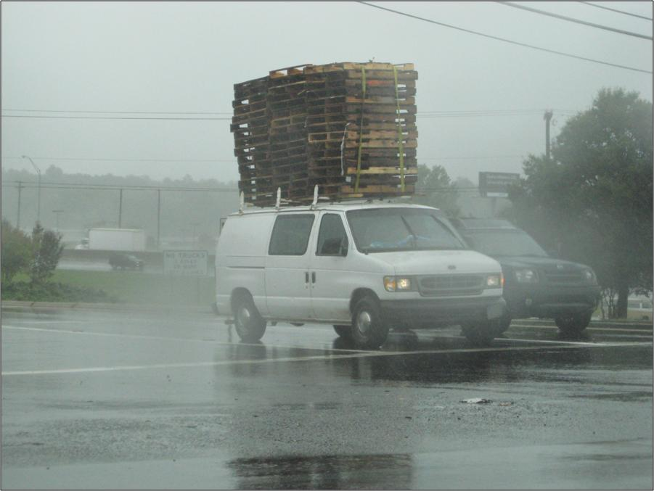
Conklin

Slide 15
Shift your thinking from “Why”
to “How”
Conklin

Slide 16
Workers
Are Masters of
Complex Adaptive
Behavior…
Conklin

Slide 17
Workers Discover Safety While Working…
The Gray Area:
Uncertain
interpretation
of Safe work
Clearly Safe
to do Work
Clearly Not Safe
to do Work
Conklin

Slide 18
After the Event, Safety is Clear…
Clearly Safe
to do Work
Clearly Not Safe
to do Work
Event
Conklin

Slide 19
Start
Of
Job
Hazard
Safety Understood: Drift and Accumulation
Conklin

Slide 20
Human Performance Principles
People are fallible
Error-likely situations are predictable
Individual behaviors are influenced
Operational upsets can be avoided
Management’s response to failure matters
Conklin

Slide 21
People
Make
Mistakes…
(All the time)
Conklin

Slide 22
Origin of Human Error
Human Errors
System Induced Error
Operational Upsets
Individual
Error
Human Error
Equipment Failures
Conklin

Slide 23
Human
Error
Expertise
Identification
Exercise
Conklin

Slide 24
How many times does the uppercase or lowercase letter“F”appear in the following sentence?
Finished files are the re-
sult of years of scientific
study combined with the
experience of many years.
Finished files are the re-
sult of years of scientific
study combined with the
experience of many years.
Conklin

Slide 25
Limitations of Human Nature
“Mistakes arise directly from the way the mind handles information, not through stupidity or carelessness.”
-Edward de Bono PhD
Conklin

Slide 27
The thing about being wrong
is that before you know you are wrong… it feels exactly like you are right.
Conklin

Slide 28
Error
is not a choice.
Mistakes
=
Violations
Conklin

Slide 29
We must design, manage, and sustain systems tolerant of both
error and violation.
Conklin

Slide 30
Event Prevention
Happens Through
Learning.
Conklin

Slide 31
Resilience Model
Adapt
Plan
Learn
Recover
Absorb
Event
(in motion)
Linkov 2013

Slide 32
It is not the strongest of the species that survives, nor the most intelligent that survives. It is the one that is the most adaptable to change.
Charles Darwin
Conklin

Slide 33
A reliable organization can spot an action going wrong…not an action gone wrong.

Slide 34
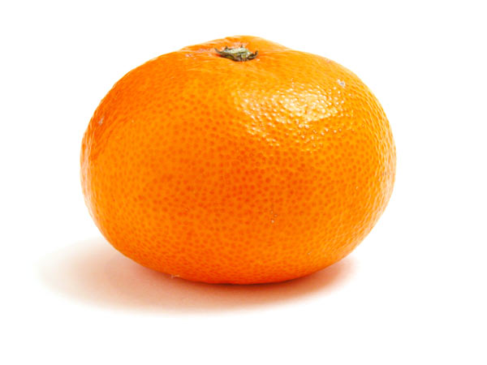
Is the juice worth the squeeze?
Conklin

Slide 35
The Power of
Early
Hazard
ID
Capacity
Identified
or Discovered
Problem
Conklin

Slide 36
The Power of
Early
Hazard
ID
Capacity
Identified
or Discovered
Problem
Conklin

Slide 37
Its pretty simple…
You can
Blame & Punish
Or
Learn & Improve.
Conklin

Slide 38
Reliability is not the absence of Failure.
Reliability is the presence of Defenses.
Capacity.
Conklin

Slide 39
For More…
Listen to the
PreAccident
Podcast
Subscribe Today!
Conklin

