Slide 1
Technology as a Force for Good
Lisa Gelobter, The White House
Chief Digital Service Officer, US Dept of Education
Notes:
Mikey Dickerson was here a year ago telling his story – Rescue of Healthcare.gov & subsequent founding of the US Digital Service.
I will say I never expected to be here in front of you talking about this- Tech as a Force For Good.
I’m not involved in politics or any civic organizations.
Fortunate enough for my code to ship to 100s of millions of people (Shockwave, Hulu, BET Digital)
But nothing prepared me for the kind of meaningful impact of the work we’re doing.
While Tech is the underlying fabric of much of the world today, I hadn’t come to realize what a direct and dramatic impact my BS in CS could have on real people’s lives.
I’m here to share with y’all.

Slide 2

Notes:
Who we are
There’s a new IT sheriff in town in the Federal Government. The Administration’s “Smarter IT” agenda
Coalition of independent organizations: Office of CTO, PIF, 18F, USDS HQ, USDS Agency Teams
Each with different strengths, aka superpowers
Working in alignment to use technology to improve the way government serves the American people

Slide 3
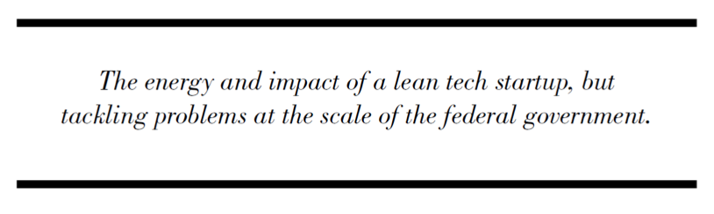
Notes:
Starting at agencies where people are literally dying for want of services.
Enabling Health care
Improving delivery of Veteran benefits
Streamlining how people immigrate to America
Opening the doors to higher education for the most vulnerable populations
Taking methodologies from silicon valley for a decade and apply here.

Slide 4
Healthcare.gov
Notes:
This whole thing was modeled after the Rescue of Healthcare.gov
48mm without healthcare; 45k die b/c no healthcare – 1 in 1000 die in each calendar year
The adhoc team: 7 people, 6 weeks.
Results: 150 enrolled per day to 150k enrolled per day.
End of end 3/31/14 – final score: 8.1mm enrolled in affordable care act from orig estimate of 7mm
In 2015 Open Enrollment: 10.2mm

Slide 5

PRE App 2.0
76 screens
worst case application
20 minutes
average time to complete
an application
12
9 3
6
Notes:
What we did
Original systems

Slide 6

POST App 2.0
16 screens
worst case application
9 minutes
average time to complete
an application
12
9 3
6
Notes:
Improved

Slide 7


PRE SLS
$70 million
cost of operating
ID mgmt
$
up to 25%
errors rate for
ID mgmt
seconds of max response time
Notes:
Identity management or login system
Responsible for the largest % of the errors
Original $200mm to build, $70mm to operate.
Response rate - astronomical

Slide 8


POST SLS
$4 million
cost of operating
ID mgmt
$
0%
errors rate for
ID mgmt
seconds of max response time
Notes:
Re-built login system in 6 months.
$4mm to build, less than $4mm to operate.
Response time
Capacity – broke load testing system
Real world (infamous) example of how Tech has directly helped save lives.

Slide 9
Immigration

Slide 10
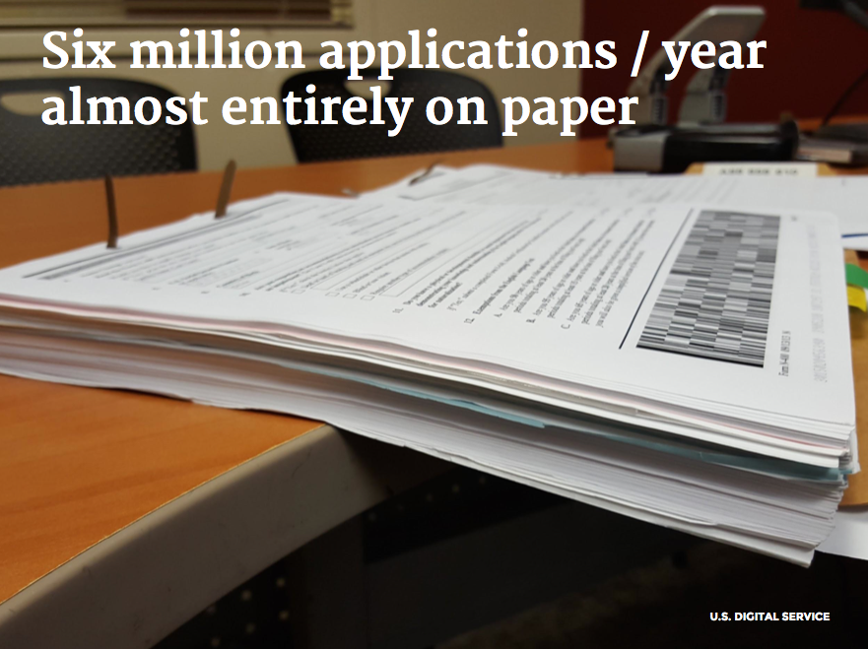
Notes:
I-90 Form – application to renew or replace your green card
6 million applications per year
Entirely paper based process.
Many businesses formed around getting thru the system
Lots of lawyers
Goal: Put it online and make it more efficient.
USCIS spent 7 years and $1.2bn and failed.
Independent study said it made the process worse than paper.
So re-upped for $2.5bn and 10 years -- with the same vendor!
The definition of crazy, doing the same thing over and over again and expecting different results.

Slide 11
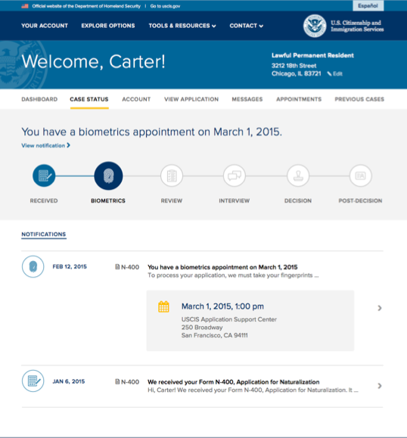
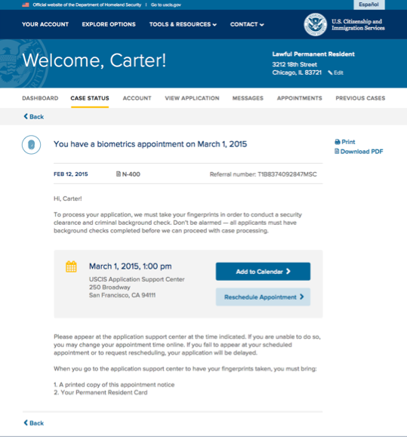
Notes:
Wiser minds prevailed
The CIO at USCIS in conjunction with the Digital Coalition scrapped that idea and started over.
Moved from Waterfall to Agile
Moved to the Public Cloud
Implemented Real-time Monitoring
Left the building and did User research in the field
Over the course of several months, they successfully launched an online system to process your replacement green card.
The new online version allows users to track the status of their replacement request and sends out e-notifications
Over 40k people have filed online already.
18F also built MyUSCIS – focused on getting users the info they need to navigate the immigration process.

Slide 12
College Scorecard
Notes:
My 1st project.
A College degree is the surest path to the middle class.
For Millenials ages 25-32:
Unemployment rates for someone with a bachelors is 3.8%, and is 12.2% if you only have a HS diploma.
Earn $1mm more over the course of your lifetime.
21.8% of HS only graduates live in poverty.
President wanted to create a tool to help students:
understand the value a school provides and
enable them to make more informed choices (and not get ripped off).

Slide 13
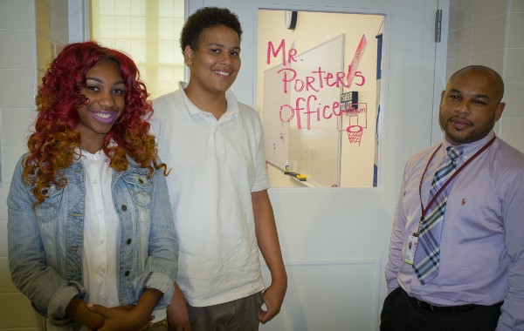
Goal: Engage and educate potential college students of any age or background and those that support and
advise them, to find schools best suited to them.
Notes:
First we had to decide what to build to achieve the goal
We had to understand how students search for colleges
So we went out and asked them.
79 users and stakeholders.
The Mall
Written letters to the president
Anacostia High School

Slide 14
PLACEHOLDER FOR ANALYTICS
Here’s a really nice story I wrote
about some important stuff.
You guys, this stuff is really
important, ok?
Notes:
How to achieve goal: reach audience and change conversation
2 Products:
Consumer Tool,
Mobile first
Capturing what we learned in our user research
as reference implementation
API
Most importantly
To reach students anywhere they might be searching for schools.
Enable other developers to create tools tailored to vulnerable audiences, like low-income and first generation college go-ers

Slide 15
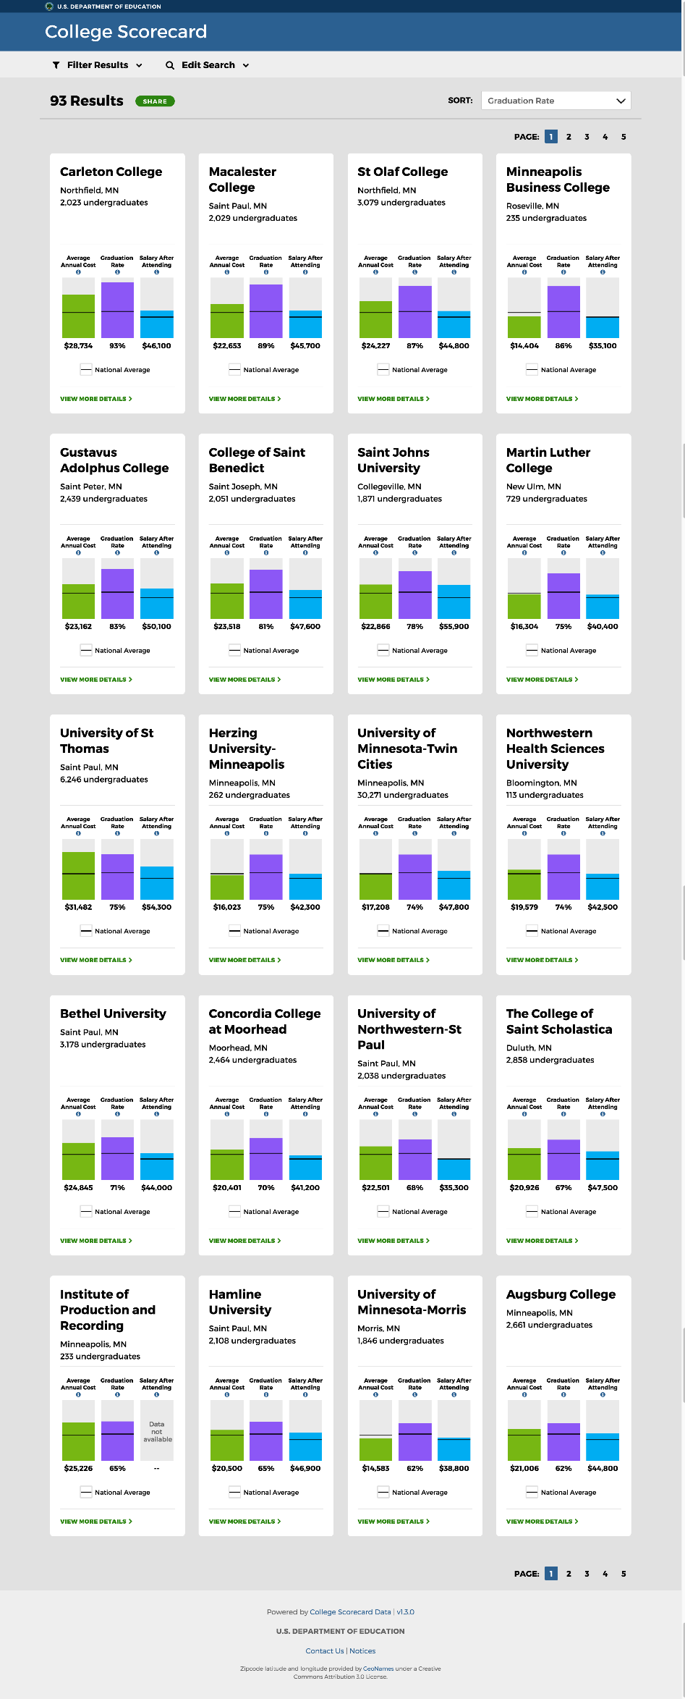
Here’s a really nice story I wrote
about some important stuff.
You guys, this stuff is really
important, ok?
Notes:
Launched an MVP 4 weeks ago.
Rollout has been successful thus far.
President’s Weekly Address announced the project
Lots of press coverage
In the 1st 4 days, got about 8x more usage than the earlier College Scorecard has in the previous 12 months.
Data folks have loved it. – used earnings data to look at gender inequity in pay 10 years after starting school.
Institutions are revisiting their data submissions.
11 organizations already using these data to launch new tools
* I look forward to the data being put to good use and having an impact on how students pick schools

Slide 16



MANY MORE EXAMPLES…..
Veterans’ Medical Health Record Interoperability
The Police Data Initiative: Using technology and data to improve community policing
Crowd-sourced mapping effort streamlined aid delivery to Nepal’s earthquake-hit remote communities
Notes:
8 Million Veterans, 163 Hospitals, 135 Nursing Homes;
25% of Nation Potentially Eligible for VA Services - veterans, families, survivors;
60% of doctors use the VA’s Electronic Health Record System
------------------------------------
In the wake of Mike Brown and Eric Garner, 2 Presidential Innovation fellows, engineers,
wanted to see how they could help the national dialog around policing reform.
Results: 21 jurisdictions participating in the effort; how best to collect and publish data, AND how to use it to drive local dialogue and build community trust.
------------------------------------
Mapgive is: the state department’s public diplomacy campaign supporting open street map for humanitarian response
April 25th, 2015 7.8-magnitude earthquake struck Nepal at 11.56 am
The quake struck at a depth of 9.3 miles, and combined with the tremors and aftershocks that followed has killed at least 5,000 people.
In 48 hours, 2000 digital volunteers, trawling over 13,000 miles of satellite imagery, identifying over 3000 damaged buildings.
To help direct relief workers on the ground know where they should head first. What roads were unblocked, where buildings were collapsed, etc…

Slide 17
How we fix it
Notes:
It’s not rocket science
We really are bringing modern practices to bear on these massive problems and seeing results bear fruit.

Slide 18

Notes:
Modern Product Management and Software Development Practices:
Goal-setting and success criteria
Modern technology stacks
User-centered Design
Iteration
Open Data
Open Source
Design Patterns
Monitoring and Dashboards
Mythbusting & Remove Policy Roadblocks:
The Cloud
Usability and A/B Testing
Agile BPA Marketplace
Agile Marketplace – Agencies can go to pick from vetted, approved vendors. not fill out 500 page doc promising to be agile and modular. Instead you have to build a product in a week and check your code into github. One vendor couldn’t get their code working who has lots of gov’t contracts.

Slide 19
Join us!
Notes:
Those are the tools we’re using.
And anything else that might work.
We are making change that will impact millions and millions of lives.
But we need people.
Join us.

