Slide 1
Can a monitoring tool pass the turning test? Alois Reitbauer, ruxit @aloisreitbauer

Slide 2
The Turing test is a test of a machine's ability to exhibit intelligent behavior equivalent to, or indistinguishable from, that of a human. Alan Turing proposed that a human evaluator would judge natural language conversations between a human and a machine that is designed to generate human-like responses.

Slide 3
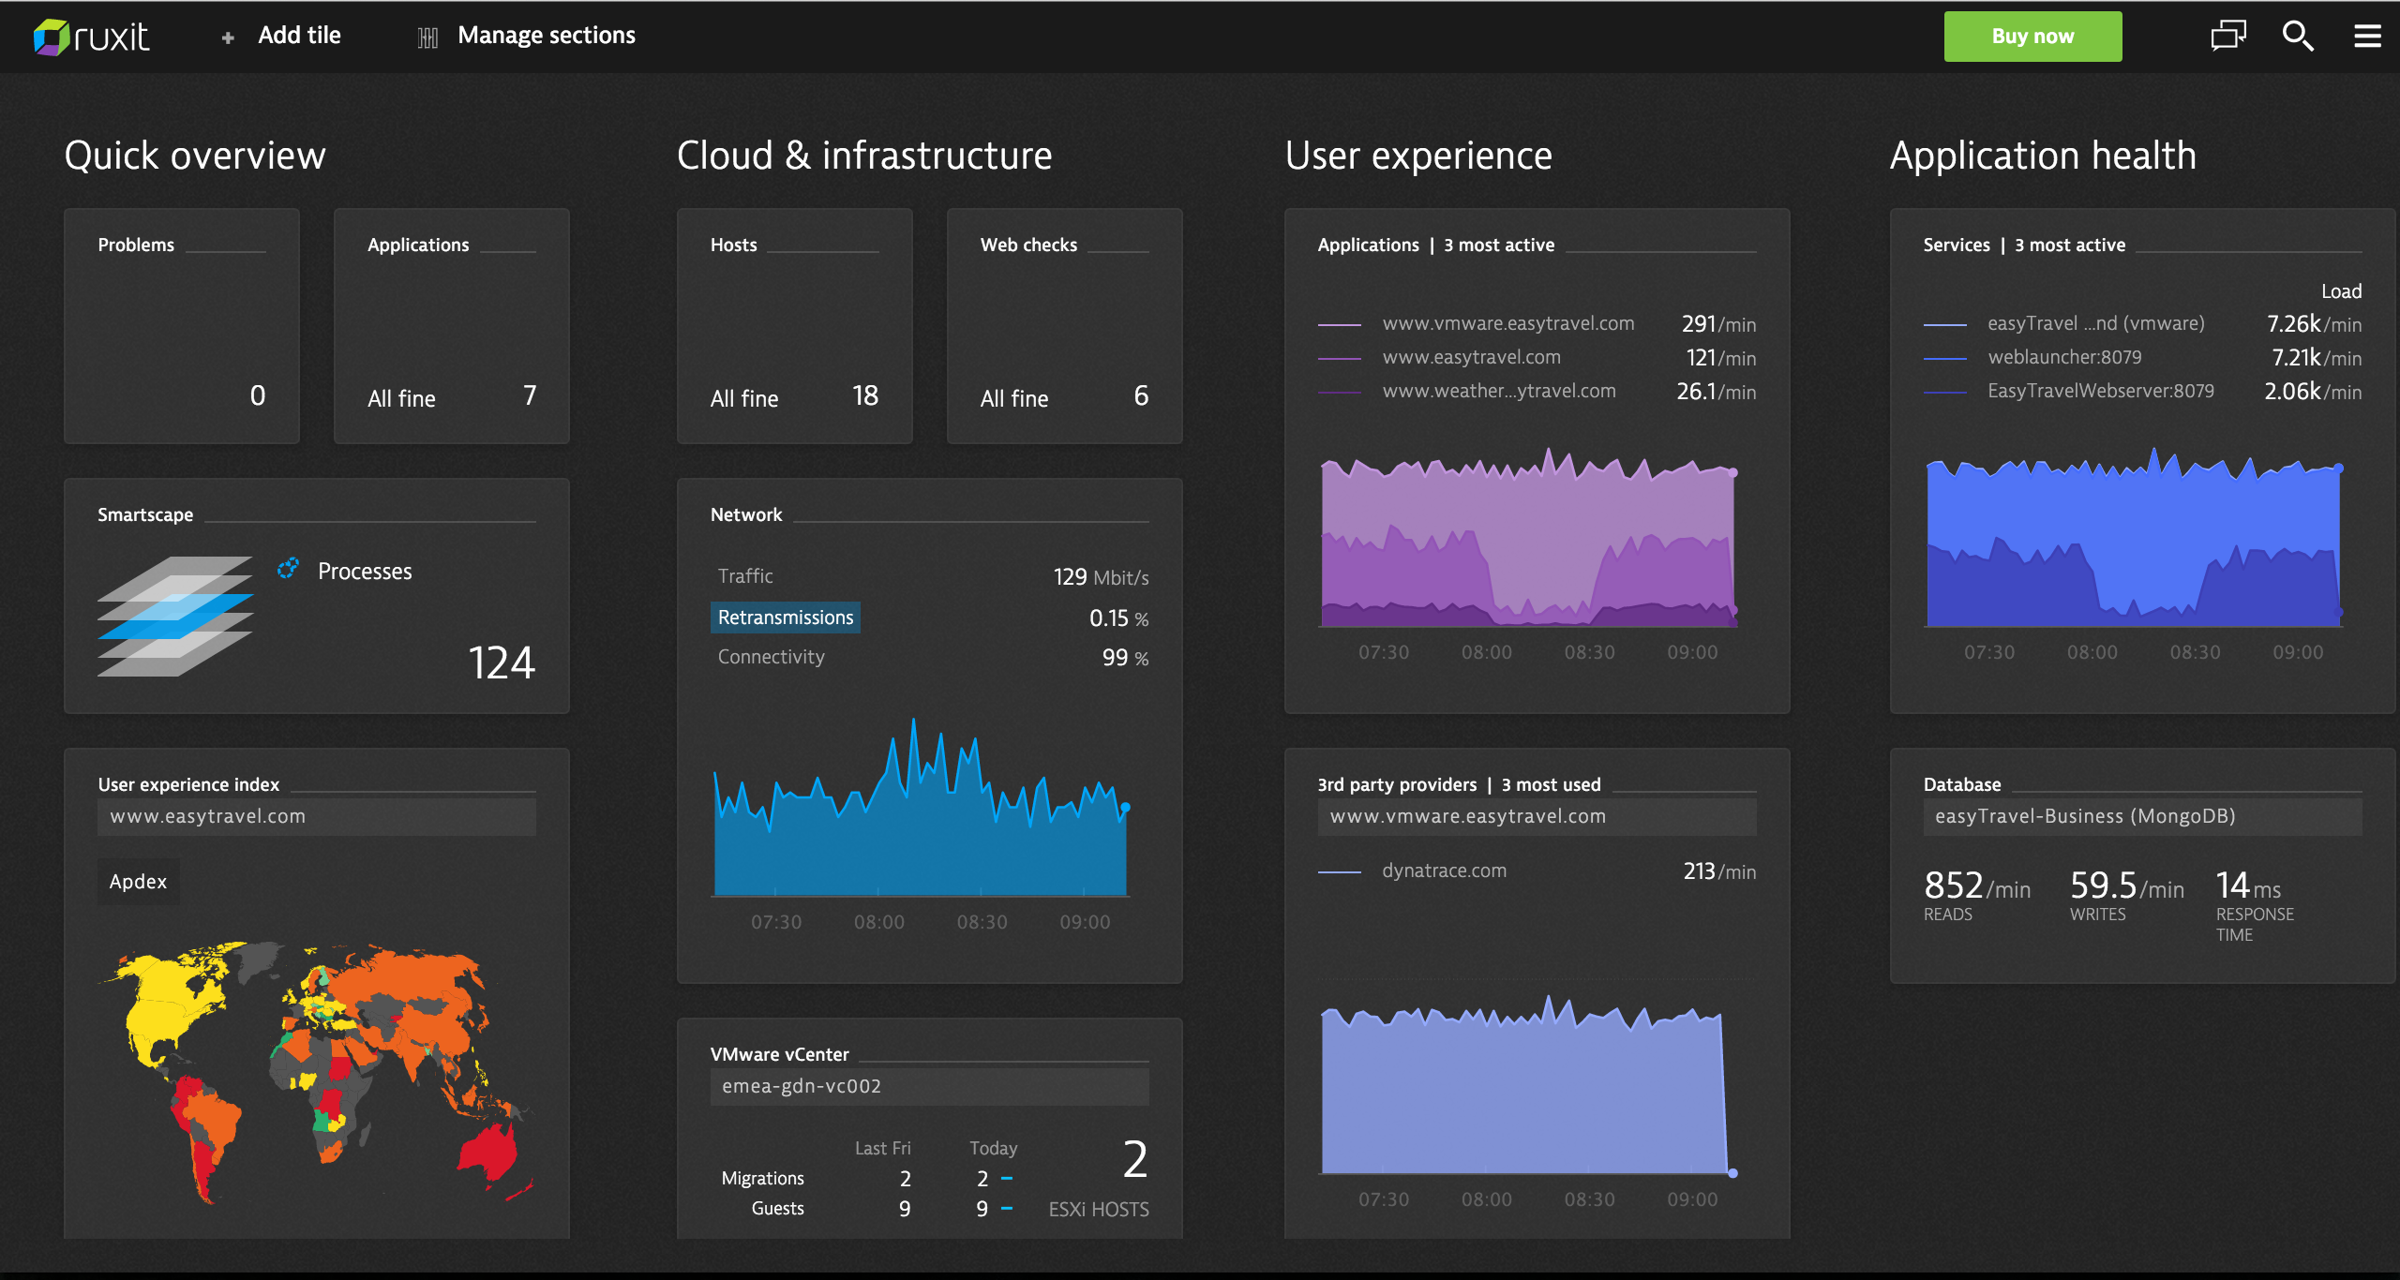

Slide 4
chatops conversation-driven operations

Slide 5
more than simple commands
Proactive
Knowledge based
Guided interactions

Slide 6
Demo

Slide 7
We don’t need human like intelligence
Just A Rather Very Intelligent System

Slide 8
Thank you! Alois Reitbauer, ruxit @aloisreitbauer

