Slide 1
Preparing Your Site
for Major Events
Gopal Brugalette
Senior Applied Architect
5.27.2015

Slide 2
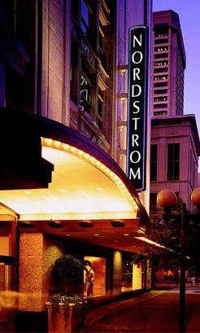
1901 Founded
63,000 employees
118 Nordstrom stores
167 Nordstrom Rack stores
Notes:
+Leading Upscale Fashion Retailer
+ Brick and Mortar US, Canada, PR
+online and mobile for an omni-channel offering

Slide 3
Gopal Brugalette
Senior Architect, Performance Engineering

Slide 4
Our Customer is Our Guide
Notes:
+goal: to deliver the Best Customer Experience possible
+ customer expectations are constantly changing
+constantly evolve to server them better

Slide 5
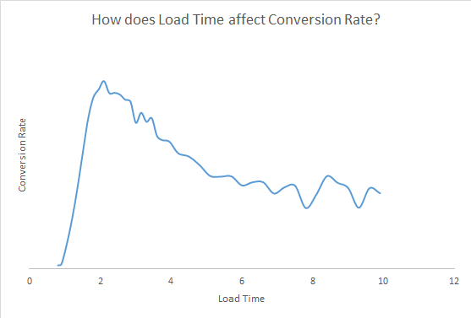
Performance Impacts the Customer Experience
Notes:
Our customers clearly tell us what they expect –

Slide 6
Nordstrom’s Major Events
Early Access
Holiday
Notes:
+matters all year long, always want a great customer experience
+every interaction
+ and it hits all our IT systems

Slide 7
How do we prepare?
We are always
getting ready
Notes:
Anything that goes into production has to support anniversary and holiday
Anything that ships is ready to support our peak load

Slide 8
This wasn’t always the case
Notes:
+4 years didn’t have same focus on the customer experience
+just worried about would the site crash?
+ and customer experience suffered all year
+csat scores dropped

Slide 9
Performance is a Feature Instrumentation and Data Continuous Improvement
Embrace a Cultural Shift
Notes:
+ joint effort – Product Management- everyone owns it
+ APM tools – need the tools – when where what RCA
+ Continuous Improvement –Kaizens, Value Stream Mapping, 7 wastes of lean
+, incremental improvements, automation, new tools, new processes

Slide 10
How are we always getting ready?
Every feature
at Development
Analyze - Test - Monitor
Notes:
+As part of that cultural shift – performance is embedded – everyone is thinking about performance – about the big events
+Anything that ships supports our peak loads

Slide 11
Analyze Test Monitor
Customer Impact?
Technical Impact?
What is the
Study the past
Understand the present
Model the future
Notes:
+Product management and technology
+how are things changing
+ EX – Password Reset,+EX EA– more credit card, wishlist, EX - Enormous growth in mobile,
+How are user behaviors changing over time?

Slide 12
AnalyzeTest Monitor
Early, Often, Everywhere
Projections & Contingencies
Support your results
Notes:
+You wouldn’t ship functional defects, don’t ship performance defects
+ customer be your guide
+Mini-bag – too crazy – should have accepted sooner –past freeze dates

Slide 13
Analyze Test Monitor
Development and Test Environments
Production at Deployment
Production regularly
Build a Feedback Loop to
Product Management and Engineering
Notes:
You can’t test everything but you can monitor – APM tools– password reset
Monitoring plan in place – identify it early
+PO support- it takes time – build it into your capacity
Use your monitoring plan in testing – practice and perfect it
Look for trends
Feedback loop- prioritize those performance defects

Slide 14
During the event
Monitor, Monitor, Monitor
Contingency planning
Coordinate with Vendors
Notes:
+ not just dollar metrics, system
+customer experience metrics - CULTURE
-EX BOPUS- may need to turn off – personalizations - QPS
+3rd Parties – Fraud Alerts/ COM

Slide 15
Preparing your Site
Cultural Shift
Performance is a Feature
Instrumentation and Data Focus
Continuous Improvement
Always be Preparing
Analyze
Test
Monitor
Notes:
Manage the customer experience

Slide 16
The Future Holds…
Customer Focus
Continuous Delivery
Cloud
Continuous Improvement
Notes:
Cloud – how do things change?

Slide 17
Questions?
Office Hours Tomorrow 12:30-1:00
Email: gopal.brugalette@nordstrom.com
And we are hiring…

