Slide 1
How Go is Making Us Faster
Wilfried Schobeiri, SVP of Technology, MediaMath
May 29, 2015
Credit: Renee French

Slide 2
About our tech
2.3 million RPS, 99.92% <40ms
120 terabytes of data analyzed per day
9 POPS + cloud & thousands of servers
Many languages (Scala, C++, Go, Python, Ruby, Perl, PHP, & more)

Slide 3
This talk is about two things: #1: How Go helps us perform #2: How to make Go perform

Slide 4
Thing #1: How Go Helps Us Perform

Slide 5
2012: ONE BIG MONOLITH

Slide 6
2015: LESS MONOLITH MORE MICROSERVICE

Slide 7
Source: http://i.imgur.com/YOmDuDV.jpg

Slide 8
Go makes it easy to solve these problems

Slide 9
It’s easy to create services from scratch
Simple Language → Low mental footprint
Compiles super quickly to a static binary
Channels and Goroutines!
Awesome stdlib!

Slide 10
Awesome stdlib
net/http (and co)
encoding/json (and co)
os
sync, sync/atomic
fmt, strconv, strings, bytes
tar, zip, gzip, bzip2
crypto/many

Slide 11
Lots of community libraries and utils
Consul & Etcd
Docker & CoreOS
Go-raft & memberlist
Influxdb, boltdb, groupcache, prometheus
Gin
Spacemonkey’s monitor
And more

Slide 12
Awesome Tool: go fmt
Is the best thing since sliced bread
Code Format = spec
Rewrites your spaces into tabs
Trigger on save!

Slide 13
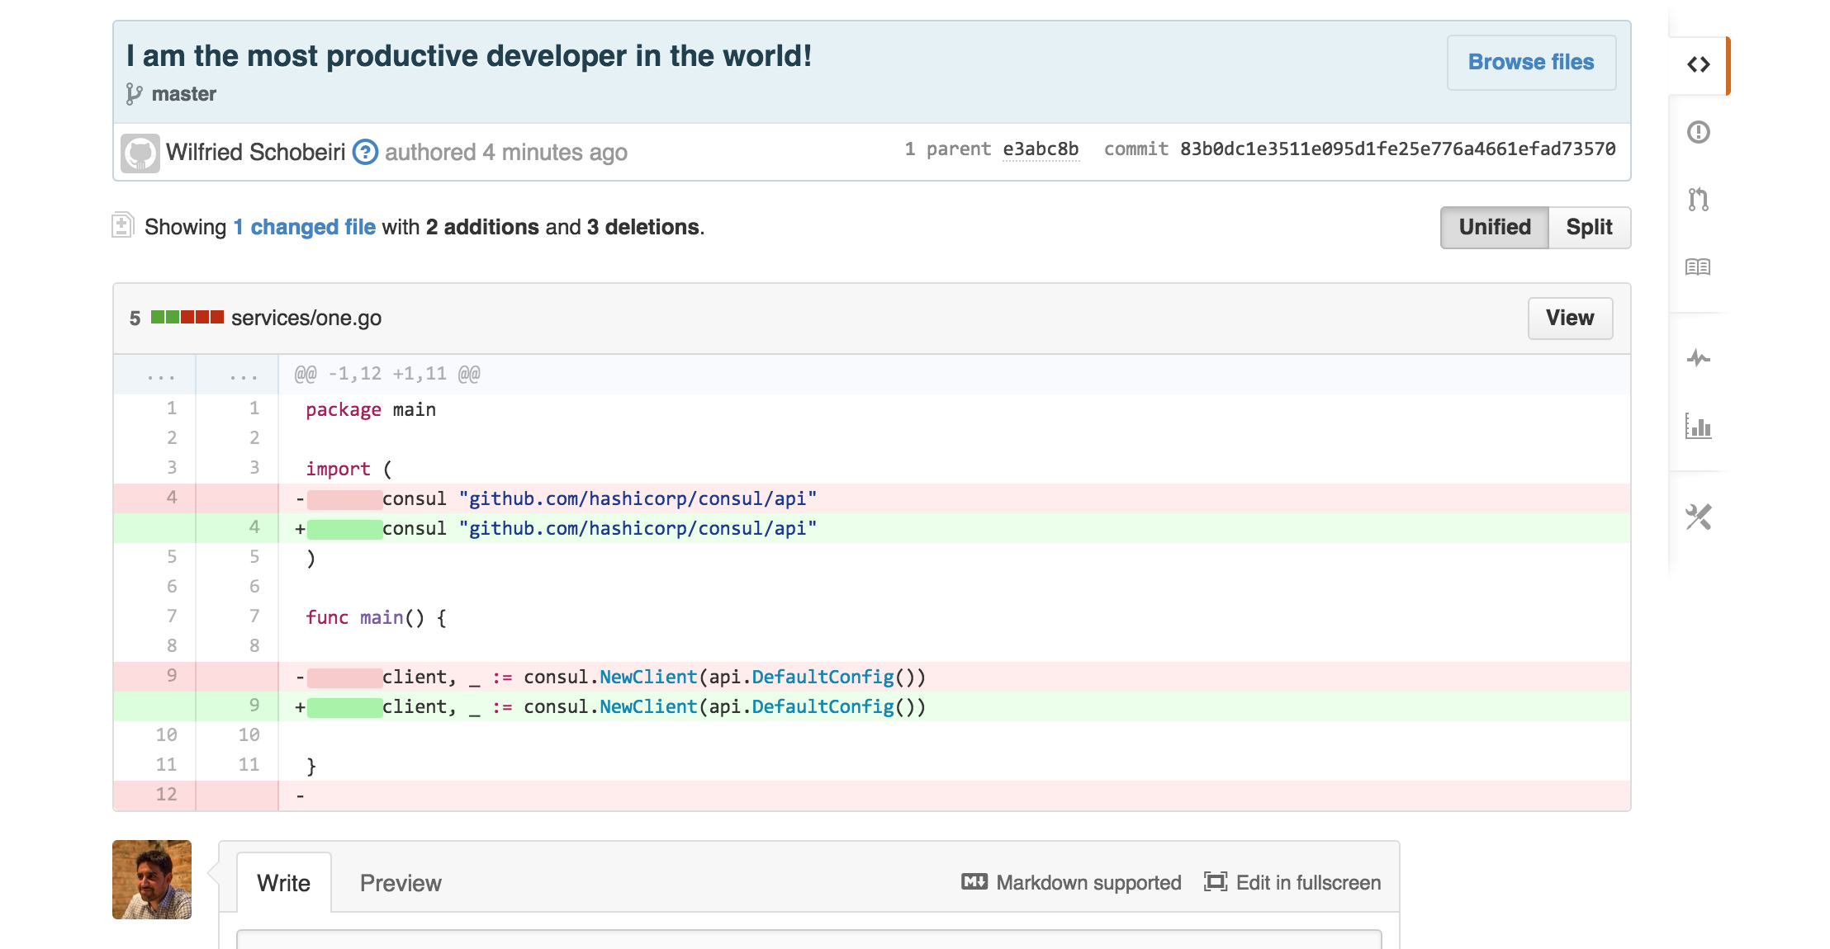

Slide 14
Awesome Tool: go test
Test your code, in your code
And now there’s never a question about how to do unit tests!

Slide 15
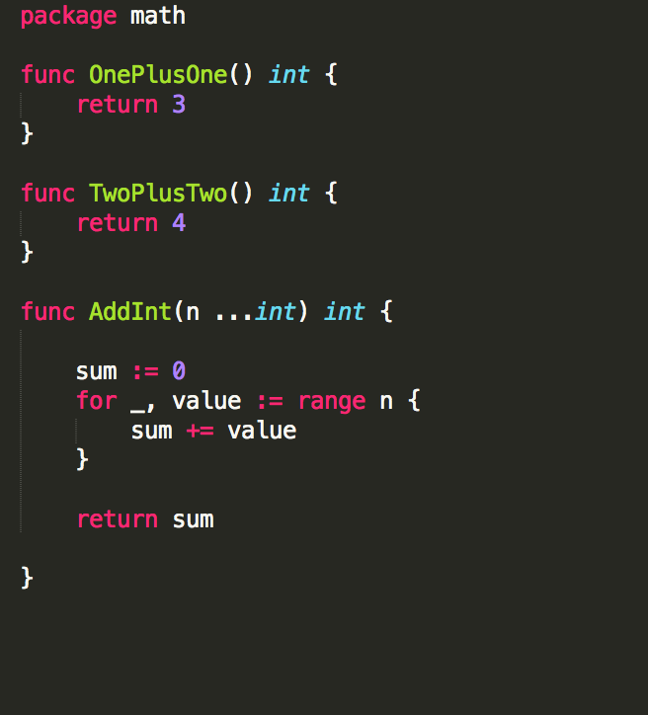
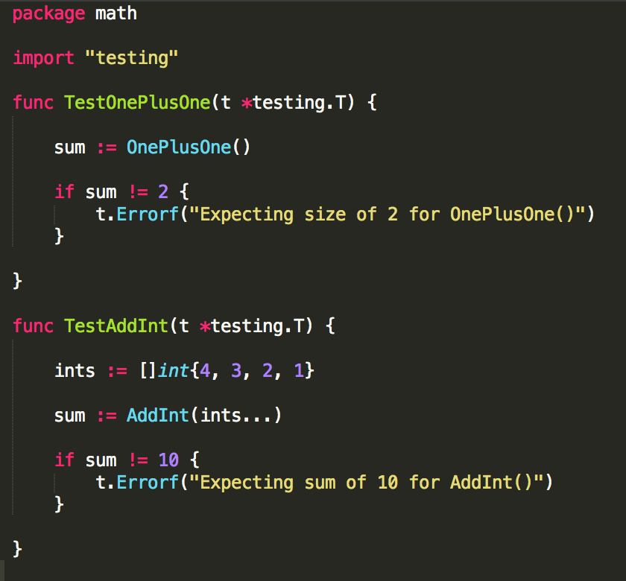

Slide 16
$ go test -coverprofile=coverage.out
--- FAIL: TestOnePlusOne (0.00s)
math_test.go:10: Expecting size of 2 for OnePlusOne()
FAIL
coverage: 83.3% of statements
exit status 1
FAIL github.com/nphase/math-test 0.005s
$ go tool cover -html=coverage.out

Slide 17
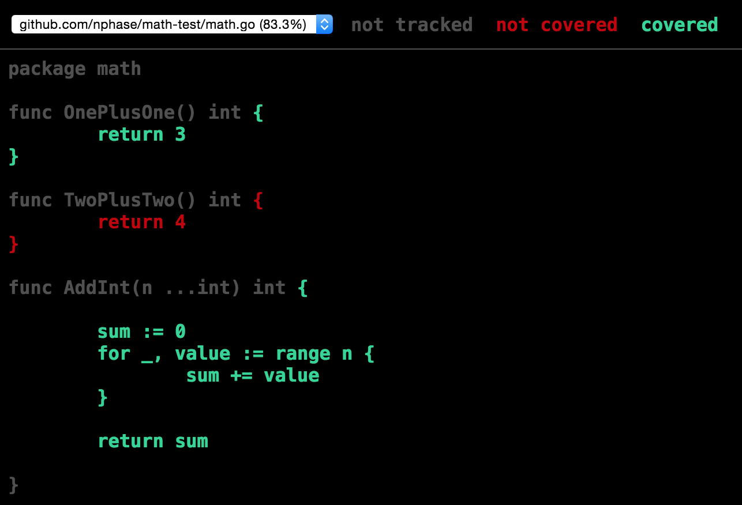

Slide 18
Awesome Tool: Go’s race detector
$ go run –race
$ go test –race
Finds race condition, then panics
==================
WARNING: DATA RACE
Read by goroutine 5:
main.func·001()
race.go:14 +0x169
Previous write by goroutine 1:
main.main()
race.go:15 +0x174
Goroutine 5 (running) created at:
time.goFunc()
src/pkg/time/sleep.go:122 +0x56
timerproc()
src/pkg/runtime/ztime_linux_amd64.c:181 +0x189
==================

Slide 19
Awesome Tool: go vet
Catches suspicious things the compiler might miss

Slide 20
It just feels productive (to me).

Slide 21
Ship it!

Slide 22
AND WE HAVE SHIPPED IT
Infinity % growth!

Slide 23
So how fast is Go?

Slide 24
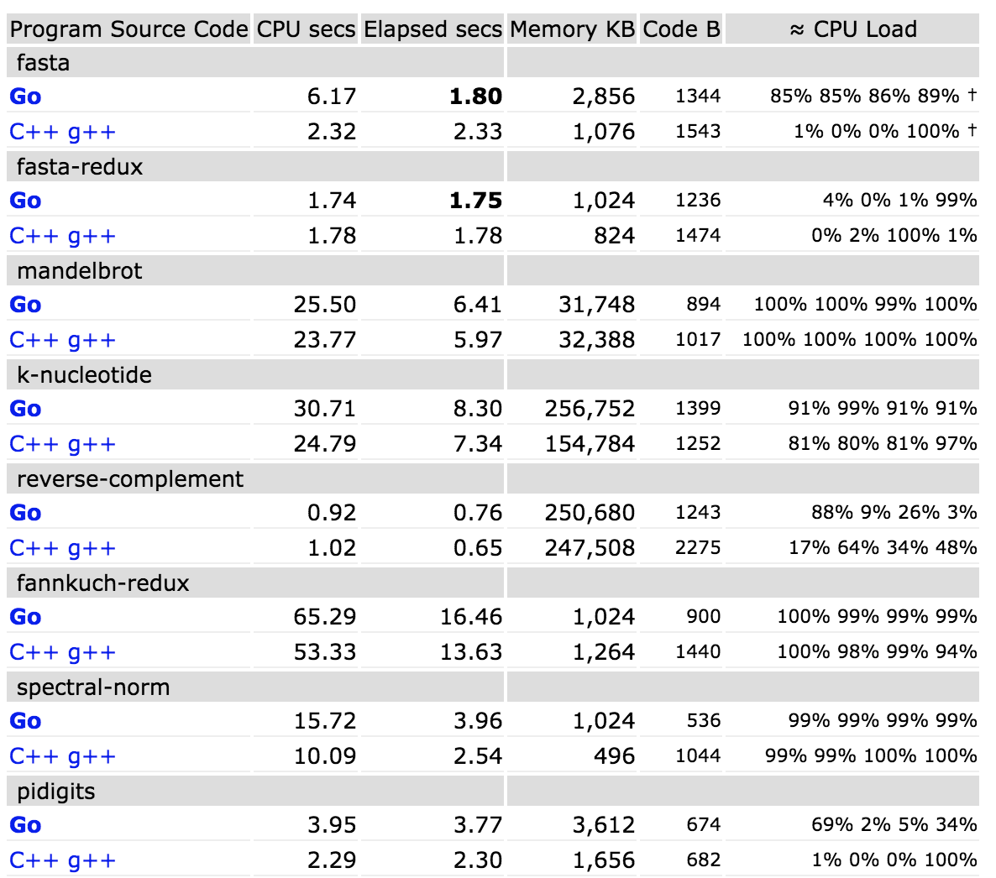
Go vs C++
Nearly as fast as C++
http://benchmarksgame.alioth.debian.org/u64q/go.html

Slide 25
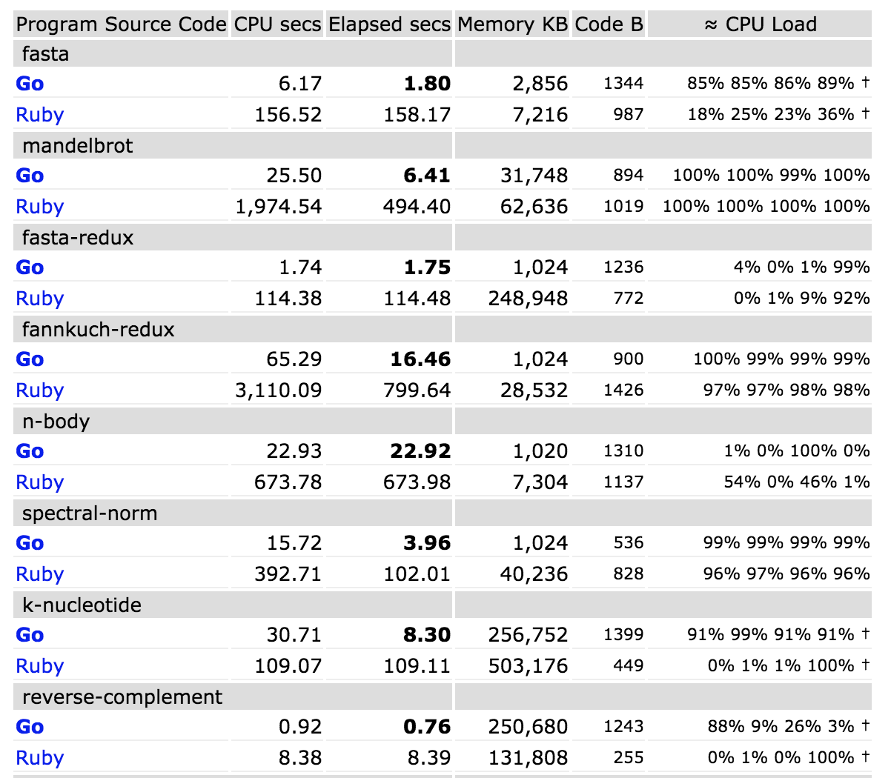
Go kills Ruby
Ruby can’t compete
http://benchmarksgame.alioth.debian.org/u64q/go.html

Slide 26
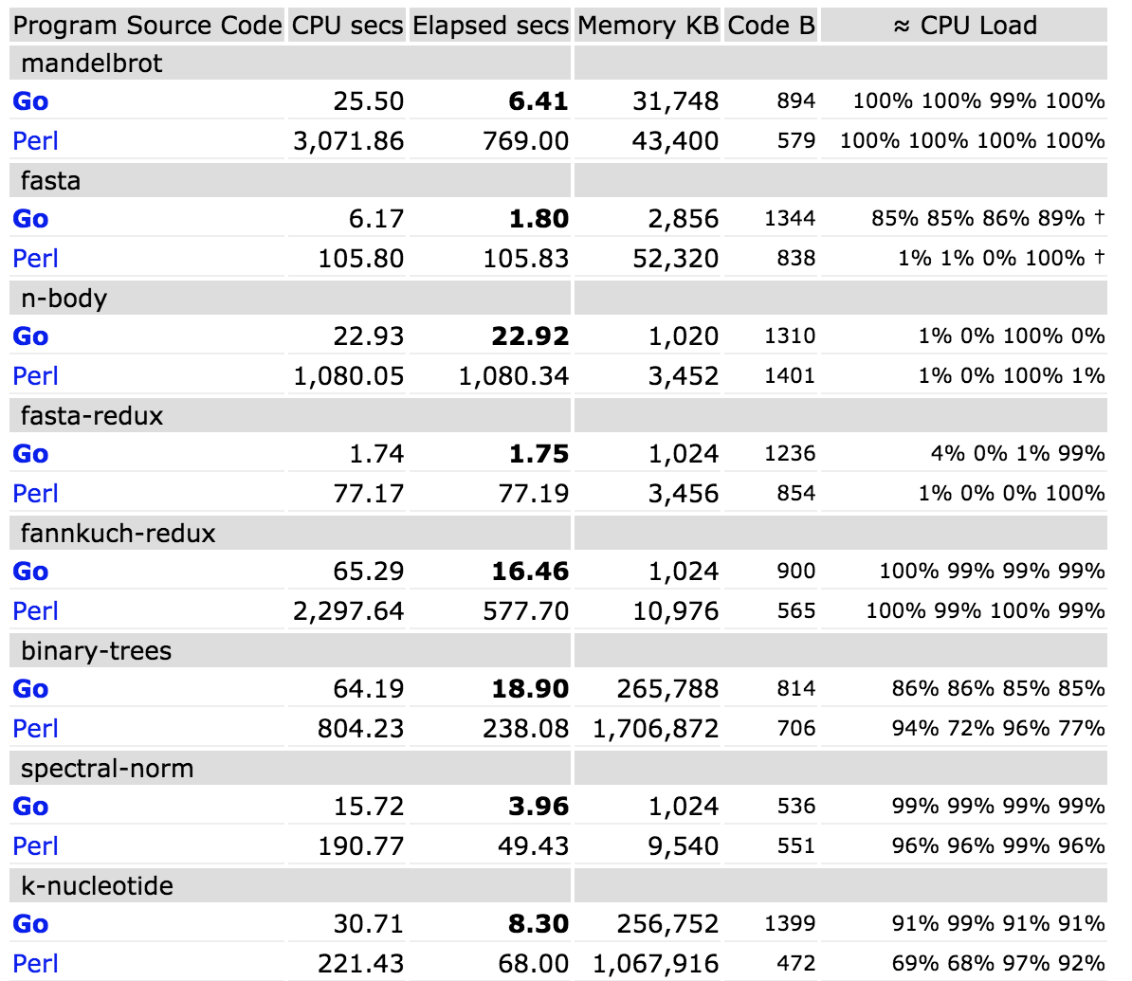
Go destroys Perl
No contest!
http://benchmarksgame.alioth.debian.org/u64q/go.html

Slide 27
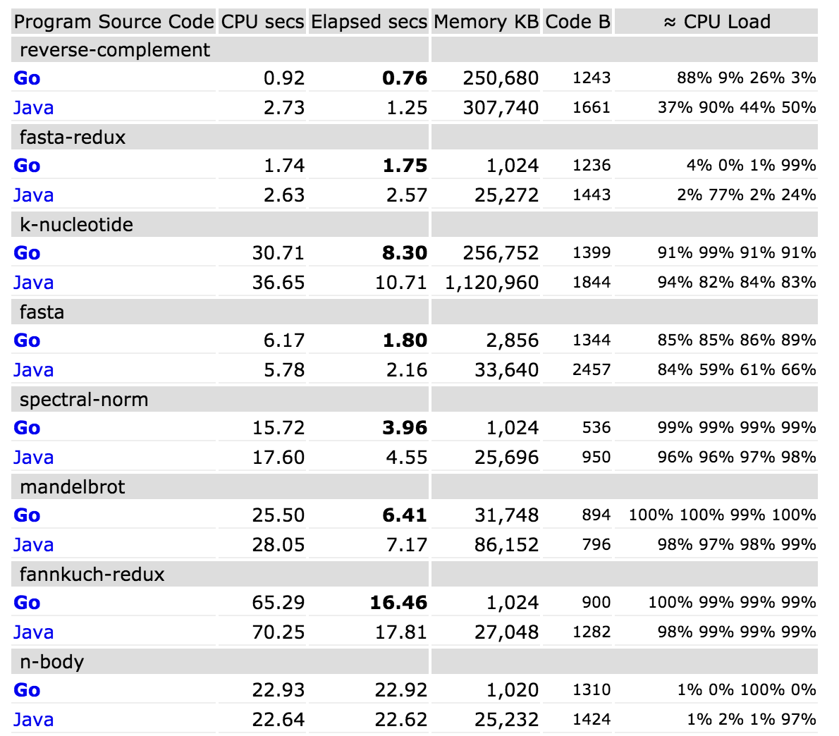
Go vs Java
Go is faster!
http://benchmarksgame.alioth.debian.org/u64q/go.html

Slide 28
Go owns Node.js
http://benchmarksgame.alioth.debian.org/u64q/go.html

Slide 29
No, but really, Go is pretty fast
DCS: 95th % latency under <10ms on 2 boxes per POP handling live bidder traffic
Rollerskates: One tiny VM handling all imp metrics on five dimensions
Auth.go: Handles all DCS traffic, ~1ms 95th%
Plex: capable of handling >100k inbound rps per single node (OS bound!)
And all with relatively little effort!

Slide 30
Any response cobbled together from multiple services is only as fast as your slowest link

Slide 31
Thing #2: How to Make Your Go perform

Slide 32
go test – supports performance tests
How to make your go perform
Testing.B: loop-based performance tests
// from fib_test.go
func BenchmarkFib10(b *testing.B) {
// run the Fib function b.N times
for n := 0; n < b.N; n++ {
Fib(10)
}
}
% go test -bench=.PASSBenchmarkFib10 5000000 509 ns/op
ok github.com/davecheney/fib 3.084s

Slide 33
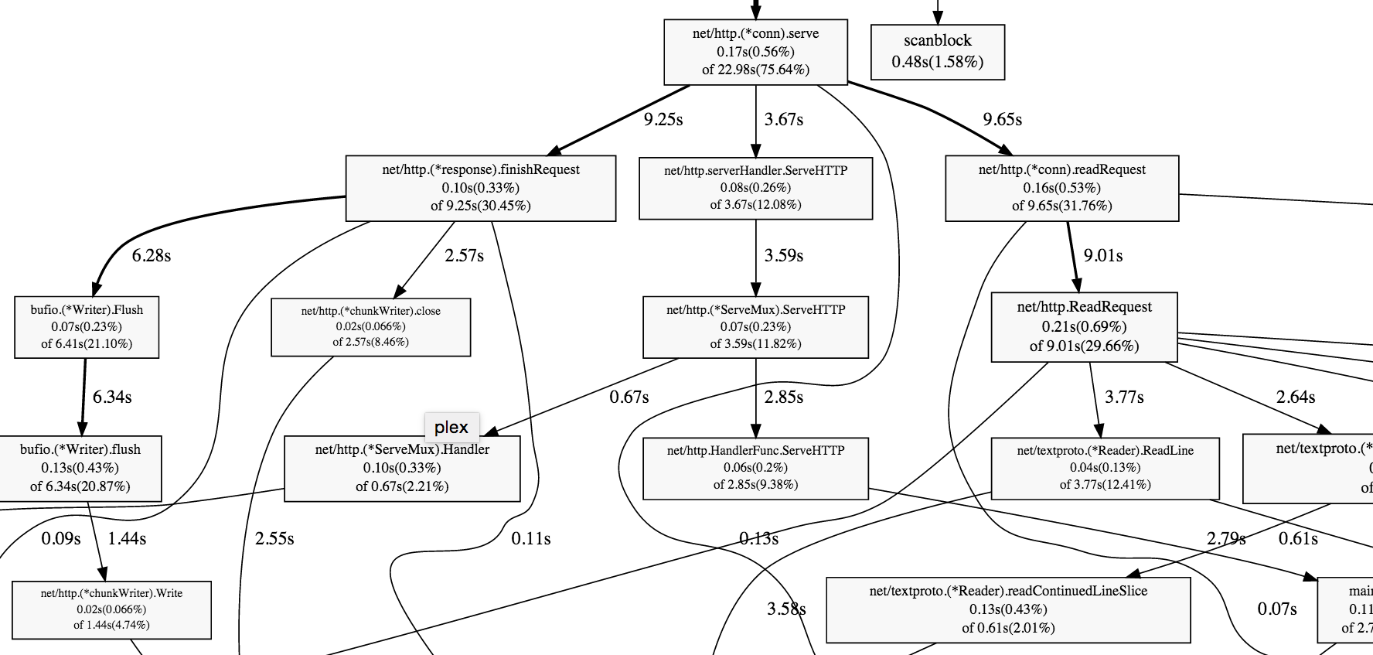
Use pprof
How to make your go perform
Thanks, Google!

Slide 34
Dealing with GC, which is not very good yet
How to make your go perform
What you can do about it:
Avoid creating garbage
Use pprof to find allocations causing collections
Do this after your code is complete as part of optimization.
Hope for the future?
GC has been getting better
GC became fully precise in 1.4
1.5 introduces concurrent collection

Slide 35
Beware GOMAXPROCS
How to make your go perform
GOMAXPROCS is the number of OS threads your code can run on
Increasing GOMAXPROCS doesn’t automatically make things faster
Your concurrent code may not automatically scale across multiple processors. Lock contention? Blocking? Race conditions? Memory locality?
Use Testing.B
Go 1.5 sets GOMAXPROCS to # CPU
Note: GOMAXPROCS=1 doesn’t stop the os calls from running across multiple cores

Slide 36
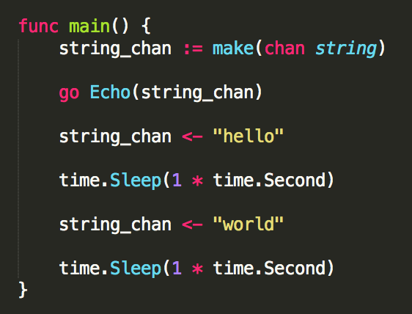
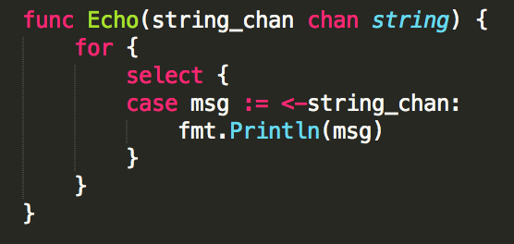
Channels are like magic!
How to make your go perform

Slide 37
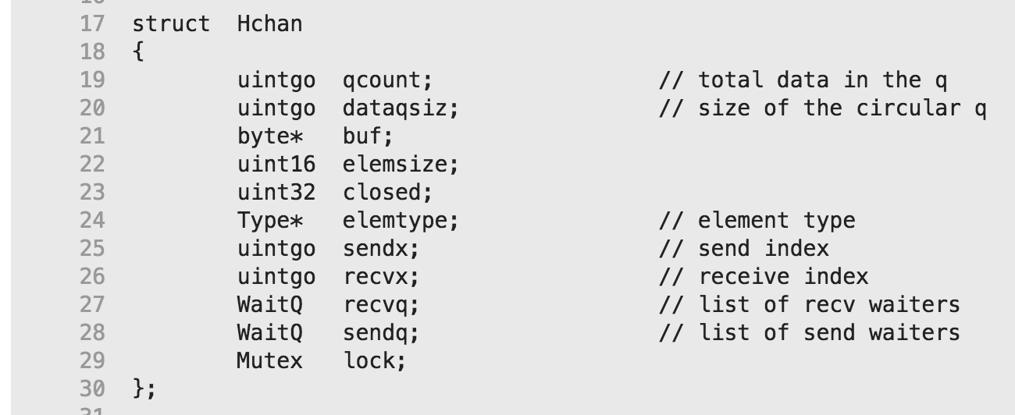
Channels are not actually magic…
How to make your go perform

Slide 38
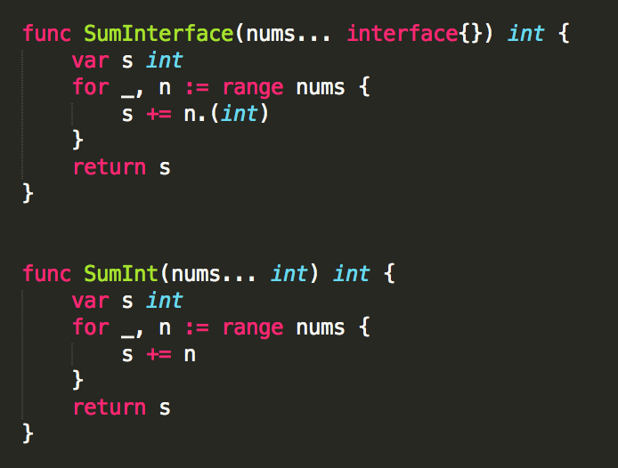
interface{} much slower than Type
How to make your go perform

Slide 39
interface{} much slower than Type
How to make your go perform
$ go test -bench=.
PASS
BenchmarkInterface 500000 2905 ns/op
BenchmarkType 30000000 49.6 ns/op
ok _/Users/nphase/bench 3.025s

Slide 40
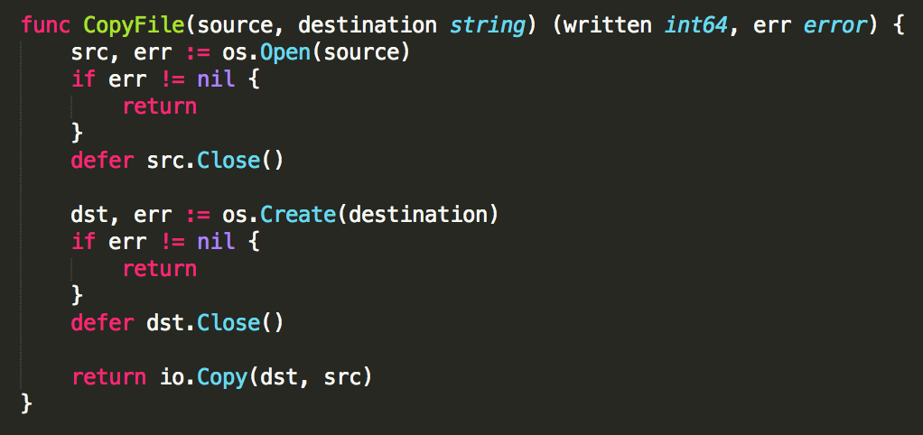
Defer is super convenient
How to make your go perform

Slide 41
Defer is slow
HOW TO MAKE YOUR GO PERFORM
$ Go test -bench '.' defer_test.Go
PASS
Benchmarkdefermutex 10000000 163 ns/op 6.11 MB/s
Benchmarknodefermutex 30000000 56.9 ns/op 17.59 MB/s
Ok command-line-arguments 3.596s

Slide 42
Gccgo may be faster
How to make your go perform
Compiles code more slowly
Supports more powerful optimizations
May be good for CPU bound workloads
Gccgo: We tried it, to negligible benefit

Slide 43
Go: Drawbacks

Slide 44
Go: Things to Watch Out For
Very opinionated
Limited type system
No generics
No exceptions
Learning “idiomatic go” can take a while
Dependency management is a pain
GC still needs work
!

Slide 45
THANK YOU
Wilfried Schobeiri
@nphase
devblog.mediamath.com
We’re hiring!

