Slide 1
Engineering for the long game
Managing system complexity over time
Astrid Atkinson, May 2015
Notes:
Hi, my name is Astrid, and I’m going to be talking about building and managing distributed systems for long-term success.

Slide 2
What is this “long game”?
Notes:
So, what does it really mean to do this? What are we even talking about here?
When I was looking for pictures for this slide, I started looking for a nice stereotypical open road shot, but I realized in a hurry that in addition to being a cliche, that would be a total lie. I’m going to talk about ten years of growth and change, and that’s never a straight road to an empty horizon. You’ll never know where you’re going to end up. You might not even recognize it when you’re done. This is actually a picture of the sacramento river delta emptying into Bay. It’s a little chaotic but I think it’s kind of beautiful.
Let me start with some back story...

Slide 3
What is this “long game”?
In 2004 I joined a small company...

Slide 4
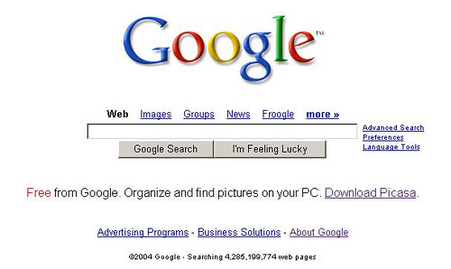
What is this “long game”?
Notes:
This was Google in 2004.
It wasn’t exactly tiny, but it was a hell of a lot smaller than it is today. It had about 2500 employees, maybe 800 in engineering. It seemed huge.
When I joined, it had the biggest systems I’d ever seen, some of the biggest that had ever been built. One of my colleagues tells a story about discovering that there were as many machines in *repairs* as he’d been told existed in the whole company before he was hired. But, Google did basically one thing - websearch, and ads of course. We hadn’t even added Maps yet so there was a lot of growth to come.
I was working with the production engineering team, which grew into the modern Site Reliability and tech infrastructure teams, and at the time, we were rolling out the first pieces of the production environment which would carry Google through the next ten years of scaling. A lot of systems have changed a lot of times since then, but that was a pivotal moment, not least because it was the moment when we were asking questions like, “Where should the config files go?” “How do we name the jobs?” and things like that. You can get really caught up in conversations like that.

Slide 5
Rules of the long game
Imagine that you will be very, very successful.
Notes:
So the first rule of the long game is to imagine that you’re going to be very successful. If all goes well, you (or your successors) will be living with the systems you build for a long time to come. (If things don’t go well, you’re going to be looking for a new job anyway, and none of this will ever apply, so let’s just kind of run with this.)
Every year on Google’s annual employee survey, I always click the box for “I’ll probably still be here in 1 year”, but then “I probably will not be here in 5 years.” So far, I’ve been wrong about the latter. Nobody knows what the future holds. A lot of what I inherited ten years ago is gone, and a lot of what I helped to build is gone too, but a lot of it still stands. Given that you can’t plan precisely for the future, the one thing you *can* do is act as if you will have to live with the consequences.

Slide 6
Rules of the long game
Complexity increases over time.
Notes:
Complexity always increases with scale. It increases with growth, it increases with success. It also increases with failure, so it’s not a metric so much as just a byproduct of a lot of people working frantically to hit a launch deadline or work around a bug or fix some other scaling problem. You can’t prevent it or wind it back - but you *can* manage it.

Slide 7
Scale systems, not teams
Good teams and people are precious
Your team will (hopefully!) outlast any single piece of code
Adding scale shouldn’t have to mean adding people
Notes:
So how do you do this? The first thing to keep in mind is that you want to scale the system, not the team. You will have to grow with time, of course, but good people and good teams are precious, and finite. It takes a huge investment to find and build them. Software is easy, people are hard.
Your team will hopefully outlast any single piece of code. So while you focus on your system, remember also to think about things like culture, communication, and managing conflict and burnout. Burnout is short-term thinking. You can run at redline for a while, but not forever, or you’ll spend all your time replacing the people who decide they’d prefer the lower-stress lifestyle of a primary school teacher. You need to balance urgency with sustainability.
And the single most important thing about really managing both scale and complexity effectively is that it’s an engineering problem. Adding scale shouldn’t have to mean adding people. You want sublinear growth of team size while allowing for exponential growth of the system, and that is an engineering problem at heart - you will have to think not just about how systems are built, but also about how they are maintained - the operational overhead, how hard they are to understand, how hard they are to change.

Slide 8
How systems grow: diversification
Starting small...
Web server
App server
Storage
Notes:
So, I’m going to talk a little bit about how systems grow, and the things to keep in mind at various points in a system’s lifecycle.
Most systems start pretty small, during an experimental and early release phase. It’s rare that anyone plans from day 1 to reach ludicrous size, and wouldn’t necessarily be helpful. One of the golden rules of infrastructure is that too much is as bad as too little, and when a system or a product is young, you want to be able to keep things scrappy.

Slide 9
How systems grow: diversification
Getting complex...
Email
Authentication
Pub-
sub
API
Web server
Web server
Web server
Web server
App server
App server
App server
Storage
Better storage
Really fast storage
Notes:
As systems scale up, there are a few axes to worry about. Most people think of vertical scale - more traffic, higher qps. And that implies some amount of differentiation on its own. But there is also horizontal scale - more products, more subsystems - and that’s hard because it’s also an organizational problem.
This kind of diversification has a huge advantage for developer velocity in a fast changing system and a growing company, because it lets teams control their own code, their own release schedule, and so on. But diversification has a high operational cost.

Slide 10
Enabling growth
Manage software, not machines
Notes:
In this phase, it’s important to remember that you don’t want to *limit* growth. In some ways massive diversification is a sign that things are going well. When I started at Google there were only a handful of services, but we were in the process of rolling out the early Borg ecosystem, which effectively abstracts the machine layer from people running workloads. Lowering the production overhead enough for teams to manage their own software and services allowed for this amazing explosion of growth and diversity. We went from dozens of services to thousands in just a few years.
This is where deploying on a cloud really goes hand in hand with a certain scale of growth. It’s not easy to manage scale when you’re also managing machines. So I’m excited to see things like growth of Docker for packaging and of management systems like Chef and Puppet in the cloud world, because managing scale beyond a certain point really requires tooling.

Slide 11
Enabling growth
Manage software, not machines
Standardize your environment
Notes:
Even if your system is growing very quickly, standardization in a few key areas like metrics export, common monitoring, and common source control, etc makes an enormous difference. One of the things they got right very early at Google is that every server built on the common codebase, no matter how different it is, exports a standard metrics page, so for any given server you can go to the “/status” url and see some basic info, like how long it’s been up, whether it’s healthy, whether it’s getting any traffic. Something as simple as that makes it possible to understand at least a little about a system even if you’ve never seen it before. It’s like a small common language of debugging.

Slide 12
Engineer for maintainability
Keep an eye on what’s costing time, and consider “cost” broadly
Use shared infrastructure
Notes:
And this brings us back to engineering for maintainability. If the goal is to keep the overhead low (and getting lower all the time, as new things come along), how do you do that?
One, automate repetitive tasks. Audit what’s costing time and resources, and invest in paying that down. Even if you’re coming in to a system where this hasn’t been done and it seems like it’s *all* overhead, you can still pick through one thing at a time, and try to make a cold-eyed assessment of whether the cost of bearing the overhead is higher than the cost of paying it down.
And remember to consider “cost” broadly. If your engineering team is ploughing through changes but your ops load is exploding, you’re not winning.
You should always be carrying a small tax of investing in paying down overhead, even if you’re mostly focused on growth. Otherwise you’ll end up spending your time on nothing *but* overhead.
And lastly, don’t discount opportunity cost. If you find yourself making frequent compromises on product goals because you’re worried that the system won’t scale, that’s a good time to think about a bigger investment in engineering for robustness.

Slide 13
How systems grow: consolidation
Shared frontend proxy & loadbalancing layer
Web serving
Static serving
Auth service
Pubsub
The actual business logic
Shared storage
Speciality fast storage
Notes:
Which brings us to consolidation. Google always had some shared layers, where we’d started early on the problem of supporting massive service growth, but over time we’ve shifted more and more to a microservices and shared infrastructure model.
This is basically the same deal if you’re using a hosted cloud infrastructure service. This can be great because it prevents you from having to make the same parallel investment for multiple products, and it acts as a kind of shared repository of best practices - you fix that loadbalancer bug once, and it stays fixed. Or you tune the security parameters in one place, instead of several.
The thing about this is that although the box diagram looks neater, it’s not an unqualified win. You always accept some loss of flexibility in return for not having to worry about the details. Making any change to this system is probably going to require changing more than one of the boxes. And then you have to wait for the rollout schedule of each box, and worry about testing, and so on.

Slide 14
When systems consolidate...
Pick your moment
Be conservative - avoid building new systems wherever possible
Notes:
When you’re thinking about building on shared infrastructure it’s always a judgement call. It’s not something you want to worry much about early,, but there will come a time when one of the engineering teams is proposing a new image processing pipeline, and you find yourself asking questions like, “Don’t we already have three of those? Why do we need a new one?”
And then they say something like, “Well, our requirements are SLIGHTLY DIFFERENT, in a way that is TOTALLY INCOMPATIBLE.” And then you find yourself thinking about the likely number of engineers it will take to staff the new slightly different system, and what happens when they don’t want to carry a pager any more, and at some point between 1 and 5 identical systems you will need to think about consolidation if you don’t want to be picking your way through a post-apocalyptic rubble of abandoned projects.

Slide 15
Engineer for flexibility
Shared systems require coordination
It’s not enough just to build it, you have to move existing workloads
Systems should protect themselves
Notes:
When I was running the web serving SRE team, we reached a point where we spent so much time saying no to requests to host content on the homepage servers that we eventually decided to make a new static content serving system. This was interesting because almost every service had their own small web serving layer, and it was never so expensive to maintain that they wanted to get rid of it. But sometimes, projects showed up that needed huge amounts of serving capacity, and then they’d have to spend a lot of time building something custom. When we built the shared service we partnered with a couple of those, and built a system together. It was about the same cost, but the payoff was huge - after that, the “I just want to serve 5 terabytes” problem was solved, and future teams could worry about other things.
Even for simple systems like that one, though, it’s a lot of work to build good shared infrastructure. You need to worry about things like making sure that users can’t hurt each other - can one internal customer overwrite another’s files? what if one generates a lot of traffic? Ideally a shared system is fairly self-service, and doesn’t require massive daily oversight.
And shared systems are shared vulnerabilities. All of our best dos attacks have come from internal sources. Software often has bugs, so a shared system needs to be prepared to limit harm from badly-behaved clients. We enforce a few rules for communication between components, such as exponentially backing off retry attempts after communication failure, which help to lower risk throughout the system.

Slide 16
Second systems: cake or death?
Time to start over?
Notes:
Eventually you come to a place where you ask yourself whether it would be better to just drop everything and start over. This is a big question.

Slide 17
Second systems: cake or death?
Cake please!
Notes:
The answer is almost always no.
I’ve seen a few second system projects conclude successfully, but I’ve seen a lot of them fail, too. It’s always a huge risk to go away for two years to write a new system - even in the best case, by the time you’re done, the target has changed.

Slide 18
Iterate early and often
Get changes in production early
If your second system doesn’t unlock new capabilities, don’t do it
Big changes require long lead times
Notes:
When you get to this point, a few thoughts:
Iterative development is always better, whether it’s a new codebase or not. This is often easier when you’re refactoring, but it applies to new development as well. Get a prototype in production early, see how it works, and adjust.
Years ago, our web servers - the Google Web Server, GWS - was single-threaded. When we wanted more scale we just added more instances, which worked really well for a while. But way off in the horizon was the small light of an oncoming train. The machines we deployed on were getting bigger, and we were pushing more and different kinds of traffic. Two or four GWS processes on a machine was one thing, but 16 or 32 was starting to look pretty wasteful - especially considering a fixed RAM overhead per process. I was running the SRE team at the time, and I sat down with the dev leads, and we decided to push ahead with a project to multi-thread GWS. It took 2 years, refactoring one request flow at a time.
There’s overhead in a distributed system for adding sufficiently large numbers of any one layer. We completed the refactoring project just as we ran out of the ability to add any more instances behind the frontend loadbalancing layer. So it was just in time. And it unlocked another generation of growth in terms of the demands we could place on that layer.

Slide 19
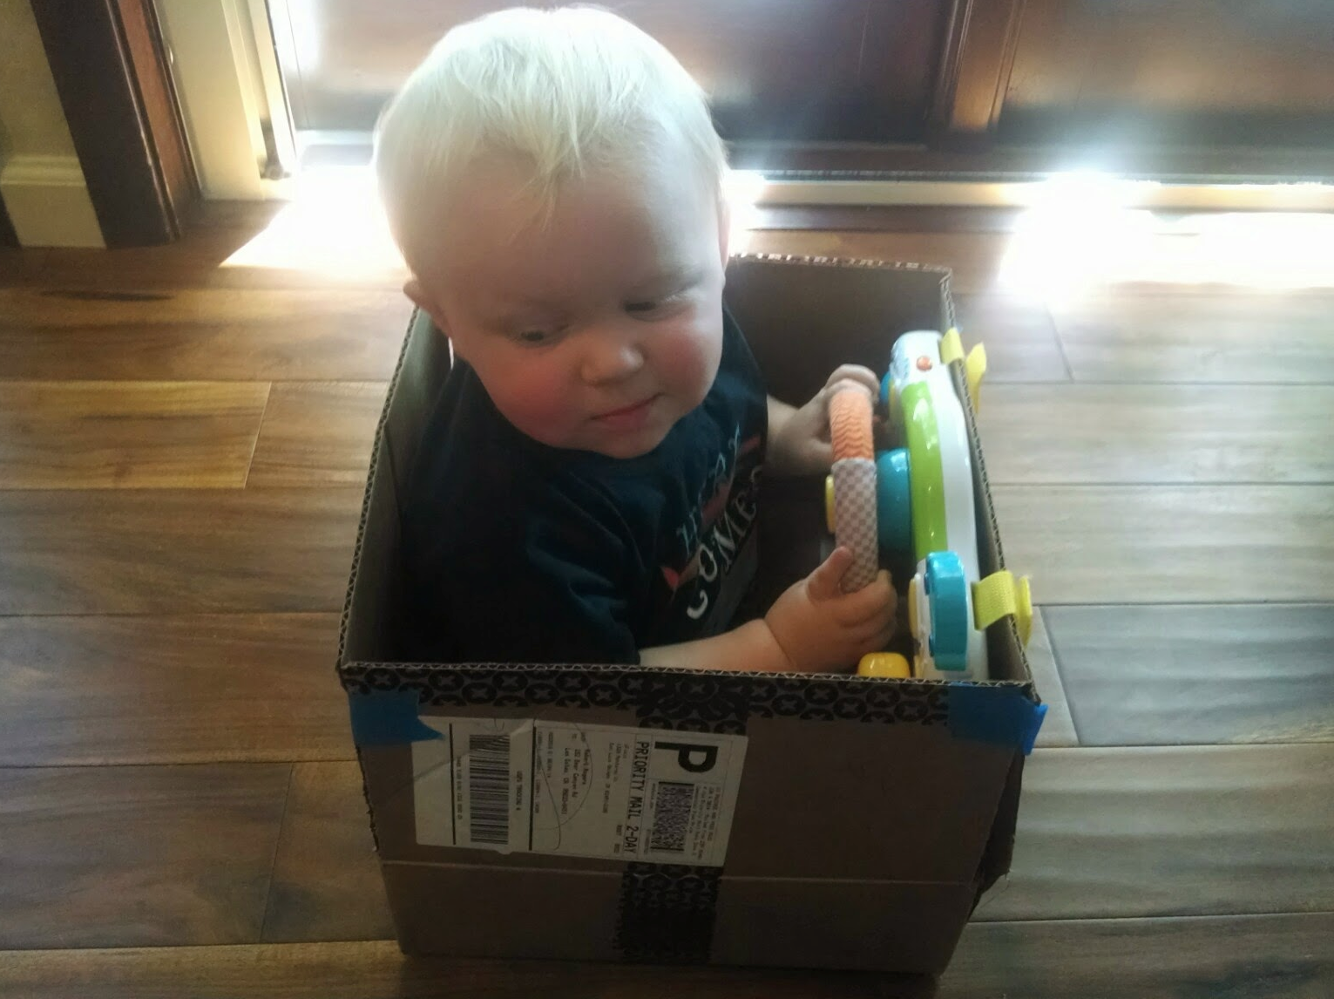
Move the biggest customer first
or
?
Notes:
If you *are* signing on for a 2-year plan:
Prototype and test right away
Pick a trivial use case to deploy early
Then move the biggest thing you need to support. This one is controversial, but in my experience it’s much more often successful - there’s a tendency to want to pick a small thing or a medium thing to make it easier, but you’ll spend just as long tuning a new system for a small or medium use case as for a large one, and if you leave your big customer for last, you might find that your system can’t scale to support them at all. My picture is a bit of an extreme example, but you get the idea. If you’re building a race car, you don’t want to spend more than about ten minutes building a great cardboard box.
When we were rolling out the borg ecosystem, the first real service we moved was websearch. That was a pretty big risk, but in some ways it’s a bigger risk to wait. After search, we knew everybody else would fit.

Slide 20
Rules of the long game
Don’t let the weeds get higher than the garden.
Invest in your support tools (build, release, test)
Monitor from a user’s perspective
Automate anything that you do more than twice

Slide 21
Take care of your team
Not eng OR ops - systems need both
Manage interrupt load
Keep the noise floor low
Your team IS your service. If you burn them out, you won’t last.

Slide 22
Victory?
Notes:
Lastly, remember that there isn’t really a finish line. This is an infinite game. All systems are ephemeral - they exist to serve some need, and not for their own sake. It’s easy to get fixated on specific decisions, get into religious wars about whether the config files should be organized by infrastructure or by product, but as long as they’re organized by something, it’s probably going to be okay. It’s very unlikely that you’ll really be able to plan around every possible future minefield. What matters is outcome: the product, the team, your users. Keep your eye on the outcome, correct when necessary, and the rest is details.

