Slide 1
Applying CRO concepts to your entire organization
Jon Correll, CEO
Maxly
Conversion Voodoo
Jon Correll @MaxlyOfficial

Slide 2
Who here has implemented any type of optimization tests CRO , Site Speed, etc.?
Jon Correll @MaxlyOfficial
Notes:
How many have run tests? How Many test??
How many plan to do optimization testing this year?

Slide 3
Why this talk?
Jon Correll @MaxlyOfficial

Slide 4
Why this talk?
To keep you from feeling crippling fear, frustration and disappointment on your optimization projects.
Jon Correll @MaxlyOfficial

Slide 5
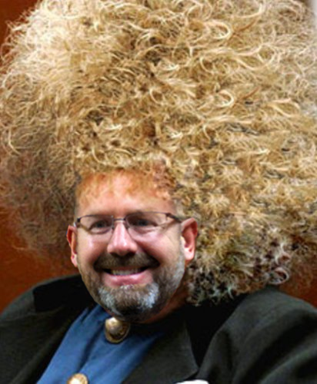
This is me just a few
short years ago...
Before I learned a few simple “secret ancient techniques”
Jon Correll @MaxlyOfficial
Notes:
(Learned a bit too late to save my hair)

Slide 6
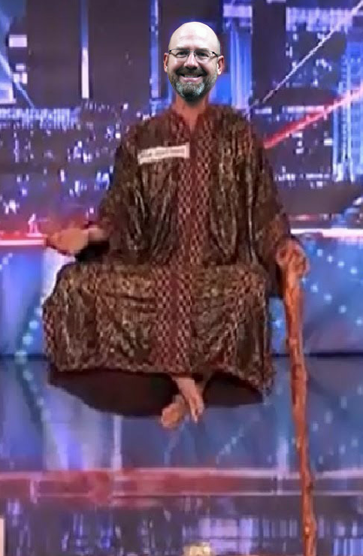
Become a Zen Master of Optimization
Ommmmm...
Jon Correll @MaxlyOfficial

Slide 7
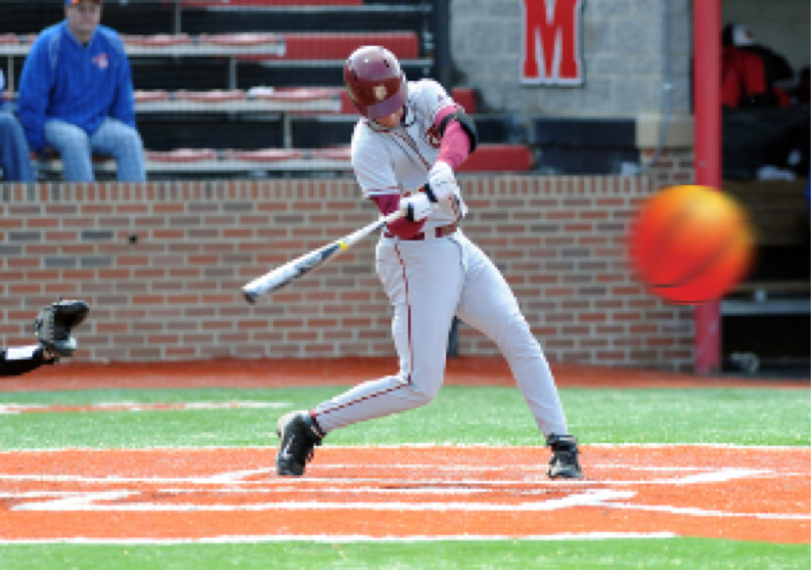
Change the rules of the Game
Jon Correll @MaxlyOfficial

Slide 8
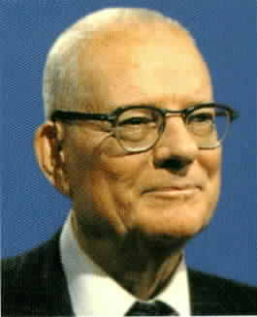
#1 Focus on Process NOT Result
“If you can’t describe what you are doing as a process, you don’t know what you’re doing”
~ W. Edward Deming
Jon Correll @MaxlyOfficial
Notes:
Focus on the PROCESS, not the result
“If you can’t describe what you are doing as a process, you don’t know what you’re doing” ~ W. Edward Deming
This Eases Stress, Undue Pressure, and Faulty Expectations
If your organization can’t change this, then hire out to other “Triers”
Process beats Genius EVERYTIME

Slide 9
Ever get excited to try a new design & new idea for your website?
Jon Correll @MaxlyOfficial

Slide 10
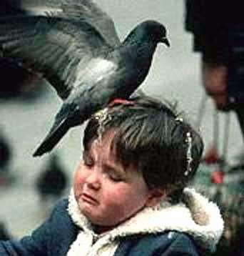
Then the results come back...
Jon Correll @MaxlyOfficial

Slide 11
#1 Focus on Process NOT Result
Why do we experience fear and disappointment
running conversion optimization tests?
Jon Correll @MaxlyOfficial

Slide 12
#1 Focus on Process NOT Result
Expectation
Jon Correll @MaxlyOfficial

Slide 13
#1 Focus on Process NOT Result
Unrealistic
Expectation
Jon Correll @MaxlyOfficial

Slide 14
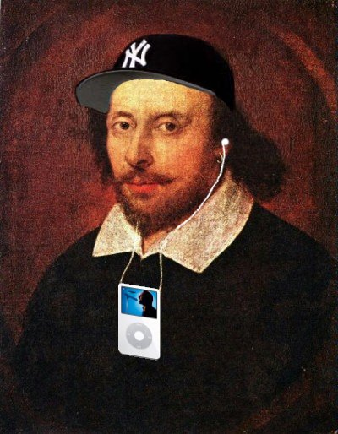
#1 Focus on Process NOT Result
“Expectation is the root of all heartache.”
~ William Shakespeare
Jon Correll @MaxlyOfficial

Slide 15
#1 Focus on Process NOT Result
I
Jon Correll @MaxlyOfficial

Slide 16
#1 Focus on Process NOT Result
I
BUT...
Jon Correll @MaxlyOfficial

Slide 17
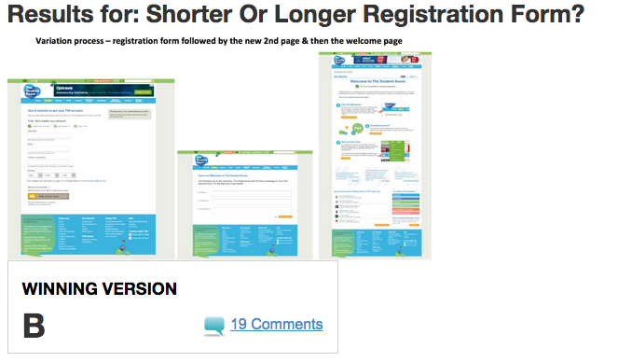
#1 Focus on Process NOT Result
Which test won?
How much increase in engagement from this one simple test?
www.WhichTestWon.com
Jon Correll @MaxlyOfficial

Slide 18
#1 Focus on Process NOT Result
Which test won?
How much increase in engagement from this one simple test?
972%?!?!?!
Jon Correll @MaxlyOfficial

Slide 19
Holy Crap!!!
Unrealistic Expectations
Makes a solid result look bad.
Jon Correll @MaxlyOfficial

Slide 20
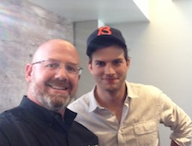
Even my wife knows…
Never compare me to someone like Ashton Kutcher
Jon Correll @MaxlyOfficial

Slide 21
Personal Example of My Stupidity
$750mm Online Travel Services
Contracted 10% increase
Jon Correll @MaxlyOfficial

Slide 22
Personal Example of My Stupidity
Delivered 11% increase in about
5-6 months
Jon Correll @MaxlyOfficial

Slide 23
Personal Example of My Stupidity
Delivered 11% increase in about
5-6 months
(That’s about $75m in revenue)
Jon Correll @MaxlyOfficial

Slide 24
Personal Example of My Stupidity
Their reaction:
Bored. Unexcited.
Disappointed.
Unrealistic Expectation Strikes again!
Jon Correll @MaxlyOfficial
Notes:
This was the straw that helped me to change our process. Even though the client gets results, we turbo charged our FOCUS on process internally.

Slide 25
#1 Focus on Process NOT Result
“If you can’t describe what you are doing as a process, you don’t know what you’re doing”
~ W. Edward Deming
Jon Correll @MaxlyOfficial
Notes:
Focus on the PROCESS, not the result
“If you can’t describe what you are doing as a process, you don’t know what you’re doing” ~ W. Edward Deming
This Eases Stress, Undue Pressure, and Faulty Expectations
If your organization can’t change this, then hire out to other “Triers”
Process beats Genius EVERYTIME

Slide 26
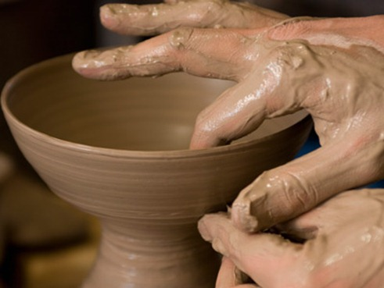
#2 Create Culture of “Try It”
The book Art & Fear
Those who focused on quantity did better than those who focused on result
Jon Correll @MaxlyOfficial
Notes:
By changing the focus to Process, you’ll run more tests, you’ll learn more, You’ll win!!

Slide 27
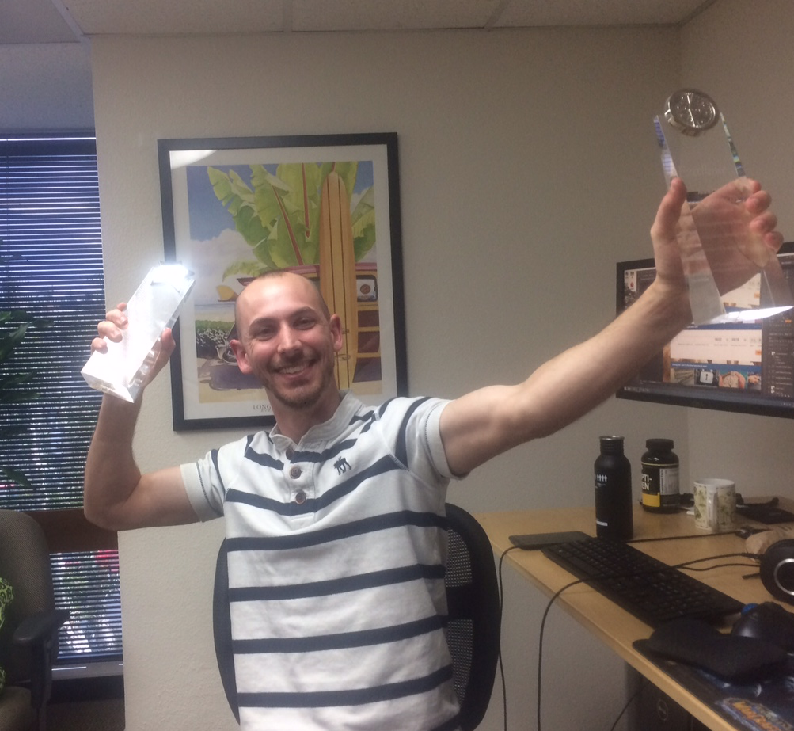
#2 Create Culture of “Try It”
What’s The Goal Now?
Learn and Grow in Understanding and Skill
Rinse → Repeat OFTEN
Make it creative & results will come!
Jon Correll @MaxlyOfficial
Notes:
Make it fun. Have internal “competitions” for ideas
Give awards for Biggest Loser or Craziest Idea
Measure everything
Understand deeply
Try new tools and techniques to build your skillset

Slide 28
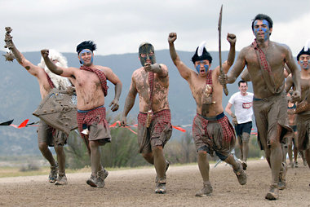
#2 Create Culture of “Try It”
To Become Fearless
Optimization Warriors…
Jon Correll @MaxlyOfficial
Notes:
By changing the focus to Process, you’ll run more tests, you’ll learn more, You’ll win!!

Slide 29
#2 Create Culture of “Try It”
To Become Fearless
Optimization Warriors…
Embrace Failure
Jon Correll @MaxlyOfficial
Notes:
By changing the focus to Process, you’ll run more tests, you’ll learn more, You’ll win!!

Slide 30
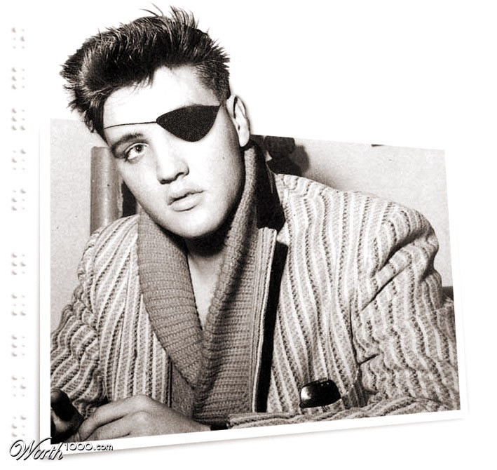
#3 How to cure your Blindness
“In the land of the blind, the one-eyed man is king.”
~ Desiderius Erasmus
Jon Correll @MaxlyOfficial

Slide 31
#3 How to cure your Blindness
We get blind over time
Jon Correll @MaxlyOfficial
Notes:
When you stare at an object for a long time you can experience adaptation-induced blindness
We get blind to what we’re focusing on
How can we overcome our own “site blindness”
Process blindness

Slide 32
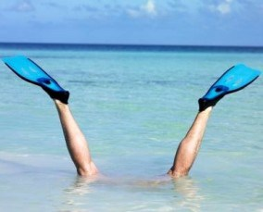
#3 How to cure your Blindness
Deep dive new analytics
Jon Correll @MaxlyOfficial
Notes:
Deep dive new analytics
Form and Funnel analytics
Site recording analytics
Segment analytics by device (mobile, desktop, tablet)
On page analytics (Heat maps etc.)
Look for the weird

Slide 33
#3 How to cure your Blindness
See through your customers’ Eyes
Jon Correll @MaxlyOfficial
Notes:
Watch others interact with your site – See in their Eyes
This applies to other optimization projects, not just CRO
Watch people go through your site on different devices
Listen to Custom Service calls or Sales calls
Create simple Focus Groups (Craig’s list is a great, cheap way)
(We got a headline that from a Craigslist person that is still running today)

Slide 34
#3 How to cure your Blindness
What are others doing?
Jon Correll @MaxlyOfficial
Notes:
What are others doing?
Look at your competition
Look at other industries and their leaders
Look at what is new and cutting edge
(Careful with “bleeding edge”)

Slide 35
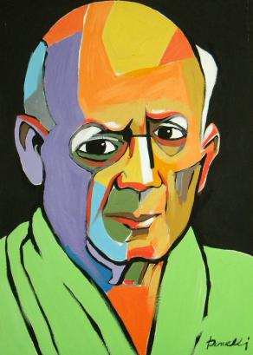
#3 How to cure your Blindness
Good Artists Copy;
Great Artists Steal
~ Pablo Picaso
Jon Correll @MaxlyOfficial
Notes:
What are others doing?
Look at your competition
Look at other industries and their leaders
Look at what is new and cutting edge
(Careful with “bleeding edge”)

Slide 36
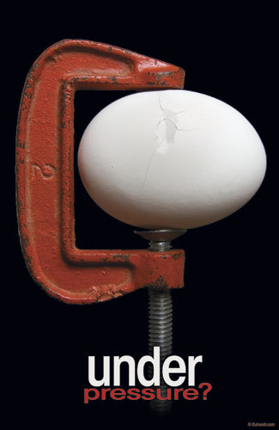
IN 2015 - Client for 6 years
They expect Great Results
They pay for Great Results
Contract is GONE without Great Results
Will there be a Year 7???
Jon Correll @MaxlyOfficial

Slide 37
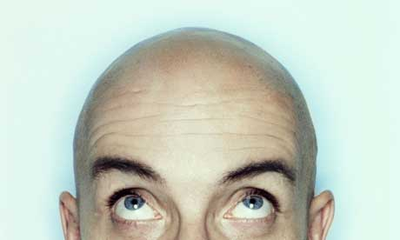
IN 2015 - Client for 6 years
Fear & Pressure to Perform Kicks in…
What do we do now???
Go back to basics… Process.
(I have no more hair to lose!!)
Jon Correll @MaxlyOfficial

Slide 38
It Works!
6 year client gets a solid result
From “boring” new mobile funnel
14.2% CR increase mobile traffic…
Tested over 40,000 conversions.
Jon Correll @MaxlyOfficial
Notes:
Note it was validation, form fields, order of fields, date pickers, etc.

Slide 39
It Works!
Focus on Process, Not The Result
Culture of Try It
Cure your Blindness
Jon Correll @MaxlyOfficial
Notes:
Note it was validation, form fields, order of fields, date pickers, etc.

Slide 40
Email me for tools list Happy failing!! ;-)
Jon Correll, CEO
Maxly
Conversion Voodoo
jon@ConversionVoodoo.com
Jon Correll @MaxlyOfficial

