Slide 1

Big Data Stories:
Decisions That Drive Successful Projects
Ellen Friedman
Strata Conference San Jose
18 February 2015

Slide 2
Contact Information
Ellen Friedman
Solutions Consultant and Commentator
Apache Mahout committer, Apache Drill contributor
Email ellenf@apache.org
efriedman@maprtech.com
Twitter @Ellen_Friedman @ApacheDrill
Hashtag today: #StrataHadoop

Slide 3
Data Driven Decisions
What lies behind successful projects?

Slide 4

“My best decision, really, was to make time to think.”
Camille Fournier
Head of Engineering, Rent-the-Runway
Committer, Apache Zookeeper project
quote from her blog post 6 Dec 2014
bit.ly/camille-best-decision
@skamille
Notes:
A woman I know had a really good idea on her blog: she thought her best decision for 2014 was to do daily releases, which really really paid off. But then she realized that was her 2nd best decision – the best was to have decided to set aside time on Wed pms to think – away from deadlines, from details. – and without that she wouldn’t have made the other decision.

Slide 5

Set aside time to think…
© 2014 Ellen Friedman
… you may be surprised at what occurs to you.
Notes:
Talk track: …

Slide 6
Decision 1:
Make time to think

Slide 7
Decision 2:
Listen to your data
(make sure it’s good data)

Slide 8

Oddly, that’s where his real adventure starts.
Matthew Fountain Maury was a sailor in the 1830s.
Injured his leg, so the US Navy gave him a “desk job”.

Slide 9
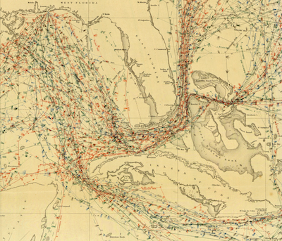
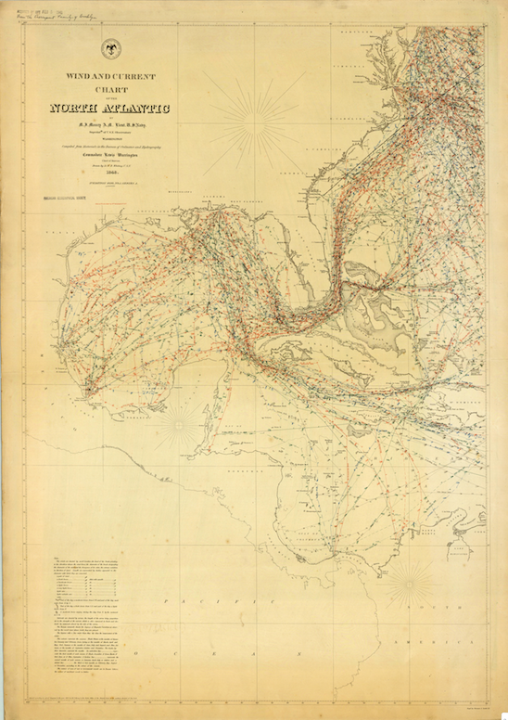
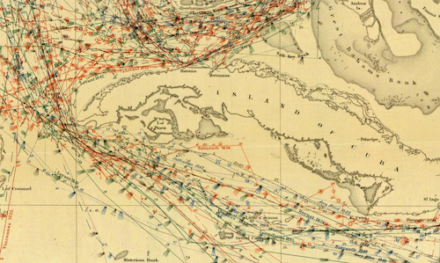
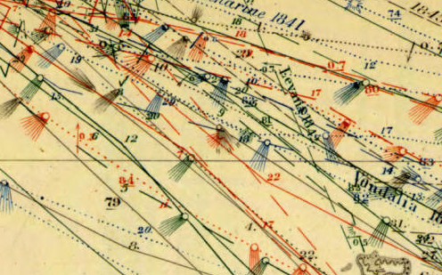
Big data project: Maury’s Wind and Currents charts
At first, no body was interested in them…
…until Captain Jackson shaved a month off the run from Baltimore to
Rio de Janeiro

Slide 10
Decision 3:
Transform your thinking

Slide 11
Big Data Technologies
What about Apache Hadoop & NoSQL technology?

Slide 12
It isn’t magic and you don’t just plug it in…
$
$
$
$
$

Slide 13
Working with Apache Hadoop and NoSQL databases
The need to transform thinking:
You’re not stuck with your first decisions – learn to take advantage of flexibility
Save more data and save it longer
Explore new data sources and new formats
Combine data sources for more powerful insights

Slide 14
“Technology is a tool. People solve problems.”
John Omernick
VP Big Data Analytics & Manager of Fraud Center
of Excellence at Zions Bancorporation
quote from personal communication 4 Feb 2015

Slide 15
Decision 4:
Recognize that people solve problems

Slide 16
Decision 5:
Be realistic about goals & SLAs

Slide 17
What if you needed to uniquely identify every person in India?
All 1.2 billion of them….

Slide 18


1.2 B
Aadhaar Project: Largest Biometric DB in the World
Unique 12 – digit number for each person in India
Proof of identity, authenticated anytime, anywhere
Runs on NoSQL database MapR-DB
PEOPLE
People
Notes:
Issued by the Unique Identification Authority of India (UIDAI)
In India, there is no social security card. It’s difficult for the average citizen to set up a bank account, access benefit programs, and enjoy economic mobility. It’s difficult for the government as well with over a $1B of government aid classified as leakage, the result of fraud and corruption.
The Aadhaar program is poised to change all that by leveraging the unique IDs that all people are born with to create the largest biometric database in the world
The program aims to get fingerprints and retina scans for all 1.2 billion citizens. The scale of this project required MapR’s in-Hadoop database that is capable of 200 millisecond response times while supporting millions of concurrent look-ups.

Slide 19
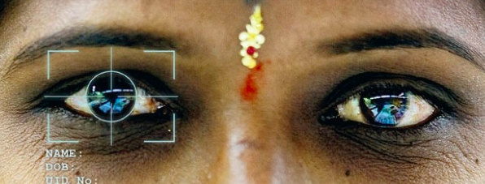
What does Aadhaar mean for India?
Better delivery of welfare services
More open society
  Identification without regard to cast, creed, religion or geography
Reduction in embezzlement – save billions in government funds
Notes:
Talk track: If you can’t identify people, you can’t count how many people receive aid or work on a govt supported project. Already estimates of reduction in graft equivalent to 1% of GDP. Went live exclusively on MapR this month.

Slide 20
A Day in the Life of the Aadhaar Project
Data platform must handle:
1 million new enrollments /day
  After 4 years, ~ 700 million of the 1.2 billion already enrolled
  4+ PB of raw data
Each new enrollment needs de-duplication
  100s of millions of transaction over billions of records doing 100s of trillions of biometric matches/day
Online sub-second authentications, anytime, anywhere
  as many as 100 million per day
  Runs on MapR data platform’s NoSQL database (MapR-DB)
Official website of Unique Identification Authority of India (UIDAI)
    http://uidai.gov.in

Slide 21
Decision 6:
See performance as more than a sprint

Slide 22
Decision 7:
Recognize common design patterns that cross verticals

Slide 23

Design patterns for solutions cut across verticals
Example: Anomaly detection well known technique for finding fraud and security breaches such as in the financial sector
But anomaly detection is also useful to understand sporadic web traffic, which is useful for online marketing

Slide 24
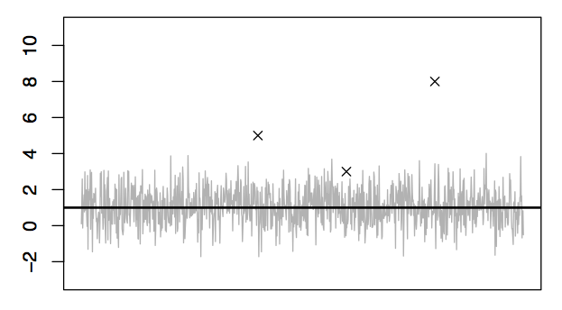
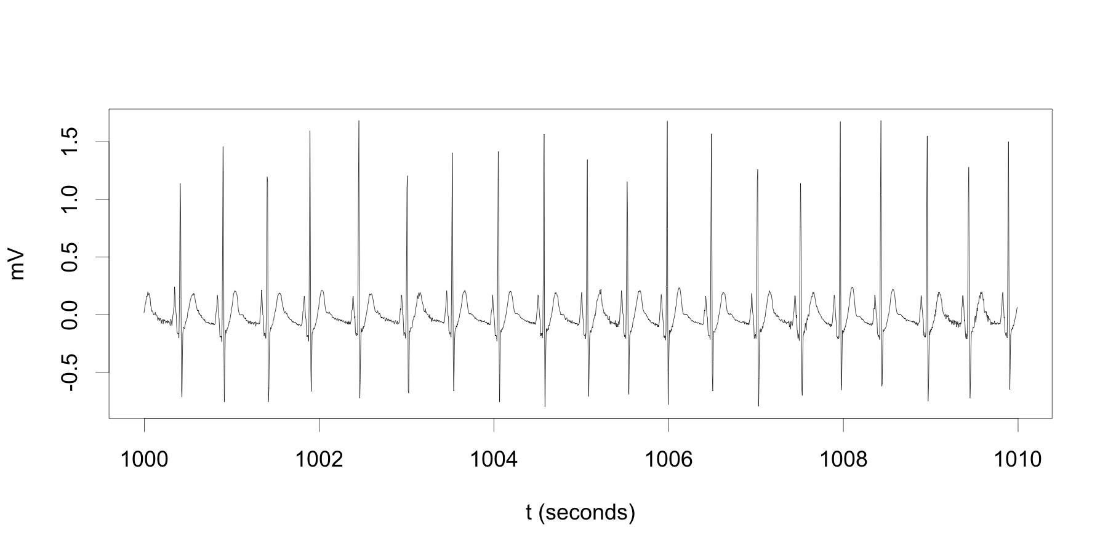
Believe your data: Discover instead of define
Anomaly detection done well has a common theme:
First make an adaptive model to discover what is normal, then you can recognize outliers with anomalous behavior.

Slide 25
Communication matters…
Notes:
Talk track: Another benefit of getting past details is that it gets you to fundamental ideas sometimes of great value AND lets you see a more comprehensive image of your project - If you stay lost in local details of implementation you may miss the big picture… like the old idea of 7 blind men trying to describe an elephant…

Slide 26
Decision 5:
Look for basic concepts & the big picture

Slide 27
Think beyond individual use cases…

Slide 28
Decision 8:
Think in terms of new approach across organization

Slide 29

“Let go of your fear of failure.”
Mike Brown
CTO, comScore
Quote from personal communication, January 2015

Slide 30
Decision 9:
Create safe setting for experimentation

Slide 31
Decision 10:
Future proof your org by building experience

Slide 32

Please support women in tech – help build girls’ dreams of what they can accomplish
© Ellen Friedman 2015

Slide 33

Real World Hadoop
by Ted Dunning and Ellen Friedman © Feb 2015 (published by O’Reilly)
eBook courtesy of MapR:
http://bit.ly/mapr-real-world-hadoop

Slide 34
Real World Hadoop
by Ted Dunning and Ellen Friedman © Feb 2015 (published by O’Reilly)
Free print copy during book signings at MapR booth
Today 5:15 pm
Thur 5:30 pm
Fri 10:10 am

Slide 35
Related events at Strata this week:
“Real World Use Cases: Hadoop and NoSQL in Production” Ted Dunning & Ellen Friedman Thur 19 Feb 2015 at 10:40am
http://bit.ly/hadoop-use-cases
Office hour Ellen Friedman Thur 19 Feb 2015 at 11:30 am
Plus news of Myriad: new OSS collaboration for global resource management:
“YARN vs. Mesos: Can’t We All Just Get Along” Ted Dunning
Fri 20 Feb 2015 at 2:20pm
http://bit.ly/strata2015-myriad

Slide 36
Contact Information
Ellen Friedman
Solutions Consultant and Commentator
Apache Mahout committer, Apache Drill contributor
Email ellenf@apache.org
efriedman@maprtech.com
Twitter @Ellen_Friedman @ApacheDrill
Hashtag today: #StrataHadoop

